Slide 1
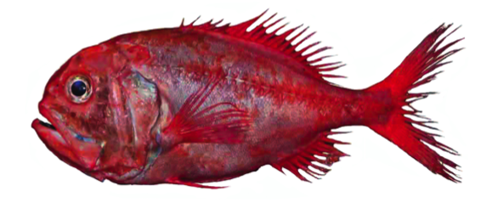
2.6. SUSTAINABLE FISHING: ORANGE ROUGHY
Focus question: What characteristics of orange roughy make them susceptible to overfishing?
KŌRERORERO / DISCUSSION
Orange roughy live in dark cold, still waters 1000 metres deep
The oldest is around 149 years old!
In the 1980s and 1990s global stocks of Orange Roughy were overfished
In 2000 Aotearoa New Zealand Orange Roughy catch limits were reduced
Since that time, new science has been applied [explored more in topic 3] and stocks have recovered
60% of Aotearoa New Zealand Orange Roughy is now Marine Stewardship Council certified
Notes:
TEACHER NOTES

Slide 2
SUSTAINABLE FISHING: ORANGE ROUGHY
KŌRERORERO / DISCUSSION
Orange Roughy are susceptible to overfishing due to the length of time that it takes for them to reach a reproductive age
For this reason bycatch of small and juvenile fish needs to be limited
Orange Roughy are caught using the ‘Bottom Trawling’ method that can impact on special habitats and species such as deepwater corals and sponges
MSC certified fisheries however ensure there is no long term damage to these sensitive habitats
MAHI / ACTIVITY
Complete 2.6 Sustainable Fishing Orange Roughy factsheet and worksheet
Notes:
TEACHER NOTES
More reading for the experts [included on 2.6 Sustainable fishing Orange Roughy factsheet / worksheet]
Check out the Southern Fried Science article called ‘A slimehead by any other name should never be on your plate’
Marine Stewardship Council description of Bottom Trawling
Deepwater Group paper by Cordue, P. L. called The Story of New Zealand Orange Roughy
Marine Stewardship Council Track a Fishery: New Zealand Orange Roughy

Slide 3
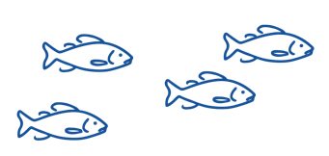
2.7. REVIEWING KEY CONCEPTS
Focusing Question: What have we learnt?
MAHI / ACTIVITY
Complete Topic 2 Summary Quiz Kahoot
Define it! Act it! Your teacher will give you a term. Write your own group definition. Then …. Act it out using mime. No words!. The rest of the class will try and guess your term!
Bony fishes
Habitat
Consumer
Primary producer
Predator
Food chain
Decomposer
Prey
Notes:
TEACHER NOTES
https://www.msc.org/docs/default-source/default-document-library/education-page/msc-lesson-plan-using-the-oceans-resources-responsibly.pdf?sfvrsn=5c15a87a_14

Slide 4
In the next topic (3) we will learn about:
SUSTAINABLE FISH STOCKS, CATCH LIMITS & THE ROLE OF SCIENCE
Notes:
TEACHER NOTES

Slide 5
He kura kainga te moana, he kura huna te moana
The oceans environment,
is a source of untapped knowledge

