Slide 1
MIHI / INTRODUCTION
Can you imagine a world without fish?
What would that be like?
No more sushi! No more fishing!
No more fish & chips! No more….?
Notes:
TEACHER NOTES
Try to get learners to connect with the personal impact of overfishing and unsustainable practices. What would it be like for ME if there were few or no fish left in the sea!

Slide 2
MIHI / INTRODUCTION
The good news is… some special people are working hard to make sure this doesn’t happen!
In this topic look more closely at what is a ‘sustainable catch’ and the role of scientists in ensuring we don’t catch too many fish
Let’s take a moment to think about what we know already about sustainable fishing

Slide 3
3.1 SUSTAINABLE FISHING & SUSTAINABLE CATCH
Focus Question: What is sustainable fishing and what do we mean by a ‘sustainable catch?
MĀTAKI TĒNEI / WATCH THIS
Watch this short film [1:29] What is the MSC and why is certified sustainable seafood important?
HE PĀTAI / CONSIDER THIS
Why do you think it might be important to know where your kai moana [fish and shellfish that you eat] comes from?
MAHI / ACTIVITY
Add new learning to your prior knowledge chart (previous slide)
Notes:
TEACHER NOTES
URL for film clip: https://www.youtube.com/watch?v=3rVeSBdpO6Q

Slide 4
SUSTAINABLE FISHING & SUSTAINABLE CATCH
SUSTAINABLE FISHING PRIOR KNOWLEDGE CHART
What we know | What we would like to know | What we have learned
HE PĀTAI / CONSIDER THIS
What do we already know about sustainable fishing?
MAHI / ACTIVITY
Complete the Prior Knowledge Chart columns 1 & 2
Notes:
TEACHER NOTES
You could go back and review Topic 1
Start to define the difference between the concept of sustainable fishing (includes care for the ecosystem) and sustainable catch (the number of fish caught)

Slide 5
SUSTAINABLE FISHING & SUSTAINABLE CATCH
Sustainable fishing means looking after the environment where fish live and not overfishing
A sustainable catch means catching an amount of fish that can carry on forever
KŌRERORERO / DISCUSSION
In Aotearoa New Zealand, Māori were the first fishers – they depended largely on fish and shellfish for protein
In recent years, fish and fishing has grown in importance for many New Zealanders
HE PĀTAI / CONSIDER THIS
Do you catch fish - what type of fish do you catch?
If you eat fish - what type of fish do you eat?
Where does the fish that you eat come from?
What do you do to help ensure the fish that you eat and / or catch are caught sustainably?
What do you think : Is sustainable fishing important? Why / Why not?
Notes:
TEACHER NOTES
Invite a kaumātua or grandparent to visit and get them to talk about how fishing has changed over time and what measures have been used locally over time to ensure sustaianable fishing.
Homework activity – learners interview a member of their whānau, family or community about their fishing practices (can adapt questions from this slide)
Learners share their own fishing stories or those from family, whānau or community to share
Start to define the difference between the concept of sustainable fishing (includes care for the ecosystem) and sustainable catch (the number of fish caught)

Slide 6
SUSTAINABLE FISHING & SUSTAINABLE CATCH
HE PĀTAI / CONSIDER THIS
What did you learn?
What are the Marine Stewardship Councils three principles used to assess sustainability?
A sustainable catch is one that can carry on ________________.
[Click again to reveal answers]
The three principles are:
Principle 1: Sustainability of the stock
Principle 2: Environmental impacts
Principle 3: Effective management
In this topic we focus on the idea of a sustainable catch which is the basis of MSC Principle 1 (Principles 2 and 3 are the focus of Topics 4 and 5)
A sustainable catch is one that can carry on Indefinitely (aka forever)!
Notes:
TEACHER NOTES

Slide 7
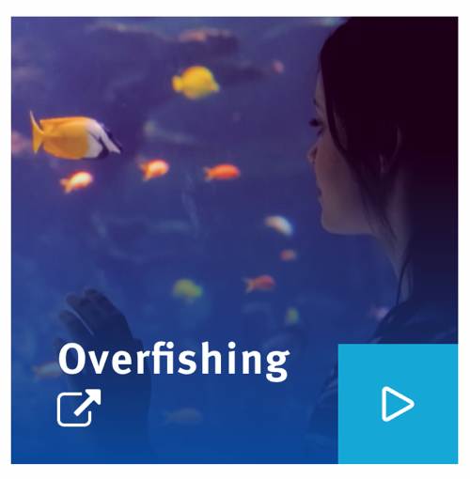
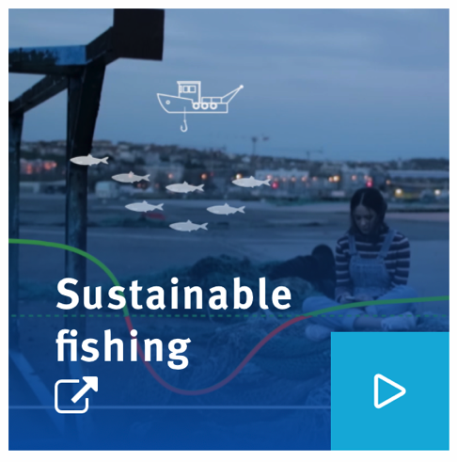
SUSTAINABLE FISHING & SUSTAINABLE CATCH
MĀTAKI TĒNEI / WATCH THIS
Watch these two film clips ‘Overfishing’ [2:55] and ‘Sustainable Fishing’ [2:55]
MAHI / ACTIVITY
What did you learn? Check your understanding of sustainable fishing using Sustainable Fishing Concept Cards and/ or play Kahoot
Add new learning to the prior knowledge chart
Notes:
TEACHER NOTES
Film clips are cut sections from My Dad the Fisherman and can be found at: https://www.msc.org/en-au/for-teachers/teach-learn-about-ocean-sustainability/film-and-clips
NOTE. These film clips can take a long time to download (up to 30 minutes) so best to download prior to class!
MAHI / ACTIVITY
Estimated time to complete is 20+ minutes
Use concept cards or the Kahoot quiz to reinforce key learning
See 3.1 Sustainable Fishing Concept Cards for extension activities
HOW TO PLAY KAHOOT
Connect a device to a projector or screen in front of the classroom.
Navigate to the game called Marine Stewardship Council NZ 3.1 Sustainable Fishing Concepts or enter this URL: https://create.kahoot.it/share/marine-stewardship-council-nz-3-1-sustainable-fishing-concepts/650166e3-c71e-4eb9-bc3e-d5afa7df801d
Select settings
At Kahoot.it, learners enter game-pin and nickname on their own devices (phone, tablet, or computer).
Press “Start now”. The fun begins!
Learners answer questions on their own devices by selecting one of the four answer buttons.
See additional instructions, options, and how to make your own Kahoot at: https://kahoot.com

Slide 8
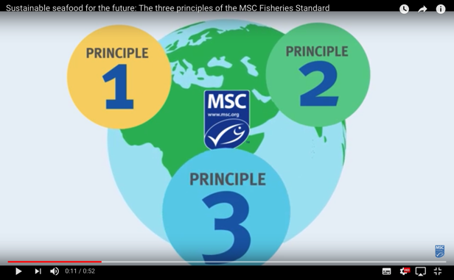
SUSTAINABLE FISHING & SUSTAINABLE CATCH
KŌRERORERO / DISCUSSION
Fisheries found to be sustainable can be sold with the Marine Stewardship Council blue fish tick label
Fisheries must meet three principles to be considered sustainable
MĀTAKI TĒNEI / WATCH THIS
Short film [0:52] outlining the three principles of Marine Stewardship Council’s Fisheries Standard
Be ready to answer a couple of questions!
(next slide)
Notes:
TEACHER NOTES
Film clip URL is: https://www.youtube.com/watch?time_continue=1&v=qEE3iUIbm7U&feature=emb_logo

Slide 9
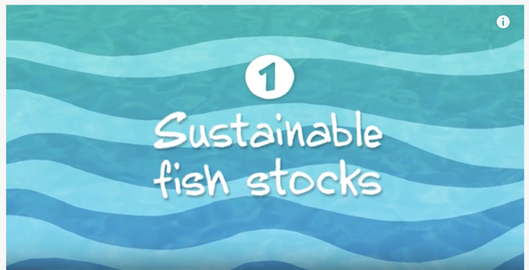
SUSTAINABLE FISHING & SUSTAINABLE CATCH
MAHI / ACTIVITY
Complete Sustainable fish stocks worksheet
Watch the video a second time and think:
What information helps the Marine Stewardship Council tell if a fish stock is sustainable?
Brainstorm answers
Complete the chart on the following slide
MĀTAKI TĒNEI / WATCH THIS
Short video [2:34] on Sustainable fish stocks (Principle One)
Notes:
TEACHER NOTES
Film URL: https://www.youtube.com/watch?v=EhosdSmvWrI
MAHI / ACTIVITY
Answers on slide after next

Slide 10
SUSTAINABLE FISHING & SUSTAINABLE CATCH
MAHI / ACTIVITY: Brainstorm…
Answers on the next slide
…WHAT INFORMATION HELPS THE MSC TELL IF A FISH STOCK IS SUSTAINABLE?
Notes:
TEACHER NOTES
Answers on next slide :]

Slide 11
SUSTAINABLE FISHING & SUSTAINABLE CATCH
MAHI / ACTIVITY: Brainstorm…
Catch samples showing data
on the maturity of the fish
(Age, Gender, Quantity)
Knowing what fish stock a fish has come from
……WHAT INFORMATION HELPS THE MSC TELL IF A FISH STOCK IS SUSTAINABLE?
Knowing the size of the fish stock
Scientists calculations
on the health of the
fish stocks
Data showing changes
in fish stock size
(natural or human induced)
Knowing how fishers will respond to
declines in catches / fish stocks
Notes:
TEACHER NOTES

Slide 12
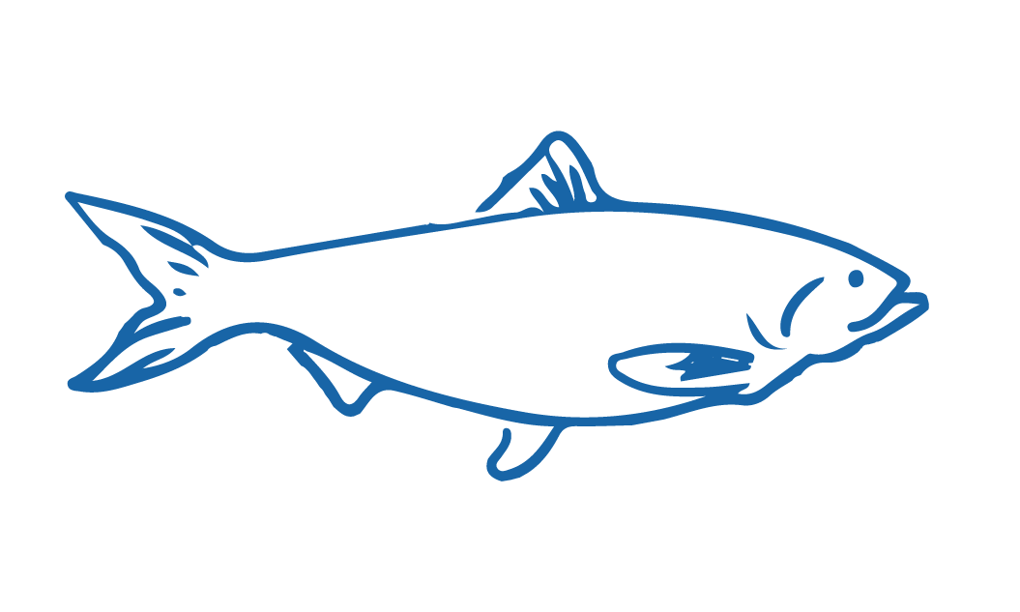
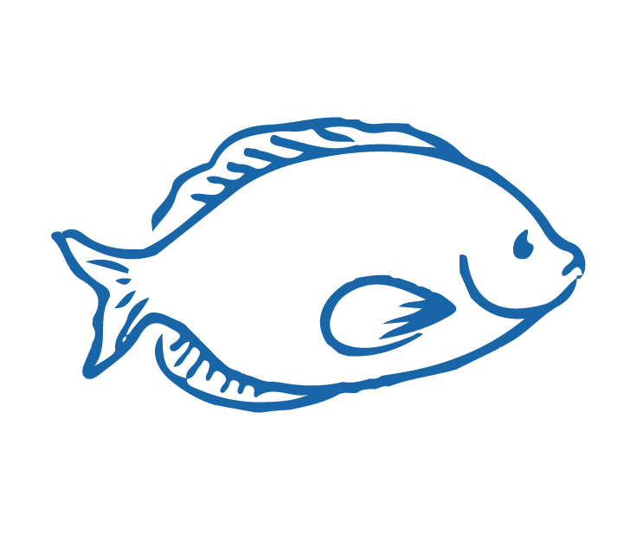
SUSTAINABLE FISHING & SUSTAINABLE CATCH
HE PĀTAI / CONSIDER THIS
So sustainable fishing means making sure fish stocks do not drop below levels where they cannot _____________ and grow faster than they are caught
Fishers need to know as much as they can about the fish and shellfish they catch, and the _________________ they live in
Fisheries work with ____________ to understand how the fish and shellfish stock grows and shrinks over time
Put a word in each gap to complete the sentences
reproduce
Ready for some possible answers?
ecosystems
scientists
Notes:
TEACHER NOTES

