Slide 1
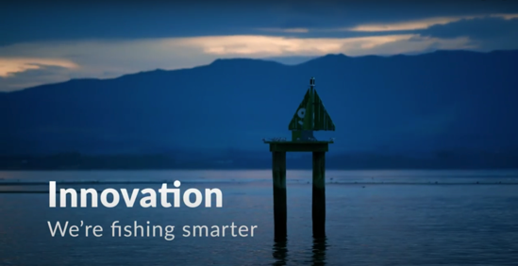
4.4. REDUCING IMPACTS: NEW & MODIFIED FISHING METHODS
Focus Question: How are fishing methods developed & modified to reduce impacts on habitat & sea life?
HE PĀTAI / CONSIDER THIS
What are commercial fishers doing to avoid catching seabirds?
What new technology is helping commercial fishers to reduce their environmental impact?
What is meant by “the changing culture of the industry”?
MĀTAKI TĒNEI / WATCH THIS
Watch this short film [4:45] from Seafood New Zelaand about Innovation – We’re Fishing Smarter
Notes:
TEACHER NOTES:
VIDEO LINKS: Innovation – We’re fishing Smarter (Seafood New Zealand) URL:
https://www.youtube.com/watch?time_continue=3&v=7CRbG7sPobs&feature=emb_title
HE PĀTAI – ANSWERS (all information needed to answer is in the short film ‘Innovation’)
Setting at night; using tori lines to deter birds; getting trained in seabird smart fishing; traceability (cameras on boats and GPS locators); bird detectors on cameras;
Traceability; cameras on deck; AOS (ability to identify fish; PSH gear development
The culture of the fishing industry is changing – in the past commercial fishers were seen as having a ‘catch at any cost’ mentality. Commercial fishers were seen as the bad guys - people who went out and caught as much as they could and didn’t really care about the environment! But now fishers are working with conservationists and scientists to look after the marine environment
USEFUL RESOURCES / RĀRANGI PUKAPUKA
Here are a few other innovations fishers use to reduce bycatch and habitat damage:
1. Acoustic alarms (pingers) deter marine mammals by emitting noise
2. Gear modification:
Breakaway links let large whales break out of nets when they struggle and exert force
Tori lines to scare away the birds (long lining and trawling)
Reflective nets are more detectable to marine mammals so they can avoid them.
Turtle excluder devices (TEDs) help turtles to escape through a built-in hatch in trawls.
Modification of mesh size helps marine mammals better detect nets so they can avoid them.
3. Time- area closures: Setting nets at different times of the day (setting longlines at night minimizes seabird bycatch); setting nets in areas that are less heavily frequented by mammals, birds and turtles.
HOMEWORK / EXTENSION – HOW DOES THIS RELATE TO ME AND MY WHĀNAU
Invite a kaumātua or grandparent to visit and get them to talk about how fishing has changed over time and what measures have been used locally to reduce impacts on marine habitat and sea life.
Homework activity – learners interview a member of their whānau, family or community about their fishing practices (can adapt questions from this slide)
Learners share their own fishing stories or those from family, whānau or community to share

Slide 2
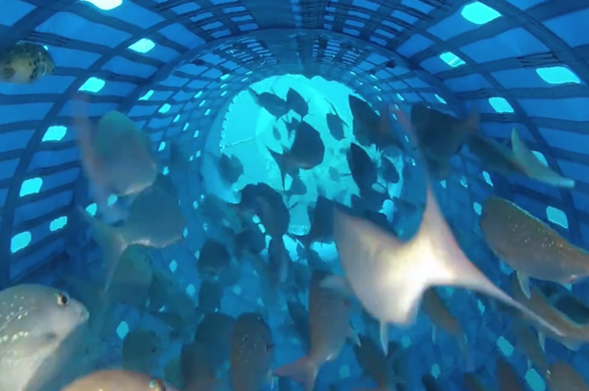
4.4. REDUCING IMPACTS: NEW & MODIFIED FISHING METHODS
KŌRERORERO / DISCUSSION
New sustainable fishing methods are being created
Tiaki Precision Seafood Harvesting (PSH) has been developed in Aotearoa New Zealand to:
Land fish on the boat in water and alive
Allow smaller fish to escape or be returned alive
Image: Tiaki.com
Notes:
TEACHER NOTES:

Slide 3
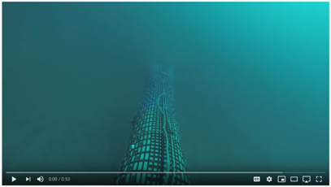
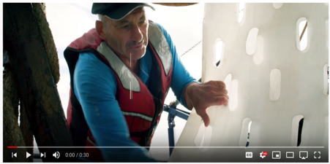
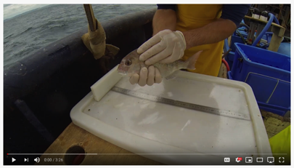
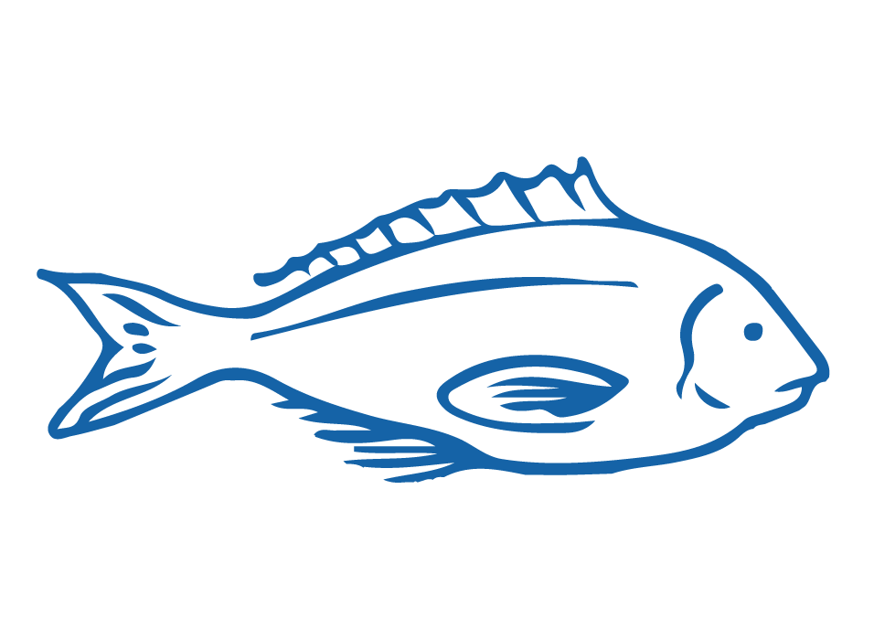
4.4. REDUCING IMPACTS: NEW & MODIFIED FISHING METHODS
MĀTAKI TĒNEI / WATCH THIS
Tiaki crew show how the nets work (0:53)
One fisher talk about how PSH works (0:30)
The results of the first trials of PSH (3:26)
What do you think?
Share in groups. And compare this method with an existing method?
Notes:
TEACHER NOTES:
VIDEO LINKS:
Tiaki crew show how the nets work - https://www.youtube.com/watch?v=cJqhz6RAHLI
One fishers view on PSH - https://www.youtube.com/watch?v=4yaPT7R6XpI
Watch the results of the first trail of PSH - https://www.youtube.com/watch?v=A5Hq4gVQgc4
GROUP BRAINSTORM:
Make a list of what is good about this new method of fishing?
Small fish escape
Bycatch arrives on deck alive and has better survival chance
Has been developed in NZ
Lands fish in water and alive so fish are better quality
And therefore likely to be worth more…

Slide 4
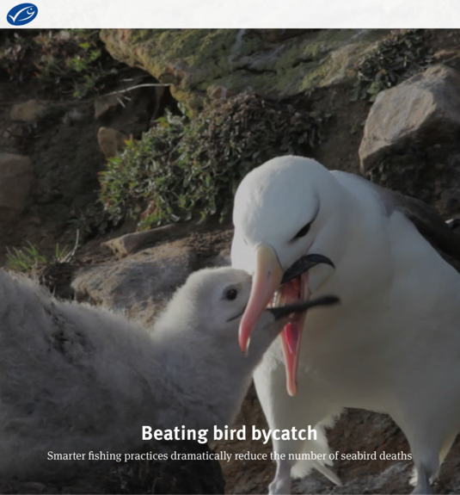
4.4. REDUCING IMPACTS: NEW & MODIFIED FISHING METHODS
KŌRERORERO / DISCUSSION
To attain the Marine Stewardship Council blue fish tick label many fisheries have had to modify their fishing methods to reduce bycatch
KŌRERO PUKAPUKA / READ
Read the Beating Bird Bycatch story
HE PĀTAI / CONSIDER THIS
What changes did the fishery make to reduce bird bycatch?
Notes:
TEACHER NOTES:
STORYLINK:
http://beating-bird-bycatch-stories.msc.org/?_ga=2.269112817.1435697534.1598919667-1303352827.1595455374
ANSWERS
Increasing the weight of fishing lines so that they sink faster
Using white lines that are less visible to birds
Improving the design of Tori lines (multi-coloured streamer lines hung vertically above the longline as it is set) to deter birds from diving to eat the baited hooks attached to longlines
Using a protective barrier of hanging streamers to keep birds away from the hauling point while the lines are hauled in
Closing the fishery during the grey petrel breeding season, from 1 February to 15 March.

