Slide 1
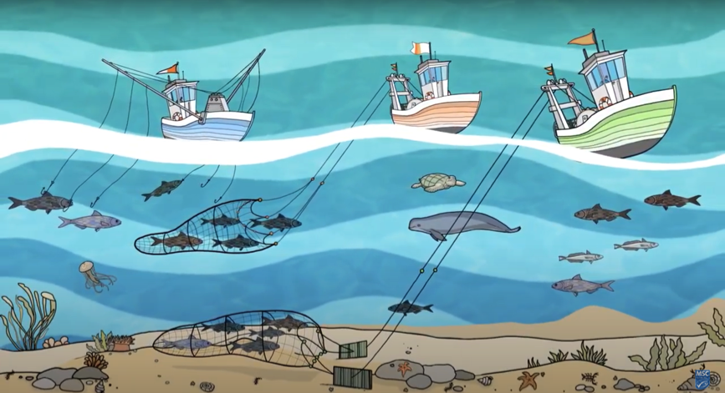
4.5. REVIEWING KEY CONCEPTS Focus Question: What have we learnt?
MĀTAKI TĒNEI / WATCH THIS
Short video [2:11] on marine habitat and species protection
MAHI / ACTIVITY
Reflect on your learning and demonstrate your understanding by writing a script for Marine Stewardship Council booklet:
See the Write a story Worksheet
Notes:
TEACHER NOTES
Film URL: https://www.youtube.com/watch?v=s1jg8-LZXws
MAHI / ACTIVITY
Activity 4.1 gets learners to write a script using images from this short film clip to make a booklet about Marine Stewardship Council’s Principle 2. All information needed by learners to complete this activity is in the short film. However, the activity draws on all learning from the topic.

