Slide 1

MIHI / INTRODUCTION
Can you imagine a world without fish?
What would that be like?
No more sushi! No more fishing!
No more fish & chips! No more….?
Notes:
TEACHER NOTES

Slide 2
MIHI / INTRODUCTION
The good news is… some special people are working hard to make sure this doesn’t happen!
In this topic look more closely at fisheries management including how fisheries are managed in Aotearoa New Zealand
Let’s take a moment to think about our responsibility as kaitiaki [guardians] of our marine environment?
Notes:
TEACHER NOTES

Slide 3


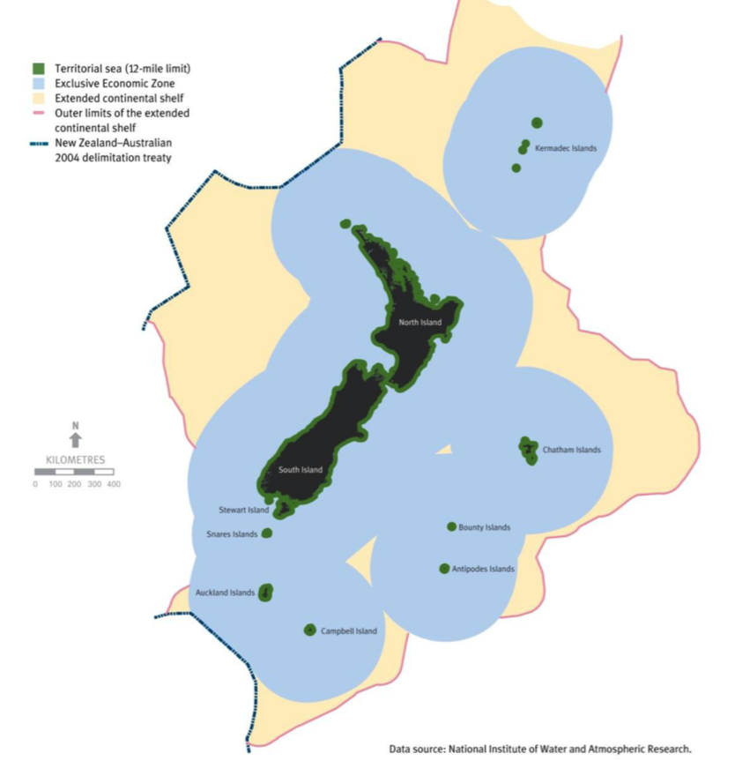
5.1 WELL MANAGED FISHERIES
Focus question: What are some indicators of ‘well managed’
(sustainable) fisheries
What is fisheries management? … the process that creates and enforces the rules that are needed to prevent overfishing and help overfished stocks rebound
KŌRERORERO / DISCUSSION
Kaitiakitanga is the idea of guardianship
As kaitiaki [guardians] it is our responsibility to care for our environment
Kaitiakitanga [guardianship] is an important part of well managed [looked after] fisheries in Aotearoa New Zealand
We are responsible for managing the ocean and fish that live there out to 200 nautical miles from land (blue area on map)
See final slide for larger map!
Notes:
TEACHER NOTES

Slide 4

WELL MANAGED FISHERIES
HE PĀTAI / CONSIDER THIS
What can you do to help look after our sea and kai moana [seafood]?
MAHI / ACTIVITY
Complete the Kaitiakitanga worksheet
‘Toitu te marae a Tane, Toitu te marae a Tangaroa, Toitu te iwi’
If the land is well and the sea is well, the people will thrive
HE PĀTAI / CONSIDER THIS
What does this whakataukī or proverb suggest about looking after our fisheries?
Notes:
TEACHER NOTES
SUGGEST: Inviting a kaitiaki / tiaki to visit the class
ANSWERS: Whakataukī suggests if we look after our kai moana and our moana then we look after ourselves
What good things can we do?
Only buy and eat fish caught legally and sustainably
Make sure we are good kaitiaki and have good tikanga when fishing (e.g. throw the small ones back; know and follow the rules about what and how much we can catch)
Support organisations like the MSC
Remind others of our kaitiakitanga obligations

Slide 5
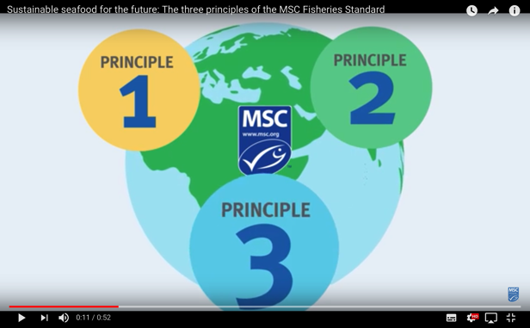



WELL MANAGED FISHERIES
KŌRERORERO / DISCUSSION
How do the Marine Stewardship Council help us in our role as kaitiaki?
Only fisheries found to be sustainable can be sold with the Marine Stewardship Council blue fish tick label
To get the label they must be well managed
MĀTAKI TĒNEI / WATCH THIS
Marine Stewardship Council’s
Fisheries Standard [0:52]
Notes:
TEACHER NOTES
Film clip URL is: https://www.youtube.com/watch?time_continue=1&v=qEE3iUIbm7U&feature=emb_logo

Slide 6
WELL MANAGED FISHERIES
In this topic we focus on the idea of fisheries management which is the basis of Marine Stewardship Council Principle 3 (Principles 1 and 2 are the focus of Topics 3 and 4)
HE PĀTAI / CONSIDER THIS
Watch again the short film on slide 11 What are the three Marine Stewardship Councils principles used to certify sustainable fisheries?
  Principle 1: Sustainability of the stock
  Principle 2: Environmental impacts
  Principle 3: Effective management
Notes:
TEACHER NOTES

Slide 7
WELL MANAGED FISHERIES
HE PĀTAI / CONSIDER THIS
Before we look at what we mean by ‘well managed’ fisheries let’s think what we know already about fisheries management?
MAHI / ACTIVITY
Complete the Prior Knowledge Chart columns 1 & 2
Fishery Management PRIOR KNOWLEDGE CHART
What we know | What we would like to know | What we have learned
Notes:
TEACHER NOTES
You could go back and review Topic 1

Slide 8
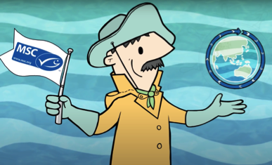
WELL MANAGED FISHERIES
KŌRERORERO / DISCUSSION
Well managed fisheries
➔ use science / observation to ensure:
stocks are fished responsibly
marine habitats are preserved
fishing is environmentally & economically sustainable
use controls to manage fishing effort:
number and size of fishing boats
restrict fishing days or times
Fisheries managers can also:
Improve or modify fishing methods
Employ fishing observers
MAHI / ACTIVITY
Add new learning to the prior knowledge chart
Notes:
TEACHER NOTES

Slide 9
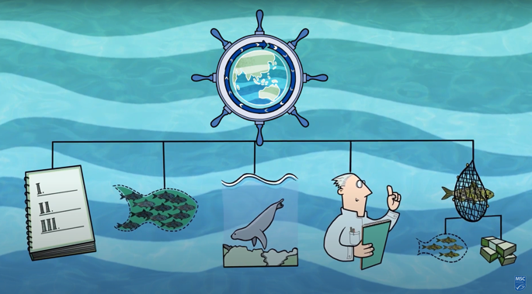

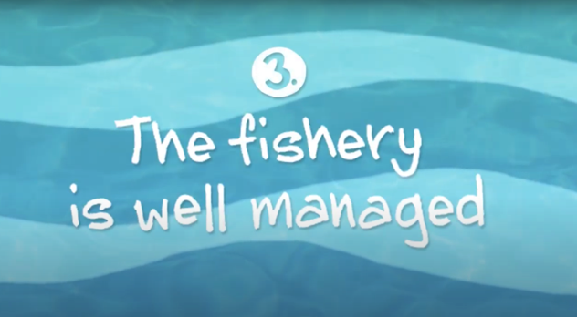
WELL MANAGED FISHERIES
MĀTAKI TĒNEI / WATCH THIS
Short video [2:11] The fishery is well managed (Principle Three)
Well managed
fisheries
ensure…
MAHI / ACTIVITY
Watch the video a second time and label the picture above (answers on next slide)
Notes:
TEACHER NOTES
Film can be downloaded from https://www.youtube.com/watch?v=XjaPUV0yaHQ
Having watched the video “What does the MSC label mean? 3. The fishery is well managed”… have learners add to their lists the types of things ‘fisheries managers’ might do to manage fish stocks effectively / sustainably? Discuss as a class.

Slide 10

WELL MANAGED FISHERIES
Economically
sustainable
Well managed
fisheries
ensure…
Environmentally
sustainable
Stocks fished responsibly
Habitat
preserved
Informed by
Knowledge / science / observation
Notes:
TEACHER NOTES

Slide 11
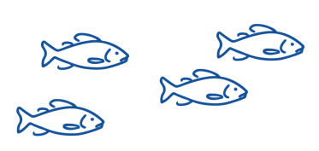
WELL MANAGED FISHERIES
Habitat
Preserved
HE PĀTAI / CONSIDER THIS
Brainstorm indicators of well managed fisheries that are mentioned in the MSC film clip ‘The fishery is well managed’ . We’ve added a couple to get you started!
(Answers on next slide)
Indicators of
well managed fisheries
Informed by science
/ observation
Notes:
TEACHER NOTES

Slide 12
WELL MANAGED FISHERIES
Stocks fished responsibly
Habitat
preserved
Environmentally
sustainable
Indicators of
well managed fisheries
Fishing is a stable and profitable job
Controls fishing effort
(e.g. by limiting number of
Boats/hooks or time / days
fishing occurs
Informed by science
/ observation
Adapts fishing methods
as needed to ensure
sustainable fishing
Use of
fishing observers
Notes:
TEACHER NOTES

Slide 13
Larger map version from 5.1
Note:
NM = Nautical Miles

