Slide 1
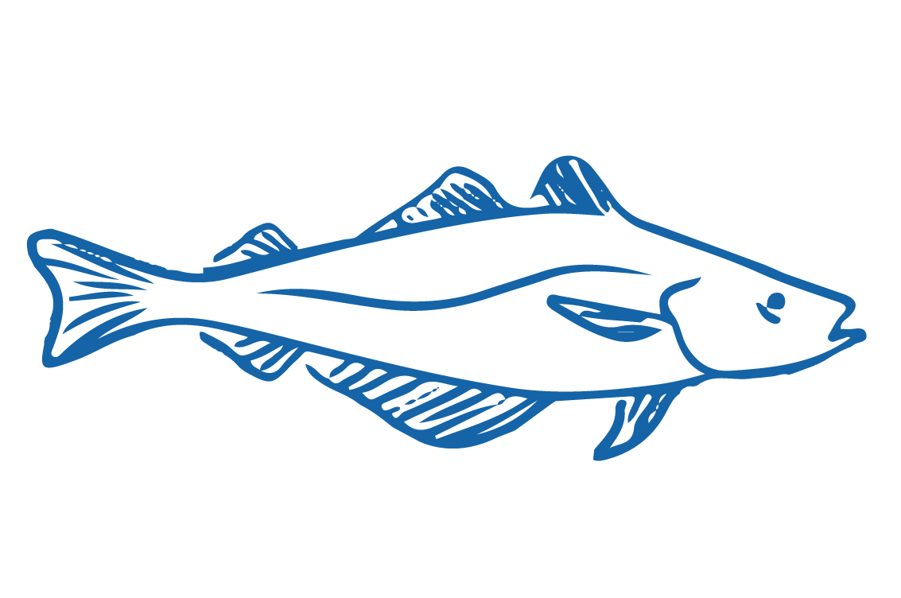
5.2. TRADITIONAL FISHERIES MANAGEMENT Focus Question: What are some traditional Māori fishery management tools?
KŌRERORERO / DISCUSSION
Over hundreds of years Māori developed an intimate understanding (science of sorts) about fish and environment
This understanding was gained through direct experience and observation
For example, the cycle of the moon taught them the best times to fish
Māori developed fishery management techniques or Tikanga [ways of doing things] to protect fish stocks and habitat such as:
Not gutting fish near the sea [can deplete fish as predators are attracted]
Always releasing first catch of the day as a gift to Tangaroa!
Notes:
TEACHER NOTES
USEFUL RESOURCES / RĀRANGI PUKAPUKA
For more information on tikanga and rāhui etc see : http://www.learnz.org.nz/sustainableseas181/bg-standard-f/kaitiakitanga-o-te-moana
For information on current rāhui see: https://www.rahui.org.nz
For general rāhui information see: https://teara.govt.nz/en/kaitiakitanga-guardianship-and-conservation/page-6

Slide 2
TRADITIONAL FISHERIES MANAGEMENT
KŌRERORERO / DISCUSSION
If there were signs of overfishing, a rāhui or temporary ban is put in place to allow fishery recovery
Rāhui is a traditional fishery management tool still used in Aotearoa New Zealand to help fish stocks recover when depleted
Today’s fishery laws allow rāhui to be put in place by kaitiaki (guardians) of an area
HE PĀTAI / CONSIDER THIS
What tikinga would or do you follow when fishing?
How would you manage your own fishing to take care of fish stocks & the sea?
Notes:
TEACHER NOTES
USEFUL RESOURCES / RĀRANGI PUKAPUKA
For more information on tikanga and rāhui etc see : http://www.learnz.org.nz/sustainableseas181/bg-standard-f/kaitiakitanga-o-te-moana
For information on current rāhui see: https://www.rahui.org.nz
For general rāhui information see: https://teara.govt.nz/en/kaitiakitanga-guardianship-and-conservation/page-6

Slide 3
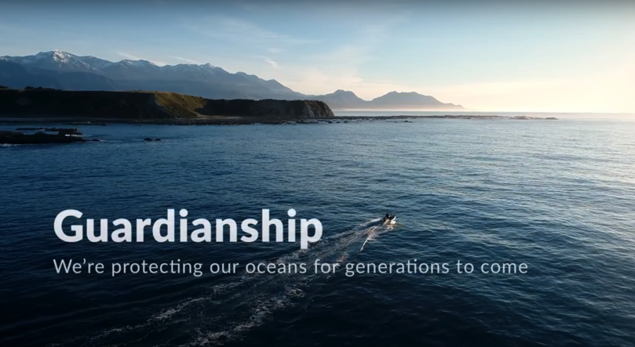
TRADITIONAL FISHERIES MANAGEMENT
HE PĀTAI / CONSIDER THIS
Who is responsible for ensuring our fisheries are managed sustainably?
What role can you play?
MAHI / ACTIVITY
Visit Te Ara – Traditional practices, invite a kuia or kaumātua or use your own knowledge to make a list of traditional fishery management tools used by Māori
MĀTAKI TĒNEI / WATCH THIS
Watch the short film
’Guardianship’ [4:48]
Notes:
TEACHER NOTES
MĀTAKI TĒNEI / WATCH THIS
Link to film clip is: https://www.youtube.com/watch?v=Obp4SU4zd8o&t=1s
MAHI / ACTIVITY
Te Ara page is part of the story Te hī ika Māori fishing – Traditional Practices located at: https://teara.govt.nz/en/te-hi-ika-maori-fishing/page-3
Traditional fishery management tools include:
Karakia
Te ika whaktaki – the first fish thrown back
Maui / Talismans
Prohibitions / Rāhui

Slide 4
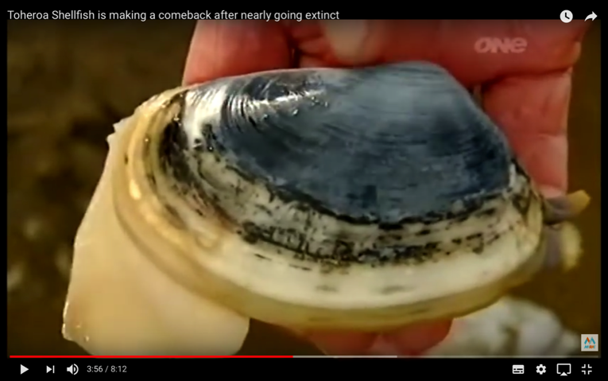
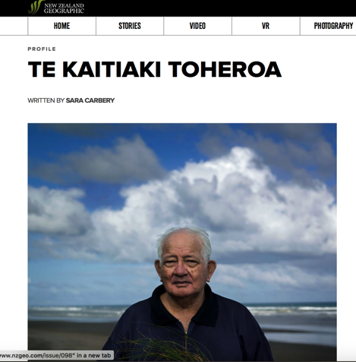
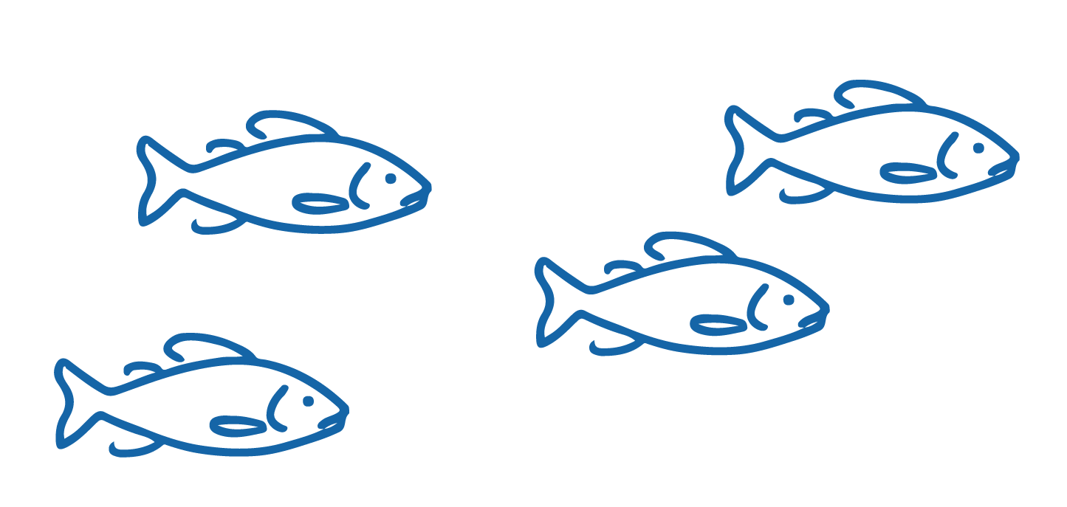
TRADITIONAL FISHERIES MANAGEMENT
MĀTAKI TĒNEI / WATCH THIS
MaraeTV story [8:12] about Toheroa local kaitiaki Jim and Barry
MAHI / ACTIVITY
Read the story Te Kaitiaki Toheroa
Complete Te Kaitiaki Toheroa Worksheet
Notes:
TEACHER NOTES
MĀTAKI TĒNEI / WATCH THIS
https://www.youtube.com/watch?v=x0GcneKoT18
MAHI / ACTIVITY
https://www.nzgeo.com/stories/te-kaitiaki-toheroa/#https://www.nzgeo.com/stories/te-kaitiaki-toheroa/
Complete the Te Kaitiaki Toheroa Worksheet and discuss answers.
USEFUL RESOURCES / RĀRANGI PUKAPUKA
For a more detailed and up to date article see: Decades of fishing bans have not rescued seafood delicacy toheroa at https://www.stuff.co.nz/environment/110671140/decades-of-fishing-bans-have-not-rescued-seafood-delicacy-toheroa
To deepen learning about toheroa and the role of mātauranga Māori and science in fisheries management WATCH Toheroa: Rejuvinating a Delicacy [26:05] (https://www.sciencelearn.org.nz/videos/565-toheroa-rejuvenating-a-delicacy)

Slide 5
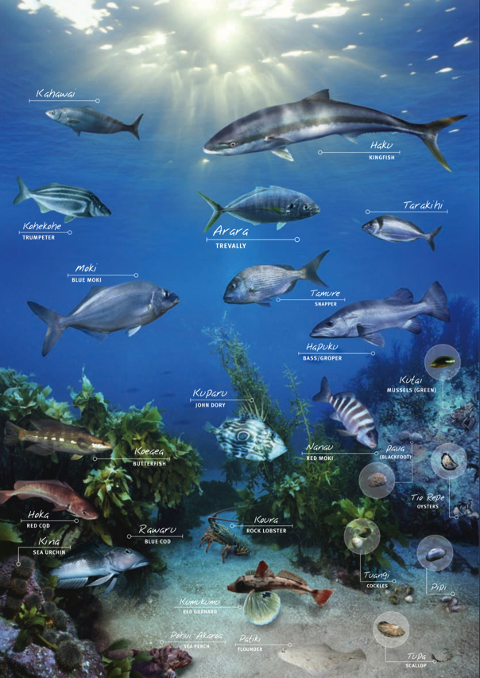
TRADITIONAL FISHERIES MANAGEMENT
KŌRERORERO / DISCUSSION
Traditional Māori fisheries management tools still ‘live’
The Quota Management System (QMS) and Māori customary fishing regulations enable
Appointment of kaitiaki / tiaki [guardians]
Rāhui [temporary bans] on fishing / fishing areas
Acknowledgement of rohe moana [traditional fishing grounds]
Establishment of mataitai and taiāpure [traditional fishery management areas]
Source: Fisheries New Zealand
Notes:
TEACHER NOTES
We will explore customary fisheries today under the QMS in more detail in 5.3
For more detailed information on Customary Fisheries under the QMS see the Customary Fisheries Manual: https://openseas.org.nz/wp-content/uploads/2017/06/MPI_CustomaryFishingManual_2009.pdf

