Slide 1
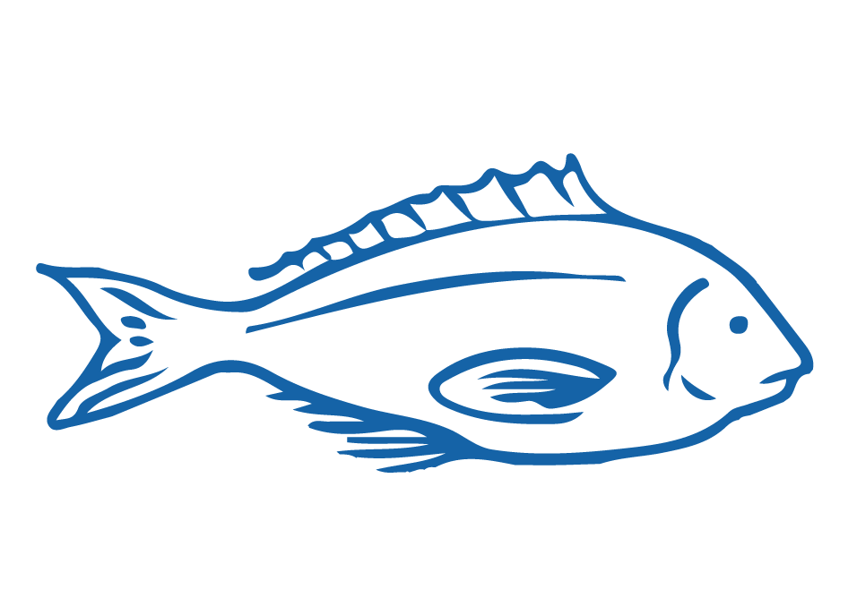
5.4. EEZ & LAW OF THE SEA Focus Question: What is the EEZ & how is this relevant to fishery management?
HE PĀTAI / CONSIDER THIS
Can a commercial fishing boat from another country take fish (without quota) from our waters within 200 nautical miles from land?
Why or why not?
NO! They can’t! They would need to purchase quota under the QMS!
The United Nations Convention on the Law of the Sea (UNCLOS) gave all countries the right to manage all resources out to 200 nautical miles from land
Notes:
TEACHER NOTES

Slide 2
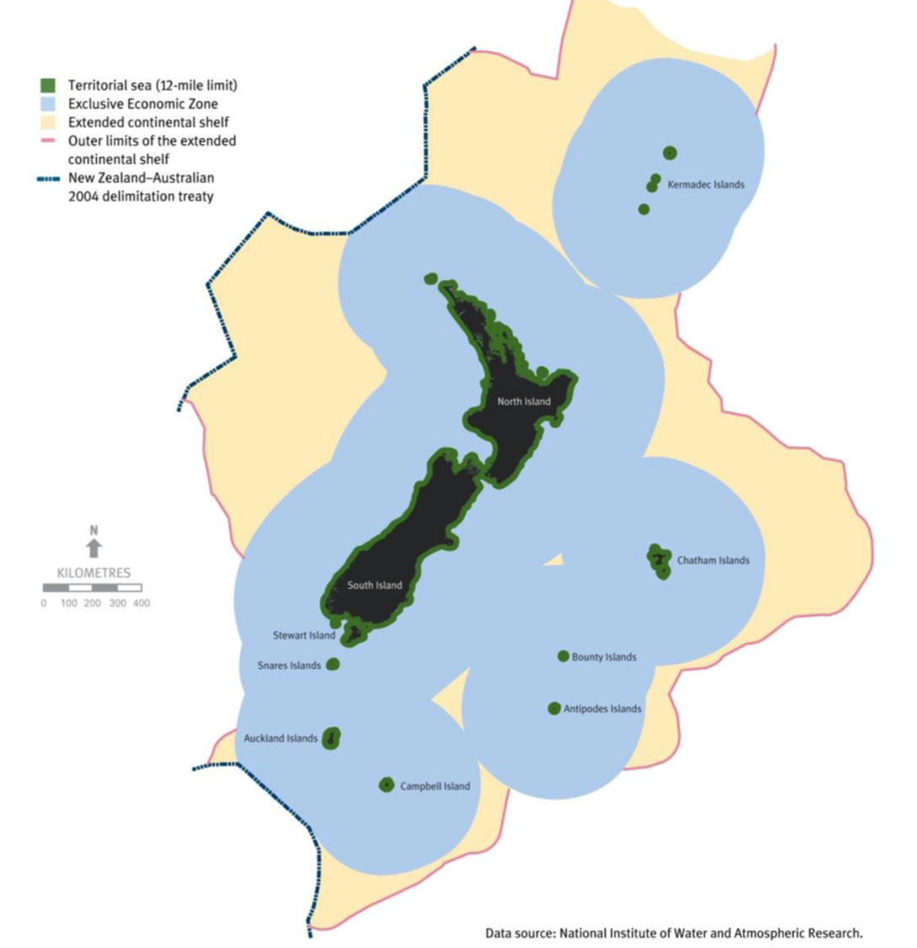
EEZ & LAW OF THE SEA
HE PĀTAI / CONSIDER THIS
Where do Aotearoa New Zealand waters start and stop? Which fish are included under the QMS?
KŌRERORERO / DISCUSSION
We have a territorial sea (12 miles out to sea) (green area close to land) and all our laws apply within this area
We manage all ocean resources out to 200 nautical miles (blue area)
And we manage the seafloor beyond 200 miles (yellow area)
MAHI / ACTIVITY
Create your own map of Aotearoa New Zealand. Label the EEZ, Territorial Sea and Continental shelf territory!
Draw pictures or write some notes to remind yourself what rights we have in each zone!
Need Help? Visit MFE’s marine zone page
Notes:
TEACHER NOTES
For more information about our oceans and UNCLOS see – NZ Foreign Affairs and Trade page at https://www.mfat.govt.nz/en/environment/oceans/
For a different map and more information on maritime zones see – NZ Foreign Affairs and Trade page at https://www.mfat.govt.nz/en/environment/oceans/our-maritime-zones-and-boundaries/
For more information about international fisheries management see– NZ Foreign Affairs and Trade page at https://www.mfat.govt.nz/en/environment/oceans/international-fisheries-management/
MFE marine zone page is at: https://www.mfe.govt.nz/marine/nz’s-rights-and-obligations-marine-zone

Slide 3
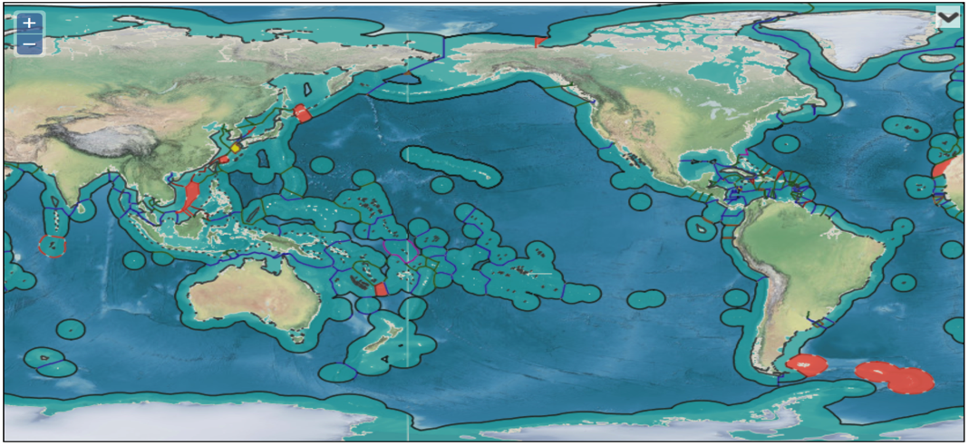
EEZ & LAW OF THE SEA
KŌRERORERO / DISCUSSION
All countries with coastal boundaries manage fisheries within their EEZ (Exclusive Economic Zone)
MAHI / ACTIVITY
Open this interactive map
Look at all the EEZs - how does our EEZ compare to other countries? Can you see any countries that have no EEZs? Or countries with very large EEZs?
Zoom in to your home area. Can you find the part of the ocean closest to where you live?
Source: marineregions.org
Notes:
TEACHER NOTES
Interactive map can be found at: See: https://www.marineregions.org/eezmapper.php
Large EEZs include:
France (due to all it’s protectorates)
USA; Australia; Russia; New Zealand; UK; Indonesia; Canada; Japan; Chile; Brazil
Landlocked countries have no EEZ and include:
Switzerland
Rwanda
Burundi
Hungary
Malawi
Austria
Serbia Slovakia
Afganistan
Zimbabwe
Laos
Monbgloia
Ethiopia
USEFUL RESOURCES / RĀRANGI PUKAPUKA
Awesome oceans facts: https://www.worldatlas.com/aatlas/infopage/oceans.htm#anchor1

