Slide 1

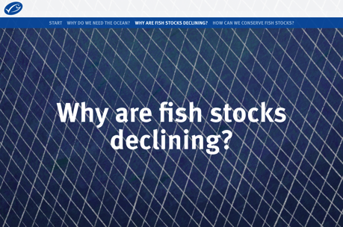


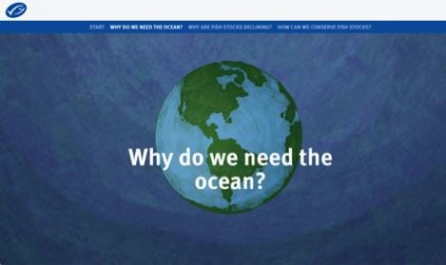
5.5. REVIEWING KEY CONCEPTS
Focusing Question: What have we learnt?
MAHI / ACTIVITY
This is a great summary of this topic and also Topics 1-5
Review the summary of much covered in this topic on the global MSC website
Notes:
TEACHER NOTES
The summary can be found at: https://dad-fishes-for-the-future.msc.org/?_ga=2.178911460.1759312358.1578727525-1836922175.1578727525#start-dOPb2kpn4D

Slide 2

5.5. REVIEWING KEY CONCEPTS
MAHI / ACTIVITY
Play the fisheries management game! This is fun and a great way to summarise and reflect on learning! [see teacher outline]
Make a quiz! Reflect on what you have learnt – write two questions and answers and hand them in to your teacher!
Notes:
TEACHER NOTES

Slide 3
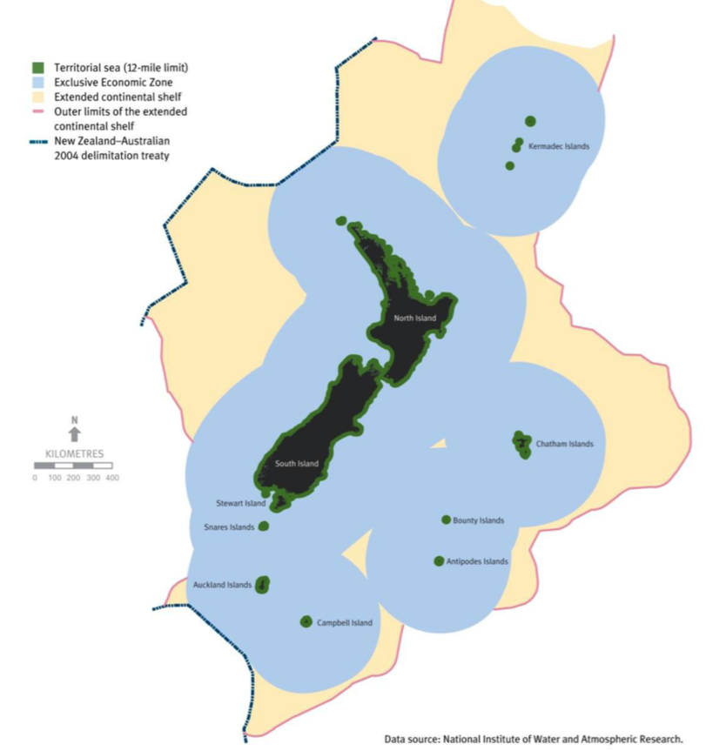
Larger map version from 5.1
Note:
NM = Nautical Miles

