Slide 1
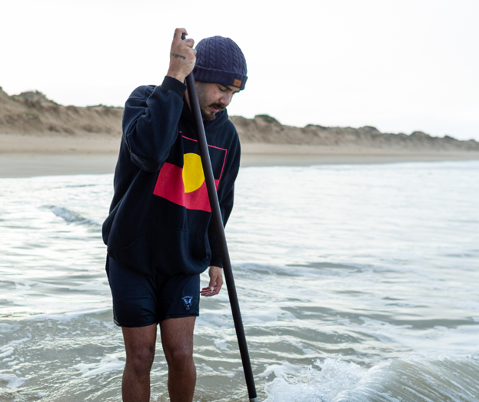
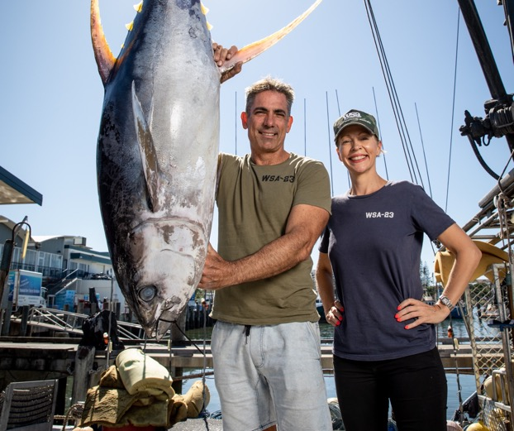
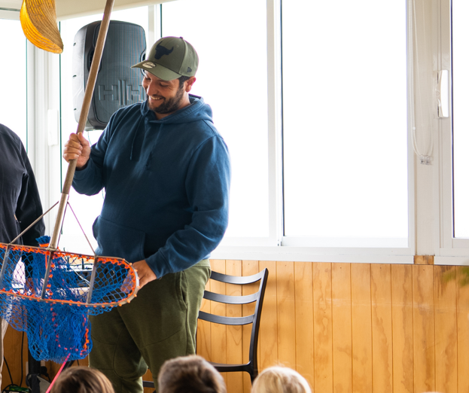
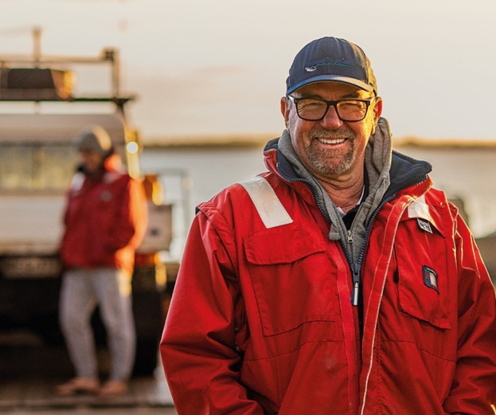

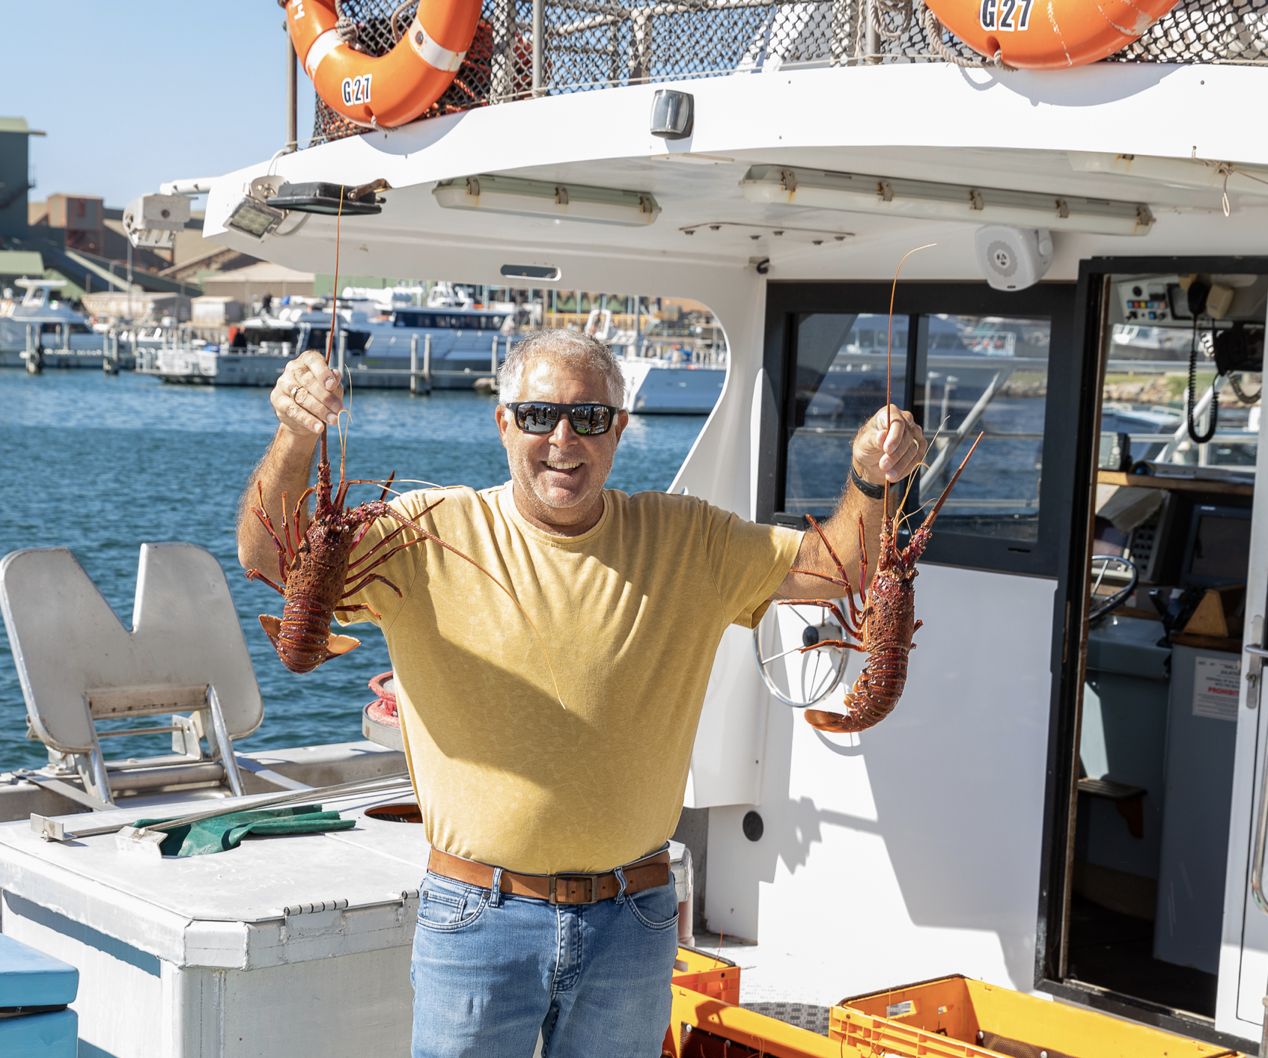
THANK YOU, FISHERS!

Slide 2

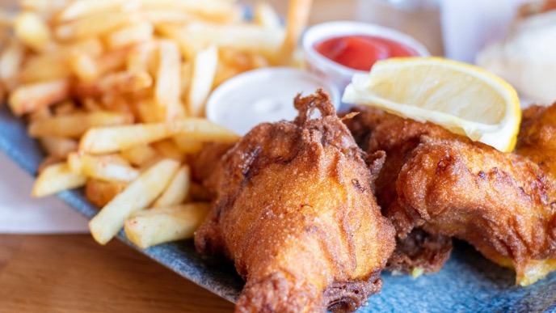
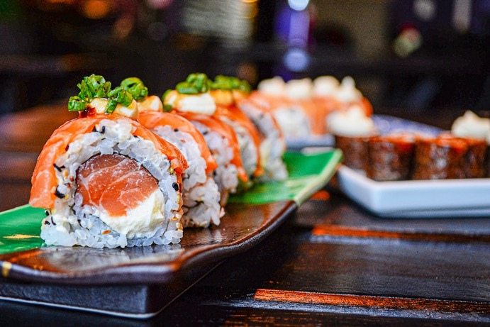
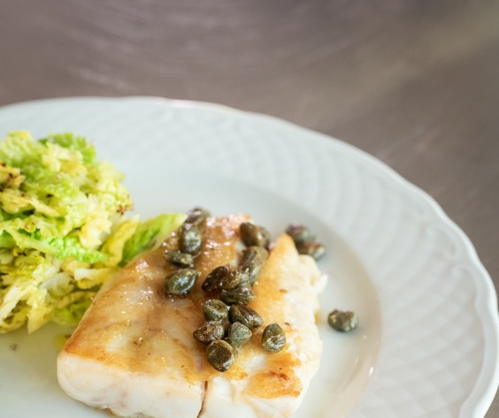
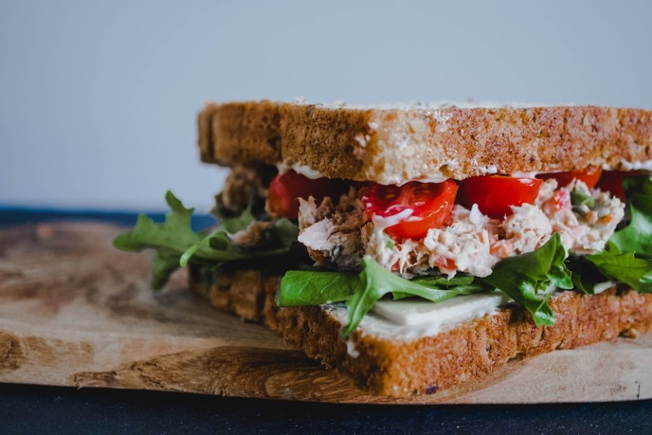
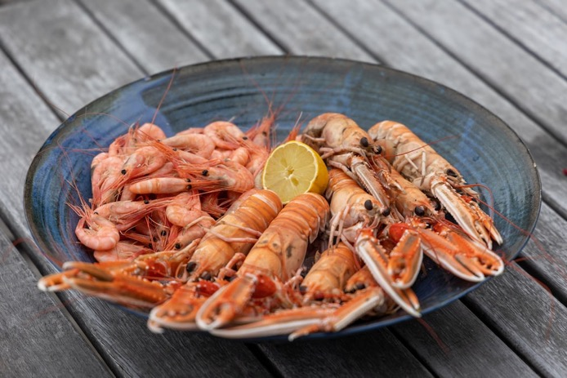
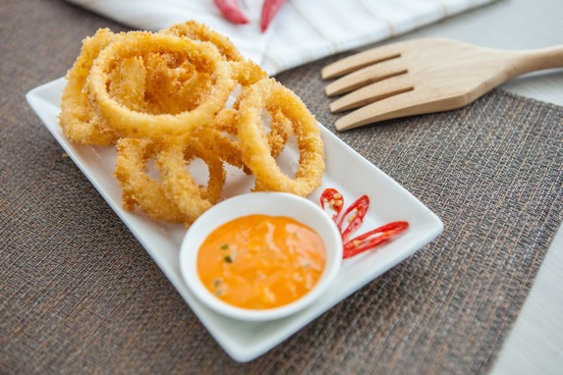
WHAT SEAFOOD DO YOU LIKE TO EAT?

Slide 3
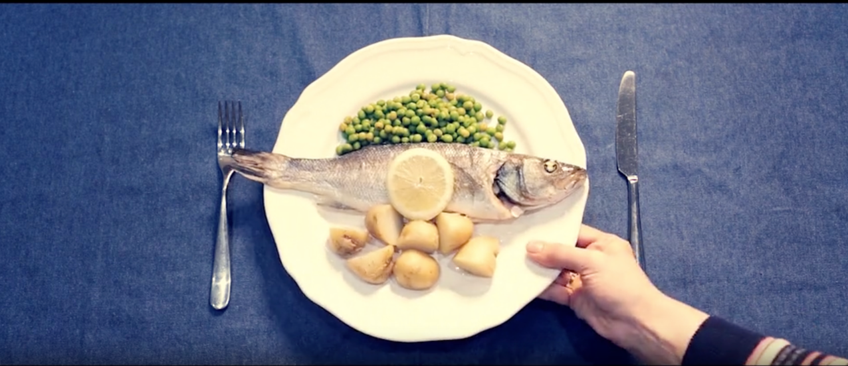
THE MOST TRADED FOOD IN THE WORLD
Video Link
https://www.msc.org/docs/default-source/aus-files/education/2-the-most-traded-food.mp4?sfvrsn=1bc9f508_2

Slide 4
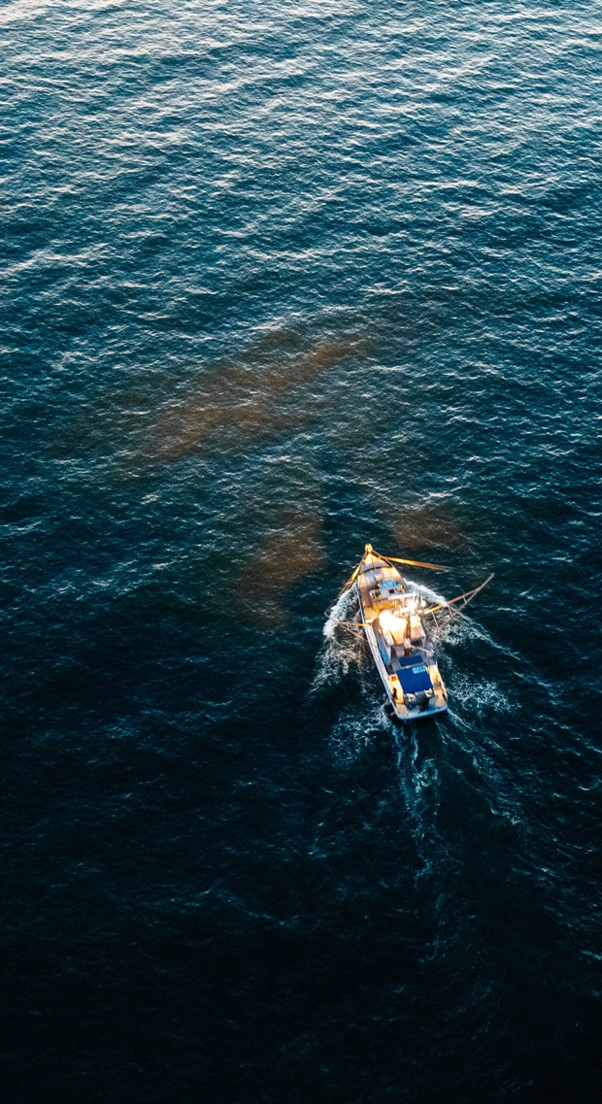
FISHING AROUND THE WORLD
Many communities around the world depend on the fishing industry for food and income.
3.3 billion people get at least 20% of their daily animal protein intake from fish
There are 39 million fishers around the world, catching wild fish and seafood from our ocean
492 million people’s livelihoods (jobs) are supported by small-scale fisheries
Over 50% of the world’s traded seafood comes from low- and middle- income countries
What could happen when so many people rely on fish and fishing for food and livelihoods?
Notes:
From https://www.msc.org/what-we-are-doing/ oceans-at-risk/the-impact-on-communities
All bullet 4 figures from the UNFAO SOFIA 2022 report

Slide 5
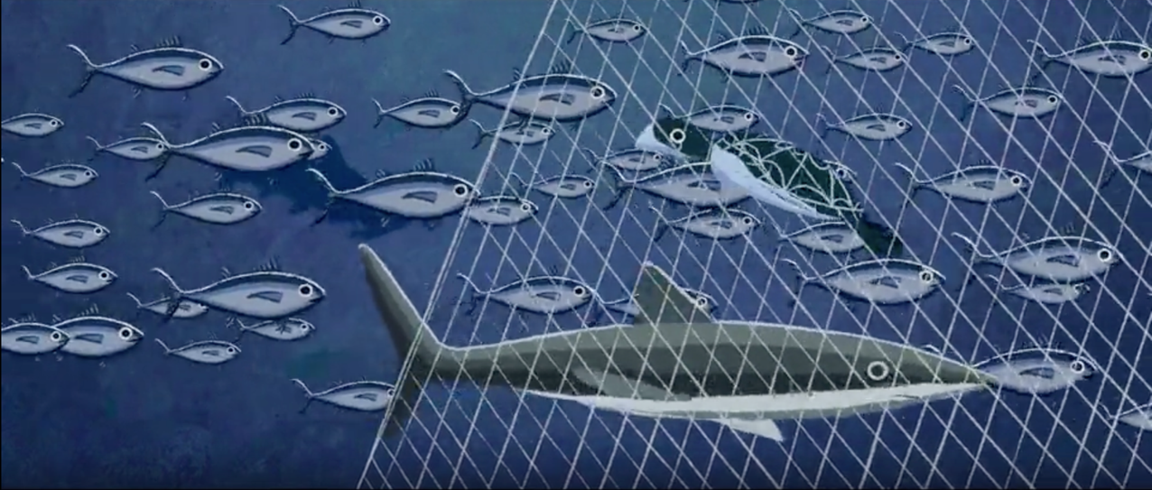
OVERFISHING
Video Link
https://www.msc.org/docs/default-source/aus-files/education/3-overfishing.mp4?sfvrsn=4b92d2ee_2

Slide 6
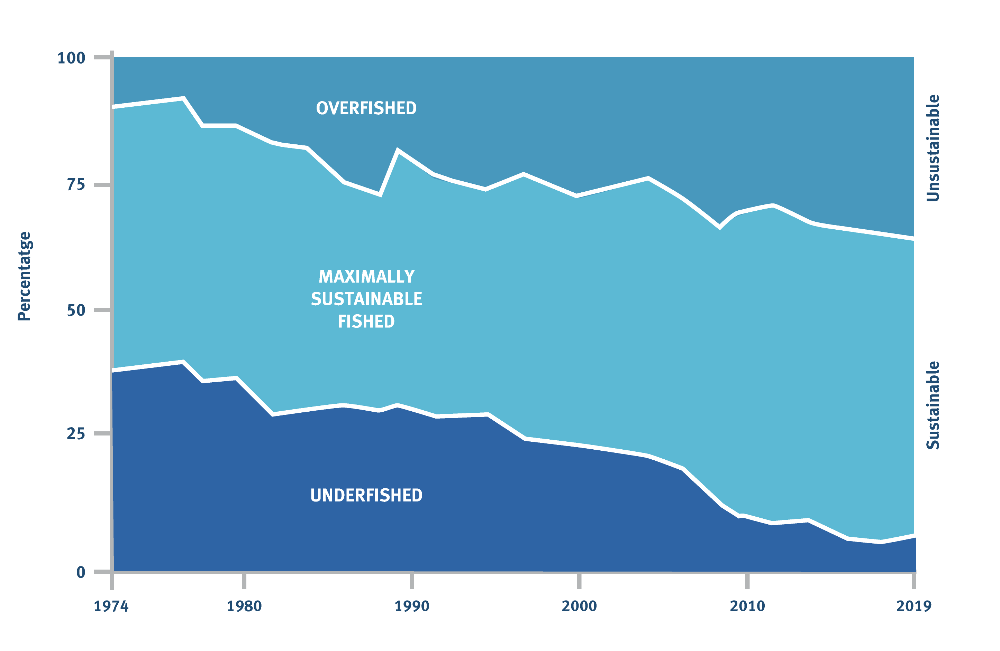
Overfishing is a serious global problem that threatens ocean wildlife, livelihoods and seafood for future generations.
Today, a third of global fish stocks is still overfished, so there’s a risk some species could disappear forever.
MARINE FISHERIES SUSTAINABILITY
© FAO SOFIA 2022

Slide 7
QUESTIONS
What does overfishing mean?
What impact does overfishing have on people’s lives and livelihoods?
What is the relationship between fishing and marine ecosystems (whole ocean environment)

Slide 8
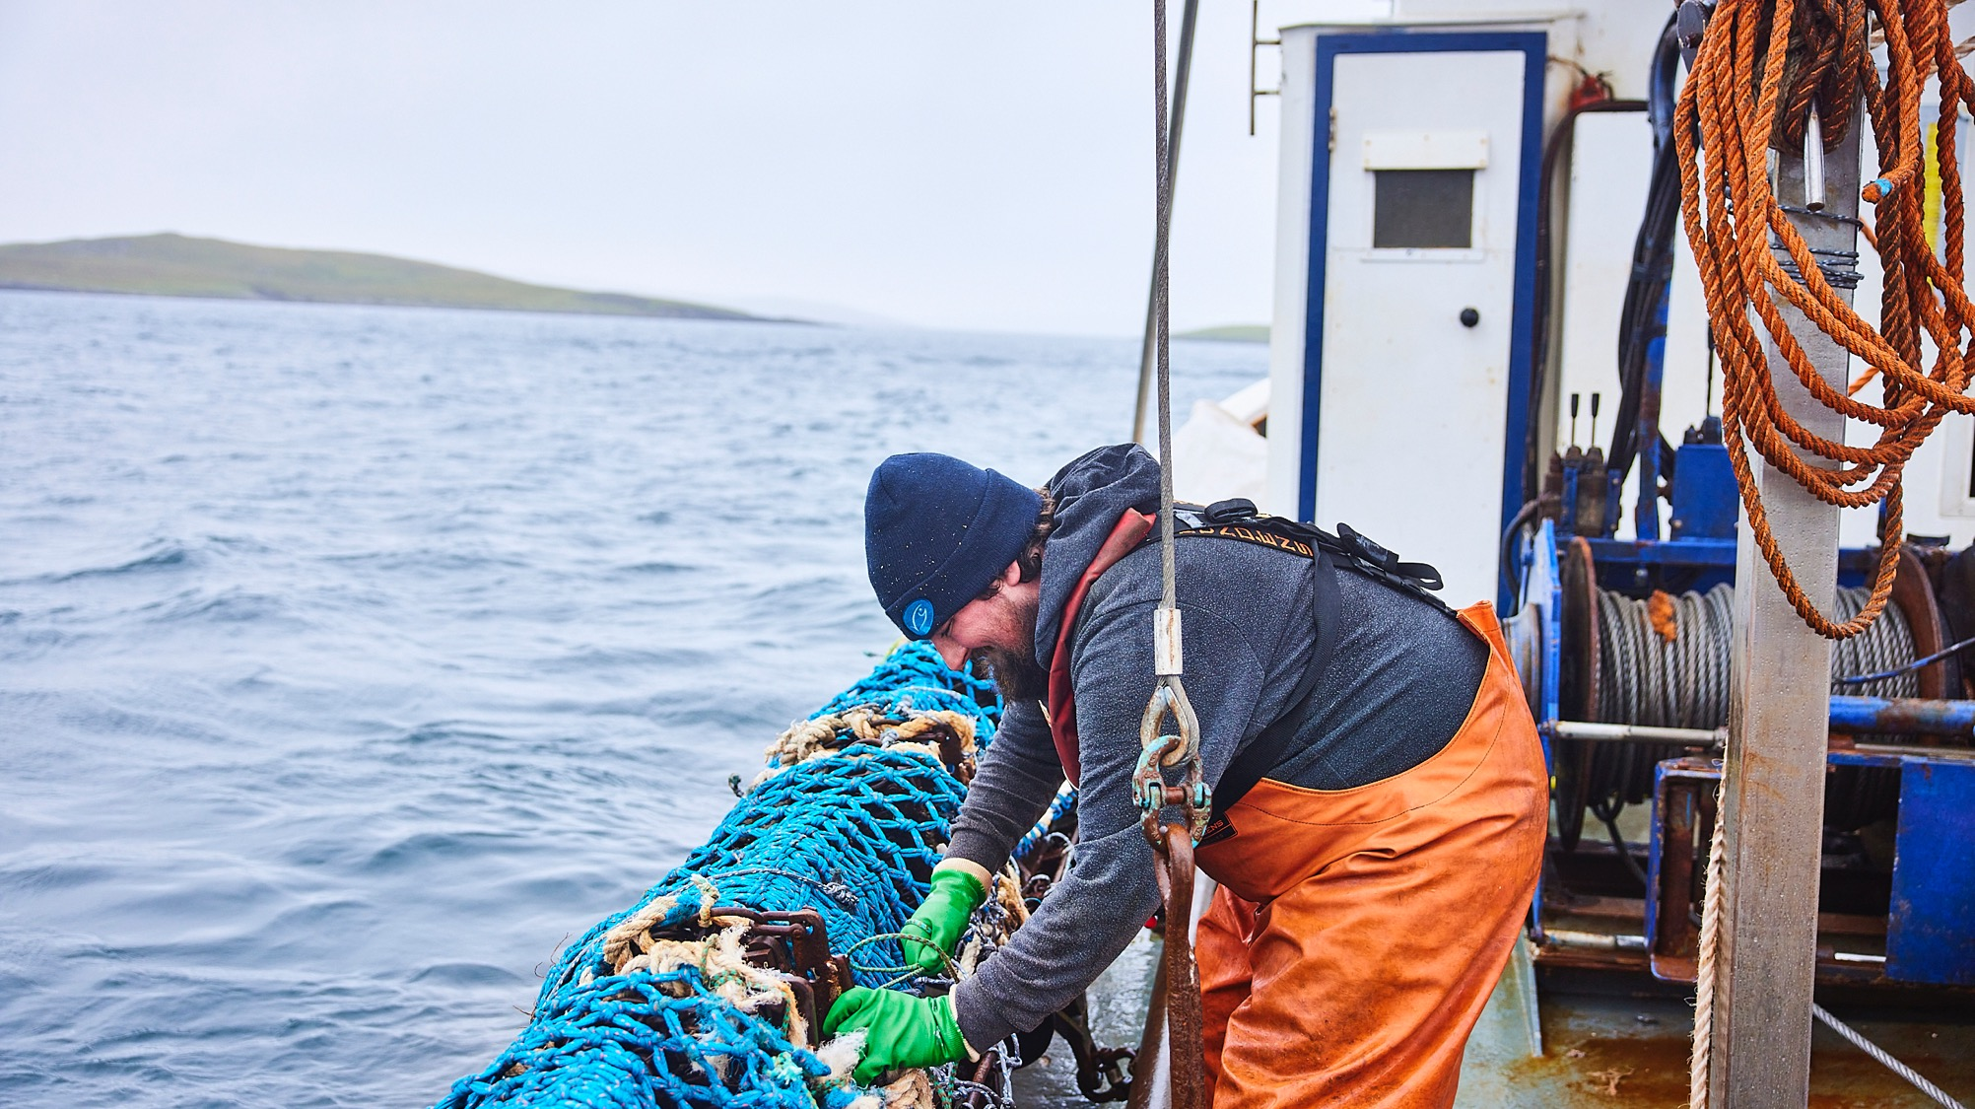
Sustainable fishing means leaving enough fish in the ocean and protecting habitats and threatened species. By safeguarding the oceans, people who depend on fishing can maintain their livelihoods.
Notes:
video: https://www.msc.org/docs/default-source/default-document-library/education-page/4-fishing-sustainably.mp4?sfvrsn=f32fd95d_4

Slide 9
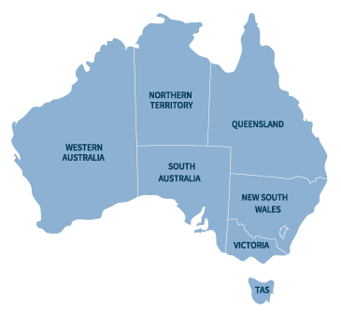
AUSTRALIAN MSC FISHERIES (Feb 23)
51% of Australian landings are MSC-engaged
Northern Prawn
South Sea Pearls**
WA Sea Cucumber
Exmouth Gulf Prawn
Eastern King Prawn*
Shark Bay Prawn
Australian Eastern Tuna and Billfish Fishery
Abrolhos Scallop
Western Rock Lobster
Eastern Rock Lobster*
Peel Harvey Crab & Mullet
SG Prawns
Royal Red Prawn*
WA Octopus
WA Abalone
SA Sardine
Small Pelagic Fishery
Bass Strait Scallop
Deep Sea Crab
Rare Foods Abalone
Goolwa Pipi’s
Blue Grenadier
HIMI Toothfish
Great Australia Bight Fishery*
Macquarie Island Toothfish
HIMI Icefish
* = full assessment

Slide 10
THE MSC FISHERY STANDARD
1
Sustainability of fish stocks (populations)
2
21
Minimising environmental impacts
3
Effective fishery management

Slide 11
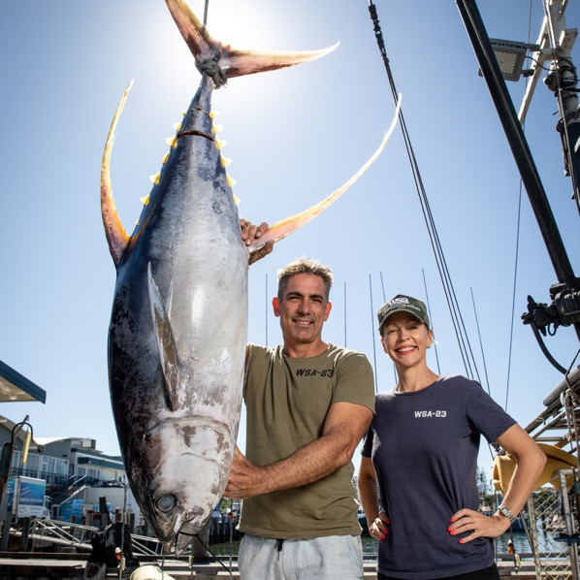
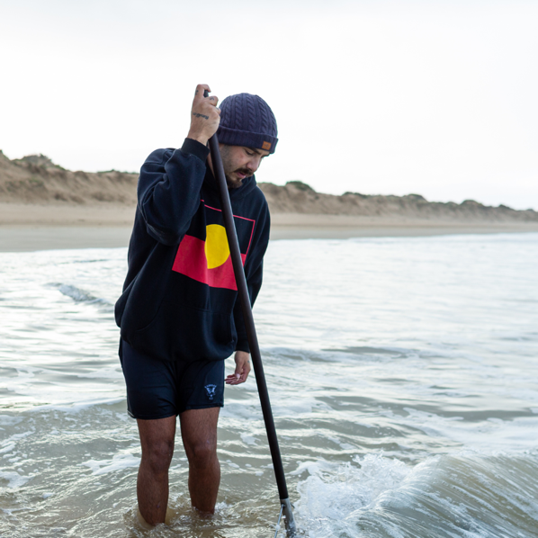
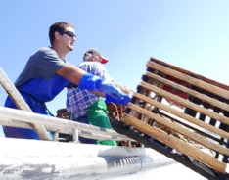
CHOOSE A CASE STUDY FISHERY
Tuna Australia
Goolwa Pipis
Western Australia Rock Lobster

