Slide 2
Notes:
He tai moana, he tai ika,
He tai timu, he ika nunumi
A sea that is healthy, is a sea that flourishes with life
A sea in decline, becomes void of sea life
Whaktauki or proverb – it outlines a two way context; the need for caring for the ocean or the repercussions of mismanagement of resources

Slide 3
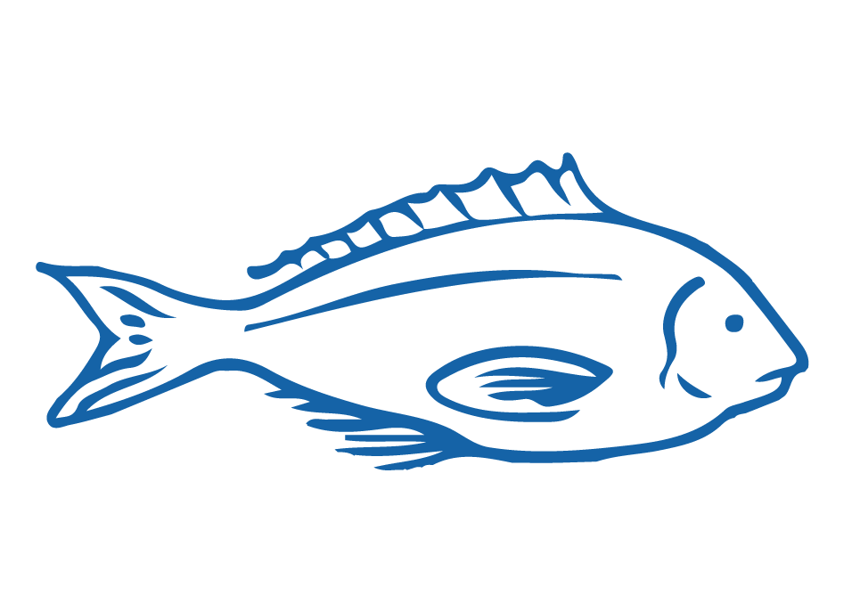
HELPFUL STUFF FOR TEACHERS
Target age range:
10–15 years
Welcome to OUR STORY!
This is topic one - an introduction to our nine topic series
Level 3-5 Science, Social Science, Hauora & Pūtaiao
See Topic 1 Planner for detail on curriculum links, learning outcomes and summary of activities
See also teacher notes below slides
Each subtopic also has a Teacher Outline
Most activities have variations [easy, harder and extending]
Slides with trickier content are labelled expert [top right corner]

Slide 4
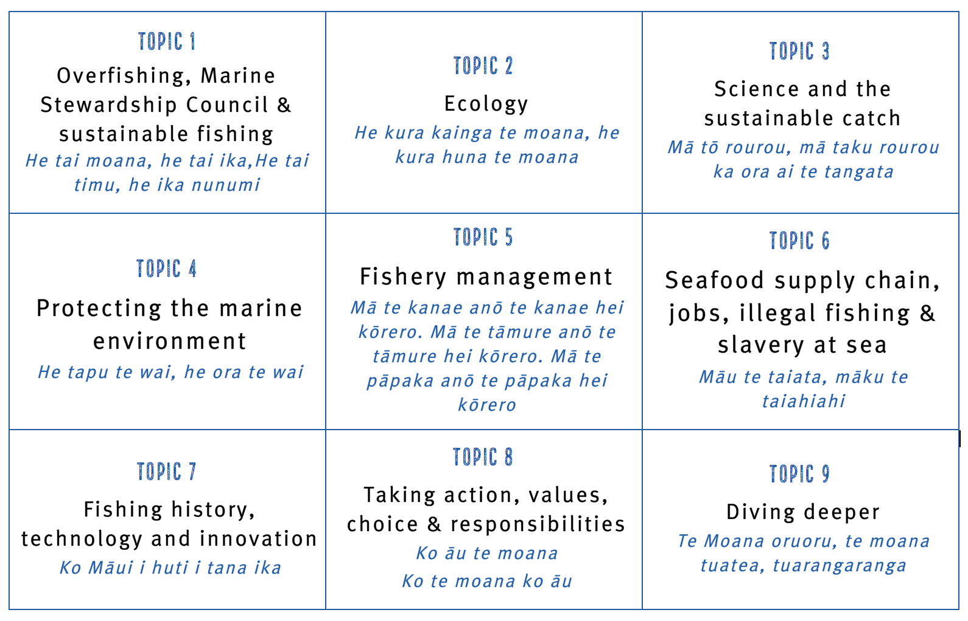
HELPFUL STUFF FOR TEACHERS
Welcome to OUR STORY!
This is topic one - an introduction to our nine topic series

Slide 5
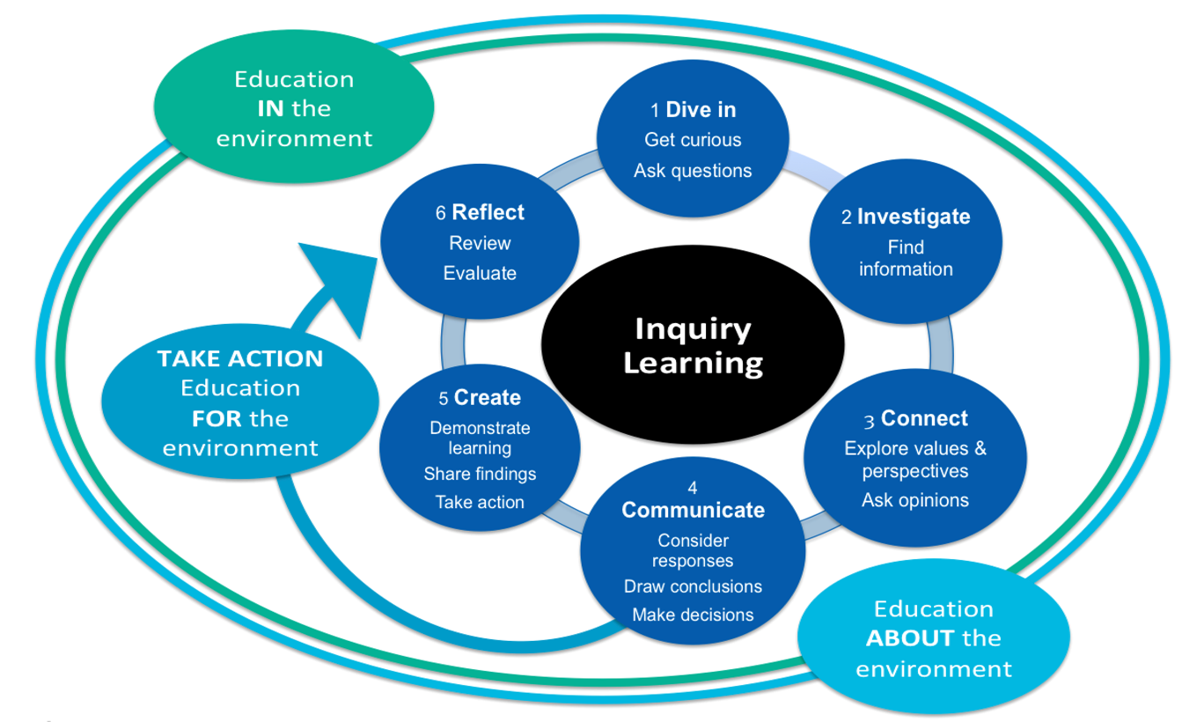
HELPFUL STUFF FOR TEACHERS

Slide 6
IN THIS TOPIC WE LEARN ABOUT…
Importance of sea creatures & the sea (1.1)
Overfishing & how it impacts people & environments (1.2)
The Marine Stewardship Council (1.3)
The Marine Stewardship Council blue fish tick label (1.3)
Sustainable fishing (1.4)
New scientific and fisheries related vocabulary (1.5, All)

Slide 7
MIHI / INTRODUCTION
Can you imagine a world without fish?
What would that be like?
No more sushi! No more fishing!
No more fish & chips! No more….?
Notes:
TEACHER NOTES
Try to get learners to connect with the personal impact of overfishing and unsustainable practices. What would it be like for ME if there were few or no fish left in the sea!

Slide 8
MIHI / INTRODUCTION
The good news is… some special people are working hard to make sure this doesn’t happen!
We will explore their story:
The story of OVERFISHING,
the MARINE STEWARDSHIP COUNCIL
& SUSTAINABLE FISHING
Let’s take a moment to think why and how …the sea is important!
Notes:
TEACHER NOTES
If you are short on time then you could jump straight to slide 11

Slide 9
1.1. IMPORTANCE OF THE SEA TO US Focusing Questions: Why is the sea important for me? How am I connected with the sea?
KŌRERORERO / DISCUSSION
In te ao Māori [the Māori world]:
All things are inter-connected
We are related to the sea through whakapapa [family tree]
People and the sea are children of Papatūānuku [earth mother] and Ranginui [sky father]
“Ko au te moana, te moana ko au” [I am the sea, the sea is me]
Source: Te Ara.govt.nz
HE PĀTAI / CONSIDER THIS
What kai moana [seafood] have you eaten or caught lately?
What beaches have you visited?
Notes:
TEACHER NOTES
USEFUL RESOURCES / RĀRANGI PUKAPUKA
To read more about Tangaroa see: https://teara.govt.nz/en/tangaroa-the-sea/print
Image source: Te Ahukaramū Charles Royal, 'Papatūānuku – the land - Papatūānuku – the
earth mother', Te Ara - the Encyclopedia of New Zealand,
http://www.TeAra.govt.nz/en/whakapapa/11430/papatuanukus-children
(accessed 14 January 2020)

Slide 10
IMPORTANCE OF THE SEA TO US
KŌRERORERO / DISCUSSION
Oceans cover 71% of the earth
Oceans hold 97% of the world’s water
Oceans affect climate & weather
Many of us eat fish and visit the sea
Many tūpuna / ancestors travelled to Aotearoa New Zealand by waka / boat
We are all connected to the sea
MAHI / ACTIVITY
Explore the importance of the sea more deeply using
Ocean Connections Teacher Outline (1.1)
Notes:
TEACHER NOTES
MAHI / ACTIVITY
Complete the ‘1.2 Ocean Connection’ activities
These include:
Activity 1 – True False card game (15 minutes)
Activity 2 – Online reading, vocab review, Kahoot quiz, review and discuss (25+ minutes)
Activity 3 – Matching games x 2, venn diagram, review and discuss (30+ minutes)
Activity 4 – Group share, create a table, create a graph, review and discuss (40+ minutes)
EXTENSION / HOMEWORK – Create card set or quiz (45+ minutes)
USEFUL RESOURCES / RĀRANGI PUKAPUKA
For more information on oceans importance see:
https://wwf.panda.org/our_work/oceans/open_ocean/ocean_importance/
https://www.mfe.govt.nz/marine/why-our-marine-environment-matters

Slide 11
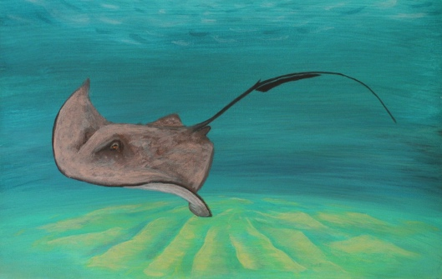
IMPORTANCE OF THE SEA TO US
KŌRERORERO/ DISCUSSION
Many of our tūpuna [ancestors] were fishing folk
The sea and its bounty is a Taonga Tuku iho [a treasure passed down from previous generations]
By being good kaitiaki [guardians or those that look after] the ocean will provide for generations to come
KŌRERO PUKAPUKA / READ
Read the story about Whaitere the stingray who became a kaitiaki
MAHI / ACTIVITY
Play Whaitere Kahoot
Notes:
TEACHER NOTES
USEFUL RESOURCES / RĀRANGI PUKAPUKA
For the Whaitere – Enchanted Stingray story (can be read in Ingarihi or English and Te Reo Māori) see: http://eng.mataurangamaori.tki.org.nz/Support-materials/Te-Reo-Maori/Maori-Myths-Legends-and-Contemporary-Stories/Whaitere-the-enchanted-stingray
For the story of the giant fish caught by Māui (can be read in Ingarihi or English and Te Reo Māori) see: http://eng.mataurangamaori.tki.org.nz/Support-materials/Te-Reo-Maori/Maori-Myths-Legends-and-Contemporary-Stories/Maui-and-the-giant-fish
For the story of the legendary explorer Kupe, who had a famous battle with a giant wheke [octopus], and was also a great fisherman (can be read in Ingarihi or English and Te Reo Māori) see: http://eng.mataurangamaori.tki.org.nz/Support-materials/Te-Reo-Maori/Maori-Myths-Legends-and-Contemporary-Stories/Kupe-and-the-Giant-Wheke
HOW TO PLAY KAHOOT
Connect a device to a projector or screen in front of the classroom.
Navigate to the game called Marine Stewardship Council NZ Whaitere or enter the URL: https://create.kahoot.it/share/marine-stewardship-council-nz-1-1-whaitere/71878f02-b4ff-4bc5-9e5d-e569a76fab2a
Select settings
At Kahoot.it, learners enter game-pin and nickname on their own devices (phone, tablet, or computer).
Press “Start now”. The fun begins!
Learners answer questions on their own devices by selecting one of the four answer buttons.
See additional instructions, options, and how to make your own Kahoot at: https://kahoot.com

