Slide 1
MIHI / INTRODUCTION
Can you imagine a world without fish?
What would that be like?
No more sushi! No more fishing!
No more fish & chips! No more….?
Notes:
TEACHER NOTES
Try to get learners to connect with the personal impact of overfishing and unsustainable practices.
What would it be like for ME if there were few or no fish left in the sea!

Slide 2
MIHI / INTRODUCTION
The good news is… some special people are working hard to make sure this doesn’t happen!
In this topic look more closely at fisheries jobs, the seafood supply chain, illegal fishing and slavery at sea!
Let’s take a moment to think about what we already know about working in the seafood and fishing industries

Slide 3
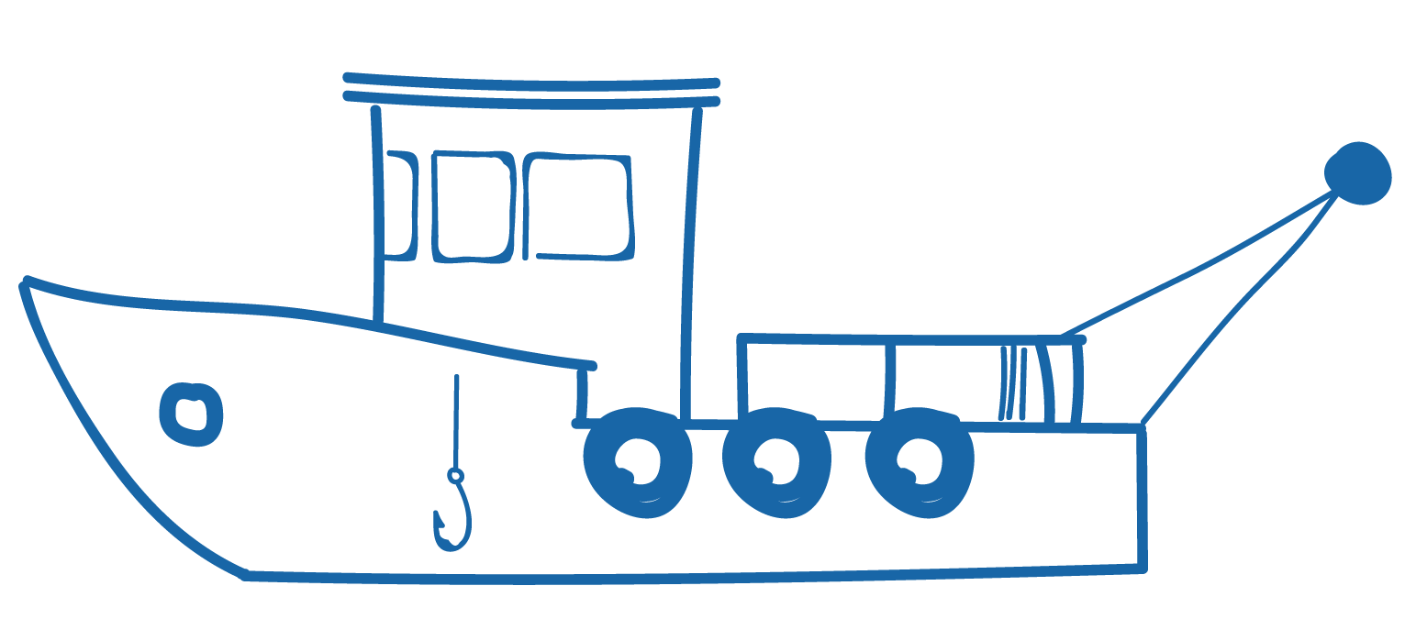
6.1. SEAFOOD INDUSTRY JOBS Focus Question: What jobs do people do in the seafood industry?
HE PĀTAI / CONSIDER THIS
Do you know any one who works in the seafood and fishing industry?
What do they do in their job?
What do you think it might be like working on a fishing boat?
MAHI / ACTIVITY
Complete the Prior Knowledge Chart columns 1 & 2
Fishing jobs PRIOR KNOWLEDGE CHART
What we know | What we would like to know | What we have learned
Notes:
TEACHER NOTES
You could go back and review Topic 1

Slide 4
SEAFOOD INDUSTRY JOBS
KŌRERORERO / DISCUSSION
About 600,000 tonnes of seafood (excluding aquaculture) is harvested from New Zealand's waters each year
2,500 people work in commercial fishing & aquaculture at sea
New Zealand’s seafood industry employs over 13,000 full time workers
Facts & Figures from Seafood New Zealand
Notes:
TEACHER NOTES
USEFUL RESOURCES / RĀRANGI PUKAPUKA
For more information see the Seafood New Zealand’s facts and figures: https://www.seafoodnewzealand.org.nz/industry/key-facts/
INVITE a local commercial fisher to come and talk about what it’s like to work at sea.

Slide 5
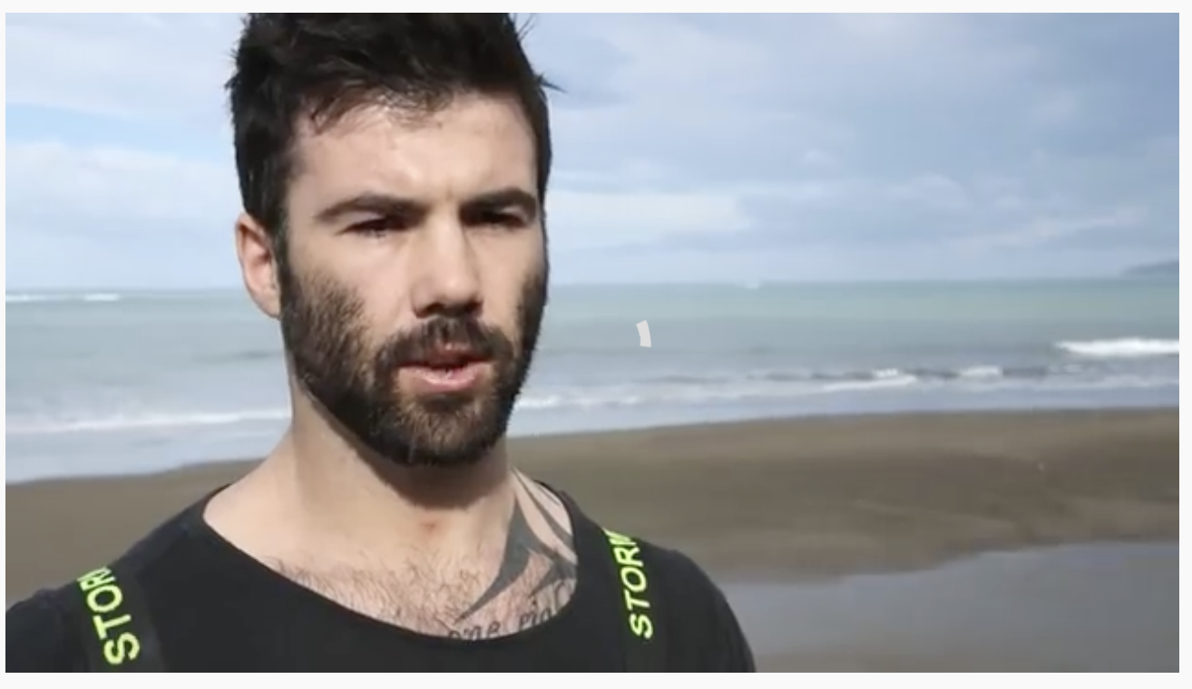
SEAFOOD INDUSTRY JOBS
HE PĀTAI / CONSIDER THIS
What would be good about doing Johnny’s job?
What would you find hard about doing Johnny’s job?
Did anything surprise you about what Johnny says about fishing for rock lobster?
MĀTAKI TĒNEI / WATCH THIS
Seafood NZ’s short film [3:22] Meet Johnny Burkhart, a rock lobster fisherman based in the Wairarapa.
Notes:
TEACHER NOTES
https://www.youtube.com/watch?v=2GAvyyw-Z-M

Slide 6
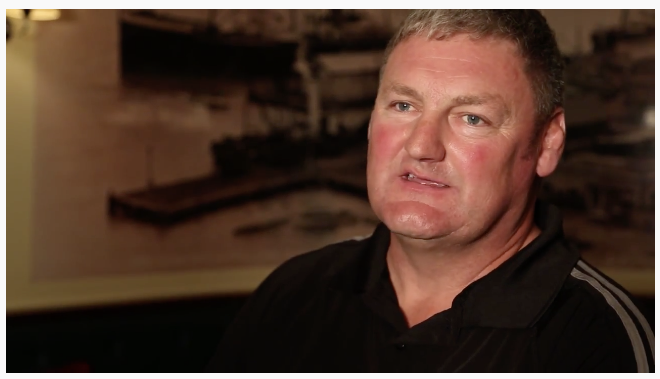
SEAFOOD INDUSTRY JOBS
HE PĀTAI / CONSIDER THIS
What does Tony catch?
How is Tony’s job different to Johnny’s?
What would you enjoy and not enjoy about Tony’s job?
Did anything surprise you about what Tony says about fishing?
MĀTAKI TĒNEI / WATCH THIS
Seafood NZ’s short film [3:08] Meet Capt. Tony Roach, an inshore skipper from Nelson
Notes:
TEACHER NOTES
They leave in the afternoon not the morning
They catch fish not crayfish
https://www.youtube.com/watch?v=MAYOi1Rm91o

Slide 7
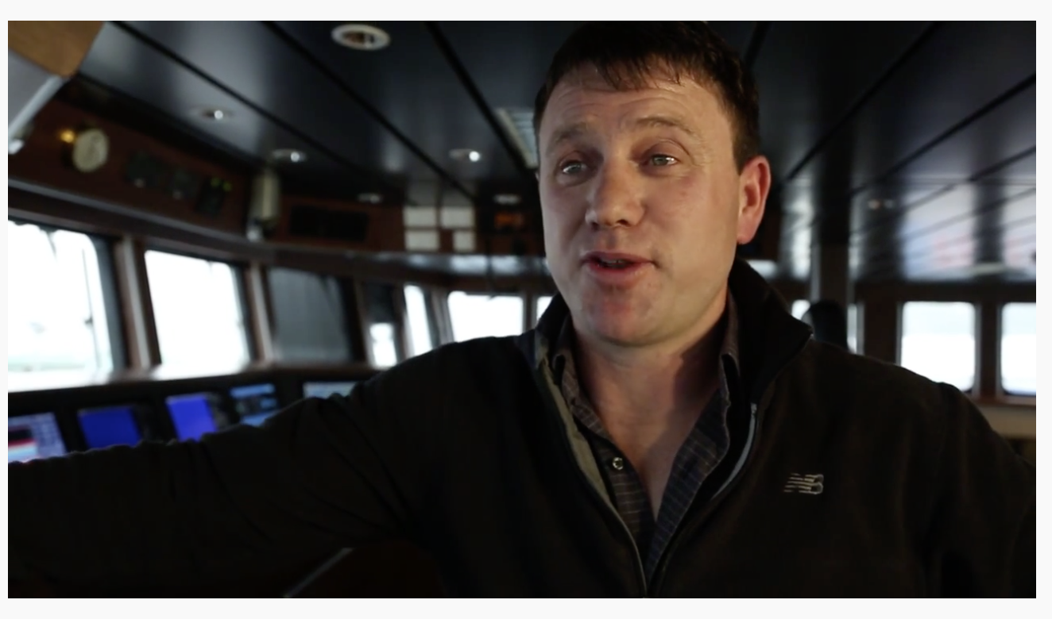
SEAFOOD INDUSTRY JOBS
HE PĀTAI / CONSIDER THIS
What type of fish does Chris catch and where?
What does Chris do to help ensure his fishing is sustainable?
How does the job, and type of fishing that Chris does, differ to that of Tony and Jonny?
MĀTAKI TĒNEI / WATCH THIS
Seafood NZ’s short film [3:08] Meet Capt. Chris Patrick, a deepwater skipper from Nelson.
Notes:
TEACHER NOTES
https://www.youtube.com/watch?time_continue=3&v=ZKGAF-upwrM
Chris works in the deep water and his vessel is factory capable
Likely to stay at sea for much longer periods of time

Slide 8
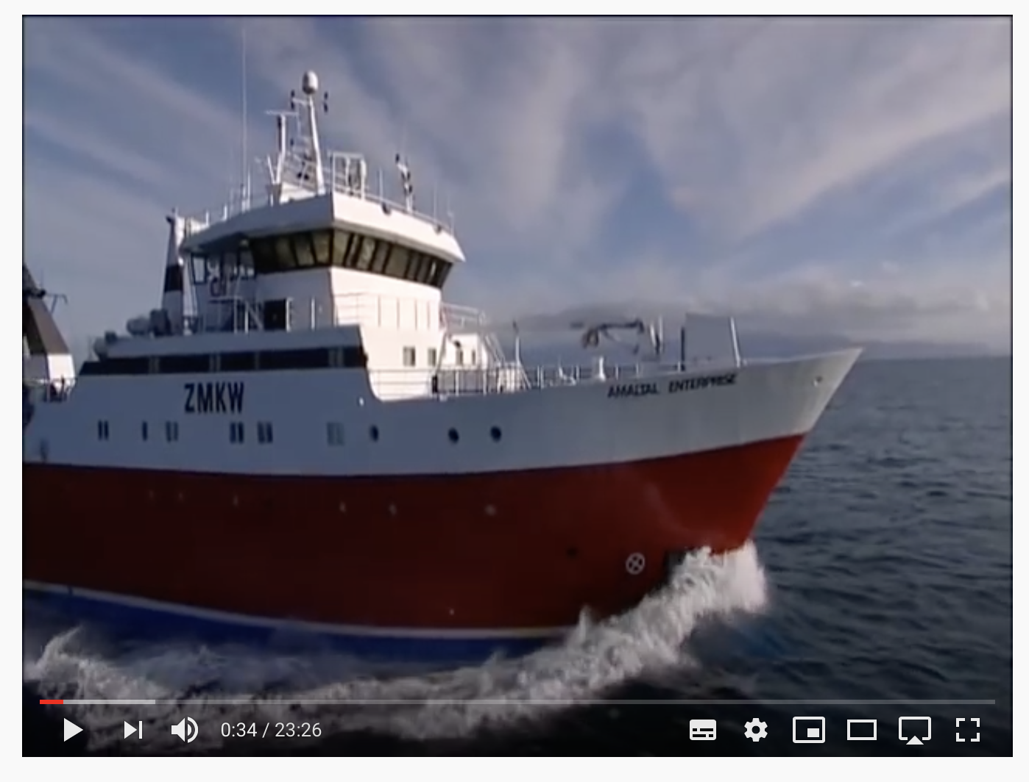
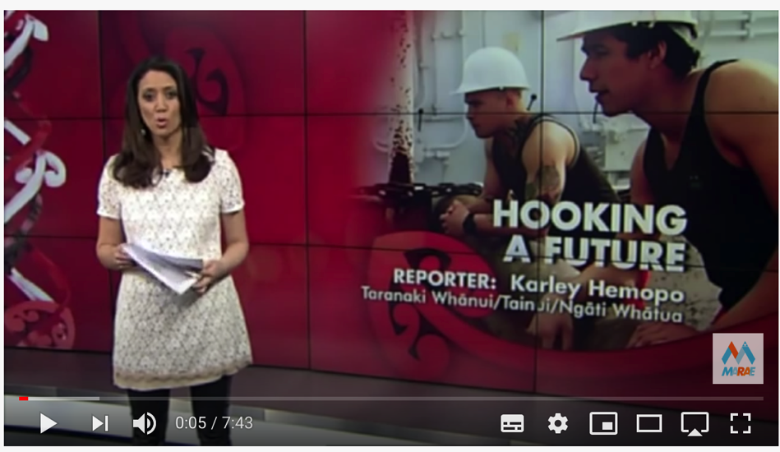
SEAFOOD INDUSTRY JOBS
MĀTAKI TĒNEI / WATCH THIS
Just the Job – Deep Sea Fishing [23: 26] investigating three different jobs working in deep sea fishing
MĀTAKI TĒNEI / WATCH THIS
Seafood NZ’s short film [7:43] A career in deep-sea fishing for young Māori
Notes:
TEACHER NOTES
Film clip #1: https://www.youtube.com/watch?v=dTxj1LAzy6s [if too long you could just watch one of the three job sections within this film]
Film clip #2: https://www.youtube.com/watch?v=WsYDcW-VWeQ

Slide 9
SEAFOOD INDUSTRY JOBS
KŌRERORERO / DISCUSSION
There are lots of cool jobs related to fishing! What do you need to know to work in a seafood industry job? How much will you earn?
MAHI / ACTIVITY
To find out… visit Careers New Zealand website. Your teacher will give you the name of a fishing related career. Complete the questions on the fishing job worksheet
Notes:
TEACHER NOTES
Fishing – we’re at the heart of communities can be found at: https://www.youtube.com/watch?v=ku-rR0rRd_Q&t=3s

Slide 10
SEAFOOD INDUSTRY JOBS
MAHI / ACTIVITY
While watching this film, list all jobs you see people doing that are involved in the supply of seafood from ocean to plate
KŌRERORERO / DISCUSSION
Which job would you MOST like to do? Why?
Which would you LEAST like to do? Why not?
MĀTAKI TĒNEI / WATCH THIS
Seafood NZ’s short film [4:38] about the people and jobs that make up the fishing industry
Notes:
TEACHER NOTES
Fishing – we’re at the heart of communities can be found at: https://www.youtube.com/watch?v=ku-rR0rRd_Q&t=3s

