Slide 1
6.2. SEAFOOD SUPPLY CHAIN Focus Question: What are key steps in the chain that delivers seafood from the ocean to our plates
The seafood supply chain is the chain of steps that happens to supply seafood from the ocean to your plate
MAHI / ACTIVITY
What do you already know about the chain of steps in the supply of seafood?
Complete the ‘What we know about fish?’ columns 1 & 2
What do we know about THE SEAFOOD SUPPLY CHAIN? PRIOR KNOWLEDGE CHART
What we know | What we would like to know | What we have learned
Notes:
TEACHER NOTES
Complete columns one and two and then add information to three at the end of 2.2

Slide 2
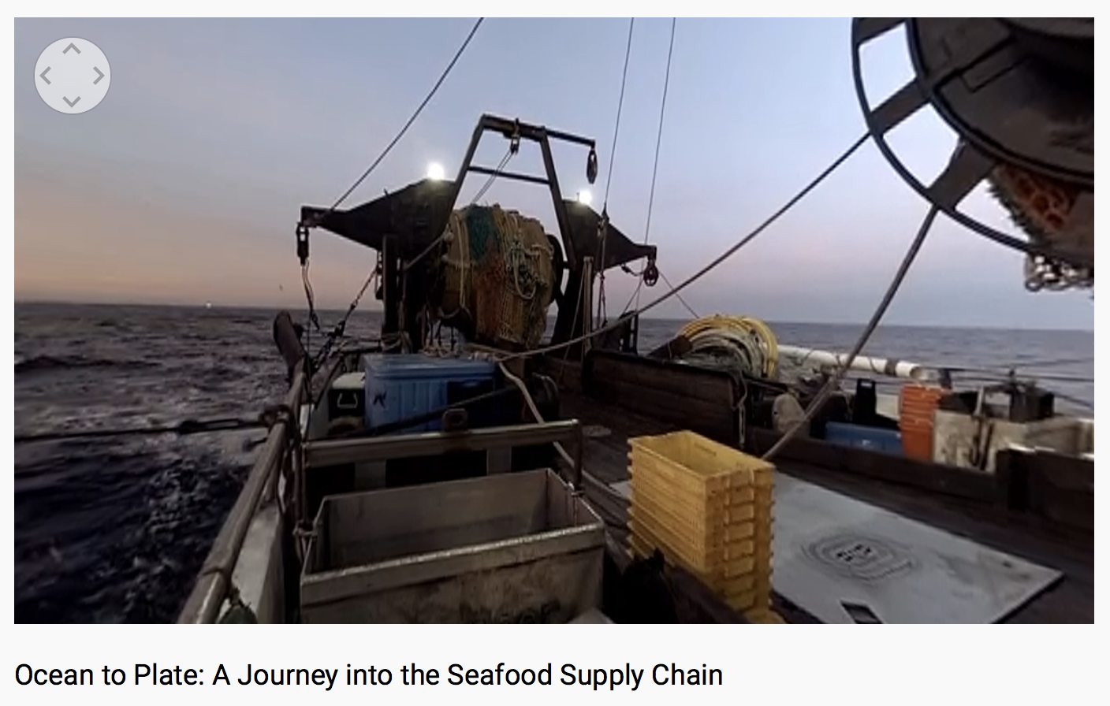
SEAFOOD SUPPLY CHAIN
MAHI / ACTIVITY
While watching this film write down steps in the journey of a fish from the ocean to a plate?
Fisheries shown here are not MSC certified you identify areas of improvement?
KŌRERORERO / DISCUSSION
Think about what you saw in this film
What improvements would you make to the ocean to plate seafood supply chain?
MĀTAKI TĒNEI / WATCH THIS
WWF short film [7:02] about seafood supply chain
Notes:
TEACHER NOTES
Ocean to Plate – Seafood Supply Chain film link: https://www.youtube.com/watch?v=pkfgILiGbVk

Slide 3
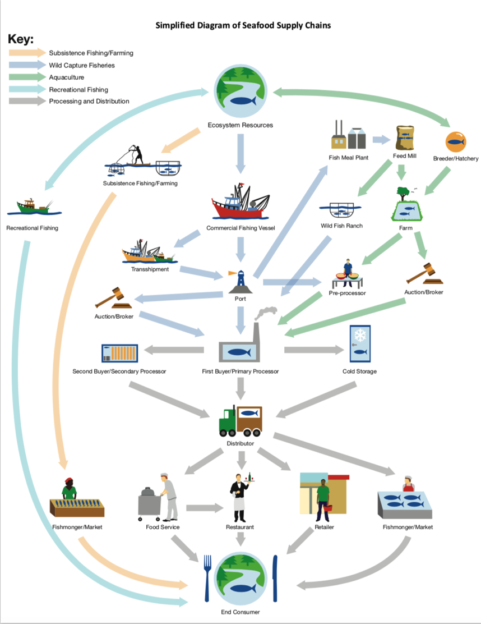
SEAFOOD SUPPLY CHAIN
KŌRERO PUKAPUKA / READ
Read & discuss: Ocean to plate in 36 hours: the Lee Fish Story
MAHI / ACTIVITY
In groups: use your notes from last slide. Draw a flow diagram showing steps a fish journeys through from the ocean to your plate (See Teacher Outline)
Click again for example!
Source: FishWise.org
Notes:
TEACHER NOTES
An example of a supply chain diagram is provided – found at http://fishwise.org/wp-content/uploads/2017/12/Seafood_Supply_Chains.pdf
https://www.nzstory.govt.nz/news/ocean-to-plate-in-36-hours-the-lee-fish-story/

