Slide 1
6.4. ILLEGAL FISHING Focus Question: What is illegal, unregulated and unreported fishing & how does it impact sustainability?
KŌRERORERO / DISCUSSION
Illegal, unreported, and unregulated (IUU) fishing is when people fish outside of the law and is a big problem around the world
It is often conducted without concern for marine life or the environment and includes:
Patagonian Toothfish
Notes:
TEACHER NOTES
USEFUL RESOURCES / RĀRANGI PUKAPUKA
Read more about MSC certification and how it helped the sustainability of Patagonion Tooth Fish:
http://patagonian-toothfish-story.msc.org
http://blog.msc.org/blog/2015/05/14/patagonia-toothfish/
Find out more about the toothfish fishery from the research conducted by NIWA: https://niwa.co.nz/fisheries/research-projects/antarctic-fisheries-research/the-toothfish-fishery

Slide 2
ILLEGAL FISHING
HE PĀTAI / CONSIDER THIS
Have you ever taken or sold seafood when you shouldn’t have?
Why do you think people sometimes take or sell kai moana that they shouldn’t?
What impact can illegal fishing and sale of kai moana have on our environment?
MAHI / ACTIVITY
Fill in columns 1 & 2
Illegal fishing PRIOR KNOWLEDGE CHART
What we know | What we would like to know | What we have learned
Notes:
TEACHER NOTES
You could go back and review Topic 1

Slide 3
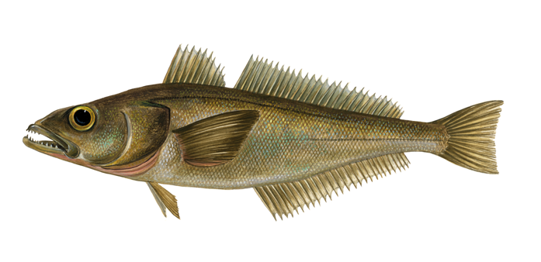
ILLEGAL FISHING
KŌRERORERO / DISCUSSION
Illegal fishing for Patagonian toothfish threatened the sustainability of this fish
MAHI / ACTIVITY
In the past, illegal fishing for Patagonian toothfish threatened sustainability of fish stocks
Read more about the Toothfish story and the hunt for pirate fishers
Notes:
TEACHER NOTES
USEFUL RESOURCES / RĀRANGI PUKAPUKA
Read more about MSC certification and how it helped the sustainability of Patagonion Tooth Fish:
http://patagonian-toothfish-story.msc.org
http://blog.msc.org/blog/2015/05/14/patagonia-toothfish/
Find out more about the toothfish fishery from the research conducted by NIWA: https://niwa.co.nz/fisheries/research-projects/antarctic-fisheries-research/the-toothfish-fishery

Slide 4
ILLEGAL FISHING
A. Fishing that is either not reported or not reported truthfully
B. Fishing by NZ boats for fish not covered by fishing laws or outside our fishery areas OR fishing by overseas boats with no permission in our fishing waters
C. Fishing by NZ boats or in NZ waters that is not conducted according to NZ law
MAHI / ACTIVITY
See if you can match these terms (1, 2, 3) to the definitions (A, B, C):
(1) illegal
(2) unreported &
(3) unregulated
Ready for some answers?
Notes:
TEACHER NOTES
(1) Illegal = C
(2) Unreported = A
(3) Unregulated = B

Slide 5
ILLEGAL FISHING
Ready for some answers?
HE PĀTAI / CONSIDER THIS
Which of the following do you think is not legal and is it an example of fishing that is
(1) Illegal
(2) Unreported or
(3) Unregulated
A recreational fisher selling fish
A commercial fisher failing to report their catch
A foreign vessel (with no quota) fishing for hapuka less than 200 miles from land
Notes:
TEACHER NOTES
(1) Illegal = A
(2) Unreported = B
(3) Unregulated = C

Slide 6
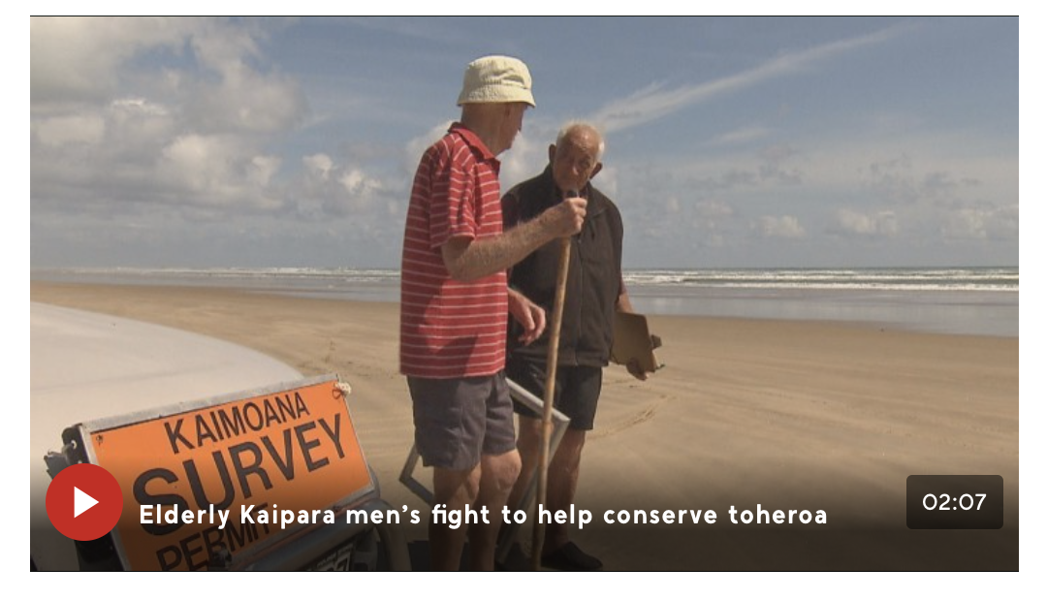
ILLEGAL FISHING
KŌRERORERO / DISCUSSION
In Aotearoa New Zealand selling fish without quota is illegal under the QMS
Taking fish beyond the recreational limit or without a customary permit is also illegal
Let’s visit Jim and Barry (Ngā kaitiaki toheroa) and see how illegal fishing or ‘poaching’ has impacted toheroa
MĀTAKI TĒNEI / WATCH THIS
Short film [2:07] about why toheroa are not recovering on Ripiro Beach
Notes:
TEACHER NOTES
Article and film clip can be found at https://www.tvnz.co.nz/one-news/new-zealand/elderly-kaipara-men-s-fight-help-conserve-prized-toheroa-shellfish

Slide 7
ILLEGAL FISHING
MAHI / ACTIVITY
Place yourself along a continuum (line) with strongly agree at one end and strongly disagree at the other end, based on your belief around the following statements
WHY? Justify your position with your neighbour!
“We all have a right to fish regardless of the rules”
“Illegal fishing has little impact on the environment or the sustainability of fisheries”
Strongly agree
Strongly disagree
Notes:
TEACHER NOTES
Spend time discussing and figuring out why they think what they do!

Slide 8
ILLEGAL FISHING
The Marine Stewardship Council is working hard to address illegal fishing as it is not sustainable
When you buy seafood that has the Blue Fish Tick you know that fish has been legally and sustainably caught
MAHI / ACTIVITY
Complete the illegal fishing worksheet
KŌRERORERO / DISCUSSION
IUU fishing threatens the sustainability of fish populations, ecosystems, and the livelihoods of those who fish legally
Notes:
TEACHER NOTES
How the MSC is working to tackle illegal fishing: http://blog.msc.org/blog/2015/04/01/tackling-illegal-fishing-one-certificate-at-a-time/

Slide 9
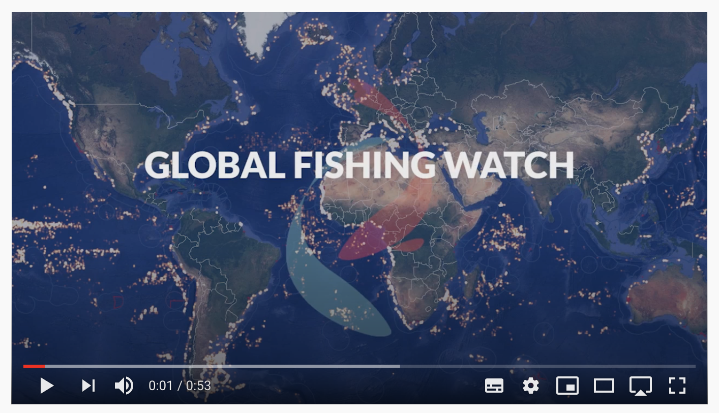
ILLEGAL FISHING
KŌRERORERO / DISCUSSION
Global Fishing Watch is an independent non profit organisation
Global Fishing Watch track global commercial fishing in real time
MĀTAKI TĒNEI / WATCH THIS
Short film about Global Fishing Watch [0:53]
Notes:
TEACHER NOTES
USEFUL RESOURCES / RĀRANGI PUKAPUKA
Visit Global Fishing Watch at https://globalfishingwatch.org/map/
Watch this about the Global Fishing Watch https://www.youtube.com/watch?v=ISbIUjCz8Pg
You can also track sustainable fisheries using the MSC Track a Fishery Tool
https://fisheries.msc.org/en/fisheries/
CONSIDER
Why are some areas fished more than others?

Slide 10
ILLEGAL FISHING
HE PĀTAI / CONSIDER THIS
Look at the global map? Where is most of the fishing activity? Why?
Where is most of the fishing happening around Aotearoa New Zealand right now?
Which parts of our ocean have the most activity (you can mouse over to see the number of objects)
MAHI / ACTIVITY
Visit the Global Fishing Watch site and explore the map
Notes:
TEACHER NOTES
Visit Global Fishing Watch at https://globalfishingwatch.org/map/
You can also track sustainable fisheries using the MSC Track a Fishery Tool: https://fisheries.msc.org/en/fisheries/
DEEPEN THE INQUIRY
To deepen learning and application of the Global Fishing Watch see a range of tutorials available at: https://globalfishingwatch.org/faqs/#faqs-video-tutorials
QUESTIONS:
Where is most of the fishing happening? Most activity in equatorial regions rather than polar ends of the map.
Why are some areas fished more than others? Mainly due to higher population (ie. More people living and fishing from mid latitudes than polar ones); (access (some areas easier to reach), underwater topography, currents etc affecting the ecology of the area and the abundance of fish (some areas are just better fishing!), legislation (some areas are protected)
How do you think global fishing watch help in the fight against illegal fishing? (transparency!)

