Slide 1
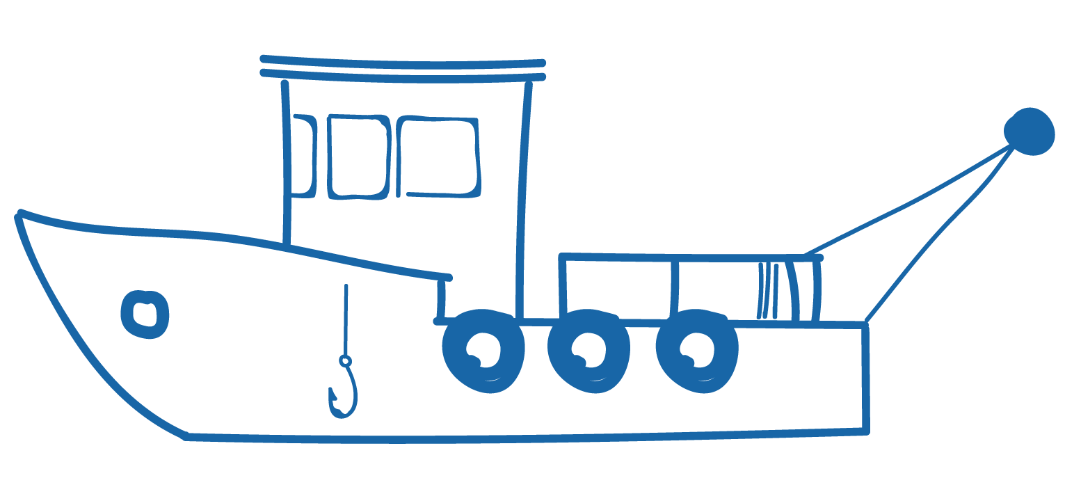
6.5. SLAVERY AT SEA Focus Question: Why do human rights abuses occur on fishing vessels at sea?
KŌRERORERO / DISCUSSION
Fishing on boats registered here in Aotearoa New Zealand can be a great job!
BUT there are cases of slavery, piracy, and tough working conditions on some overseas fishing boats
Some of these boats fly ‘flags of convenience’
What is a flag of convenience?
Every boat must be registered with a county
Some vessels are registered and fly the flag of countries that cannot or will not enforce any rules
These are ‘flags of convenience’
Notes:
TEACHER NOTES
USEFUL RESOURCES / RĀRANGI PUKAPUKA
To learn more about flags of convenience see:
https://kids.kiddle.co/Flag_of_convenience

Slide 2
SLAVERY AT SEA
HE PĀTAI / CONSIDER THIS
Watch the film again & list reasons why people being forced to work for long periods of time at sea
KŌRERORERO / DISCUSSION
The Marine Stewardship Council requires all certified fisheries to be checked to ensure they do not use forced labour or child labour aboard their fishing vessels
MĀTAKI TĒNEI / WATCH THIS
Short clip about the problem of forced labour on fishing vessels [1:00]
Notes:
TEACHER NOTES
Film clip can be found at: https://www.youtube.com/watch?v=MrJEel-n8mQ&feature=emb_logo

Slide 3
SLAVERY AT SEA
Experts ONLY!
KŌRERORERO / DISCUSSION
Forced labour and slavery at sea do not respect basic human rights
Human rights are rights that are believed to belong to every person
Example of a human right: the right to equality and freedom from discrimination
KŌRERO PUKAPUKA / READ
Read about the Human Rights at Sea organisation
HE PĀTAI / CONSIDER THIS
Why were they created and what do they do?
Notes:
TEACHER NOTES
https://www.humanrightsatsea.org/who-are-we/

Slide 4
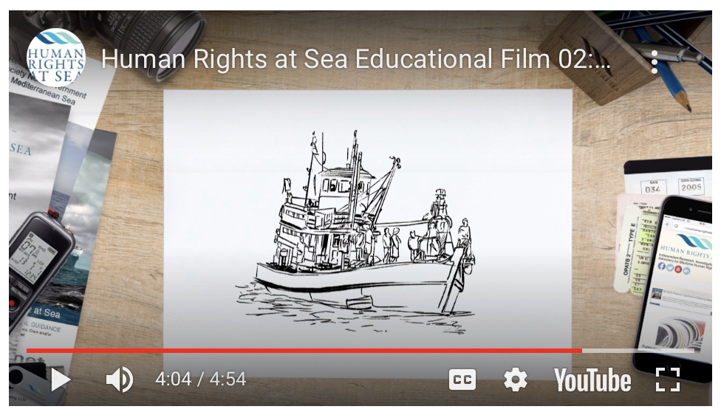
SLAVERY AT SEA
Experts ONLY!
HE PĀTAI / CONSIDER THIS
What are labour rights?
What declaration was made in 1948?
What are three basic worker rights?
Are fishing vessels subject to maritime rights?
Are labour rights human rights?
MĀTAKI TĒNEI / WATCH THIS
Human Rights at Sea [4:54]
KŌRERO PUKAPUKA / READ
Read more about Marine Stewardship Council & human rights issues at sea!
Notes:
TEACHER NOTES
Film clip can be found at: https://www.humanrightsatsea.org/educational-material/labour-rights-and-human-rights/
He Pātai
What are labour rights? Human rights that relate to work
What is declaration was made in 1948? Universal Declaration of Human Rights
What are three basic worker rights? E.g. Right to work in job of choice; Equal pay; Right to appropriate rest and leisure time or could include Freedom from forced labour; Freedom from child labour etc
Are fishing vessels included in maritime rights? YES
Are labour rights human rights? YES
MSC on Human Rights: https://www.msc.org/what-we-are-doing/our-approach/forced-and-child-labour

