Slide 1



8.4.TAKING ACTION: CONSUMER CHOICE
Focus Question: What actions can I take to help the health of kai moana [seafood] resources?
MAHI / ACTIVITY
(Viewpoint Continuum: see Teacher Outline)
There are many different viewpoints!
Place yourself along a continuum (line), based on your belief around the following statement:
“Consumers have a powerful role to play in influencing the production of goods”
Strongly agree
Strongly disagree
Notes:
TEACHER NOTES
Adapted from an activity by MBI on consumer protection.
See https://www.consumerprotection.govt.nz/resources-2/school-resources/year-9-10-school-resources/module-2-consumer-power/

Slide 2

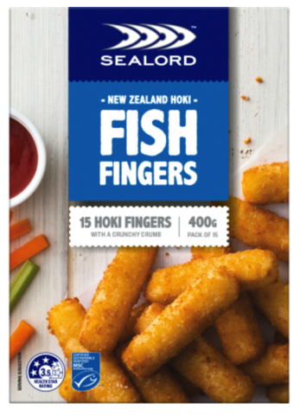
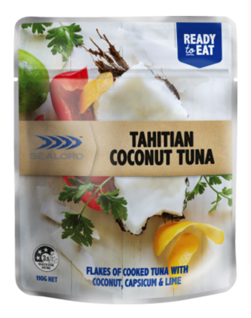
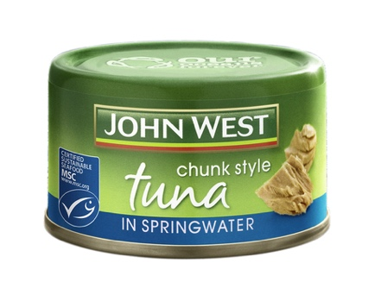
TAKING ACTION: CONSUMER CHOICE
KŌRERORERO/ DISCUSSION
A lot of thinking and research has gone in to trying to figure out what makes people buy one product over an other
HE PĀTAI / CONSIDER THIS
What makes you buy one product over another? Is it the product, the packaging or….?
Notes:
TEACHER NOTES

Slide 3

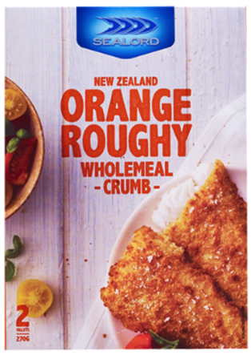
TAKING ACTION: CONSUMER CHOICE
MAHI / ACTIVITY
Rank your preferred products 1-4. Give reasons for your choices.
$5.49 per box
$1.37 per 100g
$2.00 per can
$2.10 per 100g
$5.99 per box
$2.22 per 100g
$2.79 per sachet
$2.54 per 100g
Notes:
TEACHER NOTES
Reasons might include:
MSC label / environmentally driven decisions
Price – economically driven decisions
Taste / flavour
Look
Packaging
Brand
Other

Slide 4
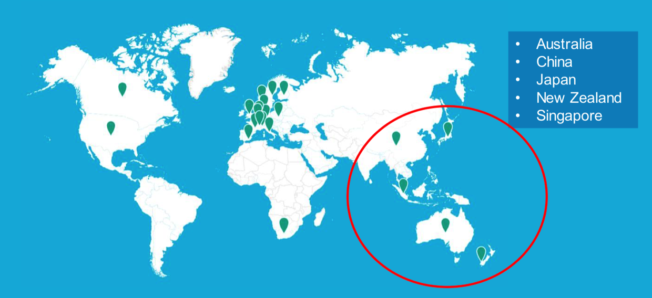
TAKING ACTION: CONSUMER CHOICE
KŌRERORERO/ DISCUSSION
Every couple of years Marine Stewardship Council conduct an independent survey to find out what seafood consumers are thinking!
Results from 2020 Asia Pacific survey of more than 5,700 consumers found 4,578 were seafood consumers
Notes:
TEACHER NOTES
USEFUL RESOURCES / RĀRANGI PUKAPUKA
For the full MSC slide show and more data see:
https://www.msc.org/docs/default-source/default-document-library/for-business/msc-globescan-understanding-consumers-webinar-deck---asia-pacific.pdf?sfvrsn=1abf2180_4

Slide 5
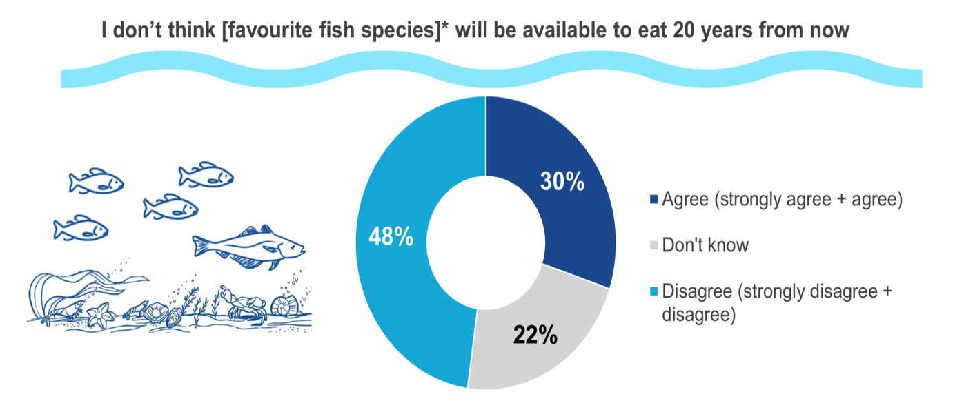
TAKING ACTION: CONSUMER CHOICE
HE PĀTAI /
CONSIDER THIS
The 2020 survey found 30% of seafood consumers felt strongly that their favourite sea food would not be available in 20 years time!
What do you think?
Notes:
TEACHER NOTES
USEFUL RESOURCES / RĀRANGI PUKAPUKA
For the full MSC slide show and more data see:
https://www.msc.org/docs/default-source/default-document-library/for-business/rise-of-the-conscious-food-consumer---asia-pacific-webinar-slides.pdf?sfvrsn=b5a32860_4

Slide 6
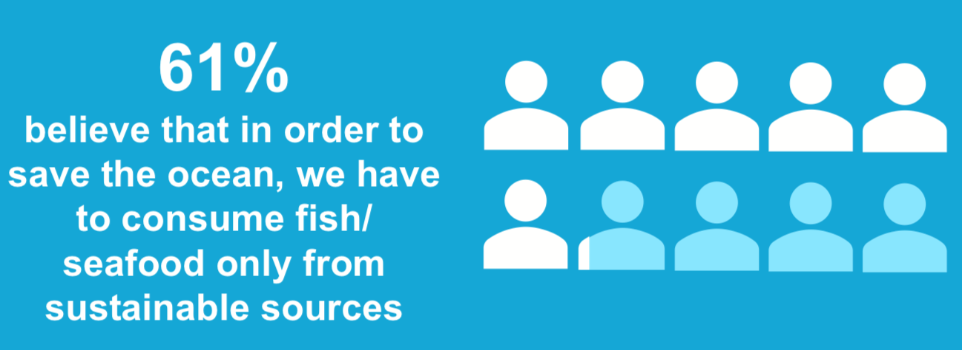

TAKING ACTION: CONSUMER CHOICE
Notes:
TEACHER NOTES
USEFUL RESOURCES / RĀRANGI PUKAPUKA
For the full MSC slide show and more data see:
https://www.msc.org/docs/default-source/default-document-library/for-business/msc-globescan-understanding-consumers-webinar-deck---asia-pacific.pdf?sfvrsn=1abf2180_4

Slide 7
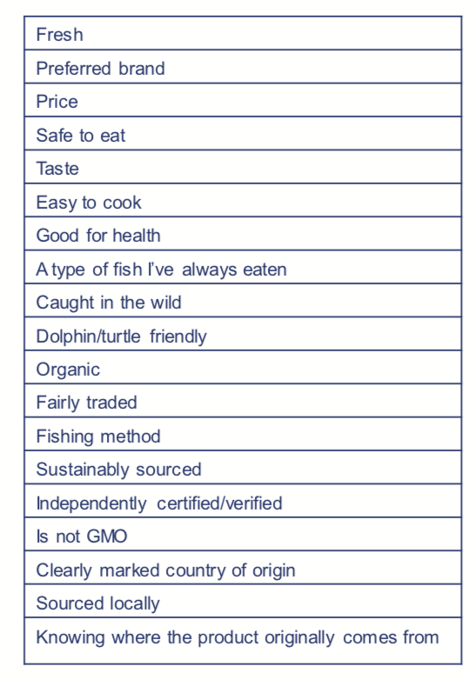


TAKING ACTION:
CONSUMER CHOICE
HE PĀTAI / CONSIDER THIS
What factors motivates you when purchasing kai moana?
MAHI / ACTIVITY
Rank your top three motivations when buying seafood. Record all individual results and then graph to show results for your entire group / rōpu
Notes:
TEACHER NOTES
USEFUL RESOURCES / RĀRANGI PUKAPUKA
For the full MSC slide show and more data see:
https://www.msc.org/docs/default-source/default-document-library/for-business/msc-globescan-understanding-consumers-webinar-deck---asia-pacific.pdf?sfvrsn=1abf2180_4

Slide 8

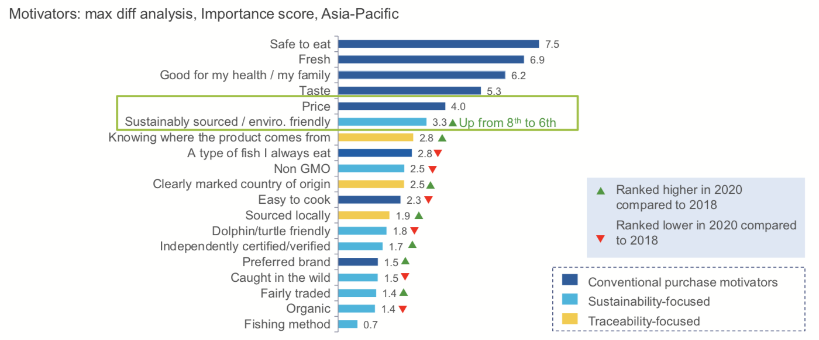
TAKING ACTION:
CONSUMER CHOICE
HE PĀTAI /
CONSIDER THIS
In 2020 MSC found conventional factors such as freshness were the main factors influencing choice
How does this compare with your group / rōpu results?
Notes:
TEACHER NOTES
USEFUL RESOURCES / RĀRANGI PUKAPUKA
For the full MSC slide show and more data see:
https://www.msc.org/docs/default-source/default-document-library/for-business/msc-globescan-understanding-consumers-webinar-deck---asia-pacific.pdf?sfvrsn=1abf2180_4

Slide 9



TAKING ACTION: CONSUMER CHOICE
MAHI / ACTIVITY (see Teacher Outline)
Conduct a survey (using Google Survey or similar) of whānau. Include questions such as:
Do you consider sustainable & ethical issues before purchasing?
Would you buy a fish of lesser quality if it were more sustainable?
Would you spend more on an equivalent fish if it was certified as sustainable?
Would you stop buying seafood if it was not caught sustainably?
Notes:
TEACHER NOTES
Analyse the data from this survey by presenting it in a series of graphs.
Have the students analyse the results by reading and interpreting the graphs.
Can they suggest explanations for the results?
Find results from a global study on consumer trends and compare these with the class survey results.

Slide 10
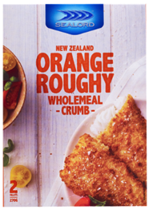
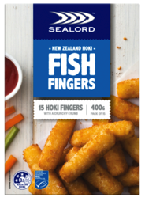
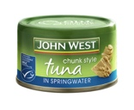
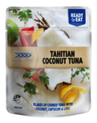
TAKING ACTION: CONSUMER CHOICE
MAHI / ACTIVITY
Revisit the continuum – have your views changed? Why / Why not?
“Consumers have a powerful role to play in influencing the production of goods”
MAHI / ACTIVITY
Have another go ranking products on slide ??
Have your rankings changed?
Why / Why not?
Strongly agree
Strongly disagree
Notes:
TEACHER NOTES
USEFUL RESOURCES / RĀRANGI PUKAPUKA
https://www.msc.org/docs/default-source/default-document-library/about-the-msc/msc-consumer-survey-2016-infographic-seafood-consumers-put-sustainability-before-price-and-brand.pdf

