Slide 1



1.4. SUSTAINABLE FISHING
Focusing Question: What is sustainable fishing?
KŌRERORERO/ DISCUSSION
The Marine Stewardship Council is on a mission to end overfishing!
Marine Stewardship Council check that fishing is ‘sustainable’ which means:
  Leaving enough fish in the ocean
  Looking after places where fish live [habitats]
  Ensuring people who fish can keep fishing
The Marine Stewardship Council put a blue fish tick label on all sustainable fish … so we know the fish we eat comes from a ‘sustainable’ fishery
Notes:
TEACHER NOTES

Slide 2

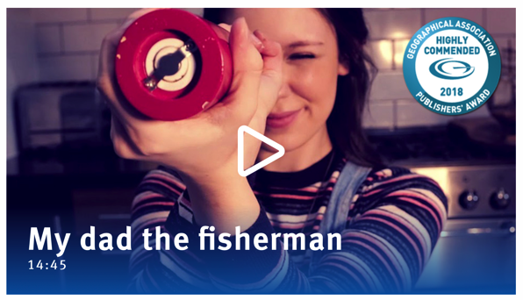

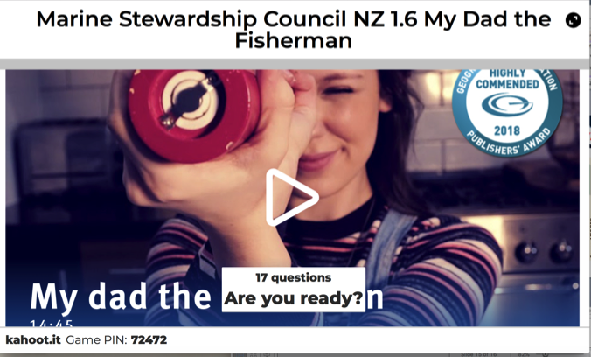
SUSTAINABLE FISHING
MĀTAKI TĒNEI / WATCH THIS
Short award winning film (14.46) called My Dad the Fisherman
MAHI / ACTIVITY
Complete the quiz on Kahoot!
To learn more about sustainable fishing: Play the Go Fish Game in Topic 3
Notes:
TEACHER NOTES
My dad the fisherman can be found at:
https://www.msc.org/en-au/for-teachers
HOMEWORK IDEAS
The ‘My Dad the Fisherman’ video clip includes most of the concepts that are key to understanding the idea of sustainable fishing.
To reinforce learning or as a good homework activity - re-watch the video ‘My Dad the Fisherman’ and play the Kahoot.
HOW TO PLAY KAHOOT
Connect a device to a projector or screen in front of the classroom.
Navigate to the game called Marine Stewardship Council NZ My Dad the Fisherman or enter this URL:
https://create.kahoot.it/share/d30aa852-2868-44b8-af32-ff5562ce44ea
Select settings
At Kahoot.it, learners enter game-pin and nickname on their own devices (phone, tablet, or computer).
Press “Start now”. The fun begins!
Learners answer questions on their own devices by selecting one of the four answer buttons.
See additional instructions, options, and how to make your own Kahoot at: https://kahoot.com

Slide 3

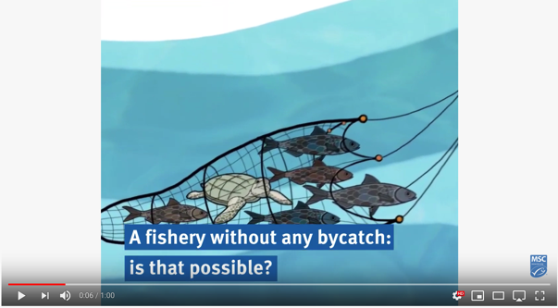
SUSTAINABLE FISHING
Aside from taking too many fish, unsustainable fishing can include:
Bycatch – lots of other sea creatures are caught, not just the target fish
Shark finning – removal of shark fins
Ghost fishing – nets thrown away or lost at sea keep entangling and catching creatures
Seafloor damage - of special habitats or places on the sea floor
TAKE ACTION!
What could you do to help with
Bycatch
Shark conservation
Ghost fishing
Seafloor protection
MĀTAKI TĒNEI / WATCH THIS
Bycatch & how it can be managed [1:00]
MAHI / ACTIVITY
Reinforce learning using Unsustainable fishing cards & activities
Notes:
TEACHER NOTES
One minute video on bycatch can be downloaded from: https://www.youtube.com/watch?v=_3od7CqoQfs
MAHI / ACTIVITY
See Teacher Outline (1.4) Unsustainable fishing practices
EASY – Matching card activities – three different sets (20+ minutes)
HARD – Matching card activities (10+ minutes)
EXTENSION – Research and create a poster activity
USEFUL RESOURCES / RĀRANGI PUKAPUKA
Shark finning
MSC on shark finning: https://www.msc.org/standards-and-certification/developing-our-standards/ending-shark-finning
WWF on sharks: https://www.worldwildlife.org/species/shark
Smithsonian: https://ocean.si.edu/ocean-life/sharks-rays/shark-finning-sharks-turned-prey
Shark Stewards: https://sharkstewards.org
Some good news about shark fin demand in Hong Kong: https://sharks.panda.org/news-blogs-updates/press-releases/hong-kong-shark-fin-imports-down-50
Watch the short film called “Shark fin Crisis” by Shark Alliance: https://vimeo.com/16811009
MSC on shark finning: https://www.msc.org/standards-and-certification/developing-our-standards/ending-shark-finning
Some great ideas on how to support conservation of great white sharks in Aotearoa NZ: https://whitesharkconservationtrust.org.nz/how-you-can-help/
Another practical NZ project for shark conservation: http://www.sustainableoceansociety.co.nz/projects/shark-conservation
See next slide notes for more resources

Slide 4
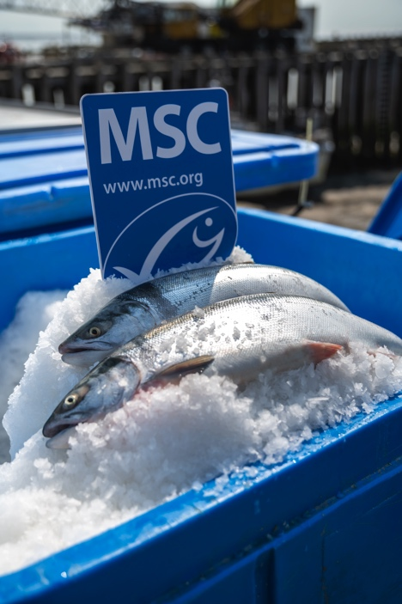
SUSTAINABLE FISHING
TAKE ACTION!
Check out Topic 8 to see how to take action on these issues! ….In the meantime … one easy action to buy fish products displaying the Marine Stewardship Council Blue Fish Tick label!
Marine Stewardship Council will only give the blue fish tick to sustainable fisheries that:
Have low BYCATCH
Do not undertake SHARK FINNING
Avoid GHOST FISHING and are finding new ways to help fisheries avoid losing gear
Do not badly DAMAGE HABITATS and the sea floor
Notes:
TEACHER NOTES
USEFUL RESOURCES / RĀRANGI PUKAPUKA
Ghost nets and ghost fishing
MSC on lost gear and ghost fishing: https://www.msc.org/standards-and-certification/developing-our-standards/preventing-lost-gear-and-ghost-fishing
WWF on ghost nets: https://www.worldwildlife.org/stories/our-oceans-are-haunted-by-ghost-nets-why-that-s-scary-and-what-we-can-do--23
Endangered ecosystems and habitats
MSC on ecosystems and habitats: https://www.msc.org/standards-and-certification/developing-our-standards/minimising-fishing-impacts-on-ecosystems-and-habitats
Bycatch
MSC on bycatch of endangered, threatened species: https://www.msc.org/standards-and-certification/developing-our-standards/protecting-endangered-species
WWF on Bycatch: https://www.worldwildlife.org/threats/bycatch
Smithsonian: https://ocean.si.edu/conservation/fishing/bycatch-cost-catching-what-you-dont-want
Cool Bycatch case study
Stats NZ Tatauranga Aotearoa. 2019. Bycatch of protected species: Hector’s and Māui dolphins. (includes a cool interactive tool)
https://www.stats.govt.nz/indicators/bycatch-of-protected-species-hectors-and-maui-dolphins

Slide 5

SUSTAINABLE FISHING
KŌRERORERO/ DISCUSSION
Over hundreds of years Māori developed Tikanga [ways of doing things] to help look after the sea and avoid overfishing
In Aotearoa New Zealand commercial fisheries are managed under a system called the Quota Management System (QMS)
In Topic 5 we look at the QMS and our approach to sustainable fisheries in Aoteaora New Zealand
HE PĀTAI / CONSIDER THIS
How do you look after the sea and creatures that live there?
What ‘tikanga’ do you know that helps look after fisheries?
What do you already know about how we prevent overfishing here in Aotearoa?
Notes:
TEACHER NOTES
Example of tikanga:
For example: not gutting or disposing of fish near the sea [can deplete fish as predators like sharks are attracted]

Slide 6

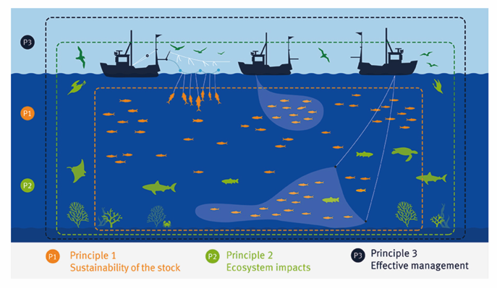
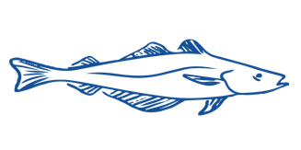
SUSTAINABLE FISHING
To receive the Marine Stewardship Council blue fish tick label, fisheries must be:
1. Sustainable fish stocks - Fishing must be at a level that it can carry on indefinitely and the fish population will stay healthy
3. Effective fisheries management - The fishery must be well managed and able to adapt to changing environmental conditions
2. Minimising environmental impact – Fishing must be done carefully so that other species and habitats are looked after
Notes:
TEACHER NOTES
These three principles are explored in much more detail in topics 3, 4 and 5
USEFUL RESOURCES / RĀRANGI PUKAPUKA
For more information see the MSC Fisheries Standard at https://www.msc.org/standards-and-certification/fisheries-standard
For more detail see also the 10 minute film called ‘Sustainable Seas: what is the MSC Fisheries Standard and how does it ensure healthy oceans’ at: https://www.youtube.com/watch?v=bw5tsy05uM8

Slide 7
SUSTAINABLE FISHING
Experts ONLY!
Consider under which principle the following would be assessed: bycatch, effect on seafloor, overfished fisheries; inability of a fish population to replenish, poor fisheries management
HE PĀTAI / CONSIDER THIS
What do you think the MSC would consider under each principle?
KŌRERORERO / DISCUSSION
Discuss your ideas in pairs. Be prepared to share answers
Check your answers against A guide to the MSC Fisheries Standard
Notes:
TEACHER NOTES
These three principles are explored in much more detail in topics 3, 4 and 5
USEFUL RESOURCES / RĀRANGI PUKAPUKA
For information see the MSC Fisheries Standard at https://www.msc.org/standards-and-certification/fisheries-standard
For more detail see also the 10 minute film called ‘Sustainable Seas: what is the MSC Fisheries Standard and how does it ensure healthy oceans’ at: https://www.youtube.com/watch?v=bw5tsy05uM8

