Slide 1

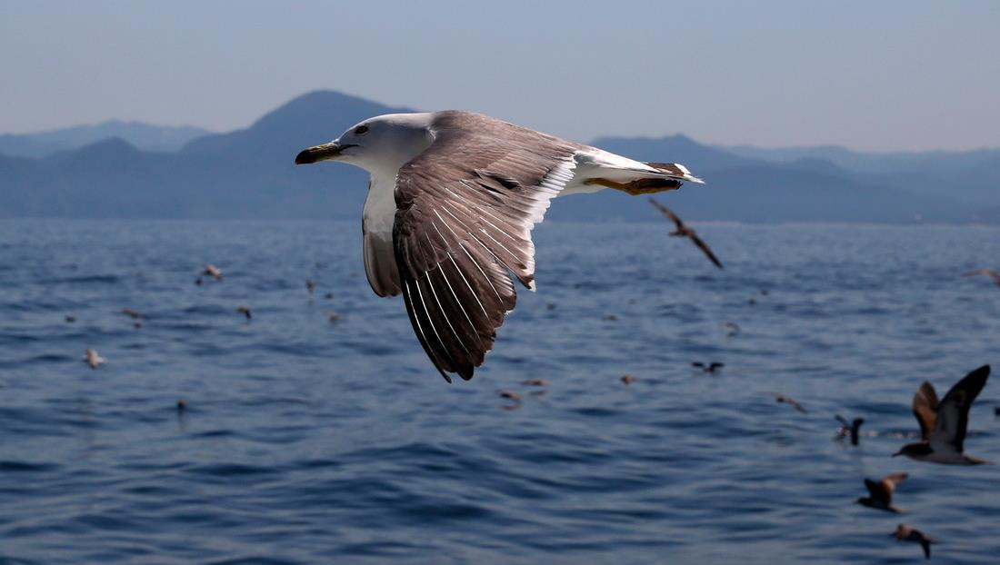
Bæredygtighedsfotos

Slide 2
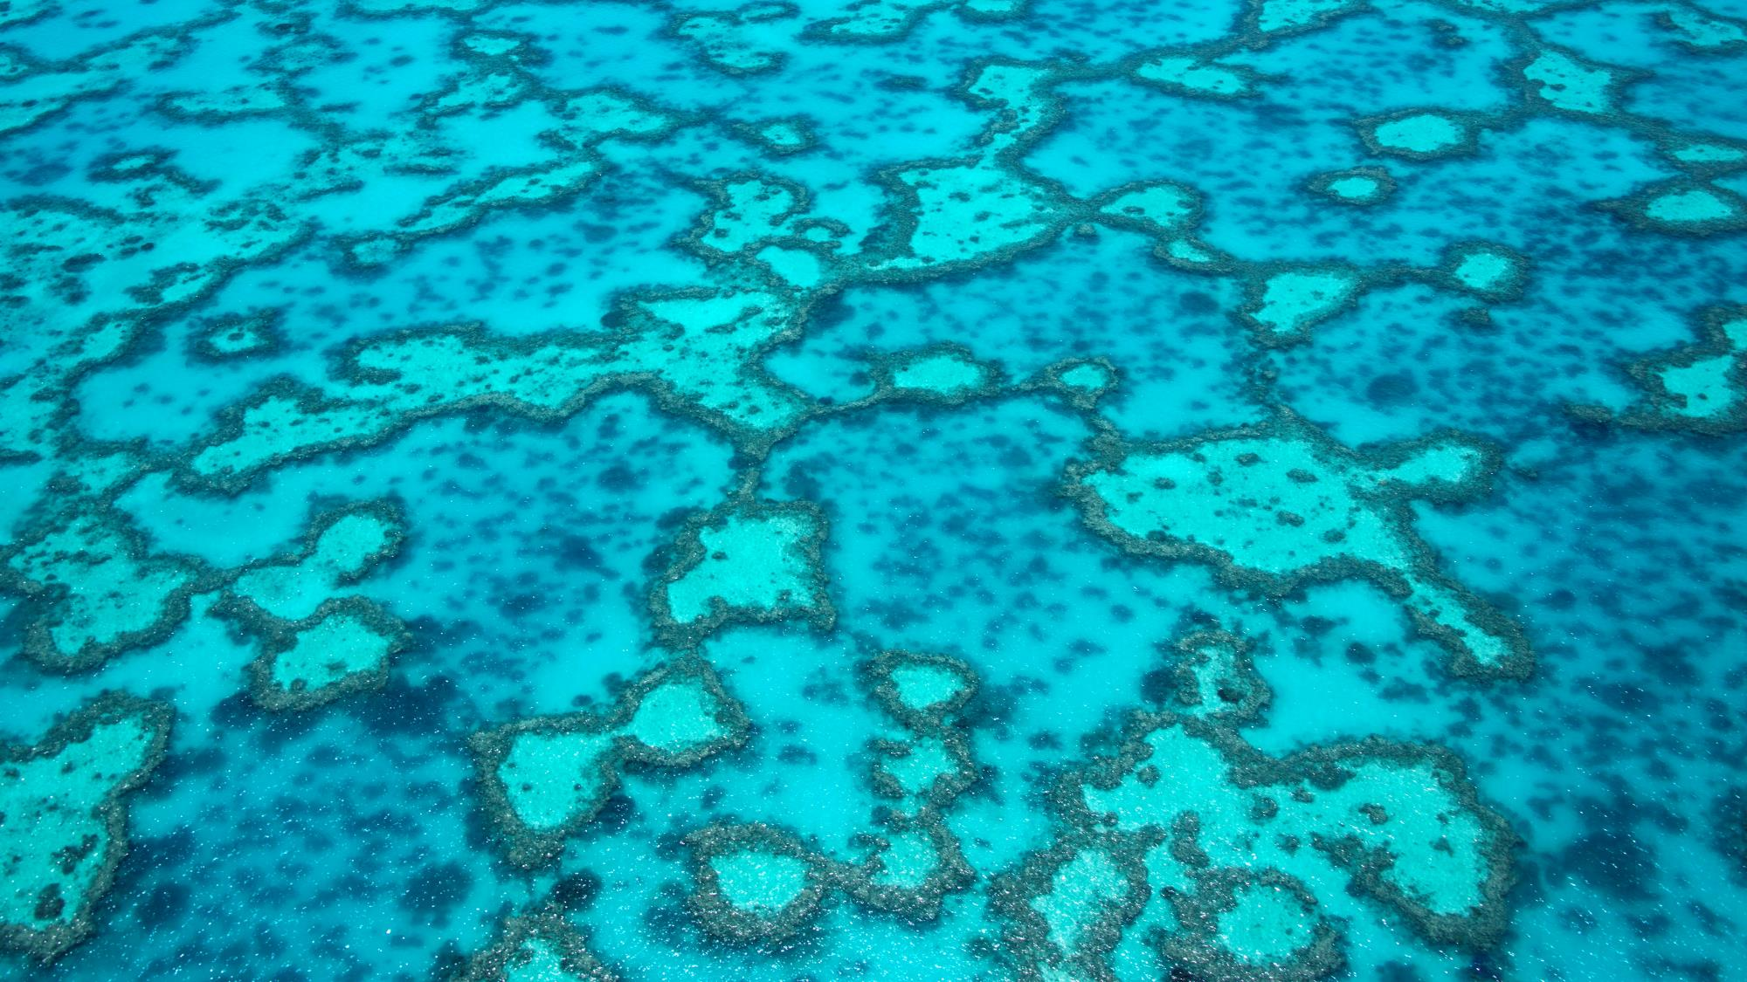
Coral reef
Photo: The Ocean Agency

Slide 3
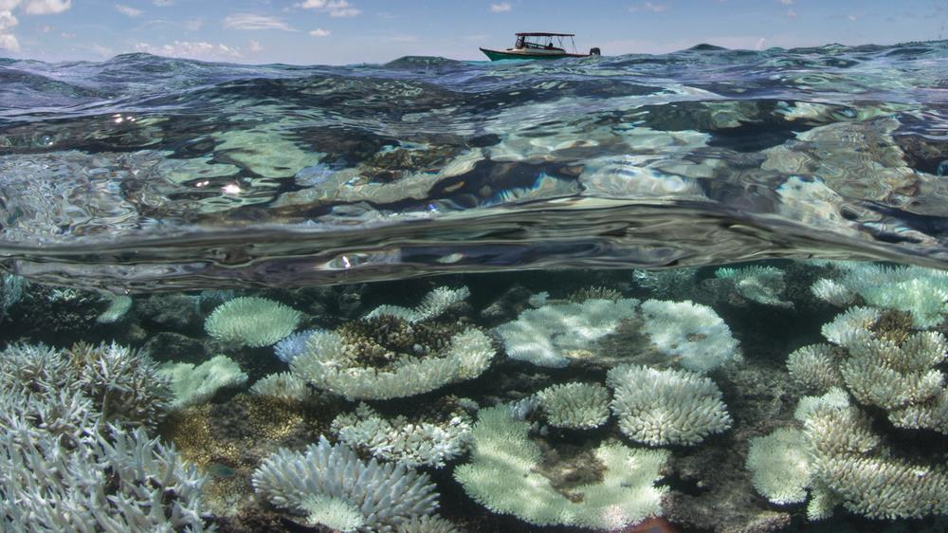
Bleached corals, Maldives 2016
Photo: The Ocean Agency

Slide 4
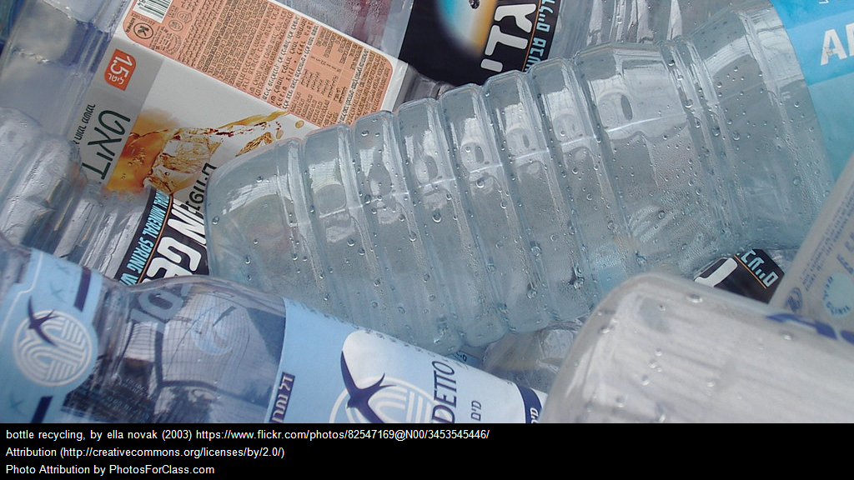
Plastic bottles
Photo: PhotosForClass.com

Slide 5
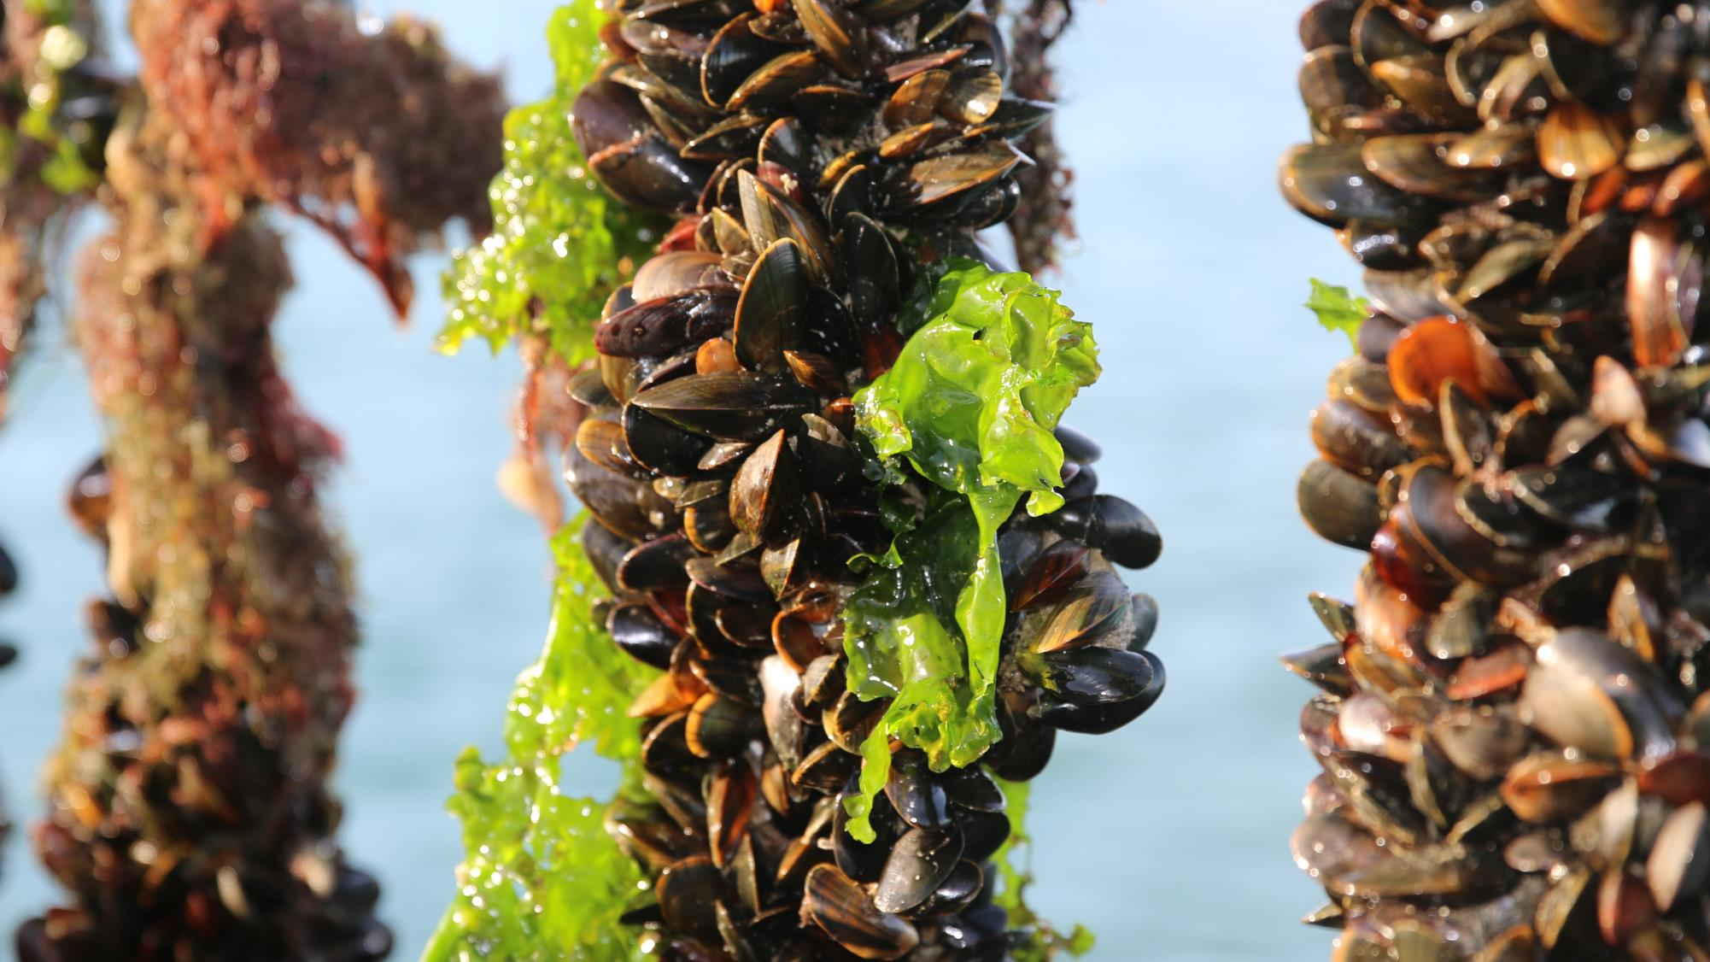
Mussel farm
Photo: Philip van Ierschot

Slide 6
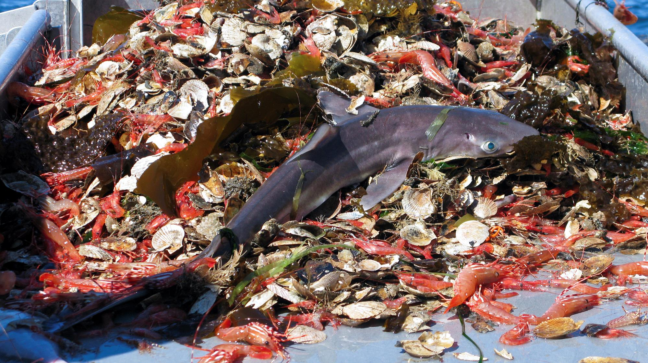
Shark bycatch
Photo: iStock images/Andreas Altenburger

Slide 7
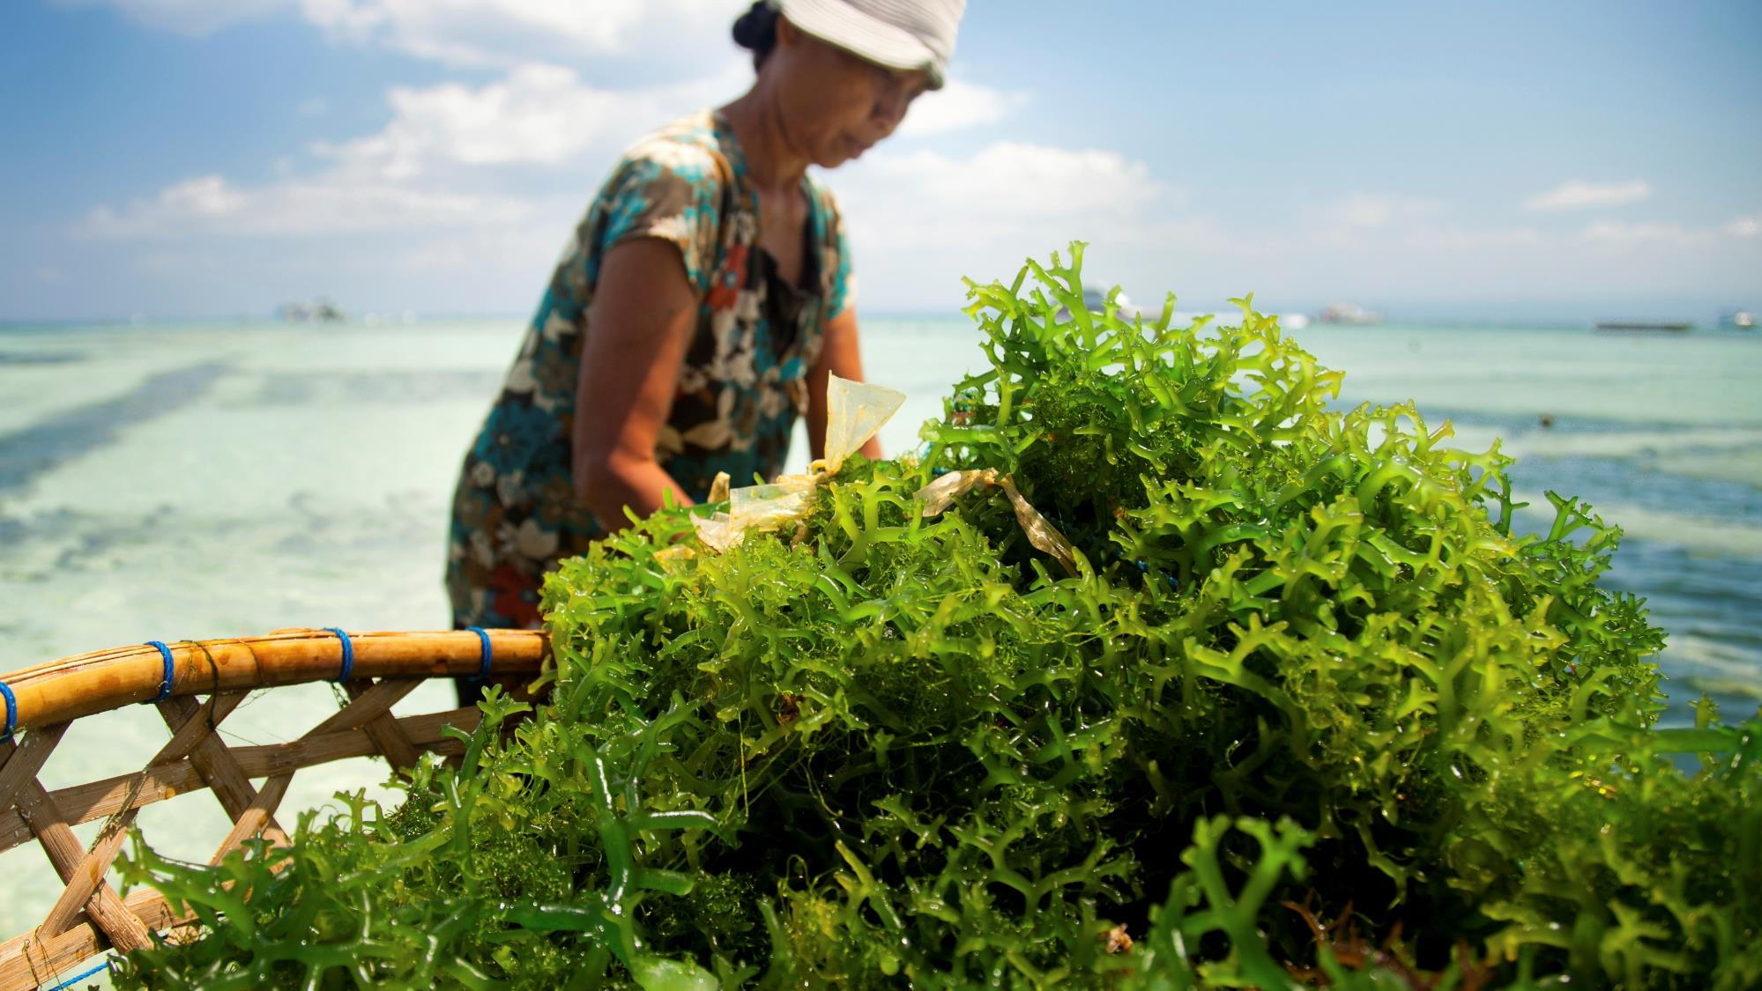
Seaweed farm
Photo: iStock images/Kerrie Kerr

Slide 8
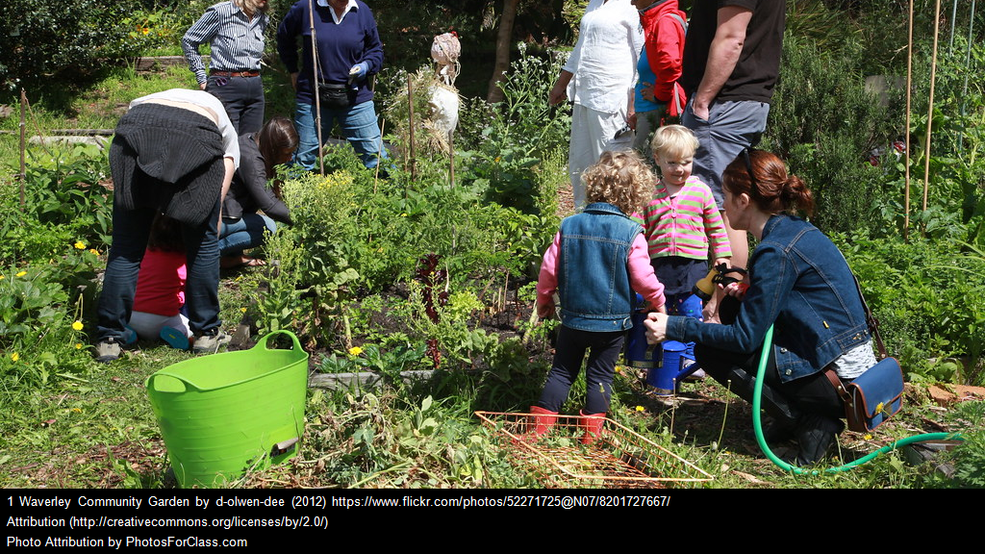
Locally grown vegetables
Photo: PhotosForClass.com

Slide 9
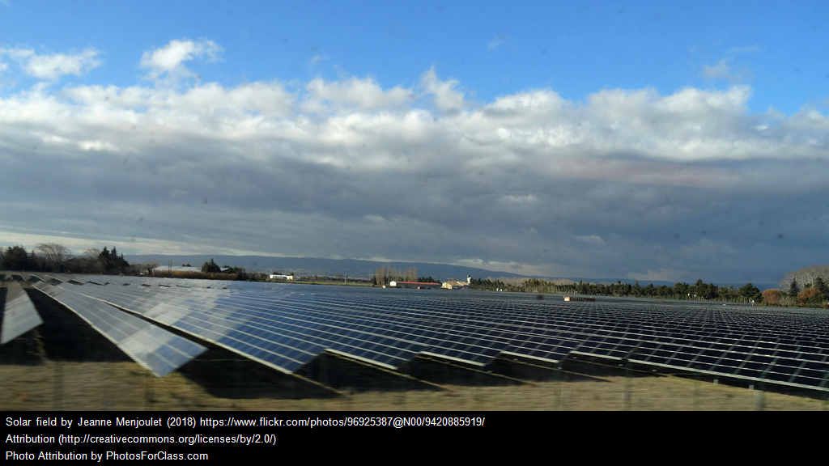
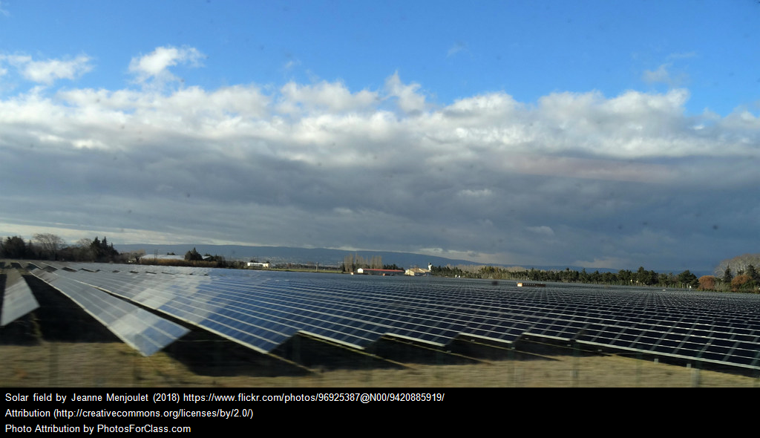
Solar panels
Photo: PhotosForClass.com

Slide 10








Hvilke af billederne repræsenterer bæredygtighed?

