Slide 1
World Ocean Day 8th June 2024
Campaign toolkit: Final edition

Slide 2
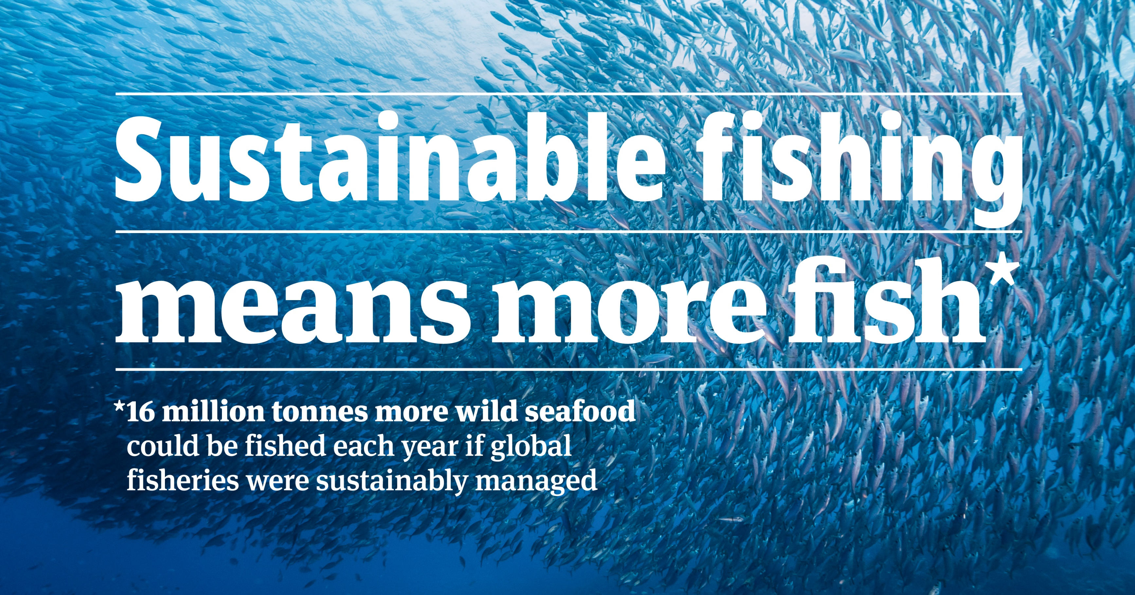
Celebrate World Ocean Day 2024
Our ocean supports life on Earth in many different ways. It feeds billions of people, regulates the world's climate and is home to an extraordinary variety of life.
But the ocean is now unquestionably under pressure. Over a third of global fish stocks are exploited at an unsustainable rate.
World Ocean Day is celebrated around the world on the 8th June each year. It is great moment to work with your class to understand how sustainable fishing contributes to protecting our ocean.
Together, help ocean lovers to understand what sustainable fishing means and what they can do to protect the ocean.

Slide 3
The activity
At the MSC, we love putting a sticker on things!
The Marine Stewardship Council works to reward sustainable fishing practices - and just as students might get a sticker as a reward for effort or achievement, only fishers who pass the tests to show that they are fishing sustainably, are rewarded with the MSC blue label. It’s a sticker for their hard work!
The tests take a year or more, and the fishers are assessed by independent experts who make sure that they are:
fishing from a sustainable fish stock
minimising damage to the wider ocean environment, and
working together with other fishers to ensure that they follow all local and international laws and quotas.

Slide 4
Learning outcomes
Age group recommended: 7-10
Subject areas: science, geography, social sciences
Time needed: 30-45 minutes
You will need:
PowerPoint presentation
Activity Worksheet (optional, slide 8)
Video clip (optional, link on slide 13)
Printed copies of 4 different Sustainable Fishing Fact Sheets (enough copies for each small group to read, slides 17-20)
Sustainable Fishing Worksheet (one per small group, slide 21)
Paper and pens
Objectives:
To build critical thinking skills by developing their own ideas about stickers and the MSC ecolabel
To improve understanding about why we need to protect the ocean and the fish and other animals and plants that live in it
To work with others to use their comprehension skills to elicit information about sustainable fishing and summarise it
Extension objective: to further develop critical thinking skills by reflecting on the benefits and drawbacks of the MSC ecolabel
Delivery notes:
- This activity is designed to be delivered using this PowerPoint, and some slides have extra notes for educators
- Slides 8, 17-20, and 21 are designed to be printed for learners. Look for the printing icon ( ).
- Before delivery you could hide any slides you don’t want to use, including this slide

Slide 5
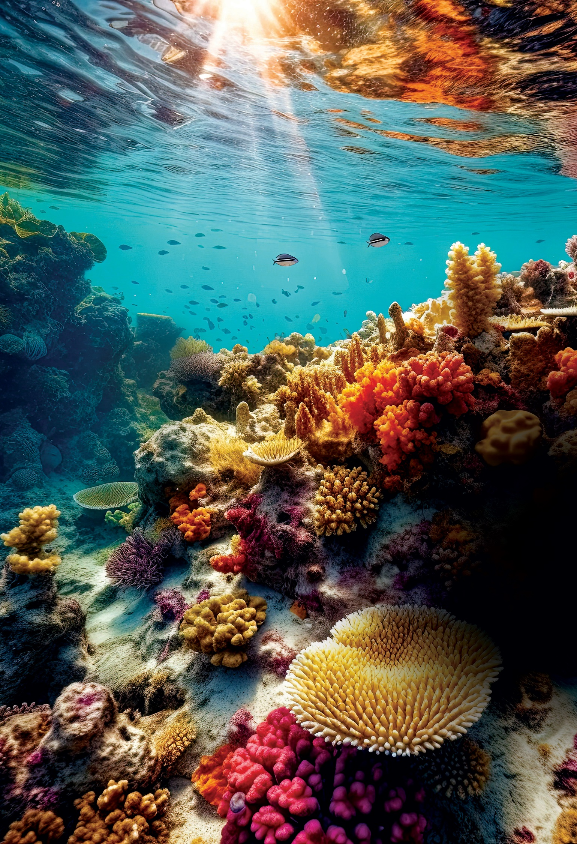
Activity background information
Our ocean sustains life on Earth in many ways. It contributes to the air we breathe, the food we eat, the livelihoods of millions of people and is home to an extraordinary variety of life.
However, the health of our ocean in under threat from global climate change and other human impacts such as pollution and overfishing. Over a third of fish stocks around the world are overfished and this is endangering the future supply of food.
Overfishing is also a concern for the wild marine environment, as it is one of the major causes of the loss of ocean life, including endangered species such as some sharks, dolphins and turtles. Every animal plays an important role in the ecosystem. For example, removing sharks can result in the populations of the species they feed on becoming too large, and negatively impact the balance of life in the ocean.
Stopping overfishing doesn’t mean stopping fishing altogether. Fisheries that are sustainably managed are better for the environment and more productive in the long-term.
Fishing is sustainable when it leaves enough fish in the ocean and minimises impacts on other plants and animals that live there. For this to happen, fisheries must be managed effectively.
Learn more about overfishing and its impacts on the ecosystem watching this short film.
Get more information here about the MSC’s approach to sustainable fishing and what the blue MSC label means when people are shopping for seafood and fish.

Slide 6
Adapting the activities
Starter for 10
You could use the Activity Worksheet to support learners with their writing or run the activity as a class discussion.
If you have less time, you could select either slide 9 or 10 to discuss with learners, rather than both.
Main activity
You could lead the whole class as a group to read about the four gadgets on screen, and then ask them to discuss which they prefer in their groups.
Once they have chosen their favourite gadget and justified their choice, you could ask groups to think of other gadgets or solutions that could help make fishing more sustainable.
Plenary
For older learners, you could play a 1min video entitled “A global challenge” (link also on slide 21). This explains the things fishers have to do in order to fish sustainably, as well as the role that everyone can have in helping to protect the ocean.
Extension
If you have more time, for learners who finish early (or for homework), take the learning further with one of the extension activity ideas.

Slide 7
Activity plan: Starter
Starter: 10 minutes
Here are two short activities, as a starter to get learners to think about the important role the ocean plays in our lives:
1
2
Starter for 10 (10 mins)
Firstly, use slide 8-9 to ask learners to think about a time they have received a sticker.
Learners could discuss the questions with a partner and then feedback, or you could start by asking one learner a question, who then asks another learner the next question, and so on. You could use the Activity Worksheet (on the next slide) to support learners.
Use slides 10-12 to introduce the MSC blue label to learners. For older learners, you could play the 3min clip (link on slide 10) ‘Overfishing’ explaining concepts of overfishing and bycatch. You could also ask:
Do you know why this sticker might be on some of our food?
What do you think the sticker is trying to communicate?
What do you think about the sticker?

Slide 8
Activity worksheet: Stickers
I got a sticker for …
Getting a sticker made me feel …
Because …
Getting a sticker is …
You can use these words to help you
achievement
behaviour
brave
disappointed
effort
excited
good work
happy
included
interested
motivated
proud
sad
special
valued
Notes:
Graphics created by Llisole, Mat fine, parkjisun, Till Teenck and Yogi Aprelliyanto, Edy Subiyanto, SBTS, Lutfi Gani al Achmad, ilCactusBlu from the Noun Project

Slide 9
Stickers
What have you had a sticker for? What did the sticker look like?
How does getting a sticker make you feel?
Why do you think people get stickers?

Slide 10
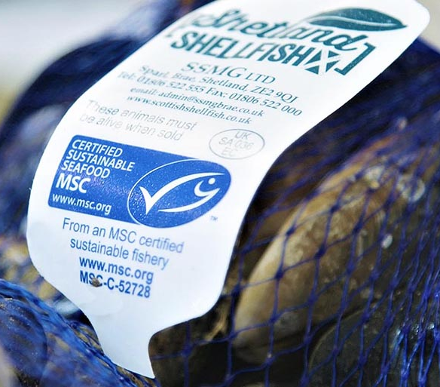
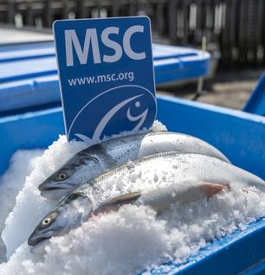
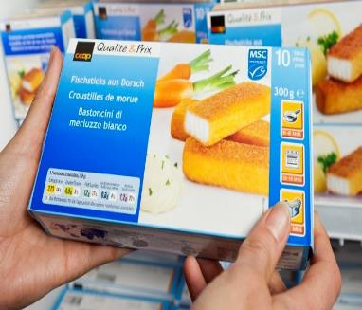
Have you seen this sticker before?
What do you think this sticker means?
Why do you think it is on some of our food?
Play the video

Slide 11
The sticker means that the fish has been caught sustainably.
Sustainable fishing means that:
1. Fishers leave enough fish in the ocean, so there are enough fish for the future
2. Fishers make sure sea life and the areas where they fish, are looked after
3. Fishers follow the rules and work together to protect the ocean

Slide 12
Sustainable fishing is not as easy as you might think. To get their sticker (the MSC blue label), fishers who catch the fish must pass tests that can last for over a year. Fishers get help from scientists, so they know how many fish they are allowed to catch. Fishers also work with scientists who help them look after the ocean and all the creatures and plants that live there. Fishers often need to make changes to how they are fishing. Then, finally, they can get their sticker. They may have to keep improving and they must complete tests every year, or they could lose their sticker!

Slide 13
Main Activity: What is your favourite fishing gadget?

Slide 14
Activity plan: Main activity
Divide your learners into four groups and ask them to nominate someone to write, someone to draw, and at least two people to speak. Explain that fishers use lots of different gadgets to make sure they look after the ocean as they fish.
Provide each group with copies of all the Sustainable Fishing Factsheets and ask them to look at the sheets together (slides 15-18).
Provide each group with one copy of the Sustainable Fishing Worksheet (slide 19).
2
Main activity: 15-20 mins
What’s your favourite fishing gadget?
1
Starter for 10 (10 mins)
Learners work together to find out about the different technologies and gadgets that fishers use. They then choose their favourite and justify their choice.
They should complete the Sustainable Fishing Worksheet (slide 19) as a group and then share their reasons for their choice with the rest of the class.

Slide 15
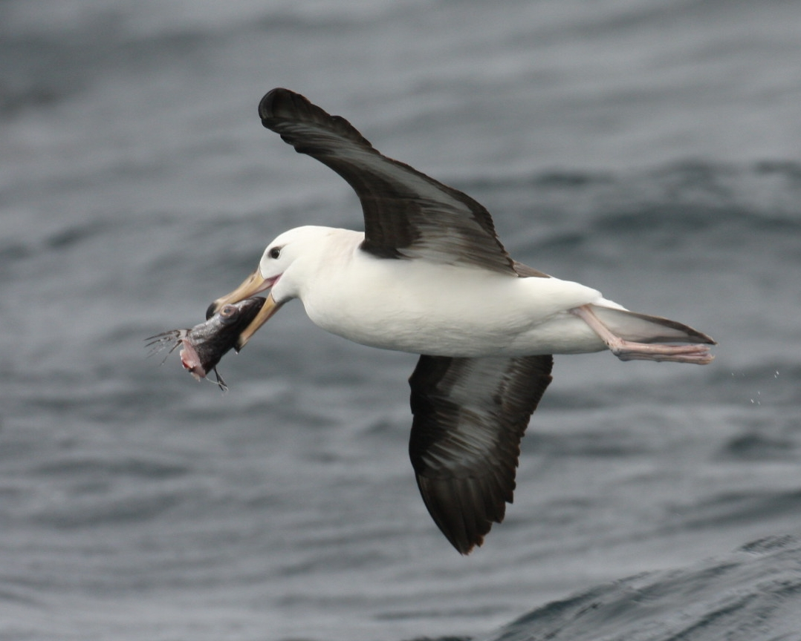
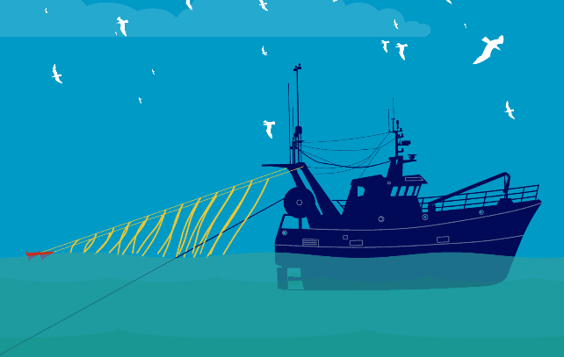
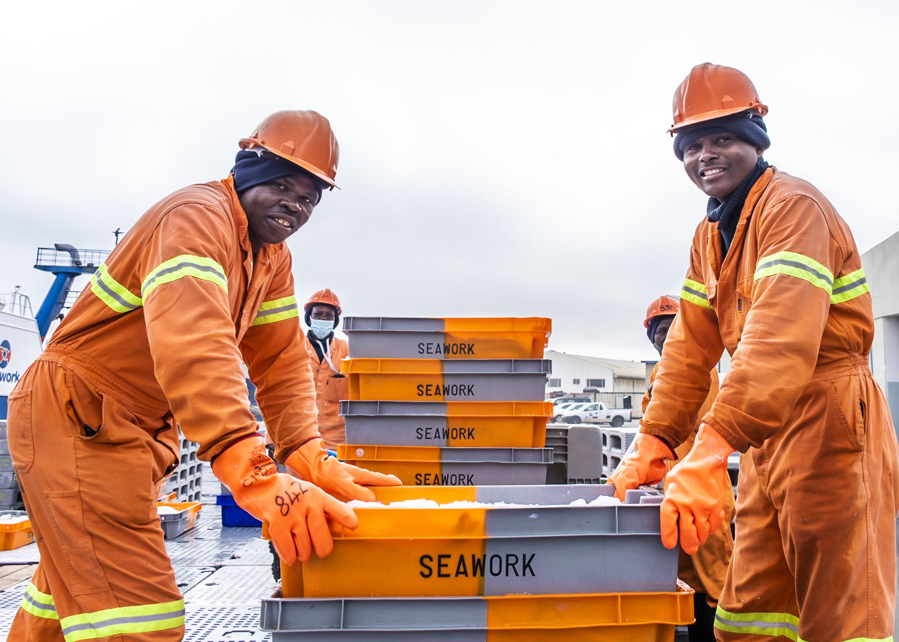
Factsheet 1: Bird-scaring lines
The problem​
Seabirds often follow fishing boats, looking for an easy meal​.
They can get caught in fishing nets.
The gadget​
Fishers can use bird-scaring gadgets called “tori lines”. ​
The bird-scaring lines are ropes with brightly coloured streamers. ​
The streamers scare away the seabirds.
Black-browed albatross fly low and take fish from the sea surface
These fishers in Namibia have reduced the number of birds getting caught in their nets by 90%.
These are bird-scaring lines!
Notes:
https://www.antarctica.gov.au/about-antarctica/animals/flying-birds/black-browed-albatross/​
https://www.msc.org/media-centre/press-releases/press-release/sustainable-hake-fishery-brings-long-term-economic-and-environmental-benefits-to-south-Africa

Slide 16
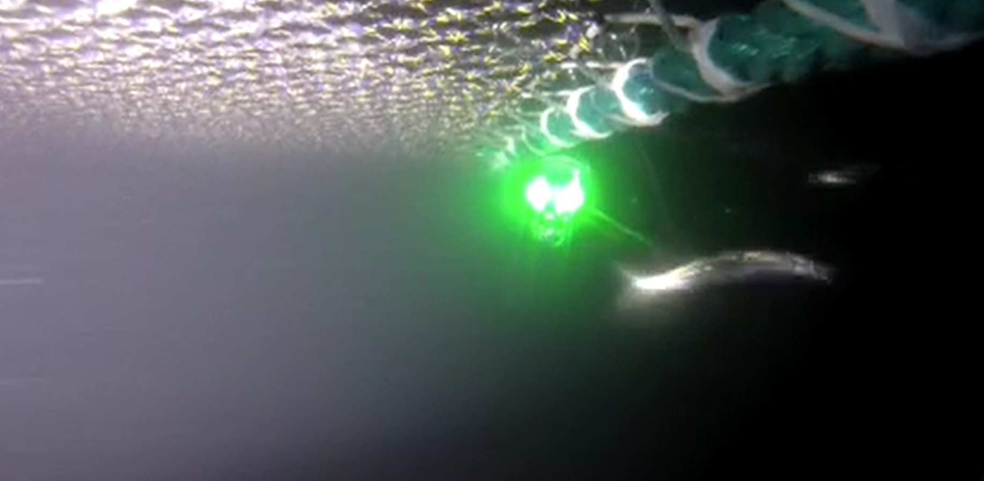
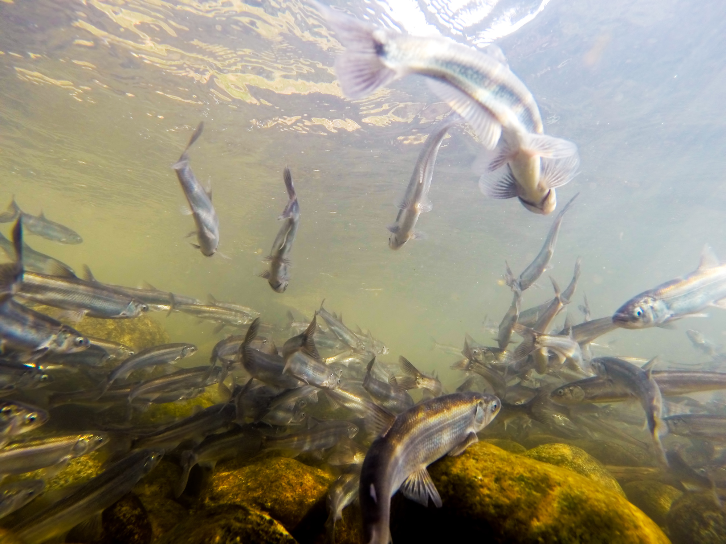
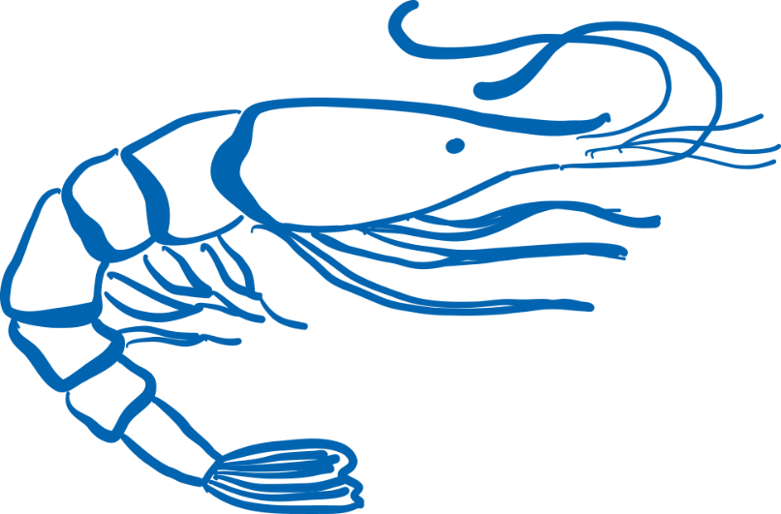
Factsheet 2: Flashing lights
The problem​
Fishers often catch fish, or other creatures, that they don’t want in their fishing nets.
The gadget​
Scientists found out that putting lights on fishing nets scares away candlefish (fish that they do not want to catch) and stops them getting caught. ​
Scientists have different theories about how the lights work. Maybe the lights show the fish how to escape? What do you think?
Shrimp fishers in the USA can catch these candlefish by mistake
Light on shrimp nets
Notes:
©Bryson Burns​
https://www.msc.org/what-we-are-doing/our-collective-impact/fisheries-improving/pink-shrimp-fishery-uses-led-lights-on-nets

Slide 17
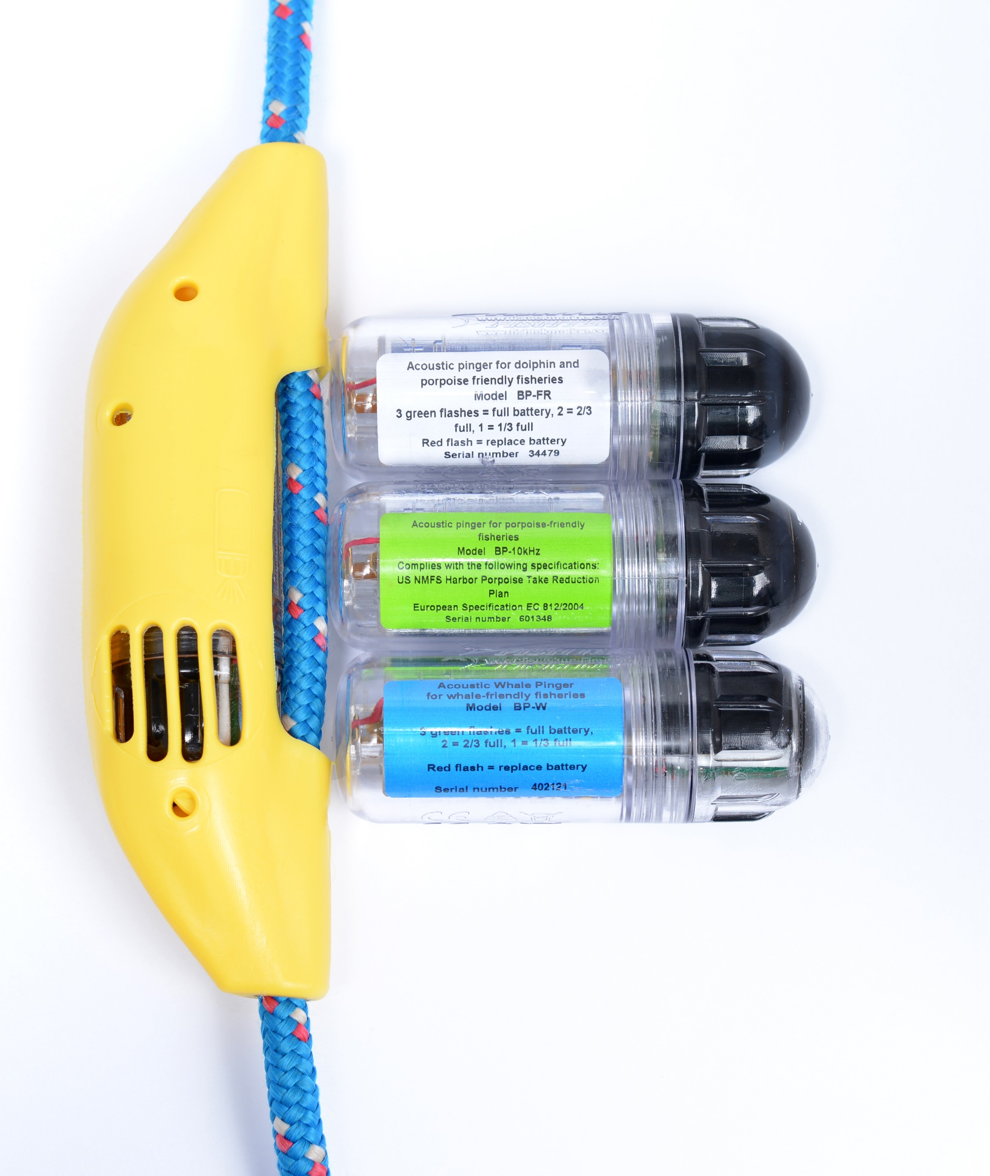
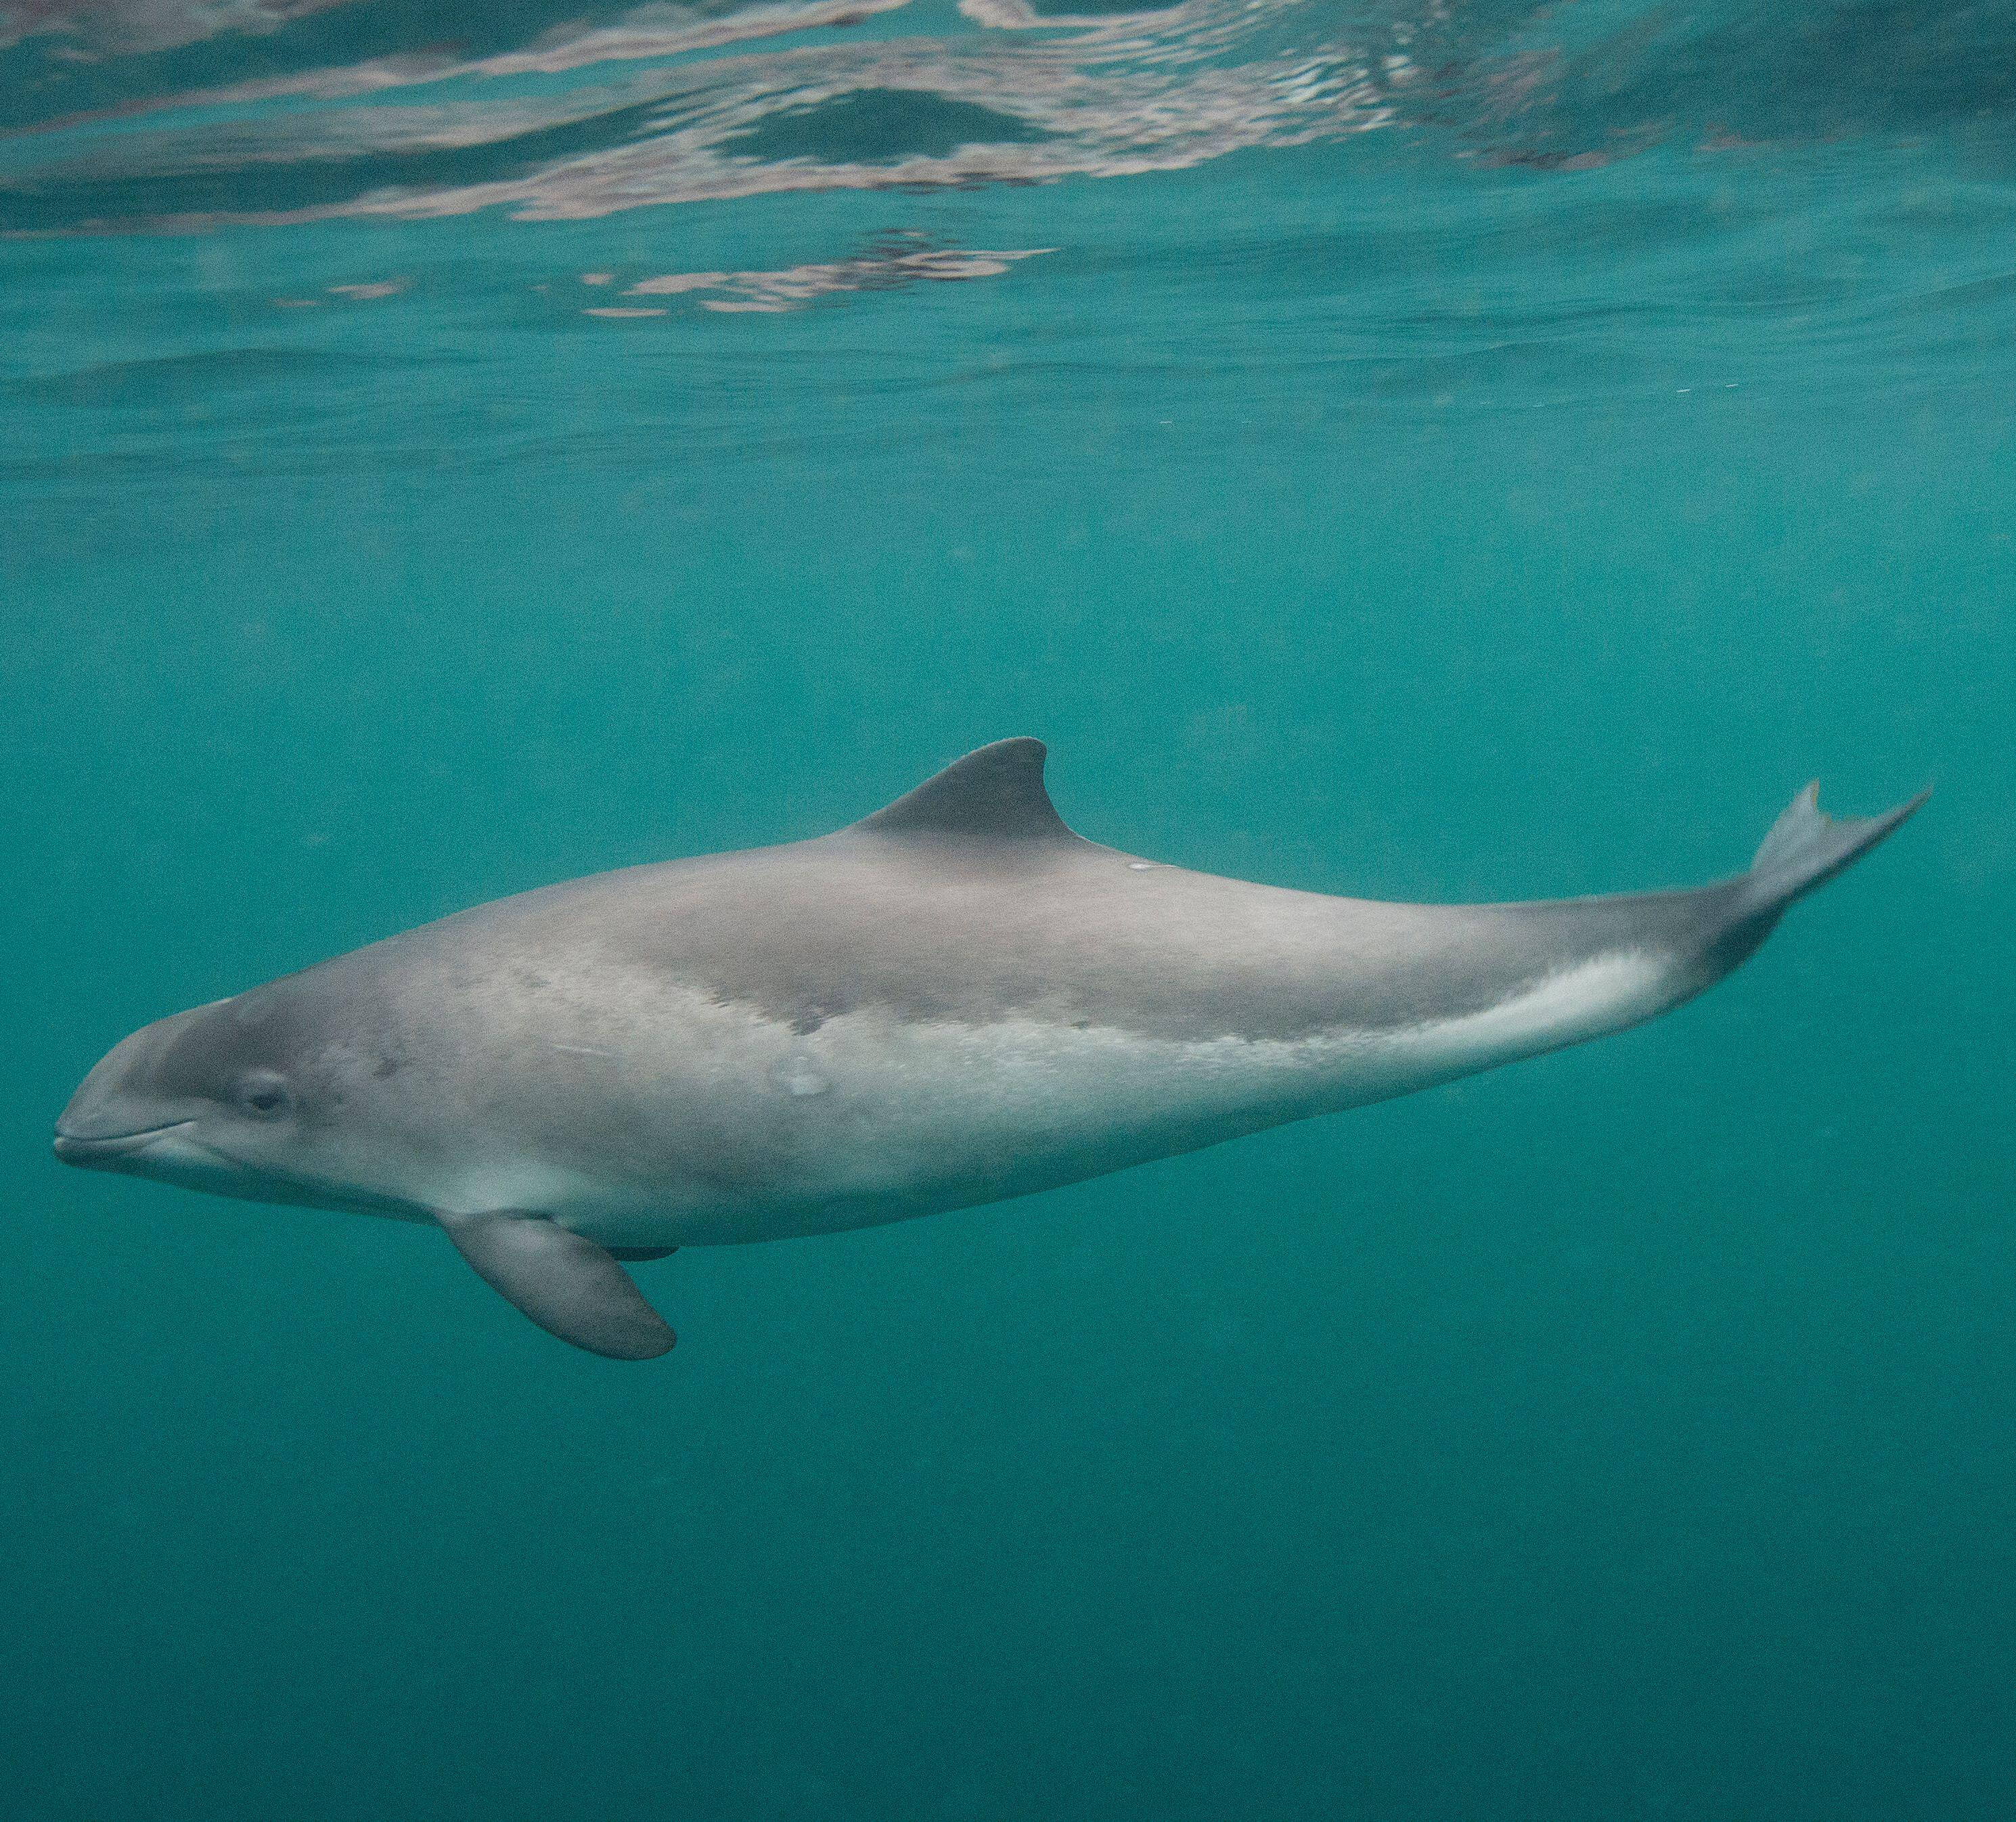
Factsheet 3: Banana pingers
The problem​
Harbour porpoises (similar to dolphins) hunt for fish to eat, near fishing boats.
The boats and the porpoises, are all looking for fish.
The porpoises can accidentally get caught in fishing nets.
The gadget​
Some fishers put “banana pingers” on their fishing nets. ​
The pinger is an electronic gadget (it looks a bit like a banana) which makes a ‘ping’ noise to warn off porpoises. ​
The underwater sound stops harbour porpoises from getting too close to nets.
Harbour
porpoise
Some fishers in the UK use banana
pingers. Fewer harbour porpoises get caught in fishing nets because of them.
Banana pinger
Notes:
@Nick Cragenza; ©Fisktek Marine, ©Ruth Williams​
https://www.msc.org/media-centre/news-opinion/news/2021/05/20/fishery-innovations-that-drive-ocean-biodiversity-research

Slide 18
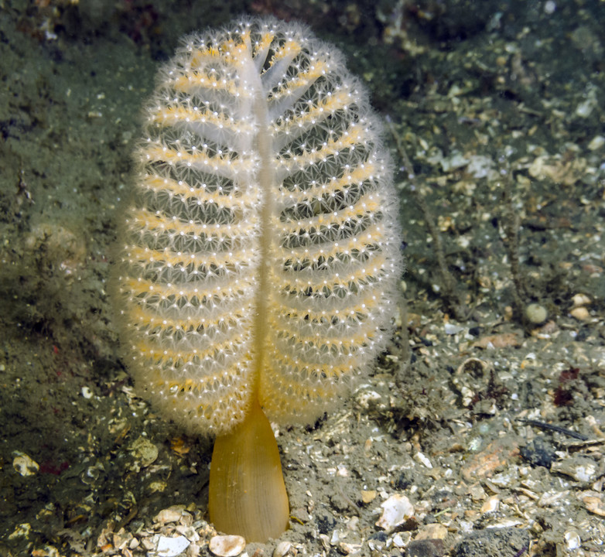
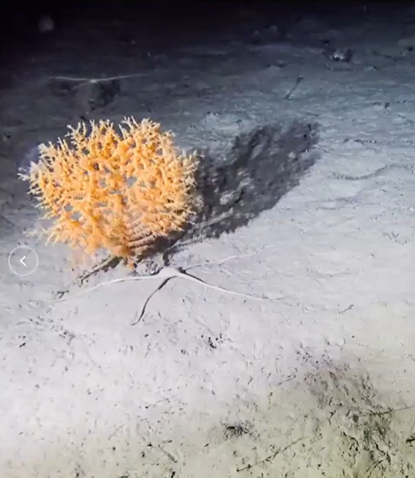
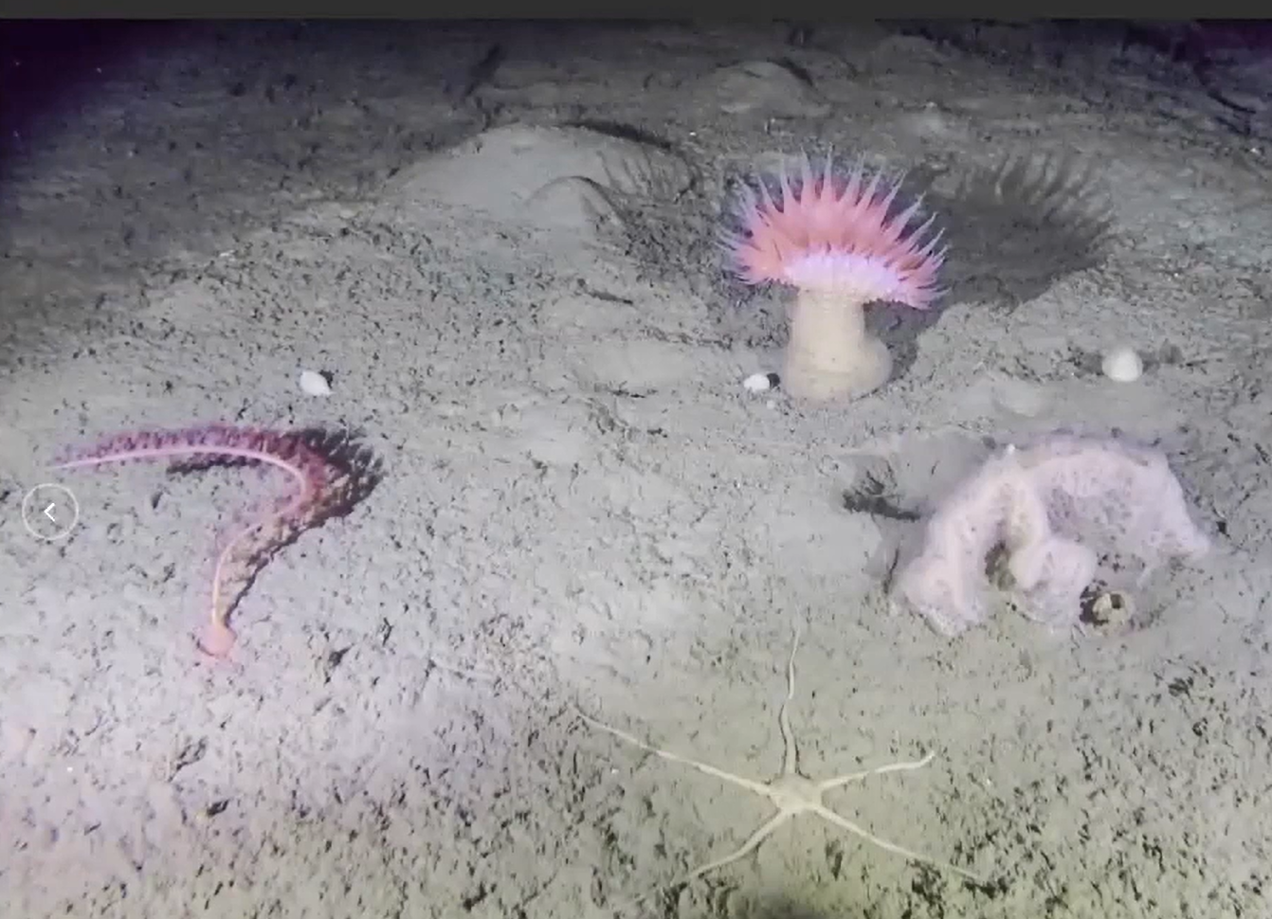
Factsheet 4: The deep-sea camera
The problem​
When fishers pull their nets across the seafloor to catch fish that live in the bottom of the sea, they can damage the animals and plants that live on the seafloor, such as corals, sponges and seapens.
These animals play an important role in the ocean, for example corals form reefs that provide a home for many other ocean species.
The gadget​
Scientists can take a camera below the surface to take photos of the sea floor and all the life that might be living there.​
With this information, fishers can avoid fishing in areas where they have identified vulnerable animals​ and be more certain they are not damaging life with their fishing activities.
Corals, sponges, seapens and anemones play an important role in the ecosystem. These animals cannot move and can get caught in the fishing nets ​
Notes:
©iStock/naturediver​
©ZSL​
https://www.msc.org/what-we-are-doing/our-collective-impact/ocean-stewardship-fund/impact-projects/analysing-trawling-impacts-vulnerable-habitats-greenland-2022
https://www.msc.org/what-we-are-doing/our-collective-impact/ocean-stewardship-fund/impact-projects/mapping-seabed-floors-ZSL

Slide 19
Worksheet: Sustainable fishing
Our favourite gadget is ...
We have chosen it because …
What does it do?
How does it help?
Write or draw something your group learnt about sustainable fishing.
You can use these words to help you:
achievement
catch
dolphin
ecosystem
effort
environment
excited
fishing
fishing net
gadget
included
interested
lights
motivated
ocean
overfishing
porpoise
robot
science
seabird
seafloor
special
species
sustainable

Slide 20
Activity plan: All together
All together: 5-15 mins
Feedback and learners’ thinking
1
2
Starter for 10 (10 mins)
Learners feed back to the class about their favourite gadget which helps make sure fishing is sustainable, and why they chose it.
Use slide 21 to ask learners what they think about the MSC ecolabel as a simple sticker on their food with a complicated story behind it.
For older learners, you could play a 1min clip “A global challenge” (link in slide 21), which explains the things fishers have to do to fish sustainably - and the role that everyone can have in helping to protect the ocean.
Don’t forget to give learners a sticker for completing the task!
I’m an ocean hero

Slide 21
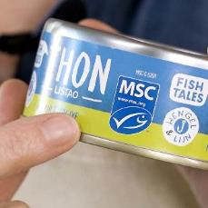
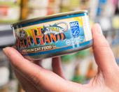
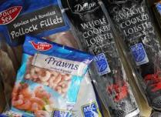
What do you think?
Do you think these stickers make a difference?
Should we do other things to protect our ocean?
Play video clip

Slide 22
Extension and homework ideas
For learners to take their learning further, they could discuss, write or think about:
Do they think the MSC blue label helps shoppers choose what to buy? Why / why not?
They could also:
Talk to someone at home about what they learnt
Write about their view on how we can protect the ocean
Use their ideas about gadgets for sustainable fishing to create a World Ocean Day display and their own writing or drawings to provide extra information. They can even make their own models of the different gadgets!

Slide 23
Thank you
For more information and education resources
visit MSC webpage at
www.msc.org/teach

