Slide 2
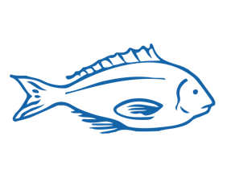
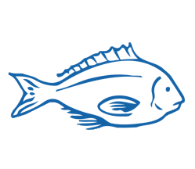
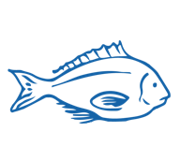
MIHI / INTRODUCTION
Can you imagine a world without fish?
What would that be like?
No more sushi! No more fishing!
No more fish & chips! No more….?
Notes:
TEACHER NOTES
Try to get learners to connect with the personal impact of overfishing and unsustainable practices. What would it be like for ME if there were few or no fish left in the sea!

Slide 3
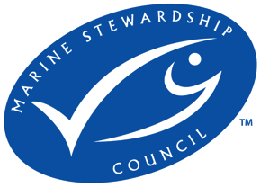
MIHI / INTRODUCTION
The good news is… some special people are working hard to make sure this doesn’t happen!

Slide 4
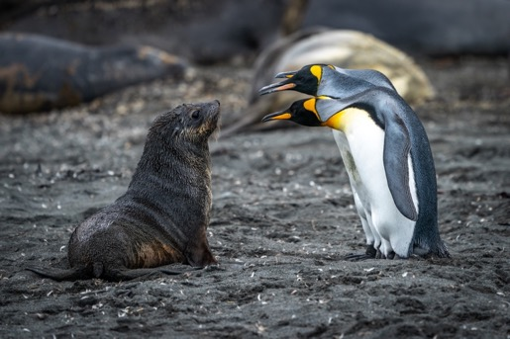
WHAKAPAPA - TANGAROA
KŌRERORERO / DISCUSSION
According to one Māori creation tradition the god of the sea and ancestor of fish is Tangaroa, the son of Ranginui (sky father) and Papatūānuku (earth mother).
Tangaroa’s son Punga was the father of Ikatere and Tūtewehiwehi. Ikatere went to the sea. He and his children became fish.
All sea creatures are part of this whakapapa or family tree. Whakapapa connects us, with the ocean and creatures that live there.
Notes:
According to one Māori creation tradition the god of the sea and ancestor of fish is Tangaroa, the son of Ranginui (sky father) and Papatūānuku (earth mother). Tangaroa’s son Punga was the father of Ikatere and Tūtewehiwehi. Ikatere went to the sea. He and his children became fish. Tūtewehiwehi journeyed inland, He and his offspring became reptiles. All sea creatures are part of this whakapapa or family tree. And this whakapapa or family tree connects us, with the ocean and creatures that live there.
Question: Where did Tūtewehiwehi go and what creatures were his children?
Answer: Inland and the reptiles

Slide 5
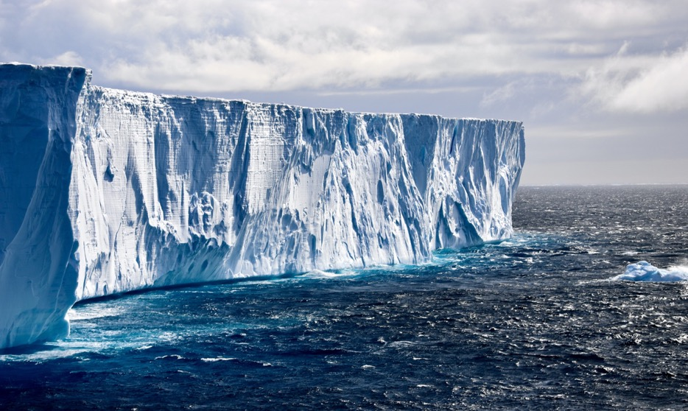
SOUTHERN OCEAN
Te Moana-tāpokopoko-a-Tāwhaki or the Southern Ocean is the area of ocean that surrounds Antarctica

Slide 6
HISTORY OF ANTARCTIC FISHING
Fishing - Antarctica PRIOR KNOWLEDGE CHART
What we know | What we would like to know | What we have learned
HE PĀTAI / CONSIDER THIS
What do you already know about past & current fishing around Antarctica?
MAHI / ACTIVITY
Complete the Prior Knowledge Chart columns 1 & 2
Notes:
TEACHER NOTES
You could go back and review Topic 1

Slide 7
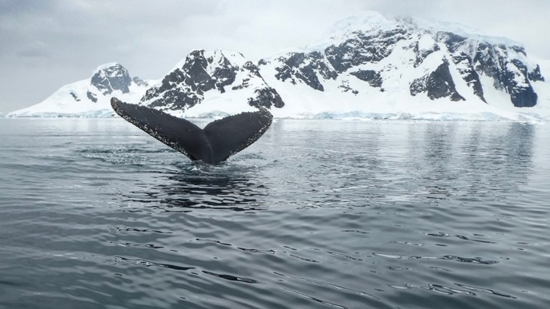
KAITIAKITANGA
HE PĀTAI / CONSIDER THIS
What makes looking after the marine life around Antarctica difficult?
No one ‘owns’ Antarctica
Antarctica’s isolation
Extreme weather
Notes:
Looking after the marine life around Antarctica is also difficult due to Antarctica’s isolation (it’s a long way from anywhere) and extreme weather.
Antarctica is the coldest, driest and windiest continent on earth. The coldest temperature ever recorded on earth was in Antarctica (-89 degrees Celsius).
Given how cold and hard to get to it is, it is amazing that living creatures have been harvested from the Southern Ocean around Antarctica since 1790.

Slide 8
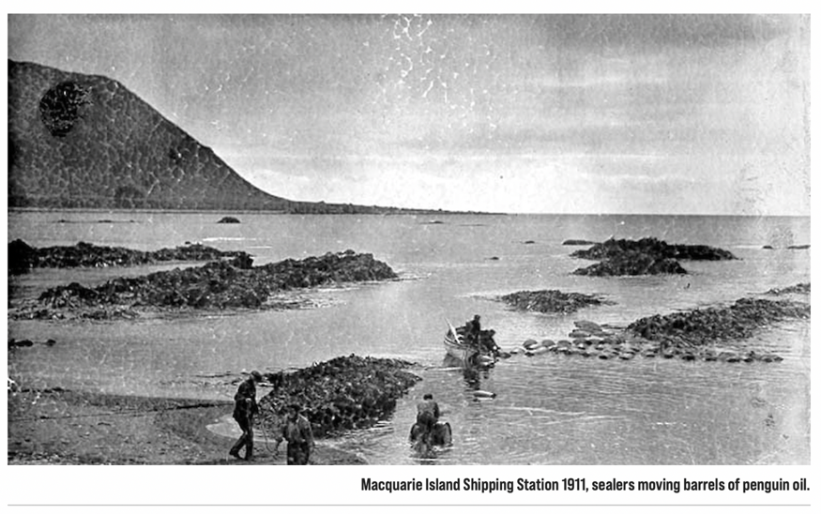
HARVEST HISTORY
KŌRERORERO / DISCUSSION
Given Antarctica is very cold and hard to get to - it is amazing living creatures have been harvested from there since 1790
Image: Australia Antarctic Programme

Slide 9
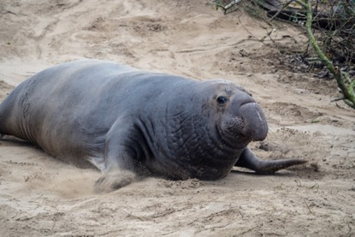
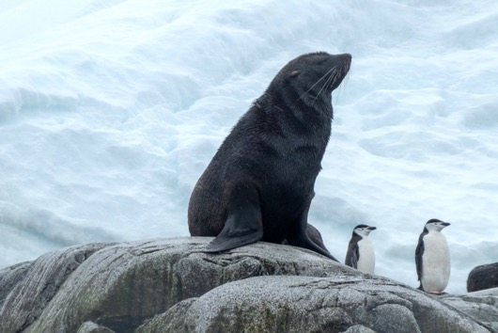
HISTORY OF ANTARCTIC FISHING
KŌRERORERO / DISCUSSION
On Macquarie Island Antarctica kēkeno or fur seals were the first to be harvested
By 1825 some groups of fur seals were almost wiped out
Hunters then focussed on ihu koropuku or elephant seals until their population was reduced by 70%

Slide 10
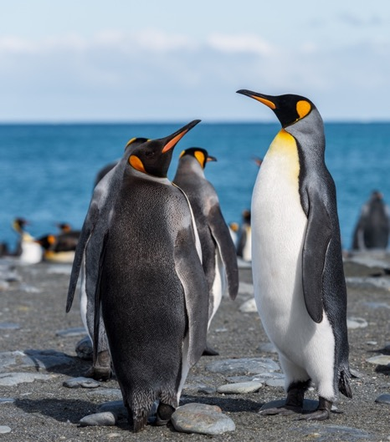
HISTORY OF ANTARCTIC FISHING
KŌRERORERO / DISCUSSION
In the 1800s hunters visiting Macquarie Island in the Southern Ocean turned their attention to King penguins
Kōrorā or Penguins were easy to catch and harvested for their oil
Once King Penguins were almost wiped out, Royal Penguins were targeted
Penguin hunting on Macquarie Island was stopped around 1920

Slide 11
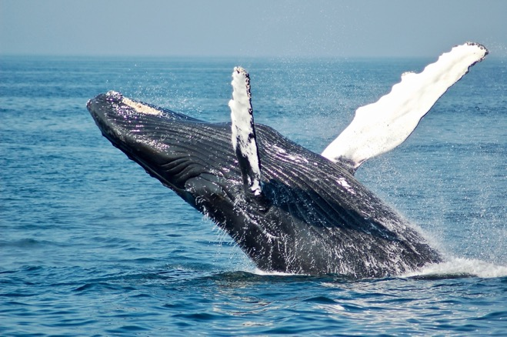
HISTORY OF ANTARCTIC FISHING
KŌRERORERO / DISCUSSION
Whaling began in 1904
Tohorā or whales were harvested mainly for oil
Whalers could extract 120 barrels of oil from a single 30m long Tohorā Puru or Blue Whale
When one species of whale was overhunted they became less common; whalers would change focus to another species of whales

Slide 12
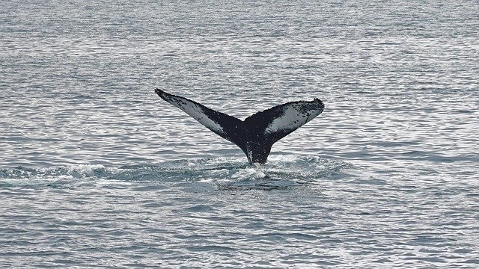
HISTORY OF ANTARCTIC FISHING
KŌRERORERO / DISCUSSION
Slowly the number of all tohorā or whales around Antarctica declined
Seven species of whales that are found in the Southern Ocean were hunted hard and at times there were just thousands or even hundreds remaining
Commercial whaling was stopped in 1986 and a whale sanctuary was created in the Southern Ocean

Slide 13
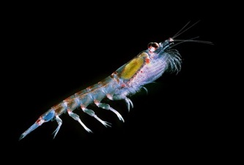
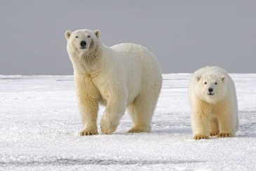
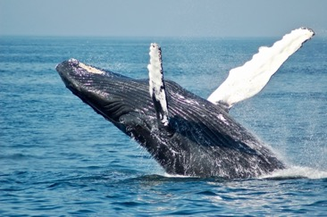
HISTORY OF ANTARCTIC FISHING
KĒMU PATAPATAI / QUIZ
What did you learn?
1. Which of these creatures have been harvested by humans from coast and ocean around Antarctica?
2. In what order?
3. Why were they harvested?
4. Are they still harvested?
Notes:
ANSWERS
Krill:
Yes
Seals, penguins, whales, krill
Oil (supplements) pet food, aquaculture feed)
Yes
King Penguin
YES
Seals, penguins, whales, krill
Oil
No
Seals
YES
Seals, penguins, whales, krill
Oil and fur pelts
No
Blue Whale
YES
Seals, penguins, whales, krill
Oil
No
Polar bear
NO – don’t live in Antarctica

Slide 14
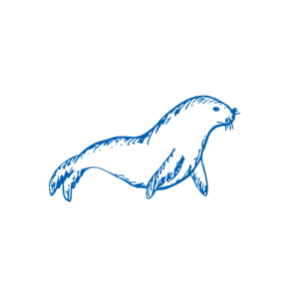
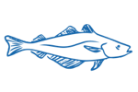
HISTORY OF ANTARCTIC FISHING
1790
MAHI / ACTIVITY
Complete one or more of the History of Antarctic Fishing Worksheets
How do you think attitudes to harvesting marine creatures from the ocean changed over time?
Today
Notes:
TEACHER NOTES

Slide 15
HISTORY OF ANTARCTIC FISHING
1700s
Current Day
Time line
MAHI / ACTIVITY
Complete one or more of the History of Antarctic Fishing Worksheets and / or use the websites provided on the following slide to create a timeline of key moments in the history of Antarctic fishing
Today
Notes:
TEACHER NOTES

Slide 16
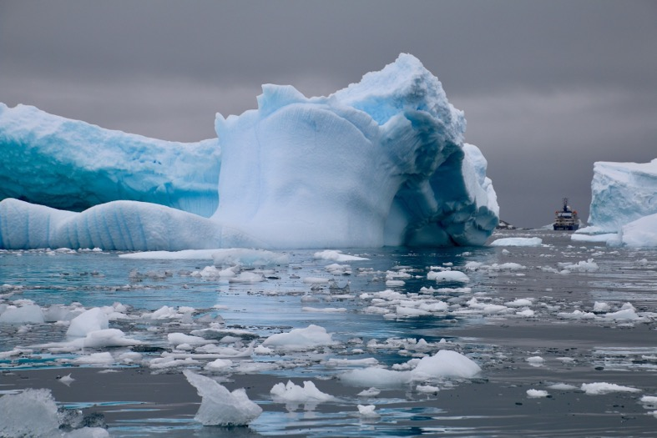
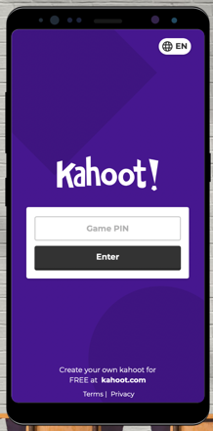
TEST YOUR KNOWLEDGE!
Play the MSC History of Antarctic Fishing Kahoot!
Notes:
https://www.msc.org/en-au/for-teachers/ocean-literacy/new-zealand-education-curriculum/kahoot-quizzes

