Slide 1
ANTARCTIC WHALES

Slide 2
ANTARCTIC WHALES: FOCUS QUESTIONS
How do whales live in Antarctic waters?
How are Antarctic whales connected with other marine life?
What role do whales play in climate and climate change?
Has overfishing affected whales and other marine life?

Slide 3
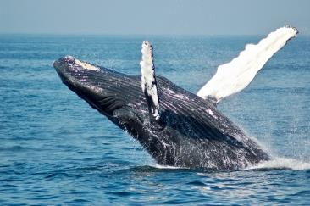
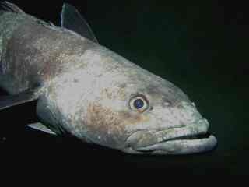
ANTARCTIC WHALES Focusing Question: How are Antarctic whales connected with other marine life?
KŌRERORERO / DISCUSSION
According to one Māori creation tradition the god of the sea and ancestor of fish is Tangaroa, the son of Ranginui (sky father) and Papatūānuku (earth mother).
Tangaroa’s son Punga was the father of Ikatere and Tūtewehiwehi.
Ikatere went to the sea. He and his children became fish.
All sea creatures are part of this whakapapa or family tree.
Paul A. Cziko
Notes:
According to one Māori creation tradition the god of the sea and ancestor of fish is Tangaroa, the son of Ranginui (sky father) and Papatūānuku (earth mother). Tangaroa’s son Punga was the father of Ikatere and Tūtewehiwehi. Ikatere went to the sea. He and his children became fish. Tūtewehiwehi journeyed inland, He and his offspring became reptiles. All sea creatures are part of this whakapapa or family tree. And this whakapapa or family tree connects us, with the ocean and creatures that live there.
Question: Where did Tūtewehiwehi go and what creatures were his children?
Answer: Inland and the reptiles

Slide 4
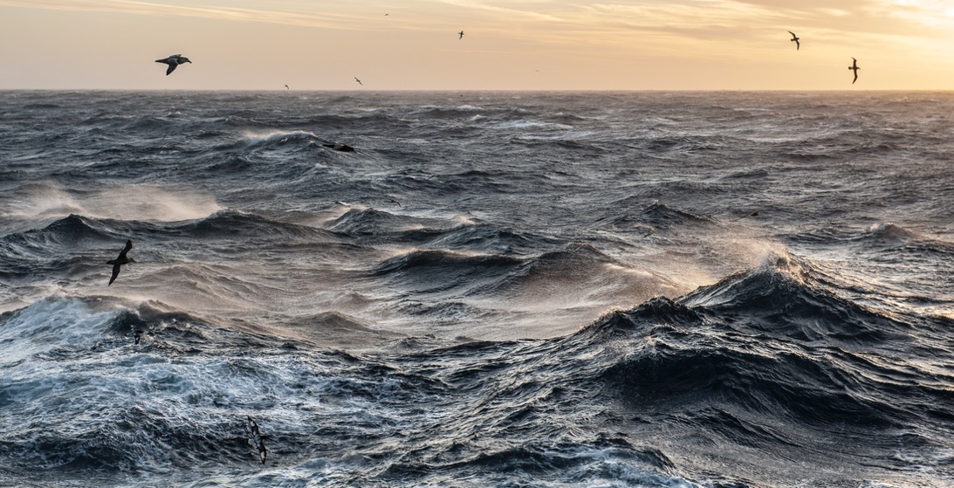
ANTARCTIC WHALES Focusing Question: How do whales live in Antarctic waters?
HE PĀTAI / CONSIDER THIS
WHAT DO YOU ALREADY KNOW ABOUT
TOHORĀ / WHALES AND OTHER MARINE LIFE IN ANTARCTICA?
Notes:
TEACHER NOTES
CHECK PRIOR KNOWLEDGE
POSSIBLE INQUIRY QUESTIONS:
What marine creatures live in Antarctica?
Do polar bears live there?
Do penguins live there?
What types of whales are there?
What do whales eat?
What do penguins eat?

Slide 5
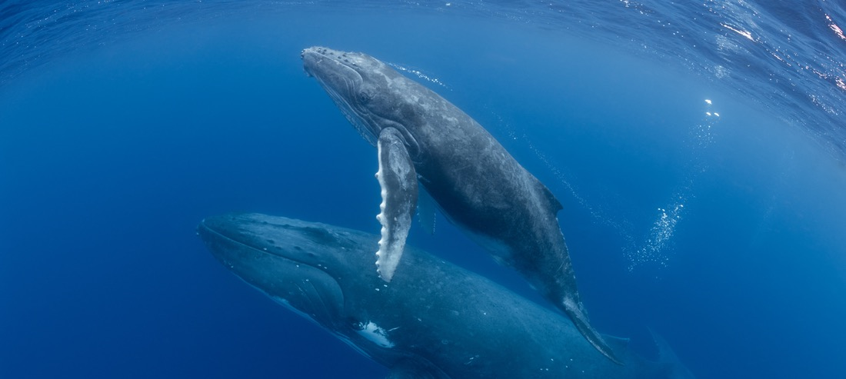
ANTARCTIC WHALES Focusing Question: How are Antarctic whales connected with other marine life?
HE PĀTAI / CONSIDER THIS
Are whales fish or mammals?
FISH | OR | MAMMALS
Notes:
TEACHER NOTES
ANSWER ON NEXT SLIDE

Slide 6
ANTARCTIC WHALES Focusing Question: How are Antarctic whales connected with other marine life?
HE PĀTAI / CONSIDER THIS
Are whales fish or mammals?
✓ MAMMALS! Unlike most fish, whales come to the surface to breathe, have lungs, give birth to live young and have mammary glands…
FISH | OR | MAMMALS
Notes:
TEACHER NOTES
Whales come to the surface to breathe, feed their young milk, always give birth to live young, are warm blooded…
Fish don’t need to come to the surface to breathe, breathe through gills, are cold blooded, reproduction occurs either by live young or eggs

Slide 7
ANTARCTIC WHALES Focusing Question: How do whales live in Antarctic waters?
HE PĀTAI / CONSIDER THIS
Take a guess – Do the large whales ever get cold in Antarctic waters?
YES | OR | NO
Notes:
TEACHER NOTES
ANSWER ON NEXT SLIDE

Slide 8
ANTARCTIC WHALES Focusing Question: How do whales live in Antarctic waters?
HE PĀTAI / CONSIDER THIS
Take a guess – Do the large whales ever get cold in Antarctic waters?
✓ NO! The large whales are adapted to live in very cold temperatures. They don’t get cold due to their large size and a ‘blanket of blubber’.
YES | OR | NO
Notes:
TEACHER NOTES
Whales can live at the same temperatures indefinitely if healthy and reasonably fed, they just don't get hypothermia - ever. The reason for this is that a large size with a low surface area to volume ratio, and a blanket of blubber around the whole animal below the skin mean that metabolic heat is retained to the degree that the coldest seas are readily survivable.
For more information:
https://www.coolantarctica.com/Antarctica%20fact%20file/wildlife/whales/whales.php

Slide 9
ANTARCTIC WHALES Focusing Question: How are Antarctic whales connected with other marine life?
HE PĀTAI / CONSIDER THIS
Take a guess – What do the great (big) whales of Antarctica most commonly eat?
KRILL & PLANKTON | OR | FISH, SHARKS & RAYS
Notes:
TEACHER NOTES
ANSWER ON NEXT SLIDE

Slide 10
ANTARCTIC WHALES Focusing Question: How are Antarctic whales connected with other marine life?
HE PĀTAI / CONSIDER THIS
Take a guess – What do the great (big) whales of Antarctica most commonly eat?
✓ KRILL & PLANKTON! Large whales gulp their food using plates of baleen instead of teeth. The inner edges of baleen plates are bristly to filter and collect food. Food is usually smallish numerous animals like krill.
KRILL & PLANKTON | OR | FISH, SHARKS & RAYS
Notes:
TEACHER NOTES
Baleen whales have plates in the mouth instead of teeth to filter food in bulk from seawater. These are made of keratin, the same tough protein that makes hair, skin, nails, hooves and horns. There are two rows of plates that hang down from the upper jaw forming two upright sides of a triangle with the lower jaw being the third side. The inner edges of these plates are bristly filters to collect food, usually smallish very numerous animals such as krill in the water they gulp in. A huge mouthful of water + food is taken in and the mouth closed, then the water is ejected by the tongue while the food is filtered out and trapped inside the mouth to be swallowed when the water has gone.
For more information:
https://www.coolantarctica.com/Antarctica%20fact%20file/wildlife/whales/whales.php

Slide 11
ANTARCTIC WHALES Focusing Question: How are Antarctic whales connected with other marine life?
HE PĀTAI / CONSIDER THIS
Take a guess – Whales can loosely be divided into two groups. Which of the following are the two groups of whales?
BALEEN WHALES |  | SHARKS |  | TOOTHED WHALES
Notes:
TEACHER NOTES
ANSWER ON NEXT SLIDE

Slide 12
ANTARCTIC WHALES Focusing Question: How are Antarctic whales connected with other marine life?
HE PĀTAI / CONSIDER THIS
Take a guess – Whales can loosely be divided into two groups. Which of the following are the two groups of whales?
✓ BALEEN WHALES & TOOTHED WHALES: Toothed whales have teeth!! They hunt and eat squid, fish, and seals. Baleen whales have plates in the mouth instead of teeth to filter food in bulk from seawater.
BALEEN WHALES |  | SHARKS |  | TOOTHED WHALES
Notes:
TEACHER NOTES
Baleen whales have plates in the mouth instead of teeth to filter food in bulk from seawater. These are made of keratin, the same tough protein that makes hair, skin, nails, hooves and horns. There are two rows of plates that hang down from the upper jaw forming two upright sides of a triangle with the lower jaw being the third side. The inner edges of these plates are bristly filters to collect food, usually smallish very numerous animals such as krill in the water they gulp in. A huge mouthful of water + food is taken in and the mouth closed, then the water is ejected by the tongue while the food is filtered out and trapped inside the mouth to be swallowed when the water has gone.
For more information:
https://www.coolantarctica.com/Antarctica%20fact%20file/wildlife/whales/whales.php

Slide 13
ANTARCTIC WHALES Focusing Question: How are Antarctic whales connected with other marine life?
HE PĀTAI / CONSIDER THIS
Take a guess – Group the whales into the categories ‘toothed whales’ and ‘baleen whales’ (Hint: Baleen whales are usually big!)?
ORCA |  | SPERM WHALE |  | HUMPBACK WHALE
BLUE WHALE |  | FIN WHALE |  | DOLPHIN
Notes:
TEACHER NOTES
ANSWER ON NEXT SLIDE

Slide 14
ANTARCTIC WHALES Focusing Question: How are Antarctic whales connected with other marine life?
HE PĀTAI / CONSIDER THIS
Take a guess – Group the whales into the categories ‘toothed whales’ and ‘baleen whales’ (Hint: Baleen whales are usually big!)?
✓ BALEEN WHALES: Blue whales, Fin whales, Humpback whales
✓ TOOTHED WHALES: Sperm whales, Dolphins, Orca
ORCA |  | SPERM WHALE |  | HUMPBACK WHALE
BLUE WHALE |  | FIN WHALE |  | DOLPHIN
Notes:
TEACHER NOTES
See https://www.worldwildlife.org/magazine/issues/fall-2019/articles/the-whales-of-antarctica

Slide 15
ANTARCTIC WHALES Focusing Question: How do whales live in Antarctic waters?
HE PĀTAI / CONSIDER THIS
Take a guess – Do the great whales of Antarctica mostly live in Antarctica all year round or do they migrate northwards during the Antarctic winter?
MIGRATE | OR | STAY ALL YEAR
Notes:
TEACHER NOTES
SEE NEXT SLIDE

Slide 16
ANTARCTIC WHALES Focusing Question: How do whales live in Antarctic waters?
HE PĀTAI / CONSIDER THIS
Take a guess – Do the great whales of Antarctica mostly live in Antarctica all year round or do they migrate northwards during the Antarctic winter?
✓ MIGRATE Many whales migrate between warmer oceans and Antarctica
MIGRATE | OR | STAY ALL YEAR
Notes:
TEACHER NOTES
Many whales migrate to the polar regions during the summer months of that region. There are often distinct southern and northern populations of species which go to their respective pole, none go to both poles. Not all individuals migrate however and in recent years, some humpback whales have been found around Antarctica during the winter rather than 7,000km (4,350miles) away off the coast of Africa where they were thought to be.

Slide 17
ANTARCTIC WHALES & FISH Focusing Question: How do whales live in Antarctic waters?
HE PĀTAI / CONSIDER THIS
Take a guess – Some Humpback whales migrate from Antarctica to Tonga to breed. What do they eat while breeding in Tonga?
NOTHING | OR | KRILL & FISH
Notes:
TEACHER NOTES
SEE NEXT SLIDE.

Slide 18
ANTARCTIC WHALES Focusing Question: How do whales live in Antarctic waters?
HE PĀTAI / CONSIDER THIS
Take a guess – Some Humpback whales migrate from Antarctica to Tonga to breed. What do they eat while breeding in Tonga?
✓ NOTHING! They live off their blubber reserves!
NOTHING | OR | KRILL & FISH
Notes:
TEACHER NOTES
They feed continuously during the super-productive summer months and then live entirely on their blubber reserves for about 4 months during the breeding season in warmer waters.

Slide 19
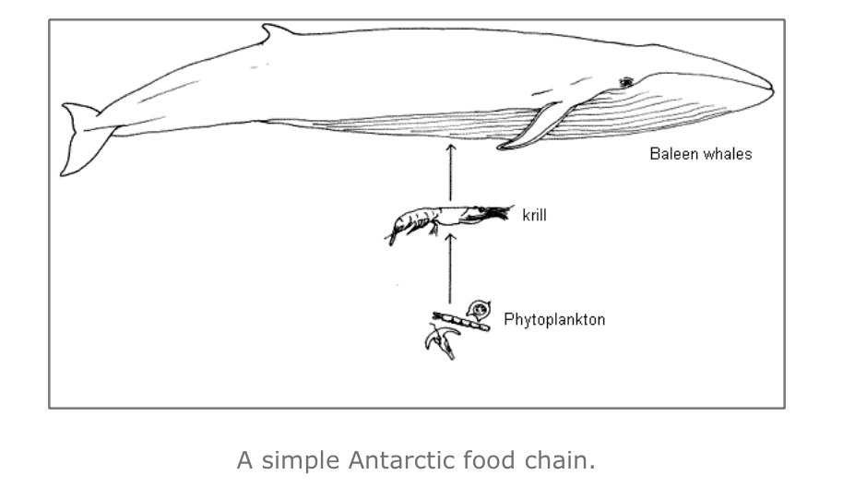
ANTARCTIC WHALES Focusing Question: How are Antarctic whales connected with other marine life?
HE PĀTAI / CONSIDER THIS
The ‘food chain’ connects marine creatures
Marine creatures depend on one another!
Source: LEARNZ.org.nz
Notes:
TEACHER NOTES

Slide 20
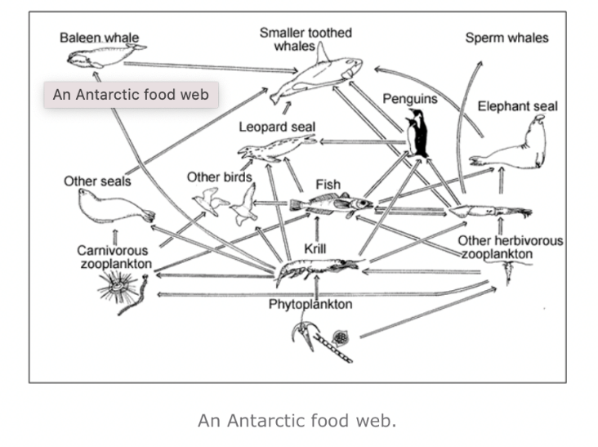
ANTARCTIC WHALES Focusing Question: How are Antarctic whales connected with other marine life?
HE PĀTAI / CONSIDER THIS
Use this food web to find how:
Fish are connected to toothed whales
Phytoplankton are connected to baleen whales
Phytoplankton are connected to sperm whales
Source: LEARNZ.org.nz
Notes:
TEACHER NOTES

Slide 21
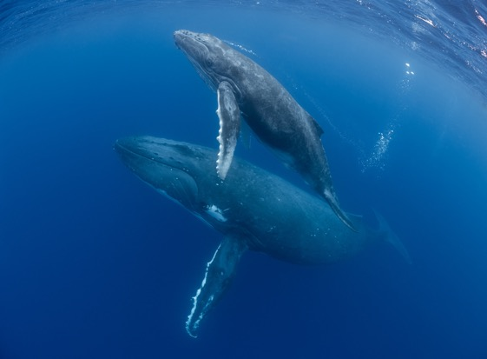
ANTARCTIC WHALES Focusing Question: What role do whales play in climate and climate change?
HE PĀTAI / CONSIDER THIS
Krill
HOW DOES THIS RELATE TO
CLIMATE & CLIMATE CHANGE?
Plankton
Whales Poo
Notes:
TEACHER NOTES
Ask students to have a go at answering this. Then watch the film clip (next slide). Then have another go!
Background reading:
https://www.theguardian.com/environment/georgemonbiot/2014/dec/12/how-whale-poo-is-connected-to-climate-and-our-lives
https://www.bbc.com/future/article/20210119-why-saving-whales-can-help-fight-climate-change
https://www.parley.tv/updates/whale-poop-loop

Slide 22
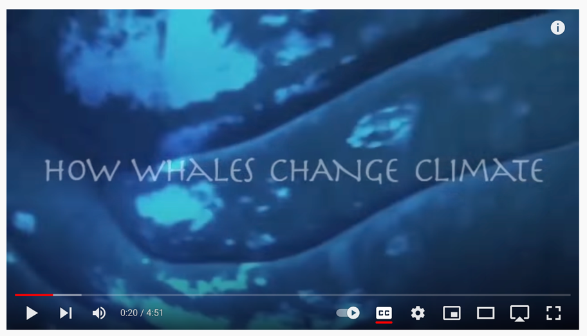
ANTARCTIC WHALES Focusing Question: What role do whales play in climate and climate change?
MĀTAKI TĒNEI / WATCH THIS
How whales change climate [4.51]
Notes:
TEACHER NOTES
Film link: https://www.youtube.com/watch?v=M18HxXve3CM&t=20s
Background reading:
https://www.theguardian.com/environment/georgemonbiot/2014/dec/12/how-whale-poo-is-connected-to-climate-and-our-lives
https://www.bbc.com/future/article/20210119-why-saving-whales-can-help-fight-climate-change

Slide 23
ANTARCTIC WHALES Focusing Question: What role do whales play in climate and climate change?
HE PĀTAI / CONSIDER THIS
Krill
HOW DOES THIS RELATE TO
CLIMATE & CLIMATE CHANGE?
Phytoplankton
Whales Poo
Notes:
TEACHER NOTES
Key points:
Phytoplankton removes CO from atmosphere through photosynthesis.
Uneaten phytoplankton eventually die and sink transferring the carbon to the deep sea.
Phytoplankton need iron to thrive.
The concentration of iron in whale faeces is more than 10 million times higher than seawater concentrations.
So whale poop acts as a fertiliser that increases phytoplankton growth, leading to a more productive ecosystem and enhanced atmospheric carbon dioxide removal.

Slide 24
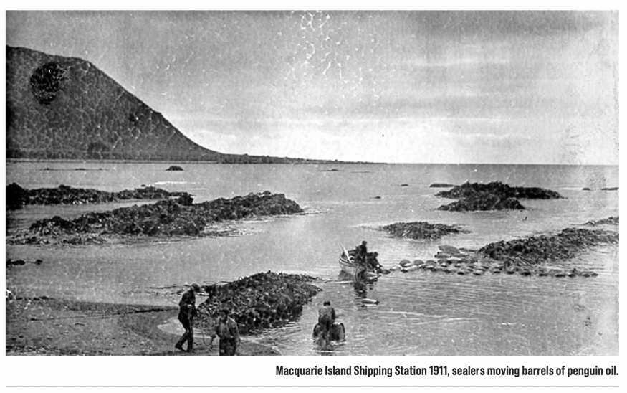
ANTARCTIC WHALES Focusing Question: Has overfishing affected Antarctic whales and other marine life?
KŌRERORERO / DISCUSSION
Antarctica is very cold and hard to get to!
Yet living creatures have been harvested from Antarctica since 1790!
Image: Australia Antarctic Programme
Notes:
TEACHER NOTES
Facts from: https://www.msc.org/what-we-are-doing/oceans-at-risk/climate-change-and-fishing
Maps from: https://www.moanaproject.org/marine-heatwave-forecast
A marine heatwave is an extended period of extremely warm ocean temperatures (the scientific definition of a marine heatwave is when seawater temperatures are warmer than the 90th percentile of the local long-term (25-year) average for at least five consecutive days)¹. As climate change affects our oceans, marine heatwaves are expected to become more frequent, intense and longer lasting. Our ocean life around New Zealand has evolved to thrive in cooler seas and marine heatwaves can have devastating effects on local ecosystems. They also pose a threat to aquaculture and fisheries, New Zealand industries worth more than $4 billion annually.

Slide 25
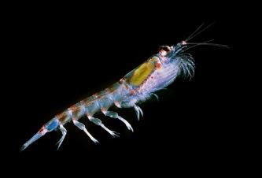
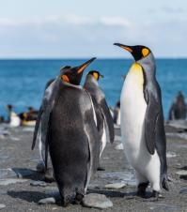
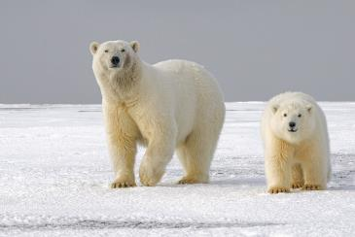
ANTARCTIC WHALES Focusing Question: Has overfishing affected Antarctic whales and other marine life?
KĒMU PATAPATAI / QUIZ
TAKE A GUESS:
1. Which of these creatures have been harvested by humans from coasts and ocean around Antarctica?
2. Which are still harvested?
Notes:
ANSWERS
Seals, penguins, whales, krill
Only krill are still harvested

Slide 26
ANTARCTIC WHALES Focusing Question: Has overfishing affected Antarctic whales and other marine life?
KŌRERORERO / DISCUSSION
Antarctic whaling began in 1904
Tohorā or whales were harvested mainly for oil
When one species of whale was overhunted they became less common
Whalers would then focus on another type of whale

Slide 27
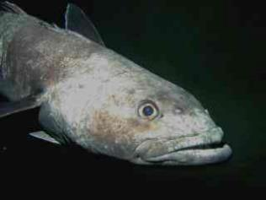
ANTARCTIC WHALES Focusing Question: Has overfishing affected Antarctic whales and other marine life?
KŌRERORERO / DISCUSSION
The harvest of whales was unsustainable leaving few whales in Antarctic waters
Fish and krill have also at time been over harvested from Antarctic waters
Paul A. Cziko

Slide 28
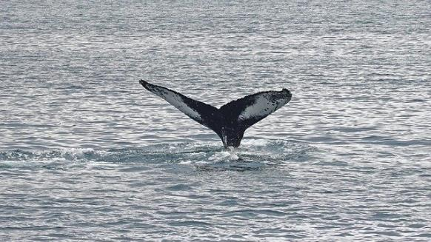
ANTARCTIC WHALES Focusing Question: Has overfishing affected Antarctic whales and other marine life?
KŌRERORERO / DISCUSSION
The good news!
Commercial whaling was stopped!
In 1986 a whale sanctuary was created in the Southern Ocean
25 countries signed up to CCAMLR Commission for the Conservation of Antarctic Marine Living Resources (in 1982) to help prevent over exploitation of Antarctic marine life
Organisations like the Marine Stewardship Council are working to support sustainable fishing around Antarctica

Slide 29
ANTARCTIC WHALES
KĒMU PATAPATAI / QUIZ
True or false? [answers on final slide]
Whales are a type of fish.
Baleen whales feed mostly on krill and plankton.
Sperm whales are toothed whales and Blue whales are baleen whales.
Migratory Antarctic baleen whales feed continuously during the Antarctic summer then travel north to warmer waters to breed.
Whales have to migrate north from Antarctica during winter as they get too cold in Antarctic waters during winter.
Notes:
TEACHER NOTES

Slide 30
ANTARCTIC WHALES: KĒMU PATAPATAI / QUIZ
True or false? [answers on final slide]
Whale poop releases iron, which feeds phytoplankton, which feeds krill… which feeds whales?
Before whaling was banned, no whales were over hunted from Antarctic waters.
There are currently organisations (like MSC), and measures (like CCAMLR), to better protect marine life in Antarctica.
Notes:
TEACHER NOTES

Slide 31
ANTARCTIC WHALES: KĒMU PATAPATAI / QUIZ: ANSWERS
Whales are a type of fish. FALSE [Whales are mammals].
Baleen whales feed mostly on krill and plankton. TRUE
Sperm whales are toothed whales and Blue whales are baleen whales. TRUE
Migratory Antarctic baleen whales feed continuously during the Antarctic summer then travel north to warmer waters to breed. TRUE
Whales have to migrate north from Antarctica during winter as they get too cold in Antarctic waters. FALSE [Some whales do stay in Antarctic waters. Whales have adapted to cope with cold (big size and blubber).
Whale poop releases iron, which feeds phytoplankton, which feeds krill… which feeds whales? TRUE
Before whaling was banned, no whales were over hunted from Antarctic waters. FALSE. [Many whale species were hunted until there were few of them left!]
There are currently organisations (like MSC), and measures (like CCAMLR), to better protect marine life in Antarctica. TRUE
Notes:
TEACHER NOTES

