Slide 1
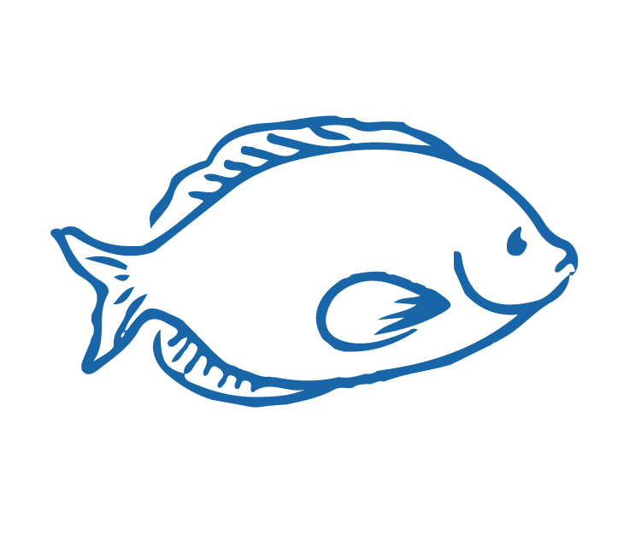
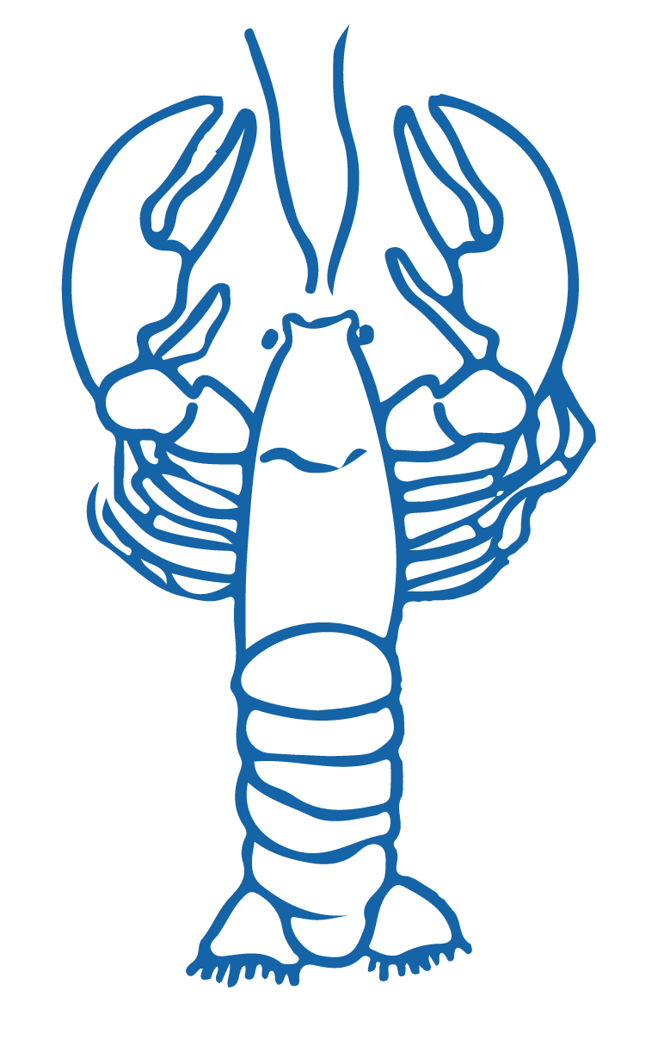
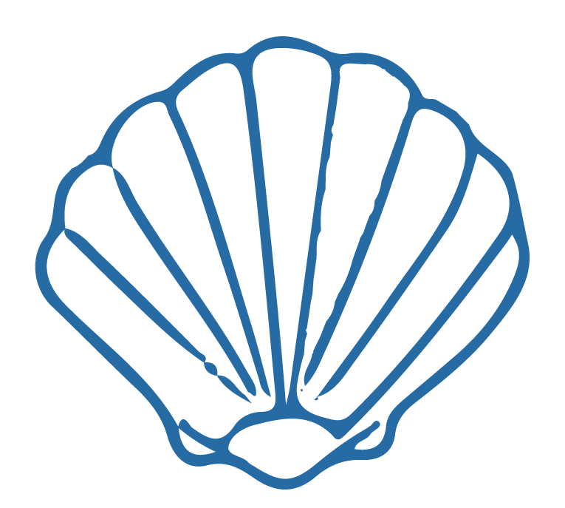
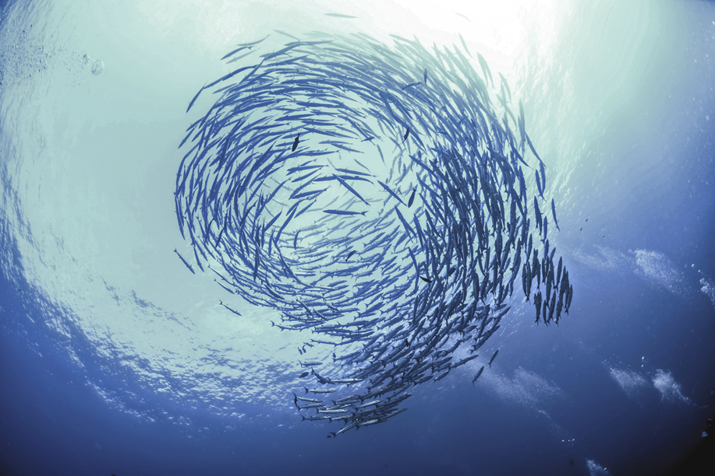
KO ĀU TE MOANA, KO MOANA TE ĀU Focus Question: How do I feel connected to the sea? How do different people value the sea? What different viewpoints do people hold about the sea? What is my viewpoint?
KŌRERORERO / DISCUSSION
In te ao Māori [the Māori world]:
- All things are inter-connected
- We are related to the sea through whakapapa [family tree]
HE PĀTAI / CONSIDER THIS
What kai moana [seafood] have you eaten or caught lately?
What beaches have you visited & why?
Notes:
TEACHER NOTES
USEFUL RESOURCES / RĀRANGI PUKAPUKA
To read more about Tangaroa see: https://teara.govt.nz/en/tangaroa-the-sea/print

Slide 2
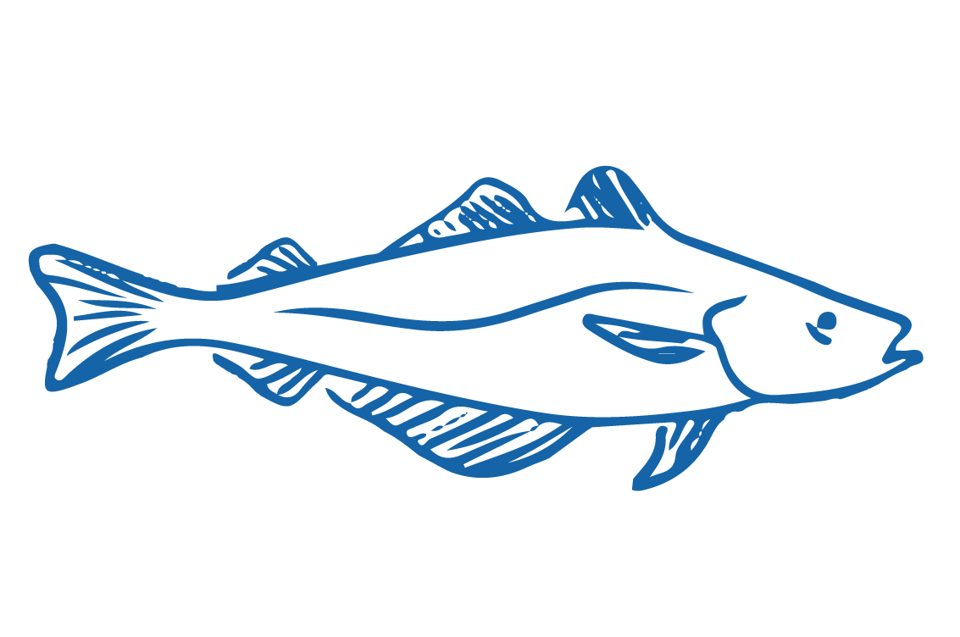
KO ĀU TE MOANA, KO MOANA TE ĀU
KŌRERORERO / DISCUSSION
In te ao Māori [the Māori world]:
We are related to the sea through whakapapa [family tree]
People and the sea are children of Papatūānuku [earth mother] and Ranginui [sky father]
“Ko au te moana, te moana ko au” [I am the sea, the sea is me]
Source: Te Ara.govt.nz
Notes:
TEACHER NOTES
USEFUL RESOURCES / RĀRANGI PUKAPUKA
To read more about Tangaroa see: https://teara.govt.nz/en/tangaroa-the-sea/print
Image source: Te Ahukaramū Charles Royal, 'Papatūānuku – the land - Papatūānuku – the earth mother', Te Ara - the Encyclopedia of New Zealand,
http://www.TeAra.govt.nz/en/whakapapa/11430/papatuanukus-children
(accessed 14 January 2020)

Slide 3
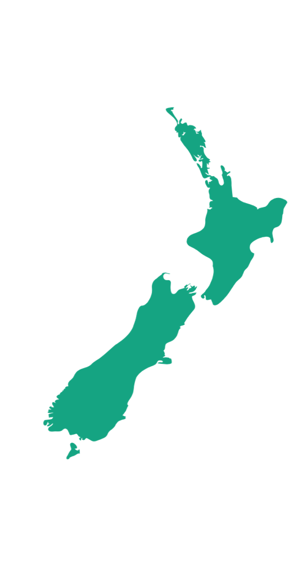
KO ĀU TE MOANA, KO MOANA TE ĀU Focus Question: What is my relationship with the sea?
KŌRERORERO/ DISCUSSION
In Aotearoa New Zealand we have a unique and strong connection to the sea. Find out more about one of the following and present back to the rest of the class: (See Activity 2 Teacher Outline)
Our whenua [land] was fished from the sea [by Maui] and many of our tūpuna [ancestors] were fishing folk
Unlike some other countries most of us live near the sea!
Notes:
TEACHER NOTES
USEFUL RESOURCES / RĀRANGI PUKAPUKA
HISTORY
Te Ara Encyclopedia is a great place to start
GEOGRAPHY
How some counties are more sea than land: https://www.weforum.org/agenda/2017/10/global-ocean-governance-all-at-sea/

Slide 4
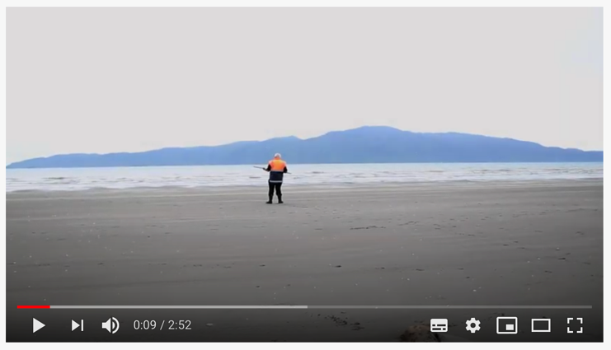
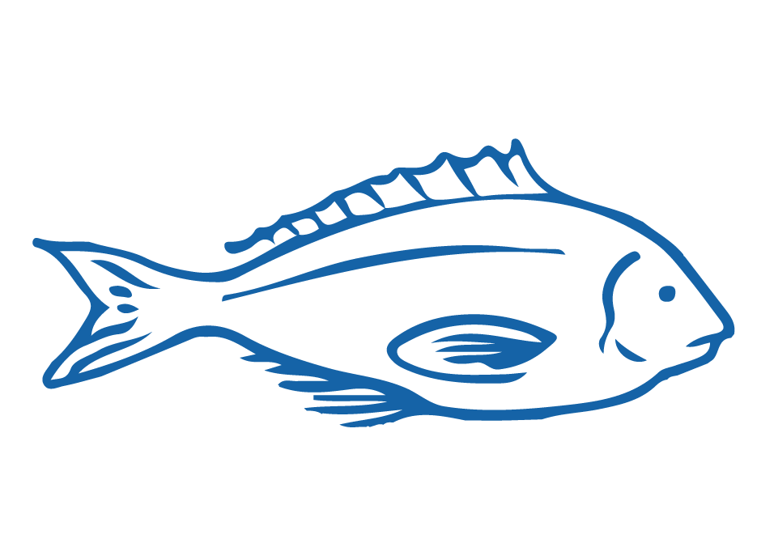
KO ĀU TE MOANA, KO MOANA TE ĀU
MAHI / ACTIVITY
Create a poem, waiata / song, piece of music or picture that conveys what the sea or a coastal place near you means to you
(See Activity 3 Ocean Citizenship Teacher Outline)
MĀTAKI TĒNEI / WATCH THIS
Ko au te Taha Moana. Ko te Taha Moana ko au [2:52]
Notes:
TEACHER NOTES
https://www.youtube.com/watch?v=EFT_SnfASNA&feature=emb_logo

Slide 5
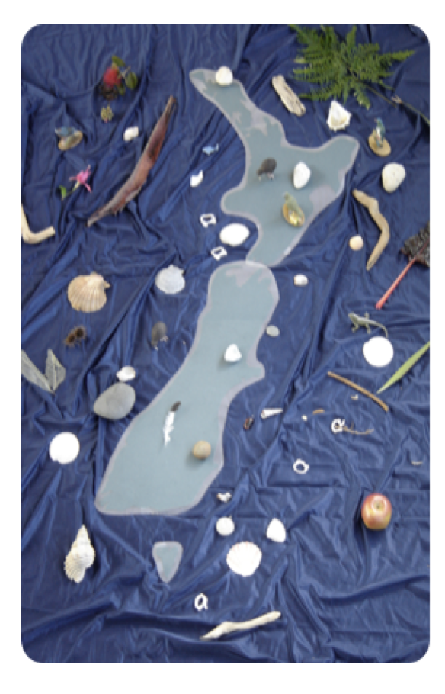
KO ĀU TE MOANA, KO MOANA TE ĀU
MAHI / ACTIVITY
Complete one or more of the following (see Teacher Outline Activities 4, 5, 6)
Identify a taonga o Tangaroa and share significance of this taonga for you
Share how your whānau [family] and tūpuna [ancestors] have used the sea
Make a short film or Powtoon that shares different viewpoints and connections with the sea
[Image and activity from Ministry of Education – Education for Sustainability]
Notes:
TEACHER NOTES
See teacher outline for fully developed activities and resources to support.

Slide 6
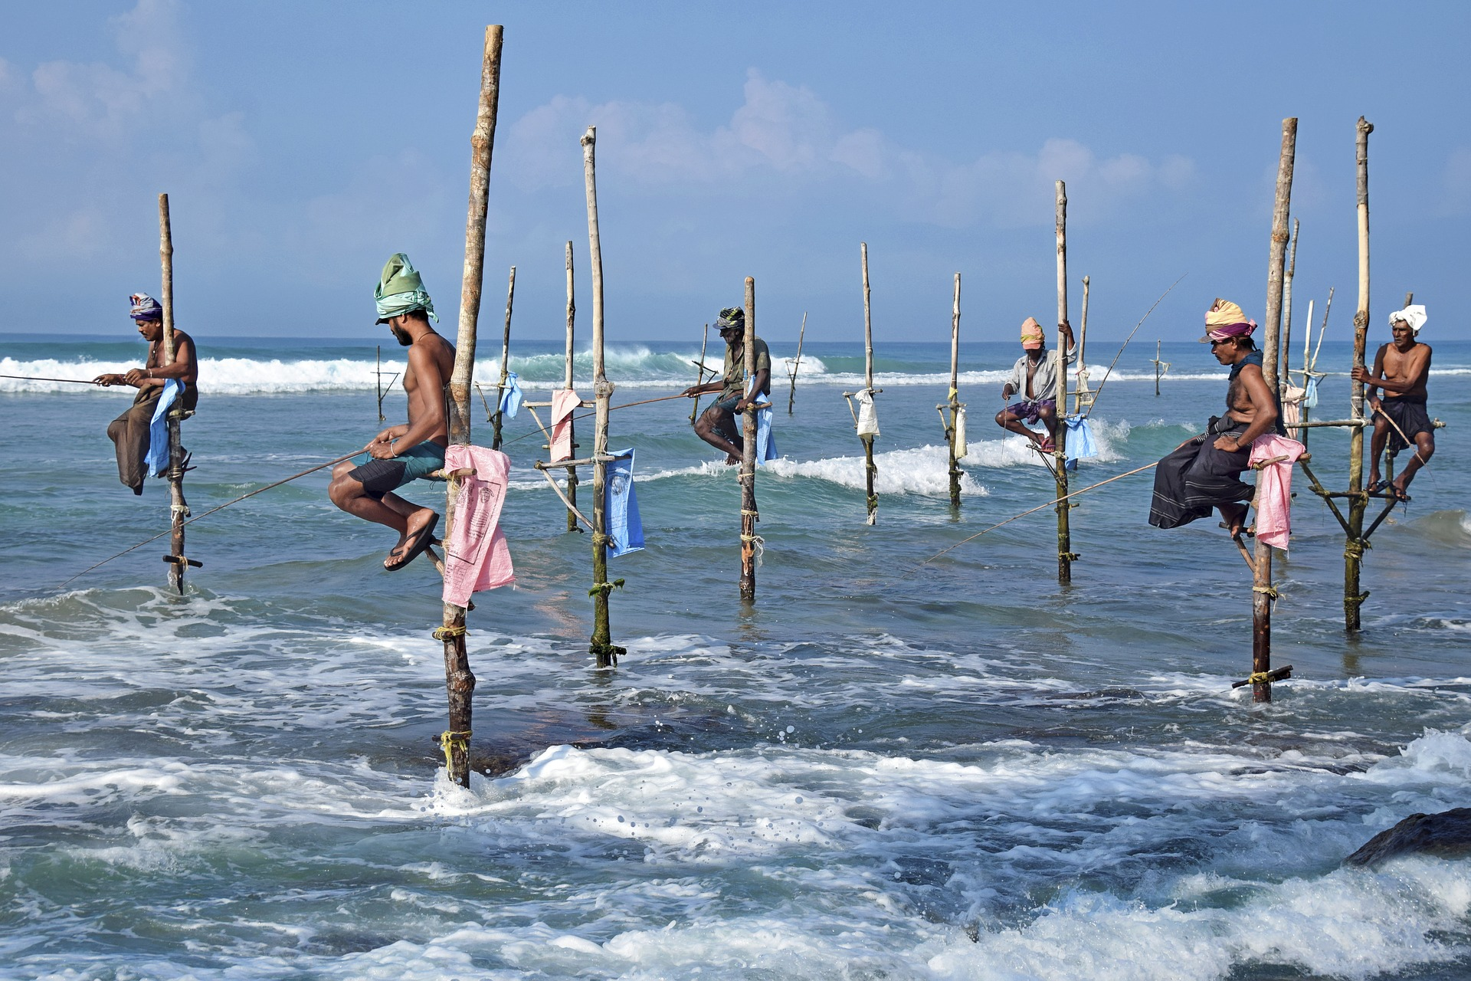
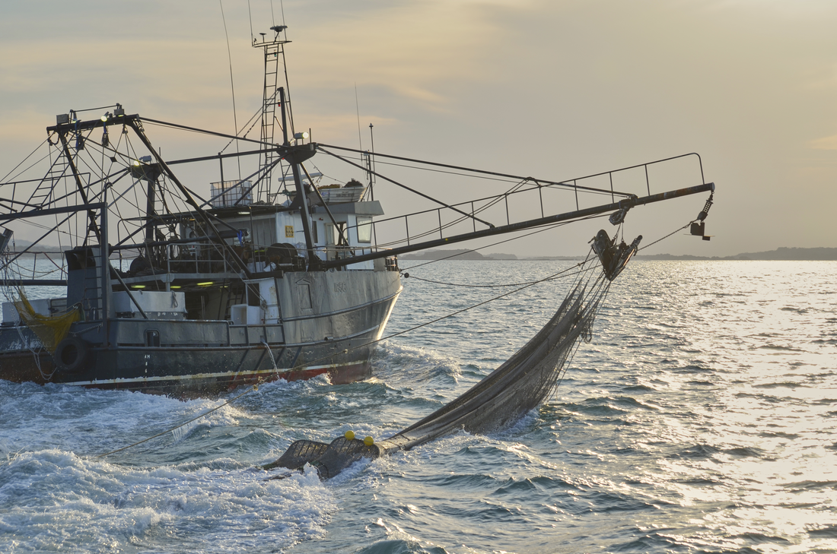
KO ĀU TE MOANA, KO MOANA TE ĀU
MAHI / ACTIVITY
Complete one or more of the following (see Teacher Outline Activities 7, 8, 9, 10)
Visit and connect with a local coastal site
Create a 360°view of a local coastal site
Collect and identify shells from your beach
Investigate other cultural and country viewpoints about the sea?
Conduct a group inquiry
Notes:
TEACHER NOTES
See teacher outline for fully developed activities and resources to support.

Slide 7
He tai moana, he tai ika,
He tai timu, he ika nunumi
A sea that is healthy, is a sea that flourishes with life
A sea in decline, becomes void of sea life
Whaktauki or proverb – it outlines a two way context; the need for caring for the ocean or the repercussions of mismanagement of resources
Notes:
TEACHER NOTES

