Slide 1
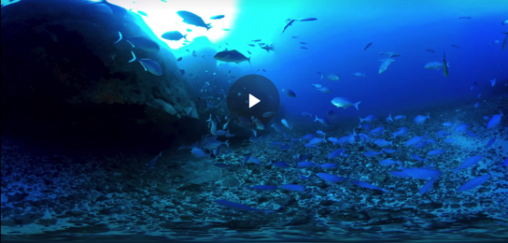
FISHY CONNECTIONS Focusing Question: How am I connected with fishes?
MĀTAKI TĒNEI / WATCH THIS
Short [1:55] film clip to see what it is like underwater in Aotearoa New Zealand [view using Chrome]
HE PĀTAI / CONSIDER THIS
What do you think it would feel like to be a fish living in the sea?
How are you connected with the fish that live in the sea?
Discuss ancestors [tīpuna] that caught fish
MAHI / ACTIVITY
Write or tell a short story called “a creature of the sea and me”
Notes:
TEACHER NOTES
The video clip may require Google Chrome to view and can be found at https://www.nzgeo.com/video/nzvr-trailer/
(Can’t be viewed through Safari)
KŌRERORERO / DISCUSSION
Answers might include words like: cold, free, floating, weightless, blue, dark, swaying…
Answers might include: whakapapa, ancestors who were fisher folk or whalers,
Discuss stories of ancestors / tīpuna that caught fish. Discuss how fish and fishing were an important part of our ancestors lives, diet, and livelihood
OTHER DISCUSSION QUESTIONS
What colour did you see most underwater?
What types of marine creatures did you recognise?
What different body shapes did you notice amongst the fish?
Was there the same amount of fish in each place? If not, why not?
Were all fish swimming in groups or schools? Why do you think fish swim in schools?

Slide 2
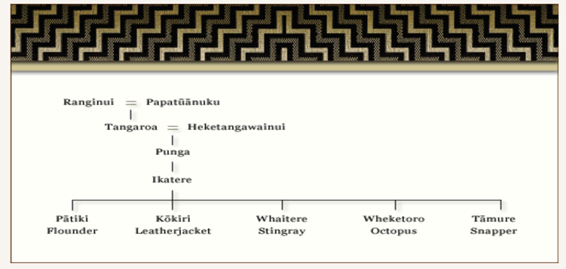
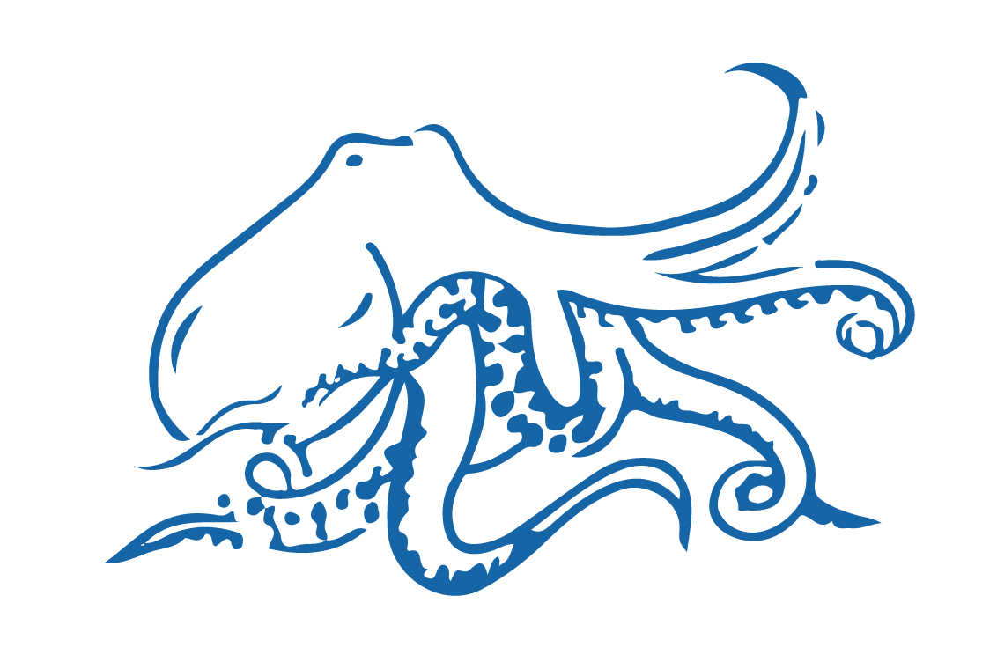
FISHY CONNECTIONS
KŌRERORERO / DISCUSSION
In te ao Māori [the Māori world]:
We are related to the sea through whakapapa [family tree]
People and the sea are the children of Papatūānuku [earth mother] and Ranginui [sky father]
Sea creatures are children of the ugly god Punga
Source: Te Ara.govt.nz
Notes:
TEACHER NOTES
USEFUL RESOURCES / RĀRANGI PUKAPUKA
To read more about Tangaroa see: https://teara.govt.nz/en/Tangaroa-the-sea/print
Image source: Te Ahukaramū Charles Royal, 'Papatūānuku – the land - Papatūānuku – the
earth mother', Te Ara - the Encyclopedia of New Zealand,
http://www.TeAra.govt.nz/en/whakapapa/11430/papatuanukus-children
(accessed 14 January 2020)

Slide 3
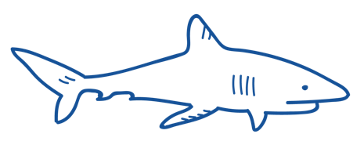
FISHY CONNECTIONS
KŌRERORERO / DISCUSSION
Polynesians, have long thought of sharks as guardian spirits
Our ancestors [tīpuna] had a close relationship with sea animals, for example Tametekapua
“Tamatekapua set out for Aotearoa New Zealand from Hawaiki and was rescued by a shark… .
…He and his people renamed their canoe, and themselves after a type of shark: Te Arawa”
HE PĀTAI / CONSIDER THIS
Find out what sea creatures feature in the history or whakapapa of your whānau [family]?
Notes:
TEACHER NOTES
USEFUL RESOURCES / RĀRANGI PUKAPUKA
To read more about Tangaroa see: https://teara.govt.nz/en/Tangaroa-the-sea/print
Image source: Te Ahukaramū Charles Royal, 'Papatūānuku – the land - Papatūānuku – the
earth mother', Te Ara - the Encyclopedia of New Zealand,
http://www.TeAra.govt.nz/en/whakapapa/11430/papatuanukus-children
(accessed 14 January 2020)

Slide 4
He kura kainga te moana, he kura huna te moana
The oceans environment,
is a source of untapped knowledge

