Slide 1
CLIMATE & OCEAN

Slide 2
Focus questions!
What role does the ocean play in climate and climate change?
What role does marine life play in climate and climate change?
How does climate change affect the ocean and marine life?

Slide 3
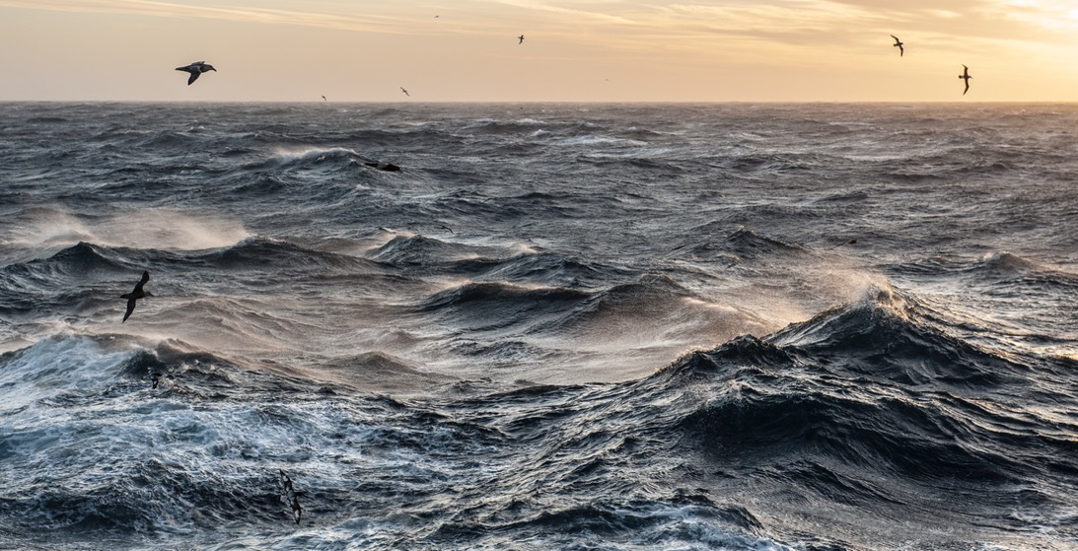
CLIMATE AND OCEAN Focusing Question: What role does the ocean play in climate & climate change?
HE PĀTAI / CONSIDER THIS
WHAT DO YOU ALREADY KNOW ABOUT
CLIMATE, CLIMATE CHANGE
& OCEANS?
Notes:
TEACHER NOTES
CHECK PRIOR KNOWLEDGE
POSSIBLE INQUIRY QUESTIONS:
What do you think climate change is?
What causes it?
Why is climate change a hot issue?
What will climate change mean for us as we get older?
How is climate different to weather?
How does climate change relate to the ocean? (we will look at this more today)
How will it affect people in Canterbury?
Is there anything we can do about it?
What do we need to know before we can make decisions?
How reliable is information you find on the web?

Slide 4
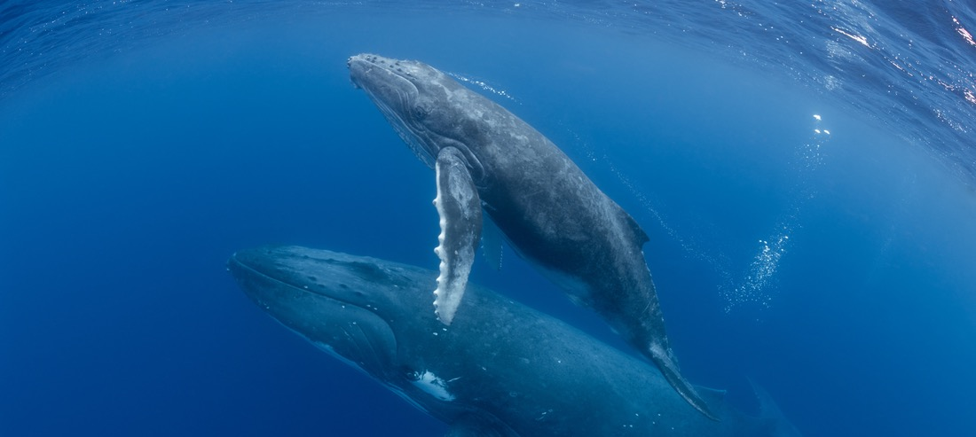
CLIMATE AND OCEAN Focusing Question: What role does the ocean play in climate & climate change?
HE PĀTAI / CONSIDER THIS
Take a guess – how much of the worlds carbon is circulated through the ocean?
3% | OR | 53% | OR | 83%
Notes:
TEACHER NOTES
ANSWER ON NEXT SLIDE

Slide 5
CLIMATE AND OCEAN Focusing Question: What role does the ocean play in climate & climate change?
HE PĀTAI / CONSIDER THIS
Take a guess – how much of the worlds carbon is circulated through the ocean?
✓ 83% of global carbon cycle is circulated through oceans.
3% | OR | 53% | OR | 83%
Notes:
TEACHER NOTES
More reading: https://www.msc.org/what-we-are-doing/oceans-at-risk/climate-change-and-fishing

Slide 6
CLIMATE AND OCEAN Focusing Question: What role does the ocean play in climate & climate change?
HE PĀTAI / CONSIDER THIS
Take a guess – How much excess heat from greenhouse emissions has been absorbed by oceans since the 1970s?
13% | OR | 43% | OR | 93%
Notes:
TEACHER NOTES
ANSWER ON NEXT SLIDE

Slide 7
CLIMATE AND OCEAN Focusing Question: What role does the ocean play in climate & climate change?
HE PĀTAI / CONSIDER THIS
Take a guess – How much excess heat from greenhouse emissions has been absorbed by oceans since the 1970s?
✓ Oceans have absorbed 93% of excess heat from greenhouse emissions since the 1970s
13% | OR | 43% | OR | 93%
Notes:
TEACHER NOTES
More reading: https://www.msc.org/what-we-are-doing/oceans-at-risk/climate-change-and-fishing

Slide 8
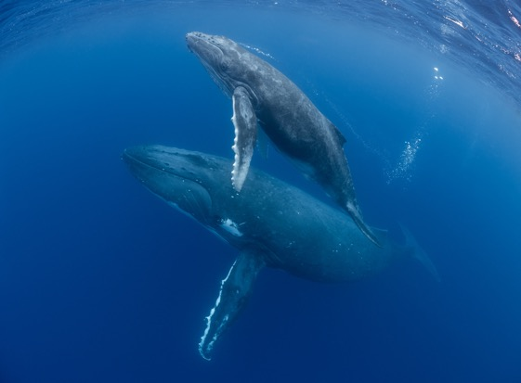
CLIMATE AND OCEAN Focusing Question: What role does marine life play in climate & climate change?
HE PĀTAI / CONSIDER THIS
Krill
HOW DOES THIS RELATE TO
CLIMATE & CLIMATE CHANGE?
Plankton
Whales Poo
Notes:
TEACHER NOTES
Ask students to have a go at answering this. Then watch the film clip (next slide). Then have another go!
Background reading:
https://www.theguardian.com/environment/georgemonbiot/2014/dec/12/how-whale-poo-is-connected-to-climate-and-our-lives
https://www.bbc.com/future/article/20210119-why-saving-whales-can-help-fight-climate-change
https://www.parley.tv/updates/whale-poop-loop

Slide 9
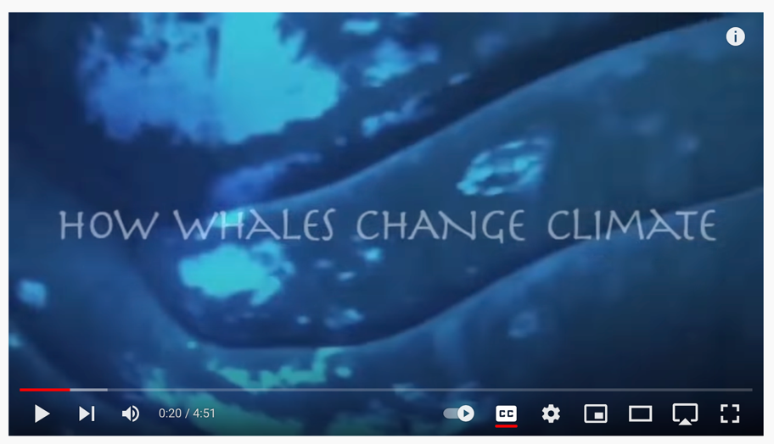
CLIMATE AND OCEAN Focusing Question: What role does marine life play in climate & climate change?
MĀTAKI TĒNEI / WATCH THIS
How whales change climate [4.51]
Notes:
TEACHER NOTES
Film link: https://www.youtube.com/watch?v=M18HxXve3CM&t=20s
Background reading:
https://www.theguardian.com/environment/georgemonbiot/2014/dec/12/how-whale-poo-is-connected-to-climate-and-our-lives
https://www.bbc.com/future/article/20210119-why-saving-whales-can-help-fight-climate-change

Slide 10
CLIMATE AND OCEAN Focusing Question: What role does marine life play in climate & climate change?
HE PĀTAI / CONSIDER THIS
Krill
HOW DOES THIS RELATE TO
CLIMATE & CLIMATE CHANGE?
Phytoplankton
Whales Poo
Notes:
TEACHER NOTES
Key points:
Phytoplankton removes CO from atmosphere through photosynthesis.
Uneaten phytoplankton eventually die and sink transferring the carbon to the deep sea.
Phytoplankton need iron to thrive.
The concentration of iron in whale faeces is more than 10 million times higher than seawater concentrations.
So whale poop acts as a fertiliser that increases phytoplankton growth, leading to a more productive ecosystem and enhanced atmospheric carbon dioxide removal.

Slide 11
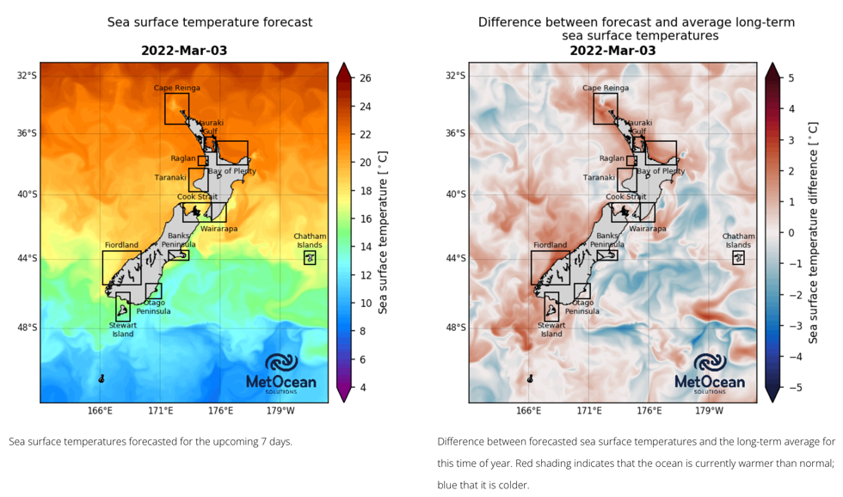
CLIMATE AND OCEAN Focusing Question: How does climate change affect the ocean?
HE PĀTAI / CONSIDER THIS
Marine heatwaves have increased by around 50%
Ocean temperatures are expected to increase by 1-4% by 2100
Source: Moana Project
Notes:
TEACHER NOTES
Facts from: https://www.msc.org/what-we-are-doing/oceans-at-risk/climate-change-and-fishing
Maps from: https://www.moanaproject.org/marine-heatwave-forecast
A marine heatwave is an extended period of extremely warm ocean temperatures (the scientific definition of a marine heatwave is when seawater temperatures are warmer than the 90th percentile of the local long-term (25-year) average for at least five consecutive days)¹. As climate change affects our oceans, marine heatwaves are expected to become more frequent, intense and longer lasting. Our ocean life around New Zealand has evolved to thrive in cooler seas and marine heatwaves can have devastating effects on local ecosystems. They also pose a threat to aquaculture and fisheries, New Zealand industries worth more than $4 billion annually.

Slide 12
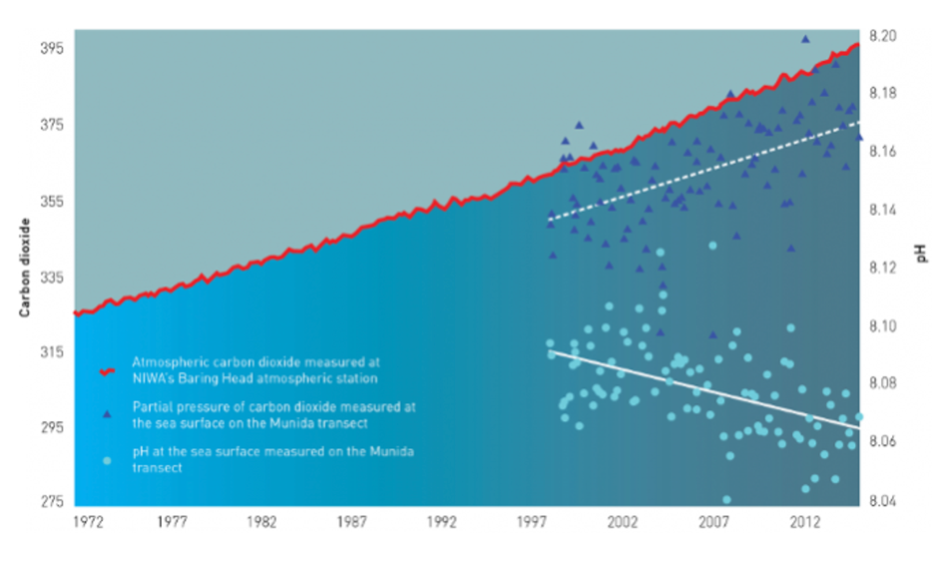
CLIMATE AND OCEAN Focusing Question: How does climate change affect the ocean?
HE PĀTAI / CONSIDER THIS
Changing temperatures are affecting acidification leading to the loss of marine habitats and species
Source: NIWA
Notes:
TEACHER NOTES
Facts from: https://www.msc.org/what-we-are-doing/oceans-at-risk/climate-change-and-fishing
Graph from: https://www.dropbox.com/s/v824636vqene4fn/Screen%20Shot%202022-03-01%20at%2012.26.55%20PM.png?dl=0
As the oceans take up carbon dioxide from the atmosphere, produced by burning fossil fuels, the waters are becoming more acidic. Land practices, such as high nutrient run-off, can also impact the acidity of coastal waters. This will have implications for marine ecosystems, particularly shell forming organisms such as kūtai, pāua, and tio, and early life stages of some fish and shellfish. NIWA and the University of Otago have been measuring ocean carbon chemistry in the waters off Otago since 1998. There is a lot of seasonal and interannual variability, however the long term trend is a gradual increase in acidity, in line with what is being observed at other places around the world. However, we do not know much about other New Zealand locations, particularly coastal regions.

Slide 13
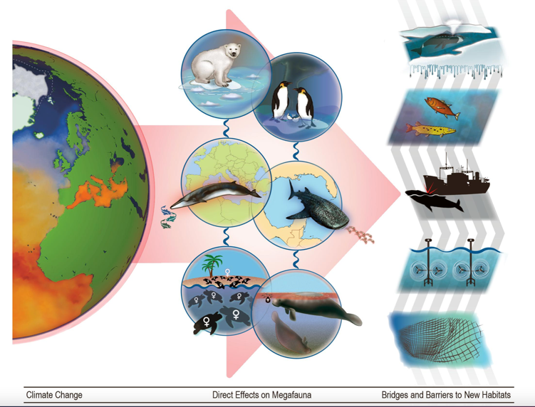
CLIMATE AND OCEAN Focusing Question: How does climate change affect marine life?
HE PĀTAI / CONSIDER THIS
Warming waters and shifting ocean currents are changing where marine creatures live, which can change an entire ecosystem
As sea temperatures rise, many species are moving poleward
Source: Grose et al 2020
Notes:
TEACHER NOTES
Facts from: https://www.msc.org/what-we-are-doing/oceans-at-risk/climate-change-and-fishing
Figure from: https://www.frontiersin.org/articles/10.3389/fmars.2020.00547/full
(see explanation below)
From: Grose SO, Pendleton L, Leathers A, Cornish A and Waitai S (2020) Climate Change Will Re-draw the Map for Marine Megafauna and the People Who Depend on Them. Front. Mar. Sci. 7:547. doi: 10.3389/fmars.2020.00547
Climate change will dramatically alter the distribution of many marine megafauna, impacting people and economies worldwide. Generally speaking, species are moving poleward as sea temperatures rise (Polovina et al., 2011; Poloczanska et al., 2016; Pecl et al., 2017). Not all species will succeed in shifting their ranges - some will go extinct, either locally or globally. Those species that do relocate will do as a result of: loss of shelter, impacts of climate change on reproduction and disease, and shifting food sources.
Figure 1. The effects of climate change on marine megafauna. As climate change continues to affect the world’s ocean (column 1), the combined effects will push many species out of their current ranges (column 2) via three illustrative pathways each here represented by two case study species. From top to bottom: via loss of shelter (polar bears and emperor penguins), via range shifts in prey (Mediterranean fin whales and whale sharks), and via changing demographics due to effects on embryonic development (sea turtles) and increased exposure to toxins (sirenians). The third column shows some bridges and barriers that respectively facilitate or impede range shifts in megafauna: ice melt in the arctic, changes in water temperature along migration routes, interactions with ships, tidal mills, and fishing gear.

Slide 14
CLIMATE AND OCEAN: KĒMU PATAPATAI / QUIZ
True or false? [answers on final slide]
Just 3% of global carbon cycle is circulated through oceans.
Ocean temperatures are expected to increase by 1-4% by 2100.
Whale poop releases iron, which feeds phytoplankton, which feeds krill… which feeds whales.
A 2010 study found the concentration of iron in whale poop to be 10 million times higher than seawater concentrations.
Notes:
TEACHER NOTES

Slide 15
CLIMATE AND OCEAN: KĒMU PATAPATAI / QUIZ
True or false? [answers on final slide]
There are fewer marine heatwaves happening.
Warming waters and shifting ocean currents are changing where marine creatures live, which can change an entire ecosystem.
As sea temperatures rise, many species are moving away from the poles towards the equator.
Notes:
TEACHER NOTES

Slide 16
CLIMATE AND OCEAN: KĒMU PATAPATAI / QUIZ: ANSWERS
Just 3% of global carbon cycle is circulated through oceans. FALSE [it is 83%]
Ocean temperatures are expected to increase by 1-4% by 2100. TRUE
Whale poop releases iron, which feeds phytoplankton, which feeds krill… which feeds whales? TRUE
A 2010 study found the concentration of iron in whale poop to be 10 million times higher than seawater concentrations. TRUE
There are less marine heatwaves happening. FALSE [marine heatwaves have increased by around 50%]
Warming waters and shifting ocean currents are changing where marine creatures live, which can change an entire ecosystem TRUE
Generally speaking, species are moving away from the poles towards the equator as sea temperatures rise. FALSE
Notes:
TEACHER NOTES
OTHER INTERESTING FACTS ABOUT WHALES, POOP AND CLIMATE
1. We breathe, in part, because whales poop in the oceans.
2. Whales are excellent recyclers, generous poopers and model contributors to a circular economy. Their faeces release iron, which feeds phytoplankton, which feeds krill… which feeds whales.
3. A 2010 study found the concentration of iron in whale poop to be 10 million times higher than seawater concentrations.
4. In the Southern Ocean, iron defecation by sperm whales removes approximately 200,000 metric tons of carbon per year from the atmosphere, the equivalent of removing 70,000 vehicles that each travel 15,000 km per year.
5. Blue whales are the largest creatures ever known to have existed. They feed on one of the smallest. A blue whale consumes as many as 40 million krill in a day, the equivalent of about 8,000 pounds.
6. A whale is even generous in its afterlife. Its carcass ignites a deep-sea feeding frenzy and creates a new microbial community, returning vital nutrients to the ocean food chain.
7. The Parley SnotBot crew has declared whale poop samples at customs when traveling in the name of conservation science.
8. Fecal matter isn’t the only substance whales leave at the surface. Mucus emitted from a whale’s blowhole provides biological data about the health of whales and their habitat.
9. A rare type of sperm whale poop called ambergris is used in high-end perfumes (and sometimes cuisine). These waxy lumps of dung have reportedly netted $400,000.
10. Antarctic krill populations have declined more than 80% since the 1970s. When one species disappears, it affects the entire ecosystem. Antarctic krill play an especially vital role in supporting ocean life and mitigating climate change.

