Slide 1
Insert heading page Topic 3

Slide 2
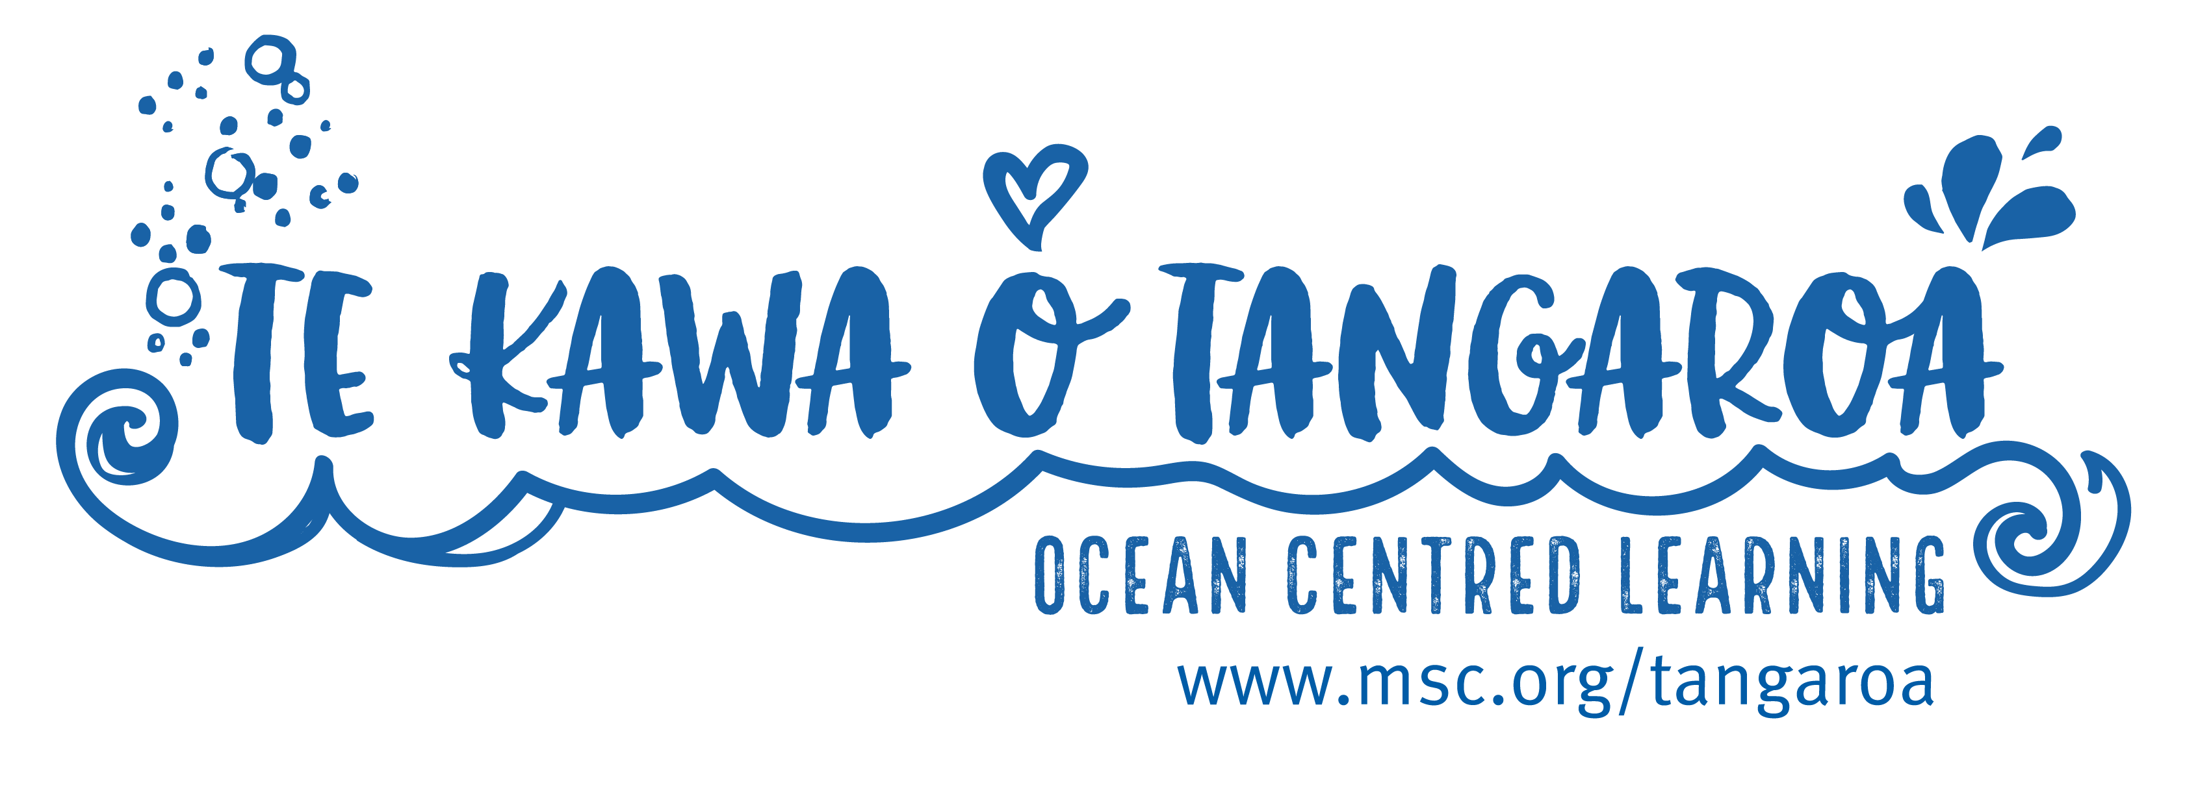

Slide 3
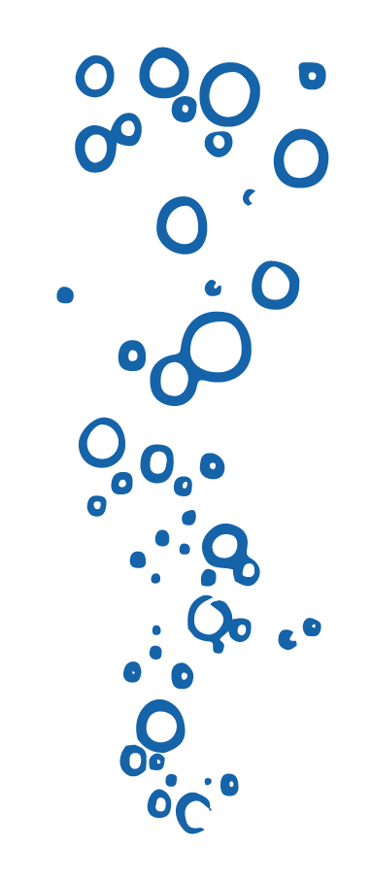
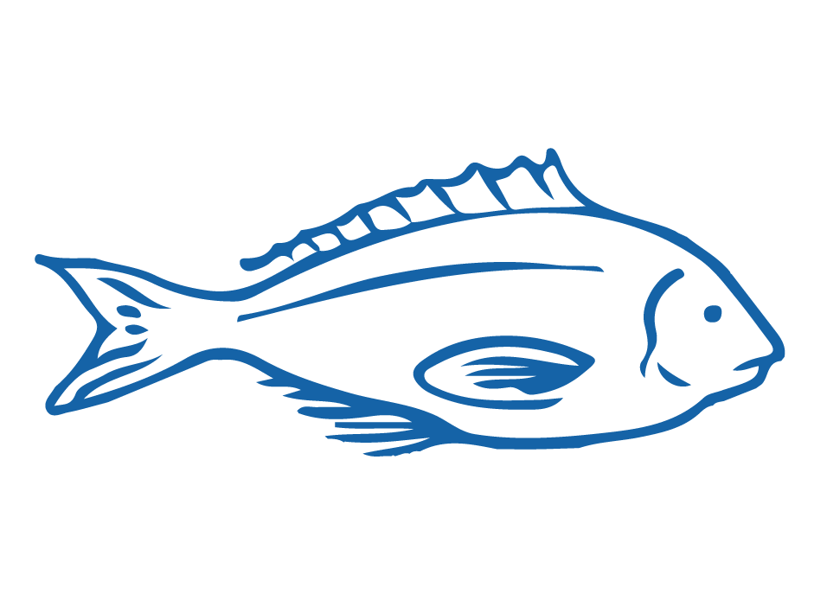
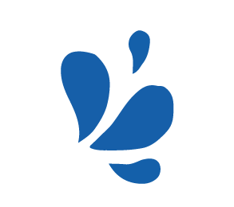
HELPFUL STUFF FOR TEACHERS
Target age range:
10–15 years
Welcome to OUR STORY!
In this topic we explore protection measures that limit impacts from fishing on the marine environment
Topic focus: Protecting the marine environment
Curriculum Level: Level 3 - 5+
Curriculum: Geography; Science; Social Science; Tikanga-ā-iwi; Pūtaiao; Hauora; Maths; Technology
Key competencies: Thinking; Managing Self; Using language, symbols & texts; Relating to others
Planning: See also Protecting the Marine Environment Planner and teacher notes below slides
Extending learning: See Topic Outlines and slides labelled expert [top right corner]

Slide 4
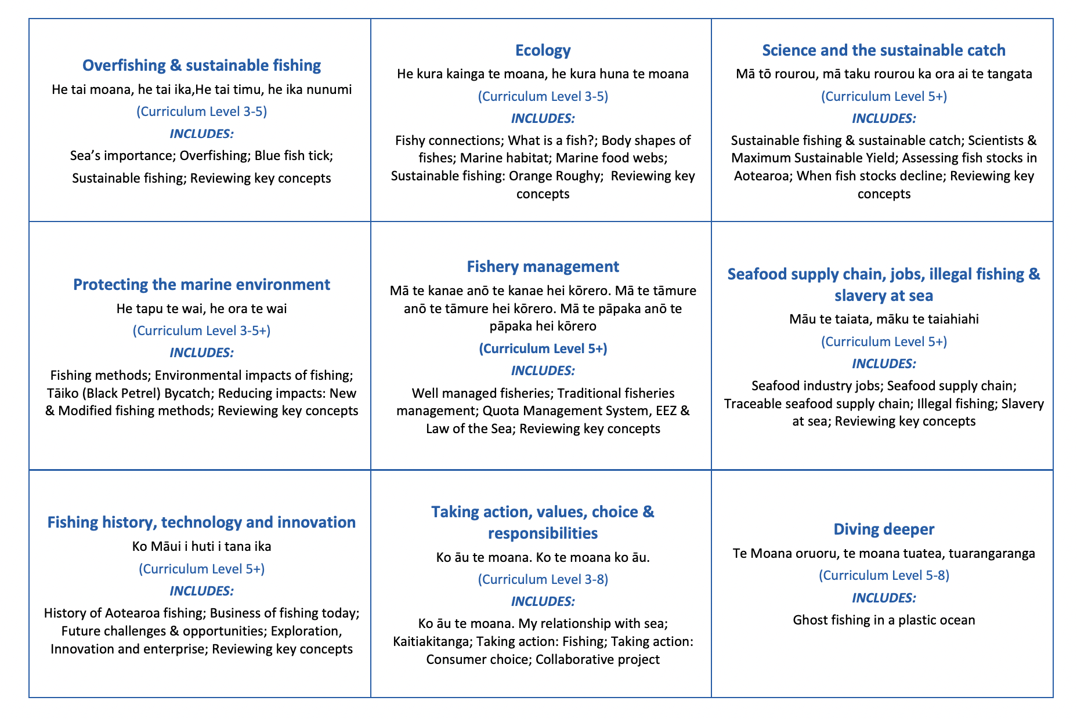
HELPFUL STUFF FOR TEACHERS
Welcome to OUR STORY!
In this topic we explore protection measures that limit impacts from fishing on the marine environment

Slide 5
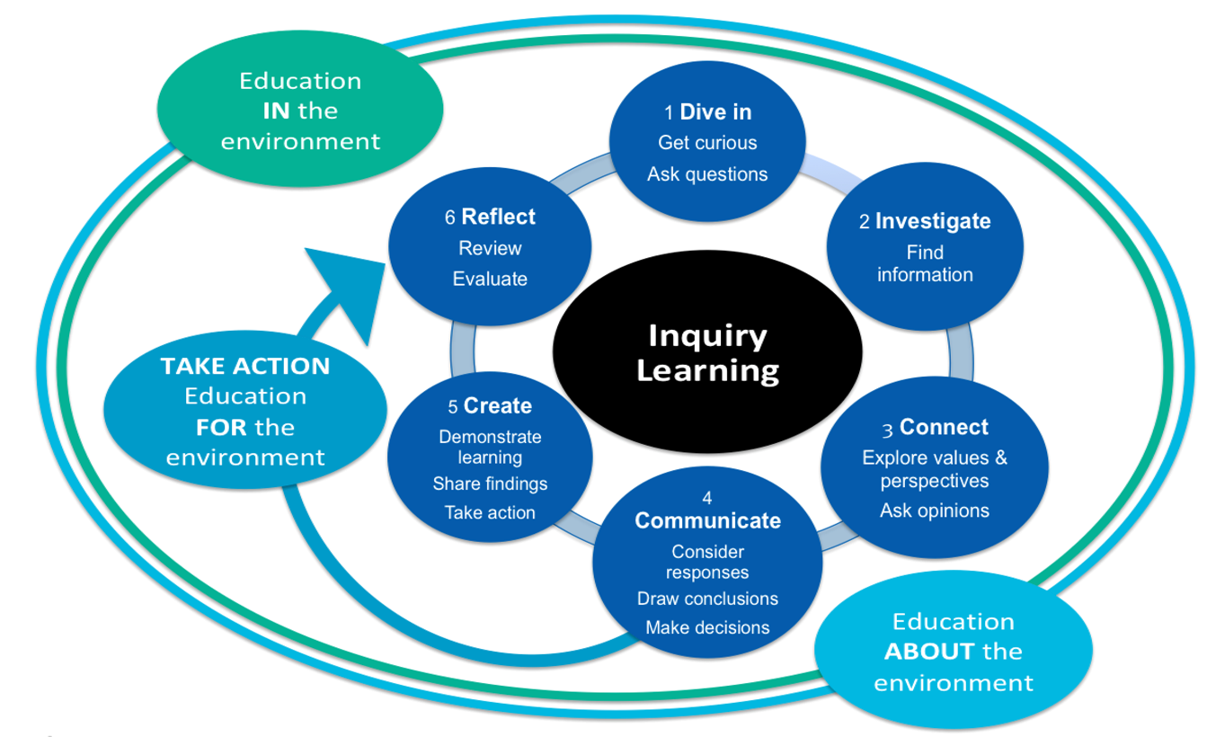
HELPFUL STUFF FOR TEACHERS
Notes:
TEACHER NOTES

Slide 6
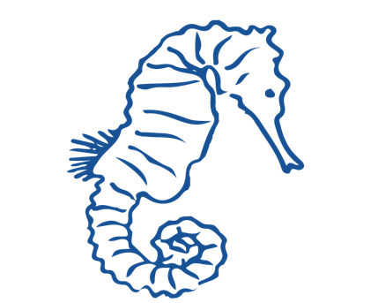
IN THIS TOPIC WE WILL LEARN ABOUT…
How fishing can impact habitat and non target species (and how impacts must be minimised for fish to receive the MSC Blue Fish Tick)
How Tāiko (Black Petrel) can be impacted by fishing
Fishing methods; the type of fish they might catch and from which habitat
How fishing methods impact on marine habitats and non target species
Ways that fishing methods can be modified, and new methods created, to reduce bycatch and impacts on habitats
New scientific and fishery related vocabulary

Slide 7
MIHI / INTRODUCTION
Can you imagine a world without fish?
What would that be like?
No more sushi! No more fishing!
No more fish & chips! No more….?

Slide 8
MIHI / INTRODUCTION
The good news is… some special people are working hard to make sure this doesn’t happen!
In this topic look more closely at …. The environmental impacts of fishing
Think for a moment – what fishing methods have you used? And have you ever caught a marine animal that you didn’t mean to catch?

Slide 9
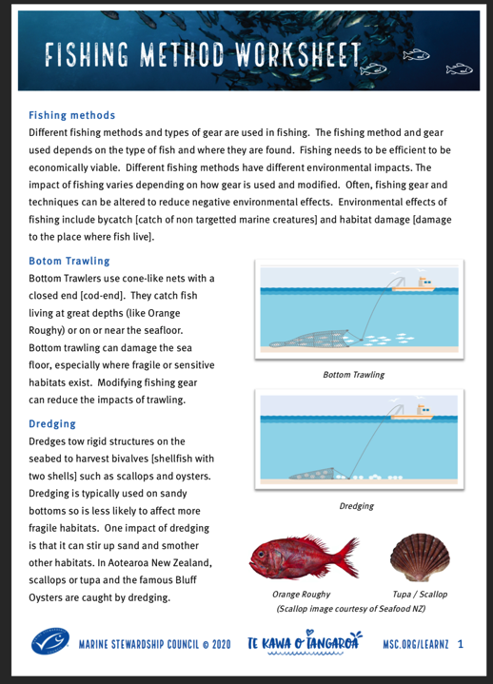
FISHING METHODS
Focus Question: What methods are used to catch fish? What fish are caught & from which habitat?
KŌRERORERO / DISCUSSION
Fishing methods are usually selected as they are efficient [making fishing economically viable]
Some methods of fishing are more sustainable than others
How sustainable fishing is can depend on a range of factors including:
Characteristics of the environment
How fishing is undertaken
Exact nature of gear used
MAHI / ACTIVITY
Complete Fishing Method Worksheet
Notes:
TEACHER NOTES
USEFUL RESOURCES / RĀRANGI PUKAPUKA
Information on different types of fishing methods see: https://www.msc.org/en-au/what-we-are-doing/our-approach/fishing-methods-and-gear-types

Slide 10
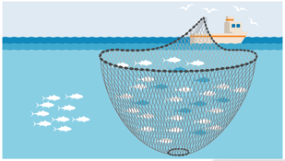
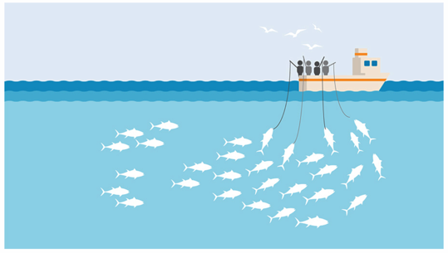
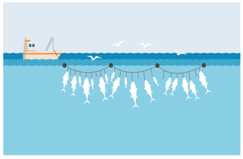
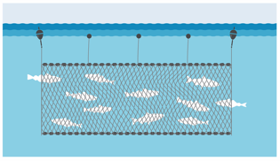
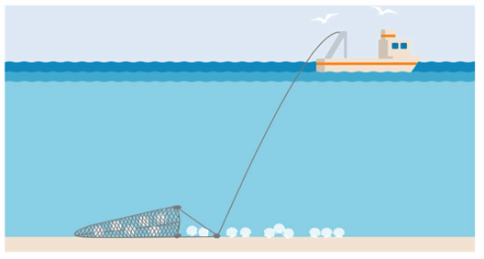
FISHING METHODS
Focus Question: What methods are used to catch fish? What fish are caught & from which habitat?
MAHI / ACTIVITY
Can you match the picture to the method above? [click for answers]
KŌRERORERO / DISCUSSION
Fishing methods include:
Pole fishing
Purse seining
Long lining
Gill netting
Bottom trawling
Dredging
2
1
3
4
6
5
Notes:
TEACHER NOTES
USEFUL RESOURCES / RĀRANGI PUKAPUKA
Information on different types of fishing methods see: https://www.msc.org/en-au/what-we-are-doing/our-approach/fishing-methods-and-gear-types

Slide 11
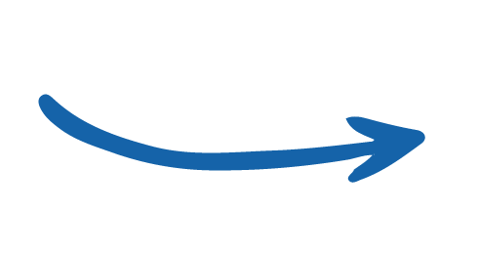
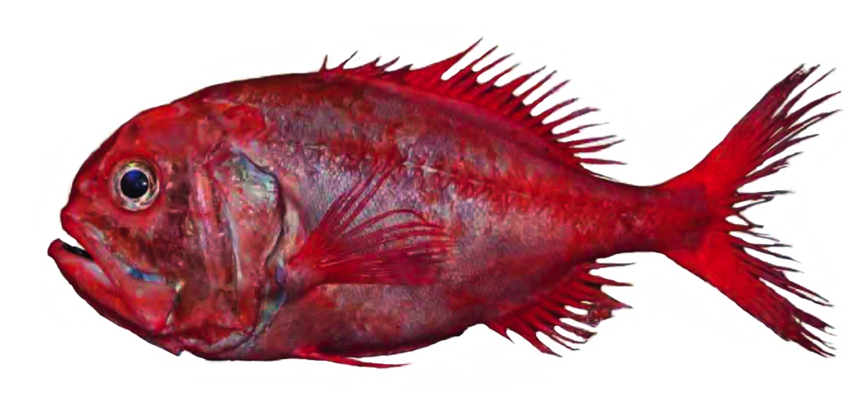
FISHING METHODS
KŌRERORERO / DISCUSSION
Bottom Trawlers
Use cone-like nets with a closed end [cod-end]
Catch fish living at great depths or on the seafloor
In Aotearoa New Zealand Orange Roughy are caught in deep water near the seafloor using bottom trawl
Notes:
TEACHER NOTES
Impacts include bycatch of non target species and habitat damage if trawl is towed across the seafloor.

Slide 12
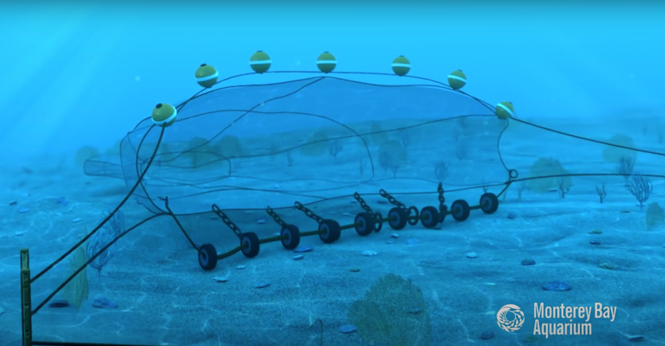
FISHING METHODS
HE PĀTAI / CONSIDER THIS
1. Could this fishing method affect the seafloor? How?
2. Could this fishing method impact other [non target] fish and marine creatures? How?
3. How can these impacts be reduced?
MĀTAKI TĒNEI / WATCH THIS
Watch this short film [0:51] from Monterey Bay Aquarium showing how a bottom trawl functions
Notes:
TEACHER NOTES
Film can be found on You Tube at: https://www.youtube.com/watch?time_continue=51&v=BcJFSl_YJHk&feature=emb_title
1 and 2 Impacts include bycatch of non target species and habitat damage if trawl is towed across the seafloor. Non target species could be caught in the trawl net.
3. While demersal trawling often interacts with the seabed, modifications and careful management of fishing operations can reduce environmental impacts and increase sustainability.
MSC certified trawl fisheries have made many improvements to their practices. These include monitoring and mapping fishing areas, avoiding fishing in known sensitive or protected habitats, and banning bottom trawling during spawning season. Gear modifications, such as rock hoppers (balls or discs, often rubber), can also reduce the amount of contact between the net and the seabed.

Slide 13
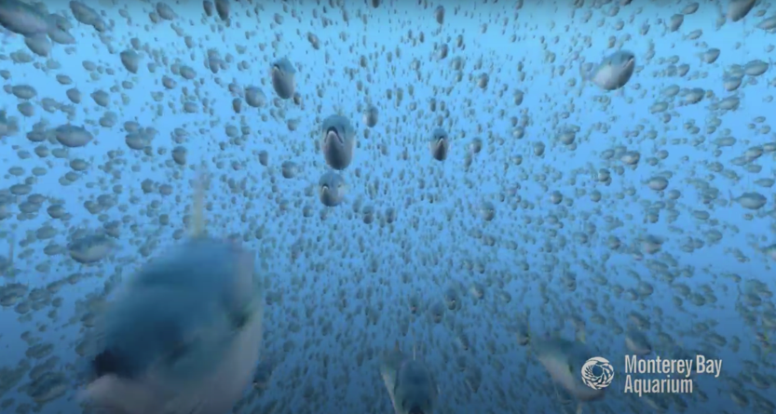
FISHING METHODS
HE PĀTAI / CONSIDER THIS
How is this method different to bottom trawling?
Could this fishing method affect the habitat or seafloor?
3. Could this fishing method impact other [non target] fish and marine creatures? How?
4. How can these impacts be reduced?
MĀTAKI TĒNEI / WATCH THIS
Watch this short film [0:49] from Monterey Bay Aquarium about midwater trawling
Notes:
TEACHER NOTES
Film can be found on You Tube at: https://www.youtube.com/watch?time_continue=6&v=DzSFB4H9MC8&feature=emb_logo
EXTENSION: You could also make a table and compare the similarities and differences between bottom trawling and midwater trawling

Slide 14
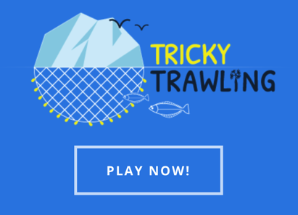
FISHING METHODS
MAHI / ACTIVITY
Learn about fishing in Greenland and get a feel for how hard it is to trawl by playing this super cool Tricky Trawling game
Game created by ZSL See campaign.zsl.org
Notes:
TEACHER NOTES
Tricky Trawling Game URL: https://campaign.zsl.org/trickytrawling/
ZSL has also created a glossary of terms and a set of activities to accompany this game! See:
https://www.zsl.org/sites/default/files/KS3%20Tricky%20Trawling%20-%20Activities%20to%20explore%20Ecosystems%20and%20Sustainability.pdf

Slide 15
FISHING METHODS
KŌRERORERO / DISCUSSION
Dredges
Tow rigid structures on the seabed to harvest bivalves [shellfish with two shells]
Are used to catch ngā tupa or scallops in Aotearoa New Zealand
The famous tio paruparu or Bluff Oysters are also fished using the dredge method
Notes:
TEACHER NOTES
For more information see: https://www.msc.org/what-we-are-doing/our-approach/fishing-methods-and-gear-types

Slide 16
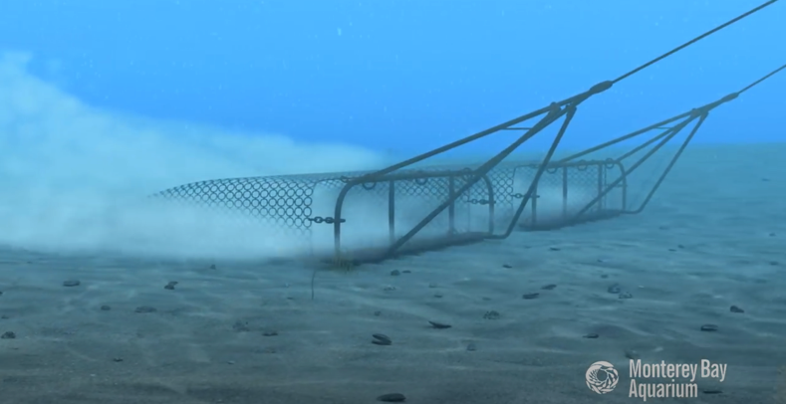
FISHING METHODS
HE PĀTAI / CONSIDER THIS
1. Could this fishing method affect the seafloor? How?
2. Could this fishing method impact other [non target] fish and marine creatures? How?
3. How can these impacts be reduced?
MĀTAKI TĒNEI / WATCH THIS
Watch this short film [0:45] from Monterey Bay Aquarium showing how a dredge functions
Notes:
TEACHER NOTES
Film can be found on You Tube at:
https://www.youtube.com/watch?time_continue=17&v=pK767idHYmM&feature=emb_logo
The design of dredges varies depending on the species being targeted, but many consist of a triangular frame. A bar (with or without teeth) at the front of this frame dislodges shellfish as it is dragged over the sediment and passes them into a metal collecting basket. By contrast, hydraulic dredges use jets of water to disturb the seabed and dislodge shellfish. The use of specific mesh sizes and escape panels prevents any undersized or non-target species being retained in the basket.
The environmental impact of dredging varies significantly depending on the type of sediment on the seabed and the habitat it supports. As such, there is often strict regulation around the types of dredge permitted, and the frequency with which they can operate in an area.
MSC certified dredge fisheries have taken measures to minimize the impacts on seabed habitats. These include restricting the area within which dredging can take place, replacing traditional dredges with lighter dredges and introducing boulder exclusion devices to prevent the loss of habitat features.

Slide 17
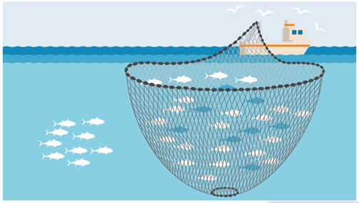
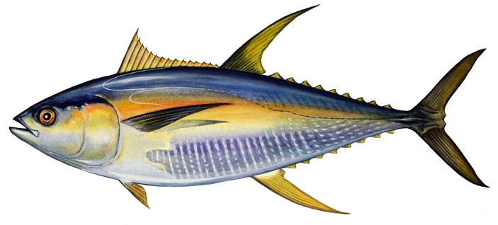
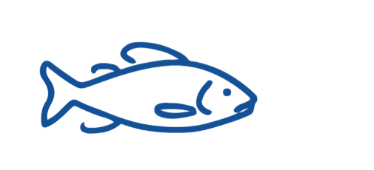
FISHING METHODS
KŌRERORERO / DISCUSSION
Purse seiners
Are a vertical net ‘curtain’ that surrounds a school of fish in the open ocean, then the bottom is drawn together
Target pelagic [mid-water] fish like kahawai & tuna in Aotearoa New Zealand
Why do fish swim in schools?
Notes:
TEACHER NOTES
Why do fish swim in schools?
Many species evolved to swim this way
to protect themselves from predators
increase the chances of finding their next meal
and also to help them swim more efficiently
For more information see:https://www.deepseaworld.com/animal-behaviour/why-do-fish-swim-in-schools-2/

Slide 18
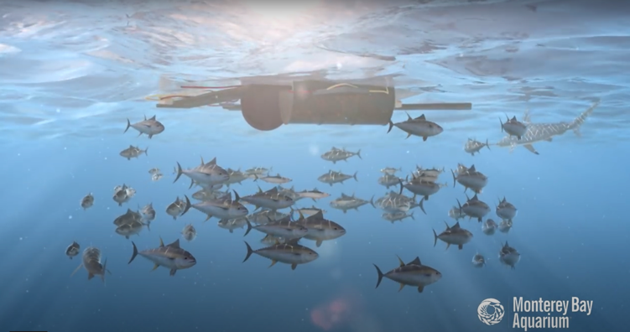
FISHING METHODS
HE PĀTAI / CONSIDER THIS
1. Could this fishing method affect the seafloor? How?
2. Could this fishing method impact other [non target] fish and marine creatures? How?
3. How can these impacts be reduced?
MĀTAKI TĒNEI / WATCH THIS
Watch this short film [1:05] from Monterey Bay Aquarium about purse seining
Notes:
TEACHER NOTES
Film can be found on You Tube at:
https://www.youtube.com/watch?v=kljRgbODbOw&feature=emb_logo
Purse-seine fishing in open water is generally considered to be an efficient form of fishing. It has no contact with the seabed and can have low levels of bycatch (accidental catch of unwanted species).
MSC certified fisheries using purse seines must ensure that they leave enough fish in the ocean to reproduce. This can be achieved by targeting schools of adult fish and using a mesh size large enough to allow smaller fish to swim free.
Purse seines can also be used to catch fish congregating around fish aggregating devices (FADs). This fishing method can result in higher levels of bycatch, making it harder for these fisheries to achieve MSC certification.

Slide 19
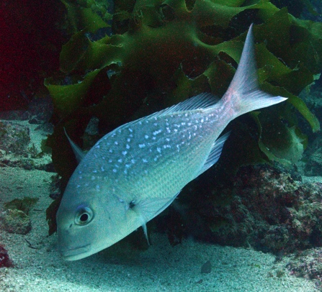
FISHING METHODS
KŌRERORERO / DISCUSSION
Long liners
Trail a long line with many hooks, usually behind the boat & can be set for pelagic [mid-water] or demersal [bottom living] fish
Much of Aotearoa New Zealand snapper or tāmure are caught using long line
HE PĀTAI / CONSIDER THIS
Do you know…
How deep
snapper swim?
How long do they live for?
Seldom found below 100m
Slow growing & live for up to 60 years old
Notes:
TEACHER NOTES
Snapper are quite slow growing and live for up to 60 years.
Snapper are seldom found below 100m. Juveniles are usually found in <50m.
Snapper are often fished 30-50cm but can reach 100cm.
They can weigh anywhere from 1-2.5kg to 19kg!

Slide 20
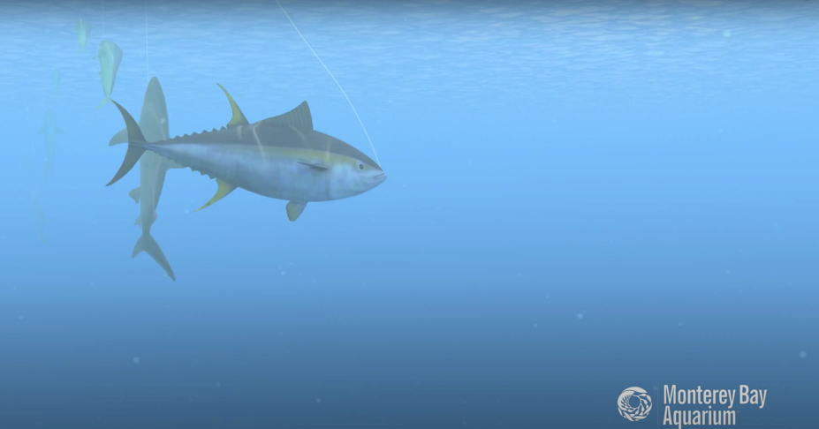
FISHING METHODS
HE PĀTAI / CONSIDER THIS
1. Could this fishing method affect the habitat or seafloor? How?
2. Could this fishing method impact other [non target] fish and marine creatures? How?
3. How can these impacts be reduced?
MĀTAKI TĒNEI / WATCH THIS
Watch this short film [1:25] from Monterey Bay Aquarium about long lining
Notes:
TEACHER NOTES
Film can be found on You Tube at:
https://www.youtube.com/watch?v=cjQQI56BT2o&feature=emb_logo
Without careful management, longline fisheries can have unintended interactions with non-target fish, seabirds, and other marine life. Because of this, to become MSC certified, they are often required to make improvements to their monitoring programs, and to mitigate interactions with non-target species.
MSC certified longline operations, such as those fishing for Patagonian toothfish in the Southern Ocean, have employed measures such as weighted long lines that sink more quickly, and tori-lines that scare away seabirds. Some have even made changes to fishing times to avoid interaction with endangered, threatened and protected (ETP) species.
Careful data collection and regulations, such as those followed by longline vessels in the Icelandic cod fishery, ensure sustainable catches.

Slide 21
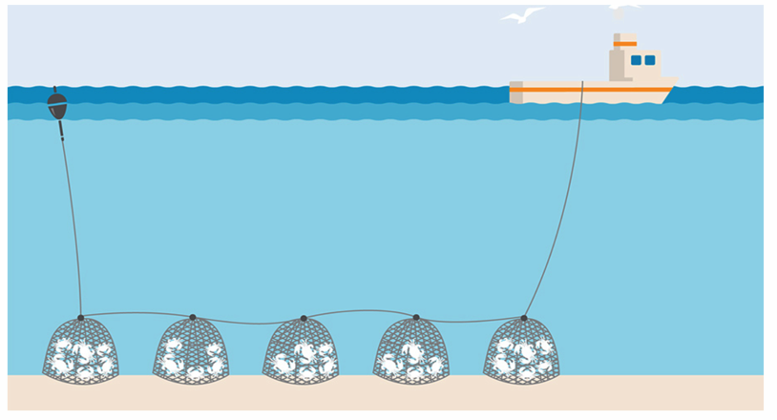
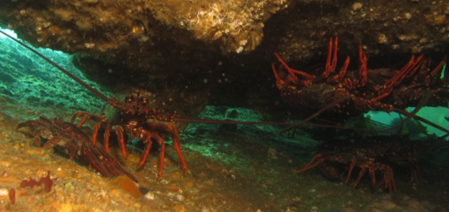
FISHING METHODS
KŌRERORERO / DISCUSSION
Pots and traps
Are typically made from wood, wire netting or plastic
Are used to catch crustaceans such as lobsters and crabs
Are used to catch koura or rock lobster and pāpaka or paddle crabs in Aotearoa New Zealand
Notes:
TEACHER NOTES

Slide 22
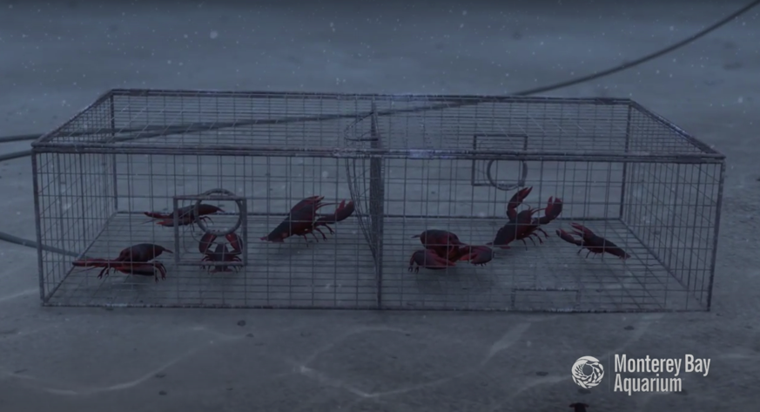
FISHING METHODS
HE PĀTAI / CONSIDER THIS
1. Could this fishing method affect the habitat or seafloor? How?
2. Could this fishing method impact other [non target] marine creatures? How?
3. How can any impacts be reduced?
MĀTAKI TĒNEI / WATCH THIS
Watch this short film [0:42] from Monterey Bay Aquarium about pots or traps
Notes:
TEACHER NOTES
Film can be found on You Tube at:
https://www.youtube.com/watch?time_continue=2&v=dTlwIIHYs7k&feature=emb_logo
MSC certified fisheries, such as the Normandy and Jersey lobster fishery, take measures to ensure that undersized individuals can escape through the mesh walls of their traps. Exclusion devices are also used to prevent larger marine animals such as sea lions from accidentally becoming entangled while foraging for shellfish. MSC certification resulted in the Western Australian rock lobster fishery reducing its sea lion bycatch to zero.

Slide 23
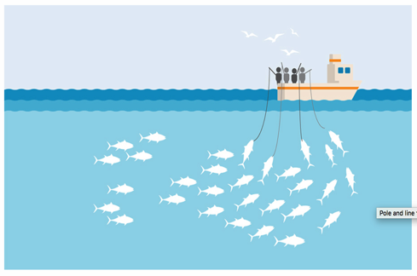
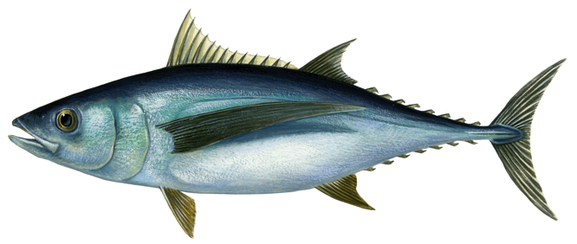
FISHING METHODS
KŌRERORERO / DISCUSSION
Pole and lines
Catch large pelagic [midwater] fish one at a time
Method has very low catch of unwanted marine life
Are sometimes used to catch albacore tuna in Aotearoa New Zealand waters
Imagine a fish living in the very bottom of the deepest ocean and a pelagic [mid water] fish living in the bright blue open ocean. Which would have better eyesight and be able to swim faster?
Notes:
TEACHER NOTES
Imagine you are a fish living in the bottom of the deep sea. Then imagine you are a fish living in the middle of the open sea. What would each be like? Which fish do you think is likely to swim faster?
Pelagic or open ocean fish are often torpedo shaped to increase their swimming speed. Most fish this shape live in the open ocean and are good fast swimmers.
Many deep water fish have big eyes to maximise their ability to capture light.

Slide 24
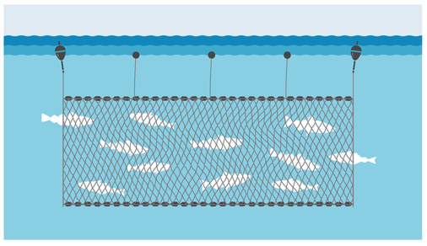
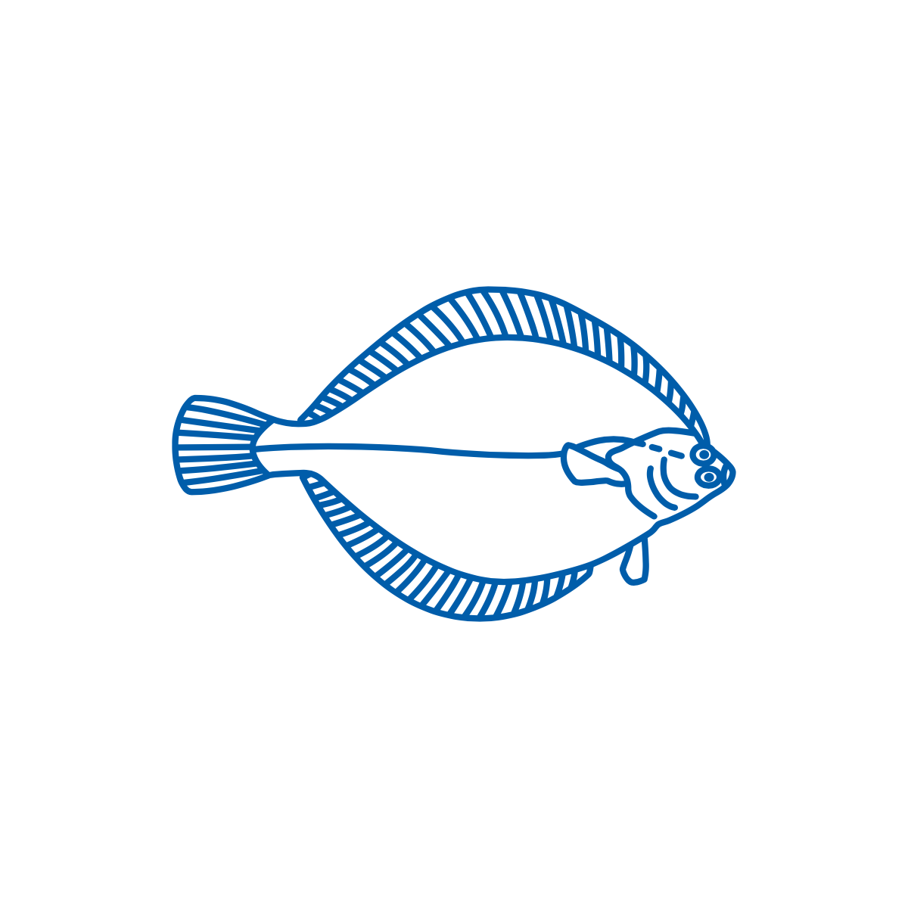
FISHING METHODS
KŌRERORERO / DISCUSSION
Gill nets
Are a hanging curtain of net that target schooling fish (like sardines)
Gill nets can float in deep water or set [anchored] to the seafloor
In Aotearoa New Zealand Pātiki or Yellow Belly Flounder are caught using set gill nets
Look at the body of the flounder. What can you guess about how / where flounder live?
Notes:
TEACHER NOTES
Impacts
Bycatch can be a problem for set netters
About flounder?
Flounder body shape is the way it is as it has adapted to living on the seafloor. Mouth is under the body, eyes are on top of the body, and it camouflages itself on a flat sandy floor by being so very flat!

Slide 25
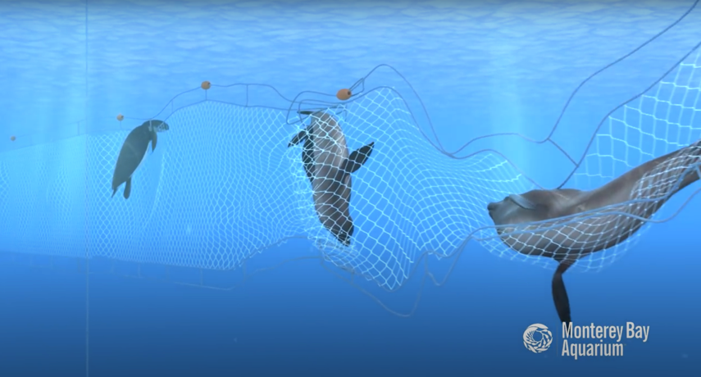
FISHING METHODS
HE PĀTAI / CONSIDER THIS
1. Could this fishing method affect the seafloor? How?
2. Could this fishing method impact other [non target] fish and marine creatures? How?
3. How can these impacts be reduced?
MĀTAKI TĒNEI / WATCH THIS
Watch this short film [0:56] from Monterey Bay Aquarium about gill netting
Notes:
TEACHER NOTES
Film can be found on You Tube at:
https://www.youtube.com/watch?v=AXyCCVXFmWk&feature=emb_logo
Gillnets generally have low environmental impacts with minimal seabed interaction. The size of fish caught can be determined by the mesh size, helping to avoid catching juvenile fish.
While particular species of fish can be targeted by area, gillnets do carry the risk of bycatch (accidental capture of unwanted species) and interaction with other marine animals.
In order to be MSC certified, gillnet fisheries are often required to make improvements, which include increased monitoring and independent observer coverage. Gear modifications have also been made and some fisheries use ‘pingers’: acoustic alarms attached to nets which deter marine mammals.

Slide 26
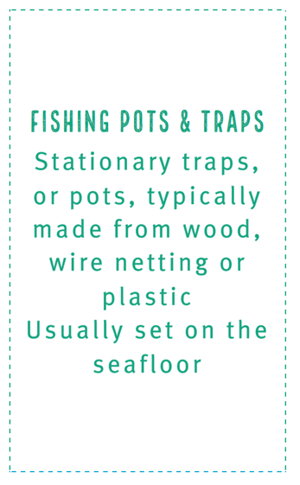
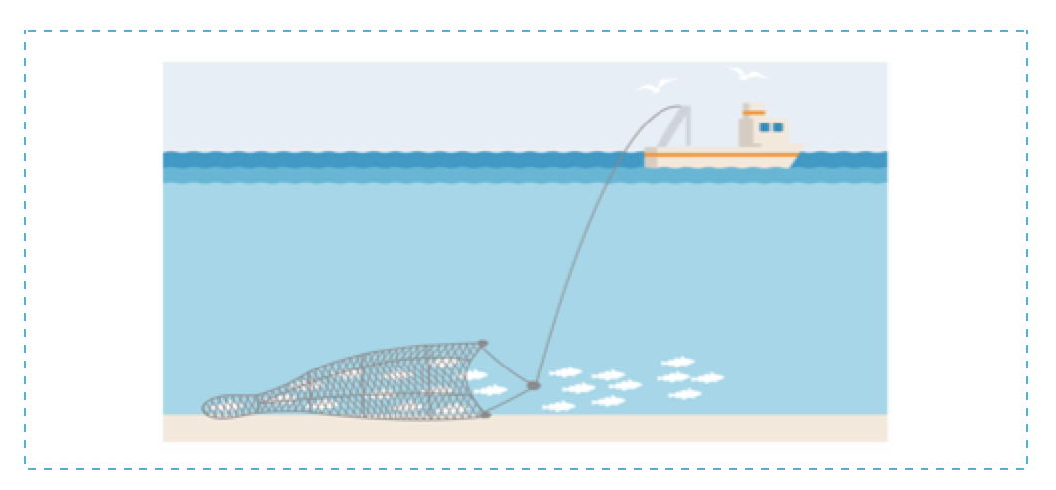
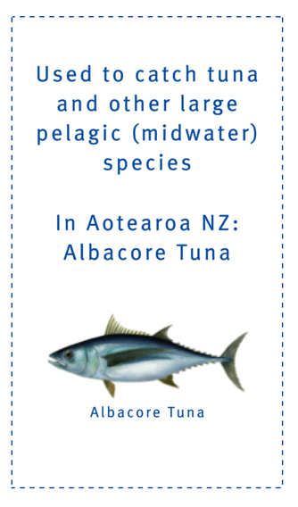
FISHING METHODS
MAHI / ACTIVITY
Use Fishing Method Cards [see Teacher Outline] to test your knowledge and match:
The method description
With the correct method picture
And most relevant species / habitat card!
Notes:
TEACHER NOTES

Slide 27
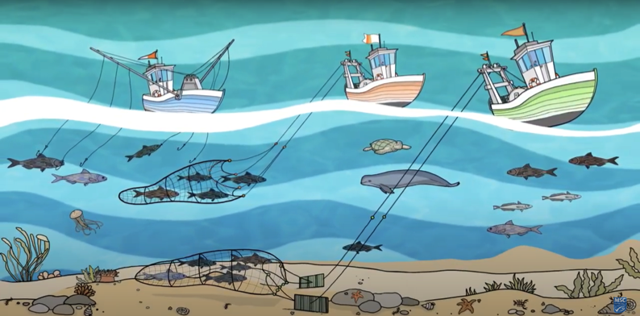
ENVIRONMENTAL IMPACTS OF FISHING (PRINCIPLE 2) Focus Question: How does fishing impact habitat and non target species?
KŌRERORERO / DISCUSSION
Two important ways that fishing can affect the marine environment are:
Habitat damage
Bycatch
HE PĀTAI / CONSIDER THIS
Consider with a partner: (1) Have you ever caught an animal by mistake? (2) Or hurt the home of an animal? (3) What happened and how did you feel?
MĀTAKI TĒNEI / WATCH THIS
Short video [2:11] on marine habitat and species protection (Principle Two)
Notes:
TEACHER NOTES
https://www.youtube.com/watch?v=s1jg8-LZXws

Slide 28
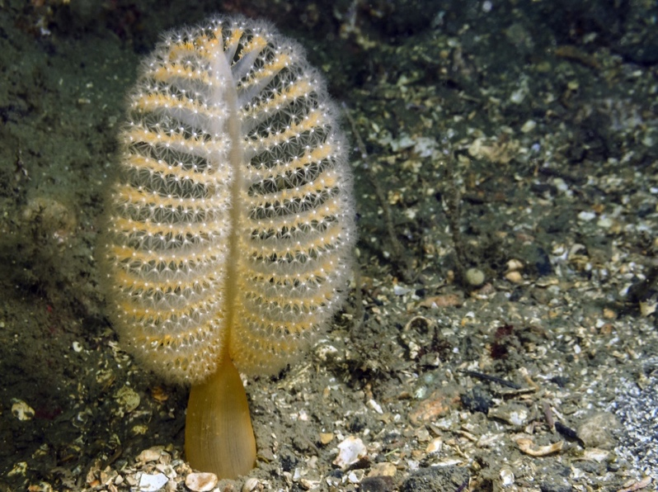
ENVIRONMENTAL IMPACTS OF FISHING (PRINCIPLE 2)
KŌRERORERO / DISCUSSION
(1) Habitat damage happens when fishing gear damages the seafloor
Fishing gear can damage delicate seafloor habitats where there are endangered or slow-growing creatures such as sea pens and sponges grow
Is a sea pen an animal or a plant?
Sea Pen
Notes:
TEACHER NOTES
Sea pens are animals and belong to the phylum cnidaria (known for their stinging cells). Other cnidarians include sea anemone, jelly fish and corals. Sea pens grow up to 45cm tall and are found on sandy seafloors in the ocean at depths of 45 – 225m.
USEFUL RESOURCES / RĀRANGI PUKAPUKA
For more information on sea pens see: https://www.montereybayaquarium.org/animals/animals-a-to-z/sea-pen

Slide 29
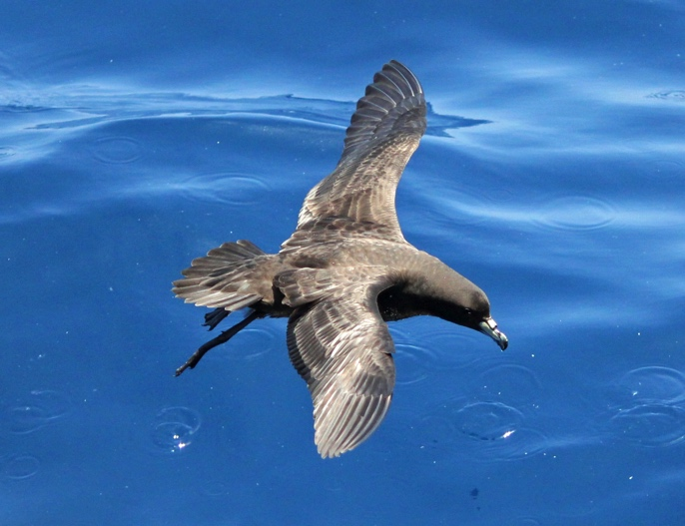
ENVIRONMENTAL IMPACTS OF FISHING (PRINCIPLE 2)
KŌRERORERO / DISCUSSION
(2) Bycatch (or unwanted catch) happens when fish or other marine species are caught by accident while trying to catch another type of fish
Marine life caught as bycatch can include:
Whales and dolphins
Seals and sea lions
Seabirds (like Tāiko, the Black Petrel))
Turtles, sharks and rays
Other (non target) fish and shellfish
Photo: Charlie Westerinen
Tāiko or the Black Petrel
Sometimes caught as ‘bycatch’
by commercial fishers
Notes:
TEACHER NOTES

Slide 30
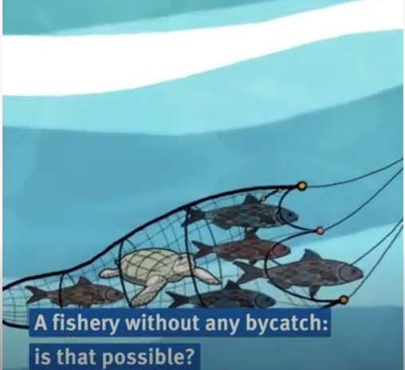
ENVIRONMENTAL IMPACTS OF FISHING (PRINCIPLE 2)
MAHI / ACTIVITY
Complete Activity ‘Bycatch in a Bucket’ OR ‘Bycatch Field Trip’ to experience the dilemma of fishing for a target species with no bycatch
Create your own Bycatch game using Scratch. Check out this one as an example
MĀTAKI TĒNEI / WATCH THIS
Short video [1:00] on What is Bycatch and how it can be managed
Notes:
TEACHER NOTES
Film URL: https://www.youtube.com/watch?v=s1jg8-LZXws
MAHI / ACTIVITY
Activity 4.1 Bycatch in a bucket is a game that can be played indoors and encourages learners to experience how hard it is to catch just the species that you want!
Scratch home page URL: https://scratch.mit.edu
Scratch example game URL: https://scratch.mit.edu/projects/181036139/

Slide 31
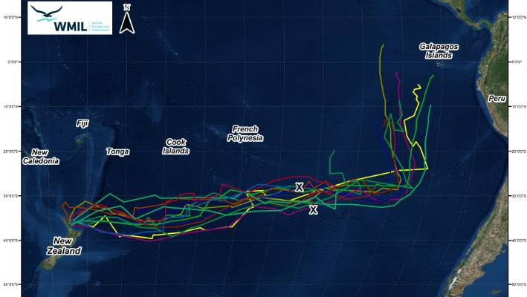
TĀIKO (BLACK PETREL) BYCATCH Focus Question: How are Tāiko (Black Petrel) impacted by fishing?
KŌRERORERO / DISCUSSION
Tāiko or Black Petrel are:
A nationally vulnerable seabird
Endemic [unique] to Aotearoa NZ
Sometimes caught as bycatch by longliners and trawlers
Long distance flyers – the lines on this map shows where they fly to in Winter (South America!)
Photo: Charlie Westerinen
Trust & Map: Wildlife Management International
Notes:
TEACHER NOTES
Film URL: https://www.youtube.com/watch?v=bV6ZIGIAgNw

Slide 32
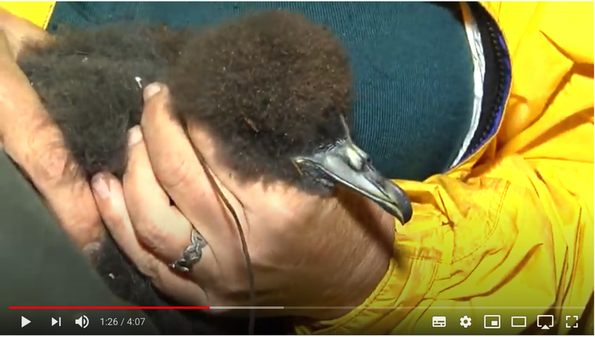
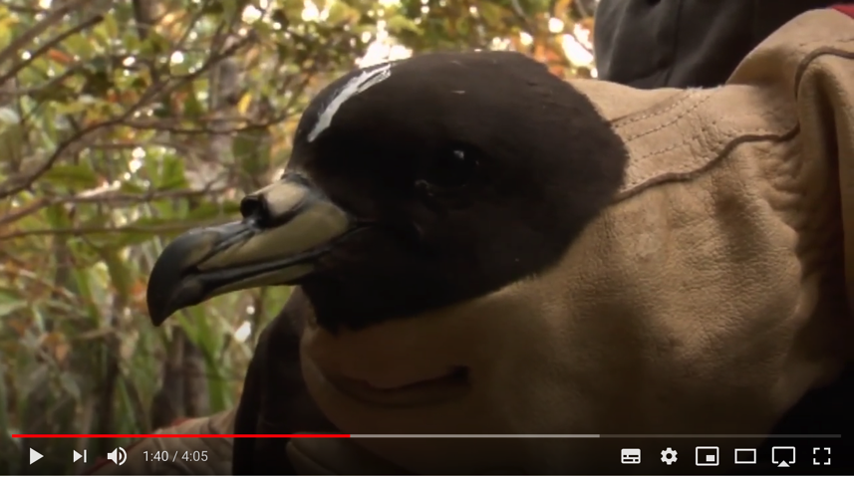
TĀIKO (BLACK PETREL) BYCATCH
MĀTAKI TĒNEI / WATCH THIS
Short film [4:07] from Moana NZ about Commercial fishers work in helping look after Tāiko or Black Petrel
MĀTAKI TĒNEI / WATCH THIS
Short film [4:05] on Tāiko / Black Petrel
Notes:
TEACHER NOTES
Film URL #1: https://www.youtube.com/watch?v=bV6ZIGIAgNw
Film URL #2: https://www.youtube.com/watch?v=qU0QfYw-4EU

Slide 33
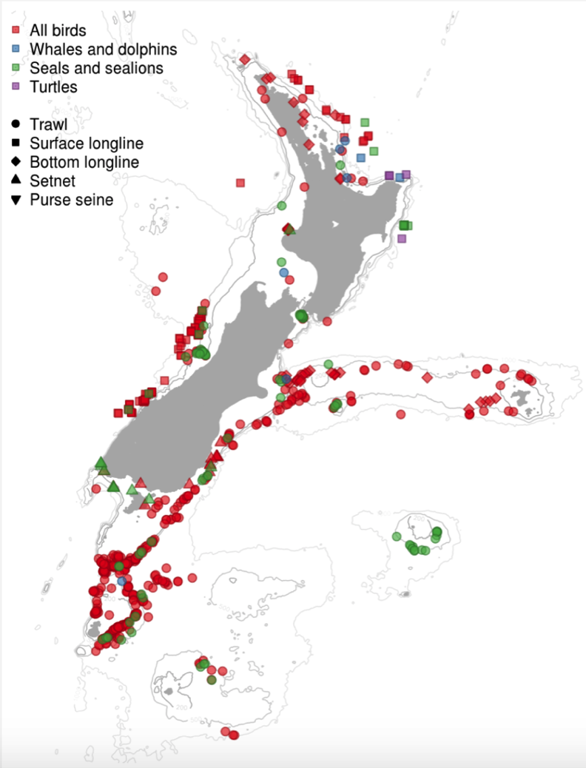
TĀIKO (BLACK PETREL) BYCATCH
KŌRERORERO / DISCUSSION
In Aotearoa New Zealand government observers on commercial fishing vessels record any protected species bycatch incidents that occur
This map shows all observed captures for the fishing year 2017–18
The colour of symbols shows the type of animal caught
The shape of the symbol shows fishing method
Source: MPI
Notes:
TEACHER NOTES
This figure shows the position of all captures reported by fisheries observers. The colour of the symbol indicates the type of animal that was caught, and the shape of the symbol indicates the fishing method.
Find more data and graphs at MPIs protected species capture data collection site : https://protectedspeciescaptures.nz/PSCv6/released/black-petrel/trawl/all-vessels/eez/2019-20/

Slide 34
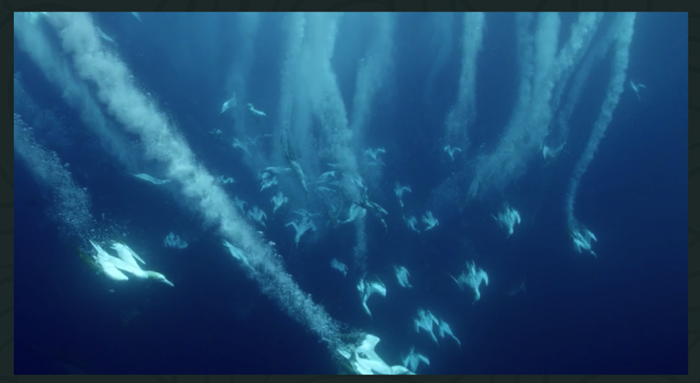
TĀIKO (BLACK PETREL) BYCATCH
MAHI / ACTIVITY
Check out the how many observed captures of the Tāiko or Black Petrel there have been in recent years by completing Activity ‘Bycatch Data’
MĀTAKI TĒNEI / WATCH THIS
And if you have time watch this awesome film [4:05] where Riley and her dad come across Black Petrel and False Killer Whales
Notes:
TEACHER NOTES
Film URL: https://www.youngoceanexplorers.com/yoe/video/405949642273#cplayer
All data for Aotearoa New Zealand protected species can be explored at: https://psc.dragonfly.co.nz/2019v1/released/2017-18/

Slide 35
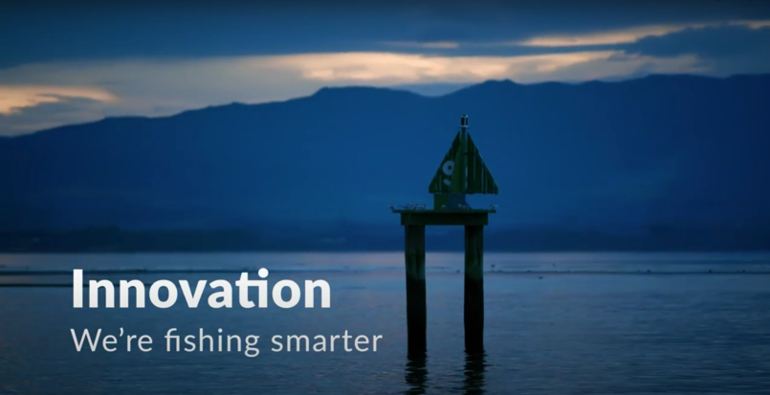
REDUCING IMPACTS: NEW & MODIFIED FISHING METHODS
Focus Question: How are fishing methods developed & modified to reduce impacts on habitat & sea life?
HE PĀTAI / CONSIDER THIS
What are commercial fishers doing to avoid catching seabirds?
What new technology is helping commercial fishers to reduce their environmental impact?
What is meant by “the changing culture of the industry”?
MĀTAKI TĒNEI / WATCH THIS
Watch this short film [4:45] from Seafood New Zelaand about Innovation – We’re Fishing Smarter
Notes:
TEACHER NOTES:
VIDEO LINKS: Innovation – We’re fishing Smarter (Seafood New Zealand) URL:
https://www.youtube.com/watch?time_continue=3&v=7CRbG7sPobs&feature=emb_title
HE PĀTAI – ANSWERS (all information needed to answer is in the short film ‘Innovation’)
Setting at night; using tori lines to deter birds; getting trained in seabird smart fishing; traceability (cameras on boats and GPS locators); bird detectors on cameras;
Traceability; cameras on deck; AOS (ability to identify fish; PSH gear development
The culture of the fishing industry is changing – in the past commercial fishers were seen as having a ‘catch at any cost’ mentality. Commercial fishers were seen as the bad guys - people who went out and caught as much as they could and didn’t really care about the environment! But now fishers are working with conservationists and scientists to look after the marine environment
USEFUL RESOURCES / RĀRANGI PUKAPUKA
Here are a few other innovations fishers use to reduce bycatch and habitat damage:
1. Acoustic alarms (pingers) deter marine mammals by emitting noise
2. Gear modification:
Breakaway links let large whales break out of nets when they struggle and exert force
Tori lines to scare away the birds (long lining and trawling)
Reflective nets are more detectable to marine mammals so they can avoid them.
Turtle excluder devices (TEDs) help turtles to escape through a built-in hatch in trawls.
Modification of mesh size helps marine mammals better detect nets so they can avoid them.
3. Time- area closures: Setting nets at different times of the day (setting longlines at night minimizes seabird bycatch); setting nets in areas that are less heavily frequented by mammals, birds and turtles.
HOMEWORK / EXTENSION – HOW DOES THIS RELATE TO ME AND MY WHĀNAU
Invite a kaumātua or grandparent to visit and get them to talk about how fishing has changed over time and what measures have been used locally to reduce impacts on marine habitat and sea life.
Homework activity – learners interview a member of their whānau, family or community about their fishing practices (can adapt questions from this slide)
Learners share their own fishing stories or those from family, whānau or community to share

Slide 36
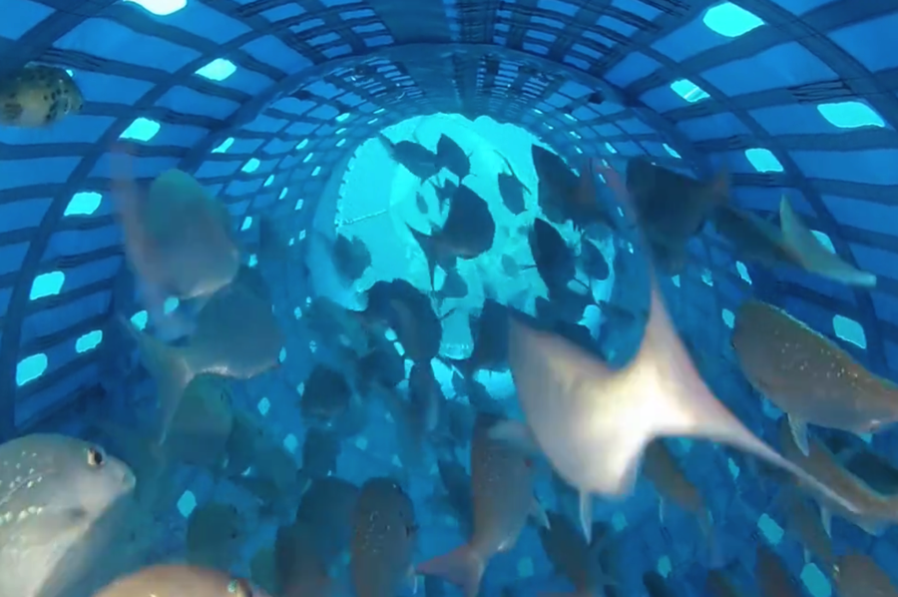
REDUCING IMPACTS: NEW & MODIFIED FISHING METHODS
KŌRERORERO / DISCUSSION
New sustainable fishing methods are being created
Tiaki Precision Seafood Harvesting (PSH) has been developed in Aotearoa New Zealand to:
Land fish on the boat in water and alive
Allow smaller fish to escape or be returned alive
Image: Tiaki.com
Notes:
TEACHER NOTES:

Slide 37
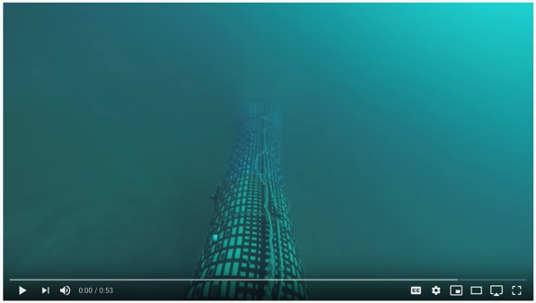
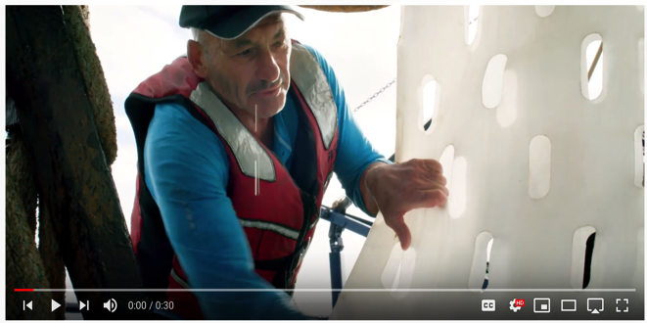
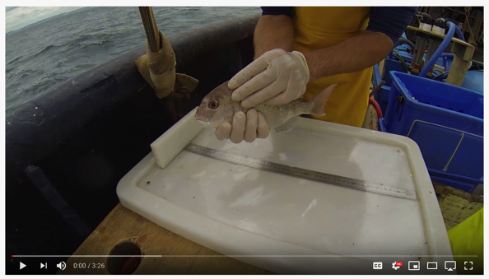
REDUCING IMPACTS: NEW & MODIFIED FISHING METHODS
MĀTAKI TĒNEI / WATCH THIS
Tiaki crew show how the nets work (0:53)
One fisher talk about how PSH works (0:30)
The results of the first trials of PSH (3:26)
What do you think?
Share in groups. And compare this method with an existing method?
Notes:
TEACHER NOTES:
VIDEO LINKS:
Tiaki crew show how the nets work - https://www.youtube.com/watch?v=cJqhz6RAHLI
One fishers view on PSH - https://www.youtube.com/watch?v=4yaPT7R6XpI
Watch the results of the first trail of PSH - https://www.youtube.com/watch?v=A5Hq4gVQgc4
GROUP BRAINSTORM:
Make a list of what is good about this new method of fishing?
Small fish escape
Bycatch arrives on deck alive and has better survival chance
Has been developed in NZ
Lands fish in water and alive so fish are better quality
And therefore likely to be worth more…

Slide 38
REDUCING IMPACTS: NEW & MODIFIED FISHING METHODS
KŌRERORERO / DISCUSSION
To attain the Marine Stewardship Council blue fish tick label many fisheries have had to modify their fishing methods to reduce bycatch
KŌRERO PUKAPUKA / READ
Read the Beating Bird Bycatch story
HE PĀTAI / CONSIDER THIS
What changes did the fishery make to reduce bird bycatch?
Notes:
TEACHER NOTES:
STORYLINK:
http://beating-bird-bycatch-stories.msc.org/?_ga=2.269112817.1435697534.1598919667-1303352827.1595455374
ANSWERS
Increasing the weight of fishing lines so that they sink faster
Using white lines that are less visible to birds
Improving the design of Tori lines (multi-coloured streamer lines hung vertically above the longline as it is set) to deter birds from diving to eat the baited hooks attached to longlines
Using a protective barrier of hanging streamers to keep birds away from the hauling point while the lines are hauled in
Closing the fishery during the grey petrel breeding season, from 1 February to 15 March.

Slide 39
REVIEWING KEY CONCEPTS – ENVIRONMENT & FISHING Focus Question: What have we learnt?
MĀTAKI TĒNEI / WATCH THIS
Short video [2:11] on marine habitat and species protection (Principle Two)
MAHI / ACTIVITY
Reflect on your learning and demonstrate your understanding by writing a script for Marine Stewardship Council booklet:
See Activity 4.5
Notes:
TEACHER NOTES
Film URL: https://www.youtube.com/watch?v=s1jg8-LZXws
MAHI / ACTIVITY
Activity 4.1 gets learners to write a script using images from this short film clip to make a booklet about Marine Stewardship Council’s Principle 2. All information needed by learners to complete this activity is in the short film. However, the activity draws on all learning from the topic.

