Slide 1
WHAT IS A FISH? Focusing Question: What makes a fish a fish? What fish live near us?
KŌRERORERO / DISCUSSION
Today over 17% of global fisheries are certified sustainable by the Marine Stewardship Council
HE PĀTAI / CONSIDER THIS
What exactly is a ‘FISH’?
A fish is a scaly skinned vertebrate [animal with back bone] that breathes using gills and lives in water
Notes:
TEACHER NOTES
A fish is a scaly skinned vertebrate [animal with back bone] that breathes using gills and lives in water

Slide 2
WHAT IS A FISH?
MAHI / ACTIVITY
What do you already know about fish?
Think about where and how fish live [habitat] …?
Complete the ‘What we know about fish?’ columns 1 & 2
Test your knowledge of local fishes using the Ika Moana o Aotearoa Cards
Play the Kahoot!
What do we know about fish? PRIOR KNOWLEDGE CHART
What we know | What we would like to know | What we have learned
Notes:
TEACHER NOTES
Complete columns one and two and then add information to three at the end of 2.2
Take the Ngā Ika Moana o Aotearoa / NZ Marine Fishes Kahoot Quiz – see https://www.msc.org/en-au/for-teachers/ocean-literacy/new-zealand-education-curriculum/kahoot-quizzes

Slide 3
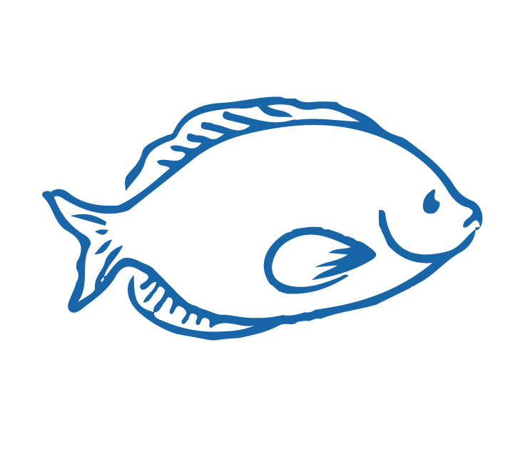
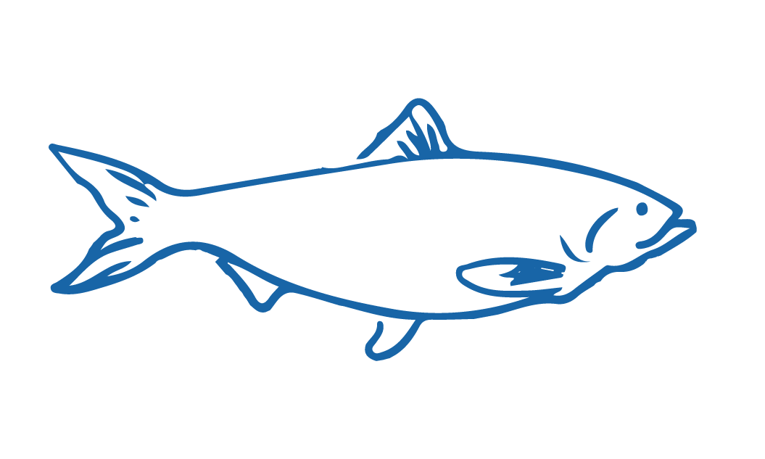
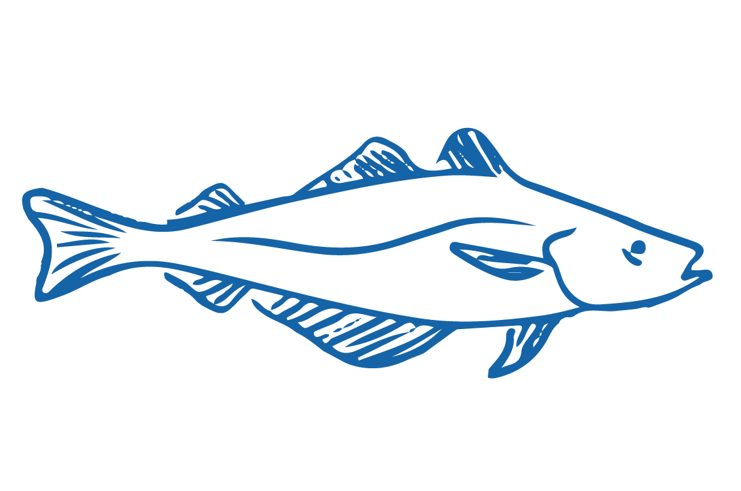
WHAT IS A FISH?
HE PĀTAI / CONSIDER THIS
Which of the following do fish NOT have?
Bony or cartilaginous (sharks and rays) skeletons
Gills (instead of lungs)
Gas filled swim bladders (buoyancy)
Fins (steering, moving forward & back, stability)
Sometimes colourful bodies (camouflage)
Warm blooded bodies
Body shape, mouth & eyes to suit habitat & lifestyle
Did you get the answer?
MAHI / ACTIVITY
Complete Fishy worksheet. Add any new knowledge to the Prior Knowledge Chart
Fish most often have cold blooded bodies
Notes:
TEACHER NOTES

Slide 4
WHAT IS A FISH?
MAHI / ACTIVITY
Work in pairs to label this fish? Use information from the Fishy Worksheet
Check answers using the next slide
FINS OF A FISH
Notes:
TEACHER NOTES
The fish is a Southern Blue Whiting. These fish live between 200 and 600m depth where there is little light (but it is not completely dark). They are schooling fish living near the seabed and moving up the water column at night to feed on plankton and small fish.

Slide 5
WHAT IS A FISH?
Lateral line
Dorsal fin(s)
HE PĀTAI / CONSIDER THIS
Can you also identify the eye, mouth & gill?
FINS OF A FISH
Learn more about fishy features by booking a virtual or real life visit with our partners, the education team at the National Aquarium of New Zealand
Caudal [tail] fin
Pelvic fin
Pectoral fin
Anal fin
Notes:
TEACHER NOTES
The fish is a Southern Blue Whiting. These fish live between 200 and 600m depth where there is little light (but it is not completely dark). They are schooling fish living near the seabed and moving up the water column at night to feed on plankton and small fish.

Slide 6
WHAT IS A FISH?
FISH & THE SEA NEAR US PRIOR KNOWLEDGE CHART
What we know | What we would like to know | What we have learned
MAHI / ACTIVITY
Complete the prior knowledge chart
Complete Local fish fact sheet: Spotty and answer the questions provided
OR
Use the Local fish work sheet if you are targeting a different fish
Notes:
TEACHER NOTES
If you don’t have Spotties near you then use the 2.2 Local fish worksheet instead of the Spotty fact sheet. You might need to complete the first part of this worksheet with lower level learners. Higher level learners could research and complete themselves.

Slide 7
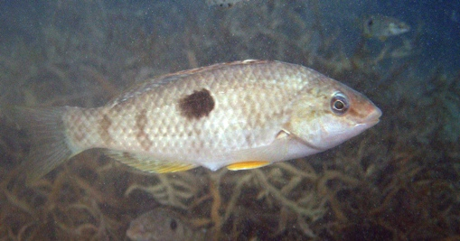
WHAT IS A FISH?
KŌRERORERO / DISCUSSION
Lets try and capture a fish! [See Field Trip & Worksheet]
Our target is a local fish – the small Spotted Wrasse called ‘Spotty’
This is what a Spotty looks like!
A ‘bait catcher’ fishing method gives us a good chance of capturing a Spotty!
Can’t get down to the wharf? A virtual bait catching field trip at the wharf with our partners, the education team at the National Aquarium of New Zealand is coming soon!
HE PĀTAI / CONSIDER THIS
While you are trying to catch your fish think about how this method would stand up to assessment for bycatch & impact on environment with Marine Stewardship Council
Notes:
TEACHER NOTES

Slide 8
He kura kainga te moana, he kura huna te moana
The oceans environment,
is a source of untapped knowledge

