Slide 1
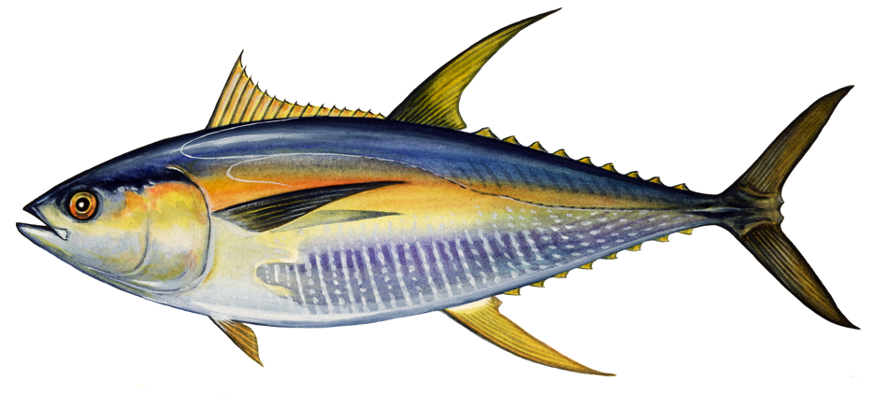
BODY SHAPES OF FISHES Focusing Question: What patterns can we see in body shapes of fish from similar habitats?
KŌRERORERO / DISCUSSION
ADAPTATION is an evolutionary process [something that happens over time] where a creature becomes well suited to living in a certain place [habitat]
Fishes have adapted their bodies to suit where they live [habitat]
These adaptations give clues to where fish live
Adaptation 1: Eyes on either side of head are good for swimming above the seafloor
Adaptation 2: Torpedo shaped body & forked tail for fast swimming
Look at my shape. What can you guess about the habitat where I live? Why?
[Another clue is on the next slide]
Adaptation 3: Colours (dark on top and light underneath) help camouflage in open water
Notes:
TEACHER NOTES

Slide 2
BODY SHAPES OF FISHES
KŌRERORERO / DISCUSSION
The body shape of a fish gives clues to where and how the fish lives
Using a scientific key like this one can help classify the body shape of a fish
MAHI / ACTIVITY
Use the key (see Scientific Keys Fish Adaptations) to see if your guess from the previous slide was correct?
Notes:
TEACHER NOTES
You can extend this activity by showing learners pictures of fish from any identification book. Ask learners to identify the shape of the fish and where the fish might live. Most identification books have some information about the habitat of the fish so you can check their answers.
Scientific Keys can be found as a supplementary file called Scientific Keys Fish Adaptations

Slide 3
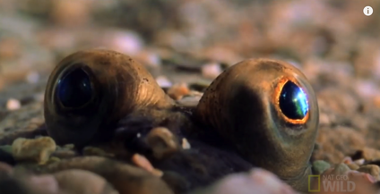
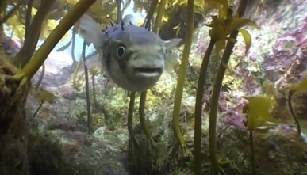
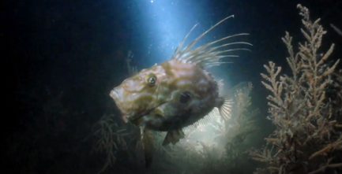
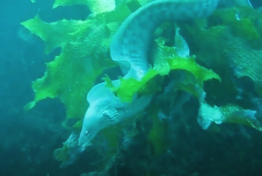
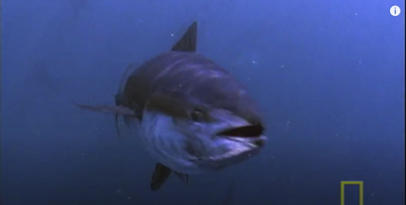
BODY SHAPES OF FISHES
MĀTAKI TĒNEI / WATCH THIS
Watch these short video clips…
Flounder [2:01] Pufferfish [0:56] John Dory [1:44] Moray eel [0:45] Bluefin Tuna [1:51]
MAHI / ACTIVITY
…and guess which fish has each of the following body shapes
1.Torpedo shape 2.Boxy shape 3.Round & narrow 4.Flat 5. Elongated
Notes:
TEACHER NOTES
This could be a good homework activity!
Blue fin tuna - https://www.youtube.com/watch?v=XzZhSl_00pI&t=36s
Pufferfish - https://www.youtube.com/watch?v=-ntITHjweTk
John Dory - https://www.youtube.com/watch?v=ISQY54cLfhg
Flounder - https://www.youtube.com/watch?v=EIMRSt40OMk
Moray eel - https://www.youtube.com/watch?v=nZRQMuxzIdk
Answers:
Torpedo shape – Bluefin tuna
Boxy shape – Puffer fish
Round and narrow – John Dory
Flat – Flounder
Elongated – Moray eel

Slide 4
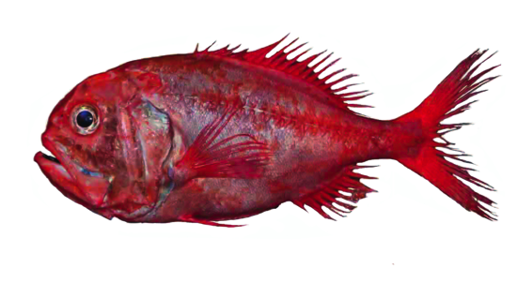
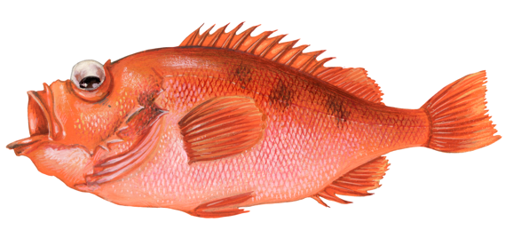
BODY SHAPES OF FISHES
MAHI / ACTIVITY
Use Scientific Keys Fish Adaptations to complete the following:
A. Look at the eyes of this fish. Use scientific key 2. What can you tell about where this fish lives?
B. Look at the mouth of this fish. Use scientific key 3. What can you tell about how it eats?
C. Look at the tail of this fish. Use scientific key 4. What can you tell about its swimming speed?
Notes:
TEACHER NOTES
Scientific Keys can be found as a supplementary file called Scientific Keys Fish Adaptations

Slide 5
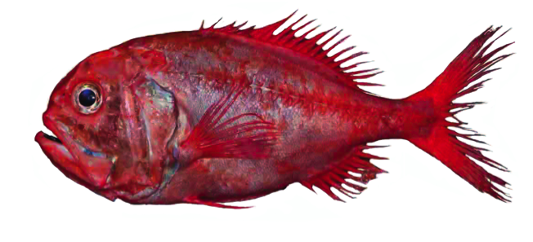
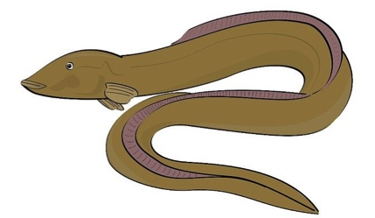
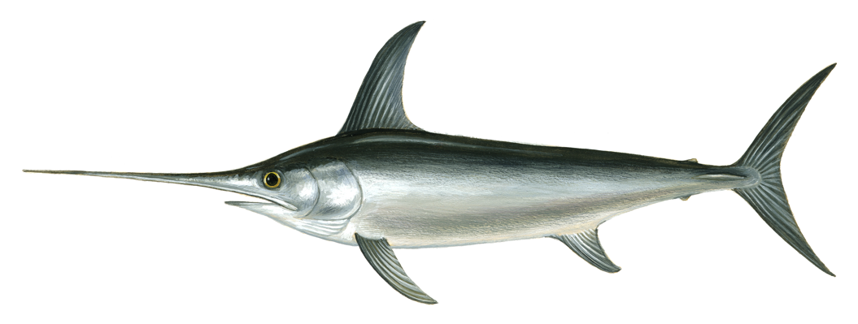
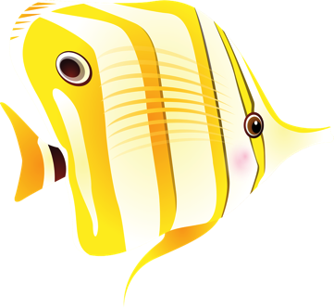
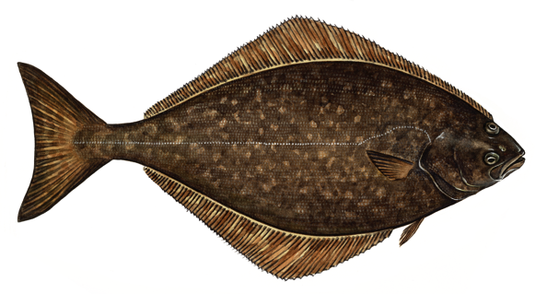
BODY SHAPES OF FISHES
MAHI / ACTIVITY
Use Scientific Keys Fish Adaptations for clues about how and where these fish live?
1
3
2
5
4
6
Notes:
TEACHER NOTES
1. Orange roughy – has eyes either side of it’s head so swims above the bottom. Has big eyes – suggesting low light environment. Lives in 400m – 1800m depth.
2. Eel – oceanic eels mostly hide in holes or rocky caves and crevices.
3. Tuna – forked tail indicates very fast swimmer. Body shape indicates open ocean swimming above the bottom.
4. Butterfly fish – tall and slim so can move amongst corals and rocks, pointy mouth helps it dig out prey from crevices
5. Swordfish – very fast swimmer (forked tail); lives above the bottom (eyes on either side of it’s head) in open water. Kills prey by stunning first with it’s sword!
6. Flounder or halibut – lives on the sandy seafloor (eyes on top of one side), mouth on underside so feeds on bottom.
Scientific Keys can be found as a supplementary file called Scientific Keys Fish Adaptations

Slide 6
BODY SHAPES OF FISHES
EXPERTS ONLY!
MAHI / ACTIVITY
Use books and websites to confirm your findings. Present back to the rest of the class.
1
3
2
5
4
6
Notes:
TEACHER NOTES
1. Orange roughy – has eyes either side of it’s head so swims above the bottom. Has big eyes – suggesting low light environment. Lives in 400m – 1800m depth.
2. Eel – oceanic eels mostly hide in holes or rocky caves and crevices.
3. Tuna – forked tail indicates very fast swimmer. Body shape indicates open ocean swimming above the bottom.
4. Butterfly fish – tall and slim so can move amongst corals and rocks, pointy mouth helps it dig out prey from crevices
5. Swordfish – very fast swimmer (forked tail); lives above the bottom (eyes on either side of it’s head) in open water. Kills prey by stunning first with it’s sword!
6. Flounder – lives on the sandy seafloor (eyes on top of one side), mouth on underside so feeds on bottom.
Scientific Keys can be found as a supplementary file called Scientific Keys Fish Adaptations

Slide 7
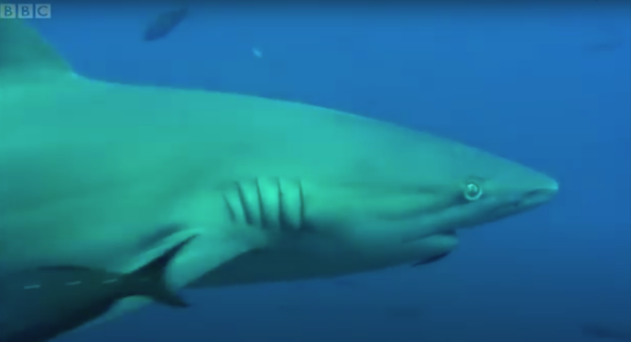
BODY SHAPES OF FISHES
MĀTAKI TĒNEI / WATCH THIS
Short BBC [3.39] footage of pelagic [open ocean] species
HE PĀTAI / CONSIDER THIS
What was one cool new thing you learnt?
What is it like in the open ocean? What might it be like in the open ocean
What changes [adaptations] have fish made to live in the open ocean? Make a list
How might deep oceans creatures benefit from pelagic feeding frenzies like this one?
Notes:
TEACHER NOTES
Fish bait ball in open water | Blue Planet | BBC can be found at https://www.youtube.com/watch?v=B6M_XgiONoo
HE PĀTAI / CONSIDER THIS
Anything they found interesting or new
Answers should include: light, open water with absense of sea floor (nowhere to hide), little pressure … the links below will give you more information
Forked tails, streamline bodies, strong swimmers, camouflage colourings (see excerpt below)
Food drifts down to deep ocean zomes
EXTENDING
Try exploring the following:
“Oceanic fish” (Te Ara) See: https://teara.govt.nz/en/oceanic-fish
“Open ocean” (Te Ara) See: https://teara.govt.nz/en/open-ocean
“Pelagic Ecology” (University of Hawaii) See: http://www.soest.hawaii.edu/oceanography/courses_html/OCN201/laboratory/Lab_Readings/Pelagic_Reading.pdf
The following excerpt may also be helpful “…pelagic habitat is ‘three-dimensional’—organisms must be able to move (and preferably see) in all directions. Second, there are no solid substrates to provide refuge. For these reasons, superior swimming ability is an important means of survival for many large fishes such as tuna, helping them to capture prey and avoid predators. Indeed, many pelagic fishes are migratory, covering vast distances of the open ocean in search of food. These types of fish are streamlined, with thick bodies and heavy musculature. Various forms of camouflage are common in pelagic organisms. Fishes in the epipelagic realm are generally countershaded, so their bodies show a color gradient from dark on the dorsal surface to light on the ventral surface. This type of coloration makes them difficult to see, both from above and below. Others are silvery, helping them to reflect sunlight near the surface, and blend in with the surrounding waters.” (University of Hawaii, 2011)

Slide 8
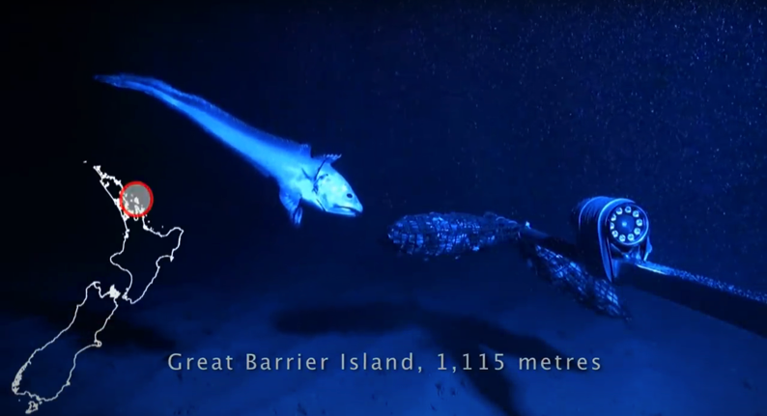
BODY SHAPES OF FISHES
MĀTAKI TĒNEI / WATCH THIS
Short Te Papa video clip of deep water species
HE PĀTAI / CONSIDER THIS
What was one cool thing you learnt?
What is it like in the deep ocean? What might it be like in the deep ocean
What changes [adaptations] have creatures made to their bodies to live in the deep ocean? Make a list
Notes:
TEACHER NOTES
The deep water species video is produced by Museum of New Zealand Te Papa Tongarewa and can be found at https://www.youtube.com/watch?v=x2X6H1llkb0
HE PĀTAI / CONSIDER THIS
Anything they found interesting or new
Answers should include: dark, high pressure, cold, no photosynthesis [below 200m] … the links below will give you more information
Large eyes, large mouths, luminous organs, long feelers or sensory tentacles..
EXTENDING
Try exploring the following:
“What conditions exist for life in the deep ocean?” (NOAA) See: https://oceanexplorer.noaa.gov/facts/deep-habitat.html
“Deep sea creatures” (Te Ara) See: https://teara.govt.nz/en/deep-sea-creatures
“Deep sea fish” (Britannica) See: https://www.britannica.com/animal/deep-sea-fish
MAHI / ACTIVITY
Investigate adaptations of deep water fish such as the Viperfish or Anglerfish. Find ten cool facts and create a set of true false cards. Share with the class. Review and discuss. What did we learn? What do we want to know more about? How might we find out this information? Identify and discuss new words.

Slide 9
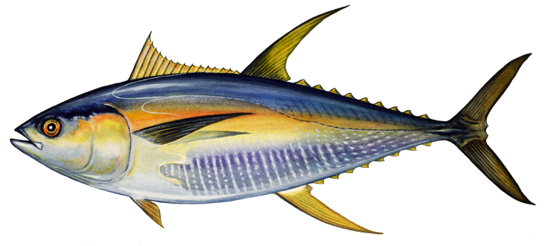
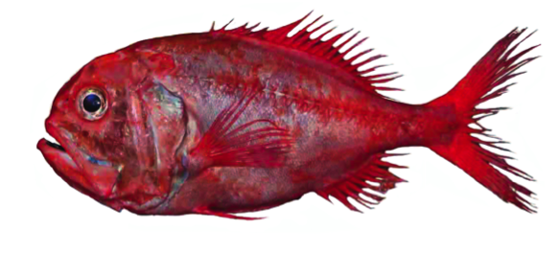
BODY SHAPES OF FISHES
MAHI / ACTIVITY
Each fish shown here lives in a different place or habitat within the ocean
Use 2.3 Scientific Keys Fish Adaptations to figure out which fish lives where?
Open ocean
Deep ocean
Rocky or coral reef
Sandy seafloor
Notes:
TEACHER NOTES
Orange roughy – has eyes either side of it’s head so swims above the bottom. Has big eyes – suggesting low light environment. Lives in 400m – 1800m depth.
Tuna – forked tail indicates very fast swimmer. Body shape indicates open ocean swimming above the bottom.
Butterfly fish – tall and slim so can move amongst corals and rocks, pointy mouth helps it dig out prey from crevices
Flounder or halibut – lives on the sandy seafloor (eyes on top of one side), mouth on underside so feeds on bottom.
Scientific Keys can be found as a supplementary file called Scientific Keys Fish Adaptations

Slide 10
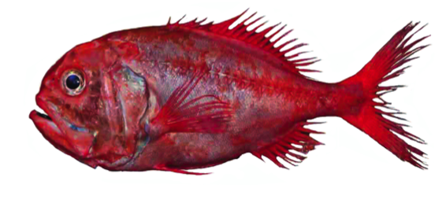
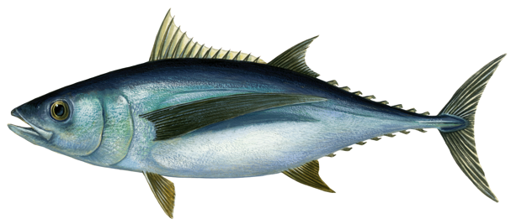
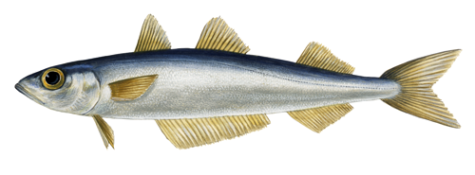
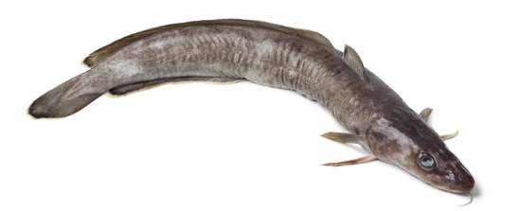
BODY SHAPES OF FISHES
MAHI / ACTIVITY
Select one of the fish pictures below. All are fished in Aotearoa New Zealand waters and are MSC certified. Observe your fish. What adaptations [eyes, mouth, body shape, fins etc] do you see? Think about how the fish moves, eats, protects itself. Draw your own picture of the fish and label the picture to show your observations.
3. Hoki
1. Orange Roughy
2. Albacore Tuna
4. Southern Blue Whiting
5. Ling
Notes:
TEACHER NOTES
1. Orange roughy – has eyes either side of it’s head so swims above the bottom. Has big eyes – suggesting low light environment. Lives in 400m – 1800m depth.
2. Eel – oceanic eels mostly hide in holes or rocky caves and crevices.
3. Tuna – forked tail indicates very fast swimmer. Body shape indicates open ocean swimming above the bottom.
4. Butterfly fish – tall and slim so can move amongst corals and rocks, pointy mouth helps it dig out prey from crevices
5. Swordfish – very fast swimmer (forked tail); lives above the bottom (eyes on either side of it’s head) in open water. Kills prey by stunning first with it’s sword!
6. Flounder or halibut – lives on the sandy seafloor (eyes on top of one side), mouth on underside so feeds on bottom.
Other Australian and Aotearoa New Zealand fishes certified by the MSC can be found at:https://www.msc.org/what-you-can-do/eat-sustainable-seafood/fish-to-eat
Scientific Keys can be found as a supplementary file called Scientific Keys Fish Adaptations

Slide 11
He kura kainga te moana, he kura huna te moana
The oceans environment,
is a source of untapped knowledge

