Slide 1
MARINE HABITAT Focusing Question: How do marine habitats differ from one another?
KŌRERORERO / DISCUSSION
The Marine Stewardship Council has certified fisheries in many different habitats. A Habitat is:
A place where a group [community] of living things [organisms] live and breed
Different habitats have different characteristics: temperature, current, tide, seafloor [substrate], light
MARINE HABITAT – PRIOR KNOWLEDGE CHART
What we know | What we would like to know | What we have learned
MAHI / ACTIVITY
What do you know about marine habitats & the creatures that live there? Complete Marine Habitat Prior Knowledge Chart columns 1 & 2
Notes:
TEACHER NOTES

Slide 2
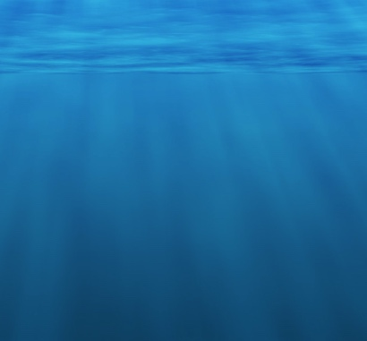
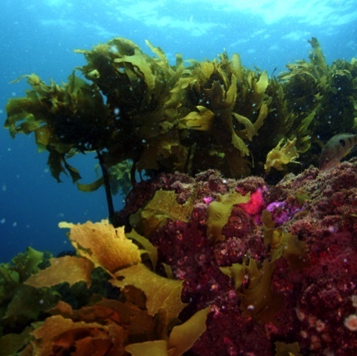
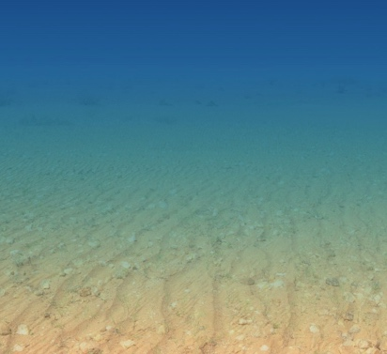
MARINE HABITAT
Most Marine Stewardship Council certified fisheries are in open water and sandy bottom habitats!
KŌRERORERO / DISCUSSION
Habitats are really made by physical things such as light, depth, pressure, bottom type [substrate], temperature
These physical things then create an environment for a community of creatures, plants, algae to live
Main ocean habitat types are:
Open water (very large)
Soft sandy to muddy bottom (large)
Hard (rocky, coral) bottom (small area but has the most diversity / variety of life)
Notes:
TEACHER NOTES

Slide 3
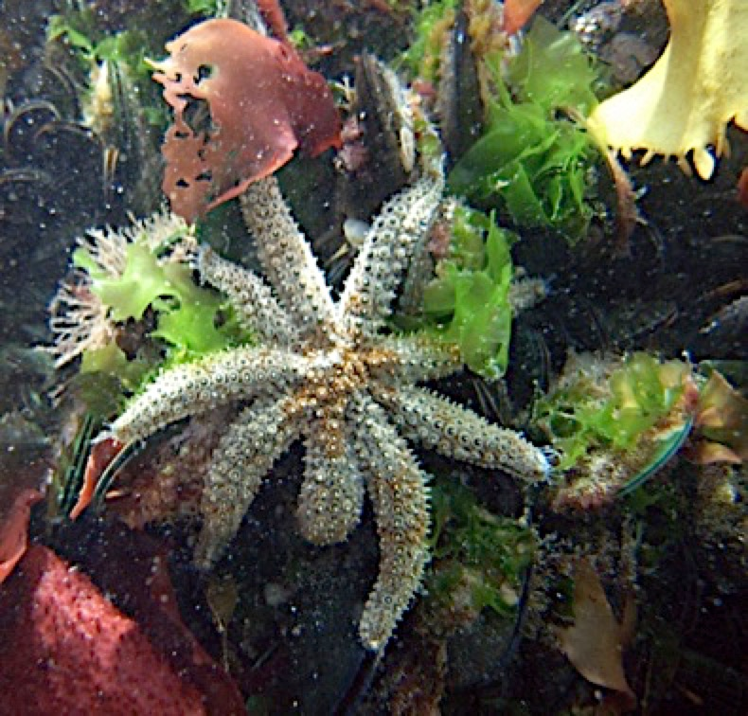
MARINE HABITAT
KŌRERORERO / DISCUSSION
Within each of the main habitat types there are many smaller habitats
Every habitat is home to many types of organisms [living things]
Fisheries certified by the Marine Stewardship Council have been assessed to ensure impacts on local habitats are minimised
HE PĀTAI / CONSIDER THIS
Look carefully! Is the starfish the only living thing in this tiny patch of rocky reef habitat?
Notes:
TEACHER NOTES
HE PĀTAI / CONSIDER THIS
Answer– No! There are several species of seaweed and green lipped mussels visible. Beneath this there will also be a myriad of smaller creatures – possibly sponges, anenomes, blennies etc

Slide 4
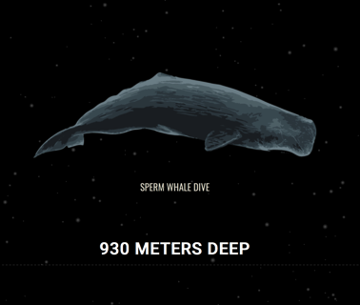
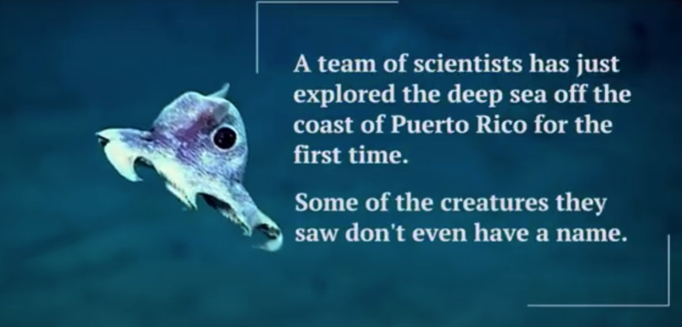
MARINE HABITAT
MĀTAKI TĒNEI / WATCH THIS
Visit our partner organisation The National Aquarium of New Zealand click on Deep Sea Exploration. Watch the film [1:30] and have a go at the activity!
MAHI / ACTIVITY
Just for fun! Check out The Deep Sea
by Neal Agarwal!
Play the true false card game and the matching game (see Habitat Cards or Teacher Outline)
Notes:
TEACHER NOTES
MĀTAKI TĒNEI / WATCH THIS
National Aquarium film clip on Deep Sea Exploration can be found at https://www.nationalaquarium.co.nz/learn/education-from-our-place-to-yours/
MAHI / ACTIVITY
The Deep Sea can be found at https://neal.fun/deep-sea

Slide 5
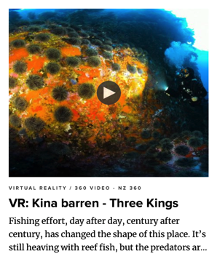
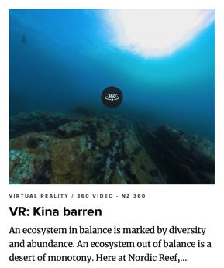
MARINE HABITAT
EXPERTS ONLY!
MĀTAKI TĒNEI / WATCH THIS
Watch the kina barren 360 VR videos and take on the task of being a virtual marine biologist. Record your observations from each virtual expedition!
KŌRERORERO / DISCUSSION
Scientists now believe that reduced numbers of fish (such as Tāmure or Snapper) is how kina [sea urchin] barrens are created
Tāmure / Snapper eat kina [sea urchins] who eat seaweed [kelp]
Less Tāmure / Snapper has resulted in more kina and less kelp
Notes:
TEACHER NOTES
This activity has been adapted with kind permission by BLAKE – The Sir Peter Blake Trust. You can check out more of what they do at blakenz.org
All videos available at: https://www.nzgeo.com/lessons-fishing/

Slide 6
He kura kainga te moana, he kura huna te moana
The oceans environment,
is a source of untapped knowledge

