Slide 1


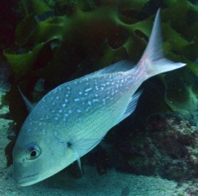
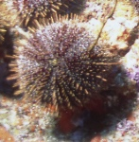
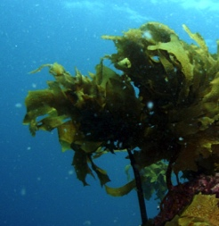
MARINE FOOD WEBS
Focusing Question: What is a food web and how can overfishing affect food webs?
KŌRERORERO / DISCUSSION
Many of the creatures that live together [community] in a habitat are connected in predator – prey relationships
In other words they eat each other!
These relationships can be shown simply as a food chain
Tāmure / Snapper
Kina / Sea urchin
Seaweed / Kelp
EATS
EATS
Notes:
TEACHER NOTES

Slide 2
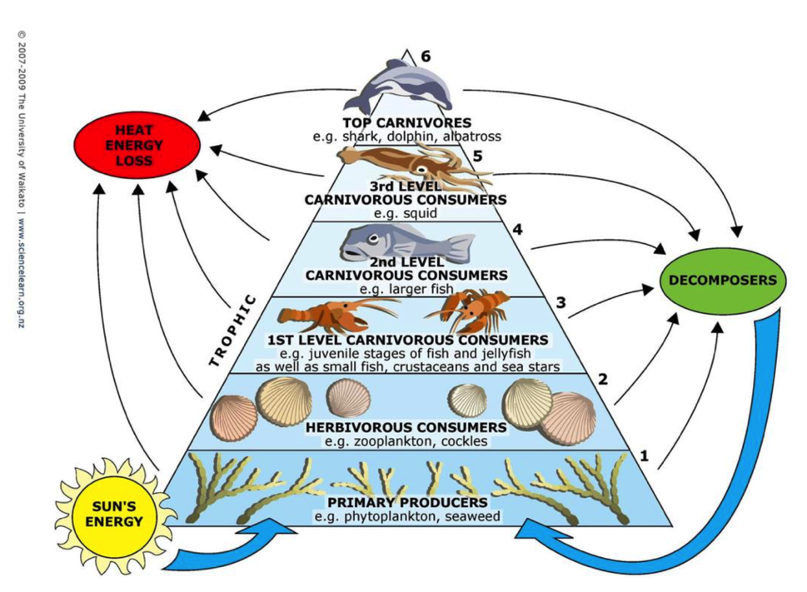


MARINE FOOD WEBS
KŌRERORERO / DISCUSSION
Food webs are a more realistic way of showing food chain relationships
In a food web, energy and nutrients [in the form of food] are passed from one living thing to another
MAHI / ACTIVITY
Use the Marine Stewardship Council NZ Marine Food Web Terms Quizlet to help with new words
MARINE TROPHIC PYRAMID
© Science Learning Hub – Pokapū Akoranga Pūtaiao, University of Waikato, www.sciencelearn.org.nz
Notes:
TEACHER NOTES
Quizlet cards are saved as Marine Stewardship Council NZ Marine Food Web Terms – see www.quizlet.com or follow this link: https://quizlet.com/_81dyjy?x=1jqt&i=2nkyj4

Slide 3
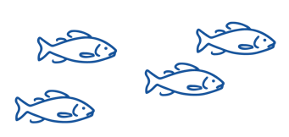
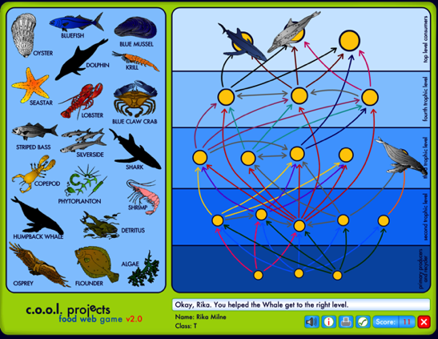
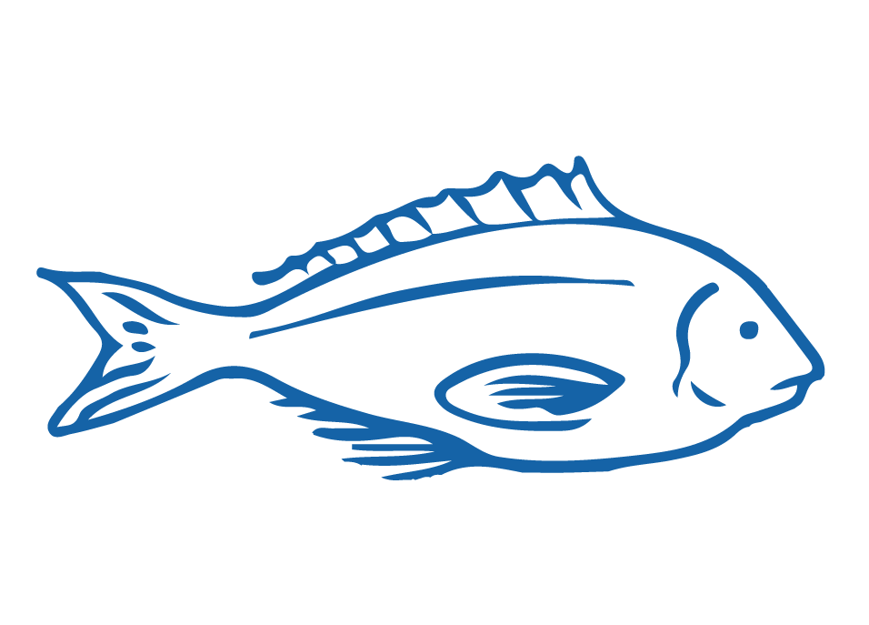
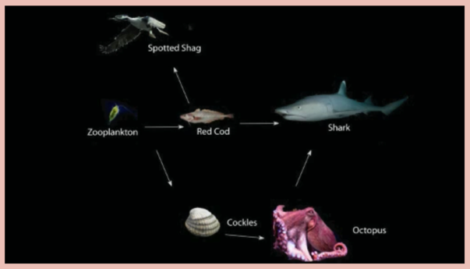
MARINE FOOD WEBS
MAHI / ACTIVITY
Play the String game NZ & Food web game
MAHI / ACTIVITY
Play the online food web game
MĀTAKI TĒNEI / WATCH THIS
A short video [2.06] explaining food webs
Notes:
TEACHER NOTES
MĀTAKI TĒNEI / WATCH THIS
https://www.sciencelearn.org.nz/videos/37-understanding-food-webs
We are part of the Foodweb as we eat fish. So we are at or near the top of the Foodweb. We rely on all the parts of the Foodweb that are below us or connected to us. If one aspect of the Foodweb ceases to function then the whole food web can collapse.
MAHI / ACTIVITY
http://coolclassroom.org/flash/food_web/

Slide 4



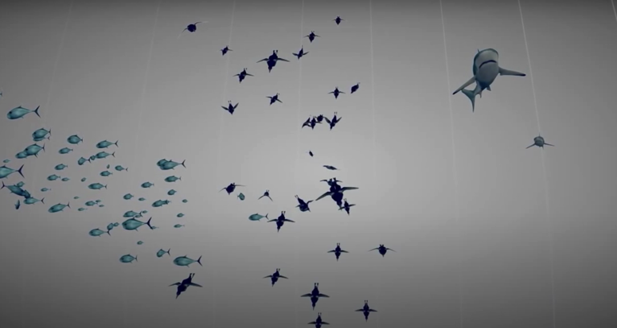
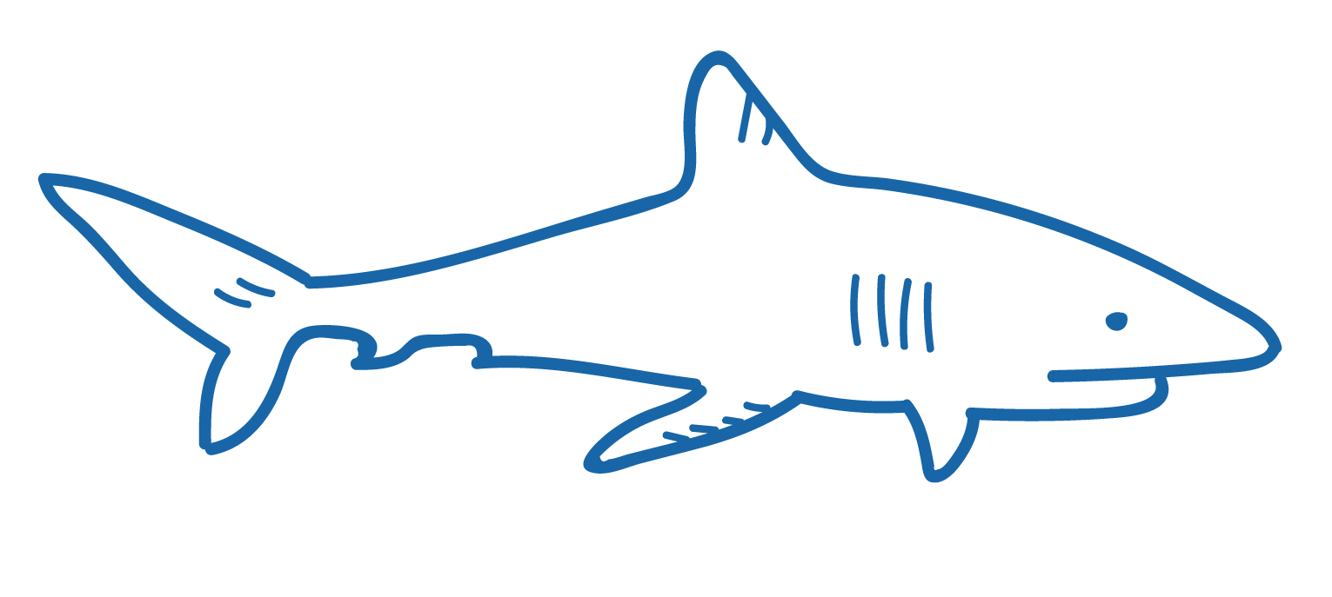
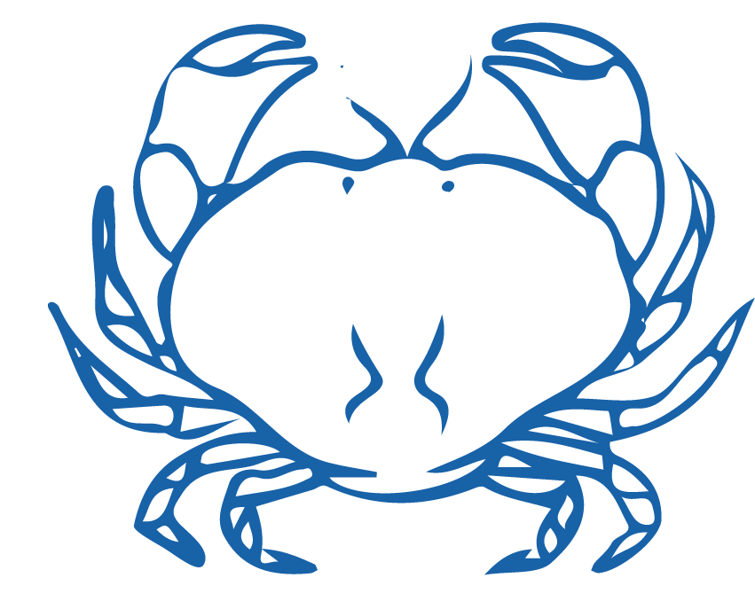
MARINE FOOD WEBS
HE PĀTAI / CONSIDER THIS
What happens when large numbers of one type of animal (or plant) are removed from a habitat?
MĀTAKI TĒNEI / WATCH THIS
Short film by Pew on the role that sharks play in ocean food webs [1:35]
Want to know more about food webs? Take a virtual food web and adaptation lesson with our partners, the education team at the National Aquarium of New Zealand
It can cause the entire nature of the community to change
Notes:
TEACHER NOTES
Shark film clip by Pew can be found at https://www.youtube.com/watch?v=yDqzGOa-adc

Slide 5

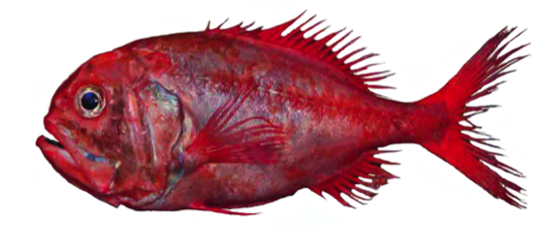
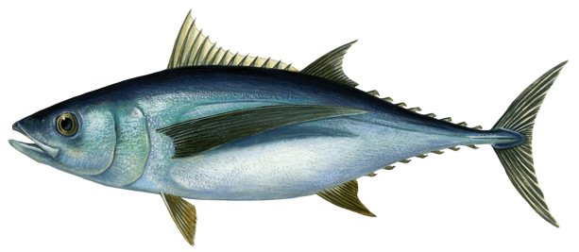
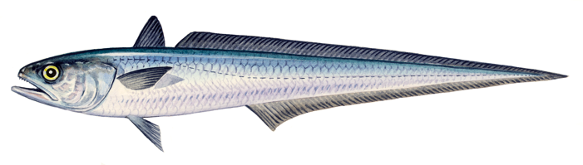
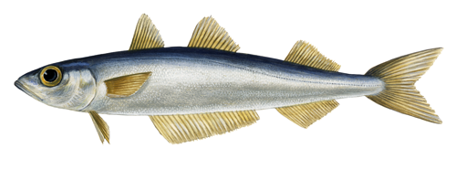
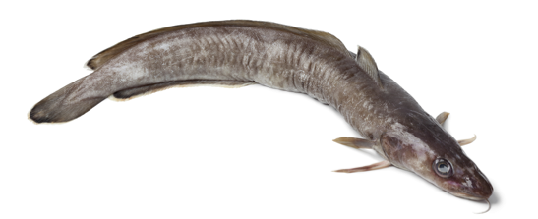
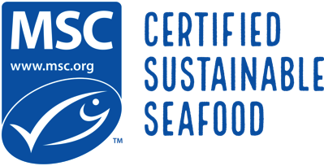
MARINE FOOD WEBS
EXPERTS ONLY!
MAHI / ACTIVITY
Select one of the fish pictures below. All are fished in Aotearoa New Zealand waters and are MSC certified. Research where the fish lives [habitat]. What does the fish eat and what eats it? Create a food chain or a food web for the fish. What impacts would overfishing have on the community and habitat of this fish?
3. Hoki
1. Orange Roughy
2. Albacore Tuna
4. Southern Blue Whiting
5. Ling
Notes:
TEACHER NOTES
1. Orange roughy – has eyes either side of it’s head so swims above the bottom. Has big eyes – suggesting low light environment. Lives in 400m – 1800m depth.
2. Eel – oceanic eels mostly hide in holes or rocky caves and crevices.
3. Tuna – forked tail indicates very fast swimmer. Body shape indicates open ocean swimming above the bottom.
4. Butterfly fish – tall and slim so can move amongst corals and rocks, pointy mouth helps it dig out prey from crevices
5. Swordfish – very fast swimmer (forked tail); lives above the bottom (eyes on either side of it’s head) in open water. Kills prey by stunning first with it’s sword!
6. Flounder or halibut – lives on the sandy seafloor (eyes on top of one side), mouth on underside so feeds on bottom.
Fish keys are provided as pdfs for printing.

Slide 6

He kura kainga te moana, he kura huna te moana
The oceans environment,
is a source of untapped knowledge

