Slide 1
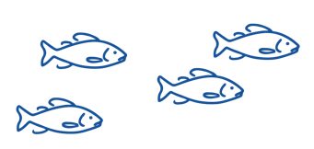
REVIEWING KEY CONCEPTS
Focusing Question: What have we learnt?
MAHI / ACTIVITY
Complete Marine Ecology Summary Quiz Kahoot
Define it! Act it! Your teacher will give you a term. Write your own group definition. Then …. Act it out using mime. No words!. The rest of the class will try and guess your term!
Bony fishes
Habitat
Consumer
Primary producer
Predator
Food chain
Decomposer
Prey
Notes:
TEACHER NOTES
https://www.msc.org/docs/default-source/default-document-library/education-page/msc-lesson-plan-using-the-oceans-resources-responsibly.pdf?sfvrsn=5c15a87a_14

Slide 2
He kura kainga te moana, he kura huna te moana
The oceans environment,
is a source of untapped knowledge

