Slide 1



Slide 2
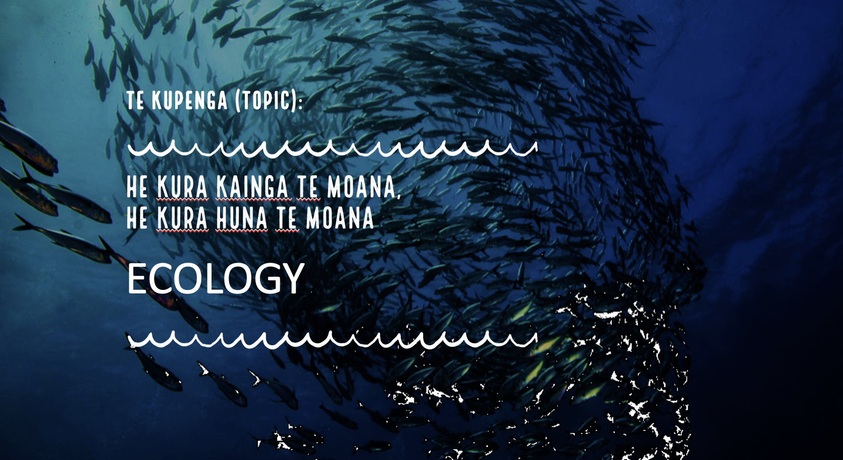
[Version 1.3 – 2024]
Notes:
He kura kainga te moana, he kura huna te moana
The oceans environment, is a source of untapped knowledge

Slide 3


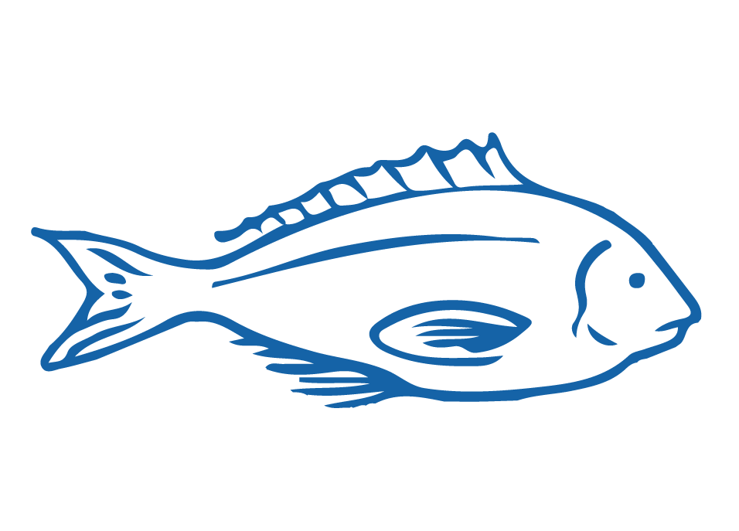


HELPFUL STUFF FOR TEACHERS
Target age range:
10–15 years
Topic focus: Ecology
Curriculum Level: Level 3 - 5
Curriculum relevance: Science; Pūtaiao
Key competencies: Thinking; Managing Self; Using language, symbols & texts; Relating to others
Planning: See also Marine Ecology Planner and teacher notes below slides
Extending learning: See Topic Outlines and slides labelled expert [top right corner]
Welcome to OUR STORY!
In this topic we explore MARINE ECOLOGY

Slide 4

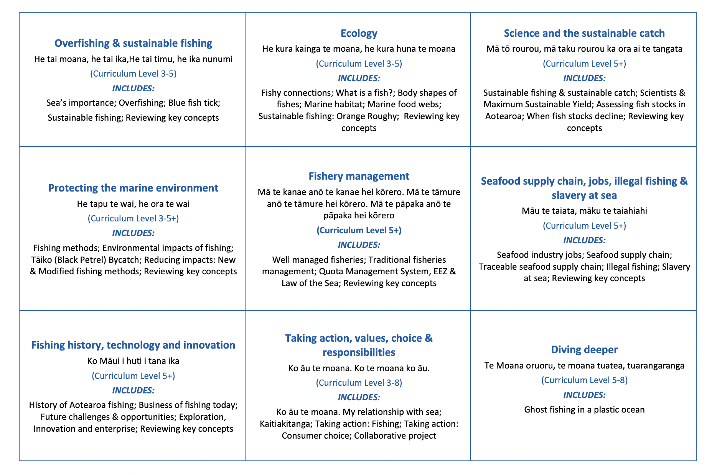
HELPFUL STUFF FOR TEACHERS
Welcome to OUR STORY!
In this topic we explore MARINE ECOLOGY

Slide 5
HELPFUL STUFF FOR TEACHERS
Learning outcomes
LO1 Identify ways we as people are connected with fish
LO2 Describe key features of fishes including fish certified by Marine Stewardship Council
LO3 Observe a fish and record evidence
LO4 Experience and identify local marine species
LO5 Identify key adaptations of fishes to suit their habitat and use a scientific key
LO6 Describe patterns in body shapes of fish that live in the same habitat
LO7 Describe the concept of ‘habitat’ and identify differences amongst three marine habitats
LO8 Describe the concept of food web and the effect unsustainable fishing has on food webs
LO9 Describe a characteristic of orange roughy that makes it susceptible to overfishing
LO10 Use scientific and fishery related vocabulary
Target age range:
10–15 years

Slide 6
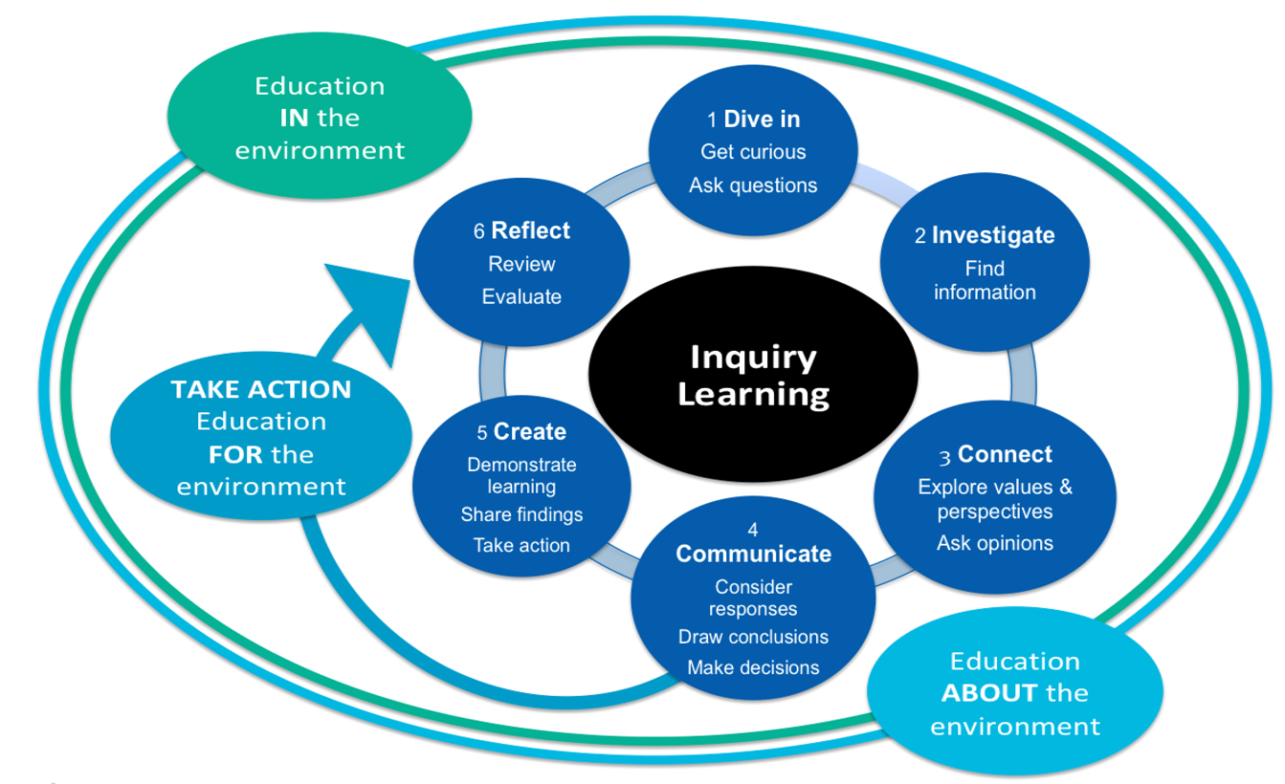
HELPFUL STUFF FOR TEACHERS
Notes:
TEACHER NOTES

Slide 7


IN THIS TOPIC WE WILL LEARN ABOUT…
How am I connected with fishes?
What makes a fish a fish? What fish live near us?
What patterns do we see in the body shapes of fish from similar habitats?
How do marine habitats differ from one another?
What is a food web and how can overfishing affect food webs?
What characteristics of orange roughy make them susceptible to overfishing?
What new words and concepts have we learnt?

Slide 8


MIHI / INTRODUCTION
Can you imagine a world without fish?
What would that be like?
No more sushi! No more fishing!
No more fish & chips! No more….?
Notes:
TEACHER NOTES
Try to get learners to connect with the personal impact of overfishing and unsustainable practices.
What would it be like for ME if there were few or no fish left in the sea!

Slide 9
MIHI / INTRODUCTION
The good news is… some special people are working hard to make sure this doesn’t happen!
In this topic we learn about
… fish & other creatures that live in the ocean
Notes:
TEACHER NOTES
If you are short on time then you could jump straight to slide 11

Slide 10


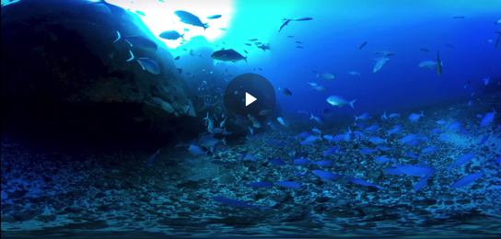
FISHY CONNECTIONS
Focusing Question: How am I connected with fishes?
MĀTAKI TĒNEI / WATCH THIS
Short [1:55] film clip to see what it is like underwater in Aotearoa New Zealand [view using Chrome]
HE PĀTAI / CONSIDER THIS
What do you think it would feel like to be a fish living in the sea?
How are you connected with the fish that live in the sea?
Discuss ancestors [tīpuna] that caught fish
MAHI / ACTIVITY
Write or tell a short story called “a creature of the sea and me”
Notes:
TEACHER NOTES
The video clip may require Google Chrome to view and can be found at https://www.nzgeo.com/video/nzvr-trailer/
(Can’t be viewed through Safari)
KŌRERORERO / DISCUSSION
Answers might include words like: cold, free, floating, weightless, blue, dark, swaying…
Answers might include: whakapapa, ancestors who were fisher folk or whalers,
Discuss stories of ancestors / tīpuna that caught fish. Discuss how fish and fishing were an important part of our ancestors lives, diet, and livelihood
OTHER DISCUSSION QUESTIONS
What colour did you see most underwater?
What types of marine creatures did you recognise?
What different body shapes did you notice amongst the fish?
Was there the same amount of fish in each place? If not, why not?
Were all fish swimming in groups or schools? Why do you think fish swim in schools?

Slide 11
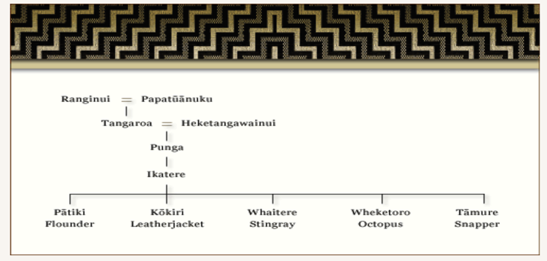
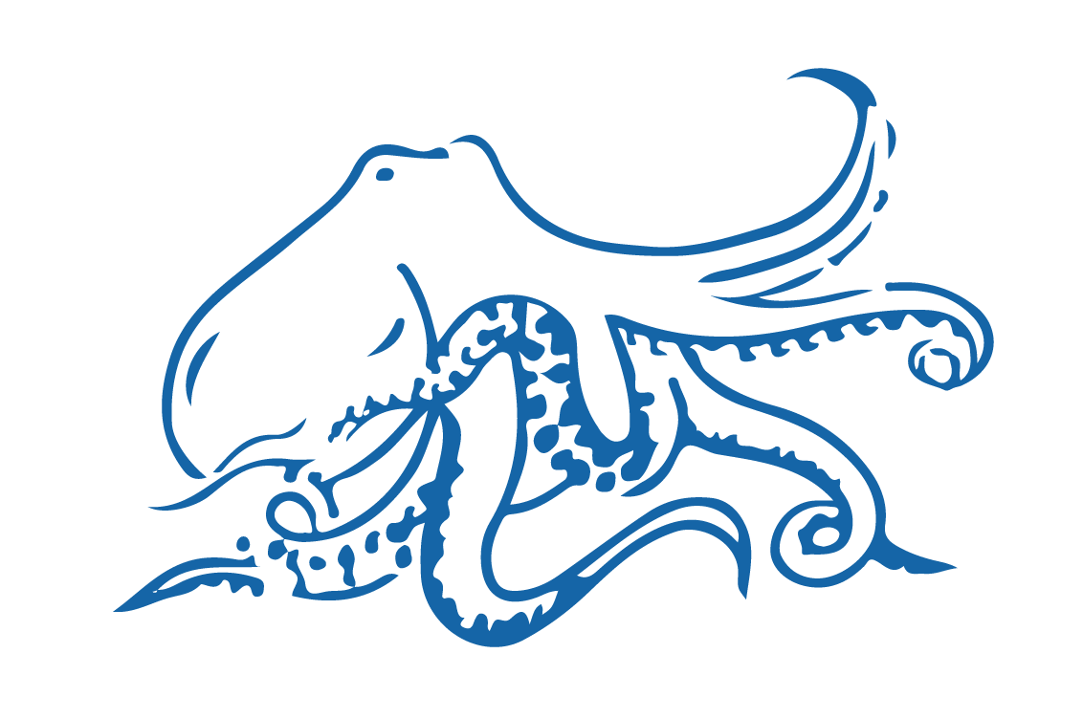
FISHY CONNECTIONS
KŌRERORERO / DISCUSSION
In te ao Māori [the Māori world]:
We are related to the sea through whakapapa [family tree]
People and the sea are the children of Papatūānuku [earth mother] and Ranginui [sky father]
Sea creatures are children of the ugly god Punga
Source: Te Ara.govt.nz
Notes:
TEACHER NOTES
USEFUL RESOURCES / RĀRANGI PUKAPUKA
To read more about Tangaroa see: https://teara.govt.nz/en/Tangaroa-the-sea/print
Image source: Te Ahukaramū Charles Royal, 'Papatūānuku – the land - Papatūānuku – the
earth mother', Te Ara - the Encyclopedia of New Zealand,
http://www.TeAra.govt.nz/en/whakapapa/11430/papatuanukus-children
(accessed 14 January 2020)

Slide 12
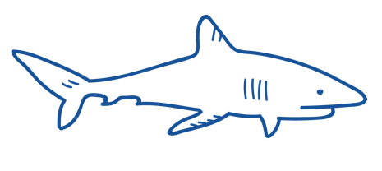
FISHY CONNECTIONS
KŌRERORERO / DISCUSSION
Polynesians, have long thought of sharks as guardian spirits
Our ancestors [tīpuna] had a close relationship with sea animals, for example Tametekapua
“Tamatekapua set out for Aotearoa New Zealand from Hawaiki and was rescued by a shark… .
…He and his people renamed their canoe, and themselves after a type of shark: Te Arawa”
HE PĀTAI / CONSIDER THIS
Find out what sea creatures feature in the history or whakapapa of your whānau [family]?
Notes:
TEACHER NOTES
USEFUL RESOURCES / RĀRANGI PUKAPUKA
To read more about Tangaroa see: https://teara.govt.nz/en/Tangaroa-the-sea/print
Image source: Te Ahukaramū Charles Royal, 'Papatūānuku – the land - Papatūānuku – the
earth mother', Te Ara - the Encyclopedia of New Zealand,
http://www.TeAra.govt.nz/en/whakapapa/11430/papatuanukus-children
(accessed 14 January 2020)

Slide 13


WHAT IS A FISH?
Focusing Question: What makes a fish a fish? What fish live near us?
KŌRERORERO / DISCUSSION
Today over 17% of global fisheries are certified sustainable by the Marine Stewardship Council
HE PĀTAI / CONSIDER THIS
What exactly is a ‘FISH’?
A fish is a scaly skinned vertebrate [animal with back bone] that breathes using gills and lives in water
Notes:
TEACHER NOTES
A fish is a scaly skinned vertebrate [animal with back bone] that breathes using gills and lives in water

Slide 14

WHAT IS A FISH?
MAHI / ACTIVITY
What do you already know about fish?
Think about where and how fish live [habitat] …?
Complete the ‘What we know about fish?’ columns 1 & 2
Test your knowledge of local fishes using the Ika Moana o Aotearoa Cards
Play the Kahoot!
What do we know about fish? PRIOR KNOWLEDGE CHART
What we know | What we would like to know | What we have learned
Notes:
TEACHER NOTES
Complete columns one and two and then add information to three at the end of 2.2
Take the Ngā Ika Moana o Aotearoa / NZ Marine Fishes Kahoot Quiz – see https://www.msc.org/en-au/for-teachers/ocean-literacy/new-zealand-education-curriculum/kahoot-quizzes

Slide 15
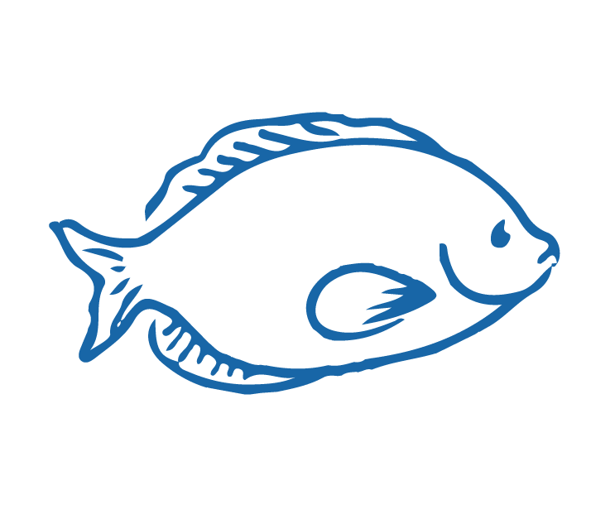
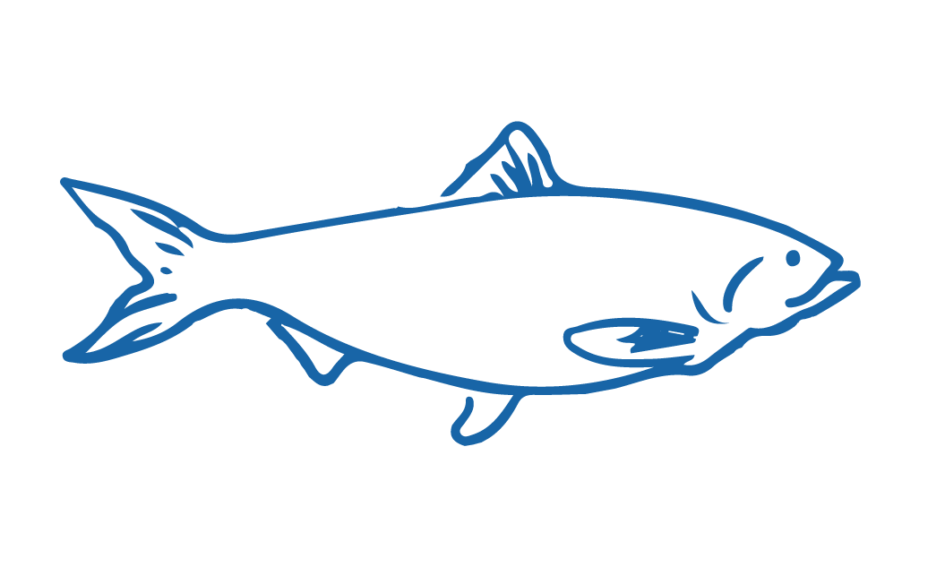
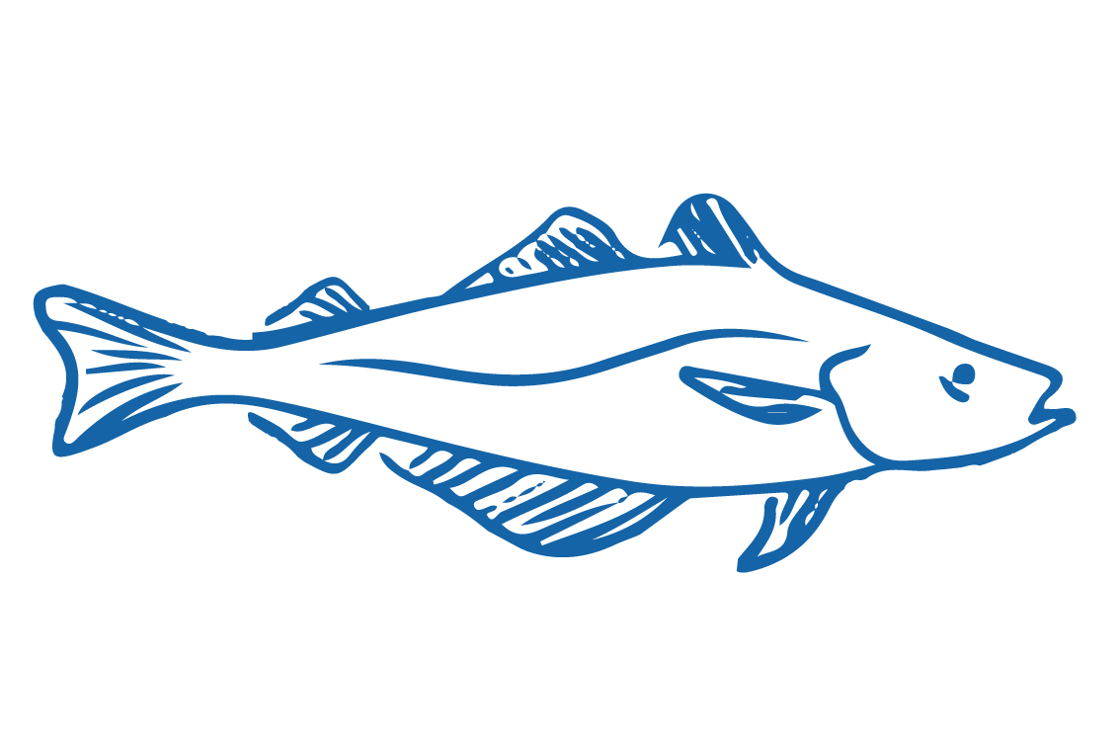
WHAT IS A FISH?
HE PĀTAI / CONSIDER THIS
Which of the following do fish NOT have?
Bony or cartilaginous (sharks and rays) skeletons
    Gills (instead of lungs)
    Gas filled swim bladders (buoyancy)
    Fins (steering, moving forward & back, stability)
    Sometimes colourful bodies (camouflage)
    Warm blooded bodies
    Body shape, mouth & eyes to suit habitat & lifestyle
Did you get the answer?
MAHI / ACTIVITY
Complete Fishy worksheet. Add any new knowledge to the Prior Knowledge Chart
Fish most often have cold blooded bodies
Notes:
TEACHER NOTES

Slide 16
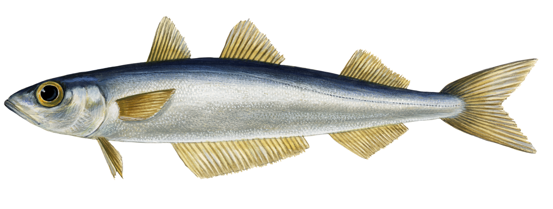
WHAT IS A FISH?
MAHI / ACTIVITY
Work in pairs to label this fish? Use information from the Fishy Worksheet
Check answers using the next slide
FINS OF A FISH
Notes:
TEACHER NOTES
The fish is a Southern Blue Whiting. These fish live between 200 and 600m depth where there is little light (but it is not completely dark). They are schooling fish living near the seabed and moving up the water column at night to feed on plankton and small fish.

Slide 17
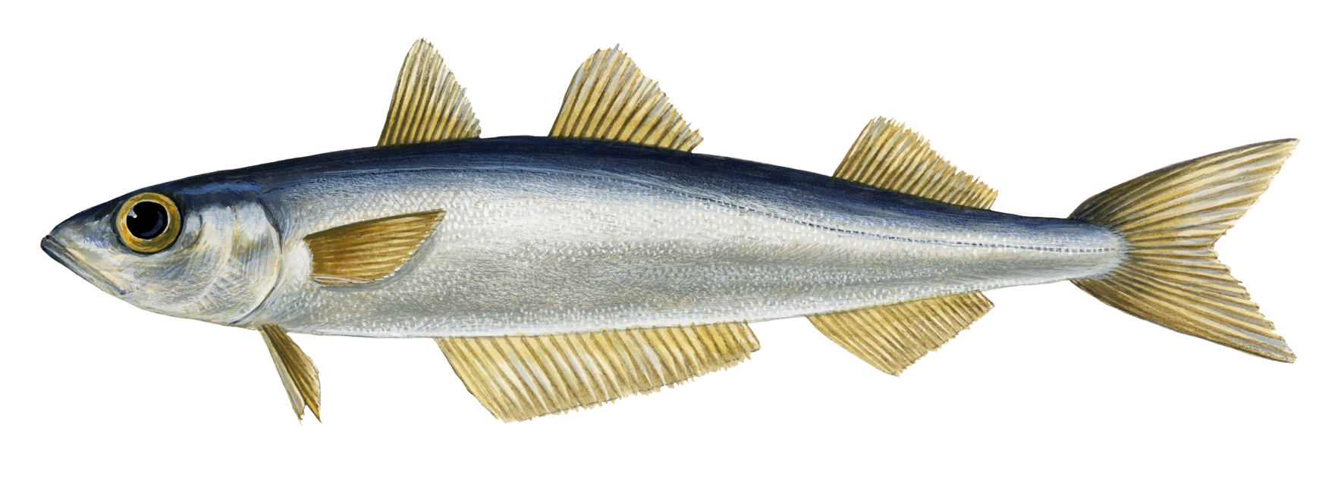
WHAT IS A FISH?
Lateral line
Dorsal fin(s)
HE PĀTAI / CONSIDER THIS
Can you also identify the eye, mouth & gill?
FINS OF A FISH
Learn more about fishy features by booking a virtual or real life visit with our partners, the education team at the National Aquarium of New Zealand
Caudal [tail] fin
Pelvic fin
Pectoral fin
Anal fin
Notes:
TEACHER NOTES
The fish is a Southern Blue Whiting. These fish live between 200 and 600m depth where there is little light (but it is not completely dark). They are schooling fish living near the seabed and moving up the water column at night to feed on plankton and small fish.

Slide 18
WHAT IS A FISH?
Lateral line
Dorsal fin(s)
Caudal [tail] fin
FINS OF A FISH
Pelvic fin
Pectoral fin
Anal fin
Notes:
TEACHER NOTES
The fish is a Southern Blue Whiting. These fish live between 200 and 600m depth where there is little light (but it is not completely dark). They are schooling fish living near the seabed and moving up the water column at night to feed on plankton and small fish.

Slide 19

WHAT IS A FISH?
FISH & THE SEA NEAR US PRIOR KNOWLEDGE CHART
What we know | What we would like to know | What we have learned
MAHI / ACTIVITY
Complete the prior knowledge chart
Complete Local fish fact sheet: Spotty and answer the questions provided
OR
Use the Local fish work sheet if you are targeting a different fish
Notes:
TEACHER NOTES
If you don’t have Spotties near you then use the 2.2 Local fish worksheet instead of the Spotty fact sheet. You might need to complete the first part of this worksheet with lower level learners. Higher level learners could research and complete themselves.

Slide 20
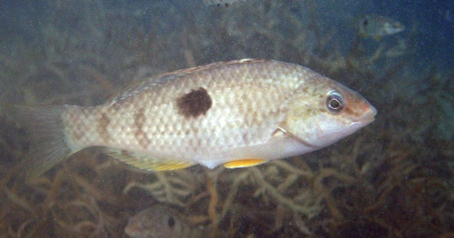
WHAT IS A FISH?
KŌRERORERO / DISCUSSION
Lets try and capture a fish! [See Field Trip & Worksheet]
Our target is a local fish – the small Spotted Wrasse called ‘Spotty’
This is what a Spotty looks like!
A ‘bait catcher’ fishing method gives us a good chance of capturing a Spotty!
Can’t get down to the wharf? A virtual bait catching field trip at the wharf with our partners, the education team at the National Aquarium of New Zealand is coming soon!
HE PĀTAI / CONSIDER THIS
While you are trying to catch your fish think about how this method would stand up to assessment for bycatch & impact on environment with Marine Stewardship Council
Notes:
TEACHER NOTES

Slide 21
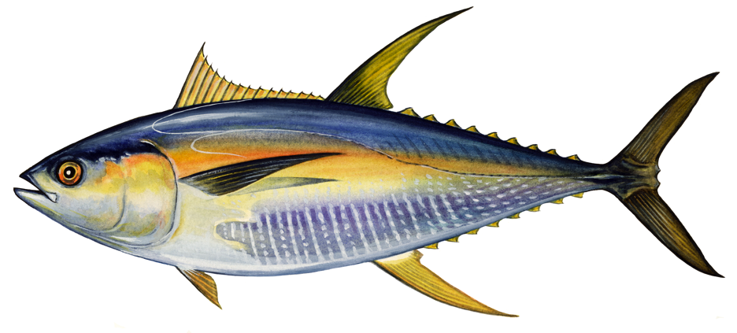
BODY SHAPES OF FISHES
Focusing Question: What patterns can we see in body shapes of fish from similar habitats?
KŌRERORERO / DISCUSSION
ADAPTATION is an evolutionary process [something that happens over time] where a creature becomes well suited to living in a certain place [habitat]
Fishes have adapted their bodies to suit where they live [habitat]
These adaptations give clues to where fish live
Adaptation 1: Eyes on either side of head are good for swimming above the seafloor
Adaptation 2: Torpedo shaped body & forked tail for fast swimming
Look at my shape. What can you guess about the habitat where I live? Why?
[Another clue is on the next slide]
Adaptation 3: Colours (dark on top and light underneath) help camouflage in open water
Notes:
TEACHER NOTES

Slide 22
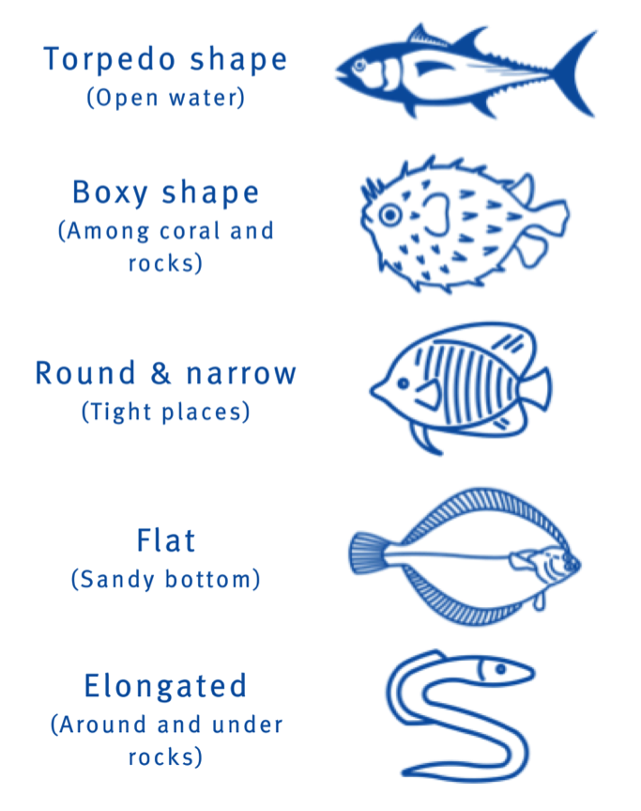

BODY SHAPES OF FISHES
KŌRERORERO / DISCUSSION
The body shape of a fish gives clues to where and how the fish lives
Using a scientific key like this one can help classify the body shape of a fish
MAHI / ACTIVITY
Use the key (see Scientific Keys Fish Adaptations) to see if your guess from the previous slide was correct?
Notes:
TEACHER NOTES
You can extend this activity by showing learners pictures of fish from any identification book. Ask learners to identify the shape of the fish and where the fish might live. Most identification books have some information about the habitat of the fish so you can check their answers.
Scientific Keys can be found as a supplementary file called Scientific Keys Fish Adaptations

Slide 23
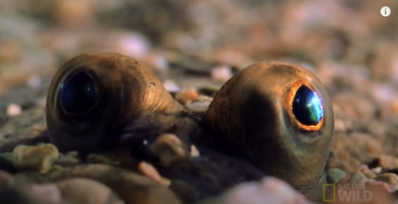
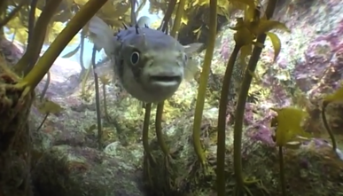
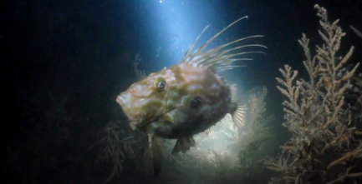
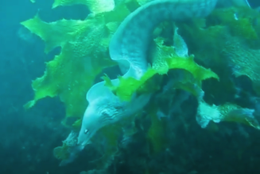
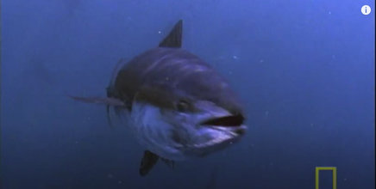
BODY SHAPES OF FISHES
MĀTAKI TĒNEI / WATCH THIS
Watch these short video clips…
Flounder [2:01] Pufferfish [0:56] John Dory [1:44] Moray eel [0:45] Bluefin Tuna [1:51]
MAHI / ACTIVITY
…and guess which fish has each of the following body shapes
1.Torpedo shape 2.Boxy shape 3.Round & narrow 4.Flat 5. Elongated
Notes:
TEACHER NOTES
This could be a good homework activity!
Blue fin tuna - https://www.youtube.com/watch?v=XzZhSl_00pI&t=36s
Pufferfish - https://www.youtube.com/watch?v=-ntITHjweTk
John Dory - https://www.youtube.com/watch?v=ISQY54cLfhg
Flounder - https://www.youtube.com/watch?v=EIMRSt40OMk
Moray eel - https://www.youtube.com/watch?v=nZRQMuxzIdk
Answers:
Torpedo shape – Bluefin tuna
Boxy shape – Puffer fish
Round and narrow – John Dory
Flat – Flounder
Elongated – Moray eel

Slide 24
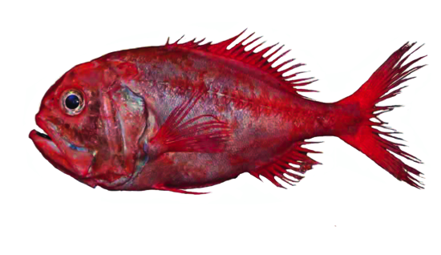

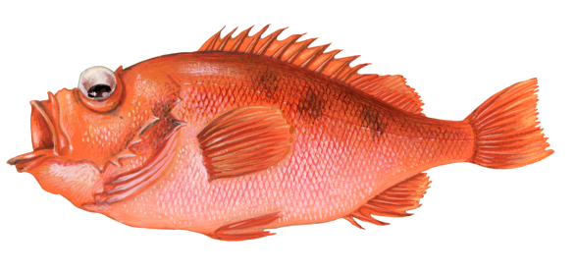
BODY SHAPES OF FISHES
MAHI / ACTIVITY
Use Scientific Keys Fish Adaptations to complete the following:
A. Look at the eyes of this fish. Use scientific key 2. What can you tell about where this fish lives?
B. Look at the mouth of this fish. Use scientific key 3. What can you tell about how it eats?
C. Look at the tail of this fish. Use scientific key 4. What can you tell about its swimming speed?
Notes:
TEACHER NOTES
Scientific Keys can be found as a supplementary file called Scientific Keys Fish Adaptations

Slide 25

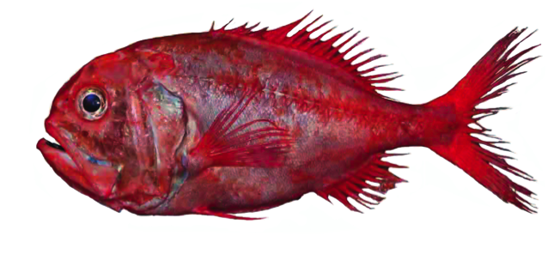
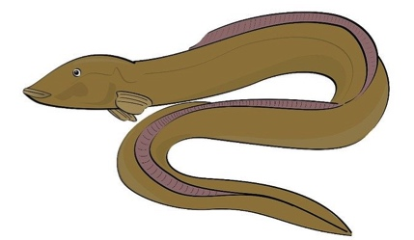
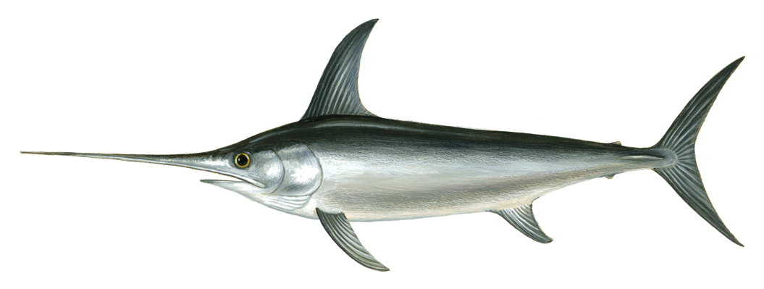
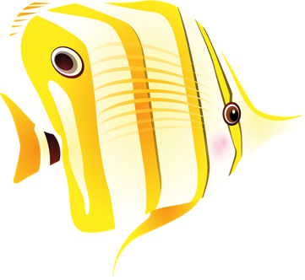
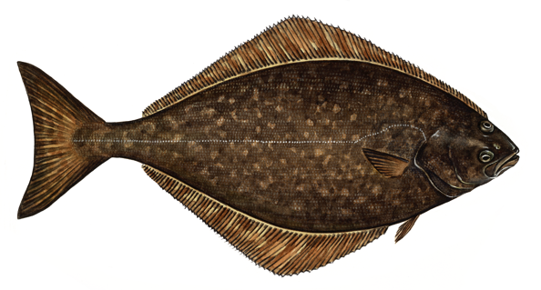
BODY SHAPES OF FISHES
MAHI / ACTIVITY
Use Scientific Keys Fish Adaptations for clues about how and where these fish live?
1
3
2
5
4
6
Notes:
TEACHER NOTES
1. Orange roughy – has eyes either side of it’s head so swims above the bottom. Has big eyes – suggesting low light environment. Lives in 400m – 1800m depth.
2. Eel – oceanic eels mostly hide in holes or rocky caves and crevices.
3. Tuna – forked tail indicates very fast swimmer. Body shape indicates open ocean swimming above the bottom.
4. Butterfly fish – tall and slim so can move amongst corals and rocks, pointy mouth helps it dig out prey from crevices
5. Swordfish – very fast swimmer (forked tail); lives above the bottom (eyes on either side of it’s head) in open water. Kills prey by stunning first with it’s sword!
6. Flounder or halibut – lives on the sandy seafloor (eyes on top of one side), mouth on underside so feeds on bottom.
Scientific Keys can be found as a supplementary file called Scientific Keys Fish Adaptations

Slide 26
BODY SHAPES OF FISHES
EXPERTS ONLY!
MAHI / ACTIVITY
Use books and websites to confirm your findings. Present back to the rest of the class.
1
3
2
5
4
6
Notes:
TEACHER NOTES
1. Orange roughy – has eyes either side of it’s head so swims above the bottom. Has big eyes – suggesting low light environment. Lives in 400m – 1800m depth.
2. Eel – oceanic eels mostly hide in holes or rocky caves and crevices.
3. Tuna – forked tail indicates very fast swimmer. Body shape indicates open ocean swimming above the bottom.
4. Butterfly fish – tall and slim so can move amongst corals and rocks, pointy mouth helps it dig out prey from crevices
5. Swordfish – very fast swimmer (forked tail); lives above the bottom (eyes on either side of it’s head) in open water. Kills prey by stunning first with it’s sword!
6. Flounder – lives on the sandy seafloor (eyes on top of one side), mouth on underside so feeds on bottom.
Scientific Keys can be found as a supplementary file called Scientific Keys Fish Adaptations

Slide 27
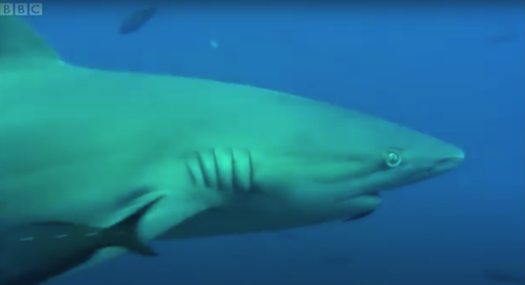
BODY SHAPES OF FISHES
MĀTAKI TĒNEI / WATCH THIS
Short BBC [3.39] footage of pelagic [open ocean] species
HE PĀTAI / CONSIDER THIS
What was one cool new thing you learnt?
What is it like in the open ocean? What might it be like in the open ocean
What changes [adaptations] have fish made to live in the open ocean? Make a list
How might deep oceans creatures benefit from pelagic feeding frenzies like this one?
Notes:
TEACHER NOTES
Fish bait ball in open water | Blue Planet | BBC can be found at https://www.youtube.com/watch?v=B6M_XgiONoo
HE PĀTAI / CONSIDER THIS
Anything they found interesting or new
Answers should include: light, open water with absense of sea floor (nowhere to hide), little pressure … the links below will give you more information
Forked tails, streamline bodies, strong swimmers, camouflage colourings (see excerpt below)
Food drifts down to deep ocean zomes
EXTENDING
Try exploring the following:
“Oceanic fish” (Te Ara) See: https://teara.govt.nz/en/oceanic-fish
“Open ocean” (Te Ara) See: https://teara.govt.nz/en/open-ocean
“Pelagic Ecology” (University of Hawaii) See: http://www.soest.hawaii.edu/oceanography/courses_html/OCN201/laboratory/Lab_Readings/Pelagic_Reading.pdf
The following excerpt may also be helpful “…pelagic habitat is ‘three-dimensional’—organisms must be able to move (and preferably see) in all directions. Second, there are no solid substrates to provide refuge. For these reasons, superior swimming ability is an important means of survival for many large fishes such as tuna, helping them to capture prey and avoid predators. Indeed, many pelagic fishes are migratory, covering vast distances of the open ocean in search of food. These types of fish are streamlined, with thick bodies and heavy musculature. Various forms of camouflage are common in pelagic organisms. Fishes in the epipelagic realm are generally countershaded, so their bodies show a color gradient from dark on the dorsal surface to light on the ventral surface. This type of coloration makes them difficult to see, both from above and below. Others are silvery, helping them to reflect sunlight near the surface, and blend in with the surrounding waters.” (University of Hawaii, 2011)

Slide 28
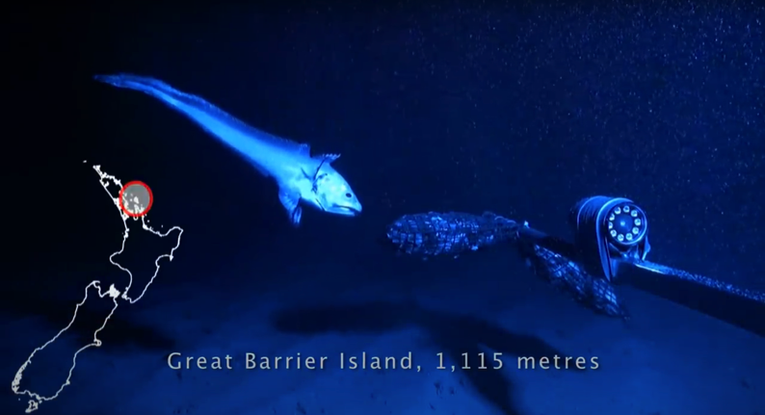
BODY SHAPES OF FISHES
MĀTAKI TĒNEI / WATCH THIS
Short Te Papa video clip of deep water species
HE PĀTAI / CONSIDER THIS
What was one cool thing you learnt?
What is it like in the deep ocean? What might it be like in the deep ocean
What changes [adaptations] have creatures made to their bodies to live in the deep ocean? Make a list
Notes:
TEACHER NOTES
The deep water species video is produced by Museum of New Zealand Te Papa Tongarewa and can be found at https://www.youtube.com/watch?v=x2X6H1llkb0
HE PĀTAI / CONSIDER THIS
Anything they found interesting or new
Answers should include: dark, high pressure, cold, no photosynthesis [below 200m] … the links below will give you more information
Large eyes, large mouths, luminous organs, long feelers or sensory tentacles..
EXTENDING
Try exploring the following:
“What conditions exist for life in the deep ocean?” (NOAA) See: https://oceanexplorer.noaa.gov/facts/deep-habitat.html
“Deep sea creatures” (Te Ara) See: https://teara.govt.nz/en/deep-sea-creatures
“Deep sea fish” (Britannica) See: https://www.britannica.com/animal/deep-sea-fish
MAHI / ACTIVITY
Investigate adaptations of deep water fish such as Viperfish or Anglerfish
Find ten cool facts and create a set of true false cards.
Share with the class.
Review and discuss. What did we learn? What do we want to know more about? How might we find out this information? Identify and discuss new words.
Viper fish: https://www.youtube.com/watch?v=gj5AXQ6v7tM
Angler fish: https://www.montereybayaquarium.org/animals/animals-a-to-z/deep-sea-anglerfish#:~:text=Instead%20of%20expending%20energy%20to,glows%20brightly%20in%20the%20dark.

Slide 29


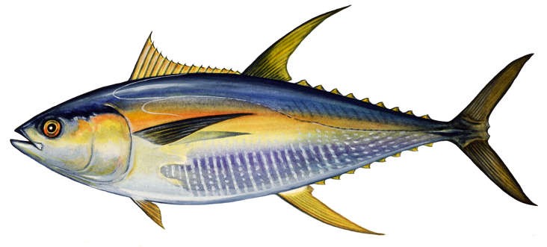
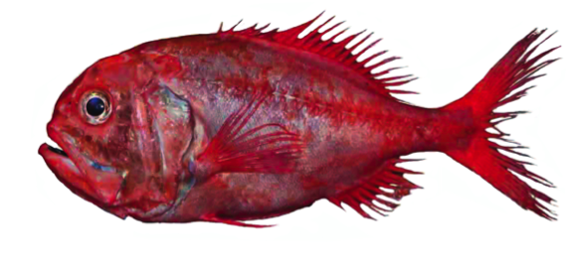
BODY SHAPES OF FISHES
MAHI / ACTIVITY
Each fish shown here lives in a different place or habitat within the ocean
Use 2.3 Scientific Keys Fish Adaptations to figure out which fish lives where?
Open ocean
Deep ocean
Rocky or coral reef
Sandy seafloor
Notes:
TEACHER NOTES
Orange roughy – has eyes either side of it’s head so swims above the bottom. Has big eyes – suggesting low light environment. Lives in 400m – 1800m depth.
Tuna – forked tail indicates very fast swimmer. Body shape indicates open ocean swimming above the bottom.
Butterfly fish – tall and slim so can move amongst corals and rocks, pointy mouth helps it dig out prey from crevices
Flounder or halibut – lives on the sandy seafloor (eyes on top of one side), mouth on underside so feeds on bottom.
Scientific Keys can be found as a supplementary file called Scientific Keys Fish Adaptations

Slide 30
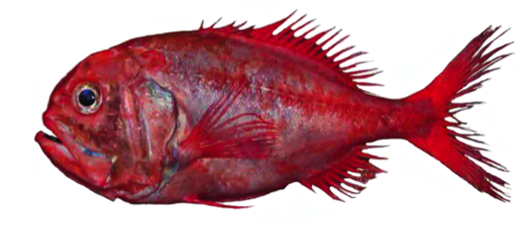
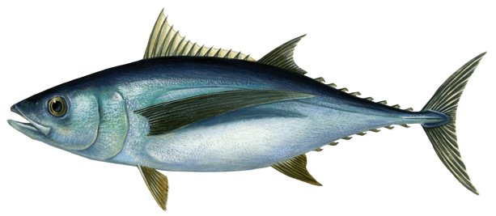
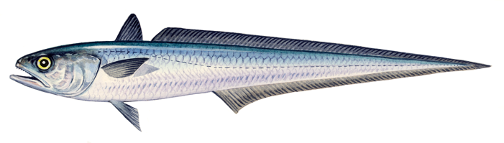

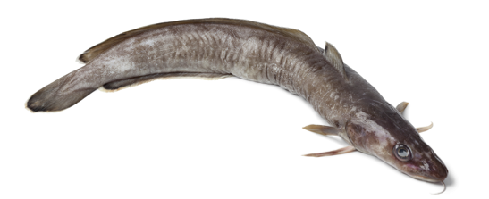

BODY SHAPES OF FISHES
MAHI / ACTIVITY
Select one of the fish pictures below. All are fished in Aotearoa New Zealand waters and are MSC certified. Observe your fish. What adaptations [eyes, mouth, body shape, fins etc] do you see? Think about how the fish moves, eats, protects itself. Draw your own picture of the fish and label the picture to show your observations.
3. Hoki
1. Orange Roughy
2. Albacore Tuna
4. Southern Blue Whiting
5. Ling
Notes:
TEACHER NOTES
1. Orange roughy – has eyes either side of it’s head so swims above the bottom. Has big eyes – suggesting low light environment. Lives in 400m – 1800m depth.
2. Eel – oceanic eels mostly hide in holes or rocky caves and crevices.
3. Tuna – forked tail indicates very fast swimmer. Body shape indicates open ocean swimming above the bottom.
4. Butterfly fish – tall and slim so can move amongst corals and rocks, pointy mouth helps it dig out prey from crevices
5. Swordfish – very fast swimmer (forked tail); lives above the bottom (eyes on either side of it’s head) in open water. Kills prey by stunning first with it’s sword!
6. Flounder or halibut – lives on the sandy seafloor (eyes on top of one side), mouth on underside so feeds on bottom.
Other Australian and Aotearoa New Zealand fishes certified by the MSC can be found at:https://www.msc.org/what-you-can-do/eat-sustainable-seafood/fish-to-eat
Scientific Keys can be found as a supplementary file called Scientific Keys Fish Adaptations

Slide 31



MARINE HABITAT
Focusing Question: How do marine habitats differ from one another?
KŌRERORERO / DISCUSSION
The Marine Stewardship Council has certified fisheries in many different habitats. A Habitat is:
A place where a group [community] of living things [organisms] live and breed
Different habitats have different characteristics: temperature, current, tide, seafloor [substrate], light
MARINE HABITAT – PRIOR KNOWLEDGE CHART
What we know | What we would like to know | What we have learned
MAHI / ACTIVITY
What do you know about marine habitats & the creatures that live there? Complete Marine Habitat Prior Knowledge Chart columns 1 & 2
Notes:
TEACHER NOTES

Slide 32

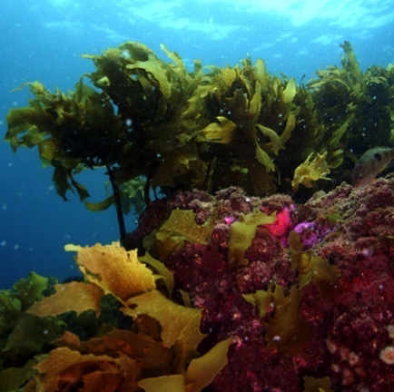
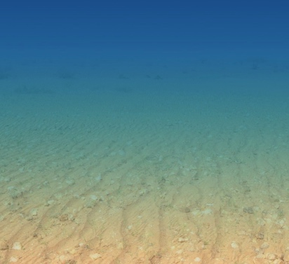
MARINE HABITAT
  Most Marine Stewardship Council certified fisheries are in open water and sandy bottom habitats!
KŌRERORERO / DISCUSSION
Habitats are really made by physical things such as light, depth, pressure, bottom type [substrate], temperature
These physical things then create an environment for a community of creatures, plants, algae to live
Main ocean habitat types are:
Open water (very large)
Soft sandy to muddy bottom (large)
Hard (rocky, coral) bottom (small area but has the most diversity / variety of life)
Notes:
TEACHER NOTES

Slide 33
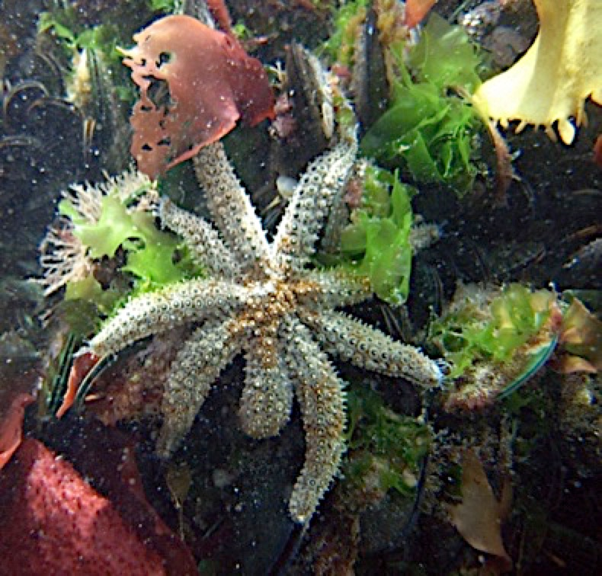

MARINE HABITAT
KŌRERORERO / DISCUSSION
Within each of the main habitat types there are many smaller habitats
Every habitat is home to many types of organisms [living things]
Fisheries certified by the Marine Stewardship Council have been assessed to ensure impacts on local habitats are minimised
HE PĀTAI / CONSIDER THIS
Look carefully! Is the starfish the only living thing in this tiny patch of rocky reef habitat?
Notes:
TEACHER NOTES
HE PĀTAI / CONSIDER THIS
Answer– No! There are several species of seaweed and green lipped mussels visible. Beneath this there will also be a myriad of smaller creatures – possibly sponges, anenomes, blennies etc

Slide 34
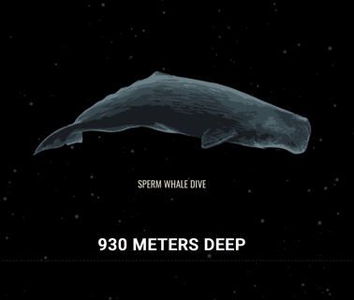
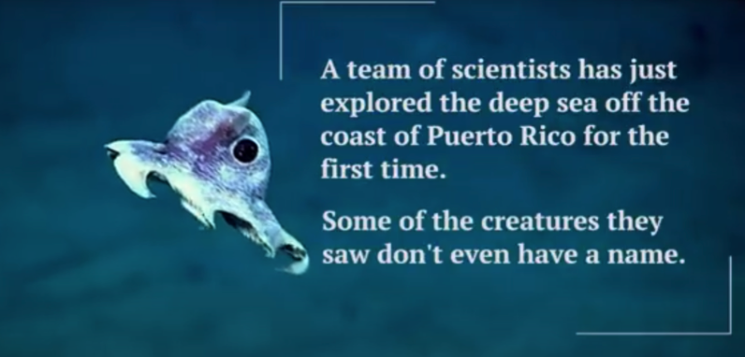
MARINE HABITAT
MĀTAKI TĒNEI / WATCH THIS
Visit our partner organisation The National Aquarium of New Zealand click on Deep Sea Exploration. Watch the film [1:30] and have a go at the activity!
MAHI / ACTIVITY
Just for fun! Check out The Deep Sea
by Neal Agarwal!
Play the true false card game and the matching game (see Habitat Cards or Teacher Outline)
Notes:
TEACHER NOTES
MĀTAKI TĒNEI / WATCH THIS
National Aquarium film clip on Deep Sea Exploration can be found at https://www.nationalaquarium.co.nz/learn/education-from-our-place-to-yours/
MAHI / ACTIVITY
The Deep Sea can be found at https://neal.fun/deep-sea

Slide 35
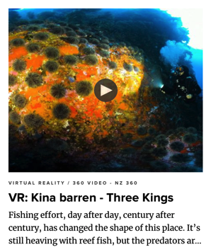
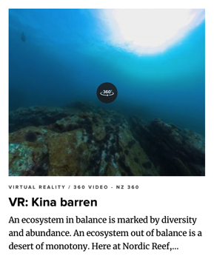
MARINE HABITAT
EXPERTS ONLY!
MĀTAKI TĒNEI / WATCH THIS
Watch the kina barren 360 VR videos and take on the task of being a virtual marine biologist. Record your observations from each virtual expedition!
KŌRERORERO / DISCUSSION
Scientists now believe that reduced numbers of fish (such as Tāmure or Snapper) is how kina [sea urchin] barrens are created
Tāmure / Snapper eat kina [sea urchins] who eat seaweed [kelp]
Less Tāmure / Snapper has resulted in more kina and less kelp
Notes:
TEACHER NOTES
This activity has been adapted with kind permission by BLAKE – The Sir Peter Blake Trust. You can check out more of what they do at blakenz.org
All videos available at: https://www.nzgeo.com/lessons-fishing/

Slide 36

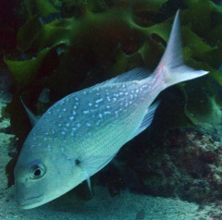
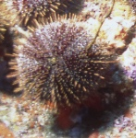
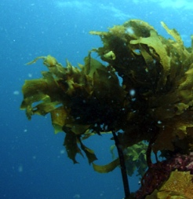
MARINE FOOD WEBS
Focusing Question: What is a food web and how can overfishing affect food webs?
KŌRERORERO / DISCUSSION
Many of the creatures that live together [community] in a habitat are connected in predator – prey relationships
In other words they eat each other!
These relationships can be shown simply as a food chain
Tāmure / Snapper
Kina / Sea urchin
Seaweed / Kelp
EATS
EATS
Notes:
TEACHER NOTES

Slide 37
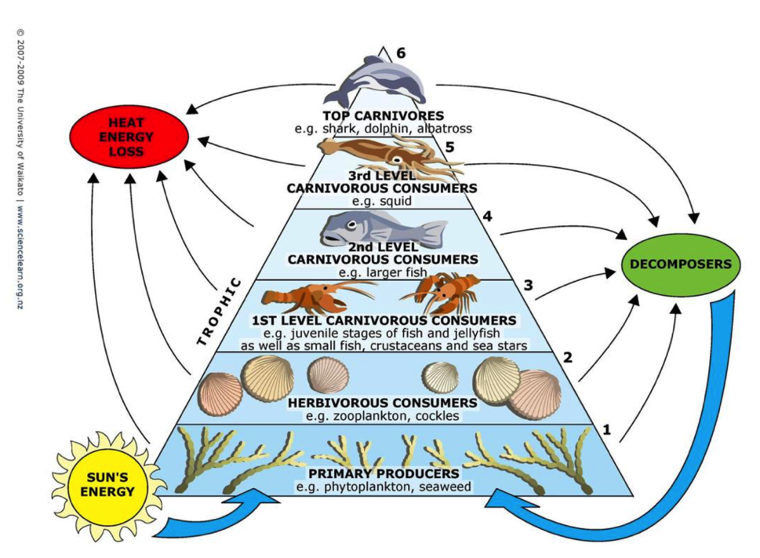
MARINE FOOD WEBS
KŌRERORERO / DISCUSSION
Food webs are a more realistic way of showing food chain relationships
In a food web, energy and nutrients [in the form of food] are passed from one living thing to another
MAHI / ACTIVITY
Use the Marine Stewardship Council NZ Marine Food Web Terms Quizlet to help with new words
MARINE TROPHIC PYRAMID
© Science Learning Hub – Pokapū Akoranga Pūtaiao, University of Waikato, www.sciencelearn.org.nz
Notes:
TEACHER NOTES
Quizlet cards are saved as Marine Stewardship Council NZ Marine Food Web Terms – see www.quizlet.com or follow this link: https://quizlet.com/_81dyjy?x=1jqt&i=2nkyj4

Slide 38
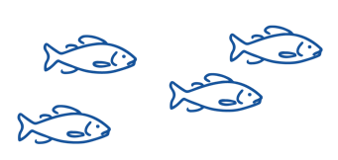
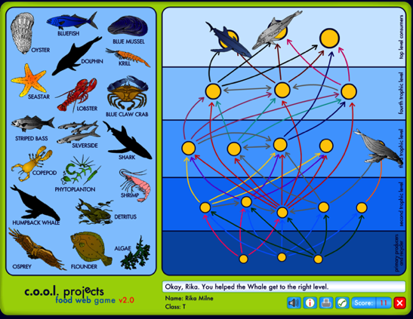
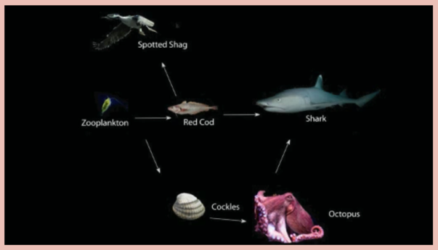
MARINE FOOD WEBS
MAHI / ACTIVITY
Play the String game NZ & Food web game
MAHI / ACTIVITY
Play the online food web game
MĀTAKI TĒNEI / WATCH THIS
A short video [2.06] explaining food webs
Notes:
TEACHER NOTES
MĀTAKI TĒNEI / WATCH THIS
https://www.sciencelearn.org.nz/videos/37-understanding-food-webs
We are part of the Foodweb as we eat fish. So we are at or near the top of the Foodweb. We rely on all the parts of the Foodweb that are below us or connected to us. If one aspect of the Foodweb ceases to function then the whole food web can collapse.
MAHI / ACTIVITY
http://coolclassroom.org/flash/food_web/

Slide 39



MARINE FOOD WEBS
HE PĀTAI / CONSIDER THIS
What happens when large numbers of one type of animal (or plant) are removed from a habitat?
MĀTAKI TĒNEI / WATCH THIS
Short film by Pew on the role that sharks play in ocean food webs [1:35]
Want to know more about food webs? Take a virtual food web and adaptation lesson with our partners, the education team at the National Aquarium of New Zealand
It can cause the entire nature of the community to change
Notes:
TEACHER NOTES
Shark film clip by Pew can be found at https://www.youtube.com/watch?v=yDqzGOa-adc

Slide 40
MARINE FOOD WEBS
EXPERTS ONLY!
MAHI / ACTIVITY
Select one of the fish pictures below. All are fished in Aotearoa New Zealand waters and are MSC certified. Research where the fish lives [habitat]. What does the fish eat and what eats it? Create a food chain or a food web for the fish. What impacts would overfishing have on the community and habitat of this fish?
3. Hoki
1. Orange Roughy
2. Albacore Tuna
4. Southern Blue Whiting
5. Ling
Notes:
TEACHER NOTES
1. Orange roughy – has eyes either side of it’s head so swims above the bottom. Has big eyes – suggesting low light environment. Lives in 400m – 1800m depth.
2. Eel – oceanic eels mostly hide in holes or rocky caves and crevices.
3. Tuna – forked tail indicates very fast swimmer. Body shape indicates open ocean swimming above the bottom.
4. Butterfly fish – tall and slim so can move amongst corals and rocks, pointy mouth helps it dig out prey from crevices
5. Swordfish – very fast swimmer (forked tail); lives above the bottom (eyes on either side of it’s head) in open water. Kills prey by stunning first with it’s sword!
6. Flounder or halibut – lives on the sandy seafloor (eyes on top of one side), mouth on underside so feeds on bottom.
Fish keys are provided as pdfs for printing.

Slide 41

REVIEWING KEY CONCEPTS
Focusing Question: What have we learnt?
MAHI / ACTIVITY
Complete Marine Ecology Summary Quiz Kahoot
Define it! Act it! Your teacher will give you a term. Write your own group definition. Then …. Act it out using mime. No words!. The rest of the class will try and guess your term!
Bony fishes
Habitat
Consumer
Primary producer
Predator
Food chain
Decomposer
Prey
Notes:
TEACHER NOTES
https://www.msc.org/docs/default-source/default-document-library/education-page/msc-lesson-plan-using-the-oceans-resources-responsibly.pdf?sfvrsn=5c15a87a_14

Slide 42

He kura kainga te moana, he kura huna te moana
The oceans environment,
is a source of untapped knowledge

