Slide 1
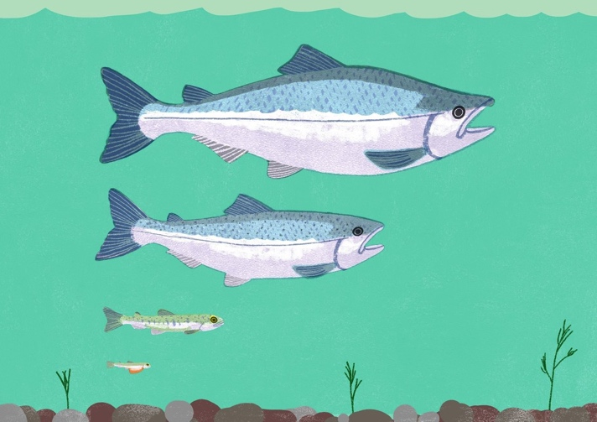
SCIENTISTS & THE MAXIMUM SUSTAINABLE YIELD
Focus Questions: What is ‘sustainable yield’? What role does science play in ensuring sustainable fishing?
KŌRERORERO / DISCUSSION
How a fish stock grows and shrinks over time is controlled by births, migrations in and out of the fishery, and deaths (including fish caught)
MAHI / ACTIVITY
Print and cut or copy the arrows and squares on the following slide
Arrange them on your desk to show factors affecting the size of a fish population
A completed diagram is provided on the slide after next
Notes:
TEACHER NOTES
How a fish stock grows and shrinks over time is controlled by births, migrations in and out of the fishery, and deaths.
This information can show how much fish can be caught without overfishing
This scientific calculation is called the maximum sustainable yield
Could also explain using a bath tub analogy: Tap of water is births and in-migration. Deaths and out migration is drain. Water level is population at any given moment.

Slide 2
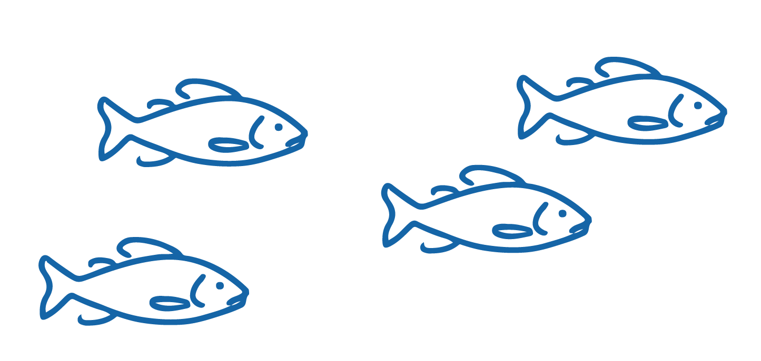
SCIENTISTS & THE MAXIMUM SUSTAINABLE YIELD
Create a diagram showing how fish stocks change in number (abundance) over time
Fish migrating out of the stock | Natural Mortality (Deaths) | Births | Fish migrating into the stock | Caught fish
Stock increases |  | Stock decreases
Notes:
TEACHER NOTES
How a fish population grows and shrinks over time is controlled by births, migrations in and out of the fishery, and deaths
This information can show how much fish can be caught without overfishing
This scientific calculation is called the maximum sustainable yield
Completed diagram is on next slide

Slide 3
SCIENTISTS & THE MAXIMUM SUSTAINABLE YIELD
Diagram showing how fish stock change in number (abundance) over time
Natural Mortality
(Deaths)
Births
Fish migrate out of stock
Fish migrate in to the stock
Caught fish
Notes:
TEACHER NOTES
How a fish stock grows and shrinks over time is controlled by births, migrations in and out of the fishery, and deaths
This information can show how much fish can be caught without overfishing
This scientific calculation is called the maximum sustainable yield

Slide 4
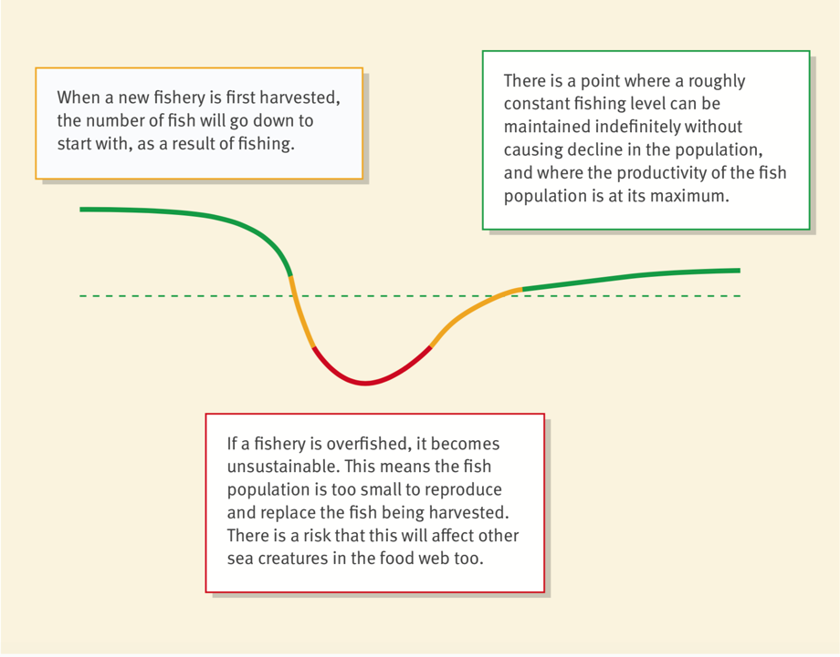
SCIENTISTS & THE MAXIMUM SUSTAINABLE YIELD
HE PĀTAI / CONSIDER THIS
1 ‘Maximum’ ‘Sustainable’ ‘Yield’ - What does each word mean?
2 Look at the diagram - what do the different colours on the line represent?
3 If this was a graph what could you label the x and y axes?
4 Where would the Maximum Sustainable Yield likely be located?
Source: MSC.ORG
Notes:
TEACHER NOTES
HE PĀTAI / CONSIDER THIS
1. Dotted line is indicative of maximum sustainable yield
Curved line shows stock of fish – high then low then increasing and leveling off
2. X axis could be time or fishing pressure over time similar; Y axis could be stock or catch
3. For the purpose of this exercise learners might identify the dotted line across the fishing curve Or a place along the green line near the end of the curve (to the right)

Slide 5
SCIENTISTS & THE MAXIMUM SUSTAINABLE YIELD
MAHI / ACTIVITY
Use the ‘Go Fish Vocab cards’
Then play the ‘Go Fish’ game
HE PĀTAI / CONSIDER THIS
What other ‘unknown’ factors could affect whether a sustainable yield remains a sustainable catch for a fishery over time?
(Possible answers on the next slide)
WHAT “UNKNOWN” FACTORS CAN AFFECT THE ONGOING SUSTAINABILITY OF A CATCH?
Notes:
TEACHER NOTES
Go Fish! Vocab cards are on the Scientists & MSY Teacher Outline.
Deepen your understanding:
NIWA (2002) Understanding ecosystems: a key to managing fisheries?
https://niwa.co.nz/publications/wa/vol10-no4-december-2002/understanding-ecosystems-a-key-to-managing-fisheries

Slide 6
SCIENTISTS & THE MAXIMUM SUSTAINABLE YIELD
Amount of food around
Poaching / Illegal fishing
Changes in the wider food web
Changes in chemistry of the ocean e.g. salinity
WHAT “UNKNOWN” FACTORS CAN AFFECT THE ONGOING SUSTAINABILITY OF A CATCH?
Changing numbers of
predators
Changing sea temperatures and currents
Natural events!
(earthquakes, tsunami etc)
Climate
Notes:
TEACHER NOTES
Deepening the inquiry
Categorise these factors as good, bad and neutral.
Look at what causes each of these factors?
Are the causes natural or human induced?
Who is responsible for each factor?
How are these factors changing over time?
How are the factors connected to one another?
Deepen your understanding:
NIWA (2002) Understanding ecosystems: a key to managing fisheries?
https://niwa.co.nz/publications/wa/vol10-no4-december-2002/understanding-ecosystems-a-key-to-managing-fisheries

Slide 7
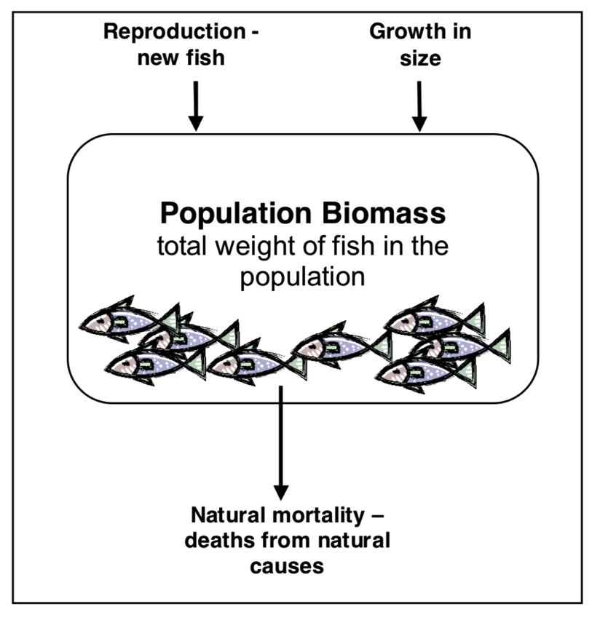
SCIENTISTS & THE MAXIMUM SUSTAINABLE YIELD
Experts ONLY!
KŌRERORERO / DISCUSSION
For the Marine Stewardship Council two key factors need to be balanced in order for fishing to be sustainable:
The weight, or biomass (B)
The fishing pressure (F)
In fisheries the term biomass refers to the total weight of fish in a stock of fish
This diagram shows factors determining the biomass of an ‘unfished’ stock of fish
Source: Ministry of Fisheries 2006
Notes:
TEACHER NOTES
To read more about the MSC approach as outlined here see URL: http://blog.msc.org/blog/2016/05/25/sustainable-fishing-really-mean/

Slide 8
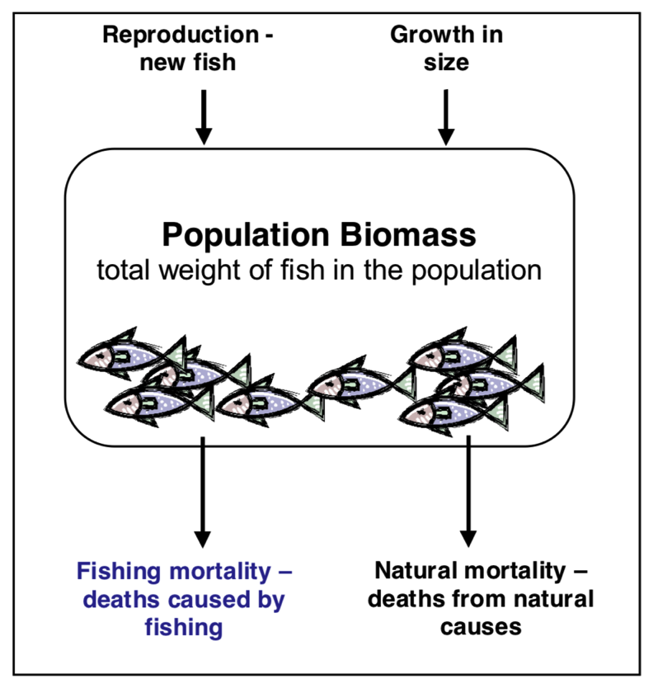
SCIENTISTS & THE MAXIMUM SUSTAINABLE YIELD
Experts ONLY!
KŌRERORERO / DISCUSSION
This diagram shows factors determining the biomass of a ‘fished’ stock of fish
HE PĀTAI / CONSIDER THIS
Which factor do people (fishers & fishery managers) have control over?
Source: Ministry of Fisheries 2006
Notes:
TEACHER NOTES
To read more about the MSC approach as outlined here see URL: http://blog.msc.org/blog/2016/05/25/sustainable-fishing-really-mean/

Slide 9
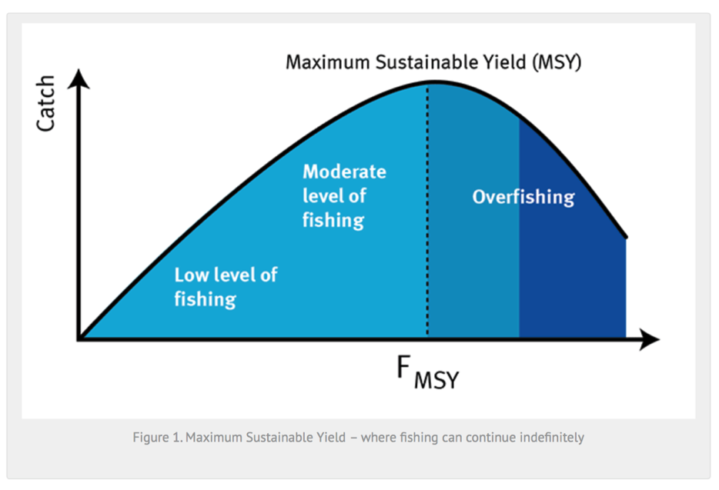
SCIENTISTS & THE MAXIMUM SUSTAINABLE YIELD
Experts ONLY!
KŌRERORERO / DISCUSSION
Fishing pressure (F) is the amount of effort (boats, nets, hooks) that is going in to fishing
The maximum catch that can be harvested sustainably is called the Maximum Sustainable Yield (MSY)
Fishing more than this, leads to smaller catches and declining stocks
Source: MSC.ORG
Notes:
TEACHER NOTES
To read more about the MSC approach as outlined here see URL: http://blog.msc.org/blog/2016/05/25/sustainable-fishing-really-mean/

Slide 10
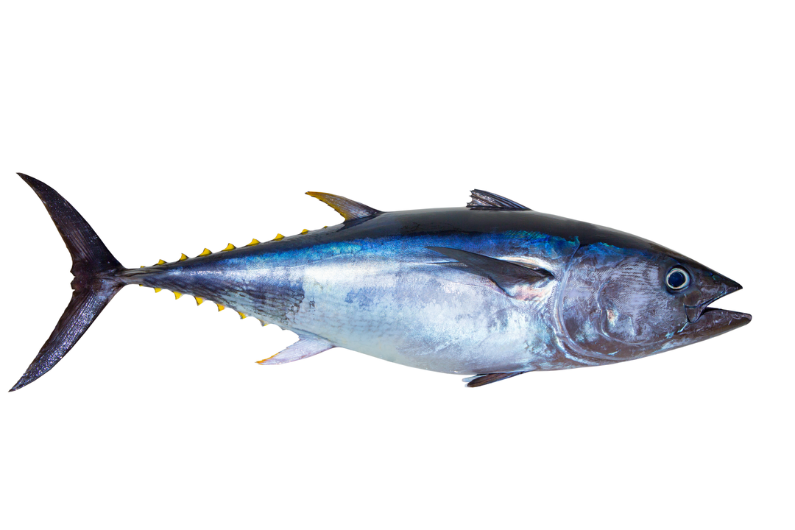
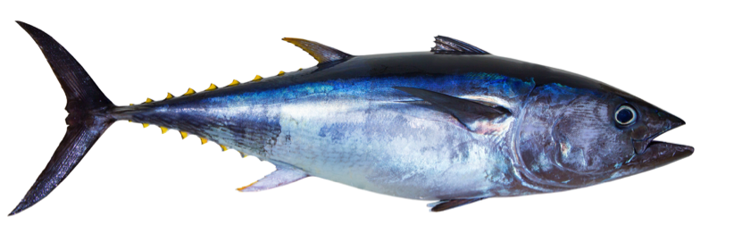
SCIENTISTS & THE MAXIMUM SUSTAINABLE YIELD
KŌRERORERO / DISCUSSION
In fishing, size does matter!
HE PĀTAI / CONSIDER THIS
What do you think might happen if there aren’t enough big adult fish?
If there aren’t enough large, mature fish (the ‘spawners’) then reproduction slows and fish stocks decline
Not enough large mature fish results in less young healthy fish to add to the stock
Albacore Tuna
Notes:
TEACHER NOTES
To read more about the MSC approach see URL: http://blog.msc.org/blog/2016/05/25/sustainable-fishing-really-mean/

Slide 11
SCIENTISTS & THE MAXIMUM SUSTAINABLE YIELD
WHAT DOES A FISHERY SCIENTIST RESEARCH? PRIOR KNOWLEDGE CHART
What we know | What we would like to know | What we have learned
HE PĀTAI / CONSIDER THIS
What do fishery scientists research to help ensure fisheries are sustainable?
MAHI / ACTIVITY
Complete the prior knowledge chart
Look at a scientific paper written about fisheries in Aotearoa New Zealand.
Be ready to discuss the topic of the paper
Notes:
TEACHER NOTES
Possible answers could include:
Size of fish
Biology of fish
Weight of fish [biomass]
Number of fish [abundance]
Maturity of fish
Reproduction
Role of currents, climate, water temperature…
Food webs
Predators and prey
Either
With a partner pick one topic from the list. Search the internet to find a scientific study on this topic. Share the topic of your paper with the wider group.
OR
If it is too hard to go searching then print out a selection of fishery related scientific papers and have learners work in group, hand out one paper per group and figure out what their paper is about. Discuss the meaning of words such as methodology, results, conclusions, findings etc
Try using Google Scholar [scholar.google.com] for the science paper search.

