Slide 1
ASSESSING FISH STOCKS IN AOTEAROA
KŌRERORERO / DISCUSSION
Scientists get an idea of how many fish there are (abundance) because we know that:
When there are more fish in an area, it's usually easier to catch the same amount of fish from one year to the next
When there are fewer fish, fishers need to work harder to catch the same amount of fish
HE PĀTAI / CONSIDER THIS
But what happens if fishers start using new & better technology? How might this affect things?
Scientists might get a false sense of how many fish there are!
Notes:
TEACHER NOTES

Slide 2
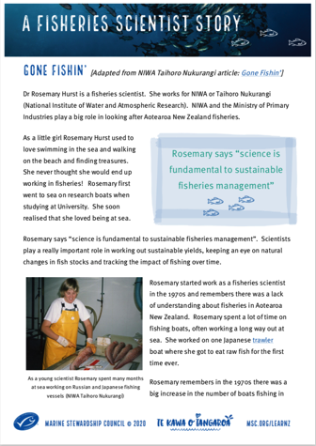
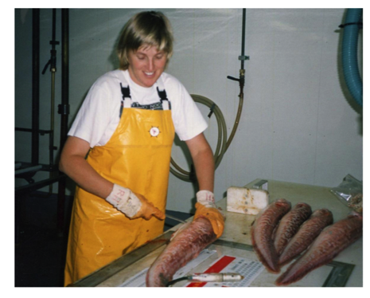
ASSESSING FISH STOCKS IN AOTEAROA
KŌRERORERO / DISCUSSION
Scientists also gather information about the length and age of fish
Some information comes from Fisheries New Zealand observers, like Holly, on board fishing vessels
If scientists know catch rates, size and age of fish being caught they can figure out if catch levels are sustainable
MAHI / ACTIVITY
Read about Dr Rosemary Hurst
‘A Fisheries Scientist Story’
Notes:
TEACHER NOTES
A Fisheries Scientist Story is a great summary of many of the themes covered in this topic and illustrates well the role of science and scientists in helping us determine sustainable catch rates
There are questions (multi choice, true and false, sentence answers and extra for quick finishers) at the end of the reading
EXTEND LEARNING
KŌRERO PUKAPUKA / READ
In groups explore one of the following. Report back three things you learnt:
How we determine the age of fish
2019 status of NZ fisheries
Read the cool information about how we determine the age of fish
URL: https://niwa.co.nz/fisheries/research-projects/determining-the-age-of-fish
Review the current status of Aotearoa commercial fisheries (2019)
URL: https://www.fisheries.govt.nz/dmsdocument/11950-the-status-of-new-zealands-fisheries-2019
EXTENDING:
Another good read is the fishery stock assessment information page from NIWA
URL: https://niwa.co.nz/fisheries/our-services/stock-assessments

