Slide 1
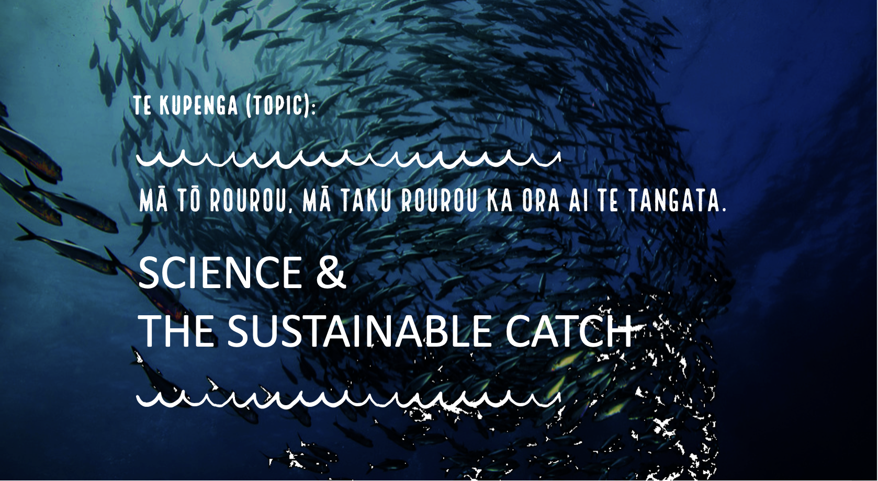
Insert heading page Topic 3

Slide 2






Slide 3

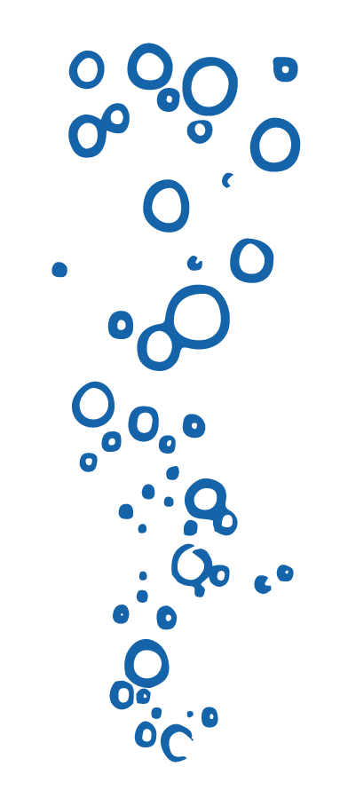
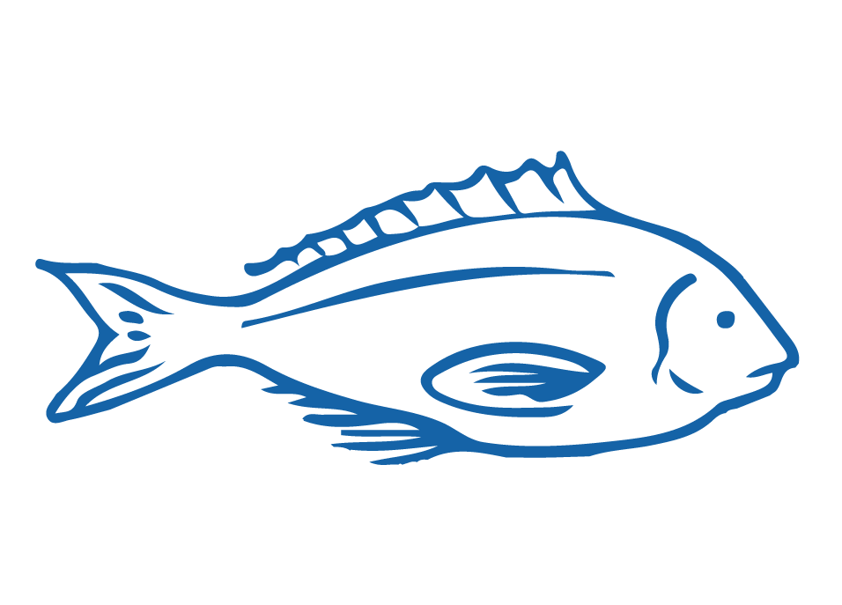


HELPFUL STUFF FOR TEACHERS
Target age range:
10–15 years
Welcome to OUR STORY!
This topic tells the story of sustainable fish stocks, catch limits and the role of science
Curriculum relevance: Science; Social Science; Tikanga-ā-iwi; Pūtaiao; Hauora
See Topic Planner for detail on curriculum links, learning outcomes and summary of activities
See also teacher notes below slides
Each subtopic has a Teacher Outline
Slides with trickier content are labelled expert [top right corner]
Notes:
TEACHER NOTES

Slide 4
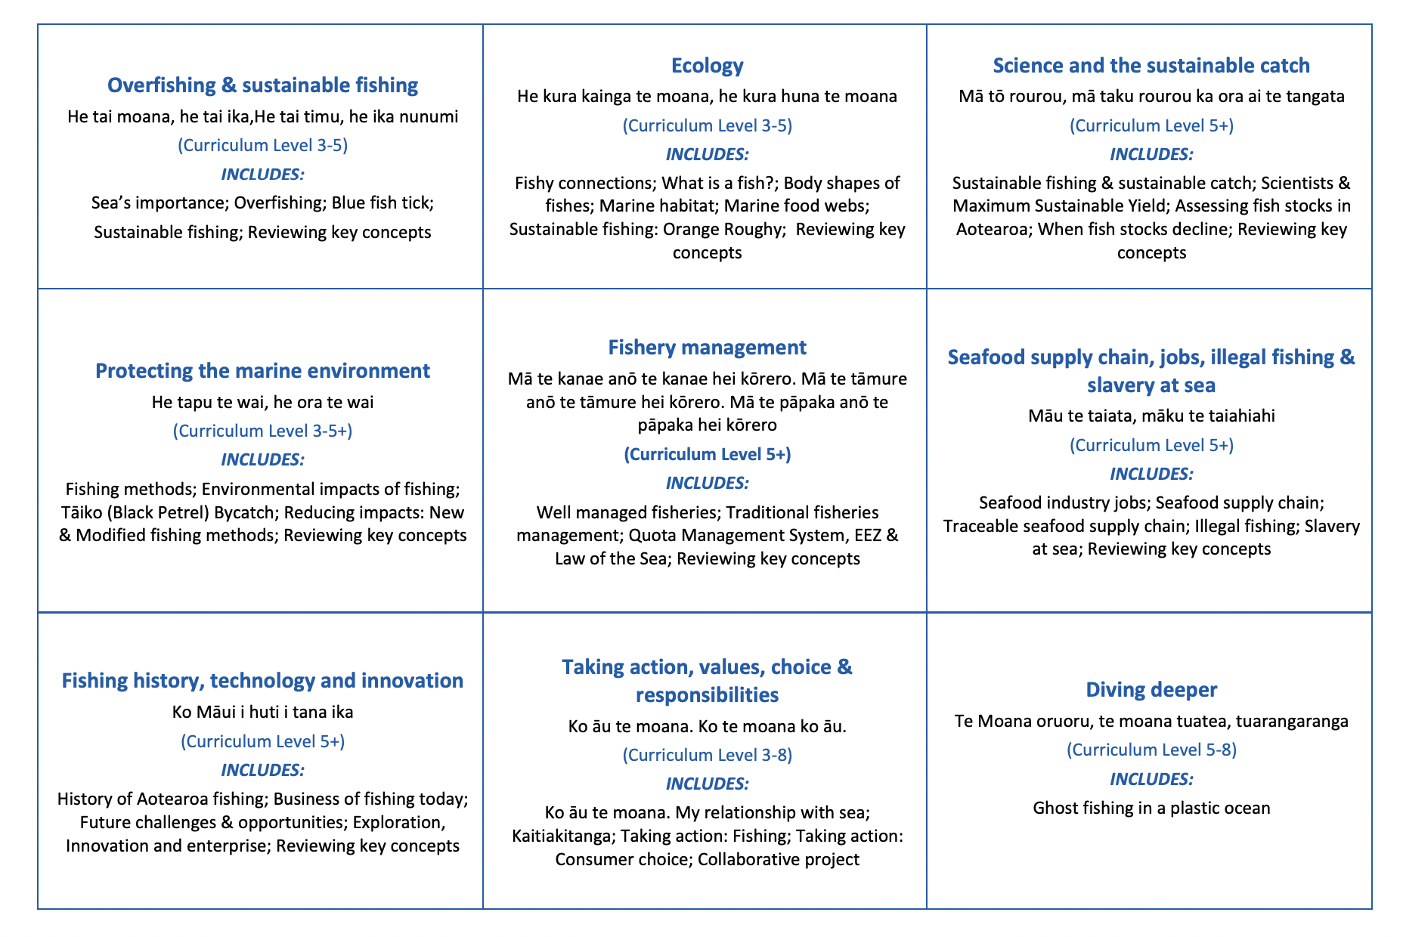

HELPFUL STUFF FOR TEACHERS
Welcome to the third topic in OUR STORY!

Slide 5
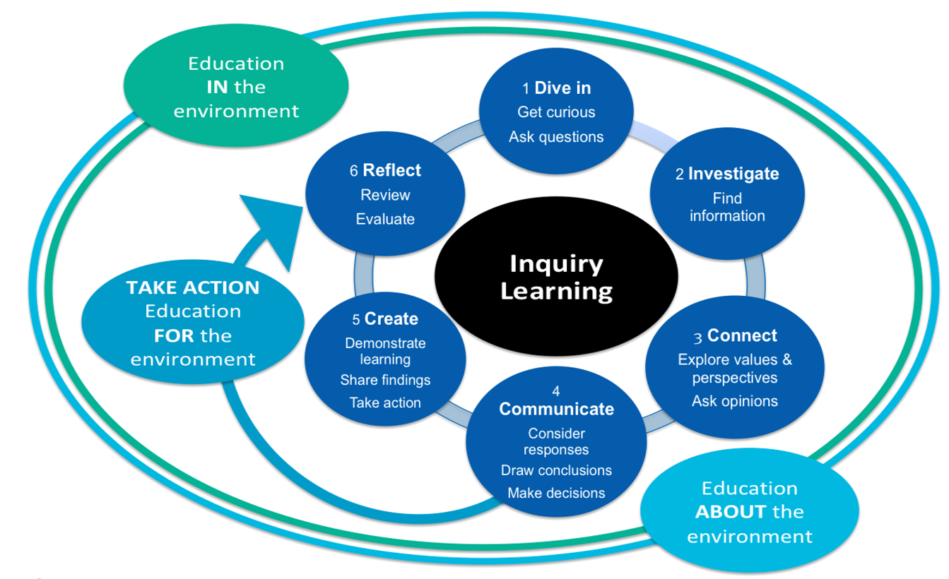
HELPFUL STUFF FOR TEACHERS
Notes:
TEACHER NOTES

Slide 6
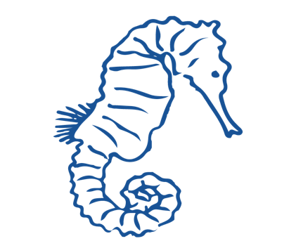

IN THIS TOPIC WE WILL LEARN ABOUT…
Sustainable fishing and ‘sustainable catch?
Maximum Sustainable Yield
How we assess fisheries in Aotearoa New Zealand
The role of science in ensuring fishing is sustainable
Impacts on people & environments when fish stocks decline
Special words and concepts used in science & fishery management

Slide 7

MIHI / INTRODUCTION
Can you imagine a world without fish?
What would that be like?
No more sushi! No more fishing!
No more fish & chips! No more….?
Notes:
TEACHER NOTES
Try to get learners to connect with the personal impact of overfishing and unsustainable practices. What would it be like for ME if there were few or no fish left in the sea!

Slide 8
MIHI / INTRODUCTION
The good news is… some special people are working hard to make sure this doesn’t happen!
In this topic look more closely at what is a ‘sustainable catch’ and the role of scientists in ensuring we don’t catch too many fish
Let’s take a moment to think about what we know already about sustainable fishing

Slide 9

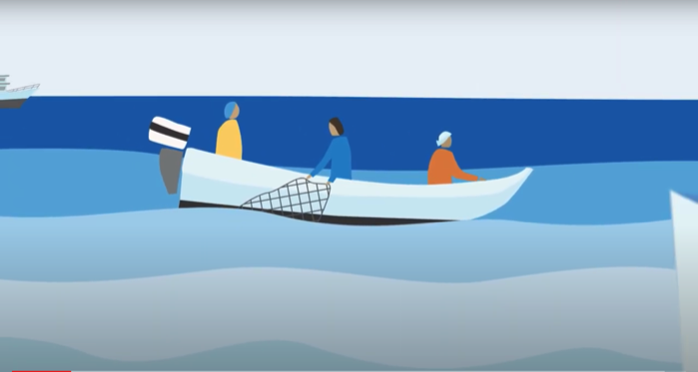
SUSTAINABLE FISHING & SUSTAINABLE CATCH
Focus Question: What is sustainable fishing and what do we mean by a ‘sustainable catch?
MĀTAKI TĒNEI / WATCH THIS
Watch this short film [1:29] What is the MSC and why is certified sustainable seafood important?
HE PĀTAI / CONSIDER THIS
Why do you think it might be important to know where your kai moana [fish and shellfish that you eat] comes from?
MAHI / ACTIVITY
Add new learning to your prior knowledge chart (previous slide)
Notes:
TEACHER NOTES
URL for film clip: https://www.youtube.com/watch?v=3rVeSBdpO6Q

Slide 10

SUSTAINABLE FISHING & SUSTAINABLE CATCH
SUSTAINABLE FISHING PRIOR KNOWLEDGE CHART
What we know | What we would like to know | What we have learned
HE PĀTAI / CONSIDER THIS
What do we already know about sustainable fishing?
MAHI / ACTIVITY
Complete the Prior Knowledge Chart columns 1 & 2
Notes:
TEACHER NOTES
For more information see the Overfishing and Sustainable fishing topic :]
Start to define the difference between the concept of sustainable fishing (includes care for the ecosystem) and sustainable catch (the number of fish caught)

Slide 11

SUSTAINABLE FISHING & SUSTAINABLE CATCH
KŌRERORERO / DISCUSSION
In Aotearoa New Zealand, Māori were the first fishers – they depended largely on fish and shellfish for protein
In recent years, fish and fishing has grown in importance for many New Zealanders
  Sustainable fishing means looking after the environment where fish live and not overfishing
  A sustainable catch means catching an amount of fish that can carry on forever
HE PĀTAI / CONSIDER THIS
Do you catch fish - what type of fish do you catch?
If you eat fish - what type of fish do you eat?
Where does the fish that you eat come from?
What do you do to help ensure the fish that you eat and / or catch are caught sustainably?
What do you think : Is sustainable fishing important? Why / Why not?
Notes:
TEACHER NOTES
Invite a kaumātua or grandparent to visit and get them to talk about how fishing has changed over time and what measures have been used locally over time to ensure sustainable fishing.
Homework activity – learners interview a member of their whānau, family or community about their fishing practices (can adapt questions from this slide)
Learners share their own fishing stories or those from family, whānau or community to share
Start to define the difference between the concept of sustainable fishing (includes care for the ecosystem) and sustainable catch (the number of fish caught)

Slide 12
SUSTAINABLE FISHING & SUSTAINABLE CATCH
HE PĀTAI / CONSIDER THIS
What did you learn?
What are the Marine Stewardship Councils three principles used to assess sustainability?
A sustainable catch is one that can carry on ________________.
[Click again to reveal answers]
  The three principles are:
  Principle 1: Sustainability of the stock
  Principle 2: Environmental impacts
  Principle 3: Effective management
In this topic we focus on the idea of a sustainable catch which is the basis of MSC Principle 1 (Principles 2 and 3 are the focus of other topics)
  A sustainable catch is one that can carry on Indefinitely (aka forever)!
Notes:
TEACHER NOTES

Slide 13
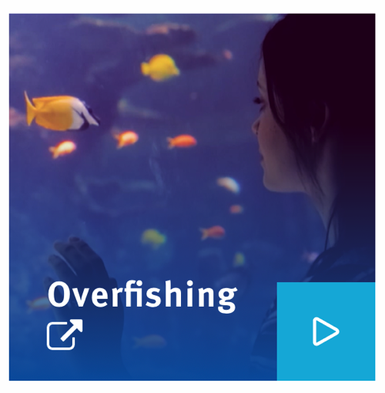

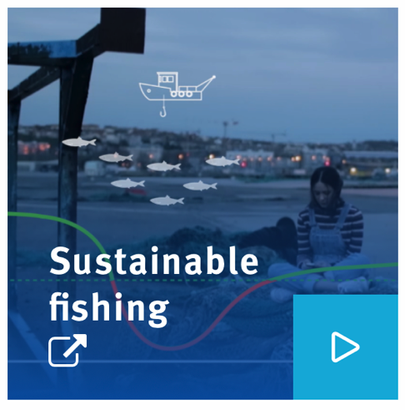
SUSTAINABLE FISHING & SUSTAINABLE CATCH
MĀTAKI TĒNEI / WATCH THIS
Watch these two film clips ‘Overfishing’ [2:55] and ‘Sustainable Fishing’ [2:55]
MAHI / ACTIVITY
What did you learn? Check your understanding of sustainable fishing using Sustainable Fishing Concept Cards and/ or play Kahoot
Add new learning to the prior knowledge chart
Notes:
TEACHER NOTES
Film clips are cut sections from My Dad the Fisherman and can be found at: https://www.youtube.com/watch?v=OIsA8xQ7WbQ
NOTE. These film clips can take a long time to download (up to 30 minutes) so best to download prior to class!
MAHI / ACTIVITY
Estimated time to complete is 20+ minutes
Use concept cards or the Kahoot quiz to reinforce key learning
See Sustainable Fishing Concept Cards for extension activities
HOW TO PLAY KAHOOT
Connect a device to a projector or screen in front of the classroom.
Navigate to the game called Marine Stewardship Council NZ Sustainable Fishing Concepts via the Kahoot page https://www.msc.org/en-au/for-teachers/ocean-literacy/new-zealand-education-curriculum/kahoot-quizzes
Select settings
At Kahoot.it, learners enter game-pin and nickname on their own devices (phone, tablet, or computer).
Press “Start now”. The fun begins!
Learners answer questions on their own devices by selecting one of the four answer buttons.
See additional instructions, options, and how to make your own Kahoot at: https://kahoot.com

Slide 14

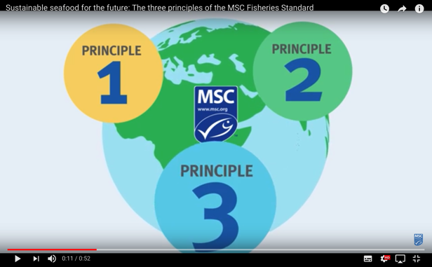
SUSTAINABLE FISHING & SUSTAINABLE CATCH
KŌRERORERO / DISCUSSION
Fisheries found to be sustainable can be sold with the Marine Stewardship Council blue fish tick label
Fisheries must meet three principles to be considered sustainable
MĀTAKI TĒNEI / WATCH THIS
Short film [0:52] outlining the three principles of Marine Stewardship Council’s Fisheries Standard
Be ready to answer a couple of questions!
(next slide)
Notes:
TEACHER NOTES
Film clip URL is: https://www.youtube.com/watch?time_continue=1&v=qEE3iUIbm7U&feature=emb_logo

Slide 15
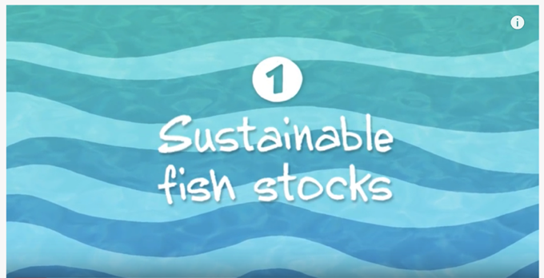
SUSTAINABLE FISHING & SUSTAINABLE CATCH
MAHI / ACTIVITY
Complete Sustainable fish stocks worksheet
Watch the video a second time and think:
What information helps the Marine Stewardship Council tell if a fish stock is sustainable?
Brainstorm answers
Complete the chart on the following slide
MĀTAKI TĒNEI / WATCH THIS
Short video [2:34] on Sustainable fish stocks (Principle One)
Notes:
TEACHER NOTES
Film URL: https://www.youtube.com/watch?v=EhosdSmvWrI
MAHI / ACTIVITY
Answers on slide after next

Slide 16

SUSTAINABLE FISHING & SUSTAINABLE CATCH
MAHI / ACTIVITY: Brainstorm…
  Answers on the next slide
…WHAT INFORMATION HELPS THE MSC TELL IF A FISH STOCK IS SUSTAINABLE?
Notes:
TEACHER NOTES
Answers on next slide :]

Slide 17
SUSTAINABLE FISHING & SUSTAINABLE CATCH
MAHI / ACTIVITY: Brainstorm…
Catch samples showing data
on the maturity of the fish
(Age, Gender, Quantity)
Knowing what fish stock a fish has come from
……WHAT INFORMATION HELPS THE MSC TELL IF A FISH STOCK IS SUSTAINABLE?
Knowing the size of the fish stock
Scientists calculations
on the health of the
fish stocks
Data showing changes
in fish stock size
(natural or human induced)
Knowing how fishers
will respond to
declines in catches / fish stocks
Notes:
TEACHER NOTES

Slide 18
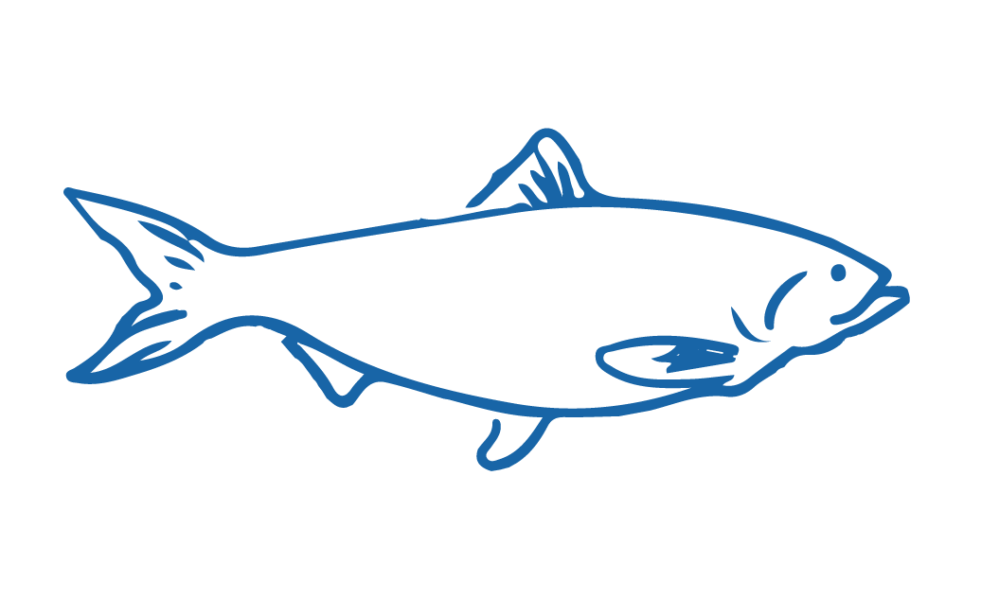
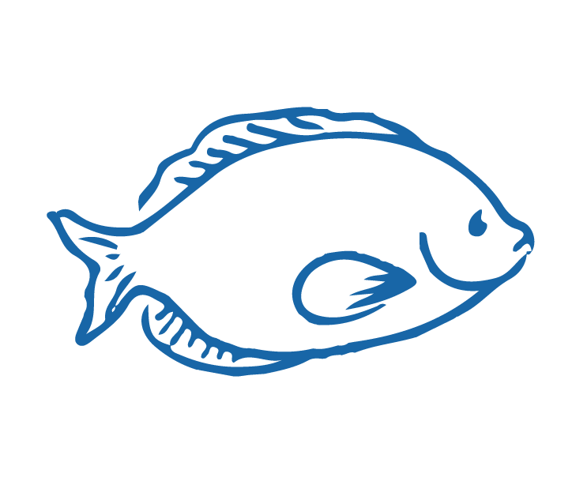
SUSTAINABLE FISHING & SUSTAINABLE CATCH
HE PĀTAI / CONSIDER THIS
So sustainable fishing means making sure fish stocks do not drop below levels where they cannot _____________ and grow faster than they are caught
Fishers need to know as much as they can about the fish and shellfish they catch, and the _________________ they live in
Fisheries work with ____________ to understand how the fish and shellfish stock grows and shrinks over time
Put a word in each gap to complete the sentences
reproduce
Ready for some possible answers?
ecosystems
scientists
Notes:
TEACHER NOTES

Slide 19
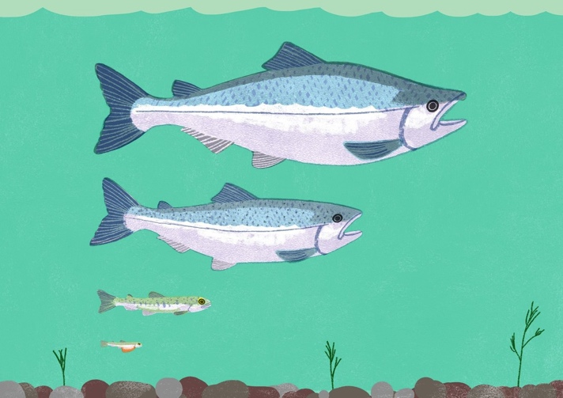
SCIENTISTS & THE MAXIMUM SUSTAINABLE YIELD
Focus Questions: What is ‘sustainable yield’? What role does science play in ensuring sustainable fishing?
KŌRERORERO / DISCUSSION
How a fish stock grows and shrinks over time is controlled by births, migrations in and out of the fishery, and deaths (including fish caught)
MAHI / ACTIVITY
Print and cut or copy the arrows and squares on the following slide
Arrange them on your desk to show factors affecting the size of a fish population
A completed diagram is provided on the slide after next
Notes:
TEACHER NOTES
How a fish stock grows and shrinks over time is controlled by births, migrations in and out of the fishery, and deaths.
This information can show how much fish can be caught without overfishing
This scientific calculation is called the maximum sustainable yield
Could also explain using a bath tub analogy: Tap of water is births and in-migration. Deaths and out migration is drain. Water level is population at any given moment.

Slide 20
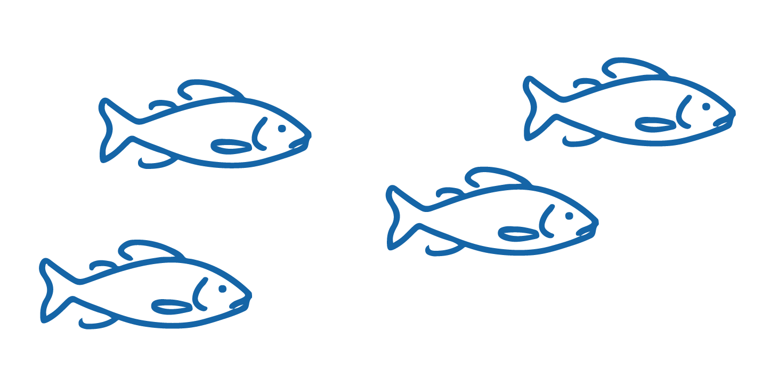
SCIENTISTS & THE MAXIMUM SUSTAINABLE YIELD
Create a diagram showing how fish stocks change in number (abundance) over time
Fish migrating out of the stock | Natural Mortality (Deaths) | Births | Fish migrating into the stock | Caught fish
Stock increases |  | Stock decreases
Notes:
TEACHER NOTES
How a fish population grows and shrinks over time is controlled by births, migrations in and out of the fishery, and deaths
This information can show how much fish can be caught without overfishing
This scientific calculation is called the maximum sustainable yield
Completed diagram is on next slide

Slide 21
SCIENTISTS & THE MAXIMUM SUSTAINABLE YIELD
Diagram showing how fish stock change in number (abundance) over time
Natural Mortality
(Deaths)
Births
Fish migrate out of stock
Fish migrate in to the stock
Caught fish
Notes:
TEACHER NOTES
How a fish stock grows and shrinks over time is controlled by births, migrations in and out of the fishery, and deaths
This information can show how much fish can be caught without overfishing
This scientific calculation is called the maximum sustainable yield

Slide 22
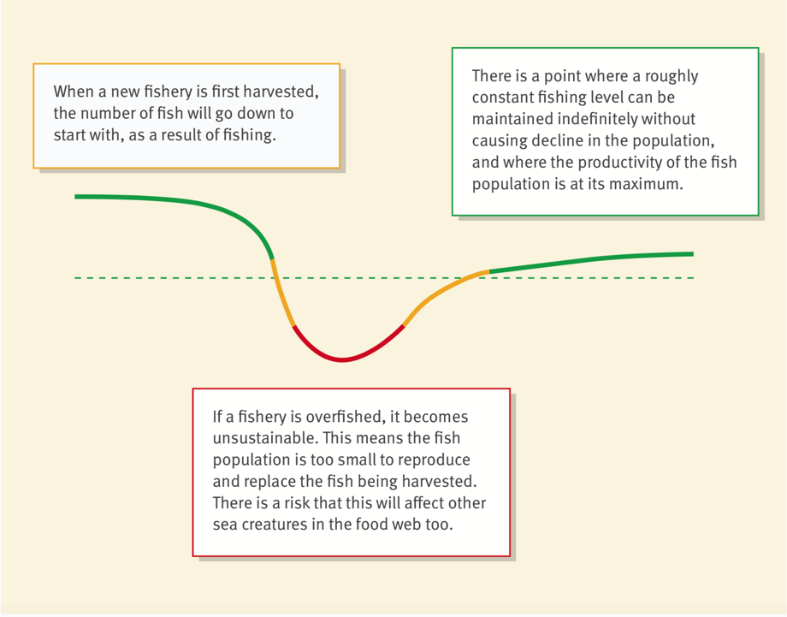
SCIENTISTS & THE MAXIMUM SUSTAINABLE YIELD
HE PĀTAI / CONSIDER THIS
1 ‘Maximum’ ‘Sustainable’ ‘Yield’ - What does each word mean?
2 Look at the diagram - what do the different colours on the line represent?
3 If this was a graph what could you label the x and y axes?
4 Where would the Maximum Sustainable Yield likely be located?
Source: MSC.ORG
Notes:
TEACHER NOTES
HE PĀTAI / CONSIDER THIS
1. Dotted line is indicative of maximum sustainable yield
Curved line shows stock of fish – high then low then increasing and leveling off
2. X axis could be time or fishing pressure over time similar; Y axis could be stock or catch
3. For the purpose of this exercise learners might identify the dotted line across the fishing curve Or a place along the green line near the end of the curve (to the right)

Slide 23
SCIENTISTS & THE MAXIMUM SUSTAINABLE YIELD
MAHI / ACTIVITY
Use the ‘Go Fish Vocab cards’
Then play the ‘Go Fish’ game
HE PĀTAI / CONSIDER THIS
What other ‘unknown’ factors could affect whether a sustainable yield remains a sustainable catch for a fishery over time?
(Possible answers on the next slide)
WHAT “UNKNOWN” FACTORS CAN AFFECT THE ONGOING SUSTAINABILITY OF A CATCH?
Notes:
TEACHER NOTES
Go Fish! Vocab cards are on the Scientists & MSY Teacher Outline.
Deepen your understanding:
NIWA (2002) Understanding ecosystems: a key to managing fisheries?
https://niwa.co.nz/water-atmosphere/vol10-no4-december-2002/understanding-ecosystems-key-managing-fisheries

Slide 24
SCIENTISTS & THE MAXIMUM SUSTAINABLE YIELD
Amount of food around
Poaching / Illegal fishing
Changes in the wider food web
Changes in chemistry of the ocean e.g. salinity
WHAT “UNKNOWN” FACTORS CAN AFFECT THE ONGOING SUSTAINABILITY OF A CATCH?
Changing numbers of
predators
Changing sea temperatures and currents
Natural events!
(earthquakes, tsunami etc)
Climate
Notes:
TEACHER NOTES
Deepening the inquiry
Categorise these factors as good, bad and neutral.
Look at what causes each of these factors?
Are the causes natural or human induced?
Who is responsible for each factor?
How are these factors changing over time?
How are the factors connected to one another?
Deepen your understanding:
NIWA (2002) Understanding ecosystems: a key to managing fisheries?
https://niwa.co.nz/publications/wa/vol10-no4-december-2002/understanding-ecosystems-a-key-to-managing-fisheries

Slide 25
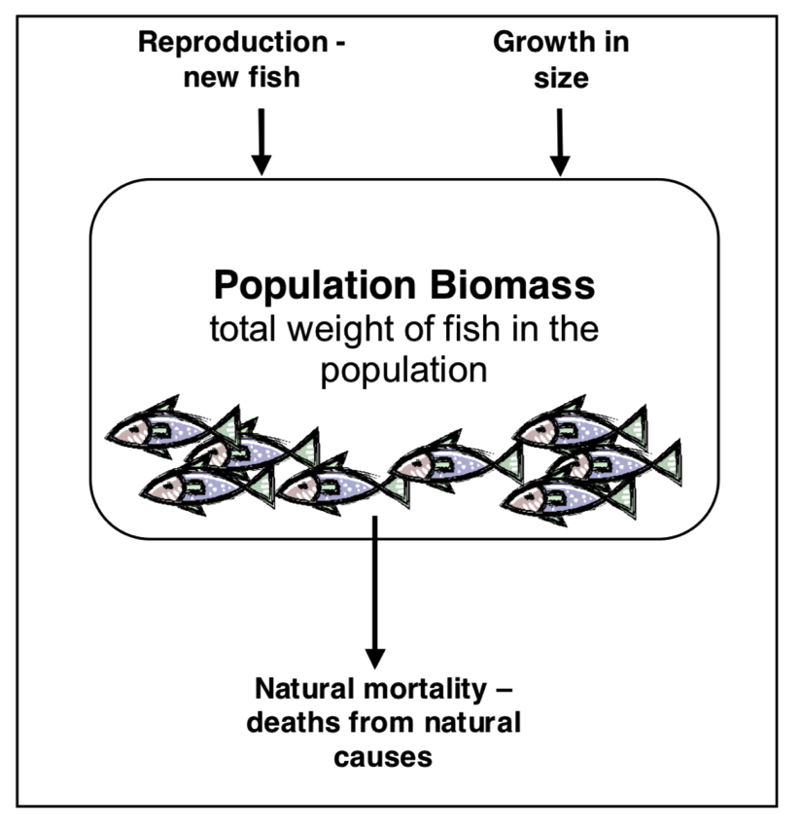
SCIENTISTS & THE MAXIMUM SUSTAINABLE YIELD
Experts ONLY!
KŌRERORERO / DISCUSSION
For the Marine Stewardship Council two key factors need to be balanced in order for fishing to be sustainable:
  The weight, or biomass (B)
  The fishing pressure (F)
In fisheries the term biomass refers to the total weight of fish in a stock of fish
This diagram shows factors determining the biomass of an ‘unfished’ stock of fish
Source: Ministry of Fisheries 2006
Notes:
TEACHER NOTES
To read more about the MSC approach as outlined here see URL:
https://www.msc.org/media-centre/news-opinion/news/2020/02/25/what-does-sustainable-fishing-really-mean

Slide 26
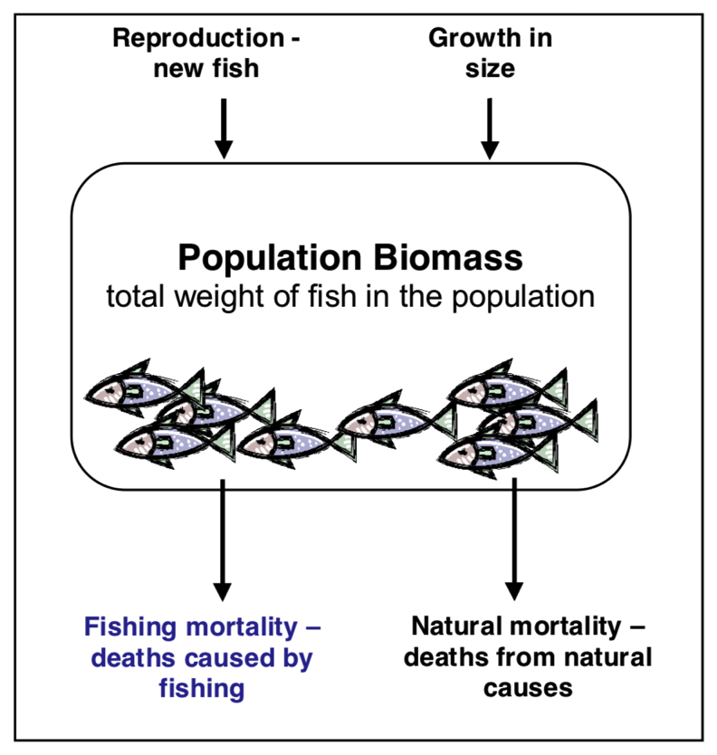
SCIENTISTS & THE MAXIMUM SUSTAINABLE YIELD
Experts ONLY!
KŌRERORERO / DISCUSSION
This diagram shows factors determining the biomass of a ‘fished’ stock of fish
HE PĀTAI / CONSIDER THIS
Which factor do people (fishers & fishery managers) have control over?
Source: Ministry of Fisheries 2006
Notes:
TEACHER NOTES
To read more about the MSC approach as outlined here see URL:
https://www.msc.org/media-centre/news-opinion/news/2020/02/25/what-does-sustainable-fishing-really-mean

Slide 27
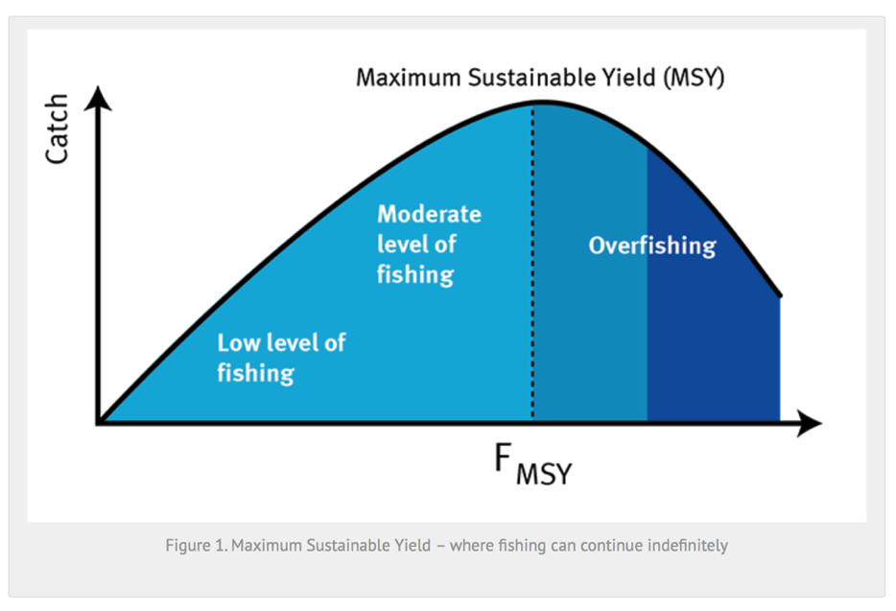
SCIENTISTS & THE MAXIMUM SUSTAINABLE YIELD
Experts ONLY!
KŌRERORERO / DISCUSSION
Fishing pressure (F) is the amount of effort (boats, nets, hooks) that is going in to fishing
The maximum catch that can be harvested sustainably is called the Maximum Sustainable Yield (MSY)
Fishing more than this, leads to smaller catches and declining stocks
Source: MSC.ORG
Notes:
TEACHER NOTES
To read more about the MSC approach as outlined here see URL:
https://www.msc.org/media-centre/news-opinion/news/2020/02/25/what-does-sustainable-fishing-really-mean

Slide 28
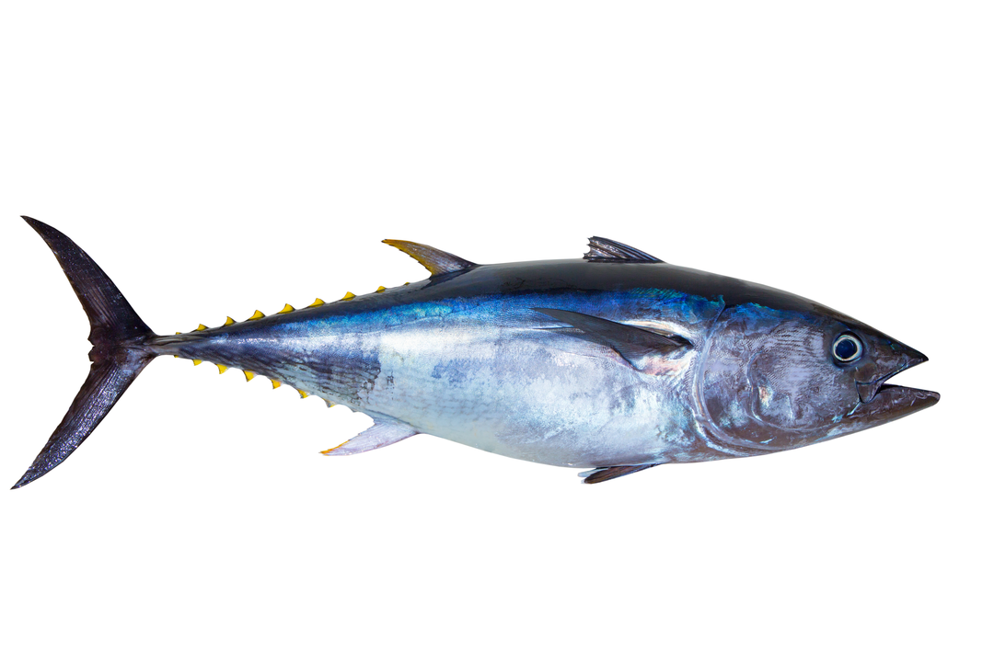
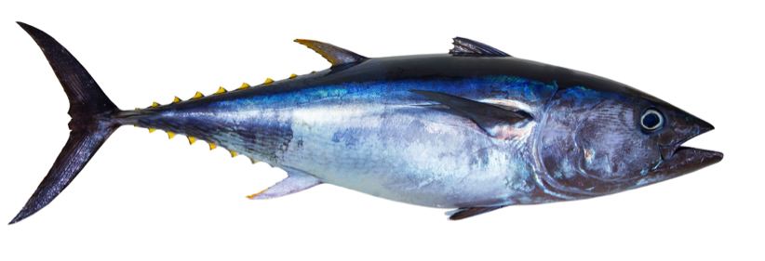
SCIENTISTS & THE MAXIMUM SUSTAINABLE YIELD
KŌRERORERO / DISCUSSION
In fishing, size does matter!
HE PĀTAI / CONSIDER THIS
What do you think might happen if there aren’t enough big adult fish?
If there aren’t enough large, mature fish (the ‘spawners’) then reproduction slows and fish stocks decline
Not enough large mature fish results in less young healthy fish to add to the stock
Albacore Tuna
Notes:
TEACHER NOTES
To read more about the MSC approach see URL:
https://www.msc.org/media-centre/news-opinion/news/2020/02/25/what-does-sustainable-fishing-really-mean

Slide 29
SCIENTISTS & THE MAXIMUM SUSTAINABLE YIELD
WHAT DOES A FISHERY SCIENTIST RESEARCH? PRIOR KNOWLEDGE CHART
What we know | What we would like to know | What we have learned
HE PĀTAI / CONSIDER THIS
What do fishery scientists research to help ensure fisheries are sustainable?
MAHI / ACTIVITY
Complete the prior knowledge chart
Look at a scientific paper written about fisheries in Aotearoa New Zealand.
Be ready to discuss the topic of the paper
Notes:
TEACHER NOTES
Possible answers could include:
Size of fish
Biology of fish
Weight of fish [biomass]
Number of fish [abundance]
Maturity of fish
Reproduction
Role of currents, climate, water temperature…
Food webs
Predators and prey
Either
With a partner pick one topic from the list. Search the internet to find a scientific study on this topic. Share the topic of your paper with the wider group.
OR
If it is too hard to go searching then print out a selection of fishery related scientific papers and have learners work in group, hand out one paper per group and figure out what their paper is about. Discuss the meaning of words such as methodology, results, conclusions, findings etc
Try using Google Scholar [scholar.google.com] for the science paper search.

Slide 30
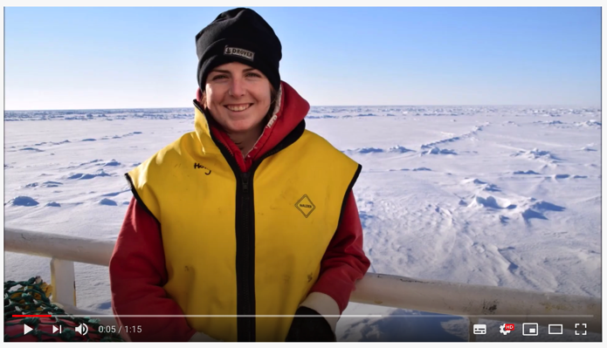
ASSESSING FISH STOCKS IN AOTEAROA
Focus Question: How do we assess fisheries in Aotearoa NZ? What role does science play?
KŌRERORERO / DISCUSSION
In Aotearoa commercial fisheries are managed under the Quota Management System (QMS)
Commercial fishers must report their catches
Fishery observers go out with commercial fishers to collect extra information
Scientists use information from commercial fishers and observes to work out how many fish there are (abundance)
MĀTAKI TĒNEI / WATCH THIS
Meet Holly Lane – fisheries observer for MPI [1:15]
Notes:
TEACHER NOTES
Film can be found at
https://www.youtube.com/watch?v=2AykyOc-rJk
LEARN MORE ABOUT REPORTING
For more information on reporting see: https://www.youtube.com/watch?v=HZEsabrSBYk

Slide 31
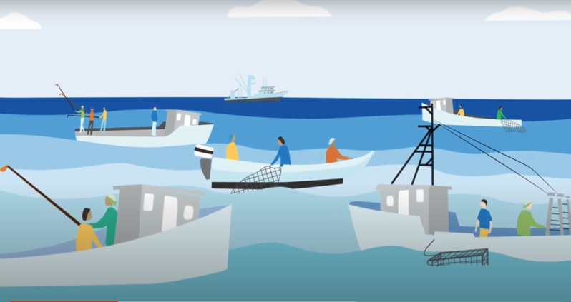
ASSESSING FISH STOCKS IN AOTEAROA
KŌRERORERO / DISCUSSION
Scientists get an idea of how many fish there are (abundance) because we know that:
When there are more fish in an area, it's usually easier to catch the same amount of fish from one year to the next
When there are fewer fish, fishers need to work harder to catch the same amount of fish
HE PĀTAI / CONSIDER THIS
But what happens if fishers start using new & better technology? How might this affect things?
Scientists might get a false sense of how many fish there are!
Notes:
TEACHER NOTES

Slide 32
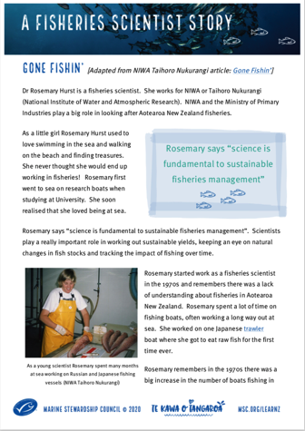
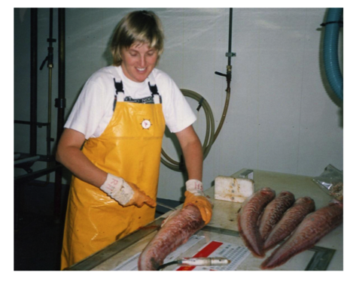
ASSESSING FISH STOCKS IN AOTEAROA
KŌRERORERO / DISCUSSION
Scientists also gather information about the length and age of fish
Some information comes from Fisheries New Zealand observers, like Holly, on board fishing vessels
If scientists know catch rates, size and age of fish being caught they can figure out if catch levels are sustainable
MAHI / ACTIVITY
Read about Dr Rosemary Hurst
‘A Fisheries Scientist Story’
Notes:
TEACHER NOTES
A Fisheries Scientist Story is a great summary of many of the themes covered in this topic and illustrates well the role of science and scientists in helping us determine sustainable catch rates
There are questions (multi choice, true and false, sentence answers and extra for quick finishers) at the end of the reading
EXTEND LEARNING
KŌRERO PUKAPUKA / READ
In groups explore one of the following. Report back three things you learnt:
How we determine the age of fish
2019 status of NZ fisheries
Read the cool information about how we determine the age of fish
URL: https://niwa.co.nz/fisheries/research-projects/determining-the-age-of-fish
Review the current status of Aotearoa commercial fisheries (2019)
URL: https://www.fisheries.govt.nz/dmsdocument/11950-the-status-of-new-zealands-fisheries-2019
EXTENDING:
Another good read is the fishery stock assessment information page from NIWA
URL: https://niwa.co.nz/fisheries/our-services/stock-assessments

Slide 33
WHEN FISH STOCKS DECLINE
Focus question: How are people and environments impacted when fish stocks decline?
HE PĀTAI / CONSIDER THIS
What impacts are there on the environment and people when fish stocks decline?
MAHI / ACTIVITY
Categorise your answers under these three headings
Complete activity When fish stocks decline (see Teacher Outline)
Add any additional impacts
1 Environmental impacts [impacts to do with the natural world less people] | 2 Economic impacts [impacts to do with money & jobs]
3 Social & cultural impacts [impacts to do with cultural values and daily lives – homes, families, recreation, education, health…]
Notes:
TEACHER NOTES
USEFUL RESOURCES / RĀRANGI PUKAPUKA
The Guardian “Overfishing is as big a threat to humanity as it is to our oceans” at https://www.theguardian.com/sustainable-business/2016/feb/16/overfishing-is-as-big-a-threat-to-humanity-as-it-is-to-our-oceans
POSSIBLE ANSWERS INCLUDE:
1 Environmental
Decline in ocean health
Changed shapes of fish (loss of predators)
Impact on habitat &food webs (multiple effects)
Changes in species dynamics
Changes in predator-prey relationships
Potential extinctions
Reduced biodiversity
2 Economic
Loss of jobs and/or reduced earnings
Economic insecurity (due to declines in fish)
Reduced economic
3 Cultural
Impact on cultural identity (mana, manakitanga, rangatiratanga…)
Impact on cultural wellbeing
And Social
Loss of enjoyment from fishing (as a recreation)
Potential food scarcity leading to malnutrition
Poverty
Loss of quality of life

Slide 34
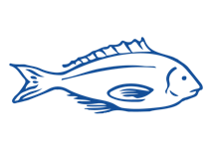
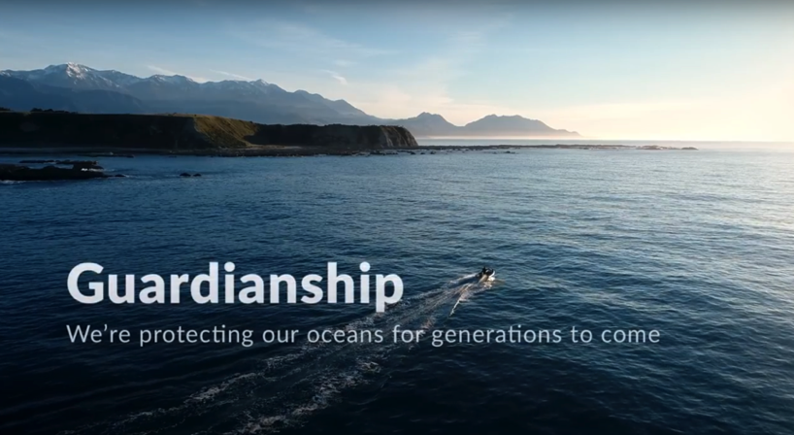
WHEN FISH STOCKS DECLINE
KŌRERORERO / DISCUSSION
Rāhui is a traditional tool used in Aotearoa New Zealand to help fish stocks recover when depleted
Rāhui can be put in place by kaitiaki (guardians) of an area
MĀTAKI TĒNEI / WATCH THIS
Watch the short film ’Guardianship’ [4:48]
MAHI / ACTIVITY
Add any additional impacts to your table [previous slide]
Notes:
TEACHER NOTES
FILM CLIP: https://www.youtube.com/watch?v=Obp4SU4zd8o&t=1s

Slide 35
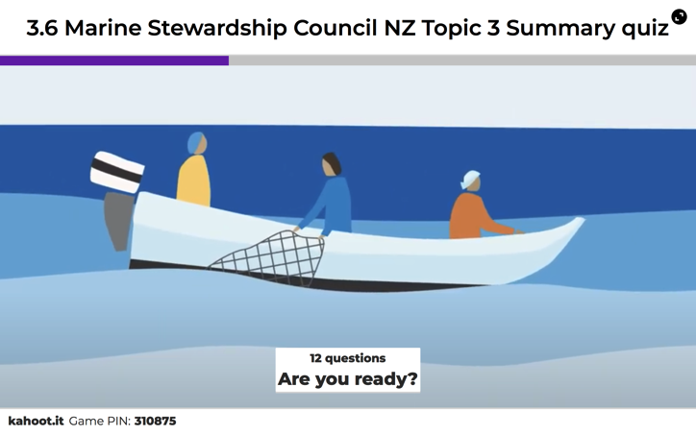
REVIEWING KEY CONCEPTS
Focus Question: What have we learnt?
MAHI / ACTIVITY
In small groups, create your own definition of
Sustainable fishing
Maximum sustainable yield
Unsustainable fishing
Act it out! For one of your definitions create a 30 second skit showing the meaning of the term from the perspective of a fisher person!
MAHI / ACTIVITY
Complete the Science & Sustainable Catch summary quiz on the following slides or play using Kahoot!
Source: MSC.ORG
Notes:
TEACHER NOTES
HOW TO PLAY KAHOOT
See other teacher notes for instructions
Find the game on the MSC NZ Kahoot page: https://www.msc.org/en-au/for-teachers/ocean-literacy/new-zealand-education-curriculum/kahoot-quizzes
Answers to quiz are provided on the slides following the quiz questions :]

Slide 36
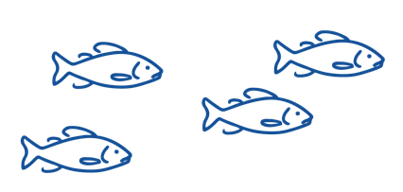
REVIEWING KEY CONCEPTS – QUIZ
True or False - A sustainable catch is one that can carry on forever?
2. Which of the following is NOT a principle applied by Marine Stewardship Council when certifying sustainable fishery
  Principle 1: Sustainability of the fish stock
  Principle 2: Environmental Impacts
  Principle 1: Economic viability assessment
  Principle 3: Effective Management

Slide 37

REVIEWING KEY CONCEPTS – QUIZ
3. Which of the following is LEAST useful to the MSC under Principle 1 to tell if a fish CATCH is sustainable?
  Knowing the size of the fish stock / population
  Scientists calculations on the health of the fish stocks
  Knowing what fish stock a fish has come from
  Knowing what other fish the boat caught
4. True or False - Sustainable fishing means making sure fish populations don’t drop below levels where they can reproduce themselves
5. True or False - Fisheries work with scientists to understand how the fish and shellfish population grows and shrinks over time

Slide 38
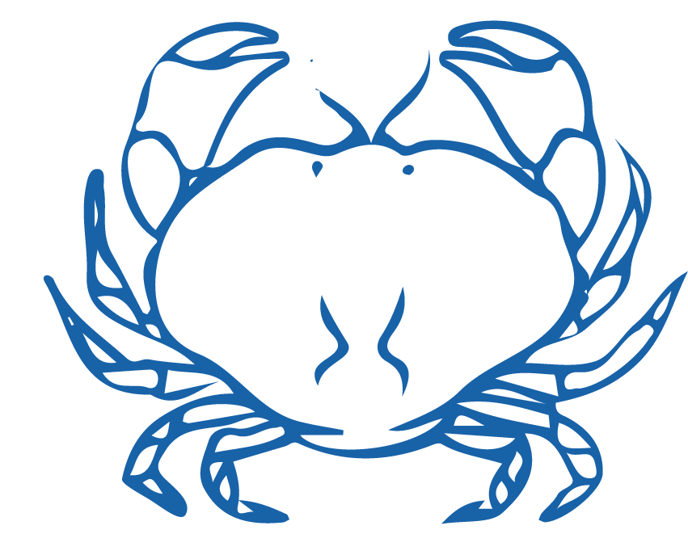
REVIEWING KEY CONCEPTS – QUIZ
6. True or False - How a fish population grows & shrinks over time is controlled by births, migrations in & out of the fishery, and deaths (including fish caught)
7. Which of the following is NOT true of sustainable yield for a fishery?
  Sustainable yield is a scientific calculation
  Sustainable yield shows how much fish can be caught without overfishing
  Sustainable yields are set to enable high catches & declining fish stocks
  Sustainable yields aim to prevent overfishing & decline of fish stocks
8.True or False - Population biomass is the total weight of fish in the population

Slide 39
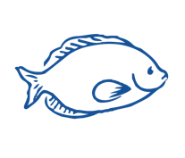
REVIEWING KEY CONCEPTS – QUIZ
9. In fishing, size does matter! Which of the following is NOT true?
  Healthy fish stocks need large, mature fish (the ‘spawners’)
  A fished population of fish is always healthy even with no big fish present
  Without big fish reproduction slows and fish stocks decline
  Not enough large mature fish means there will be less young healthy fish
10. Which of the following is not true of commercial fishing in Aotearoa NZ?
Commercial fisheries are managed under the QMS (Quota Management System)
There are no limits to the number of fish that can be caught
Scientists use info from commercial fishers to work out fishery size
Commercial fishers must report their catches

Slide 40


REVIEWING KEY CONCEPTS – QUIZ
11. True or False - The number of fish in a population is also known as 'abundance’
12. Which of the following can be a type of impact arising from the decline of a fish stock?
  Environmental impacts
  Social & cultural impacts
  Economic impacts

Slide 41
REVIEWING KEY CONCEPTS – QUIZ ANSWERS
1. True or False - A sustainable catch is one that can carry on forever?
TRUE
2. Which of the following is NOT a principle applied by Marine Stewardship Council when certifying sustainable fishery
  Principle 1: Sustainability of the fish stock
  Principle 2: Environmental Impacts
  Principle 1: Economic viability assessment
  Principle 3: Effective Management

Slide 42
REVIEWING KEY CONCEPTS – QUIZ ANSWERS
3. Which of the following is LEAST useful to the MSC under Principle 1 to tell if a fish CATCH is sustainable?
  Knowing the size of the fish stock / population
  Scientists calculations on the health of the fish stocks
  Knowing what fish stock a fish has come from
  Knowing what other fish the boat caught
4. True or False - Sustainable fishing means making sure fish populations don’t drop below levels where they can reproduce themselves TRUE
5. True or False - Fisheries work with scientists to understand how the fish and shellfish population grows and shrinks over time TRUE

Slide 43
REVIEWING KEY CONCEPTS – QUIZ ANSWERS
6. True or False - How a fish population grows & shrinks over time is controlled by births, migrations in & out of the fishery, and deaths (including fish caught) TRUE
7. Which of the following is NOT true of sustainable yield for a fishery?
  Sustainable yield is a scientific calculation
  Sustainable yield shows how much fish can be caught without overfishing
  Sustainable yields are set to enable high catches & declining fish stocks
  Sustainable yields aim to prevent overfishing & decline of fish stocks
8.True or False - Population biomass is the total weight of fish in the population TRUE

Slide 44
REVIEWING KEY CONCEPTS – QUIZ ANSWERS
9. In fishing, size does matter! Which of the following is NOT true?
  Healthy fish stocks need large, mature fish (the ‘spawners’)
  A fished population of fish is always healthy even with no big fish present
  Without big fish reproduction slows and fish stocks decline
  Not enough large mature fish means there will be less young healthy fish
10. Which of the following is not true of commercial fishing in Aotearoa NZ?
Commercial fisheries are managed under the QMS (Quota Management System)
There are no limits to the number of fish that can be caught
Scientists use info from commercial fishers to work out fishery size
Commercial fishers must report their catches

Slide 45
REVIEWING KEY CONCEPTS – QUIZ ANSWERS
11. True or False - The number of fish in a population is also known as 'abundance’ TRUE
12. Which of the following can be a type of impact arising from the decline of a fish stock?
  Environmental impacts
  Social & cultural impacts
  Economic impacts

