Slide 1


WHEN FISH STOCKS DECLINE
Focus question: How are people and environments impacted when fish stocks decline?
HE PĀTAI / CONSIDER THIS
What impacts are there on the environment and people when fish stocks decline?
MAHI / ACTIVITY
Categorise your answers under these three headings
Complete activity When fish stocks decline (see Teacher Outline)
Add any additional impacts
1 Environmental impacts [impacts to do with the natural world less people] | 2 Economic impacts [impacts to do with money & jobs]
3 Social & cultural impacts [impacts to do with cultural values and daily lives – homes, families, recreation, education, health…]
Notes:
TEACHER NOTES
USEFUL RESOURCES / RĀRANGI PUKAPUKA
The Guardian “Overfishing is as big a threat to humanity as it is to our oceans” at https://www.theguardian.com/sustainable-business/2016/feb/16/overfishing-is-as-big-a-threat-to-humanity-as-it-is-to-our-oceans
POSSIBLE ANSWERS INCLUDE:
1 Environmental
Decline in ocean health
Changed shapes of fish (loss of predators)
Impact on habitat &food webs (multiple effects)
Changes in species dynamics
Changes in predator-prey relationships
Potential extinctions
Reduced biodiversity
2 Economic
Loss of jobs and/or reduced earnings
Economic insecurity (due to declines in fish)
Reduced economic
3 Cultural
Impact on cultural identity (mana, manakitanga, rangatiratanga…)
Impact on cultural wellbeing
And Social
Loss of enjoyment from fishing (as a recreation)
Potential food scarcity leading to malnutrition
Poverty
Loss of quality of life

Slide 2


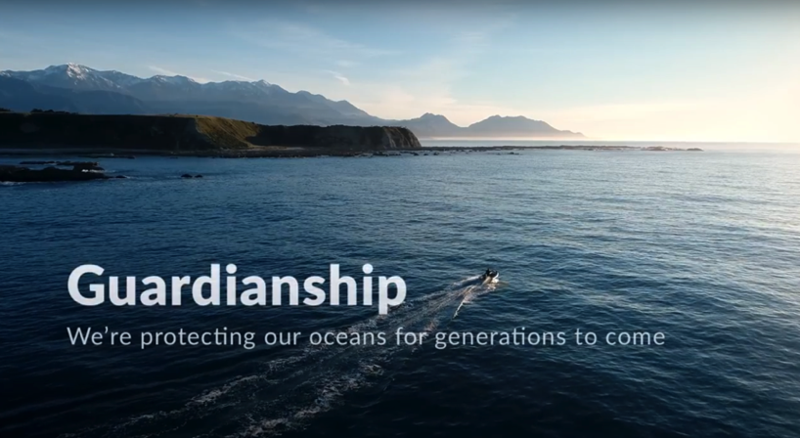

WHEN FISH STOCKS DECLINE
KŌRERORERO / DISCUSSION
Rāhui is a traditional tool used in Aotearoa New Zealand to help fish stocks recover when depleted
Rāhui can be put in place by kaitiaki (guardians) of an area
MĀTAKI TĒNEI / WATCH THIS
Watch the short film ’Guardianship’ [4:48]
MAHI / ACTIVITY
Add any additional impacts to your table [previous slide]
Notes:
TEACHER NOTES
FILM CLIP: https://www.youtube.com/watch?v=Obp4SU4zd8o&t=1s

