Slide 1

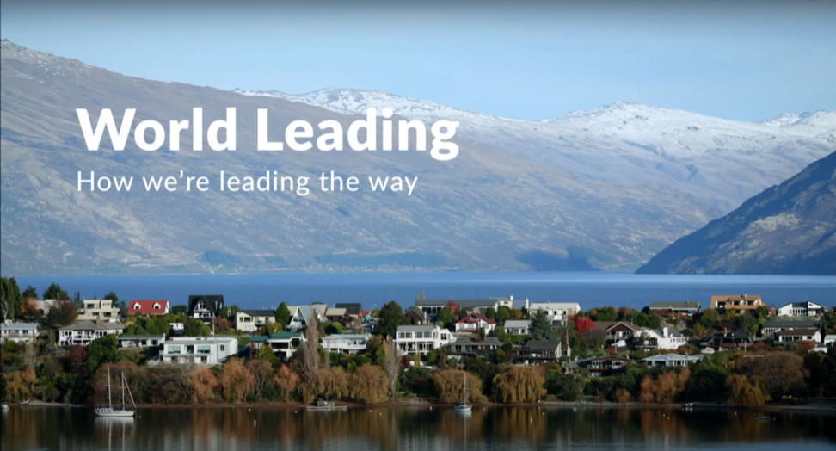
QUOTA MANAGEMENT SYSTEM (QMS)
Focus Question: What are key features of the Quota Management System (QMS)
KŌRERORERO / DISCUSSION
New Zealand fisheries are managed under the Quota Management System (QMS)
MĀTAKI TĒNEI / WATCH THIS
Short Seafood New Zealand film about our system for Fisheries Management [3:52]
Notes:
TEACHER NOTES
MĀTAKI TĒNEI / WATCH THIS
Film clip available at: https://www.youtube.com/watch?time_continue=229&v=LNRpuwN1XwI

Slide 2
QUOTA MANAGEMENT SYSTEM (QMS)
KŌRERORERO / DISCUSSION
Under the QMS, a yearly catch limit (the total allowable catch, TAC) is set for every fish stock
By controlling the amount of fish taken from each stock, the QMS helps keep New Zealand fisheries sustainable
The TAC sets rules about how much fish can be caught by recreational and customary fishing as well as commercial fishers
The commercial catch limits for each stock are known as the total allowable commercial catch (TACC)
Notes:
TEACHER NOTES

Slide 3
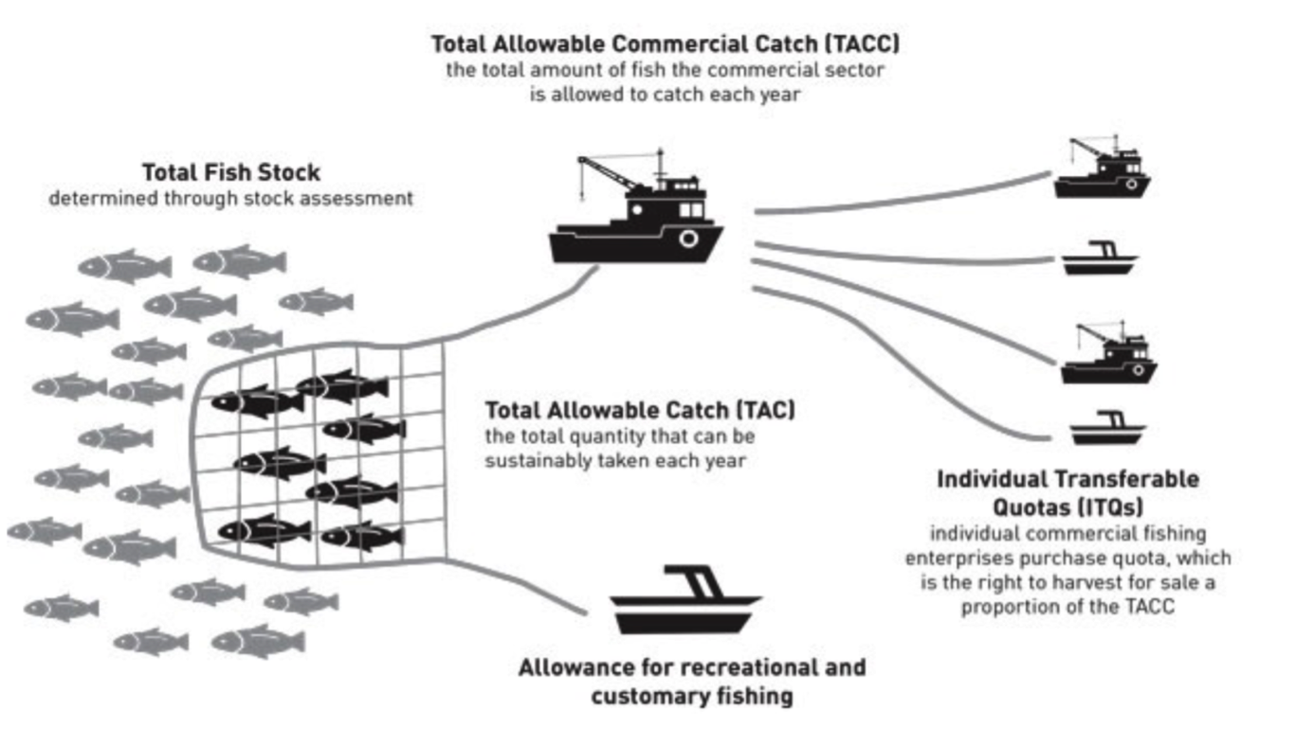
QUOTA MANAGEMENT SYSTEM (QMS)
KŌRERORERO / DISCUSSION
This diagram shows how fish stocks are shared amongst fishers under the QMS
MAHI / ACTIVITY
Complete QMS Worksheet
Source: Fisheries New Zealand
Notes:
TEACHER NOTES
Have students visit the following webpage and investigate. Identify three things they didn’t know about how fisheries are managed in Aotearoa New Zealand. In groups teach the rest of the class one of these three things (use mime, acting, skit …)
https://www.mpi.govt.nz/law-and-policy/legal-overviews/fisheries/quota-management-system/

Slide 4
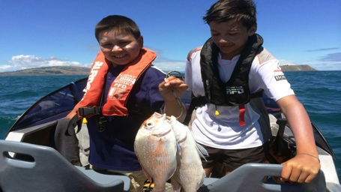
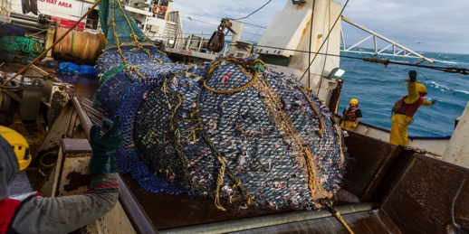
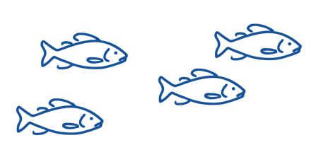
QUOTA MANAGEMENT SYSTEM (QMS)
Source: Ministry for the Environment
50% of fish are allocated to RECREATIONAL fishers and for CUSTOMARY MĀORI fishing
Recreational and customary fishers are not allowed to SELL their catch
There are size and catch limits for fish they can take
KŌRERORERO / DISCUSSION
50% of fish are allocated to COMMERCIAL fishers
They must BUY quota for each species of fish they want to catch
A commercial fisher must have quota in order to fish commercially
Notes:
TEACHER NOTES

Slide 5
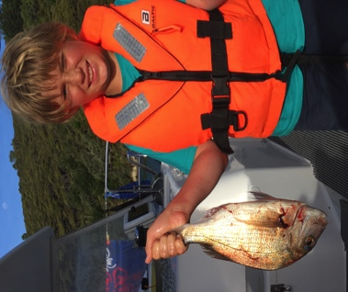
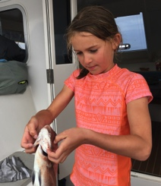
QUOTA MANAGEMENT SYSTEM (QMS)
HE PĀTAI / CONSIDER THIS
Why can’t these kids sell their fish? Is this fair?
Imagine a commercial fisher sees a recreational fisher at the wharf selling their catch, what might they feel / say?
Have you ever caught a fish? Or thrown an undersized fish back in to the sea?
MAHI / ACTIVITY
Complete Customary
and Recreational Fisheries Worksheet
Source: Ministry for
the Environment
Notes:
TEACHER NOTES

Slide 6
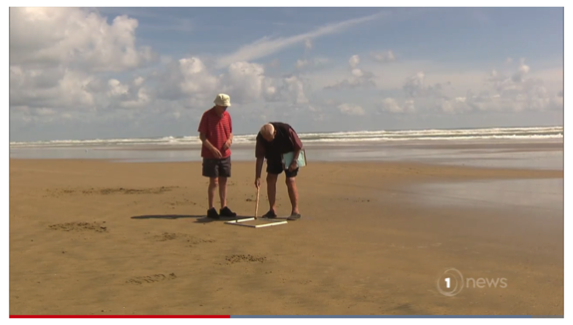

QUOTA MANAGEMENT SYSTEM (QMS)
KŌRERORERO / DISCUSSION
Selling fish without quota is illegal under the QMS
Taking fish beyond the recreational limit or without a customary permit is also illegal
MAHI / ACTIVITY
Complete the illegal fishing activity (see Teacher Outline)
MĀTAKI TĒNEI / WATCH THIS
Short film [2:07] to find out from Jim and Barry (Ngā kaitiaki toheroa) about how illegal fishing has impacted toheroa
  We look at illegal fishing in more detail in Topic 6
Notes:
TEACHER NOTES
Article and film clip can be found at:
https://www.1news.co.nz/2020/01/14/driving-restrictions-being-considered-for-southland-beach-to-protect-toheroa/
MAHI / ACTIVITY
Illegal fishing activity: Break learners into groups and have each group research one article about illegal fishing (see Teacher Outline on the Quote Management System pages 8 and 9). Questions are provided. Report back to the rest of the group.

Slide 7
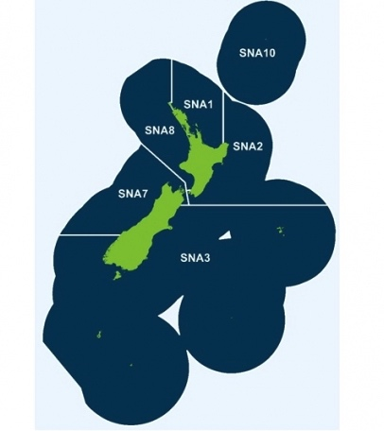

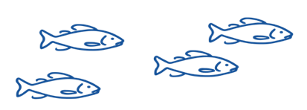
QUOTA MANAGEMENT SYSTEM (QMS)
KŌRERORERO / DISCUSSION
Under the Quota Management System fish stocks are separated by Quota Management Areas (QMAs)
For example, the snapper fishery is divided into 6 areas
Each QMA has rules
HE PĀTAI / CONSIDER THIS
Do you know fishing rules for your area?
Source: MPI.govt.nz
Notes:
TEACHER NOTES

Slide 8

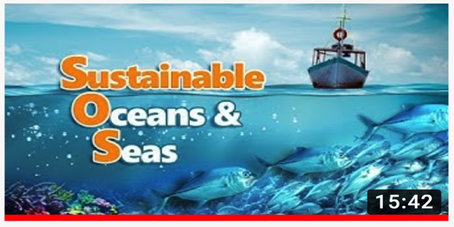

QUOTA MANAGEMENT SYSTEM (QMS)
KŌRERORERO / DISCUSSION
Some people say the QMS isn’t great
Others see it as a world leading example of well managed fisheries
MĀTAKI TĒNEI / WATCH THIS
Film [15:42] introducing sustainable fishing in Aotearoa New Zealand
MAHI / ACTIVITY
Use the Sustainable Oceans & Seas Worksheet or play Kahoot!
Conduct a survey of people’s opinions regarding the QMS [Teacher Outline]
Notes:
TEACHER NOTES
Film clip can be found at: https://www.youtube.com/watch?v=sDh2Cn2bNxk
NOTE: Filmed for an overseas audience so is interesting to see what children in other parts of the world are learning about Aotearoa NZ fisheries!
MAHI / ACTIVITY
Answer questions about what was watched using questions on Quota Management System Worksheet or Kahoot (see below).
Conduct a SURVEY of peoples opinions on the QMS [Teacher Outline]
Survey people’s knowledge and opinions on Aotearoa NZ laws around marine fishing. Simple multi choice questions that could include: Are they fishers? How often do they fish in the ocean? What is the main reason for fishing/-fun/food/both? Do they know the daily limits and size on fish and shellfish? Should this be more/less? Are recreational fishers allowed to sell their catch? What % of fish is caught by recreational fishers?
HOW TO PLAY KAHOOT
Connect a device to a projector or screen in front of the classroom.
Navigate to the game called Marine Stewardship Council NZ Kahoot page
https://www.msc.org/en-au/for-teachers/ocean-literacy/new-zealand-education-curriculum/kahoot-quizzes
Select settings
At Kahoot.it, learners enter game-pin and nickname on their own devices (phone, tablet, or computer).
Press “Start now”. The fun begins!
Learners answer questions on their own devices by selecting one of the four answer buttons.
See additional instructions, options, and how to make your own Kahoot at: https://kahoot.com

Slide 9
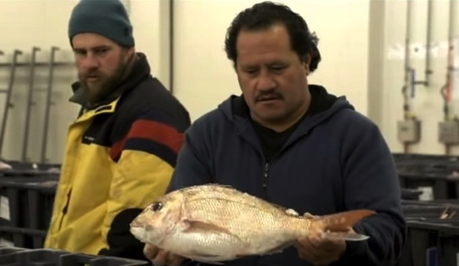
QUOTA MANAGEMENT SYSTEM (QMS)
Now switch positions.
Go stand on the opposite side.
Be prepared to argue the exact opposite.
Different viewpoints exist about fishing in Aotearoa New Zealand
MAHI / ACTIVITY
“Fisheries in Aotearoa New Zealand are sustainable, healthy and well managed”
Make a continuum – one side of the room is YES and the other NO. Where do you stand? Be prepared to justify your position!
MĀTAKI TĒNEI / WATCH THIS
Fishy Business [13:42] As you watch, choose a point of view that you particularly agree or disagree with.
Be prepared to discuss!
Notes:
TEACHER NOTES
MĀTAKI TĒNEI / WATCH THIS
Film clip can be found at: https://www.youtube.com/watch?v=tX-1nyykYJw

