Slide 1
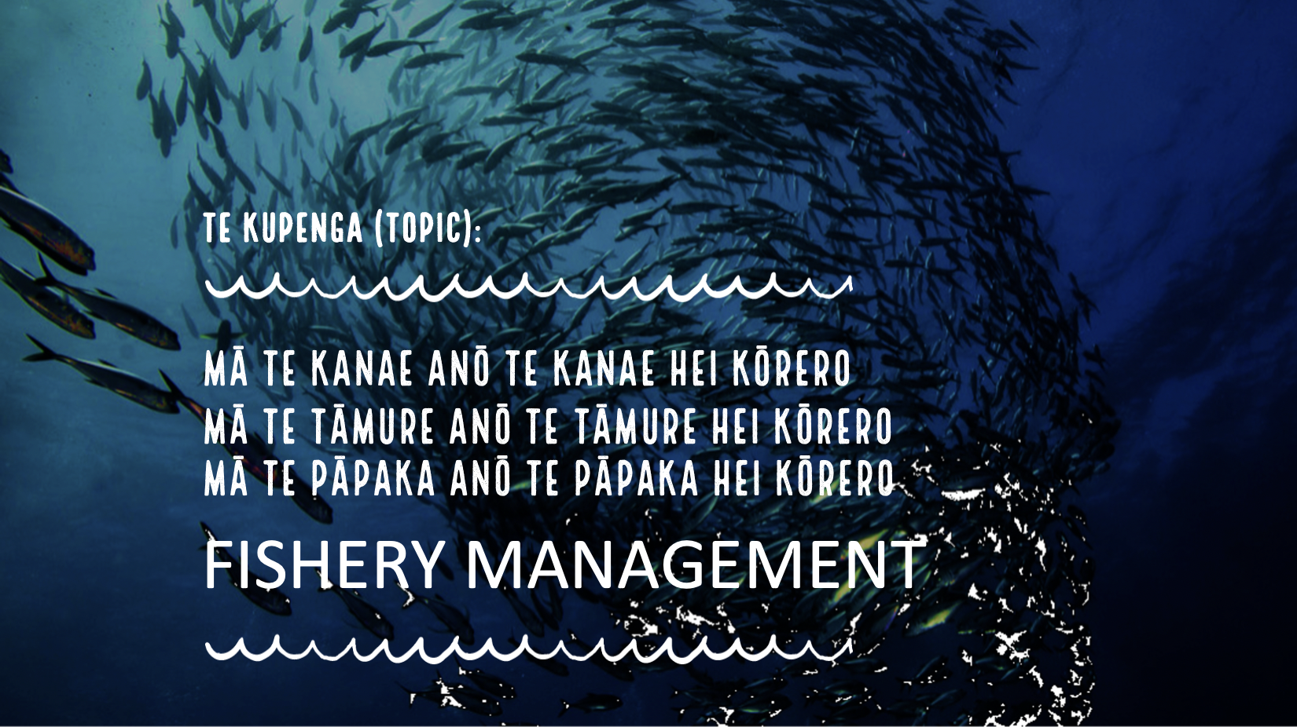
Insert heading page Topic 3

Slide 2





Notes:
TEACHER NOTES

Slide 3





HELPFUL STUFF FOR TEACHERS
Target age range:
10–15 years
Welcome to OUR STORY!
This is topic five of our nine topic series:
Te Kawa o Tangaroa
Topic focus: Fisheries Management
Curriculum Level: Level 3 - 5+
Curriculum relevance: Geography; Science; Social Science; Tikanga-ā-iwi; Pūtaiao; Hauora
Key competencies: Thinking; Managing Self; Using language, symbols & texts; Relating to others
Planning: See also Fishery Management Planner and teacher notes below slides
Extending learning: See Topic Outlines and slides labelled expert [top right corner]

Slide 4
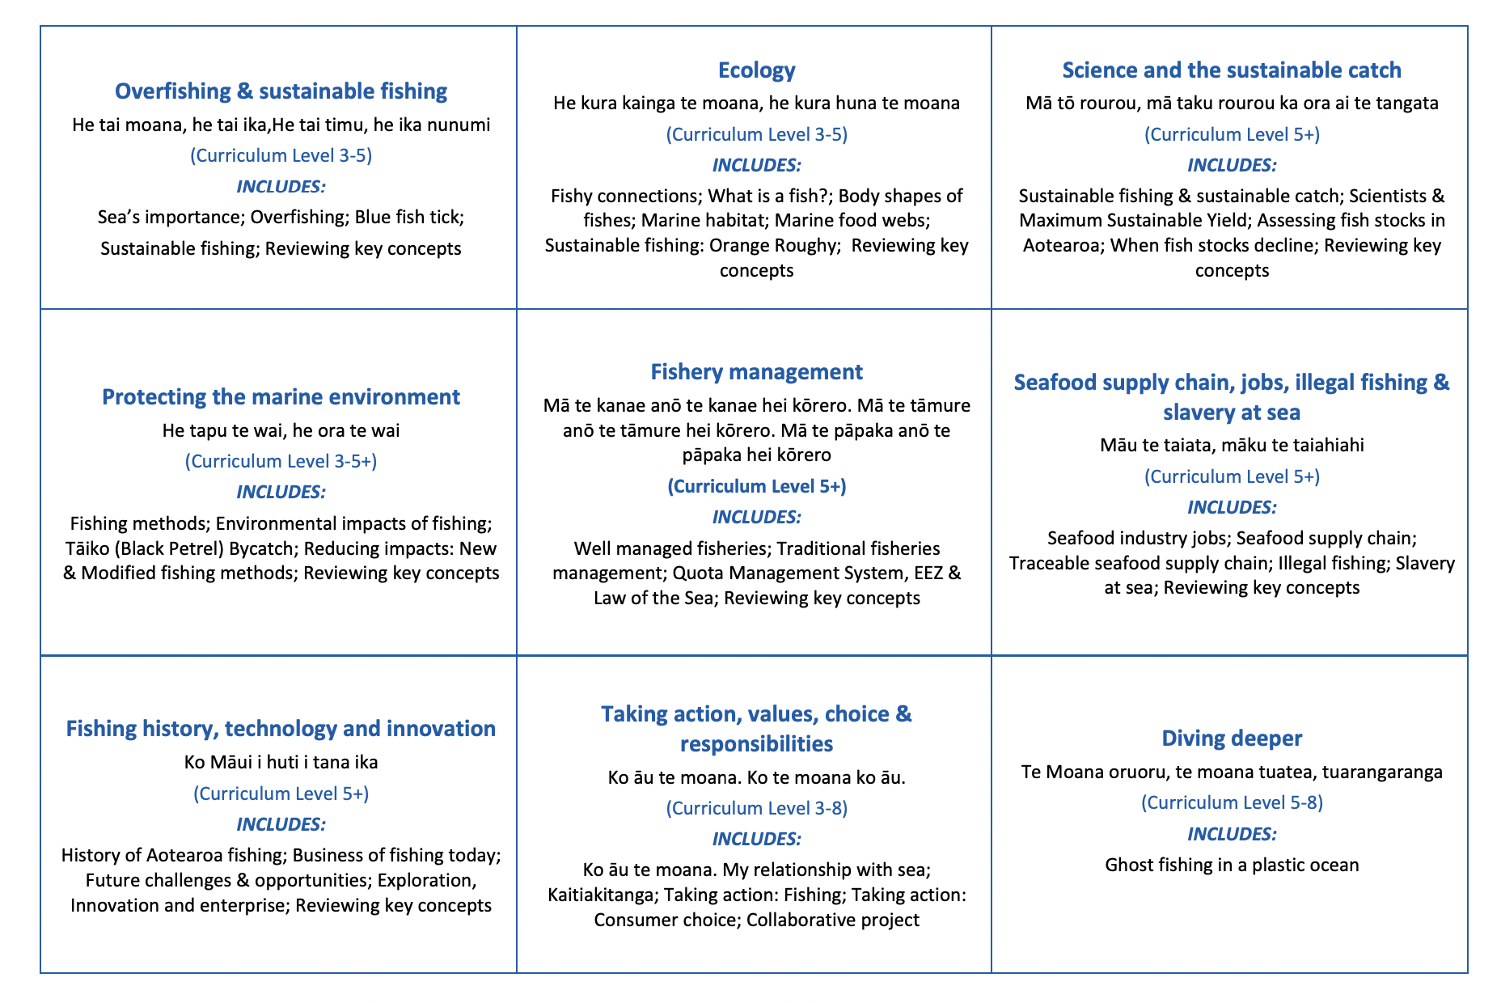

HELPFUL STUFF FOR TEACHERS
Welcome to OUR STORY!
In this topic we explore fishery management
Notes:
TEACHER NOTES

Slide 5
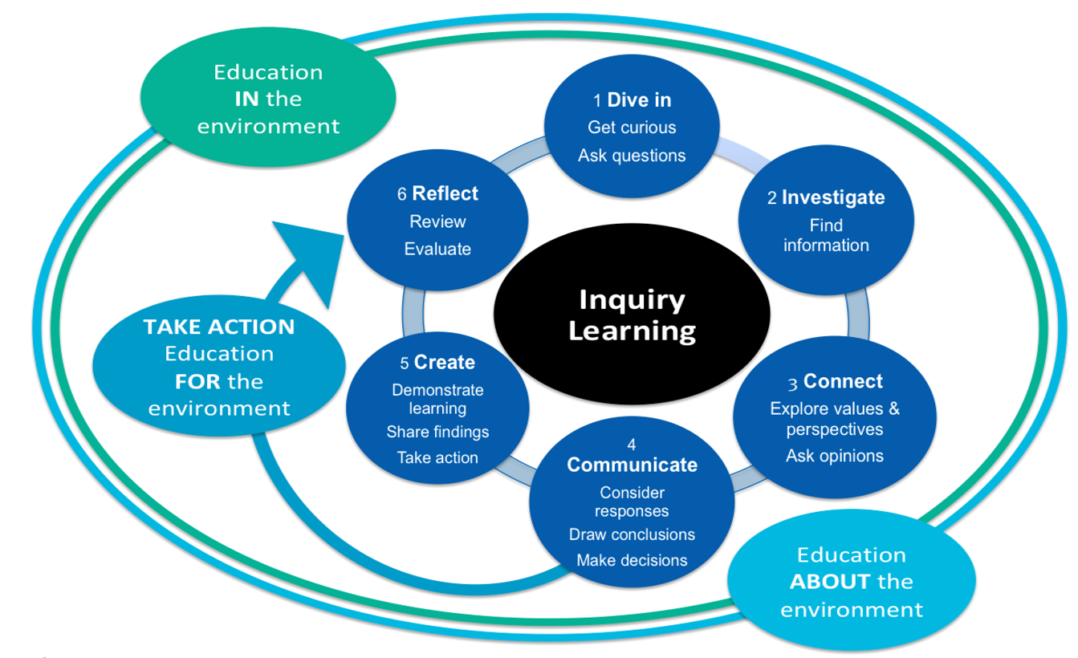
HELPFUL STUFF FOR TEACHERS
Notes:
TEACHER NOTES

Slide 6


IN THIS TOPIC WE WILL LEARN ABOUT…
Indicators of good (sustainable) fisheries management?
Traditional fishery management tools used to manage fisheries sustainably in Aotearoa New Zealand
Key features of Aotearoa New Zealand’s Quota Management System QMS
The concept of EEZ (Exclusive Economic Zone) and its relevance to fisheries management
Scientific and fishery related vocabulary
Notes:
TEACHER NOTES

Slide 7
MIHI / INTRODUCTION
Can you imagine a world without fish?
What would that be like?
No more sushi! No more fishing!
No more fish & chips! No more….?
Notes:
TEACHER NOTES

Slide 8
MIHI / INTRODUCTION
The good news is… some special people are working hard to make sure this doesn’t happen!
In this topic look more closely at fisheries management including how fisheries are managed in Aotearoa New Zealand
Let’s take a moment to think about our responsibility as kaitiaki [guardians] of our marine environment?
Notes:
TEACHER NOTES

Slide 9


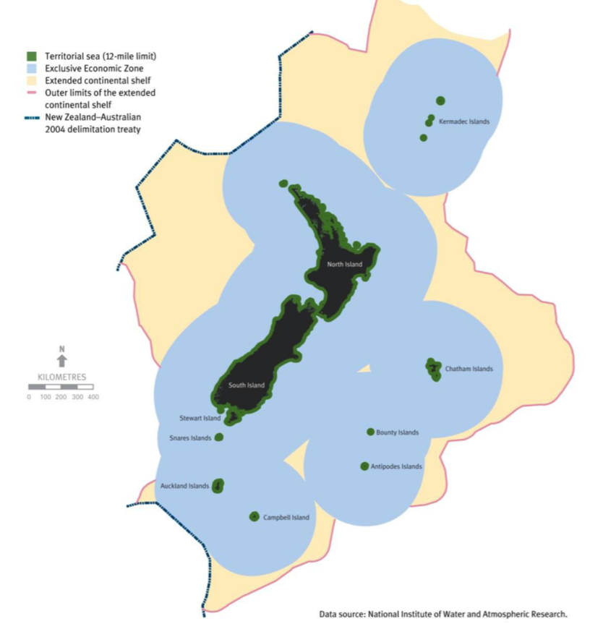
WELL MANAGED FISHERIES
Focus question: What are some indicators of ‘well managed’
(sustainable) fisheries
What is fisheries management?
… the process that creates and enforces the rules that prevent overfishing and help recovery of overfished fish stocks
KŌRERORERO / DISCUSSION
Kaitiakitanga is the idea of guardianship
As kaitiaki [guardians] it is our responsibility to care for our environment
Kaitiakitanga [guardianship] is an important part of well managed [looked after] fisheries in Aotearoa New Zealand
We are responsible for managing the ocean and fish that live there out to 200 nautical miles from land (blue area on map)
See final slide for larger map!
Notes:
TEACHER NOTES

Slide 10

WELL MANAGED FISHERIES
HE PĀTAI / CONSIDER THIS
What can you do to help look after our sea and kai moana [seafood]?
MAHI / ACTIVITY
Complete the Kaitiakitanga worksheet
‘Toitu te marae a Tane, Toitu te marae a Tangaroa, Toitu te iwi’
If the land is well and the sea is well, the people will thrive
HE PĀTAI / CONSIDER THIS
What does this whakataukī or proverb suggest about looking after our fisheries?
Notes:
TEACHER NOTES
SUGGEST: Inviting a kaitiaki / tiaki to visit the class
ANSWERS: Whakataukī suggests if we look after our kai moana and our moana then we look after ourselves
What good things can we do?
Only buy and eat fish caught legally and sustainably
Make sure we are good kaitiaki and have good tikanga when fishing (e.g. throw the small ones back; know and follow the rules about what and how much we can catch)
Support organisations like the MSC
Remind others of our kaitiakitanga obligations

Slide 11
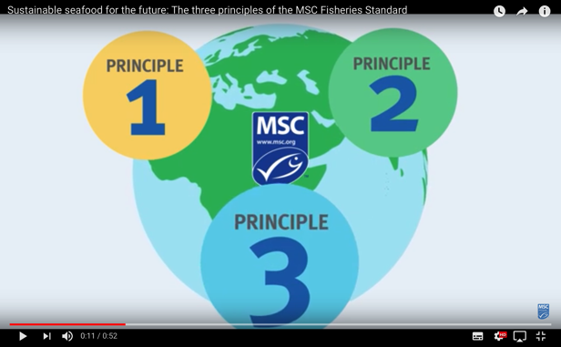



WELL MANAGED FISHERIES
KŌRERORERO / DISCUSSION
How do the Marine Stewardship Council help us in our role as kaitiaki?
Only fisheries found to be sustainable can be sold with the Marine Stewardship Council blue fish tick label
To get the label they must be well managed
MĀTAKI TĒNEI / WATCH THIS
Marine Stewardship Council’s
Fisheries Standard [0:52]
Notes:
TEACHER NOTES
Film clip URL is: https://www.youtube.com/watch?time_continue=1&v=qEE3iUIbm7U&feature=emb_logo

Slide 12
WELL MANAGED FISHERIES
In this topic we focus on the idea of fisheries management which is the basis of Marine Stewardship Council Principle 3 (Principles 1 and 2 are the focus of other topics)
HE PĀTAI / CONSIDER THIS
Watch again the short film on slide 11 What are the three Marine Stewardship Councils principles used to certify sustainable fisheries?
  Principle 1: Sustainability of the stock
  Principle 2: Environmental impacts
  Principle 3: Effective management
Notes:
TEACHER NOTES

Slide 13
WELL MANAGED FISHERIES
HE PĀTAI / CONSIDER THIS
Before we look at what we mean by ‘well managed’ fisheries let’s think what we know already about fisheries management?
MAHI / ACTIVITY
Complete the Prior Knowledge Chart columns 1 & 2
Fishery Management PRIOR KNOWLEDGE CHART
What we know | What we would like to know | What we have learned
Notes:
TEACHER NOTES
You could also look at material from the topic called sustainable fishing and overfishing

Slide 14
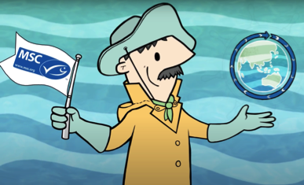
WELL MANAGED FISHERIES
KŌRERORERO / DISCUSSION
Well managed fisheries
➔ use science / observation to ensure:
stocks are fished responsibly
marine habitats are preserved
fishing is environmentally & economically sustainable
use controls to manage fishing effort:
number and size of fishing boats
restrict fishing days or times
Fisheries managers can also:
Improve or modify fishing methods
Employ fishing observers
MAHI / ACTIVITY
Add new learning to the prior knowledge chart
Notes:
TEACHER NOTES

Slide 15
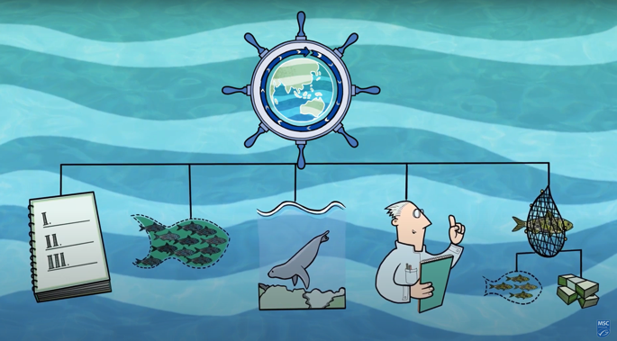

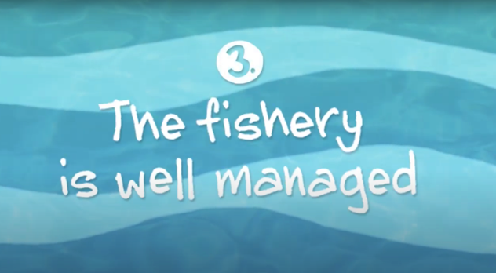
WELL MANAGED FISHERIES
MĀTAKI TĒNEI / WATCH THIS
Short video [2:11] The fishery is well managed (Principle Three)
Well managed
fisheries
ensure…
MAHI / ACTIVITY
Watch the video a second time and label the picture above (answers on next slide)
Notes:
TEACHER NOTES
Film can be downloaded from https://www.youtube.com/watch?v=XjaPUV0yaHQ
Having watched the video “What does the MSC label mean? 3. The fishery is well managed”… have learners add to their lists the types of things ‘fisheries managers’ might do to manage fish stocks effectively / sustainably? Discuss as a class.

Slide 16

WELL MANAGED FISHERIES
Economically
sustainable
Well managed
fisheries
ensure…
Environmentally
sustainable
Stocks fished responsibly
Habitat
preserved
Informed by
Knowledge / science / observation
Notes:
TEACHER NOTES

Slide 17
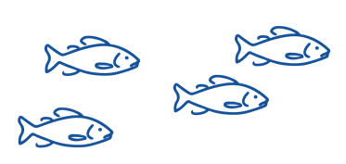
WELL MANAGED FISHERIES
Habitat
Preserved
HE PĀTAI / CONSIDER THIS
Brainstorm indicators of well managed fisheries that are mentioned in the MSC film clip ‘The fishery is well managed’ . We’ve added a couple to get you started!
(Answers on next slide)
Indicators of
well managed fisheries
Informed by science
/ observation
Notes:
TEACHER NOTES

Slide 18
WELL MANAGED FISHERIES
Stocks fished responsibly
Habitat
preserved
Environmentally
sustainable
Indicators of
well managed fisheries
Fishing is a stable and profitable job
Controls fishing effort
(e.g. by limiting number of
Boats/hooks or time / days
fishing occurs
Informed by science
/ observation
Adapts fishing methods
as needed to ensure
sustainable fishing
Use of
fishing observers
Notes:
TEACHER NOTES

Slide 19


TRADITIONAL FISHERIES MANAGEMENT
Focus Question: What are some traditional Māori fishery management tools?
KŌRERORERO / DISCUSSION
Over hundreds of years Māori developed an intimate understanding (science of sorts) about fish and environment
This understanding was gained through direct experience and observation
For example, the cycle of the moon taught them the best times to fish
  Māori developed fishery management techniques or Tikanga [ways of doing things] to protect fish stocks and habitat such as:
  Not gutting fish near the sea [can deplete fish as predators are attracted]
  Always releasing first catch of the day as a gift to Tangaroa!
Notes:
TEACHER NOTES
USEFUL RESOURCES / RĀRANGI PUKAPUKA
For more information on tikanga and rāhui etc see : http://www.learnz.org.nz/sustainableseas181/bg-standard-f/kaitiakitanga-o-te-moana
For information on current rāhui see: https://www.rahui.org.nz
For general rāhui information see: https://teara.govt.nz/en/kaitiakitanga-guardianship-and-conservation/page-6

Slide 20

TRADITIONAL FISHERIES MANAGEMENT
KŌRERORERO / DISCUSSION
If there were signs of overfishing, a rāhui or temporary ban is put in place to allow fishery recovery
Rāhui is a traditional fishery management tool still used in Aotearoa New Zealand to help fish stocks recover when depleted
Today’s fishery laws allow rāhui to be put in place by kaitiaki (guardians) of an area
HE PĀTAI / CONSIDER THIS
What tikinga would or do you follow when fishing?
How would you manage your own fishing to take care of fish stocks & the sea?
Notes:
TEACHER NOTES
USEFUL RESOURCES / RĀRANGI PUKAPUKA
For more information on tikanga and rāhui etc see : http://www.learnz.org.nz/sustainableseas181/bg-standard-f/kaitiakitanga-o-te-moana
For information on current rāhui see: https://www.rahui.org.nz
For general rāhui information see: https://teara.govt.nz/en/kaitiakitanga-guardianship-and-conservation/page-6

Slide 21
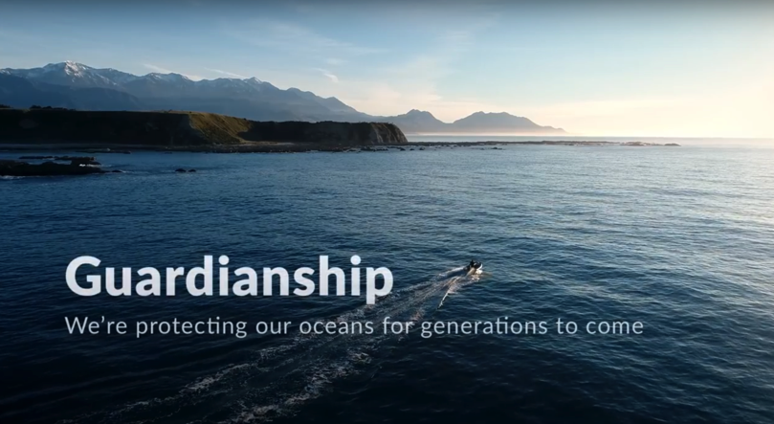
TRADITIONAL FISHERIES MANAGEMENT
HE PĀTAI / CONSIDER THIS
Who is responsible for ensuring our fisheries are managed sustainably?
What role can you play?
MAHI / ACTIVITY
Visit Te Ara – Traditional practices, invite a kuia or kaumātua or use your own knowledge to make a list of traditional fishery management tools used by Māori
MĀTAKI TĒNEI / WATCH THIS
Watch the short film
’Guardianship’ [4:48]
Notes:
TEACHER NOTES
MĀTAKI TĒNEI / WATCH THIS
https://www.youtube.com/watch?v=Obp4SU4zd8o
MAHI / ACTIVITY
Te Ara page is part of the story Te hī ika Māori fishing – Traditional Practices located at: https://teara.govt.nz/en/te-hi-ika-maori-fishing/page-3
Traditional fishery management tools include:
Karakia
Te ika whaktaki – the first fish thrown back
Maui / Talismans
Prohibitions / Rāhui

Slide 22
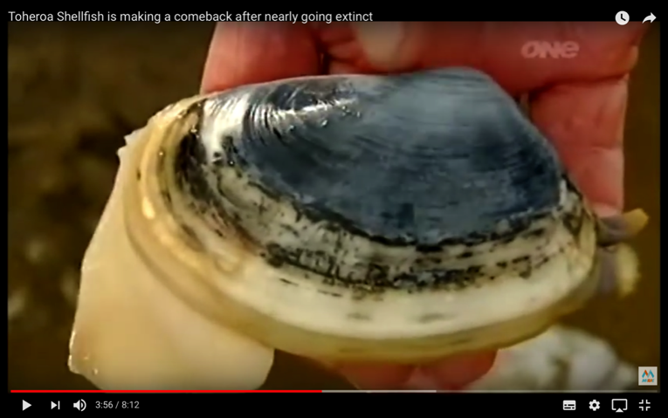
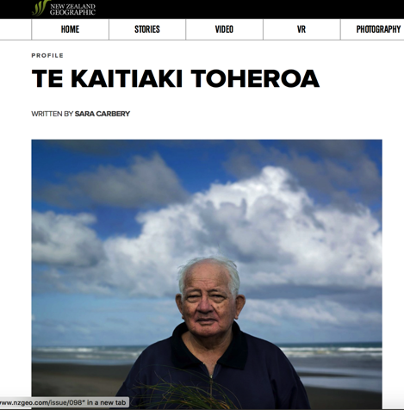
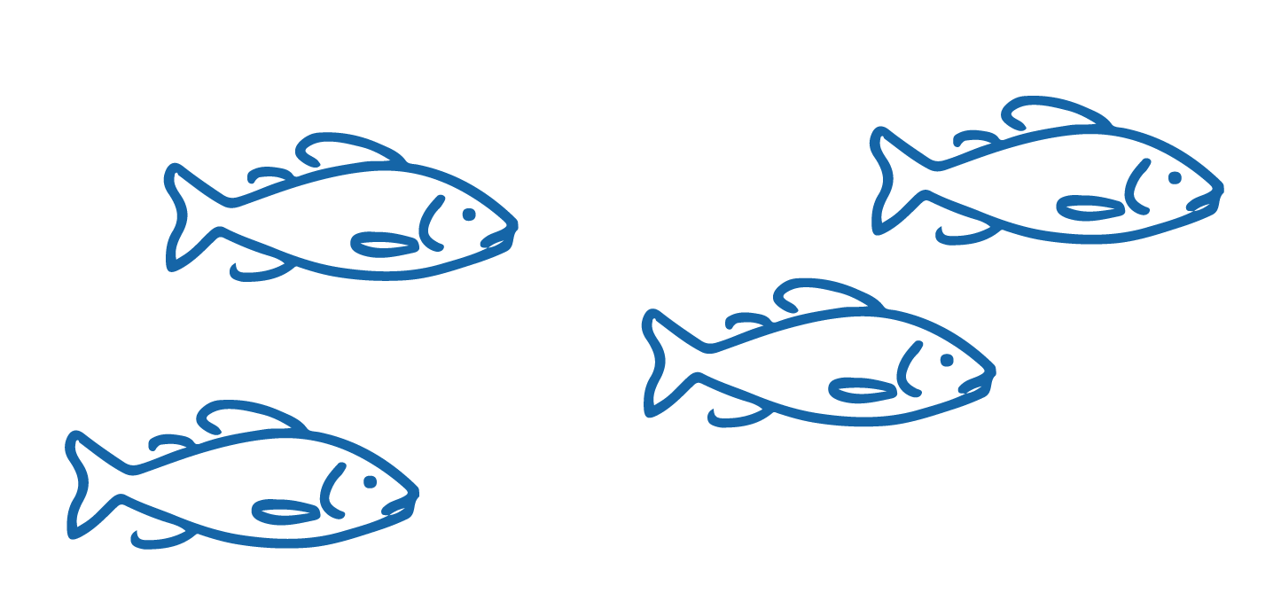
TRADITIONAL FISHERIES MANAGEMENT
MĀTAKI TĒNEI / WATCH THIS
MaraeTV story [8:12] about Toheroa local kaitiaki Jim and Barry
MAHI / ACTIVITY
Read the story Te Kaitiaki Toheroa
Complete Te Kaitiaki Toheroa Worksheet
Notes:
TEACHER NOTES
MĀTAKI TĒNEI / WATCH THIS
https://www.youtube.com/watch?v=x0GcneKoT18
MAHI / ACTIVITY
https://www.nzgeo.com/stories/te-kaitiaki-toheroa/#https://www.nzgeo.com/stories/te-kaitiaki-toheroa/
Complete the Te Kaitiaki Toheroa Worksheet and discuss answers.
USEFUL RESOURCES / RĀRANGI PUKAPUKA
For a more detailed and up to date article see: Decades of fishing bans have not rescued seafood delicacy toheroa at https://www.stuff.co.nz/environment/110671140/decades-of-fishing-bans-have-not-rescued-seafood-delicacy-toheroa
To deepen learning about toheroa and the role of mātauranga Māori and science in fisheries management WATCH Toheroa: Rejuvinating a Delicacy [26:05] (https://www.sciencelearn.org.nz/videos/565-toheroa-rejuvenating-a-delicacy)

Slide 23
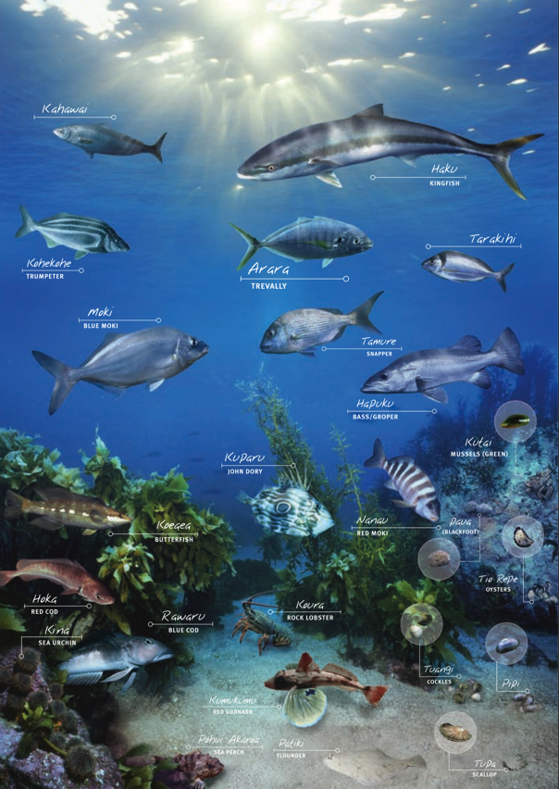
TRADITIONAL FISHERIES MANAGEMENT
KŌRERORERO / DISCUSSION
Traditional Māori fisheries management tools still ‘live’
The Quota Management System (QMS) and Māori customary fishing regulations enable
  Appointment of kaitiaki / tiaki [guardians]
  Rāhui [temporary bans] on fishing / fishing areas
  Acknowledgement of rohe moana [traditional fishing grounds]
  Establishment of mataitai and taiāpure [traditional fishery management areas]
Source: Fisheries New Zealand
Notes:
TEACHER NOTES
We will explore customary fisheries today under the QMS in more detail in 5.3
For more detailed information on Customary Fisheries under the QMS see the Customary Fisheries Manual: https://openseas.org.nz/wp-content/uploads/2017/06/MPI_CustomaryFishingManual_2009.pdf

Slide 24
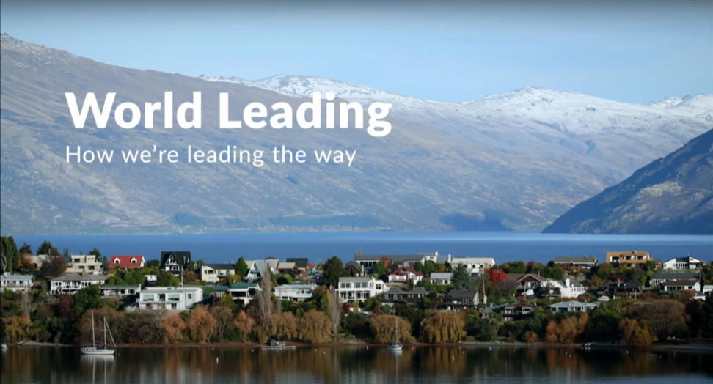
QUOTA MANAGEMENT SYSTEM (QMS)
Focus Question: What are key features of the Quota Management System (QMS)
KŌRERORERO / DISCUSSION
New Zealand fisheries are managed under the Quota Management System (QMS)
MĀTAKI TĒNEI / WATCH THIS
Short Seafood New Zealand film about our system for Fisheries Management [3:52]
Notes:
TEACHER NOTES
MĀTAKI TĒNEI / WATCH THIS
Film clip available at: https://www.youtube.com/watch?time_continue=229&v=LNRpuwN1XwI

Slide 25
QUOTA MANAGEMENT SYSTEM (QMS)
KŌRERORERO / DISCUSSION
Under the QMS, a yearly catch limit (the total allowable catch, TAC) is set for every fish stock
By controlling the amount of fish taken from each stock, the QMS helps keep New Zealand fisheries sustainable
The TAC sets rules about how much fish can be caught by recreational and customary fishing as well as commercial fishers
The commercial catch limits for each stock are known as the total allowable commercial catch (TACC)
Notes:
TEACHER NOTES

Slide 26
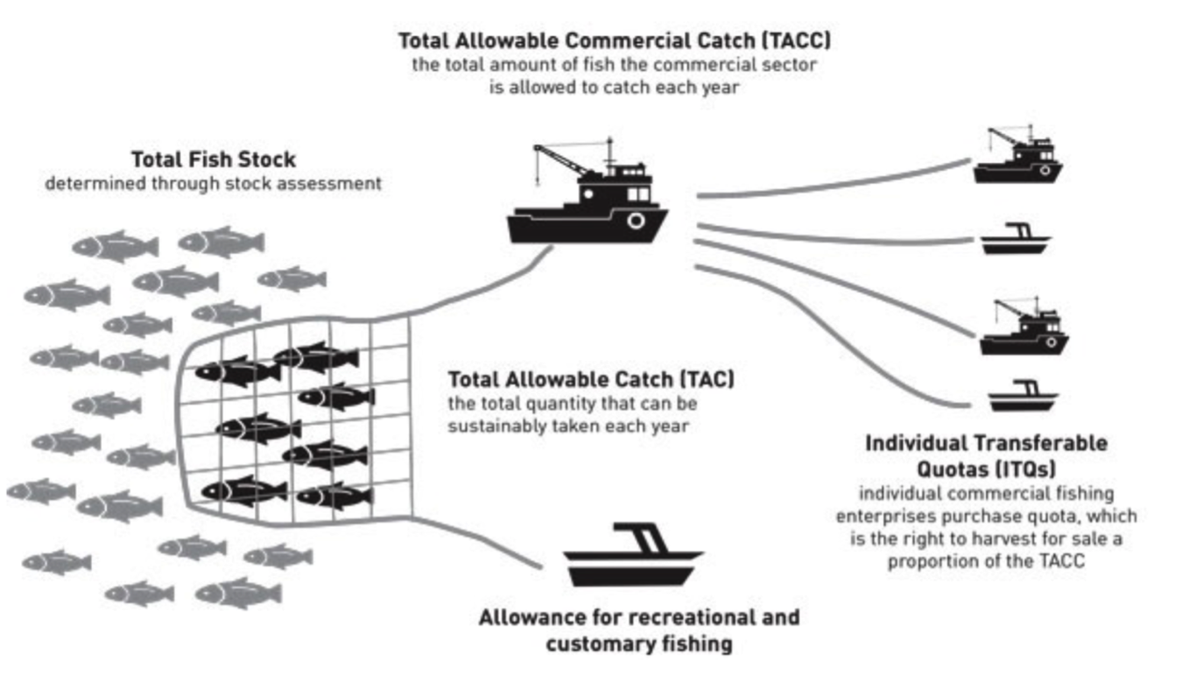
QUOTA MANAGEMENT SYSTEM (QMS)
KŌRERORERO / DISCUSSION
This diagram shows how fish stocks are shared amongst fishers under the QMS
MAHI / ACTIVITY
Complete QMS Worksheet
Source: Fisheries New Zealand
Notes:
TEACHER NOTES
Have students visit the following webpage and investigate. Identify three things they didn’t know about how fisheries are managed in Aotearoa New Zealand. In groups teach the rest of the class one of these three things (use mime, acting, skit …)
https://www.mpi.govt.nz/law-and-policy/legal-overviews/fisheries/quota-management-system/

Slide 27
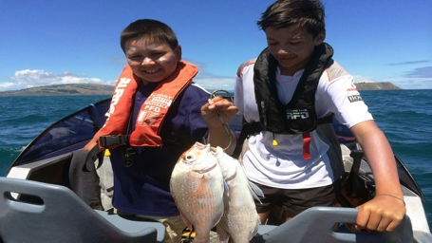
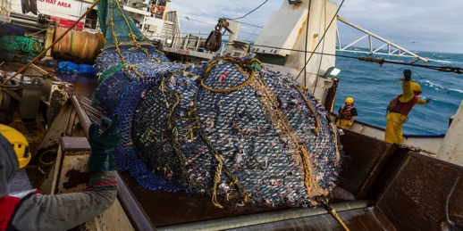

QUOTA MANAGEMENT SYSTEM (QMS)
Source: Ministry for the Environment
50% of fish are allocated to RECREATIONAL fishers and for CUSTOMARY MĀORI fishing
Recreational and customary fishers are not allowed to SELL their catch
There are size and catch limits for fish they can take
KŌRERORERO / DISCUSSION
50% of fish are allocated to COMMERCIAL fishers
They must BUY quota for each species of fish they want to catch
A commercial fisher must have quota in order to fish commercially
Notes:
TEACHER NOTES

Slide 28
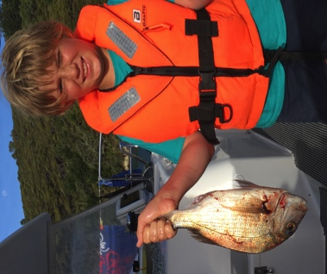
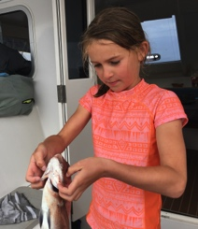
QUOTA MANAGEMENT SYSTEM (QMS)
HE PĀTAI / CONSIDER THIS
Why can’t these kids sell their fish? Is this fair?
Imagine a commercial fisher sees a recreational fisher at the wharf selling their catch, what might they feel / say?
Have you ever caught a fish? Or thrown an undersized fish back in to the sea?
MAHI / ACTIVITY
Complete Customary
and Recreational Fisheries Worksheet
Source: Ministry for
the Environment
Notes:
TEACHER NOTES

Slide 29
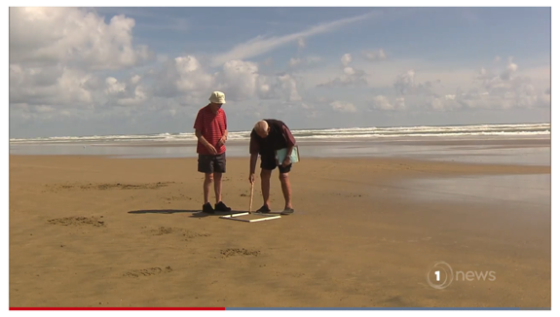
QUOTA MANAGEMENT SYSTEM (QMS)
KŌRERORERO / DISCUSSION
Selling fish without quota is illegal under the QMS
Taking fish beyond the recreational limit or without a customary permit is also illegal
MAHI / ACTIVITY
Complete the illegal fishing activity (see Teacher Outline)
MĀTAKI TĒNEI / WATCH THIS
Short film [2:07] to find out from Jim and Barry (Ngā kaitiaki toheroa) about how illegal fishing has impacted toheroa
  We look at illegal fishing in more detail in Topic 6
Notes:
TEACHER NOTES
Article and film clip can be found at https://www.tvnz.co.nz/one-news/new-zealand/elderly-kaipara-men-s-fight-help-conserve-prized-toheroa-shellfish
MAHI / ACTIVITY
Illegal fishing activity: Break learners in to groups and have each group research one article about illegal fishing (see Teacher Outline on the Quote Management System pages 8 and 9). Questions are provided. Report back to the rest of the group.

Slide 30
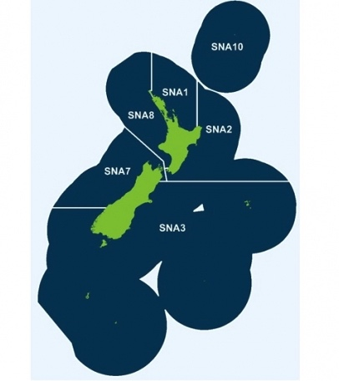

QUOTA MANAGEMENT SYSTEM (QMS)
KŌRERORERO / DISCUSSION
Under the Quota Management System fish stocks are separated by Quota Management Areas (QMAs)
For example, the snapper fishery is divided into 6 areas
Each QMA has rules
HE PĀTAI / CONSIDER THIS
Do you know fishing rules for your area?
Source: MPI.govt.nz
Notes:
TEACHER NOTES

Slide 31

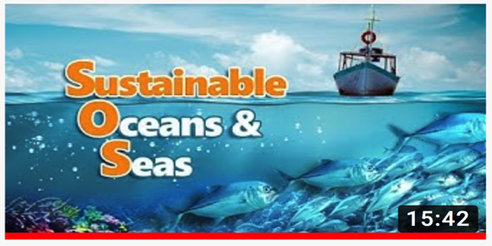
QUOTA MANAGEMENT SYSTEM (QMS)
KŌRERORERO / DISCUSSION
Some people say the QMS isn’t great
Others see it as a world leading example of well managed fisheries
MĀTAKI TĒNEI / WATCH THIS
Film [15:42] introducing sustainable fishing in Aotearoa New Zealand
MAHI / ACTIVITY
Use the Sustainable Oceans & Seas Worksheet or play Kahoot!
Conduct a survey of people’s opinions regarding the QMS [Teacher Outline]
Notes:
TEACHER NOTES
Film clip can be found at: https://www.youtube.com/watch?v=sDh2Cn2bNxk
NOTE: Filmed for an overseas audience so is interesting to see what children in other parts of the world are learning about Aotearoa NZ fisheries!
MAHI / ACTIVITY
Answer questions about what was watched using questions on Quota Management System Worksheet or Kahoot (see below).
Conduct a SURVEY of peoples opinions on the QMS [Teacher Outline]
Survey people’s knowledge and opinions on Aotearoa NZ laws around marine fishing. Simple multi choice questions that could include: Are they fishers? How often do they fish in the ocean? What is the main reason for fishing/-fun/food/both? Do they know the daily limits and size on fish and shellfish? Should this be more/less? Are recreational fishers allowed to sell their catch? What % of fish is caught by recreational fishers?
HOW TO PLAY KAHOOT
Connect a device to a projector or screen in front of the classroom.
Navigate to the game called Marine Stewardship Council NZ Kahoot page
https://www.msc.org/en-au/for-teachers/ocean-literacy/new-zealand-education-curriculum/kahoot-quizzes
Select settings
At Kahoot.it, learners enter game-pin and nickname on their own devices (phone, tablet, or computer).
Press “Start now”. The fun begins!
Learners answer questions on their own devices by selecting one of the four answer buttons.
See additional instructions, options, and how to make your own Kahoot at: https://kahoot.com

Slide 32
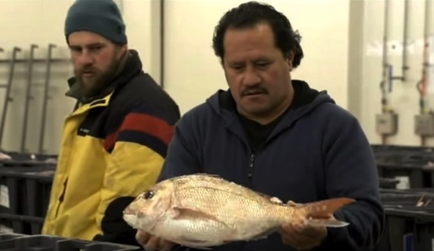
QUOTA MANAGEMENT SYSTEM (QMS)
Now switch positions.
Go stand on the opposite side.
Be prepared to argue the exact opposite.
Different viewpoints exist about fishing in Aotearoa New Zealand
MAHI / ACTIVITY
“Fisheries in Aotearoa New Zealand are sustainable, healthy and well managed”
Make a continuum – one side of the room is YES and the other NO. Where do you stand? Be prepared to justify your position!
MĀTAKI TĒNEI / WATCH THIS
Fishy Business [13:42] As you watch, choose a point of view that you particularly agree or disagree with.
Be prepared to discuss!
Notes:
TEACHER NOTES
MĀTAKI TĒNEI / WATCH THIS
Film clip can be found at: https://www.youtube.com/watch?v=tX-1nyykYJw

Slide 33
EEZ & LAW OF THE SEA
Focus Question: What is the EEZ & how is this relevant to fishery management?
HE PĀTAI / CONSIDER THIS
Can a commercial fishing boat from another country take fish (without quota) from our waters within 200 nautical miles from land?
Why or why not?
NO! They can’t! They would need to purchase quota under the QMS!
The United Nations Convention on the Law of the Sea (UNCLOS) gave all countries the right to manage all resources out to 200 nautical miles from land
Notes:
TEACHER NOTES

Slide 34

EEZ & LAW OF THE SEA
HE PĀTAI / CONSIDER THIS
Where do Aotearoa New Zealand waters start and stop? Which fish are included under the QMS?
  KŌRERORERO / DISCUSSION
  We have a territorial sea (12 miles out to sea) (green area close to land) and all our laws apply within this area
  We manage all ocean resources out to 200 nautical miles (blue area)
  And we manage the seafloor beyond 200 miles (yellow area)
  MAHI / ACTIVITY
Create your own map of Aotearoa New Zealand. Label the EEZ, Territorial Sea and Continental shelf territory!
Draw pictures or write some notes to remind yourself what rights we have in each zone!
Need Help? Visit MFE’s marine page
Notes:
TEACHER NOTES
For more information about our oceans and UNCLOS see – NZ Foreign Affairs and Trade page at https://www.mfat.govt.nz/en/environment/oceans-and-fisheries/
For a different map and more information on maritime zones see – NZ Foreign Affairs and Trade page at https://www.mfat.govt.nz/en/environment/oceans-and-fisheries/our-maritime-zones-and-boundaries/?m=137898#search:ZWV6IGJvdW5kYXJpZXM=
For more information about international fisheries management see– NZ Foreign Affairs and Trade page athttps://www.mfat.govt.nz/en/environment/oceans-and-fisheries/#bookmark6
MFE marine zone page is at: https://environment.govt.nz/facts-and-science/marine/

Slide 35
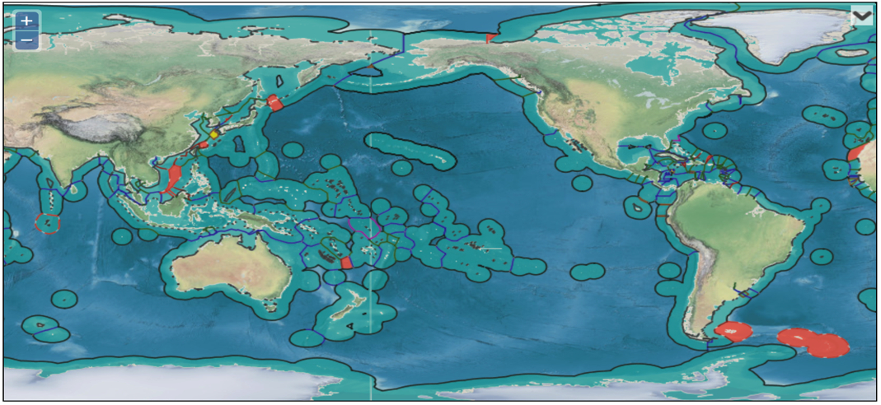
EEZ & LAW OF THE SEA
KŌRERORERO / DISCUSSION
All countries with coastal boundaries manage fisheries within their EEZ (Exclusive Economic Zone)
MAHI / ACTIVITY
Open this interactive map
Look at all the EEZs - how does our EEZ compare to other countries? Can you see any countries that have no EEZs? Or countries with very large EEZs?
Zoom in to your home area. Can you find the part of the ocean closest to where you live?
Source: marineregions.org
Notes:
TEACHER NOTES
Interactive map can be found at: See: https://www.marineregions.org/eezmapper.php
Large EEZs include:
France (due to all it’s protectorates)
USA; Australia; Russia; New Zealand; UK; Indonesia; Canada; Japan; Chile; Brazil
Landlocked countries have no EEZ and include:
Switzerland
Rwanda
Burundi
Hungary
Malawi
Austria
Serbia Slovakia
Afganistan
Zimbabwe
Laos
Monbgloia
Ethiopia
USEFUL RESOURCES / RĀRANGI PUKAPUKA
Awesome oceans facts: https://www.worldatlas.com/aatlas/infopage/oceans.htm#anchor1

Slide 36

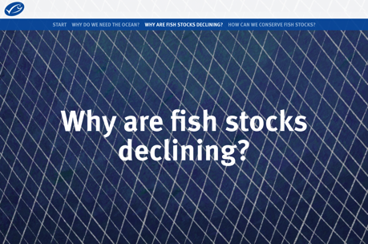
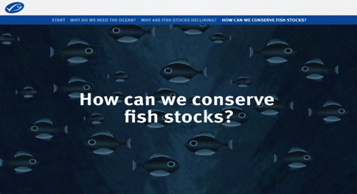
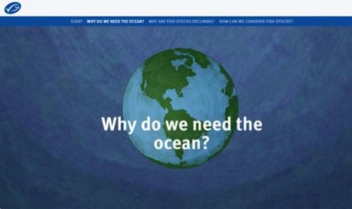
REVIEWING KEY CONCEPTS – FISHERY MANAGEMENT
Focusing Question: What have we learnt?
MAHI / ACTIVITY
This is a great summary of this fisheries management
Review the summary of much covered in this topic on the global MSC website
Notes:
TEACHER NOTES
The summary can be found at: https://dad-fishes-for-the-future.msc.org/?_ga=2.178911460.1759312358.1578727525-1836922175.1578727525#start-dOPb2kpn4D

Slide 37
REVIEWING KEY CONCEPTS
MAHI / ACTIVITY
Play the fisheries management game! This is fun and a great way to summarise and reflect on learning!
[see teacher outline]
Make a quiz! Reflect on what you have learnt – write two questions and answers and hand them in to your teacher!
Notes:
TEACHER NOTES

