Slide 1
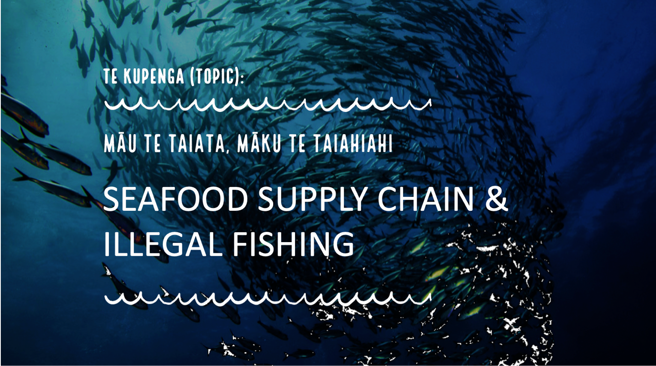
[Version 1.3 – 2024]

Slide 2


Notes:
TEACHER NOTES

Slide 3

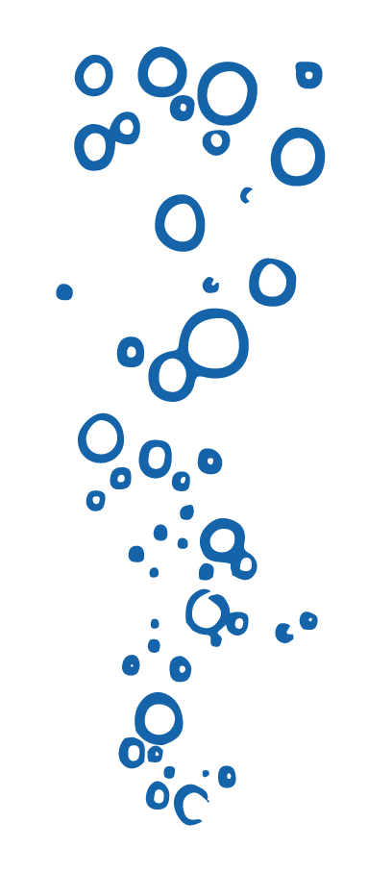
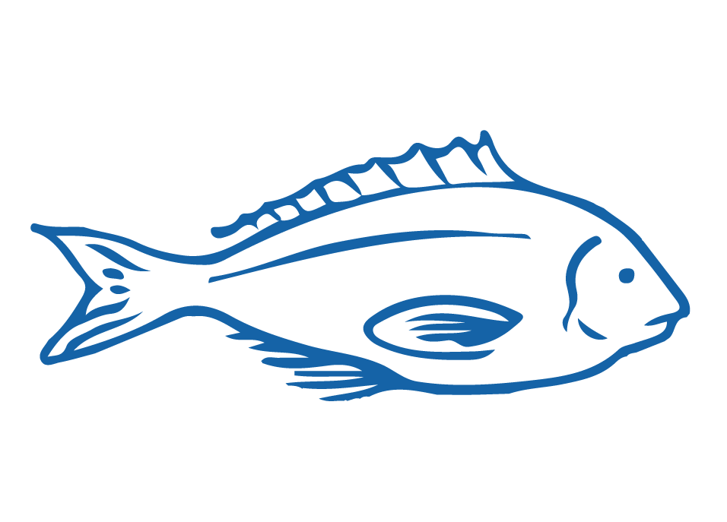


HELPFUL STUFF FOR TEACHERS
Target age range:
10–15 years
Welcome to OUR STORY!
This topic explores the Seafood Supply Chain (including Jobs in the seafood industry) and Illegal fishing
Focus: Seafood supply chain, jobs & illegal fishing
Curriculum Level: Level 3 - 5+
Curriculum: Geography; Science; Social Science; Tikanga-ā-iwi; Pūtaiao; Hauora
Key competencies: Thinking; Managing Self; Relating to others
Planning: See also the Seafood Supply Chain & Illegal Fishing Planner and teacher notes below slides
Extending learning: See Topic Outlines and slides labelled expert [top right corner]

Slide 4
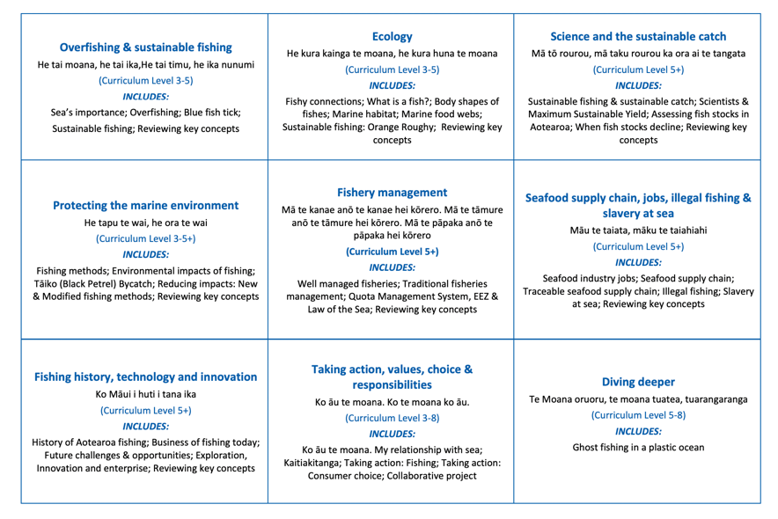

HELPFUL STUFF FOR TEACHERS
Welcome to OUR STORY!
This topic explores the Seafood Supply Chain (including Jobs in the seafood industry) and Illegal fishing
Notes:
TEACHER NOTES

Slide 5
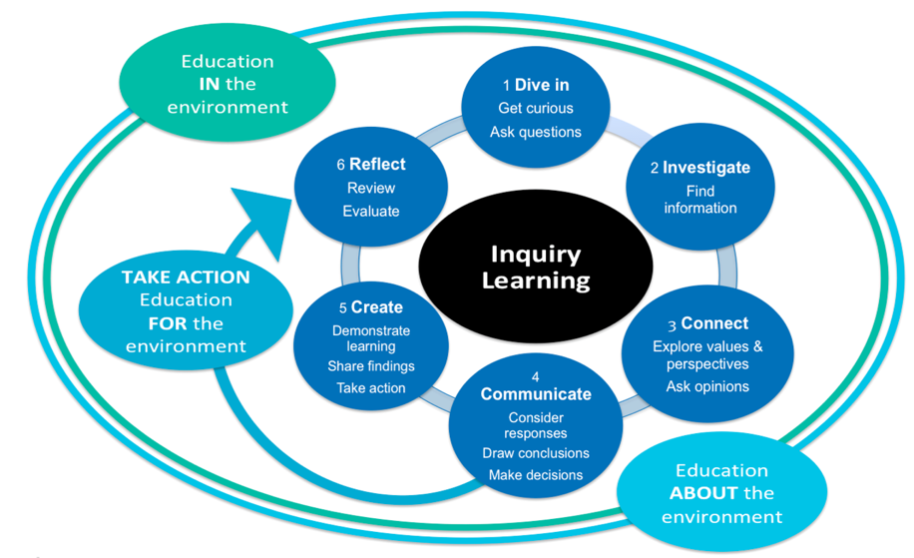
HELPFUL STUFF FOR TEACHERS
Notes:
TEACHER NOTES

Slide 6


IN THIS TOPIC WE WILL LEARN ABOUT…
Investigate fishing and seafood industry related jobs
Identify key steps in the chain that supplies seafood from the ocean to our plate
Explain how traceability in the seafood supply chain can help achieve sustainable fishing and prevent illegal fishing
Describe one or more types of illegal fishing and how this can impact on sustainability of a fish stock
Describe the key drivers for human rights issues on fishing vessels at sea
Use seafood industry related vocabulary
Notes:
TEACHER NOTES
See Topic Planner or Teacher Outlines for LOs, Focus Questions and conceptual understandings

Slide 7



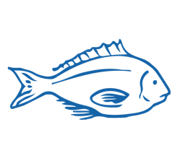
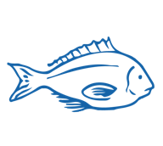
MIHI / INTRODUCTION
Can you imagine a world without fish?
What would that be like?
No more sushi! No more fishing!
No more fish & chips! No more….?
Notes:
TEACHER NOTES
Try to get learners to connect with the personal impact of overfishing and unsustainable practices.
What would it be like for ME if there were few or no fish left in the sea!

Slide 8
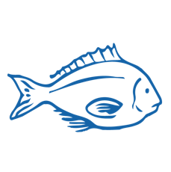
MIHI / INTRODUCTION
The good news is… some special people are working hard to make sure this doesn’t happen!
In this topic look more closely at fisheries jobs, the seafood supply chain, illegal fishing and forced labour at sea!
Let’s take a moment to think about what we already know about working in the seafood and fishing industries

Slide 9



SEAFOOD INDUSTRY JOBS
Focus Question: What jobs do people do in the seafood industry?
HE PĀTAI / CONSIDER THIS
Do you know any one who works in the seafood and fishing industry?
What do they do in their job?
What do you think it might be like working on a fishing boat?
MAHI / ACTIVITY
Complete the Prior Knowledge Chart columns 1 & 2
Fishing jobs PRIOR KNOWLEDGE CHART
What we know | What we would like to know | What we have learned
Notes:
TEACHER NOTES
You could go also look at the topic Sustainable Fishing and Overfishing

Slide 10
SEAFOOD INDUSTRY JOBS
KŌRERORERO / DISCUSSION
About 600,000 tonnes of seafood (excluding aquaculture) is harvested from New Zealand's waters each year
2,500 people work in commercial fishing & aquaculture at sea
New Zealand’s seafood industry employs over 13,000 full time workers
Facts & Figures from Seafood New Zealand
Notes:
TEACHER NOTES
USEFUL RESOURCES / RĀRANGI PUKAPUKA
For more information see the Seafood New Zealand’s facts and figures: https://www.seafoodnewzealand.org/industry/key-facts/
INVITE a local commercial fisher to come and talk about what it’s like to work at sea.

Slide 11

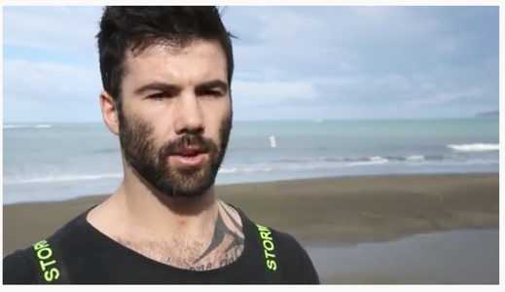
SEAFOOD INDUSTRY JOBS
HE PĀTAI / CONSIDER THIS
What would be good about doing Johnny’s job?
What would you find hard about doing Johnny’s job?
Did anything surprise you about what Johnny says about fishing for rock lobster?
MĀTAKI TĒNEI / WATCH THIS
Seafood NZ’s short film [3:22] Meet Johnny Burkhart, a rock lobster fisherman based in the Wairarapa.
Notes:
TEACHER NOTES
https://www.youtube.com/watch?v=2GAvyyw-Z-M

Slide 12
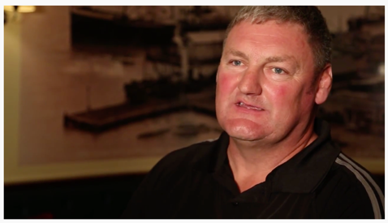
SEAFOOD INDUSTRY JOBS
HE PĀTAI / CONSIDER THIS
What does Tony catch?
How is Tony’s job different to Johnny’s?
What would you enjoy and not enjoy about Tony’s job?
Did anything surprise you about what Tony says about fishing?
MĀTAKI TĒNEI / WATCH THIS
Seafood NZ’s short film [3:08] Meet Capt. Tony Roach, an inshore skipper from Nelson
Notes:
TEACHER NOTES
They leave in the afternoon not the morning
They catch fish not crayfish
https://www.youtube.com/watch?v=MAYOi1Rm91o

Slide 13
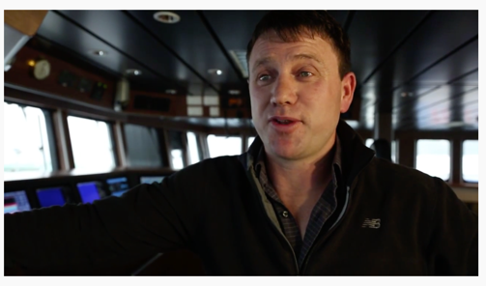
SEAFOOD INDUSTRY JOBS
HE PĀTAI / CONSIDER THIS
What type of fish does Chris catch and where?
What does Chris do to help ensure his fishing is sustainable?
How does the job, and type of fishing that Chris does, differ to that of Tony and Jonny?
MĀTAKI TĒNEI / WATCH THIS
Seafood NZ’s short film [3:08] Meet Capt. Chris Patrick, a deepwater skipper from Nelson.
Notes:
TEACHER NOTES
https://www.youtube.com/watch?time_continue=3&v=ZKGAF-upwrM
Chris works in the deep water and his vessel is factory capable
Likely to stay at sea for much longer periods of time

Slide 14
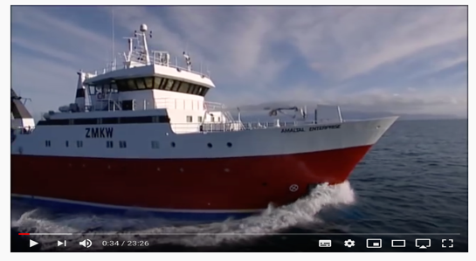
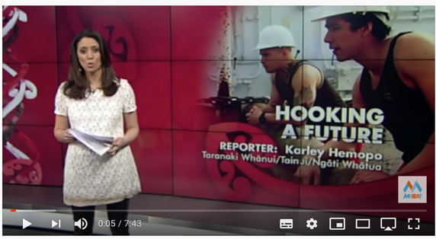
SEAFOOD INDUSTRY JOBS
MĀTAKI TĒNEI / WATCH THIS
Just the Job – Deep Sea Fishing [23: 26] investigating three different jobs working in deep sea fishing
MĀTAKI TĒNEI / WATCH THIS
Seafood NZ’s short film [7:43] A career in deep-sea fishing for young Māori
Notes:
TEACHER NOTES
Film clip #1: https://www.youtube.com/watch?v=dTxj1LAzy6s [if too long you could just watch one of the three job sections within this film]
Film clip #2: https://www.youtube.com/watch?v=WsYDcW-VWeQ

Slide 15
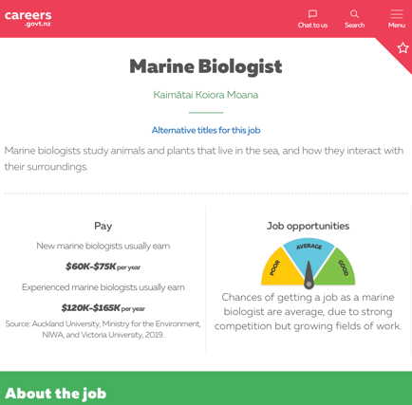
SEAFOOD INDUSTRY JOBS
KŌRERORERO / DISCUSSION
There are lots of cool jobs related to fishing! What do you need to know to work in a seafood industry job? How much will you earn?
MAHI / ACTIVITY
To find out… visit Careers New Zealand website. Your teacher will give you the name of a fishing related career.
Take the Career Quest Quiz.
Notes:
TEACHER NOTES
Fishing – we’re at the heart of communities can be found at: https://www.youtube.com/watch?v=ku-rR0rRd_Q&t=3s
Career Quest Quiz https://www.careers.govt.nz/tools/careerquest/question

Slide 16
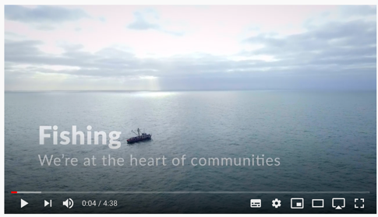
SEAFOOD INDUSTRY JOBS
MAHI / ACTIVITY
While watching this film, list all jobs you see people doing that are involved in the supply of seafood from ocean to plate
KŌRERORERO / DISCUSSION
Which job would you MOST like to do? Why?
Which would you LEAST like to do? Why not?
MĀTAKI TĒNEI / WATCH THIS
Seafood NZ’s short film [4:38] about the people and jobs that make up the fishing industry
Notes:
TEACHER NOTES
Fishing – we’re at the heart of communities can be found at: https://www.youtube.com/watch?v=ku-rR0rRd_Q&t=3s

Slide 17
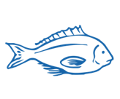
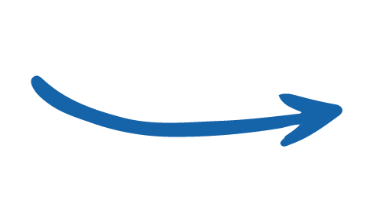
SEAFOOD SUPPLY CHAIN
Focus Question: What are key steps in the chain that delivers seafood from the ocean to our plates
The seafood supply chain is the chain of steps that happens to supply seafood from the ocean to your plate
MAHI / ACTIVITY
What do you already know about the chain of steps in the supply of seafood?
Complete the ‘What we know about fish?’ columns 1 & 2
What do we know about THE SEAFOOD SUPPLY CHAIN? PRIOR KNOWLEDGE CHART
What we know | What we would like to know | What we have learned
Notes:
TEACHER NOTES
Complete columns one and two and then add information to three at the end of 2.2

Slide 18
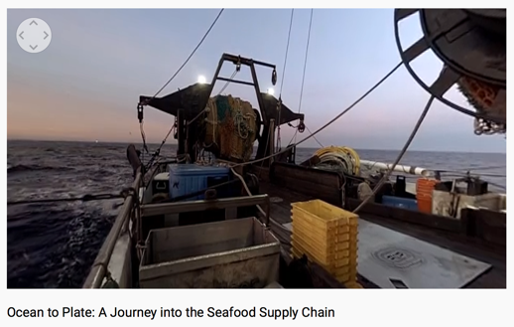
SEAFOOD SUPPLY CHAIN
MAHI / ACTIVITY
While watching this film write down steps in the journey of a fish from the ocean to a plate?
Fisheries shown here are not MSC certified.
KŌRERORERO / DISCUSSION
Think about what you saw in this film
What improvements would you make to the ocean to plate seafood supply chain?
MĀTAKI TĒNEI / WATCH THIS
WWF short film [7:02] about seafood supply chain
Notes:
TEACHER NOTES
Ocean to Plate – Seafood Supply Chain film link: https://www.youtube.com/watch?v=pkfgILiGbVk

Slide 19
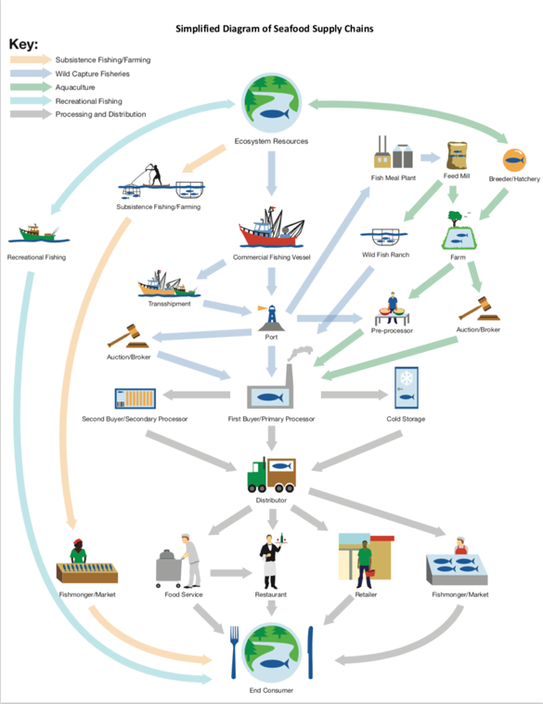
SEAFOOD SUPPLY CHAIN
KŌRERO PUKAPUKA / READ
Read & discuss: Ocean to plate in 36 hours: the Lee Fish Story
MAHI / ACTIVITY
In groups: use your notes from last slide. Draw a flow diagram showing steps a fish journeys through from the ocean to your plate (See Teacher Outline)
Click again for example!
Source: FishWise.org
Notes:
TEACHER NOTES
An example of a supply chain diagram is provided – found at http://fishwise.org/wp-content/uploads/2017/12/Seafood_Supply_Chains.pdf
https://www.nzstory.govt.nz/news/ocean-to-plate-in-36-hours-the-lee-fish-story/

Slide 20
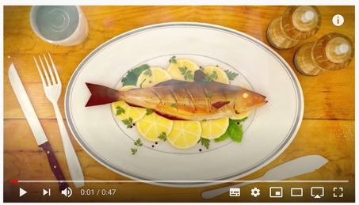
A VERIFIED SEAFOOD SUPPLY CHAIN
Focus Question: How does verification in the supply chain contribute to sustainable seafood?
KŌRERORERO / DISCUSSION
Seafood fraud is common!
Seafood fraud is the selling of seafood with a misleading label, description or promise
HE PĀTAI / CONSIDER THIS
If someone labelled and sold fish as sustainable but it wasn’t – that would be an example of seafood fraud!
What other examples of seafood fraud can you think of?
MĀTAKI TĒNEI / WATCH THIS
Short film [0:47] about Sustainable seafood from ocean to plate: Choose MSC certified sustainable fish
Notes:
TEACHER NOTES
Film clip can be found at
https://www.youtube.com/watch?time_continue=40&v=Kac1cqkjX1U&feature=emb_logo

Slide 21

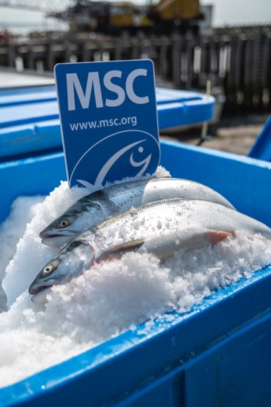
A VERIFIED SEAFOOD SUPPLY CHAIN
KŌRERORERO / DISCUSSION
Verification:
Is the ability to trace a fish directly back to its point of origin
Prevents illegal products from entering the supply chain
Protects consumers and the efforts of everyone working hard to keep our oceans healthy
Notes:
TEACHER NOTES
Film clip can be found at
https://www.youtube.com/watch?time_continue=40&v=Kac1cqkjX1U&feature=emb_logo

Slide 22
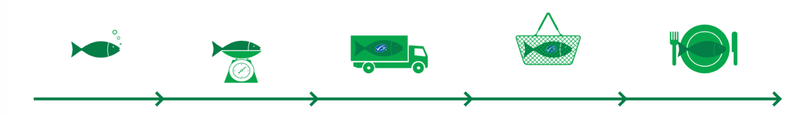
A VERIFIED SEAFOOD SUPPLY CHAIN
KŌRERORERO / DISCUSSION
The Marine Stewardship Council:
Work to ensure seafood sold with a sustainable label is in fact sustainable
Are working on creating verified seafood supply chains
Notes:
TEACHER NOTES
https://www.msc.org/en-us/what-we-are-doing/driving-change/traceable-seafood

Slide 23
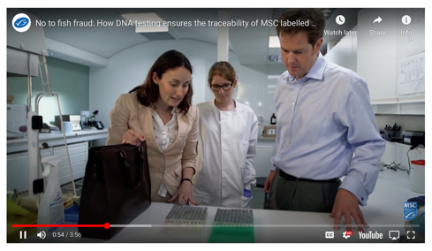
A VERIFIED SEAFOOD SUPPLY CHAIN
HE PĀTAI / CONSIDER THIS
Is being able to verify that your fish is sourced legally a good idea?
Why / Why not?
What ideas do you have about how this could be done?
MĀTAKI TĒNEI / WATCH THIS
WWF short film [3:56] about verification in the supply chain
Notes:
TEACHER NOTES
https://www.msc.org/en-us/what-we-are-doing/driving-change/traceable-seafood

Slide 24
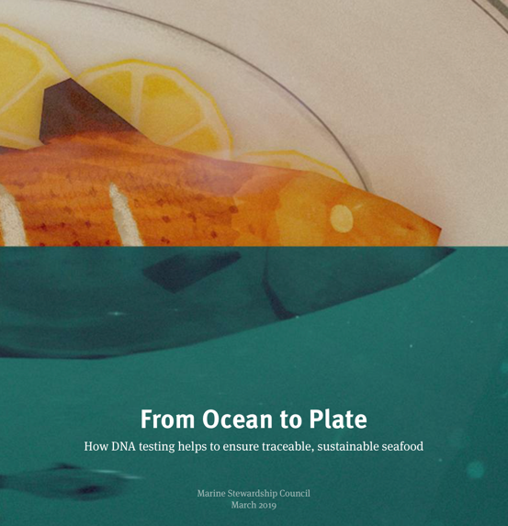
A VERIFIED SEAFOOD SUPPLY CHAIN
Experts ONLY!
KŌRERO PUKAPUKA / READ
Read From Ocean to Plate
MAHI / ACTIVITY
Complete Ocean to Plate worksheet
&
Explore the relationship between supply chain and illegal fishing using the interactive FishWise tuna supply chain
Notes:
TEACHER NOTES
http://ocean-to-plate-stories.msc.org/?
https://fishwise.org/salt/tuna-supply-chain/
_ga=2.3247414.782480448.1599085705-1303352827.1595455374
USEFUL RESOURCES / RĀRANGI PUKAPUKA
For an Aotearoa New Zealand take on the verified seafood supply see:https://www.nzstory.govt.nz/news/ocean-to-plate-in-36-hours-the-lee-fish-story/

Slide 25
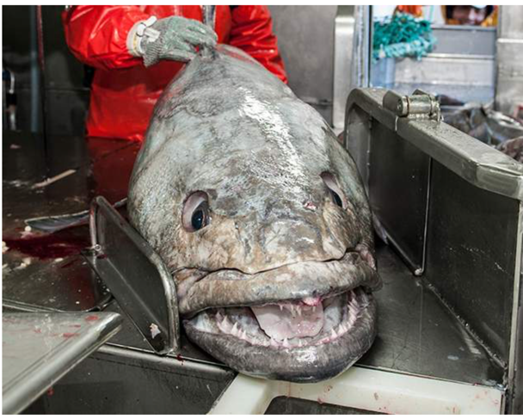
ILLEGAL FISHING
Focus Question: What is illegal, unregulated and unreported fishing & how does it impact sustainability?
KŌRERORERO / DISCUSSION
Illegal, unreported, and unregulated (IUU) fishing is when people fish outside of the law and is a big problem around the world
It is often conducted without concern for marine life or the environment and includes:
Patagonian Toothfish
Notes:
TEACHER NOTES
USEFUL RESOURCES / RĀRANGI PUKAPUKA
Read more about MSC certification and how it helped the sustainability of Patagonion Tooth Fish:
http://patagonian-toothfish-story.msc.org
http://blog.msc.org/blog/2015/05/14/patagonia-toothfish/
Find out more about the toothfish fishery from the research conducted by NIWA: https://niwa.co.nz/fisheries/research-projects/antarctic-fisheries-research/the-toothfish-fishery

Slide 26
ILLEGAL FISHING
HE PĀTAI / CONSIDER THIS
Have you ever taken or sold seafood when you shouldn’t have?
Why do you think people sometimes take or sell kai moana that they shouldn’t?
What impact can illegal fishing and sale of kai moana have on our environment?
MAHI / ACTIVITY
Fill in columns 1 & 2
Illegal fishing PRIOR KNOWLEDGE CHART
What we know | What we would like to know | What we have learned
Notes:
TEACHER NOTES

Slide 27
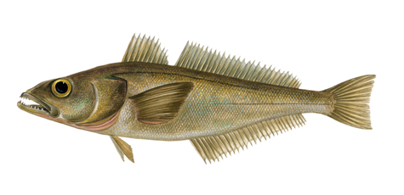
ILLEGAL FISHING
KŌRERORERO / DISCUSSION
Illegal fishing for Patagonian toothfish threatened the sustainability of this fish
MAHI / ACTIVITY
In the past, illegal fishing for Patagonian toothfish threatened sustainability of fish stocks
Read more about the Toothfish story and the hunt for pirate fishers
Notes:
TEACHER NOTES
USEFUL RESOURCES / RĀRANGI PUKAPUKA
Read more about MSC certification and how it helped the sustainability of Patagonion Tooth Fish:
http://patagonian-toothfish-story.msc.org
http://blog.msc.org/blog/2015/05/14/patagonia-toothfish/
Find out more about the toothfish fishery from the research conducted by NIWA: https://niwa.co.nz/fisheries/research-projects/antarctic-fisheries-research/the-toothfish-fishery

Slide 28

ILLEGAL FISHING
A. Fishing that is either not reported or not reported truthfully
B. Fishing by NZ boats for fish not covered by fishing laws or outside our fishery areas OR fishing by overseas boats with no permission in our fishing waters
C. Fishing by NZ boats or in NZ waters that is not conducted according to NZ law
MAHI / ACTIVITY
See if you can match these terms (1, 2, 3) to the definitions (A, B, C):
  (1) illegal
  (2) unreported &
  (3) unregulated
Ready for some answers?
Notes:
TEACHER NOTES
(1) Illegal = C
(2) Unreported = A
(3) Unregulated = B

Slide 29

ILLEGAL FISHING
Ready for some answers?
HE PĀTAI / CONSIDER THIS
Which of the following do you think is not legal and is it an example of fishing that is
(1) Illegal
(2) Unreported or
(3) Unregulated
A recreational fisher selling fish
A commercial fisher failing to report their catch
A foreign vessel (with no quota) fishing for hapuka less than 200 miles from land
Notes:
TEACHER NOTES
(1) Illegal = A
(2) Unreported = B
(3) Unregulated = C

Slide 30
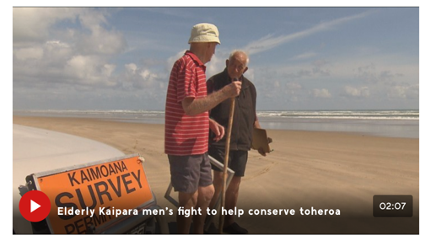
ILLEGAL FISHING
KŌRERORERO / DISCUSSION
In Aotearoa New Zealand selling fish without quota is illegal under the QMS
Taking fish beyond the recreational limit or without customary permit is also illegal
Let’s visit Jim and Barry (Ngā kaitiaki toheroa) and see how illegal fishing or ‘poaching’ has impacted toheroa
MĀTAKI TĒNEI / WATCH THIS
Short film [2:07] about why toheroa are not recovering on Ripiro Beach
Notes:
TEACHER NOTES
Article and film clip can be found at https://www.1news.co.nz/2020/01/11/elderly-kaipara-mens-fight-to-help-conserve-prized-toheroa-shellfish/

Slide 31
ILLEGAL FISHING
MAHI / ACTIVITY
Place yourself along a continuum (line) with strongly agree at one end and strongly disagree at the other end, based on your belief around the following statements
WHY? Justify your position with your neighbour!
“We all have a right to fish regardless of the rules”
“Illegal fishing has little impact on the environment or the sustainability of fisheries”
Strongly agree
Strongly disagree
Notes:
TEACHER NOTES
Spend time discussing and figuring out why they think what they do!

Slide 32

ILLEGAL FISHING
The Marine Stewardship Council is working hard to address illegal fishing as it is not sustainable
When you buy seafood that has the Blue Fish Tick you know that fish has been legally and sustainably caught
MAHI / ACTIVITY
Complete the illegal fishing worksheet
KŌRERORERO / DISCUSSION
IUU fishing threatens the sustainability of fish populations, ecosystems, and the livelihoods of those who fish legally
Notes:
TEACHER NOTES
How the MSC is working to tackle illegal fishing: http://blog.msc.org/blog/2015/04/01/tackling-illegal-fishing-one-certificate-at-a-time/

Slide 33
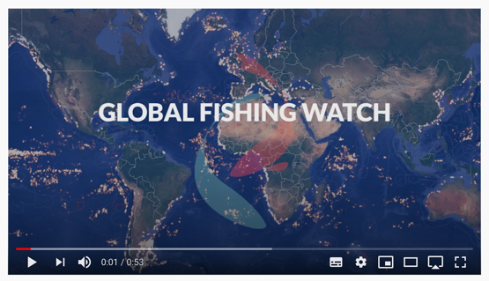
ILLEGAL FISHING
KŌRERORERO / DISCUSSION
Global Fishing Watch is an independent non profit organisation
Global Fishing Watch track global commercial fishing in real time
MĀTAKI TĒNEI / WATCH THIS
Short film about Global Fishing Watch [0:53]
Notes:
TEACHER NOTES
USEFUL RESOURCES / RĀRANGI PUKAPUKA
Visit Global Fishing Watch at https://globalfishingwatch.org/map/
Watch this about the Global Fishing Watch https://www.youtube.com/watch?v=ISbIUjCz8Pg
You can also track sustainable fisheries using the MSC Track a Fishery Tool
https://fisheries.msc.org/en/fisheries/
CONSIDER
Why are some areas fished more than others?

Slide 34
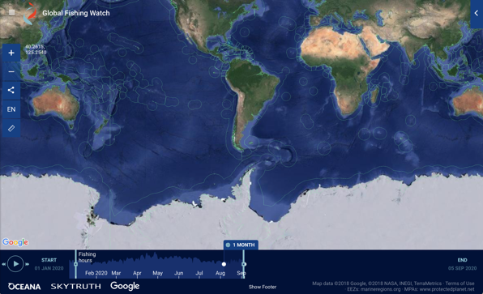
ILLEGAL FISHING
HE PĀTAI / CONSIDER THIS
Look at the global map? Where is most of the fishing activity? Why?
Where is most of the fishing happening around Aotearoa New Zealand right now?
Which parts of our ocean have the most activity (you can mouse over to see the number of objects)
MAHI / ACTIVITY
Visit the Global Fishing Watch site and explore the map
Notes:
TEACHER NOTES
Visit Global Fishing Watch at https://globalfishingwatch.org/map/
You can also track sustainable fisheries using the MSC Track a Fishery Tool: https://fisheries.msc.org/en/fisheries/
DEEPEN THE INQUIRY
To deepen learning and application of the Global Fishing Watch see a range of tutorials available at: https://globalfishingwatch.org/faqs/#faqs-video-tutorials
QUESTIONS:
Where is most of the fishing happening? Most activity in equatorial regions rather than polar ends of the map.
Why are some areas fished more than others? Mainly due to higher population (ie. More people living and fishing from mid latitudes than polar ones); (access (some areas easier to reach), underwater topography, currents etc affecting the ecology of the area and the abundance of fish (some areas are just better fishing!), legislation (some areas are protected)
How do you think global fishing watch help in the fight against illegal fishing? (transparency!)

Slide 35
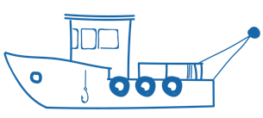
FORCED LABOUR AT SEA
Focus Question: Why do human rights abuses occur on fishing vessels at sea?
KŌRERORERO / DISCUSSION
Fishing on boats registered here in Aotearoa New Zealand can be a great job!
BUT there are cases of forced labour, piracy, and tough working conditions on some overseas fishing boats
Some of these boats fly ‘flags of convenience’
What is a flag of convenience?
Every boat must be registered with a county
Some vessels are registered and fly the flag of countries that cannot or will not enforce any rules
These are ‘flags of convenience’
Notes:
TEACHER NOTES
USEFUL RESOURCES / RĀRANGI PUKAPUKA
To learn more about flags of convenience see:
https://kids.kiddle.co/Flag_of_convenience

Slide 36
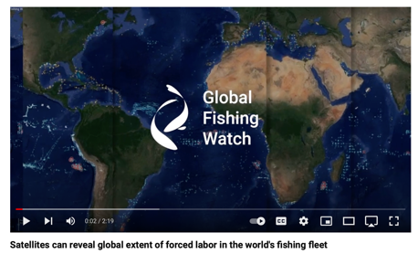
FORCED LABOUR AT SEA
KŌRERORERO / DISCUSSION
Why do you think people being forced to work for long periods of time at sea?
HE PĀTAI / CONSIDER THIS
The Marine Stewardship Council requires all certified fisheries to be checked to ensure they do not use forced labour or child labour aboard their fishing vessels.
MĀTAKI TĒNEI / WATCH THIS
Short clip about how satellites can reveal global extent of forced labour in the world's fishing fleet [2:19]
Notes:
TEACHER NOTES
Film clip can be found at: https://www.youtube.com/watch?v=G5gWgYoR_rU

Slide 37

FORCED LABOUR AT SEA
Experts ONLY!
KŌRERORERO / DISCUSSION
Forced labour and slavery at sea do not respect basic human rights
Human rights are rights that are believed to belong to every person
Example of a human right: the right to equality and freedom from discrimination
KŌRERO PUKAPUKA / READ
Read about the Human Rights at Sea organisation
HE PĀTAI / CONSIDER THIS
Why were they created and what do they do?
Notes:
TEACHER NOTES
https://www.humanrightsatsea.org/who-are-we/

Slide 38
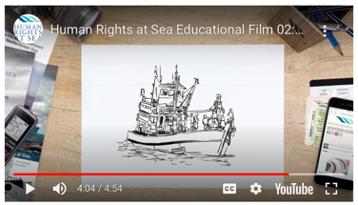
FORCED LABOUR AT SEA
Experts ONLY!
HE PĀTAI / CONSIDER THIS
What are labour rights?
What declaration was made in 1948?
What are three basic worker rights?
Are fishing vessels subject to maritime rights?
Are labour rights human rights?
MĀTAKI TĒNEI / WATCH THIS
Human Rights at Sea [4:54]
KŌRERO PUKAPUKA / READ
Read more about Marine Stewardship Council & human rights issues at sea!
Notes:
TEACHER NOTES
Film clip can be found at: https://www.humanrightsatsea.org/educational-material/labour-rights-and-human-rights/
He Pātai
What are labour rights? Human rights that relate to work
What is declaration was made in 1948? Universal Declaration of Human Rights
What are three basic worker rights? E.g. Right to work in job of choice; Equal pay; Right to appropriate rest and leisure time or could include Freedom from forced labour; Freedom from child labour etc
Are fishing vessels included in maritime rights? YES
Are labour rights human rights? YES
MSC on Human Rights: https://www.msc.org/what-we-are-doing/our-approach/forced-and-child-labour

Slide 39

REVIEWING KEY CONCEPTS
Focusing Question: What have we learnt?
MAHI / ACTIVITY
1. Select a job from the seafood supply chain that you would most love (or if there isn’t one then really not love to do).
2. Write down and be prepared to explain the following:
a. What is your job?
b. Why you would love / not love to do this job?
c. Where in the supply chain would your job fit?
d. In your job how could you help prevent illegal fishing?
3. Create a line across the room with ocean at one end and the plate at the other. Place yourself in that job along that ocean to plate supply chain line.
Notes:
TEACHER NOTES

Slide 40

He kura kainga te moana, he kura huna te moana
The oceans environment,
is a source of untapped knowledge
Notes:
TEACHER NOTES

