Slide 1
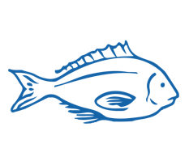
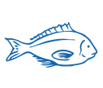
KAITIAKITANGA & SUSTAINABILITY Focus Question: What is my role in our kaitiakitanga of the ocean??
KŌRERORERO/ DISCUSSION
Kaitiakitanga is often understood as guardianship
Kaitiakitanga is about reciprocity
The ocean will sustain us only if it is looked after
MAHI / ACTIVITY
Complete the Kaitiakitanga worksheet
He tai moana, he tai ika,
He tai timu, he ika nunumi
A sea that is healthy, is a sea that flourishes with life
A sea in decline, becomes void of sea life
HE PĀTAI / CONSIDER THIS
What does this whakataukī or proverb suggest about looking after our ocean & kai moana [seafood]?
Notes:
TEACHER NOTES

Slide 2
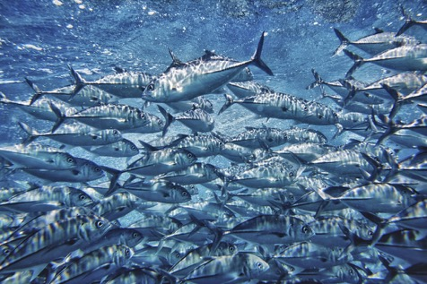
KAITIAKITANGA & SUSTAINABILITY
KŌRERORERO / DISCUSSION
The sea and its bounty is a Taonga Tuku iho [treasure passed down from previous generations]
If we are good kaitiaki [guardians] the sea will provide for generations to come
HE PĀTAI / CONSIDER THIS
Do you agree with this statement? If we are good kaitiaki [guardians] the sea will provide for generations to come - Why / Why not?
Notes:
TEACHER NOTES

Slide 3
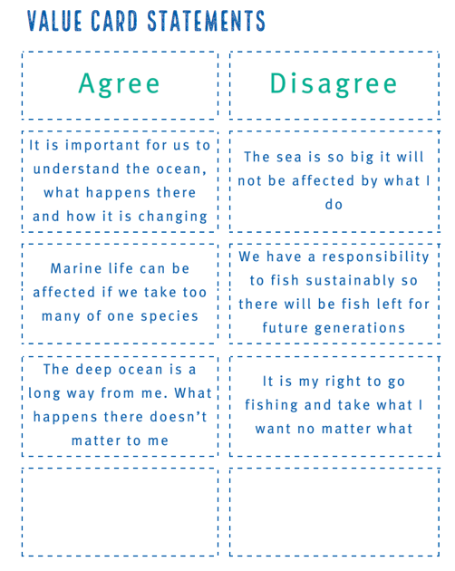
KAITIAKITANGA & SUSTAINABILITY
MAHI / ACTIVITY
Sort value statement cards according to what you agree and disagree with
(see Teacher Outline for cards)
Notes:
TEACHER NOTES
See teacher outline for fully developed activities and resources to support.

Slide 4
KAITIAKITANGA & SUSTAINABILITY
HE PĀTAI / CONSIDER THIS
People all over the world are thinking about looking after our environment
‘Sustainability’ is a term used when talking about the future of our planet!
Think about what you do every day (what you eat, where you live, what you buy…. What does the word ‘sustainability’ mean to you?
Sustainability is:
“development that meets the needs of the present without compromising the ability of future generations to meet their own needs”
Notes:
TEACHER NOTES
USEFUL RESOURCES / RĀRANGI PUKAPUKA
This definition of sustainable development comes from the Brundtland Report: Our Common Future. See: https://sustainabledevelopment.un.org/content/documents/5987our-common-future.pdf (see paragraph 27)

Slide 5
KAITIAKITANGA & SUSTAINABILITY
MAHI / ACTIVITY
Place yourself along a continuum (line) with strongly agree at one end & strongly disagree at the other based on your belief around the following statement:
“Human needs and requirements are more important than the protection of the environment. Resources (including seafood) should be fully exploited for human development.”
Strongly agree
Strongly disagree
Notes:
TEACHER NOTES
USEFUL RESOURCES / RĀRANGI PUKAPUKA
This definition of sustainable development comes from the Brundtland Report: Our Common Future. See: https://sustainabledevelopment.un.org/content/documents/5987our-common-future.pdf (see paragraph 27)

Slide 6
KAITIAKITANGA & SUSTAINABILITY
MAHI / ACTIVITY
Place yourself along a continuum (line) with strongly agree at one end & strongly disagree at the other based on your belief around the following statement:
“The ocean is a food basket. Marine life and other ocean resources primarily provide us with food and other uses.”
Strongly agree
Strongly disagree
Notes:
TEACHER NOTES
USEFUL RESOURCES / RĀRANGI PUKAPUKA
This definition of sustainable development comes from the Brundtland Report: Our Common Future. See: https://sustainabledevelopment.un.org/content/documents/5987our-common-future.pdf (see paragraph 27)

Slide 7
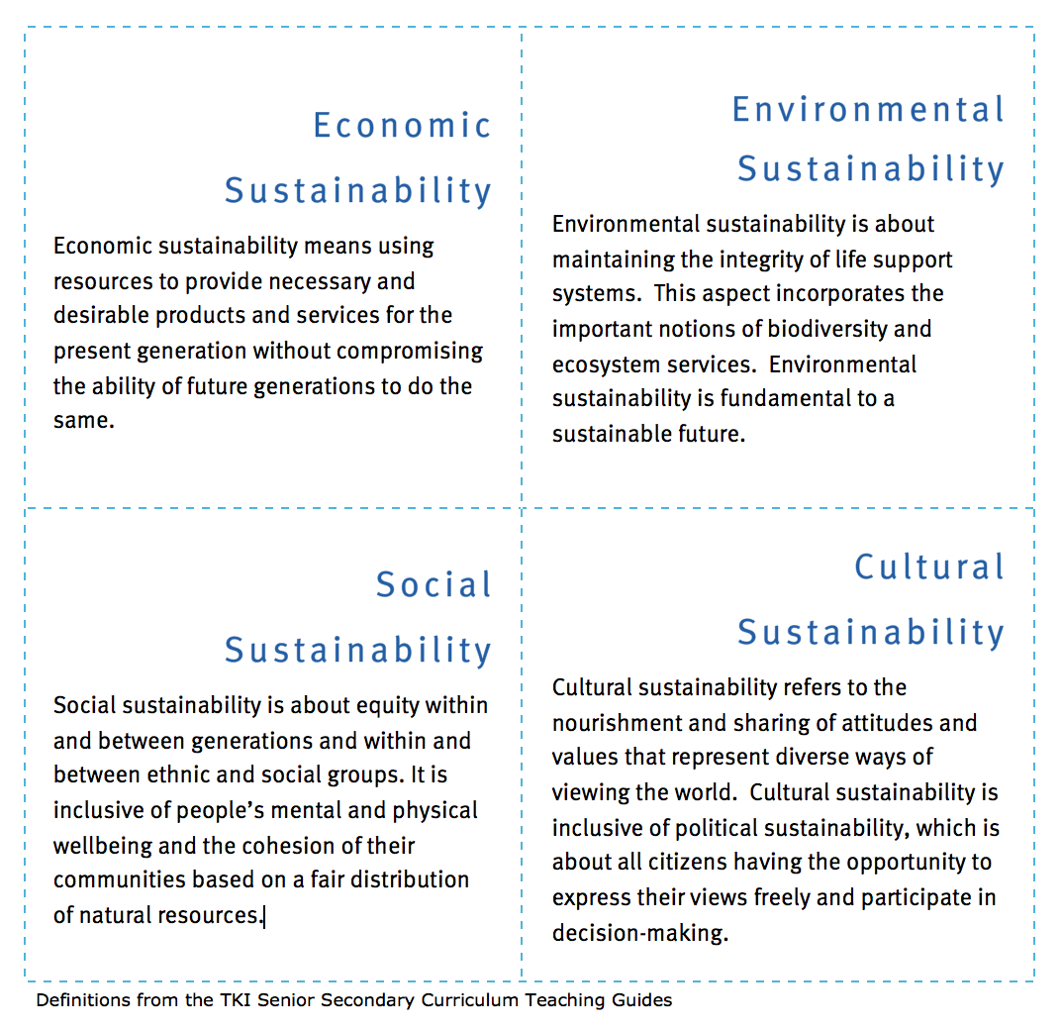
KAITIAKITANGA & SUSTAINABILITY
FOR THE EXPERTS!
HE PĀTAI / CONSIDER THIS
Consider different aspects of sustainability
Think about overfishing. Which aspect would each of the following relate to?
Notes:
TEACHER NOTES
Hoki story can be found at http://new-zealand-hoki.msc.org/

Slide 8
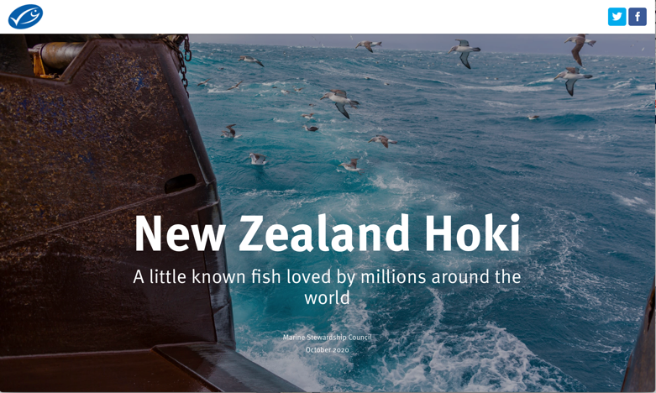
KAITIAKITANGA & SUSTAINABILITY
FOR THE EXPERTS!
KŌRERO PUKAPUKA / READ
Read the New Zealand Hoki story
MAHI / ACTIVITY
Consider different aspects of sustainability as they apply to the story of New Zealand hoki
(See Aspects of sustainability activity in Teacher Outline)
Notes:
TEACHER NOTES
Hoki story can be found at http://new-zealand-hoki.msc.org/

Slide 9
He tai moana, he tai ika,
He tai timu, he ika nunumi
A sea that is healthy, is a sea that flourishes with life
A sea in decline, becomes void of sea life
Whaktauki or proverb – it outlines a two way context; the need for caring for the ocean or the repercussions of mismanagement of resources
Notes:
TEACHER NOTES

