Slide 1

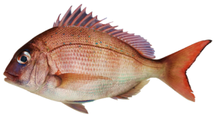
TAKING ACTION: FISHING
Focus Question: What actions can I take to help the health of kai moana [seafood] resources?
KŌRERORERO / DISCUSSION
In Aotearoa, we have limits and rules for commercial, customary and recreational fishers. If you break the rules you can be fined up to $250,000 and have your fishing gear (and boat) taken away. Rules include:
daily bag limits (how many fish you can keep)
legal size limits (the size of fish you can keep)
species restrictions (the type of fish you can keep)
closed and restricted areas (where you can’t fish)
MAHI / ACTIVITY
Measure the fork length of a snapper [see Teacher Outline]
Notes:
TEACHER NOTES
Adapted from an activity by Blake Org

Slide 2
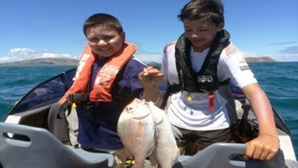
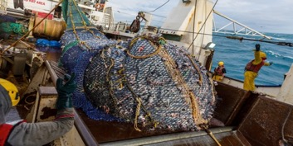

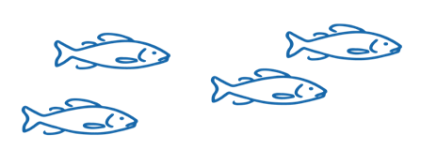
TAKING ACTION: FISHING
50% of fish are allocated to RECREATIONAL fishers and for CUSTOMARY MĀORI fishing
Recreational and customary fishers are not allowed to SELL their catch
There are size and catch limits for fish they can take
KŌRERORERO / DISCUSSION
50% of fish are allocated to COMMERCIAL fishers
They must BUY quota for each species of fish they want to catch
A commercial fisher must have quota in order to fish commercially
Photo: Ministry for the Environment
Notes:
TEACHER NOTES

Slide 3
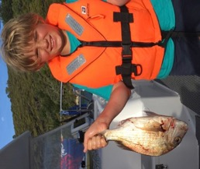
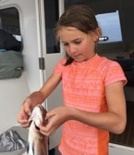
TAKING ACTION: SUSTAINABILITY & FISHING
HE PĀTAI / CONSIDER THIS
Why can’t these kids sell their fish? Is this fair?
Imagine a commercial fisher sees a recreational fisher at the wharf selling fish, what might they feel / say?
Have you ever caught a fish? Or thrown an undersized fish back in to the sea?
MAHI / ACTIVITY
Complete Customary
and Recreational Fisheries Worksheet
Source: Ministry for
the Environment
Notes:
TEACHER NOTES

Slide 4

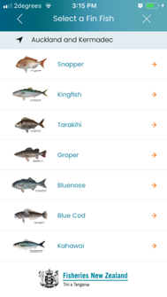


TAKING ACTION: FISHING
MAHI / ACTIVITY
Imagine you are going out for a day’s fishing with four members of your whānau {family]
Download the free NZ Fishing Rules app to see:
a) how much snapper you can legally catch?
b) what is the smallest snapper you are allowed to catch?
c) what should you do if you catch a snapper smaller than this?
NZ Fishing Rules
Notes:
TEACHER NOTES
Adapted from an activity by Blake Org

Slide 5



He tai moana, he tai ika,
He tai timu, he ika nunumi
A sea that is healthy, is a sea that flourishes with life
A sea in decline, becomes void of sea life
Whaktauki or proverb – it outlines a two way context; the need for caring for the ocean or the repercussions of mismanagement of resources
Notes:
TEACHER NOTES

