Slide 1
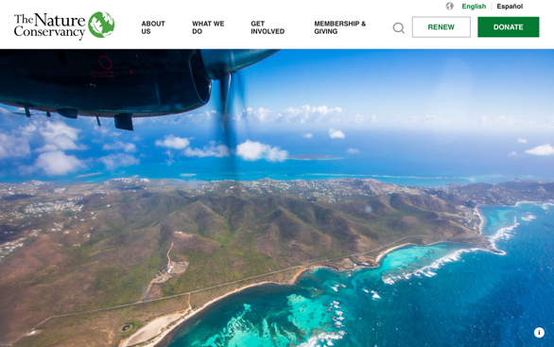
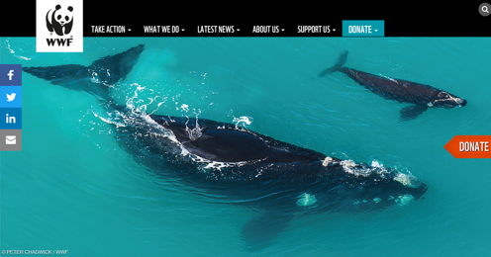
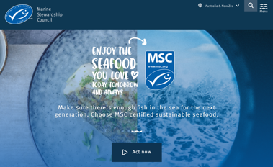
WHAKAPUĀWAI: COLLABORATIVE ACTION Focus Question: How can we collaboratively work to plan & carry out an action to help address an marine environmental issue?
MAHI / ACTIVITY
In groups, research and list ten different organisations that are working to conserve and protect our oceans. What do they do?
Select the one group and present back to the rest of your class / rōpū
Notes:
TEACHER NOTES

Slide 2
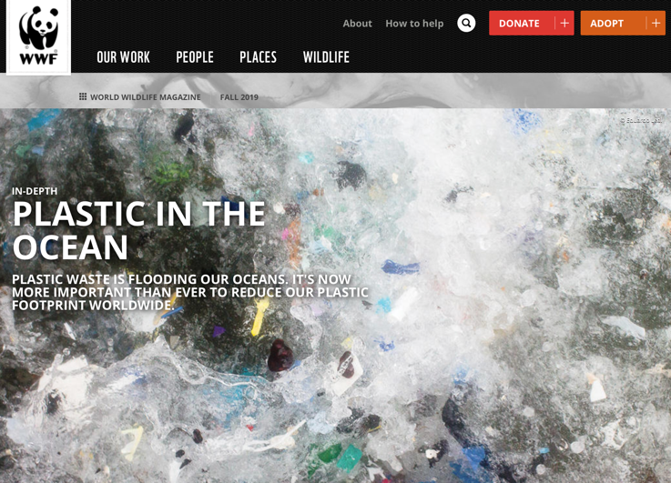
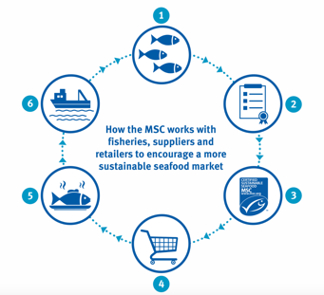
WHAKAPUĀWAI: COLLABORATIVE ACTION
MAHI / ACTIVITY
Make a LIST of issues currently affecting our oceans
SELECT three that you would personally like to work on
SHARE and discuss with a friend
Notes:
TEACHER NOTES

Slide 3
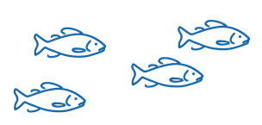
WHAKAPUĀWAI: COLLABORATIVE ACTION
MAHI / ACTIVITY
CONSIDER ways you could help make a difference for our oceans? Make a LIST! Be specific: Think… Where, Why, Who, When, What & How
Demand plastic free alternatives
Reduce your
carbon footprint
Avoid ocean harming products
Eat
sustainable
seafood
VOTE
on ocean issues
Get outside!
Explore the sea!
Clean up a beach
Notes:
TEACHER NOTES

Slide 4
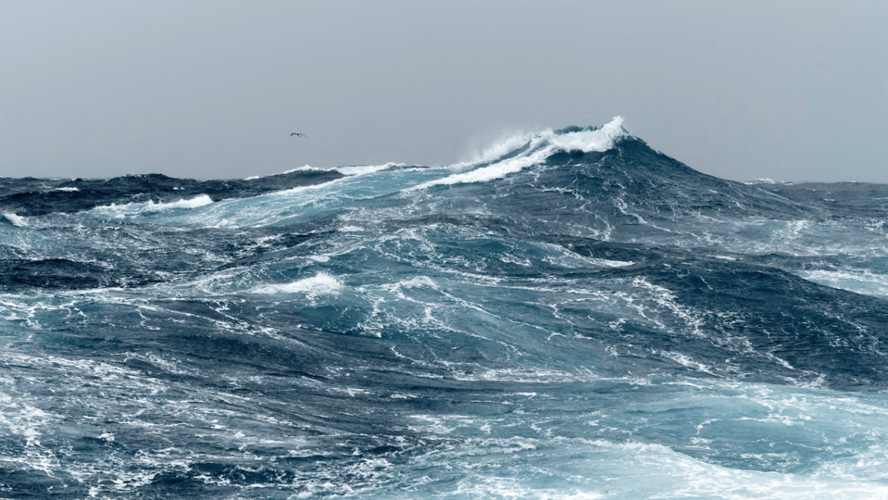
WHAKAPUĀWAI: COLLABORATIVE ACTION
Whakapuāwai Collaborative Inquiry
MAHI / ACTIVITY
IDENTIFY AND DECIDE ON AN ISSUE related to marine conservation
[See Teacher Outline]
Notes:
TEACHER NOTES

Slide 5
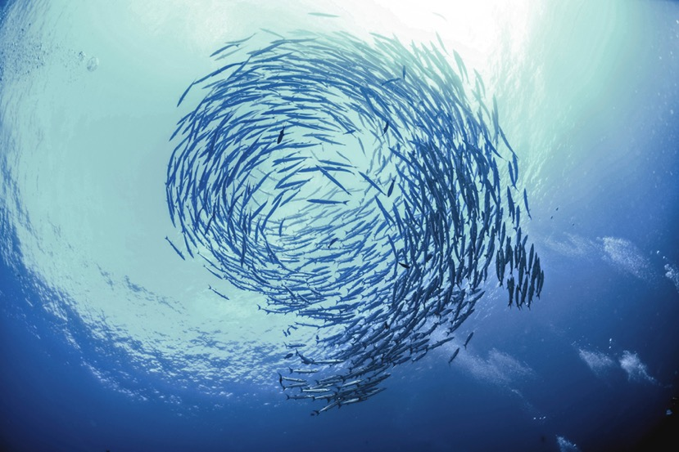
WHAKAPUĀWAI: COLLABORATIVE ACTION
Whakapuāwai Collaborative Inquiry
MAHI / ACTIVITY
CLARIFY the vision what is it that we will achieve?
[See Teacher Outline]
Notes:
TEACHER NOTES

Slide 6
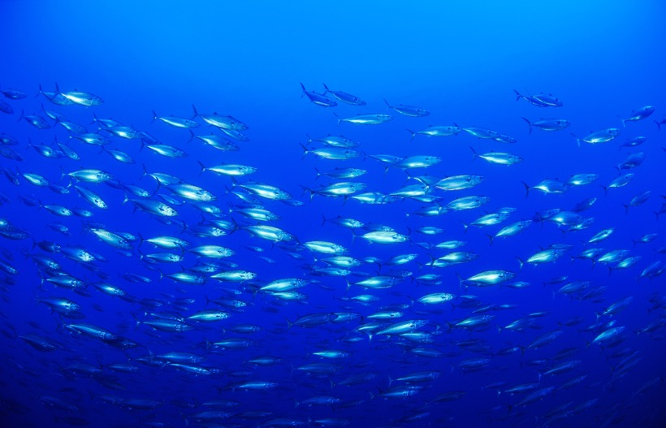
WHAKAPUĀWAI: COLLABORATIVE ACTION
Whakapuāwai Collaborative Inquiry
MAHI / ACTIVITY
Plan the ACTION
What exactly needs to be done to achieve the vision?
Check that your action addresses the issue!
[See Teacher Outline]
Notes:
TEACHER NOTES

Slide 7
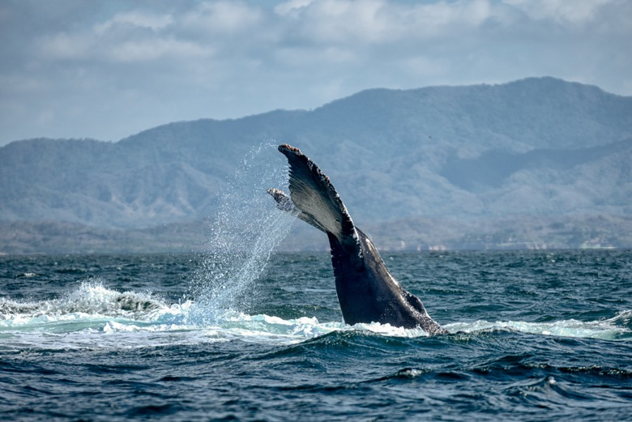
WHAKAPUĀWAI: COLLABORATIVE ACTION
Whakapuāwai Collaborative Inquiry
MAHI / ACTIVITY
Consider SKILLS needed
What skills will be needed to achieve the vision?
[See Teacher Outline]
Ehara taku toa i te toa takitahi, engari he toa takitini
Success does not come from the work of one, but the work of many
Notes:
TEACHER NOTES

Slide 8
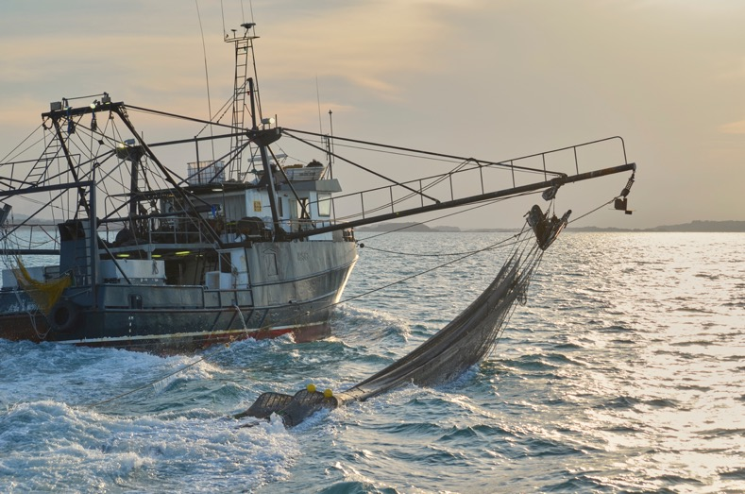
WHAKAPUĀWAI: COLLABORATIVE ACTION
Whakapuāwai Collaborative Inquiry
MAHI / ACTIVITY
How will people think and feel about the planned action?
How will you find this out?
[See Teacher Outline]
Notes:
TEACHER NOTES

Slide 9
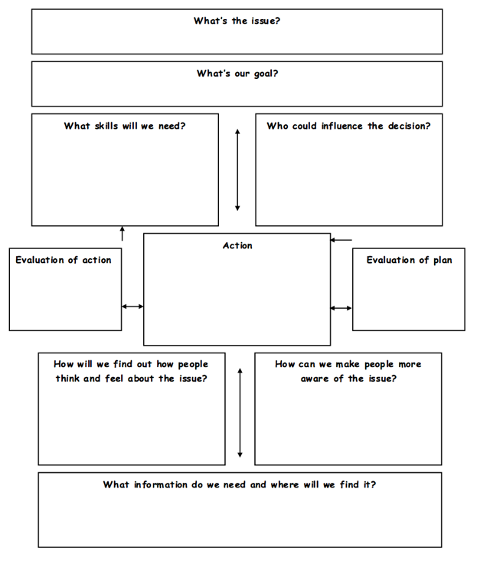
WHAKAPUĀWAI: COLLABORATIVE ACTION
Whakapuāwai Collaborative Inquiry
MAHI / ACTIVITY
DECIDE and ACT
Make some decisions
Create an action plan
Carry out the action!
Notes:
TEACHER NOTES

Slide 10
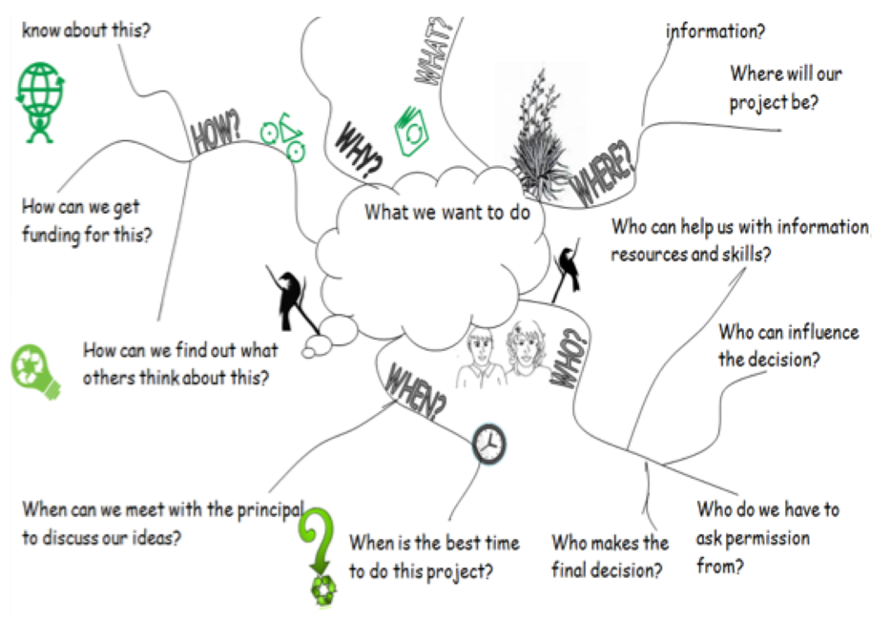
WHAKAPUĀWAI: COLLABORATIVE ACTION
Whakapuāwai Collaborative Inquiry
MAHI / ACTIVITY
DECIDE and ACT
Make some decisions
Create an action plan
Carry out the action!
Notes:
TEACHER NOTES

Slide 11
He tai moana, he tai ika,
He tai timu, he ika nunumi
A sea that is healthy, is a sea that flourishes with life
A sea in decline, becomes void of sea life
Whaktauki or proverb – it outlines a two way context; the need for caring for the ocean or the repercussions of mismanagement of resources
Notes:
TEACHER NOTES

