Slide 1

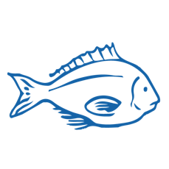
HISTORY OF AOTEAROA FISHING INDUSTRY
Focus Question: What are some key moments in the history of fishing in Aotearoa?
Hoatu he ika ki te tangata, ka kai ia mō te rā,
akohia ki te hi, ka kai ia mō ake tonu atu
Give a man a fish and he will eat for a day,
teach him to fish and his future is assured
HE PĀTAI / CONSIDER THIS
What meaning do you take from this whakataukī?
What other fishing related whakataukī, proverbs, sayings or stories do you know?
Notes:
TEACHER NOTES
USEFUL RESOURCES / RĀRANGI PUKAPUKA
Other examples:
Māu te taiata, māku te taiahiahi
For you the morning tide to tend to, for me the afternoon tide to tend to
He kura kainga te moana, he kura huna te moana
The oceans environment, is a source of untapped knowledge
Mā te kanae anō te kanae hei kōrero
Mā te tāmure anō te tāmure hei kōrero
Mā te pāpaka anō te pāpaka hei kōrero
The grey mullet will speak for itself
The snapper will speak for itself
The crab will speak for itself

Slide 2

HISTORY OF AOTEAROA FISHING INDUSTRY
History of fishing in Aotearoa PRIOR KNOWLEDGE CHART
What we know | What we would like to know | What we have learned
HE PĀTAI / CONSIDER THIS
What do you already know about the history of fishing in Aotearoa New Zealand?
MAHI / ACTIVITY
Complete the Prior Knowledge Chart columns 1 & 2
Notes:
TEACHER NOTES
You could go back and review Topic 1

Slide 3
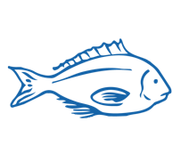
HISTORY OF AOTEAROA FISHING INDUSTRY
Early 1800s
KŌRERORERO / DISCUSSION
How attitudes to fish stocks have changed:
Traditional Māori approaches acknowledged connection with ocean and kaitiakitanga [good stewardship or guardianship]
Free for all! Early European settlers found a sea full of fish – the ocean was limitless!
Overfishing and declining fish stocks! People saw a need for limits and better data [information about fish stocks]
Demand and desire for Sustainability / Sustainable Development / Sustainable Yields
Invite Kaumātua, grandparents or local fisherfolk to come and talk!
How have they experienced the change in attitudes towards fish stocks?
Is kai moana more or less plentiful?
Today
Notes:
TEACHER NOTES

Slide 4
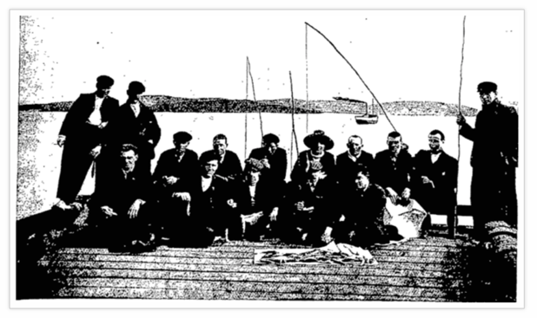

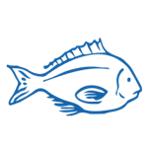

HISTORY OF AOTEAROA FISHING INDUSTRY
KŌRERORERO / DISCUSSION
Key periods in the history of Aotearoa’s fishing industry:
Māori traditional methods & tikanga
Early European settlers, refrigeration and early commercial fishing methods
The inshore boom, influx of foreign fishers, NZ’s EEZ and the Marine Reserve Act
The Quota Management System, total allowable catch and Treaty settlements
Otago Witness, 1904
Notes:
TEACHER NOTES
Suggest collaborative work – one or two students research each time period and then work together for final production.
Resources include (see Teacher Outline)
http://www.treaty2u.govt.nz/the-treaty-today/fisheries/index.htm
https://teara.govt.nz/en/fishing-industry/print
https://www.sciencelearn.org.nz/resources/1865-fisheries-in-new-zealand-timeline
https://www.nzgeo.com/stories/the-lost-art-of-fishing/

Slide 5
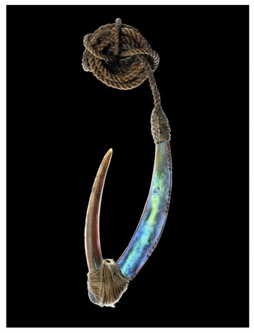



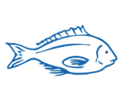
HISTORY OF AOTEAROA FISHING INDUSTRY
MAHI / ACTIVITY
Use the resources provided (see Teacher Outline) to show your understanding of key periods in the history of Aotearoa’s fishing industry by collaboratively creating one of the following:
A digital timeline
Digital Powtoon or Slowmation
A paper (non-digital) storyboard or timeline
Traditional Māori fish hook
Te Papa image from NZGeo
Notes:
TEACHER NOTES
Suggest collaborative work – one or two students research each time period and then work together for final production.
Resources include (see Teacher Outline)
https://teara.govt.nz/en/fishing-industry/print
https://www.sciencelearn.org.nz/resources/1865-fisheries-in-new-zealand-timeline
https://www.nzgeo.com/stories/the-lost-art-of-fishing/
Digital timelines - https://elearningindustry.com/top-10-free-timeline-creation-tools-for-teachers
Powtoon - https://www.powtoon.com/edu-home/
Slowmation - http://www.slowmation.com

