Slide 1

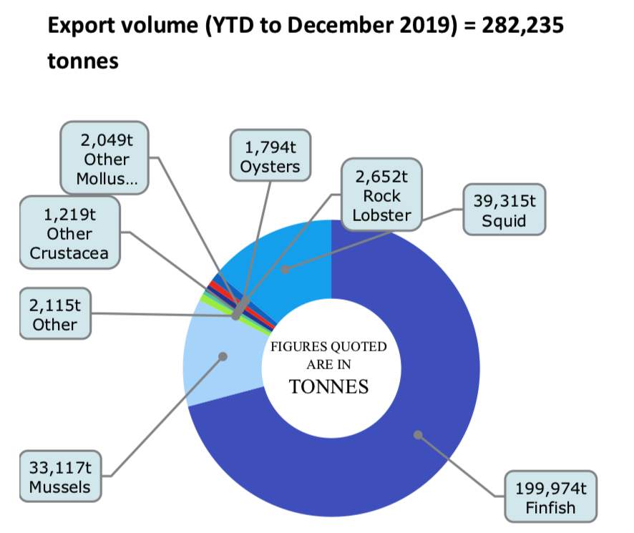

AOTEAROA: BUSINESS OF FISHING TODAY
Focus Question: What is the size & economic value of Aotearoa’s seafood industry today?
KŌRERORERO / DISCUSSION
Around 600,000 tonnes of seafood (excluding aquaculture) is harvested from New Zealand's waters each year
In 2018, 267 901 tonnes of seafood were exported from Aotearoa New Zealand
MAHI / ACTIVITY
Try graphing this data using a bar graph
Compare your graph with this one
Source: Seafood New Zealand
Notes:
TEACHER NOTES
USEFUL RESOURCES / RĀRANGI PUKAPUKA
For more information see the Seafood New Zealand’s economic summary at:
https://www.seafood.co.nz/detail-3/seafood-nz-magazine-april-2020
Or you can look for a more recent one here: https://www.seafood.co.nz/publications/magazine
NOTE – you might want to discuss what fin fish are! Ie they are fish / types of seafood with fins (rather than mussels, crayfish etc)

Slide 2
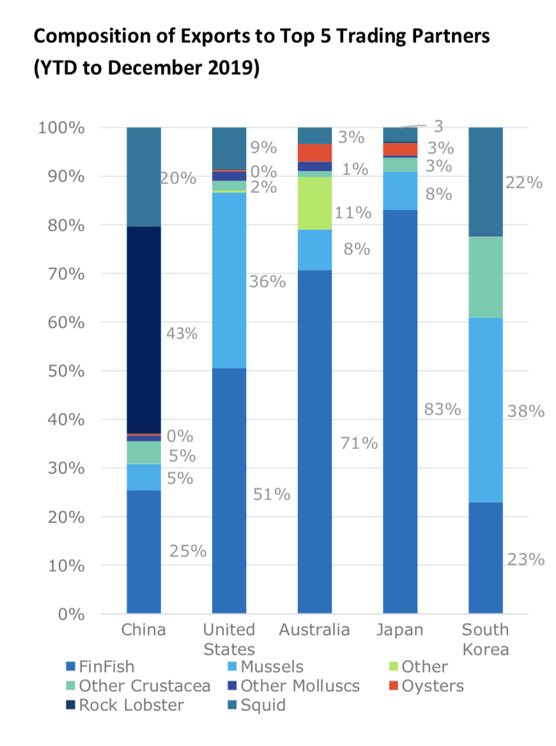
AOTEAROA: BUSINESS OF FISHING TODAY
HE PĀTAI / CONSIDER THIS
What type of seafood makes up the largest portion of seafood exports to:
1. China
2. United States
3. Australia
4. Japan
5. South Korea
What does / doesn’t surprise you about these figures?
Source: Seafood New Zealand
Notes:
TEACHER NOTES
USEFUL RESOURCES / RĀRANGI PUKAPUKA
For more information see the Seafood New Zealand’s economic summary at: https://www.seafood.co.nz/detail-3/seafood-nz-magazine-april-2020
Or you can look for a more recent one here: https://www.seafood.co.nz/publications/magazine
NOTE – you might want to discuss what fin fish are! Ie they are fish / types of seafood with fins (rather than mussels, crayfish etc)

Slide 3
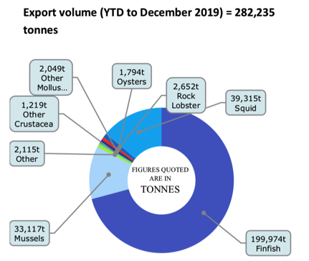
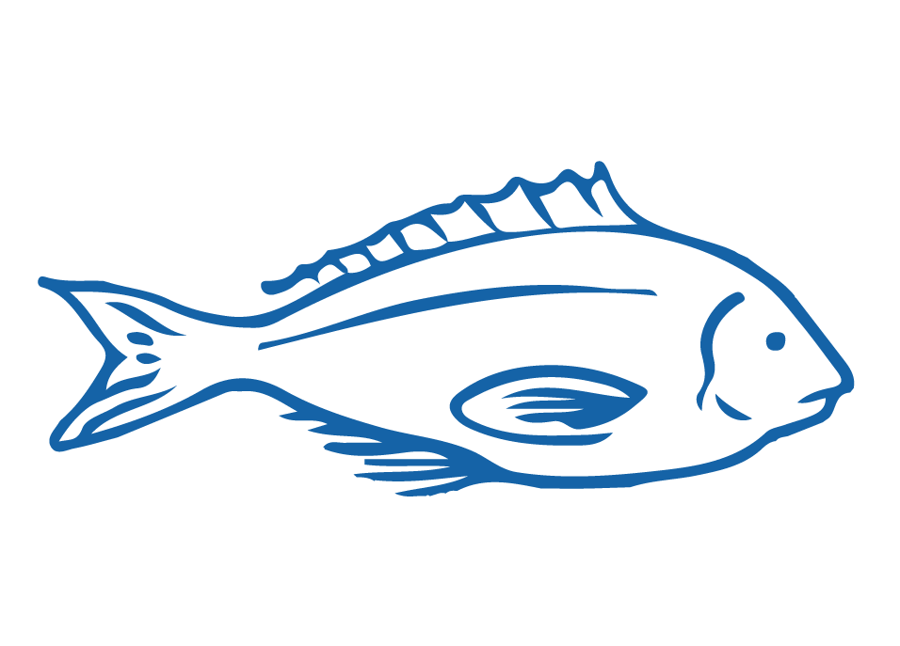
AOTEAROA: BUSINESS OF FISHING TODAY
HE PĀTAI / CONSIDER THIS
Aotearoa New Zealand’s seafood industry has:
  High export earnings
  High production
  95% of NZ landed catch from sustainable stocks
MAHI / ACTIVITY
In groups discuss the
sustainability of our fishing industry
Does our fishing industry meet the needs of the present without compromising the ability of future generations to meet their own needs?
Justify your answer: Why? And Why not?
Notes:
TEACHER NOTES
USEFUL RESOURCES / RĀRANGI PUKAPUKA
For more information see on lost and wasted seafood see the comprehensive report by FAO: http://www.fao.org/3/ca9229en/CA9229EN.pdf
See also: https://www.hakaimagazine.com/features/wasted/
And: https://www.msc.org/media-centre/news-opinion/news/2020/06/10/five-things-you-need-to-know-about-the-state-of-the-world-s-fish
ANSWERS
Waste due to many factors – spoilage,
Richer countries have the highest amount of waste

Slide 4
AOTEAROA: BUSINESS OF FISHING TODAY
TRUE OR FALSE?
MAHI / ACTIVITY: TRUE OR FALSE?
Number a page 1-12. For each of the following statements
write true or false next to the corresponding number!
1. Approximately 600,000 tonnes of seafood (excluding aquaculture) is harvested from New Zealand's waters each year
2. New Zealand's hoki fisheries were the first major fisheries in the world to be certified sustainable by the Marine Stewardship Council (MSC)
3. More than 90% of New Zealand's seabed has never been touched by trawlers
Facts & Figures from Seafood New Zealand
Notes:
TEACHER NOTES
USEFUL RESOURCES / RĀRANGI PUKAPUKA
For more information see the Seafood New Zealand’s facts and figures:
https://www.seafoodnewzealand.org/industry/key-facts/

Slide 5
AOTEAROA: BUSINESS OF FISHING TODAY
TRUE OR FALSE?
MAHI / ACTIVITY (continued)
4. 95% of New Zealand's commercially landed catch is from sustainable stocks, according to the Ministry for Primary Industries' latest Fish Stock Status report
5. New Zealand's benthic protection area (BPA) network and seamount closures cover an area 4.6 times larger than the country's landmass. It is one of the largest marine conservation areas in the world
6. 96% of New Zealand's territory is underwater & over 15,000 marine species have been identified in New Zealand's marine environment
7. Approximately 30.5% of New Zealand's total marine environment is protected
Facts & Figures from Seafood New Zealand
Notes:
TEACHER NOTES
USEFUL RESOURCES / RĀRANGI PUKAPUKA
For more information see the Seafood New Zealand’s facts and figures:
https://www.seafoodnewzealand.org/industry/key-facts/

Slide 6
AOTEAROA: BUSINESS OF FISHING TODAY
TRUE OR FALSE?
MAHI / ACTIVITY (continued)
8. New Zealand's 15,134 km long coastline is the ninth longest in the world
9. 2,500 people work in commercial fishing and aquaculture operations at sea
10. The New Zealand seafood industry employs over 13,000 full time workers
11. Aotearoa New Zealand has the fourth largest Exclusive Economic Zone (EEZ) [see topic 5 for more on EEZs]
12. Our seafood industry had a total export earning (FOB) of $1.8 billion in seafood exports in 2018
See topic 7 for a deeper look at the economic value of the global and Aotearoa New Zealand fishing industries
CLICK AGAIN FOR ANSWERS
ANSWERS are:
1-12 are all TRUE!
Facts & Figures from Seafood New Zealand
Notes:
TEACHER NOTES
USEFUL RESOURCES / RĀRANGI PUKAPUKA
For more information see the Seafood New Zealand’s facts and figures:
https://www.seafoodnewzealand.org/industry/key-facts/

Slide 7
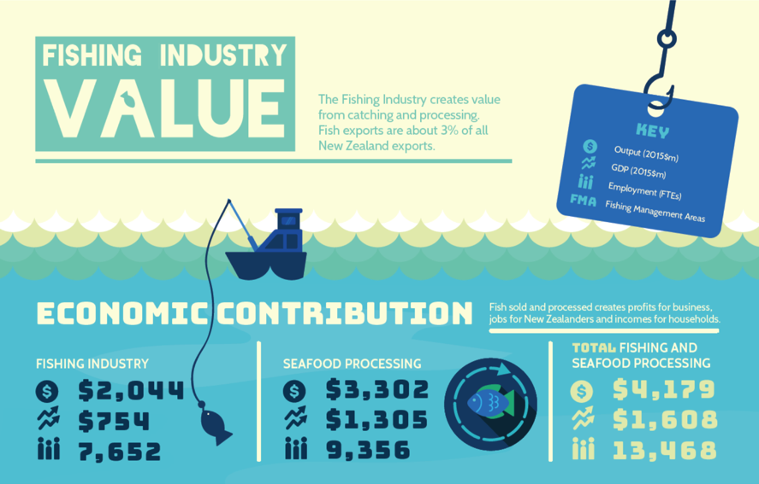
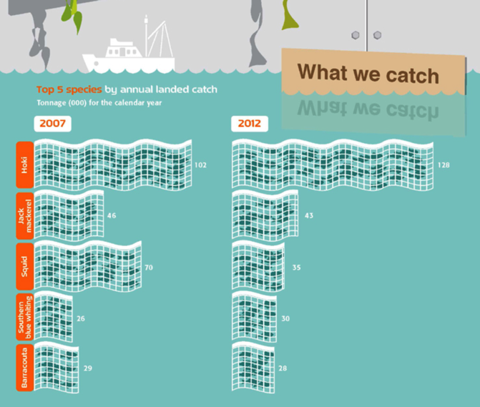
AOTEAROA: BUSINESS OF FISHING TODAY
Source: BERL Report 2017
Source: Statistics NZ
MAHI / ACTIVITY
Create your own info-graphic about the Aotearoa New Zealand fishing industry using canva
Notes:
TEACHER NOTES
USEFUL RESOURCES / RĀRANGI PUKAPUKA
For ideas and data see:
https://www.inshore.co.nz/fileadmin/Documents/Other/BERL_Report_August_2017.pdf
Canva can be found at: https://www.canva.com

Slide 8

REVIEWING KEY CONCEPTS
Focus Question: What have we learnt?
MAHI / ACTIVITY
WRITE two or three paragraphs about what you have learnt during this topic. Be sure to include the following words:
Sustainability
Seafood industry
Innovation
Opportunities
Production
Challenges
Business
Consumption
Technology
Notes:
TEACHER NOTES

