Slide 1
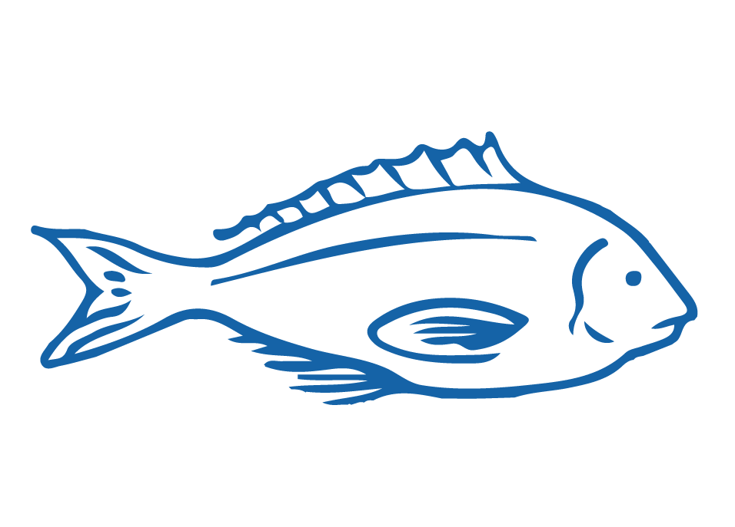
EXPLORATION, INNOVATION & ENTERPRISE
Focus Question: What role do enterprise, innovation & exploration play in
growing fishing businesses?
HE PĀTAI / CONSIDER THIS
What do we mean by each of the following words:
Innovative
Enterprising
Exploration
[click for answers]
Innovative: introducing new ideas; original and creative in thinking
Enterprising: having or showing initiative and resourcefulness
Exploration: action of exploring an unfamiliar area
Notes:
TEACHER NOTES

Slide 2
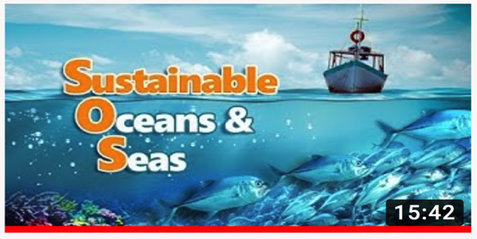

EXPLORATION, INNOVATION & ENTERPRISE
KŌRERORERO / DISCUSSION
Aotearoa New Zealand is often seen as an innovative & enterprising world leader in fisheries
HE PĀTAI / CONSIDER THIS
What are some examples of exploration, innovation and enterprise evident in fishing in Aotearoa?
MĀTAKI TĒNEI / WATCH THIS
Film [15:42] illustrating how the the rest of the world views sustainable fishing in Aotearoa New Zealand
Notes:
TEACHER NOTES
Film clip can be found at: https://www.youtube.com/watch?v=sDh2Cn2bNxk
NOTE: Filmed for an overseas audience so is interesting to see what children in other parts of the world are learning about Aotearoa NZ fisheries!
HOW TO PLAY KAHOOT
Connect a device to a projector or screen in front of the classroom.
Navigate to the game called Marine Stewardship Council NZ Kahoot page
https://www.msc.org/en-au/for-teachers/ocean-literacy/new-zealand-education-curriculum/kahoot-quizzes
Select settings
At Kahoot.it, learners enter game-pin and nickname on their own devices (phone, tablet, or computer).
Press “Start now”. The fun begins!
Learners answer questions on their own devices by selecting one of the four answer buttons.
See additional instructions, options, and how to make your own Kahoot at: https://kahoot.com

Slide 3

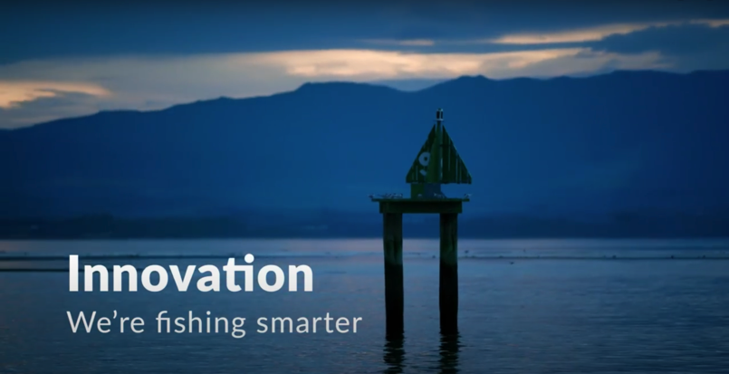
EXPLORATION, INNOVATION & ENTERPRISE
HE PĀTAI / CONSIDER THIS
What are commercial fishers doing to avoid catching seabirds?
What new technology is helping commercial fishers to reduce their environmental impact?
What is meant by “the changing culture of the industry”?
MĀTAKI TĒNEI / WATCH THIS
Watch this short film [0:56] from Seafood New Zelaand about Innovation – We’re Fishing Smarter
Notes:
TEACHER NOTES:
VIDEO LINKS: Innovation – We’re fishing Smarter (Seafood New Zealand) URL:
https://www.youtube.com/watch?time_continue=3&v=7CRbG7sPobs&feature=emb_title
HE PĀTAI – ANSWERS (all information needed to answer is in the short film ‘Innovation’)
Setting at night; using tori lines to deter birds; getting trained in seabird smart fishing; traceability (cameras on boats and GPS locators); bird detectors on cameras;
Traceability; cameras on deck; AOS (ability to identify fish; PSH gear development
The culture of the fishing industry is changing – in the past commercial fishers were seen as having a ‘catch at any cost’ mentality. Commercial fishers were seen as the bad guys - people who went out and caught as much as they could and didn’t really care about the environment! But now fishers are working with conservationists and scientists to look after the marine environment
USEFUL RESOURCES / RĀRANGI PUKAPUKA
Here are a few other innovations fishers use to reduce bycatch and habitat damage:
1. Acoustic alarms (pingers) deter marine mammals by emitting noise
2. Gear modification:
Breakaway links let large whales break out of nets when they struggle and exert force
Tori lines to scare away the birds (long lining and trawling)
Reflective nets are more detectable to marine mammals so they can avoid them.
Turtle excluder devices (TEDs) help turtles to escape through a built-in hatch in trawls.
Modification of mesh size helps marine mammals better detect nets so they can avoid them.
3. Time- area closures: Setting nets at different times of the day (setting longlines at night minimizes seabird bycatch); setting nets in areas that are less heavily frequented by mammals, birds and turtles.
HOMEWORK / EXTENSION – HOW DOES THIS RELATE TO ME AND MY WHĀNAU
Invite a kaumātua or grandparent to visit and get them to talk about how fishing has changed over time and what measures have been used locally to reduce impacts on marine habitat and sea life.
Homework activity – learners interview a member of their whānau, family or community about their fishing practices (can adapt questions from this slide)
Learners share their own fishing stories or those from family, whānau or community to share

Slide 4

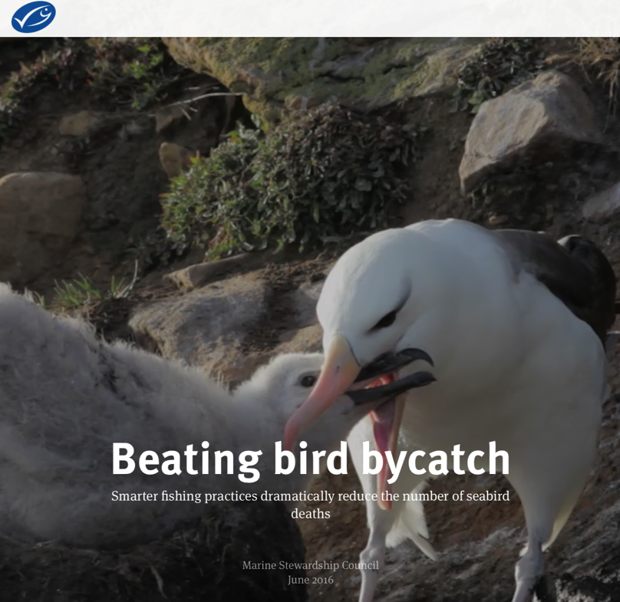

EXPLORATION, INNOVATION & ENTERPRISE
KŌRERO PUKAPUKA / READ
Read about the southern ocean toothfish fishery and how innovations have reduced seabird captures
HE PĀTAI / CONSIDER THIS
What innovations were implemented to reduce seabird captures
Notes:
TEACHER NOTES
http://beating-bird-bycatch-stories.msc.org/?_ga=2.180844327.129658065.1600647897-1303352827.1595455374

Slide 5
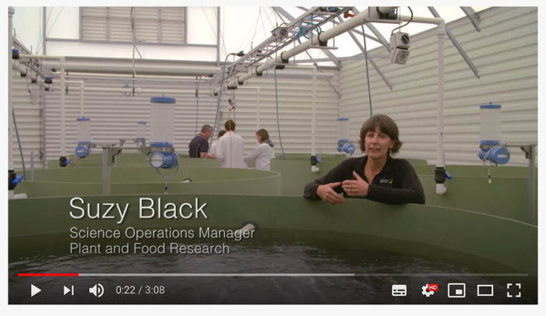
EXPLORATION, INNOVATION & ENTERPRISE
HE PĀTAI / CONSIDER THIS
How will this new technology
(1) help the environment?
(2) Improve the quality of fish when it reaches the market place?
MĀTAKI TĒNEI / WATCH THIS
About the new innovative fishing technology PSH
Notes:
TEACHER NOTES
https://www.youtube.com/watch?v=oeSFjLxyUi0

Slide 6
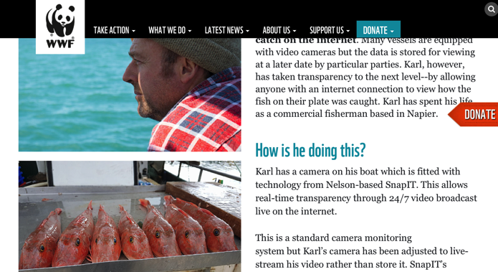
EXPLORATION, INNOVATION & ENTERPRISE
HE PĀTAI / CONSIDER THIS
How will this innovative approach help the environment?
Why has Karl started live streaming his fishing?
How could this help Karl’s business?
KŌRERO PUKAPUKA / READ
About Karl Warr, from Better Fishing, who has become the first fisherman in the world to live-stream his catch on the internet
Notes:
TEACHER NOTES
https://www.wwf.org.nz/what_we_do/marine/sustainable_fisheries/better_fishing/
USEFUL RESOURCES / RĀRANGI PUKAPUKA
You could also watch this Country Calendar episode: The Innovators: Sustainable Seas
https://www.hyundai.co.nz/hyundai-country/the-innovators/sustainable-seas

Slide 7
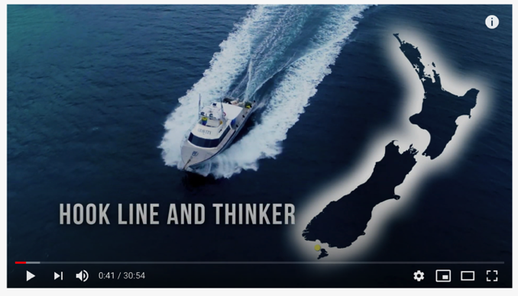
EXPLORATION, INNOVATION & ENTERPRISE
HE PĀTAI / CONSIDER THIS
Nate from Gravity Fishing, is using technology & innovation to change the way he catches, sells and markets fish:
1. How will Nate’s innovative approach help the environment?
2. Why has Nate changed his approach to fishing?
3. How is Nate’s ‘supply chain’ different?
MĀTAKI TĒNEI /
WATCH THIS
Gravity Fishing’s innovative approach to fishing [30:54]
Notes:
TEACHER NOTES
Hyundai Country Calendar Episode 33 – Hook Line and Thinker
https://www.tvnz.co.nz/shows/country-calendar/episodes/s2019-e33

Slide 8
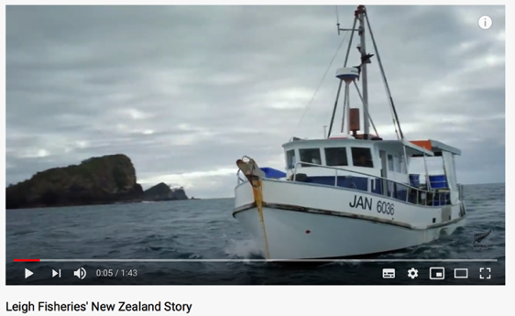
EXPLORATION, INNOVATION & ENTERPRISE
HE PĀTAI / CONSIDER THIS
Lee Fish, a small town fishmonger in Aotearoa that has innovatively developed his fishing business:
1. How long is it from ocean to plate?
2. What is traceability? How can this help with sustainability?
MAHI / ACTIVITY
Complete the Lee Fish Worksheet
MĀTAKI TĒNEI / WATCH THIS
New Zealand story [1:43] about Lee Fish who innovatively deliver high quality fish traceable from source
Notes:
TEACHER NOTES
https://www.youtube.com/watch?v=RBFVUueKCzw

Slide 9

EXPLORATION, INNOVATION & ENTERPRISE
HE PĀTAI / CONSIDER THIS
(For history on the toheroa fishery see also topic 5)
1. How do they hope their innovation will impact the toheroa industry?
2. Where will the spat [seed] come from?
KŌRERO PUKAPUKA / READ
BlueTide Aquaculture recently won an innovation award to develop sustainable toheroa aquaculture
Notes:
TEACHER NOTES
https://www.callaghaninnovation.govt.nz/news-and-events/turning-tide
History of toheroa
https://www.youtube.com/watch?v=x0GcneKoT18

Slide 10
REVIEWING KEY CONCEPTS
Focus Question: What have we learnt?
MAHI / ACTIVITY
WRITE two or three paragraphs about what you have learnt during this topic. Be sure to include the following words:
Sustainability
Seafood industry
Innovation
Opportunities
Production
Challenges
Business
Consumption
Technology
Notes:
TEACHER NOTES

