Slide 1
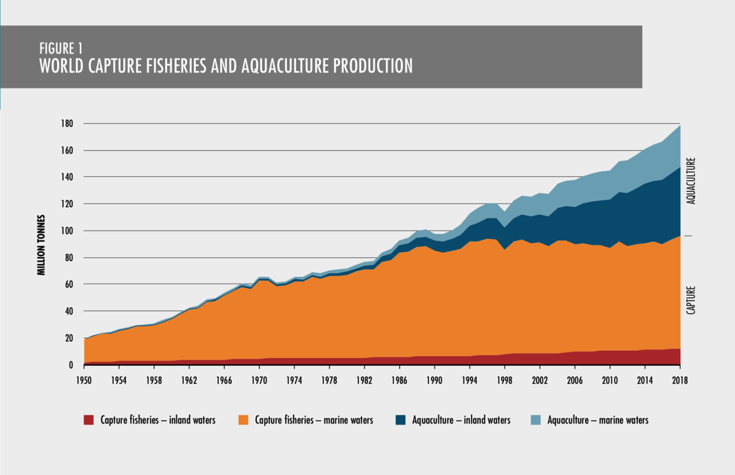
FUTURE OPPORTUNITIES & CHALLENGES Focus Question: What challenges & opportunities face Aotearoa’s seafood industry?
KŌRERORERO / DISCUSSION
Opportunity & Challenge: Global seafood production (how much seafood we catch and sell) is at an all time high!
HE PĀTAI / CONSIDER THIS
How many million tonnes were produced in 1950?
And how many in 2018?
What does this tell you about seafood production?
Source: FAO (2020)
The State of World Fisheries and Aquaculture 2020
Notes:
TEACHER NOTES
USEFUL RESOURCES / RĀRANGI PUKAPUKA
For more information see the comprehensive report by FAO: http://www.fao.org/3/ca9229en/CA9229EN.pdf
Note that aquaculture has exploded to an even greater degree than capture – why do you think this? How do you feel about the growth of aquaculture?

Slide 2
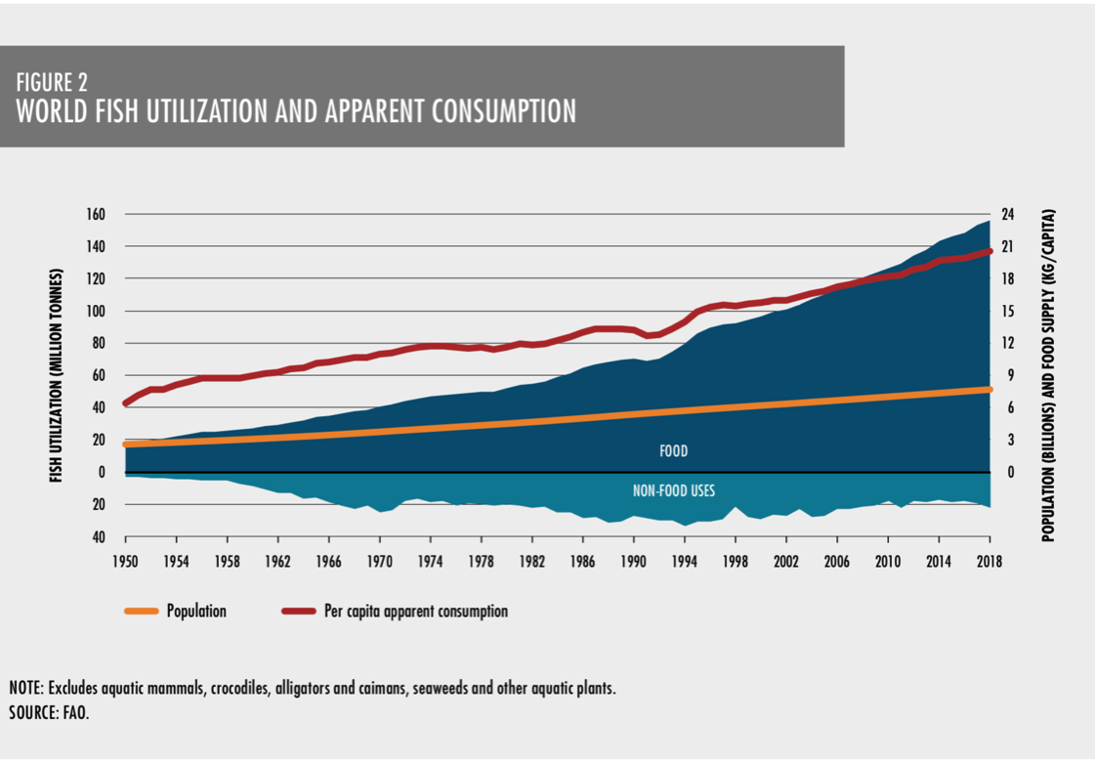
FUTURE OPPORTUNITIES & CHALLENGES
KŌRERORERO / DISCUSSION
Opportunity & Challenge: Global seafood consumption (how much seafood we buy and eat) is growing faster than ever
HE PĀTAI / CONSIDER THIS
How many million tonnes were consumed in 1950?
And how many in 2018?
What does this tell you about consumption?
Source: FAO (2020)
The State of World Fisheries and Aquaculture 2020
Notes:
TEACHER NOTES
USEFUL RESOURCES / RĀRANGI PUKAPUKA
For more information see the comprehensive report by FAO: http://www.fao.org/3/ca9229en/CA9229EN.pdf
FURTHER DISCUSSION
This graph shows that while population and apparent consumption are increasing at relatively similar rates, the catch has gone up more rapidly. So it looks like that would be an illustration of wastage?

Slide 3
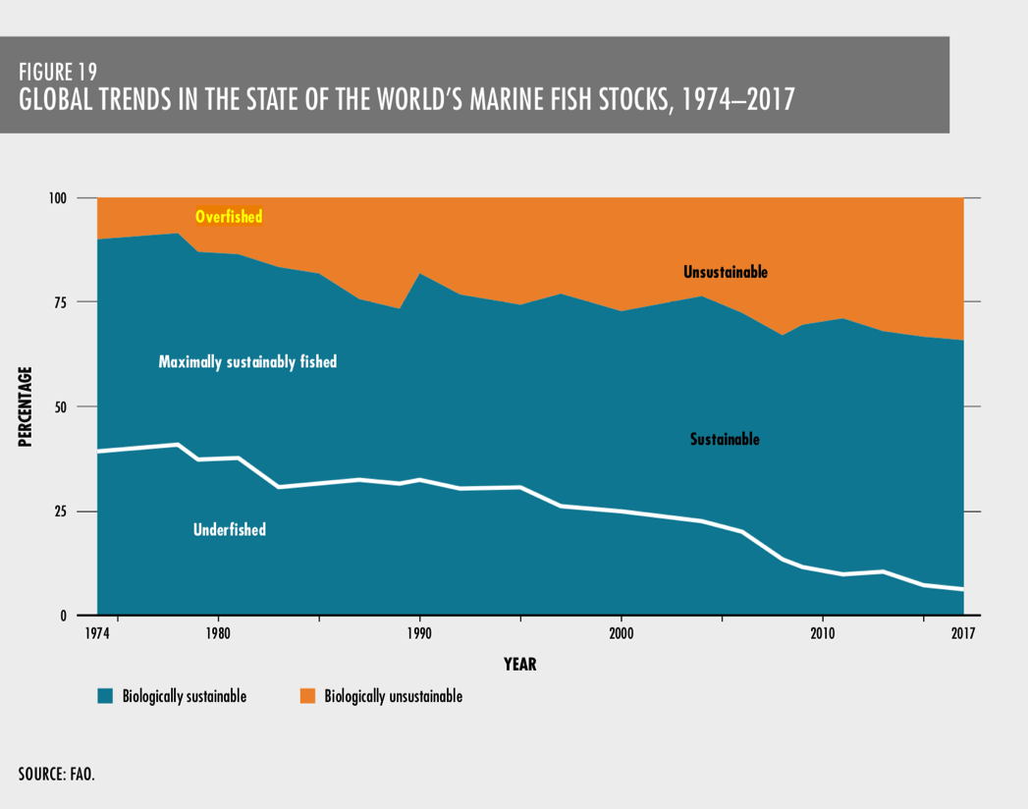
FUTURE OPPORTUNITIES & CHALLENGES
KŌRERORERO / DISCUSSION
Challenge: About a third of all fish stocks are still being overfished (MSC, 2020)
HE PĀTAI / CONSIDER THIS
How has the percentage of (1) under fished, and (2) over fished, stocks changed over time?
What does this tell you about global fish stocks?
Source: FAO (2020)
The State of World Fisheries and Aquaculture 2020
Notes:
TEACHER NOTES
USEFUL RESOURCES / RĀRANGI PUKAPUKA
For more information see the comprehensive report by FAO: http://www.fao.org/3/ca9229en/CA9229EN.pdf
See also: https://www.msc.org/media-centre/news-opinion/news/2020/06/10/five-things-you-need-to-know-about-the-state-of-the-world-s-fish

Slide 4
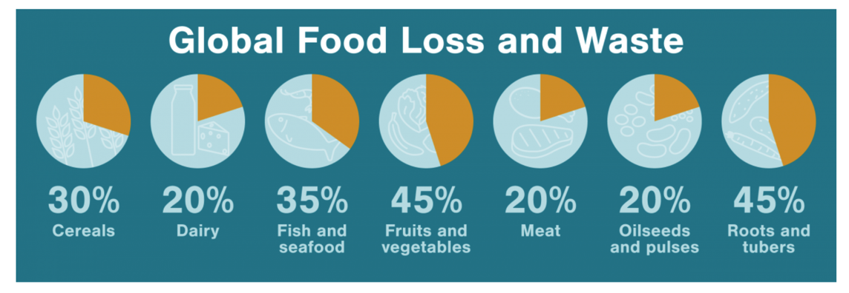
FUTURE OPPORTUNITIES & CHALLENGES
KŌRERORERO / DISCUSSION
Challenge: About 35% of the global harvest is lost or wasted every year
Our global food system discards 46 million tonnes of fish each year!
Source: FAO in Hakei
HE PĀTAI / CONSIDER THIS
Why is so much seafood wasted?
Can you guess if it is the poorer or richer countries who waste the most?
MAHI / ACTIVITY
Create a bar graph showing global food loss and waste (from chart above)
Which graph (pie or bar) shows the information best and why?
Notes:
TEACHER NOTES
USEFUL RESOURCES / RĀRANGI PUKAPUKA
For more information see on lost and wasted seafood see the comprehensive report by FAO: http://www.fao.org/3/ca9229en/CA9229EN.pdf
See also: https://www.hakaimagazine.com/features/wasted/
And: https://www.msc.org/media-centre/news-opinion/news/2020/06/10/five-things-you-need-to-know-about-the-state-of-the-world-s-fish
ANSWERS
Waste due to many factors – spoilage,
Richer countries have the highest amount of waste

Slide 5
FUTURE OPPORTUNITIES & CHALLENGES
KŌRERORERO / DISCUSSION
A common solution suggested for global supply & demand challenges is sustainable development
‘Development that meets the needs of the present without compromising the ability of future generations to meet their own needs’
MAHI / ACTIVITY
Place yourself along a continuum (line) with strongly agree at one end & strongly disagree at the other based on your belief around the following statement: “Human needs and requirements are more important than the protection of the environment. Resources (including seafood) should be fully exploited for human development.”
Strongly agree
Strongly disagree
Notes:
TEACHER NOTES
USEFUL RESOURCES / RĀRANGI PUKAPUKA
This definition of sustainable development comes from the Brundtland Report: Our Common Future. See: https://sustainabledevelopment.un.org/content/documents/5987our-common-future.pdf (see paragraph 27)

Slide 6
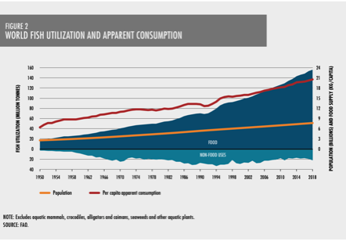
FUTURE OPPORTUNITIES & CHALLENGES
MAHI / ACTIVITY
In groups discuss the sustainability of the global fishing industry.
Does the global fishing industry meet the needs of the present without compromising the ability of future generations to meet their own needs?
Justify your answer: Why? Why not?
HE PĀTAI / CONSIDER THIS
We have a global seafood industry where:
Consumption is high
Production is high
Waste is high
Almost a third of fish stocks are overfished
Notes:
TEACHER NOTES
USEFUL RESOURCES / RĀRANGI PUKAPUKA
For more information see on lost and wasted seafood see the comprehensive report by FAO: http://www.fao.org/3/ca9229en/CA9229EN.pdf
See also: https://www.hakaimagazine.com/features/wasted/
And: https://www.msc.org/media-centre/news-opinion/news/2020/06/10/five-things-you-need-to-know-about-the-state-of-the-world-s-fish
ANSWERS
Waste due to many factors – spoilage,
Richer countries have the highest amount of waste

Slide 7
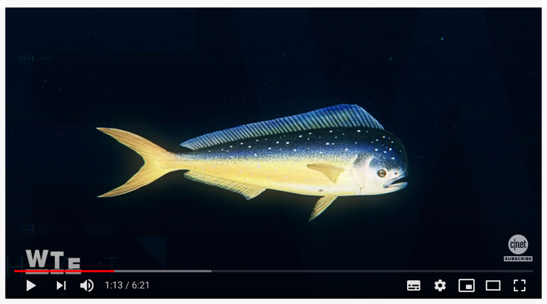
FUTURE OPPORTUNITIES & CHALLENGES
Experts ONLY!
HE PĀTAI / CONSIDER THIS
Current demand creates challenges and opportunities for the future
Is lab grown fish a potential solution? Why / Why not?
MAHI / ACTIVITY
If global demand for seafood continues to grow – how can demand be met in a way that is sustainable for the sea?
MĀTAKI TĒNEI / WATCH THIS
Will lab grown fish save oceans?
[6:21]
Notes:
TEACHER NOTES
NOTE: Language is a little tricky (and very American!)
See https://www.youtube.com/watch?v=U45_V70YiwQ

Slide 8
REVIEWING KEY CONCEPTS Focus Question: What have we learnt?
MAHI / ACTIVITY
WRITE two or three paragraphs about what you have learnt during this topic. Be sure to include the following words:
Sustainability
Seafood industry
Innovation
Opportunities
Production
Challenges
Business
Consumption
Technology
Notes:
TEACHER NOTES

