Slide 1
Insert heading page Topic 3

Slide 3
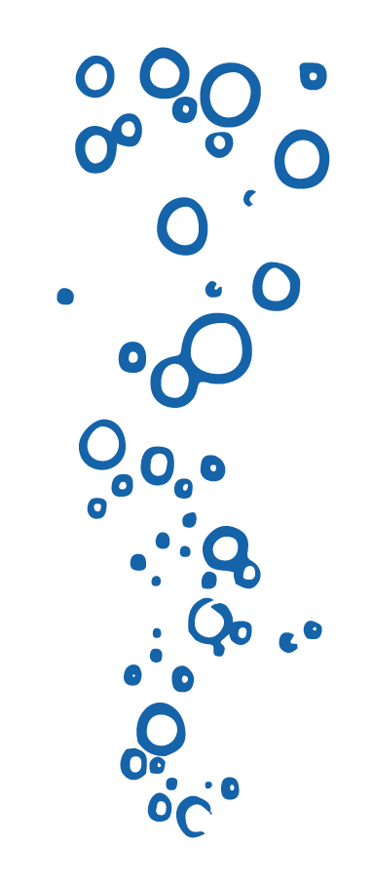
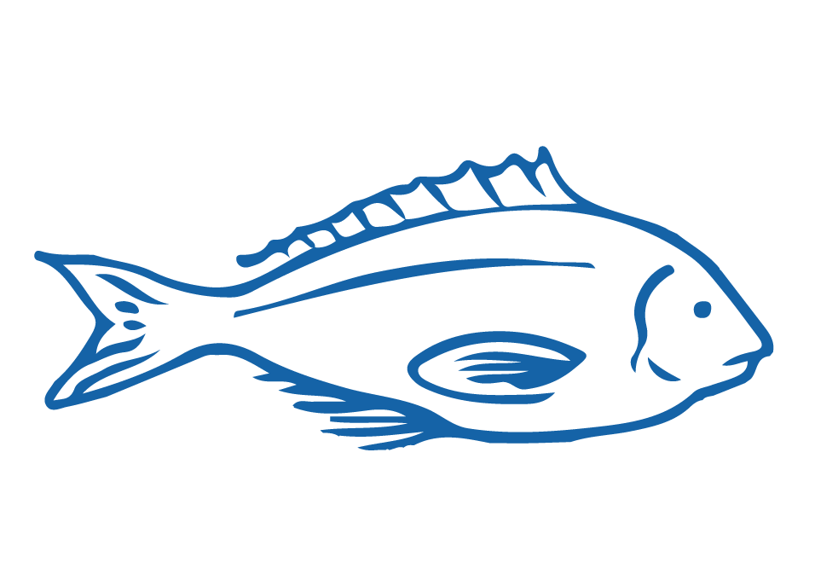
HELPFUL STUFF FOR TEACHERS
Target age range:
10–15 years
Welcome to OUR STORY!
In this topic we explore the history of fishing, technology & innovation!
Topic focus: Fishing history, technology & innovation
Curriculum Level: Level 3 - 5+
Curriculum: Geography; Science; Social Science; Tikanga-ā-iwi; Pūtaiao; Hauora; Technology
Key competencies: Thinking; Managing Self; Relating to others
Planning: See also History of Fishing, Technology & Innovation Planner and teacher notes below slides
Extending learning: See Topic Outlines and slides labelled expert [top right corner]

Slide 4
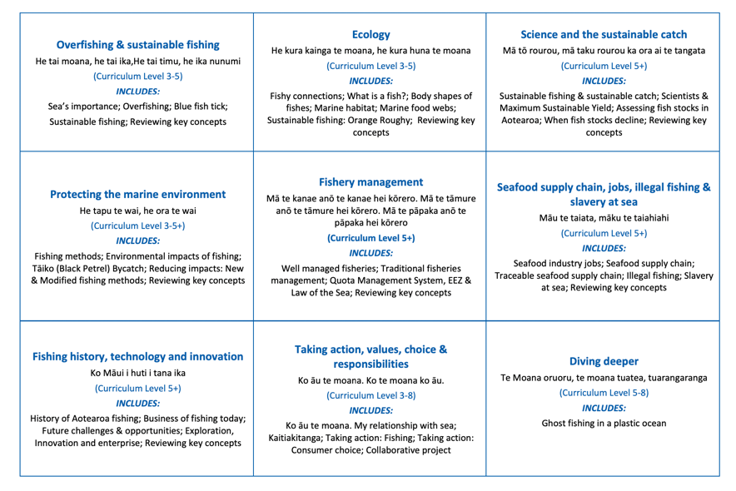
HELPFUL STUFF FOR TEACHERS
Welcome to OUR STORY!
In this topic we explore the history of fishing, technology & innovation!

Slide 5
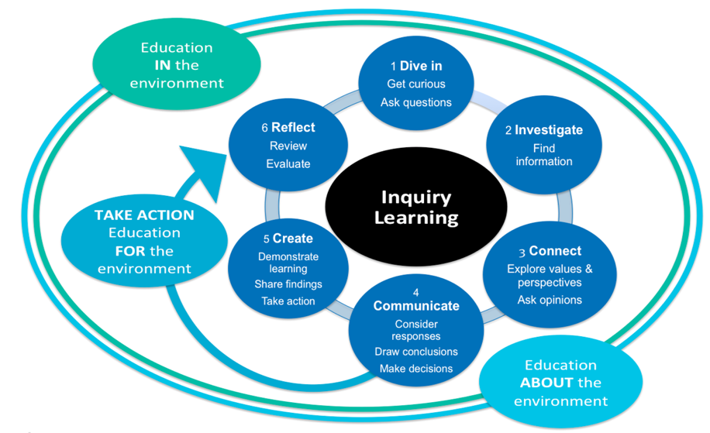
HELPFUL STUFF FOR TEACHERS

Slide 6
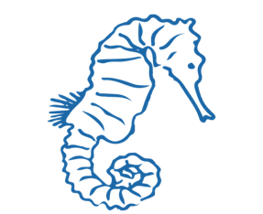
IN THIS TOPIC WE WILL LEARN ABOUT…
Describe key moments in the history of fishing and Māori fishing in Aotearoa New Zealand
Investigate the size and economic value of Aotearoa New Zealand’s seafood industry today
Explore the role of enterprise, innovation and exploration in growing fishing business
Identify future challenges and opportunities for the Aotearoa New Zealand seafood industry
Use seafood industry related vocabulary

Slide 7
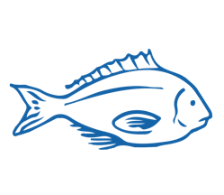
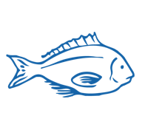
MIHI / INTRODUCTION
Can you imagine a world without fish?
What would that be like?
No more sushi! No more fishing!
No more fish & chips! No more….?
Notes:
TEACHER NOTES
Try to get learners to connect with the personal impact of overfishing and unsustainable practices. What would it be like for ME if there were few or no fish left in the sea!

Slide 8
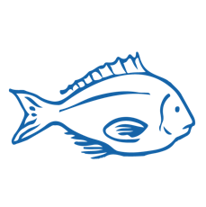
MIHI / INTRODUCTION
The good news is… some special people are working hard to make sure this doesn’t happen!
In this topic look at …. the history of fishing in Aotearoa and the fishing industry today
Let’s take a moment to consider the value of fishing to us

Slide 9
HISTORY OF AOTEAROA FISHING INDUSTRY Focus Question: What are some key moments in the history of fishing in Aotearoa?
Hoatu he ika ki te tangata, ka kai ia mō te rā,
akohia ki te hi, ka kai ia mō ake tonu atu
Give a man a fish and he will eat for a day,
teach him to fish and his future is assured
HE PĀTAI / CONSIDER THIS
What meaning do you take from this whakataukī?
What other fishing related whakataukī, proverbs, sayings or stories do you know?
Notes:
TEACHER NOTES
USEFUL RESOURCES / RĀRANGI PUKAPUKA
Other examples:
Māu te taiata, māku te taiahiahi
For you the morning tide to tend to, for me the afternoon tide to tend to
He kura kainga te moana, he kura huna te moana
The oceans environment, is a source of untapped knowledge
Mā te kanae anō te kanae hei kōrero
Mā te tāmure anō te tāmure hei kōrero
Mā te pāpaka anō te pāpaka hei kōrero
The grey mullet will speak for itself
The snapper will speak for itself
The crab will speak for itself

Slide 10
HISTORY OF AOTEAROA FISHING INDUSTRY
History of fishing in Aotearoa PRIOR KNOWLEDGE CHART
What we know | What we would like to know | What we have learned
HE PĀTAI / CONSIDER THIS
What do you already know about the history of fishing in Aotearoa New Zealand?
MAHI / ACTIVITY
Complete the Prior Knowledge Chart columns 1 & 2
Notes:
TEACHER NOTES
You could go back and review Topic 1

Slide 11
HISTORY OF AOTEAROA FISHING INDUSTRY
Early 1800s
KŌRERORERO / DISCUSSION
How attitudes to fish stocks have changed:
Traditional Māori approaches acknowledged connection with ocean and kaitiakitanga [good stewardship or guardianship]
Free for all! Early European settlers found a sea full of fish – the ocean was limitless!
Overfishing and declining fish stocks! People saw a need for limits and better data [information about fish stocks]
Demand and desire for Sustainability / Sustainable Development / Sustainable Yields
Invite Kaumātua, grandparents or local fisherfolk to come and talk!
How have they experienced the change in attitudes towards fish stocks?
Is kai moana more or less plentiful?
Today
Notes:
TEACHER NOTES

Slide 12
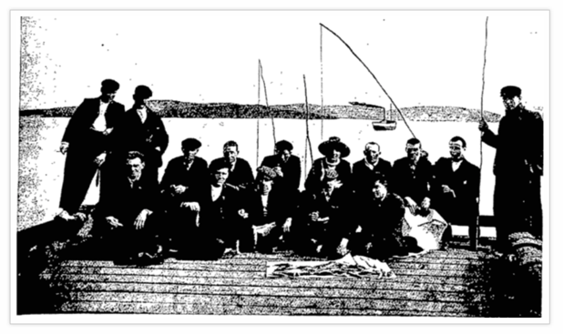
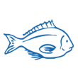
HISTORY OF AOTEAROA FISHING INDUSTRY
KŌRERORERO / DISCUSSION
Key periods in the history of Aotearoa’s fishing industry:
Māori traditional methods & tikanga
Early European settlers, refrigeration and early commercial fishing methods
The inshore boom, influx of foreign fishers, NZ’s EEZ and the Marine Reserve Act
The Quota Management System, total allowable catch and Treaty settlements
Otago Witness, 1904
Notes:
TEACHER NOTES
Suggest collaborative work – one or two students research each time period and then work together for final production.
Resources include (see Teacher Outline)
http://www.treaty2u.govt.nz/the-treaty-today/fisheries/index.htm
https://teara.govt.nz/en/fishing-industry/print
https://www.sciencelearn.org.nz/resources/1865-fisheries-in-new-zealand-timeline
https://www.nzgeo.com/stories/the-lost-art-of-fishing/

Slide 13
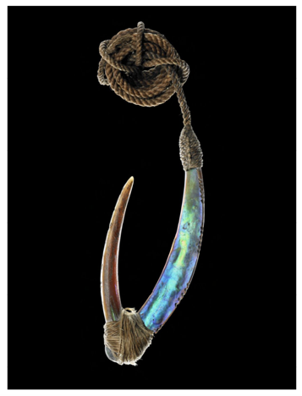
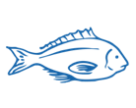
HISTORY OF AOTEAROA FISHING INDUSTRY
MAHI / ACTIVITY
Use the resources provided (see Teacher Outline) to show your understanding of key periods in the history of Aotearoa’s fishing industry by collaboratively creating one of the following:
A digital timeline
Digital Powtoon or Slowmation
A paper (non-digital) storyboard or timeline
Traditional Māori fish hook
Te Papa image from NZGeo
Notes:
TEACHER NOTES
Suggest collaborative work – one or two students research each time period and then work together for final production.
Resources include (see Teacher Outline)
https://teara.govt.nz/en/fishing-industry/print
https://www.sciencelearn.org.nz/resources/1865-fisheries-in-new-zealand-timeline
https://www.nzgeo.com/stories/the-lost-art-of-fishing/
Digital timelines - https://elearningindustry.com/top-10-free-timeline-creation-tools-for-teachers
Powtoon - https://www.powtoon.com/edu-home/
Slowmation - http://www.slowmation.com

Slide 14
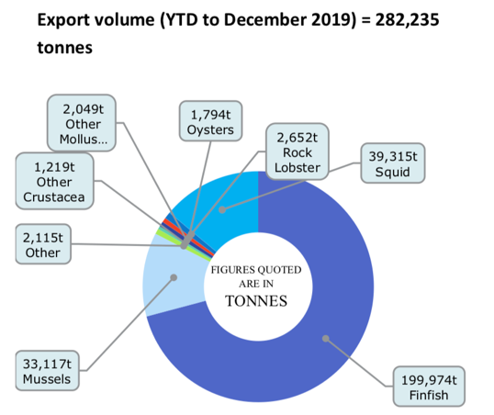
AOTEAROA: BUSINESS OF FISHING TODAY Focus Question: What is the size & economic value of Aotearoa’s seafood industry today?
KŌRERORERO / DISCUSSION
Around 600,000 tonnes of seafood (excluding aquaculture) is harvested from New Zealand's waters each year
In 2018, 267 901 tonnes of seafood were exported from Aotearoa New Zealand
MAHI / ACTIVITY
Try graphing this data using a bar graph
Compare your graph with this one
Source: Seafood New Zealand
Notes:
TEACHER NOTES
USEFUL RESOURCES / RĀRANGI PUKAPUKA
For more information see the Seafood New Zealand’s economic summary at:
https://www.seafood.co.nz/detail-3/seafood-nz-magazine-april-2020
Or you can look for a more recent one here: https://www.seafood.co.nz/publications/magazine
NOTE – you might want to discuss what fin fish are! Ie they are fish / types of seafood with fins (rather than mussels, crayfish etc)

Slide 15
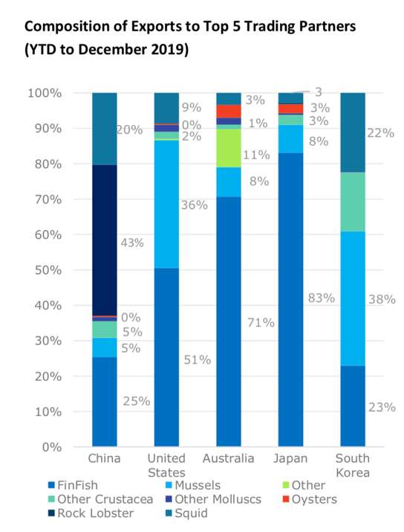
AOTEAROA: BUSINESS OF FISHING TODAY
HE PĀTAI / CONSIDER THIS
What type of seafood makes up the largest portion of seafood exports to:
1. China
2. United States
3. Australia
4. Japan
5. South Korea
What does / doesn’t surprise you about these figures?
Source: Seafood New Zealand
Notes:
TEACHER NOTES
USEFUL RESOURCES / RĀRANGI PUKAPUKA
For more information see the Seafood New Zealand’s economic summary at: https://www.seafood.co.nz/detail-3/seafood-nz-magazine-april-2020
Or you can look for a more recent one here: https://www.seafood.co.nz/publications/magazine
NOTE – you might want to discuss what fin fish are! Ie they are fish / types of seafood with fins (rather than mussels, crayfish etc)

Slide 16
AOTEAROA: BUSINESS OF FISHING TODAY
HE PĀTAI / CONSIDER THIS
Aotearoa New Zealand’s seafood industry has:
High export earnings
High production
95% of NZ landed catch from sustainable stocks
MAHI / ACTIVITY
In groups discuss the
sustainability of our fishing industry
Does our fishing industry meet the needs of the present without compromising the ability of future generations to meet their own needs?
Justify your answer: Why? And Why not?
Notes:
TEACHER NOTES
USEFUL RESOURCES / RĀRANGI PUKAPUKA
For more information see on lost and wasted seafood see the comprehensive report by FAO: http://www.fao.org/3/ca9229en/CA9229EN.pdf
See also: https://www.hakaimagazine.com/features/wasted/
And: https://www.msc.org/media-centre/news-opinion/news/2020/06/10/five-things-you-need-to-know-about-the-state-of-the-world-s-fish
ANSWERS
Waste due to many factors – spoilage,
Richer countries have the highest amount of waste

Slide 17
AOTEAROA: BUSINESS OF FISHING TODAY
TRUE OR FALSE?
MAHI / ACTIVITY: TRUE OR FALSE?
Number a page 1-12. For each of the following statements
write true or false next to the corresponding number!
1. Approximately 600,000 tonnes of seafood (excluding aquaculture) is harvested from New Zealand's waters each year
2. New Zealand's hoki fisheries were the first major fisheries in the world to be certified sustainable by the Marine Stewardship Council (MSC)
3. More than 90% of New Zealand's seabed has never been touched by trawlers
Facts & Figures from Seafood New Zealand
Notes:
TEACHER NOTES
USEFUL RESOURCES / RĀRANGI PUKAPUKA
For more information see the Seafood New Zealand’s facts and figures:
https://www.seafoodnewzealand.org/industry/key-facts/

Slide 18
AOTEAROA: BUSINESS OF FISHING TODAY
TRUE OR FALSE?
MAHI / ACTIVITY (continued)
4. 95% of New Zealand's commercially landed catch is from sustainable stocks, according to the Ministry for Primary Industries' latest Fish Stock Status report
5. New Zealand's benthic protection area (BPA) network and seamount closures cover an area 4.6 times larger than the country's landmass. It is one of the largest marine conservation areas in the world
6. 96% of New Zealand's territory is underwater & over 15,000 marine species have been identified in New Zealand's marine environment
7. Approximately 30.5% of New Zealand's total marine environment is protected
Facts & Figures from Seafood New Zealand
Notes:
TEACHER NOTES
USEFUL RESOURCES / RĀRANGI PUKAPUKA
For more information see the Seafood New Zealand’s facts and figures:
https://www.seafoodnewzealand.org/industry/key-facts/

Slide 19
AOTEAROA: BUSINESS OF FISHING TODAY
TRUE OR FALSE?
MAHI / ACTIVITY (continued)
8. New Zealand's 15,134 km long coastline is the ninth longest in the world
9. 2,500 people work in commercial fishing and aquaculture operations at sea
10. The New Zealand seafood industry employs over 13,000 full time workers
11. Aotearoa New Zealand has the fourth largest Exclusive Economic Zone (EEZ) [see topic 5 for more on EEZs]
12. Our seafood industry had a total export earning (FOB) of $1.8 billion in seafood exports in 2018
See topic 7 for a deeper look at the economic value of the global and Aotearoa New Zealand fishing industries
CLICK AGAIN FOR ANSWERS
ANSWERS are:
1-12 are all TRUE!
Facts & Figures from Seafood New Zealand
Notes:
TEACHER NOTES
USEFUL RESOURCES / RĀRANGI PUKAPUKA
For more information see the Seafood New Zealand’s facts and figures:
https://www.seafoodnewzealand.org/industry/key-facts/

Slide 20
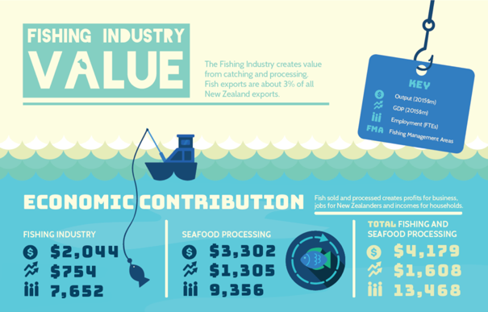
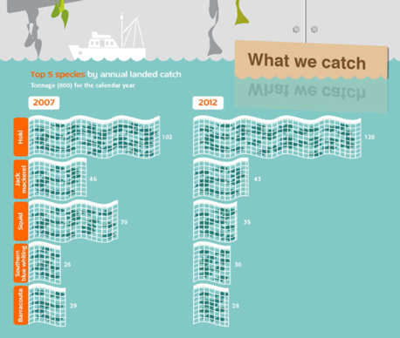
AOTEAROA: BUSINESS OF FISHING TODAY
Source: BERL Report 2017
Source: Statistics NZ
MAHI / ACTIVITY
Create your own info-graphic about the Aotearoa New Zealand fishing industry using canva
Notes:
TEACHER NOTES
USEFUL RESOURCES / RĀRANGI PUKAPUKA
For ideas and data see:
https://www.inshore.co.nz/fileadmin/Documents/Other/BERL_Report_August_2017.pdf
Canva can be found at: https://www.canva.com

Slide 21
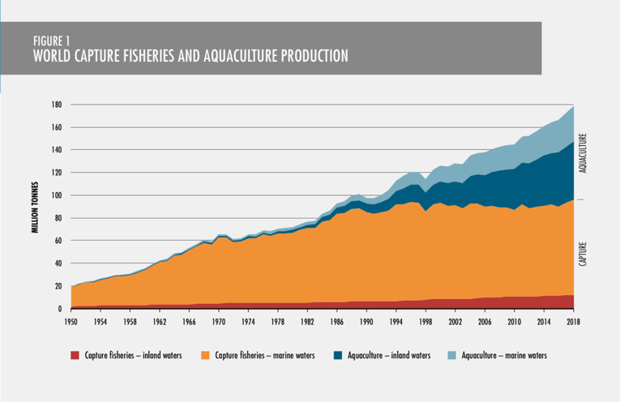
FUTURE OPPORTUNITIES & CHALLENGES Focus Question: What challenges & opportunities face Aotearoa’s seafood industry?
KŌRERORERO / DISCUSSION
Opportunity & Challenge: Global seafood production (how much seafood we catch and sell) is at an all time high!
HE PĀTAI / CONSIDER THIS
How many million tonnes were produced in 1950?
And how many in 2018?
What does this tell you about seafood production?
Source: FAO (2020)
The State of World Fisheries and Aquaculture 2020
Notes:
TEACHER NOTES
USEFUL RESOURCES / RĀRANGI PUKAPUKA
For more information see the comprehensive report by FAO: http://www.fao.org/3/ca9229en/CA9229EN.pdf
Note that aquaculture has exploded to an even greater degree than capture – why do you think this? How do you feel about the growth of aquaculture?

Slide 22
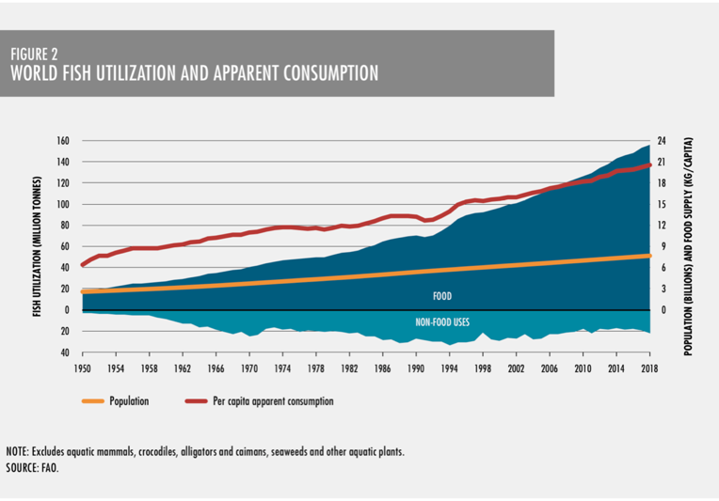
FUTURE OPPORTUNITIES & CHALLENGES
KŌRERORERO / DISCUSSION
Opportunity & Challenge: Global seafood consumption (how much seafood we buy and eat) is growing faster than ever
HE PĀTAI / CONSIDER THIS
How many million tonnes were consumed in 1950?
And how many in 2018?
What does this tell you about consumption?
Source: FAO (2020)
The State of World Fisheries and Aquaculture 2020
Notes:
TEACHER NOTES
USEFUL RESOURCES / RĀRANGI PUKAPUKA
For more information see the comprehensive report by FAO: http://www.fao.org/3/ca9229en/CA9229EN.pdf
FURTHER DISCUSSION
This graph shows that while population and apparent consumption are increasing at relatively similar rates, the catch has gone up more rapidly. So it looks like that would be an illustration of wastage?

Slide 23
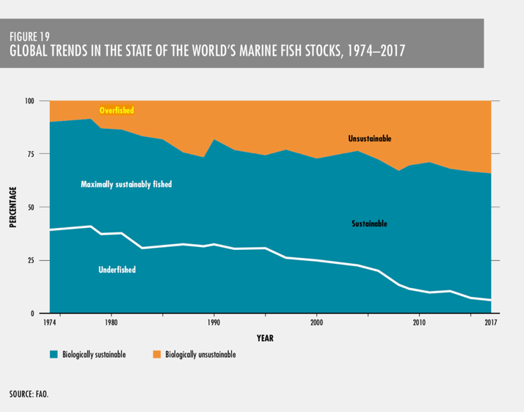
FUTURE OPPORTUNITIES & CHALLENGES
KŌRERORERO / DISCUSSION
Challenge: About a third of all fish stocks are still being overfished (MSC, 2020)
HE PĀTAI / CONSIDER THIS
How has the percentage of (1) under fished, and (2) over fished, stocks changed over time?
What does this tell you about global fish stocks?
Source: FAO (2020)
The State of World Fisheries and Aquaculture 2020
Notes:
TEACHER NOTES
USEFUL RESOURCES / RĀRANGI PUKAPUKA
For more information see the comprehensive report by FAO: http://www.fao.org/3/ca9229en/CA9229EN.pdf
See also: https://www.msc.org/media-centre/news-opinion/news/2020/06/10/five-things-you-need-to-know-about-the-state-of-the-world-s-fish

Slide 24
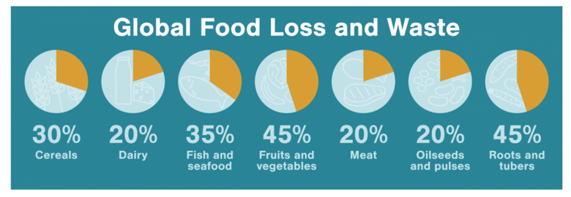
FUTURE OPPORTUNITIES & CHALLENGES
KŌRERORERO / DISCUSSION
Challenge: About 35% of the global harvest is lost or wasted every year
Our global food system discards 46 million tonnes of fish each year!
Source: FAO in Hakei
HE PĀTAI / CONSIDER THIS
Why is so much seafood wasted?
Can you guess if it is the poorer or richer countries who waste the most?
MAHI / ACTIVITY
Create a bar graph showing global food loss and waste (from chart above)
Which graph (pie or bar) shows the information best and why?
Notes:
TEACHER NOTES
USEFUL RESOURCES / RĀRANGI PUKAPUKA
For more information see on lost and wasted seafood see the comprehensive report by FAO: http://www.fao.org/3/ca9229en/CA9229EN.pdf
See also: https://www.hakaimagazine.com/features/wasted/
And: https://www.msc.org/media-centre/news-opinion/news/2020/06/10/five-things-you-need-to-know-about-the-state-of-the-world-s-fish
ANSWERS
Waste due to many factors – spoilage,
Richer countries have the highest amount of waste

Slide 25
FUTURE OPPORTUNITIES & CHALLENGES
KŌRERORERO / DISCUSSION
A common solution suggested for global supply & demand challenges is sustainable development
‘Development that meets the needs of the present without compromising the ability of future generations to meet their own needs’
MAHI / ACTIVITY
Place yourself along a continuum (line) with strongly agree at one end & strongly disagree at the other based on your belief around the following statement: “Human needs and requirements are more important than the protection of the environment. Resources (including seafood) should be fully exploited for human development.”
Strongly agree
Strongly disagree
Notes:
TEACHER NOTES
USEFUL RESOURCES / RĀRANGI PUKAPUKA
This definition of sustainable development comes from the Brundtland Report: Our Common Future. See: https://sustainabledevelopment.un.org/content/documents/5987our-common-future.pdf (see paragraph 27)

Slide 26
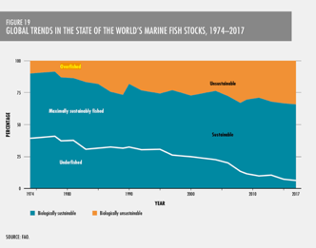
FUTURE OPPORTUNITIES & CHALLENGES
MAHI / ACTIVITY
In groups discuss the sustainability of the global fishing industry.
Does the global fishing industry meet the needs of the present without compromising the ability of future generations to meet their own needs?
Justify your answer: Why? Why not?
HE PĀTAI / CONSIDER THIS
We have a global seafood industry where:
Consumption is high
Production is high
Waste is high
Almost a third of fish stocks are overfished
Notes:
TEACHER NOTES
USEFUL RESOURCES / RĀRANGI PUKAPUKA
For more information see on lost and wasted seafood see the comprehensive report by FAO: http://www.fao.org/3/ca9229en/CA9229EN.pdf
See also: https://www.hakaimagazine.com/features/wasted/
And: https://www.msc.org/media-centre/news-opinion/news/2020/06/10/five-things-you-need-to-know-about-the-state-of-the-world-s-fish
ANSWERS
Waste due to many factors – spoilage,
Richer countries have the highest amount of waste

Slide 27
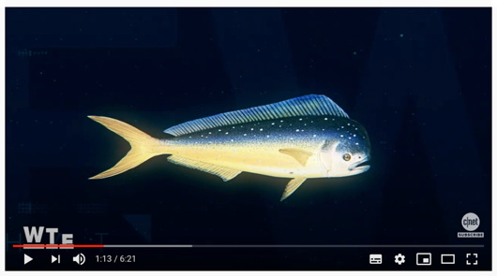
FUTURE OPPORTUNITIES & CHALLENGES
Experts ONLY!
HE PĀTAI / CONSIDER THIS
Current demand creates challenges and opportunities for the future
Is lab grown fish a potential solution? Why / Why not?
MAHI / ACTIVITY
If global demand for seafood continues to grow – how can demand be met in a way that is sustainable for the sea?
MĀTAKI TĒNEI / WATCH THIS
Will lab grown fish save oceans?
[6:21]
Notes:
TEACHER NOTES
NOTE: Language is a little tricky (and very American!)
See https://www.youtube.com/watch?v=U45_V70YiwQ

Slide 28
EXPLORATION, INNOVATION & ENTERPRISE
Focus Question: What role do enterprise, innovation & exploration play in
growing fishing businesses?
HE PĀTAI / CONSIDER THIS
What do we mean by each of the following words:
Innovative
Enterprising
Exploration
[click for answers]
Innovative: introducing new ideas; original and creative in thinking
Enterprising: having or showing initiative and resourcefulness
Exploration: action of exploring an unfamiliar area
Notes:
TEACHER NOTES

Slide 29
EXPLORATION, INNOVATION & ENTERPRISE
KŌRERORERO / DISCUSSION
Aotearoa New Zealand is often seen as an innovative & enterprising world leader in fisheries
HE PĀTAI / CONSIDER THIS
What are some examples of exploration, innovation and enterprise evident in fishing in Aotearoa?
MĀTAKI TĒNEI / WATCH THIS
Film [15:42] illustrating how the the rest of the world views sustainable fishing in Aotearoa New Zealand
Notes:
TEACHER NOTES
Film clip can be found at: https://www.youtube.com/watch?v=sDh2Cn2bNxk
NOTE: Filmed for an overseas audience so is interesting to see what children in other parts of the world are learning about Aotearoa NZ fisheries!
HOW TO PLAY KAHOOT
Connect a device to a projector or screen in front of the classroom.
Navigate to the game called Marine Stewardship Council NZ Kahoot page
https://www.msc.org/en-au/for-teachers/ocean-literacy/new-zealand-education-curriculum/kahoot-quizzes
Select settings
At Kahoot.it, learners enter game-pin and nickname on their own devices (phone, tablet, or computer).
Press “Start now”. The fun begins!
Learners answer questions on their own devices by selecting one of the four answer buttons.
See additional instructions, options, and how to make your own Kahoot at: https://kahoot.com

Slide 30
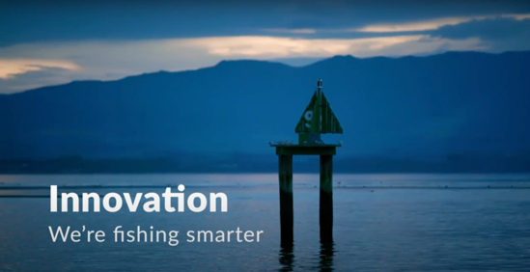
EXPLORATION, INNOVATION & ENTERPRISE
HE PĀTAI / CONSIDER THIS
What are commercial fishers doing to avoid catching seabirds?
What new technology is helping commercial fishers to reduce their environmental impact?
What is meant by “the changing culture of the industry”?
MĀTAKI TĒNEI / WATCH THIS
Watch this short film [0:56] from Seafood New Zelaand about Innovation – We’re Fishing Smarter
Notes:
TEACHER NOTES:
VIDEO LINKS: Innovation – We’re fishing Smarter (Seafood New Zealand) URL:
https://www.youtube.com/watch?time_continue=3&v=7CRbG7sPobs&feature=emb_title
HE PĀTAI – ANSWERS (all information needed to answer is in the short film ‘Innovation’)
Setting at night; using tori lines to deter birds; getting trained in seabird smart fishing; traceability (cameras on boats and GPS locators); bird detectors on cameras;
Traceability; cameras on deck; AOS (ability to identify fish; PSH gear development
The culture of the fishing industry is changing – in the past commercial fishers were seen as having a ‘catch at any cost’ mentality. Commercial fishers were seen as the bad guys - people who went out and caught as much as they could and didn’t really care about the environment! But now fishers are working with conservationists and scientists to look after the marine environment
USEFUL RESOURCES / RĀRANGI PUKAPUKA
Here are a few other innovations fishers use to reduce bycatch and habitat damage:
1. Acoustic alarms (pingers) deter marine mammals by emitting noise
2. Gear modification:
Breakaway links let large whales break out of nets when they struggle and exert force
Tori lines to scare away the birds (long lining and trawling)
Reflective nets are more detectable to marine mammals so they can avoid them.
Turtle excluder devices (TEDs) help turtles to escape through a built-in hatch in trawls.
Modification of mesh size helps marine mammals better detect nets so they can avoid them.
3. Time- area closures: Setting nets at different times of the day (setting longlines at night minimizes seabird bycatch); setting nets in areas that are less heavily frequented by mammals, birds and turtles.
HOMEWORK / EXTENSION – HOW DOES THIS RELATE TO ME AND MY WHĀNAU
Invite a kaumātua or grandparent to visit and get them to talk about how fishing has changed over time and what measures have been used locally to reduce impacts on marine habitat and sea life.
Homework activity – learners interview a member of their whānau, family or community about their fishing practices (can adapt questions from this slide)
Learners share their own fishing stories or those from family, whānau or community to share

Slide 31
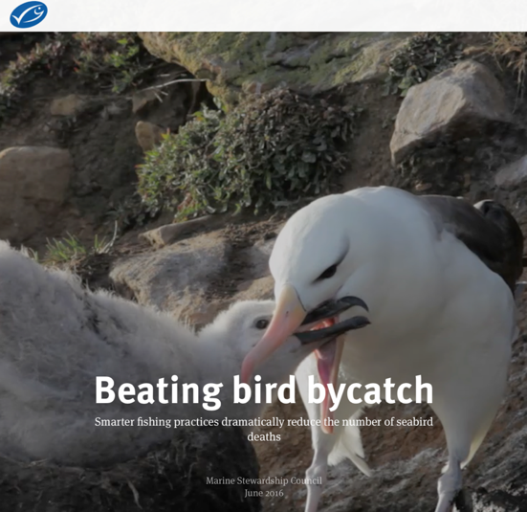
EXPLORATION, INNOVATION & ENTERPRISE
KŌRERO PUKAPUKA / READ
Read about the southern ocean toothfish fishery and how innovations have reduced seabird captures
HE PĀTAI / CONSIDER THIS
What innovations were implemented to reduce seabird captures
Notes:
TEACHER NOTES
http://beating-bird-bycatch-stories.msc.org/?_ga=2.180844327.129658065.1600647897-1303352827.1595455374

Slide 32
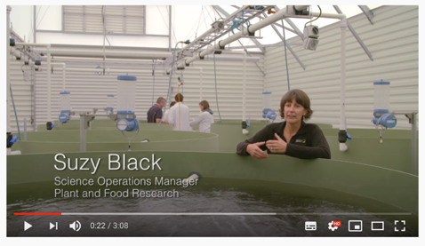
EXPLORATION, INNOVATION & ENTERPRISE
HE PĀTAI / CONSIDER THIS
How will this new technology
(1) help the environment?
(2) Improve the quality of fish when it reaches the market place?
MĀTAKI TĒNEI / WATCH THIS
About the new innovative fishing technology PSH
Notes:
TEACHER NOTES
https://www.youtube.com/watch?v=oeSFjLxyUi0

Slide 33
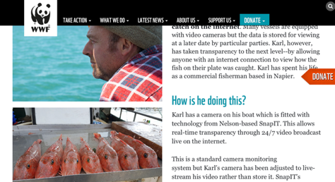
EXPLORATION, INNOVATION & ENTERPRISE
HE PĀTAI / CONSIDER THIS
How will this innovative approach help the environment?
Why has Karl started live streaming his fishing?
How could this help Karl’s business?
KŌRERO PUKAPUKA / READ
About Karl Warr, from Better Fishing, who has become the first fisherman in the world to live-stream his catch on the internet
Notes:
TEACHER NOTES
https://www.wwf.org.nz/what_we_do/marine/sustainable_fisheries/better_fishing/
USEFUL RESOURCES / RĀRANGI PUKAPUKA
You could also watch this Country Calendar episode: The Innovators: Sustainable Seas
https://www.hyundai.co.nz/hyundai-country/the-innovators/sustainable-seas

Slide 34
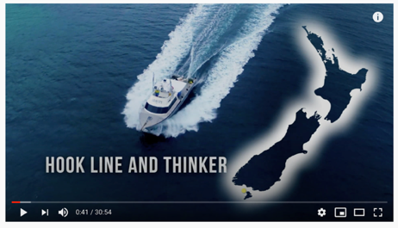
EXPLORATION, INNOVATION & ENTERPRISE
HE PĀTAI / CONSIDER THIS
Nate from Gravity Fishing, is using technology & innovation to change the way he catches, sells and markets fish:
1. How will Nate’s innovative approach help the environment?
2. Why has Nate changed his approach to fishing?
3. How is Nate’s ‘supply chain’ different?
MĀTAKI TĒNEI /
WATCH THIS
Hook Line & Thinker [30:54]
Notes:
TEACHER NOTES
Hyundai Country Calendar Episode 33 – Hook Line and Thinker
https://www.youtube.com/watch?v=JanaY6QapxQ

Slide 35
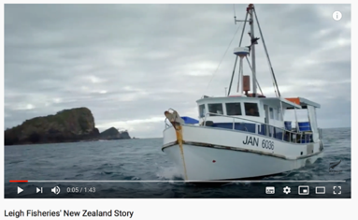
EXPLORATION, INNOVATION & ENTERPRISE
HE PĀTAI / CONSIDER THIS
Lee Fish, a small town fishmonger in Aotearoa that has innovatively developed his fishing business:
1. How long is it from ocean to plate?
2. What is traceability? How can this help with sustainability?
MAHI / ACTIVITY
Complete the Lee Fish Worksheet
MĀTAKI TĒNEI / WATCH THIS
New Zealand story [1:43] about Lee Fish who innovatively deliver high quality fish traceable from source
Notes:
TEACHER NOTES
https://www.youtube.com/watch?v=RBFVUueKCzw

Slide 36
EXPLORATION, INNOVATION & ENTERPRISE
HE PĀTAI / CONSIDER THIS
(For history on the toheroa fishery see also topic 5)
1. How do they hope their innovation will impact the toheroa industry?
2. Where will the spat [seed] come from?
KŌRERO PUKAPUKA / READ
BlueTide Aquaculture recently won an innovation award to develop sustainable toheroa aquaculture
Notes:
TEACHER NOTES
https://www.callaghaninnovation.govt.nz/news-and-events/turning-tide
History of toheroa
https://www.youtube.com/watch?v=x0GcneKoT18

Slide 37
REVIEWING KEY CONCEPTS Focus Question: What have we learnt?
MAHI / ACTIVITY
WRITE two or three paragraphs about what you have learnt during this topic. Be sure to include the following words:
Sustainability
Seafood industry
Innovation
Opportunities
Production
Challenges
Business
Consumption
Technology
Notes:
TEACHER NOTES

