Slide 1

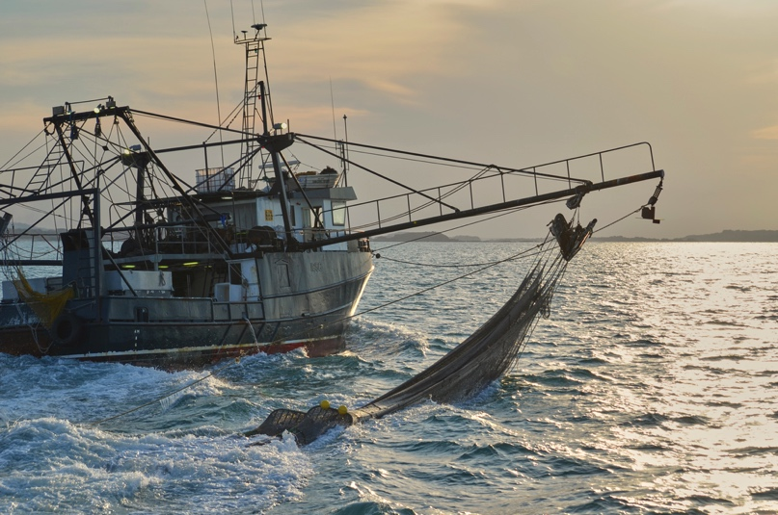
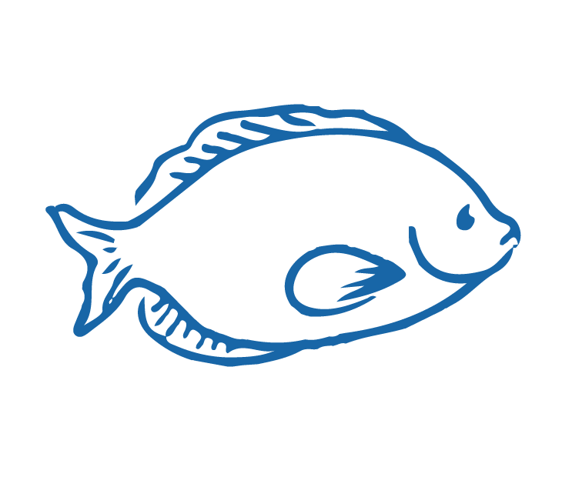
OVERFISHING
Focusing Question: What is overfishing? What impact does overfishing have?
KŌRERORERO/ DISCUSSION
Overfishing is when fish are fished too much so their numbers cannot reproduce to a healthy number so they begin to decline
Overfishing:
Does not leave enough fish in the sea
Can affect whole marine communities
Means catches decline and fishers no longer have their livelihood
Notes:
TEACHER NOTES
Entire marine communities can be affected through food web connections. For example, in Aotearoa New Zealand where snapper are overfished then kina (sea urchin) numbers start to increase and seaweed decreases (eaten by kina)

Slide 2
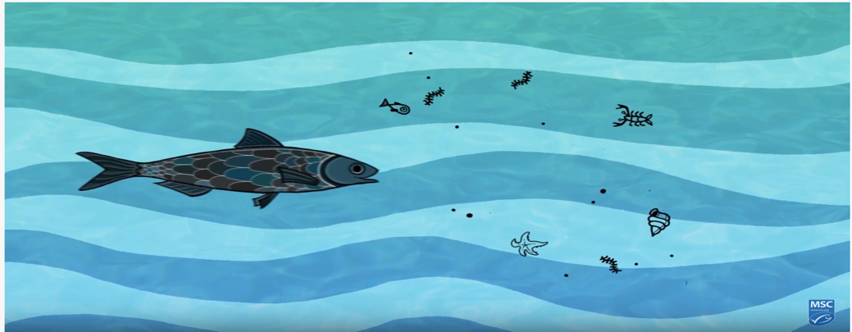
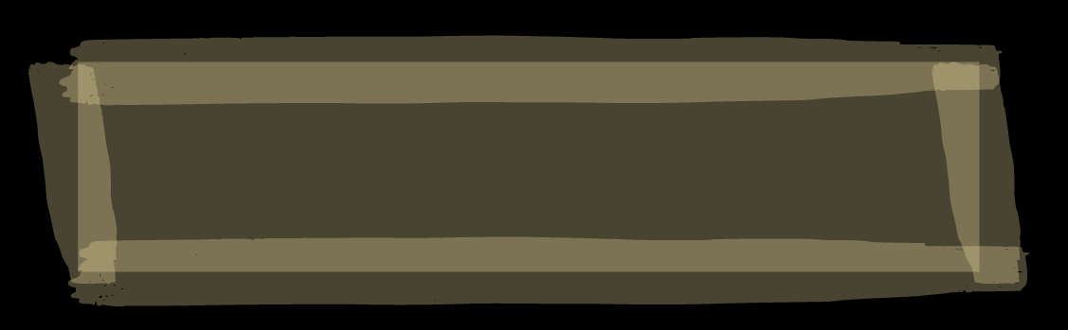
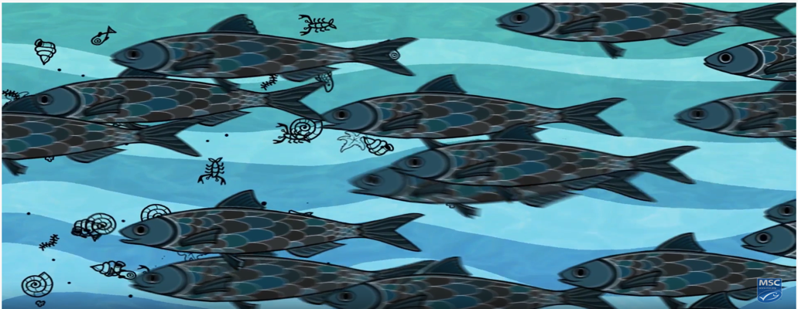
OVERFISHING
KŌRERORERO/ DISCUSSION
When one type of fish is overfished it affects those who fish as well as the whole food web [fish’s community]
HE PĀTAI / CONSIDER THIS
Which picture best shows how the sea might look if overfished?
Why (explain your answer)?
What else can affect health of fish?
Other issues that affect the health of fish and the sea include climate change and pollution
Notes:
TEACHER NOTES
Entire marine communities can be affected through food web connections. For example, in Aotearoa New Zealand where snapper are overfished then kina (sea urchin) numbers start to increase and seaweed decreases (eaten by kina)
MAHI / ACTIVITY
See also Overfishing Activities
Activities include:
Activity 1 (EASY) – images and simple statements to build foundation understanding of overfishing and sustainable fishing (15+ minutes)
Activity 2 (ALL LEVELS) – Prior Knowledge chart (15+ minutes)

Slide 3
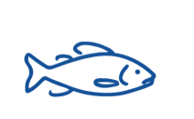
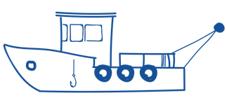

OVERFISHING
HE PĀTAI / CONSIDER THIS
What do you already know about overfishing?
MAHI / ACTIVITY
Complete the Prior Knowledge Chart columns 1 & 2 (see Teacher Outline Overfishing)
OVERFISHING PRIOR KNOWLEDGE CHART
What we know | What we would like to know | What we have learned
Notes:
TEACHER NOTES
A 2015 WWF report suggested that Marine life declined by almost half. This statistic is from WWF who found the size of marine populations had declined by almost half (49%) between 1970 and 2012 [according to WWF’s Living Blue Planet Report 2015].
MAHI / ACTIVITY
See Teacher Outline Overfishing
Warm up activities include:
Activity 1 (EASY) – images and simple statements to build foundation understanding of overfishing and sustainable fishing (15+ minutes)
Activity 2 (ALL LEVELS) – Prior Knowledge chart (15+ minutes)

Slide 4
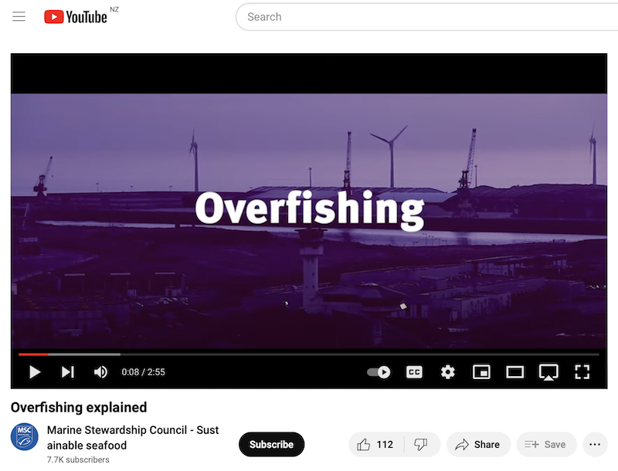
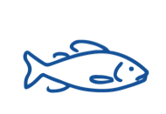
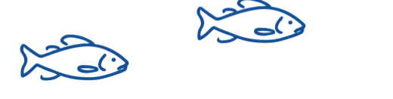
OVERFISHING
MĀTAKI TĒNEI / WATCH THIS
Short film [2:55] Overfishing
HE PĀTAI / CONSIDER THIS
What is overfishing? And what impact does overfishing have on the ocean?
MAHI / ACTIVITY
Add any new knowledge to your ‘Overfishing Prior Knowledge’ chart
Notes:
TEACHER NOTES
Film link is: https://www.youtube.com/watch?v=57QaiexyAFg&t=8s

Slide 5
OVERFISHING
Experts ONLY!
KŌRERORERO/ DISCUSSION
Science Daily says a fishery is: “an organized effort by humans to catch fish or other aquatic species, an activity known as fishing”
Fishery size depends on fish added by:
  New (young) fish
  Fish migrating in
And fish taken away as:
  Fish die
  Fish are caught
  Fish migrate out of the fishery
So what is a ‘fishery’? Have a go! See if you can write some words or even a sentence that explains what a fishery is!....
Can you think what might affect the size of a fishery [number of fish]?
Notes:
TEACHER NOTES
A second definition is a fishery is… a place where fish or shellfish are caught and a place where fish are reared for commercial purposes
USEFUL RESOURCES / RĀRANGI PUKAPUKA
What is a fishery? – Useful 3 minute video explaining what a fishery is [good for teachers and higher level learners] See: https://www.youtube.com/watch?v=I-DikSs4kRs

Slide 6
OVERFISHING
Experts ONLY!
Overfishing happens when the number of fish being taken out is much greater than the number of fish being added…. Remember..
Fishery size depends on fish added by:
  New (young) fish
  Fish migrating in
And fish taken away as:
  Fish die
  Fish are caught
  Fish migrate out of the fishery
MAHI / ACTIVITY
Deepen understanding and use online tools like Piktochart or paper and pens to create a diagram showing how overfishing affects the size of a fish population
Notes:
TEACHER NOTES
A second definition is a fishery is… a place where fish or shellfish are caught and a place where fish are reared for commercial purposes
USEFUL RESOURCES / RĀRANGI PUKAPUKA
What is a fishery? – Useful 3 minute video explaining what a fishery is [good for teachers and higher level learners] See: https://www.youtube.com/watch?v=I-DikSs4kRs

