Slide 1
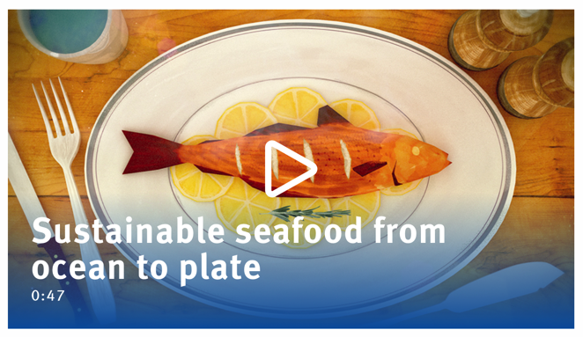



THE BLUE FISH TICK LABEL
Focusing Question: Who are the Marine Stewardship Council? What does a blue fish tick label mean?
KŌRERORERO/ DISCUSSION
The Marine Stewardship Council sees if fisheries are sustainable
When a fishery has been found to be sustainable then fish from that fishery can be sold with the Marine Stewardship Council blue fish tick label
There are still many fisheries in the world that do not have the blue fish tick label
MĀTAKI TĒNEI /
WATCH THIS
Short video (0:48) on the Blue Fish Tick Label
Notes:
TEACHER NOTES
Film clip can be found at: https://www.youtube.com/watch?v=Kac1cqkjX1U

Slide 2


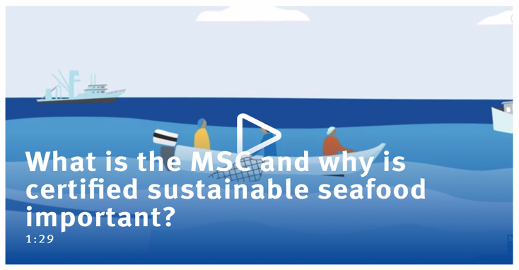
THE BLUE FISH TICK LABEL
KŌRERORERO/ DISCUSSION
The Marine Stewardship Council is an international non-profit organisation
The Marine Stewardship Council’s vision is of oceans teeming with life, and seafood supplies that are safeguarded for future generations!
MĀTAKI TĒNEI / WATCH THIS
Watch the short (1.30) film about sustainable fishing and the Marine Stewardship Council
KŌRERO PUKAPUKA / READ
Read Ocean’s at Risk Worksheet Complete the Kahoot quiz
Notes:
TEACHER NOTES
The short film can be found at https://www.youtube.com/watch?v=3rVeSBdpO6Q
KŌRERO PUKAPUKA / READ
See Ocean’s at Risk Factsheet (10-15 minutes)
Quick reading fact sheet with suggested reading and extension activity as well as literacy based questions.
Kahoot game includes questions on information contained in the fact sheet (10-15 minutes)
HOW TO PLAY KAHOOT
Connect a device to a projector or screen in front of the classroom.
Navigate to the game called Marine Stewardship Council Kahoot page
https://www.msc.org/en-au/for-teachers/ocean-literacy/new-zealand-education-curriculum/kahoot-quizzes
Select settings
At Kahoot.it, learners enter game-pin and nickname on their own devices (phone, tablet, or computer).
Press “Start now”. The fun begins!
Learners answer questions on their own devices by selecting one of the four answer buttons.
See additional instructions, options, and how to make your own Kahoot at: https://kahoot.com

Slide 3

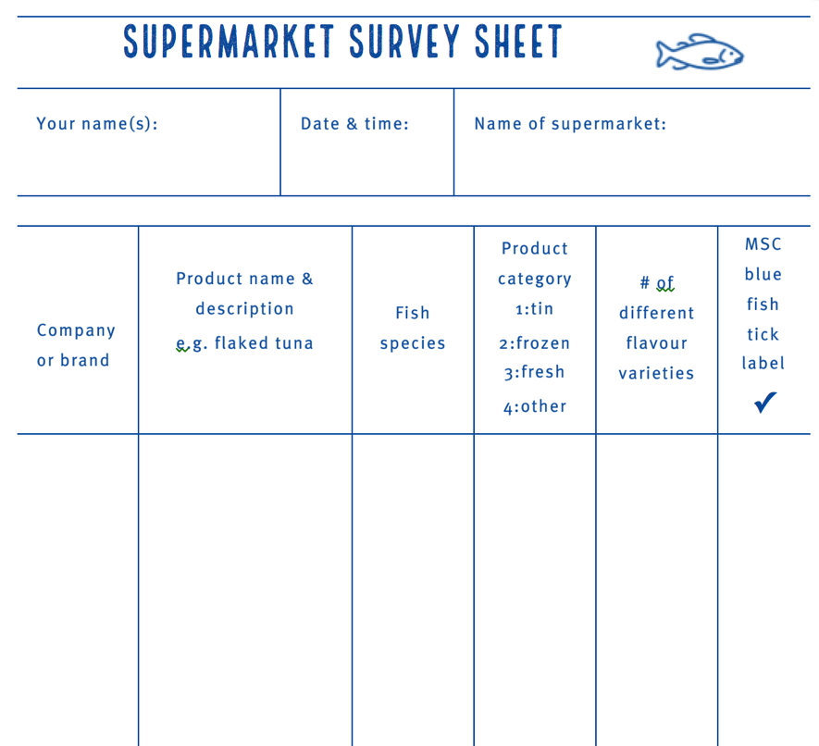
BLUE FISH TICK LABEL
MAHI / ACTIVITY
A supermarket field trip!
Visit a local supermarket and hunt for fish products that do and don’t show the Marine Stewardship Council blue label
Complete the Supermarket survey sheet
Bring your answers to share, compare and graph with the class
Just in case… this is what the Marine Stewardship Council Blue Label looks like!
Notes:
TEACHER NOTES
Estimated time to complete:
Field work: Supermarket survey: 30 – 60 minutes [depending on writing speed!]
In class: Share results, create class result table and graph: 30 – 60 minutes

Slide 4

He tai moana, he tai ika,
He tai timu, he ika nunumi
A sea that is healthy, is a sea that flourishes with life
A sea in decline, becomes void of sea life
Whaktauki or proverb – it outlines a two way context; the need for caring for the ocean or the repercussions of mismanagement of resources

