Slide 1


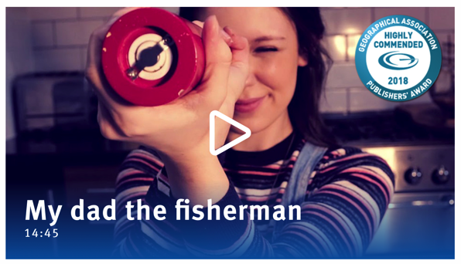

REVIEWING KEY CONCEPTS
Focusing Question: What have we learnt?
MĀTAKI TĒNEI / WATCH THIS
Re-watch the short award winning film (14.46) called My Dad the Fisherman
MAHI / ACTIVITY
Write down as many words and phrases to do with the term “sustainable oceans”
Match terms to definitions (see Key term worksheet) Create an infographic for one term
Notes:
TEACHER NOTES
My dad the fisherman can be found at:
https://www.youtube.com/watch?v=OIsA8xQ7WbQ

Slide 2

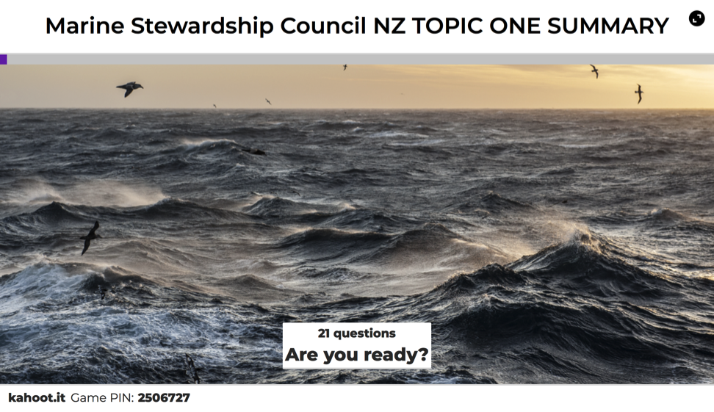
REVIEWING KEY CONCEPTS
MAHI / ACTIVITY
Complete the following:
Kahoot: Overfishing & Sustainable Fishing Topic Kahoot!
Animation: Use Powtoon to make an animation telling the story of sustainable fishing - include terms from the Key term worksheet
Notes:
TEACHER NOTES
The summary can be found at: https://dad-fishes-for-the-future.msc.org/?_ga=2.178911460.1759312358.1578727525-1836922175.1578727525#start-dOPb2kpn4D
HOMEWORK IDEAS
Any of the Kahoot, Worksheet or crossword could be good homework activities.
HOW TO PLAY KAHOOT
See other teacher notes for instructions
URL for this game is:https://create.kahoot.it/share/review-quiz-overfishing-sustainable-fishing-topic-marine-stewardship-council-nz/563e8ed3-6f56-494c-803f-b3bf840cec95
SUSTAINABLE OCEAN KEY TERM WORKSHEET
The sustainable ocean key term worksheet can be found at: https://www.msc.org/docs/default-source/default-document-library/education-page/msc-lesson-plan-using-the-oceans-resources-responsibly.pdf?sfvrsn=5c15a87a_14
ANIMATION USING POWTOON
Use Powtoon to enable learners to create their own animation that tells the story of sustainable fishing. Include the key terms from the worksheet to make sure that all the key information is included.

Slide 3

He tai moana, he tai ika,
He tai timu, he ika nunumi
A sea that is healthy, is a sea that flourishes with life
A sea in decline, becomes void of sea life
Whaktauki or proverb – it outlines a two way context; the need for caring for the ocean or the repercussions of mismanagement of resources

