Slide 1

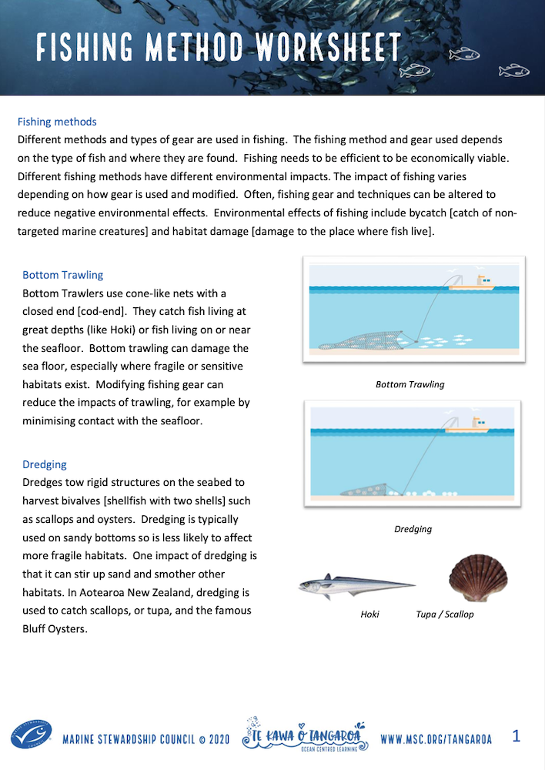
FISHING METHODS
Focus Question: What methods are used to catch fish? What fish are caught & from which habitat?
KŌRERORERO / DISCUSSION
Fishing methods are usually selected as they are efficient [making fishing economically viable]
Some methods of fishing are more sustainable than others
How sustainable fishing is can depend on a range of factors including:
  Characteristics of the environment
  How fishing is undertaken
  Exact nature of gear used
MAHI / ACTIVITY
Complete Fishing Method Worksheet
Notes:
TEACHER NOTES
USEFUL RESOURCES / RĀRANGI PUKAPUKA
Information on different types of fishing methods see: https://www.msc.org/en-au/what-we-are-doing/our-approach/fishing-methods-and-gear-types

Slide 2
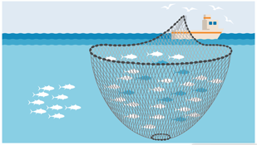
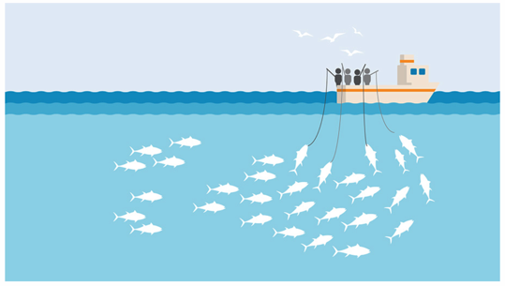
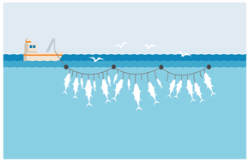
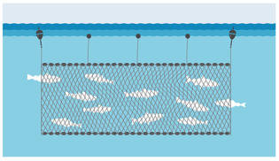
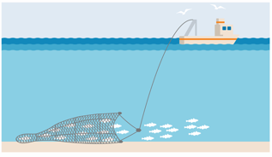
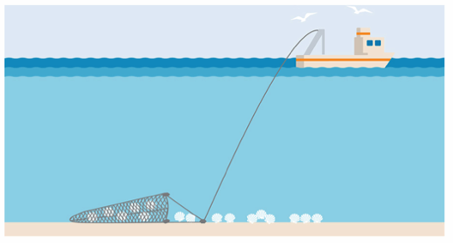
FISHING METHODS
Focus Question: What methods are used to catch fish? What fish are caught & from which habitat?
MAHI / ACTIVITY
Can you match the picture to the method above? [click for answers]
KŌRERORERO / DISCUSSION
Fishing methods include:
  Pole fishing
  Purse seining
  Long lining
  Gill netting
  Bottom trawling
  Dredging
2
1
3
4
6
5
Notes:
TEACHER NOTES
USEFUL RESOURCES / RĀRANGI PUKAPUKA
Information on different types of fishing methods see: https://www.msc.org/en-au/what-we-are-doing/our-approach/fishing-methods-and-gear-types

Slide 3
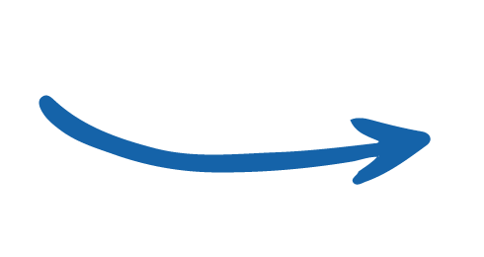
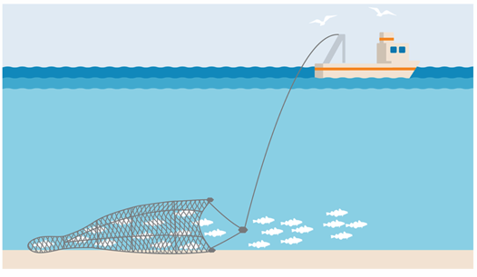


FISHING METHODS
KŌRERORERO / DISCUSSION
Bottom Trawlers
Use cone-like nets with a closed end [cod-end]
Catch fish living at great depths or on the seafloor
In Aotearoa New Zealand some Hoki are caught in deep water near the seafloor using bottom trawl
Notes:
TEACHER NOTES
Impacts include bycatch of non target species and habitat damage if trawl is towed across the seafloor.

Slide 4
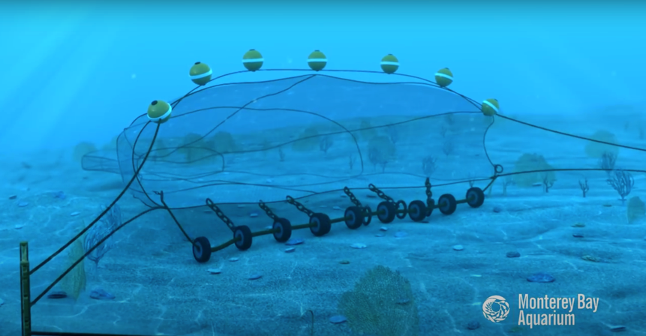
FISHING METHODS
HE PĀTAI / CONSIDER THIS
1. Could this fishing method affect the seafloor? How?
2. Could this fishing method impact other [non target] fish and marine creatures? How?
3. How can these impacts be reduced?
MĀTAKI TĒNEI / WATCH THIS
Watch this short film [0:51] from Monterey Bay Aquarium showing how a bottom trawl functions
Notes:
TEACHER NOTES
Film can be found on You Tube at: https://www.youtube.com/watch?time_continue=51&v=BcJFSl_YJHk&feature=emb_title
1 and 2 Impacts include bycatch of non target species and habitat damage if trawl is towed across the seafloor. Non target species could be caught in the trawl net.
3. While demersal trawling often interacts with the seabed, modifications and careful management of fishing operations can reduce environmental impacts and increase sustainability.
MSC certified trawl fisheries have made many improvements to their practices. These include monitoring and mapping fishing areas, avoiding fishing in known sensitive or protected habitats, and banning bottom trawling during spawning season. Gear modifications, such as rock hoppers (balls or discs, often rubber), can also reduce the amount of contact between the net and the seabed.

Slide 5
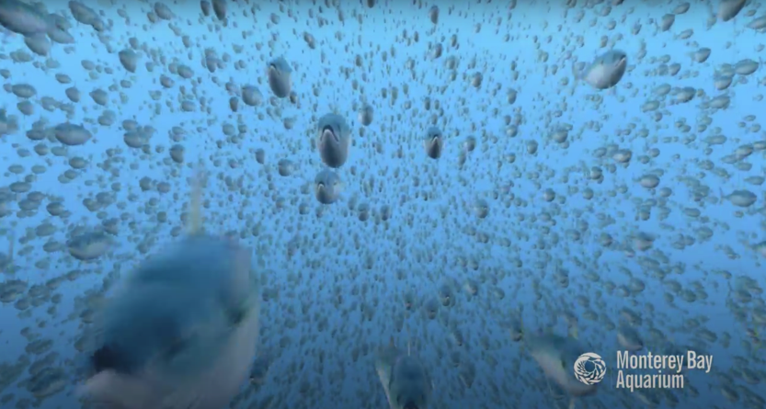
FISHING METHODS
HE PĀTAI / CONSIDER THIS
How is this method different to bottom trawling?
Could this fishing method affect the habitat or seafloor?
3. Could this fishing method impact other [non target] fish and marine creatures? How?
4. How can these impacts be reduced?
MĀTAKI TĒNEI / WATCH THIS
Watch this short film [0:49] from Monterey Bay Aquarium about midwater trawling
Notes:
TEACHER NOTES
Film can be found on You Tube at: https://www.youtube.com/watch?time_continue=6&v=DzSFB4H9MC8&feature=emb_logo
EXTENSION: You could also make a table and compare the similarities and differences between bottom trawling and midwater trawling

Slide 6
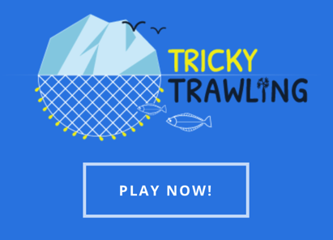
FISHING METHODS
MAHI / ACTIVITY
Learn about fishing in Greenland and get a feel for how hard it is to trawl by playing this super cool Tricky Trawling game
Game created by ZSL See campaign.zsl.org
Notes:
TEACHER NOTES
Tricky Trawling Game URL: https://campaign.zsl.org/trickytrawling/
ZSL has also created a glossary of terms and a set of activities to accompany this game! See:
https://www.zsl.org/sites/default/files/KS3%20Tricky%20Trawling%20-%20Activities%20to%20explore%20Ecosystems%20and%20Sustainability.pdf

Slide 7

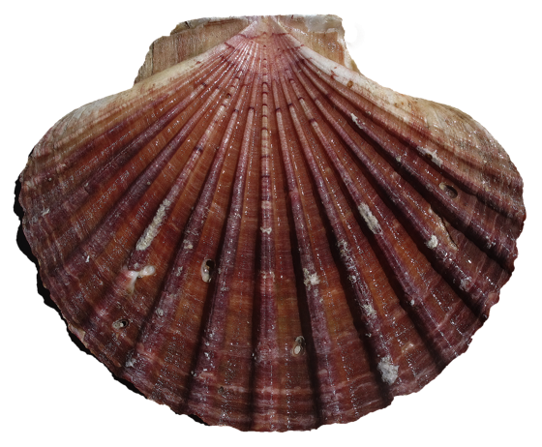
FISHING METHODS
KŌRERORERO / DISCUSSION
Dredges
Tow rigid structures on the seabed to harvest bivalves [shellfish with two shells]
Are used to catch ngā tupa or scallops in Aotearoa New Zealand
The famous tio paruparu or Bluff Oysters are also fished using the dredge method
Notes:
TEACHER NOTES
For more information see: https://www.msc.org/what-we-are-doing/our-approach/fishing-methods-and-gear-types

Slide 8
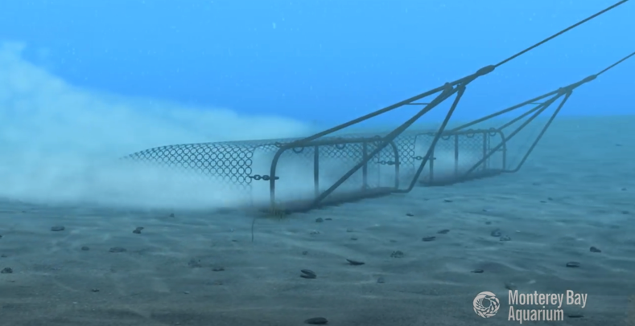
FISHING METHODS
HE PĀTAI / CONSIDER THIS
1. Could this fishing method affect the seafloor? How?
2. Could this fishing method impact other [non target] fish and marine creatures? How?
3. How can these impacts be reduced?
MĀTAKI TĒNEI / WATCH THIS
Watch this short film [0:45] from Monterey Bay Aquarium showing how a dredge functions
Notes:
TEACHER NOTES
Film can be found on You Tube at:
https://www.youtube.com/watch?time_continue=17&v=pK767idHYmM&feature=emb_logo
The design of dredges varies depending on the species being targeted, but many consist of a triangular frame. A bar (with or without teeth) at the front of this frame dislodges shellfish as it is dragged over the sediment and passes them into a metal collecting basket. By contrast, hydraulic dredges use jets of water to disturb the seabed and dislodge shellfish. The use of specific mesh sizes and escape panels prevents any undersized or non-target species being retained in the basket.
The environmental impact of dredging varies significantly depending on the type of sediment on the seabed and the habitat it supports. As such, there is often strict regulation around the types of dredge permitted, and the frequency with which they can operate in an area.
MSC certified dredge fisheries have taken measures to minimize the impacts on seabed habitats. These include restricting the area within which dredging can take place, replacing traditional dredges with lighter dredges and introducing boulder exclusion devices to prevent the loss of habitat features.

Slide 9
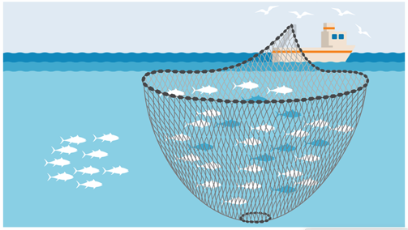
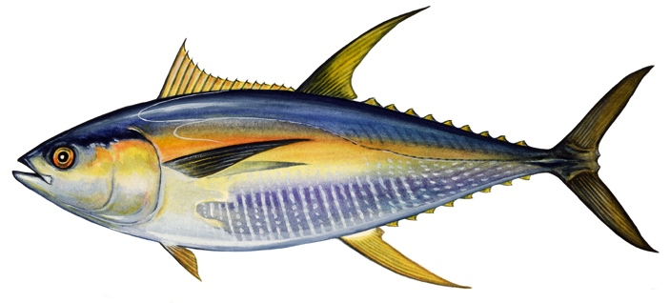
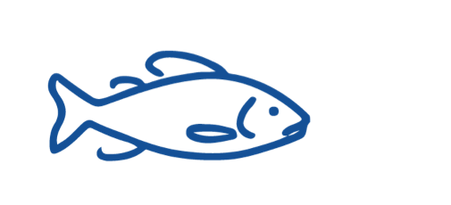
FISHING METHODS
KŌRERORERO / DISCUSSION
Purse seiners
Are a vertical net ‘curtain’ that surrounds a school of fish in the open ocean, then the bottom is drawn together
Target pelagic [mid-water] fish like kahawai & tuna in Aotearoa New Zealand
Why do fish swim in schools?
Notes:
TEACHER NOTES
Why do fish swim in schools?
Many species evolved to swim this way
to protect themselves from predators
increase the chances of finding their next meal
and also to help them swim more efficiently
For more information see:https://www.deepseaworld.com/animal-behaviour/why-do-fish-swim-in-schools-2/

Slide 10
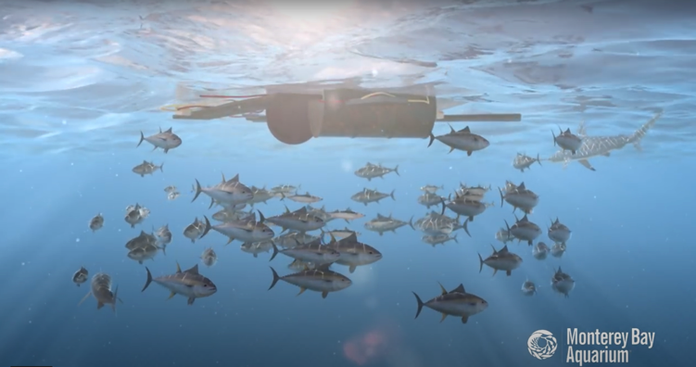
FISHING METHODS
HE PĀTAI / CONSIDER THIS
1. Could this fishing method affect the seafloor? How?
2. Could this fishing method impact other [non target] fish and marine creatures? How?
3. How can these impacts be reduced?
MĀTAKI TĒNEI / WATCH THIS
Watch this short film [1:05] from Monterey Bay Aquarium about purse seining
Notes:
TEACHER NOTES
Film can be found on You Tube at:
https://www.youtube.com/watch?v=kljRgbODbOw&feature=emb_logo
Purse-seine fishing in open water is generally considered to be an efficient form of fishing. It has no contact with the seabed and can have low levels of bycatch (accidental catch of unwanted species).
MSC certified fisheries using purse seines must ensure that they leave enough fish in the ocean to reproduce. This can be achieved by targeting schools of adult fish and using a mesh size large enough to allow smaller fish to swim free.
Purse seines can also be used to catch fish congregating around fish aggregating devices (FADs). This fishing method can result in higher levels of bycatch, making it harder for these fisheries to achieve MSC certification.

Slide 11

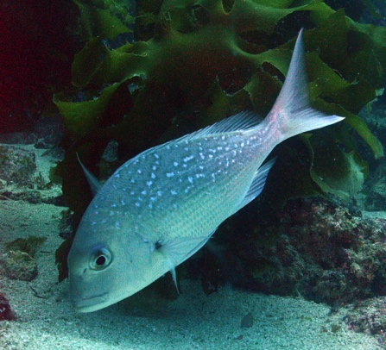
FISHING METHODS
KŌRERORERO / DISCUSSION
Long liners
Trail a long line with many hooks, usually behind the boat & can be set for pelagic [mid-water] or demersal [bottom living] fish
Much of Aotearoa New Zealand snapper or tāmure are caught using long line
HE PĀTAI / CONSIDER THIS
Do you know…
How deep
snapper swim?
How long do they live for?
Seldom found below 100m
Slow growing & live for up to 60 years old
Notes:
TEACHER NOTES
Snapper are quite slow growing and live for up to 60 years.
Snapper are seldom found below 100m. Juveniles are usually found in <50m.
Snapper are often fished 30-50cm but can reach 100cm.
They can weigh anywhere from 1-2.5kg to 19kg!

Slide 12
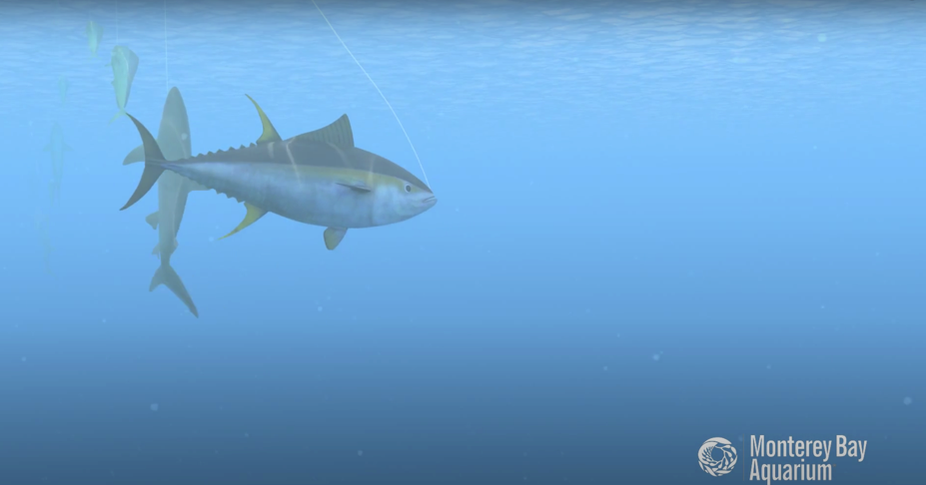
FISHING METHODS
HE PĀTAI / CONSIDER THIS
1. Could this fishing method affect the habitat or seafloor? How?
2. Could this fishing method impact other [non target] fish and marine creatures? How?
3. How can these impacts be reduced?
MĀTAKI TĒNEI / WATCH THIS
Watch this short film [1:25] from Monterey Bay Aquarium about long lining
Notes:
TEACHER NOTES
Film can be found on You Tube at:
https://www.youtube.com/watch?v=cjQQI56BT2o&feature=emb_logo
Without careful management, longline fisheries can have unintended interactions with non-target fish, seabirds, and other marine life. Because of this, to become MSC certified, they are often required to make improvements to their monitoring programs, and to mitigate interactions with non-target species.
MSC certified longline operations, such as those fishing for Patagonian toothfish in the Southern Ocean, have employed measures such as weighted long lines that sink more quickly, and tori-lines that scare away seabirds. Some have even made changes to fishing times to avoid interaction with endangered, threatened and protected (ETP) species.
Careful data collection and regulations, such as those followed by longline vessels in the Icelandic cod fishery, ensure sustainable catches.

Slide 13
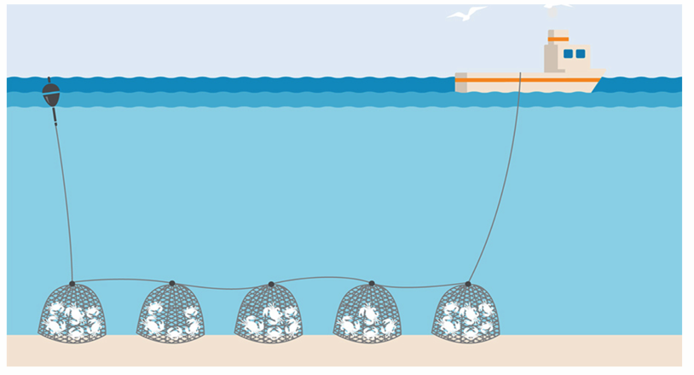
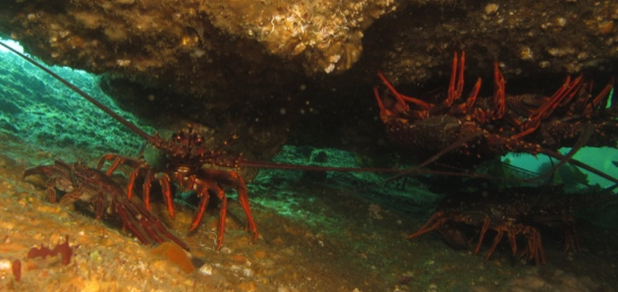
FISHING METHODS
KŌRERORERO / DISCUSSION
Pots and traps
Are typically made from wood, wire netting or plastic
Are used to catch crustaceans such as lobsters and crabs
Are used to catch koura or rock lobster and pāpaka or paddle crabs in Aotearoa New Zealand
Notes:
TEACHER NOTES

Slide 14
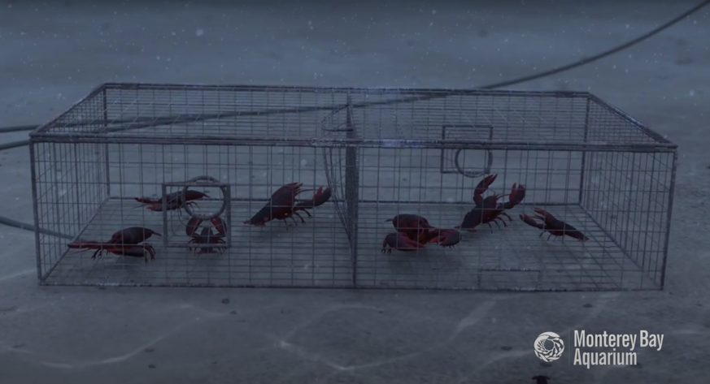
FISHING METHODS
HE PĀTAI / CONSIDER THIS
1. Could this fishing method affect the habitat or seafloor? How?
2. Could this fishing method impact other [non target] marine creatures? How?
3. How can any impacts be reduced?
MĀTAKI TĒNEI / WATCH THIS
Watch this short film [0:42] from Monterey Bay Aquarium about pots or traps
Notes:
TEACHER NOTES
Film can be found on You Tube at:
https://www.youtube.com/watch?time_continue=2&v=dTlwIIHYs7k&feature=emb_logo
MSC certified fisheries, such as the Normandy and Jersey lobster fishery, take measures to ensure that undersized individuals can escape through the mesh walls of their traps. Exclusion devices are also used to prevent larger marine animals such as sea lions from accidentally becoming entangled while foraging for shellfish. MSC certification resulted in the Western Australian rock lobster fishery reducing its sea lion bycatch to zero.

Slide 15
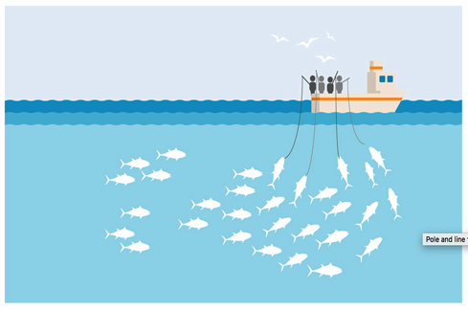
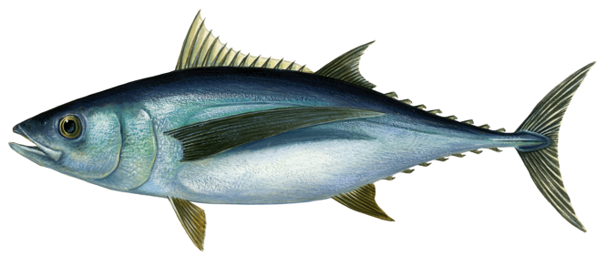
FISHING METHODS
KŌRERORERO / DISCUSSION
Pole and lines
Catch large pelagic [midwater] fish one at a time
Method has very low catch of unwanted marine life
Are sometimes used to catch albacore tuna in Aotearoa New Zealand waters
Imagine a fish living in the very bottom of the deepest ocean and a pelagic [mid water] fish living in the bright blue open ocean. Which would have better eyesight and be able to swim faster?
Notes:
TEACHER NOTES
Imagine you are a fish living in the bottom of the deep sea. Then imagine you are a fish living in the middle of the open sea. What would each be like? Which fish do you think is likely to swim faster?
Pelagic or open ocean fish are often torpedo shaped to increase their swimming speed. Most fish this shape live in the open ocean and are good fast swimmers.
Many deep water fish have big eyes to maximise their ability to capture light.

Slide 16
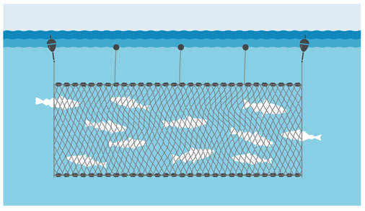
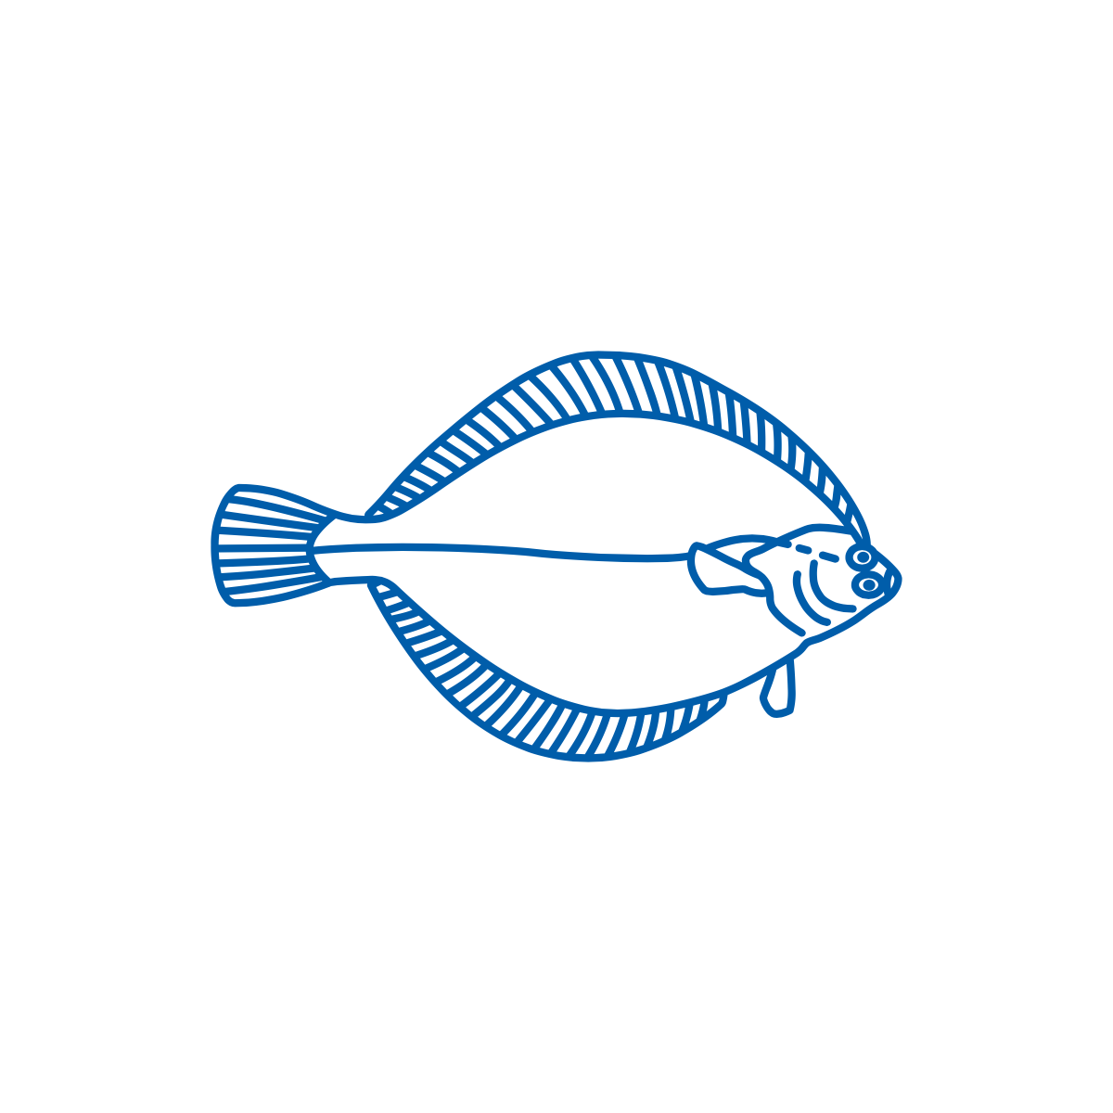
FISHING METHODS
KŌRERORERO / DISCUSSION
Gill nets
Are a hanging curtain of net that target schooling fish (like sardines)
Gill nets can float in deep water or set [anchored] to the seafloor
In Aotearoa New Zealand Pātiki or Yellow Belly Flounder are caught using set gill nets
Look at the body of the flounder. What can you guess about how / where flounder live?
Notes:
TEACHER NOTES
Impacts
Bycatch can be a problem for set netters
About flounder?
Flounder body shape is the way it is as it has adapted to living on the seafloor. Mouth is under the body, eyes are on top of the body, and it camouflages itself on a flat sandy floor by being so very flat!

Slide 17
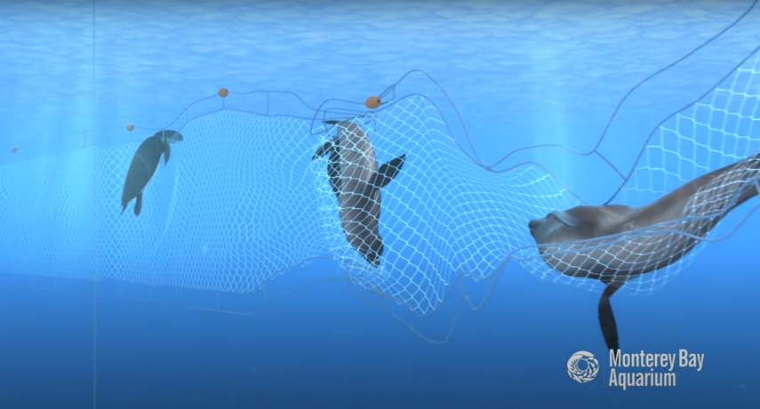
FISHING METHODS
HE PĀTAI / CONSIDER THIS
1. Could this fishing method affect the seafloor? How?
2. Could this fishing method impact other [non target] fish and marine creatures? How?
3. How can these impacts be reduced?
MĀTAKI TĒNEI / WATCH THIS
Watch this short film [0:56] from Monterey Bay Aquarium about gill netting
Notes:
TEACHER NOTES
Film can be found on You Tube at:
https://www.youtube.com/watch?v=AXyCCVXFmWk&feature=emb_logo
Gillnets generally have low environmental impacts with minimal seabed interaction. The size of fish caught can be determined by the mesh size, helping to avoid catching juvenile fish.
While particular species of fish can be targeted by area, gillnets do carry the risk of bycatch (accidental capture of unwanted species) and interaction with other marine animals.
In order to be MSC certified, gillnet fisheries are often required to make improvements, which include increased monitoring and independent observer coverage. Gear modifications have also been made and some fisheries use ‘pingers’: acoustic alarms attached to nets which deter marine mammals.

Slide 18
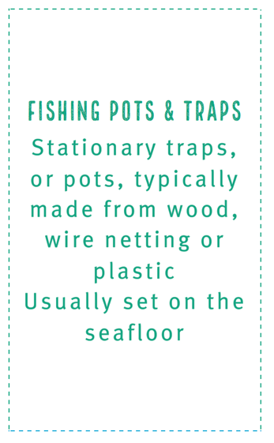
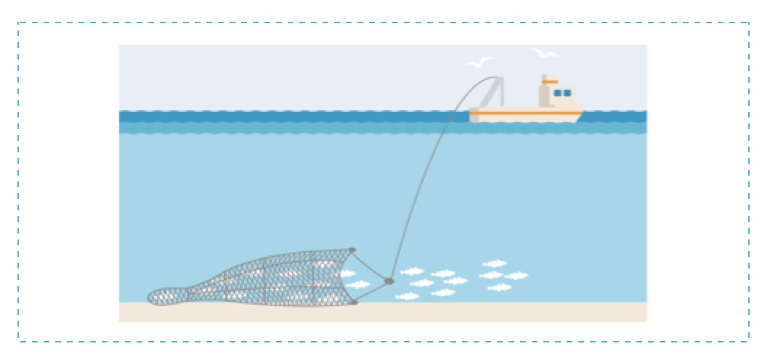
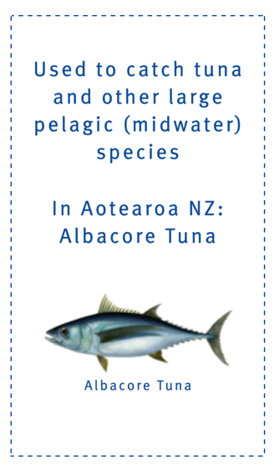
FISHING METHODS
MAHI / ACTIVITY
Use Fishing Method Cards [see Teacher Outline] to test your knowledge and match:
The method description
With the correct method picture
And most relevant species / habitat card!
Notes:
TEACHER NOTES

