Slide 1
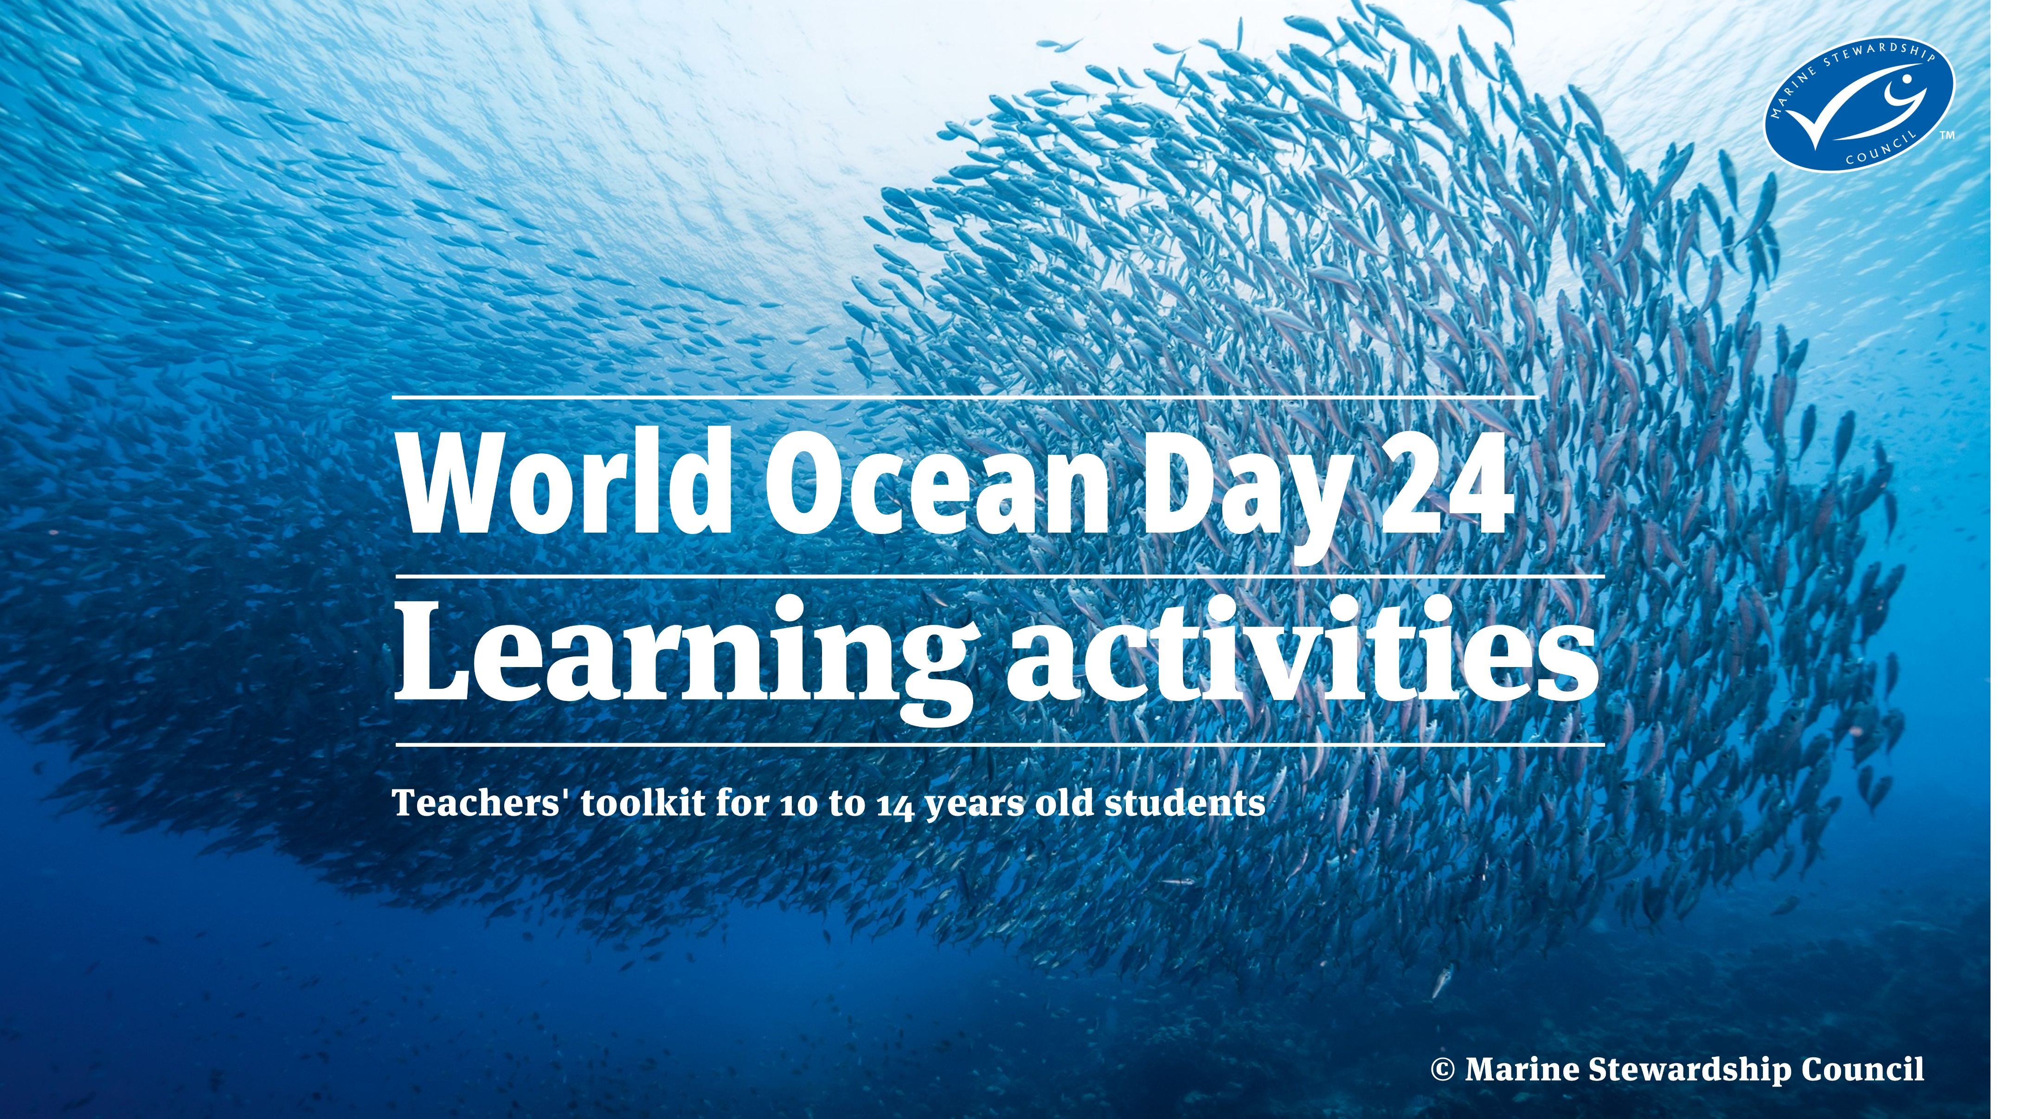

Slide 2
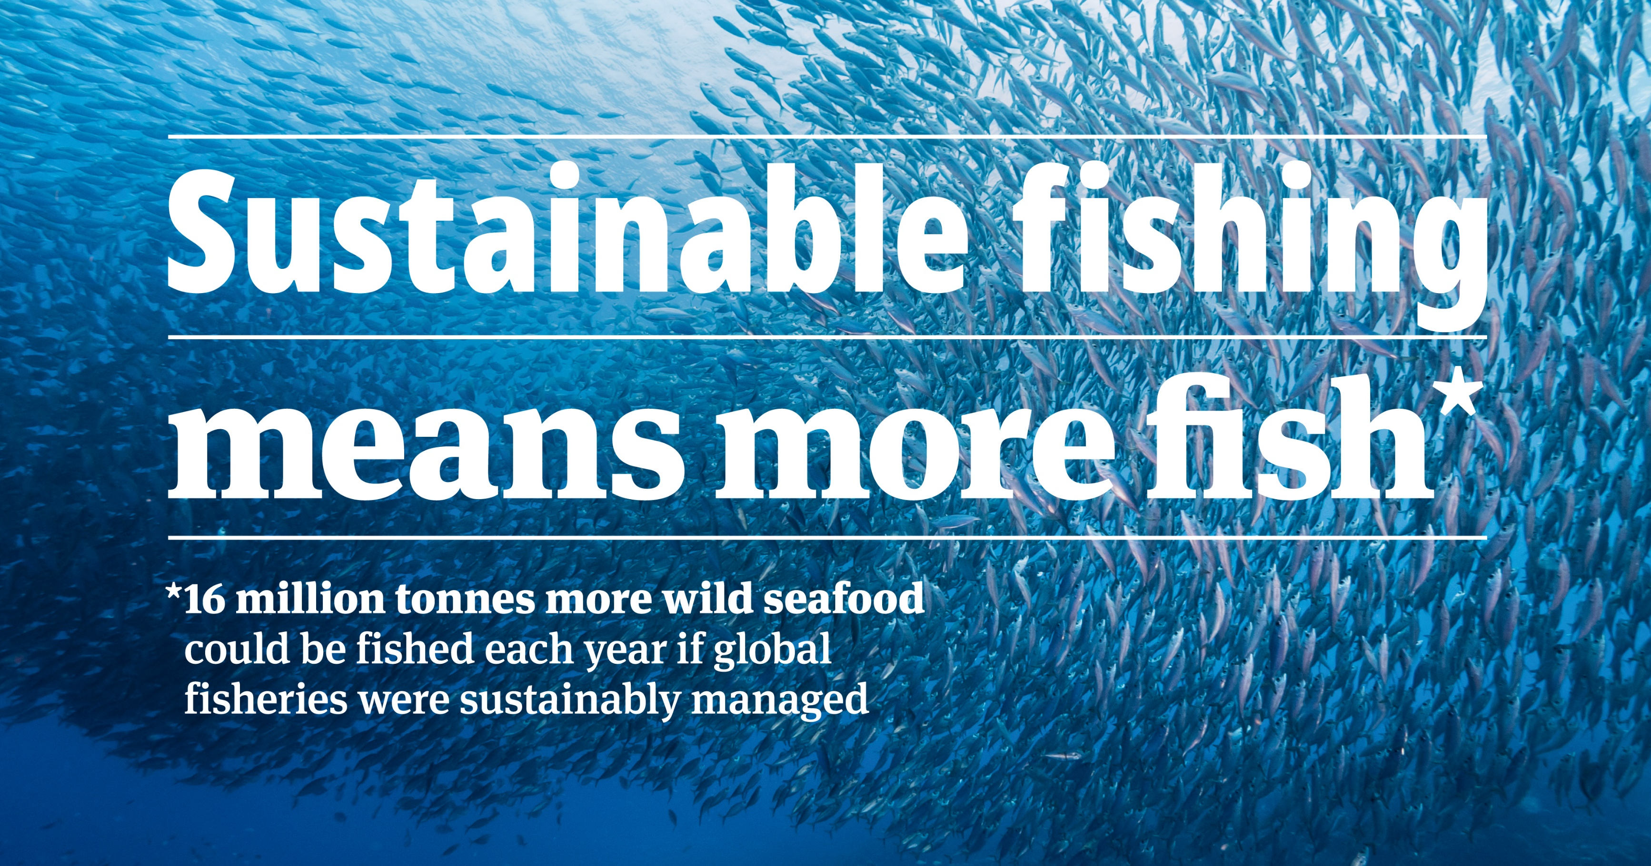
Celebrate World Ocean Day 2024
Our ocean supports life on Earth in many different ways. It feeds billions of people, regulates the world's climate and is home to an extraordinary variety of life.
But the ocean is now unquestionably under pressure. Over a third of global fish stocks are exploited at an unsustainable rate.
World Ocean Day is celebrated around the world on the 8th June each year. It is great moment to show your class how sustainable fishing contributes to protecting our ocean. Together, we can spread the word and help ocean lovers to understand what sustainable fishing means and what they can do to protect the ocean.

Slide 3
The activity
This World Ocean Day, learners can investigate how we can help protect our ocean, by using clues to solve a big ocean mystery:
Can we keep eating fish, and still have enough fish in the ocean?
Ocean sustainability is a complex challenge. It is critical to strike a balance between the economic and social benefits of fishing – from livelihoods in coastal communities, to sufficient nutritious food for a growing global population – with the need to protect the marine environment for future generations.

Slide 4
Learning outcomes
Age group recommended: 10-14
Subject areas: science, geography, social sciences
Time needed: 40-50 minutes
You will need:
PowerPoint presentation
Printed and cut-up sets of mystery activity clues for each group of 4-6 learners. Use either version 1 (slide 19) or version 2 (slide 20) for each group
Printed mystery thinking frame from slide 21 for each learner or group of learners (optional)
Access to video clips (optional)
Objectives:
To build their understanding of sustainability as a complex issue with lots of viewpoints, stakeholders and solutions
To improve their knowledge of how ocean ecosystems function and are influenced by human activity
To develop problem-solving skills, sorting relevant information, interpreting it and using it to make an informed opinion
To make links between different pieces of information, and link new information to existing knowledge
To work with others to solve a problem, developing listening, negotiating and speaking skills
Delivery notes:
- This activity is designed to be delivered using this PowerPoint, and some slides have extra notes for educators.
- Slides 18-21 are designed to be printed and cut up for groups of learners.
- Before delivery you could hide any slides you don’t want to use, including this slide.

Slide 5
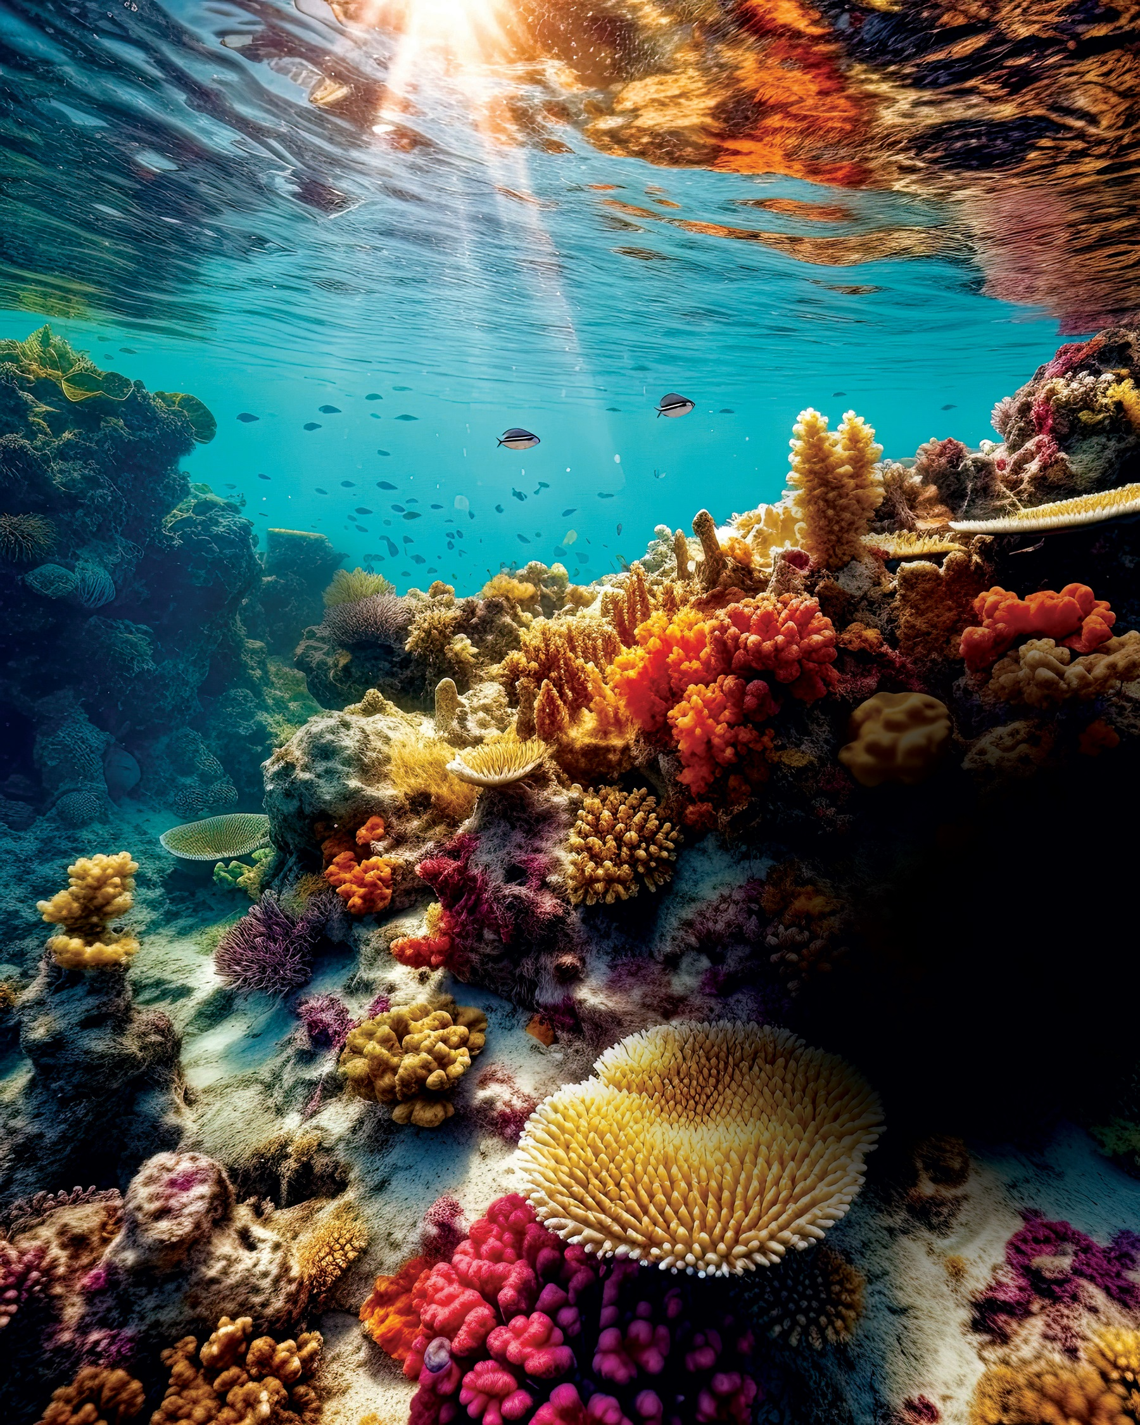
Activity background information
Tackling overfishing is a ‘win-win’ for our planet: conserving our rich marine resources enables more people to have the protein they need to live healthily.
Over a third of fish stocks around the world are overfished, endangering future food supplies as a result.
Fisheries which are managed sustainably have higher yields in the long-term.
The world is missing out on enough protein to meet the yearly needs of 72 million people, because not all fisheries have been sustainably managed.
Future generations have the right to sustainable food sources, and with the global population set to reach 10 billion by 2050, the need to harness our natural resources responsibly is more urgent than ever.
Get more information here about the MSC’s approach and what the blue MSC label means.

Slide 6
Adapting the activities (for teachers)
Starter for 10: learners could work in groups to discuss the statements or put their hands up to vote as a class. If you are short on time, you could do one of the two activities as a starter.
Mystery activity: There are two versions of the mystery activity, adaptable depending on your group or the amount of time available. Version 1 contains fewer clues than version 2.
Mystery activity: for extra support, provide each group with a Mystery Thinking Frame to help groups order their thinking.
Debrief: learners could share their conclusions as a presentation to the class, or by putting up their hands. In advance of the activity, watch our video clips on aspects of ocean sustainability and select one or two to share with the class. If you have time, include some of the key questions to ensure learners have understood the key concepts in the activity.
Homework and extension activities: there are suggested activities on slide 27
Competition: You can introduce a competition in your class “Sustainable fishing means more Ideas” and ask your students to think about ideas to make fishing more sustainable. Check slide 28

Slide 7
Activity plan: Starter
Starter: 10 minutes
Here are two short activities as a starter, to get learners to think about the important role the ocean plays in our lives:
1
2
Starter for 10 (10 mins)
Firstly, use slides 8-12 to show them statements and ask them to share with their partner (or with the class) what they think about each statement.
Then use slides 13-15 to ask learners to ‘stand where you believe’. This is a continuum line activity, where learners reflect on a question and can move from one side of the space to the other, depending on whether they want to answer yes or no – and how strongly they believe their response. Standing at one end of the continuum line would indicate a strong agreement or disagreement, whereas standing in the middle would indicate that a learner is not sure, or ambivalent about a statement.
Ask learners why they chose to stand on one side, or in the middle.

Slide 8
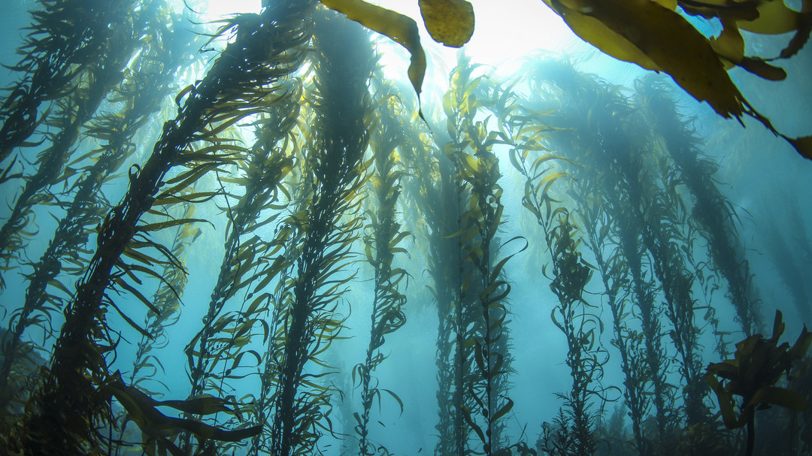
Half of the oxygen currently produced on Earth is generated by the ocean.
Source: Ocean Literacy commentary: “A myth on the fate of oceanic Oxygen” - Ocean Literacy Portal (unesco.org)

Slide 9
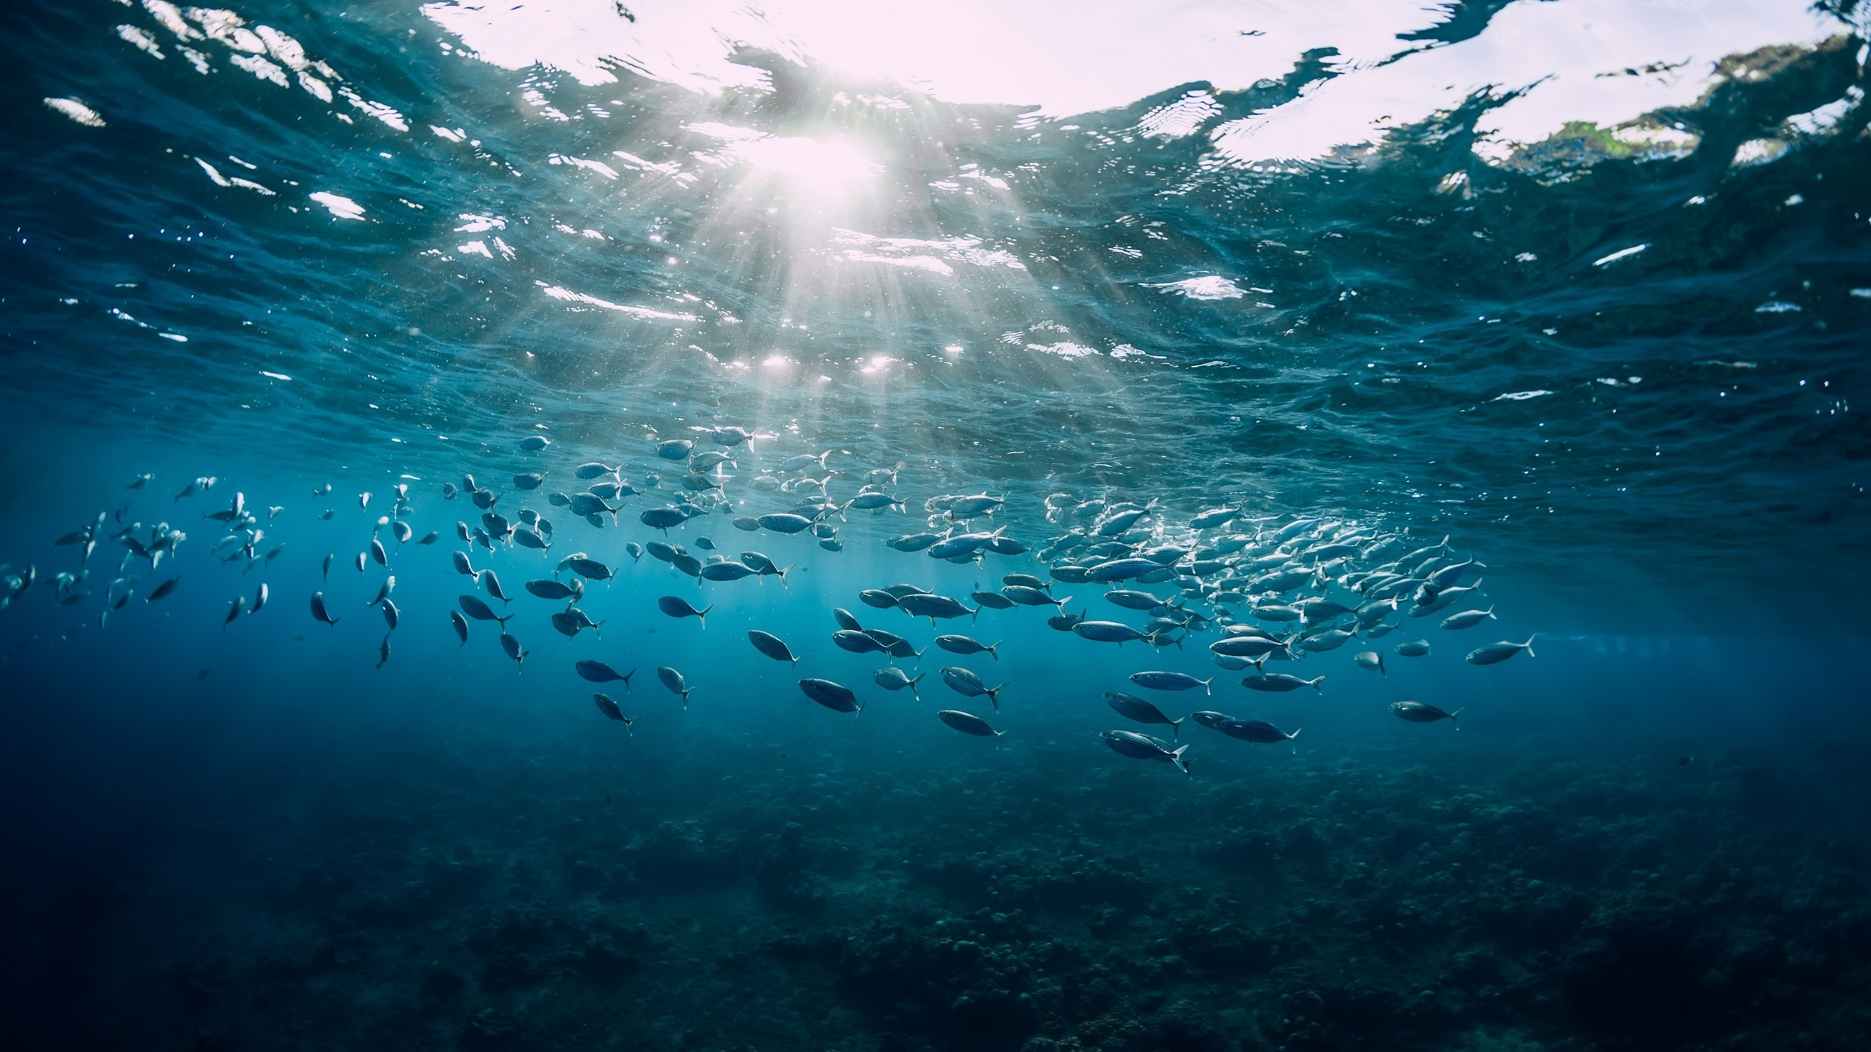
The ocean absorbs a lot of the heat created by burning fossil fuels
Source: The ocean – the world’s greatest ally against climate change | United Nations

Slide 10
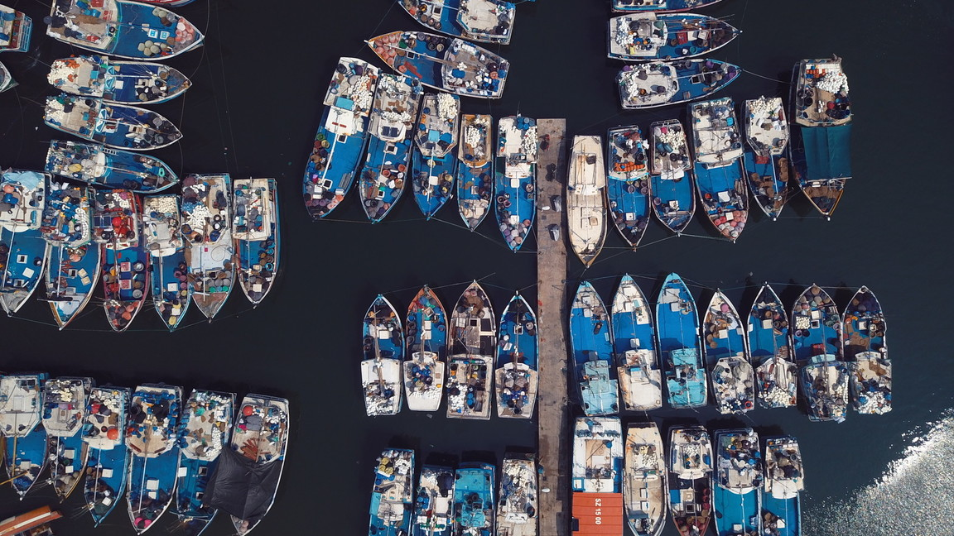
One in 10 people around the world depend on the ocean for jobs and food
Source: A Healthy Ocean Depends on Sustainably Managed Fisheries (nature.org)

Slide 11
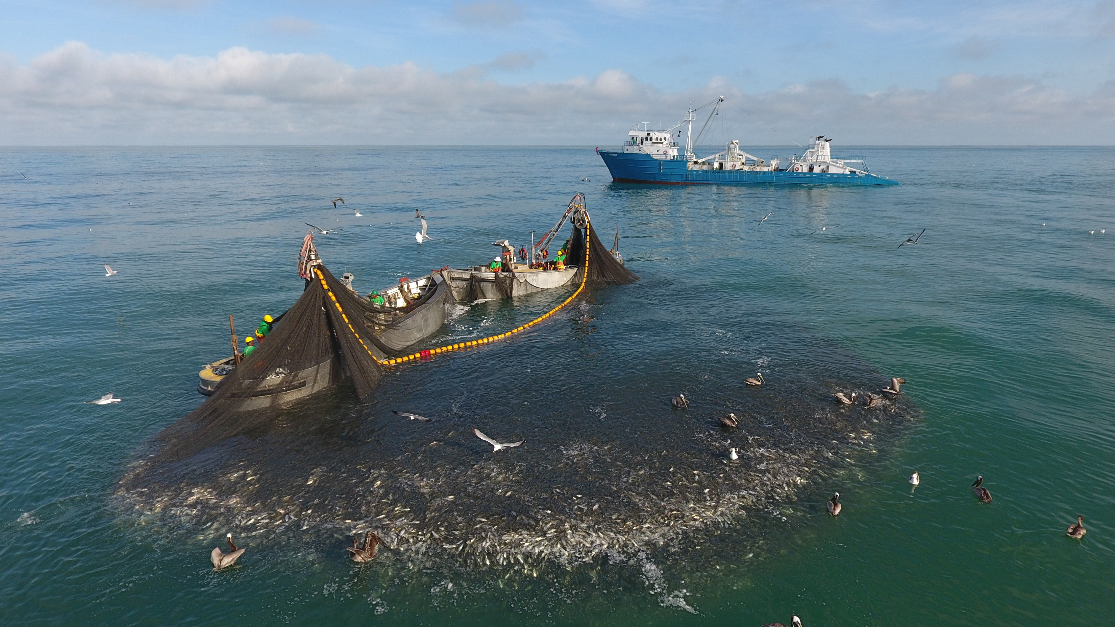
Globally, over a third of fish stocks are overfished
https://sustainablefisheries-uw.org/fao-state-of-world-fisheries-2020/

Slide 12
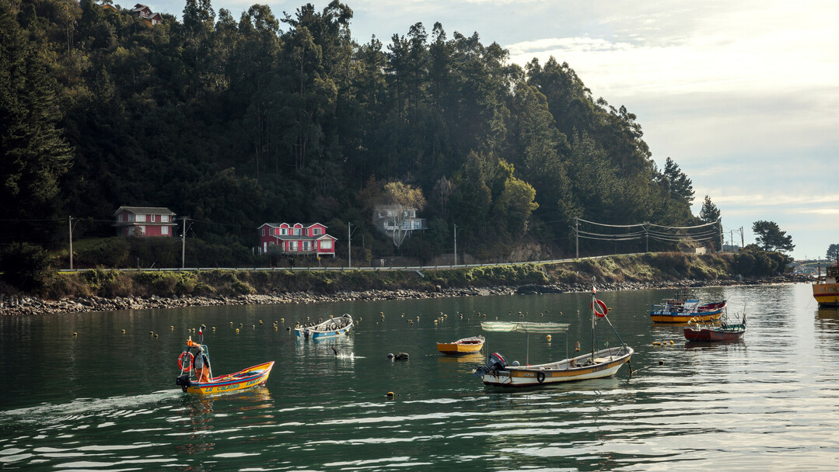
Fishing sustainably involves managing how we use the ocean’s resources.
https://www.msc.org/what-we-are-doing/our-approach/what-is-sustainable-fishing

Slide 13
Stand where you believe
Is making sure people have enough to eat more important than looking after our environment?
NO
YES

Slide 14
Stand where you believe
Does sustainable fishing mean we will have more fish?
NO
YES

Slide 15
Stand where you believe
Can we fish without having an impact on the ocean ecosystem?
NO
YES

Slide 16
Activity plan: Main activity
Main activity:
The big ocean mystery: Can we keep eating fish, and still have enough fish in the ocean?
20-30 minutes + 10 minutes for debrief
Starter for 10 (10 mins)
- Use slides 17-18 to introduce the mystery question.
- Give each group of 3-6 learners a set of mystery clues – slides 19-20 (two versions with version 2 more challenging, slide 20).
- They work together to read the clues, sort through them on a table, put them in order, and select some they think help answer the question. They could put clues in different categories, discard some they think are not relevant, and move clues around their table.
- The Mystery Thinking Frame (slide 21) can be printed to support learners to order their thinking.
- Together, they build an argument and come to their own conclusions, which they write down.
Debrief: Each group shares their conclusion and justifies their reasons using some of the clues they selected.
Either show learners one or two short video clips on aspects of ocean sustainability, to reinforce their learning (we suggest these on Overfishing and Sustainable Fishing) or use slide 22 to ask them some key questions to ensure they have understood the key concepts in the mystery.

Slide 17
The Big Ocean Mystery:
Can we keep eating fish, and still have enough fish in the ocean?

Slide 18

Instructions for students
Can you solve The Big Ocean Mystery?
Read the clues together.
Sort through them on a table.
        - You can put clues in different categories. What are those categories?
        - Look out for words that appear on more than one clue.
        Some clues include definitions of important words. You can pair these with the information about those words.
        - You can leave some clues on one side if you think they are not relevant.
        - You can move clues around the table.
Select some you think help answer the question.
Print this slide

Slide 19

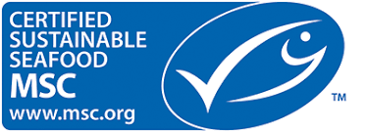
Protein is an important part of a healthy diet. | Over a third of global fish stocks are overfished.
Over 3 billion people around the world can’t afford a healthy diet. | Overfishing is when too many fish are removed from the ocean, and they are unable to reproduce back to a healthy number.
Worldwide, we eat nearly twice as much fish as we did 30 years ago. | Sometimes fishers have to stop fishing for a while to let fish stocks recover.
In the next 25 years, global population will grow to 10 billion people. | Fish stocks that are managed sustainably produce more fish.
Over three billion people rely on fish as an important source of animal protein. | Globally, 16% of fish and seafood is certified as sustainable by the MSC.
About 38 million people across the world have jobs in fishing. | Globally, the most popular fish to catch are anchovies, pollock and skipjack tuna.
Bycatch is when fishers catch fish, sea creatures or animals that they didn’t want to, like turtles, birds or dolphins. | A fishery is an area of the ocean where fish are caught, or a group of fishers who are all catching the same type of fish.
Bycatch can include fish that are too small and should be left in the ocean to grow bigger. | A fishing quota is an agreed amount of fish that fishers can catch.
Every year, over 9 million tonnes of fish are thrown away by fishers after they’ve been caught. These are known as ‘discards’. | Fishers, scientists and governments can work together to understand how fish stocks grow and shrink over time.
Fishers who fish sustainably work to reduce bycatch. | Fishing quotas should limit what fishers can catch to a sustainable level.
Sustainable fishing can include using nets with big holes, that let small fish pass through. | Many countries set agreements with each other about how many fish can be caught in different parts of the ocean.
Climate change is a big challenge for fishers, as fish move to new areas of the ocean. | Some fishers use gadgets that make a noise or have bright lights to scare sea creatures like dolphins away from their fishing nets. This helps reduce bycatch.
When you see the MSC ecolabel on seafood products, it means that fish has been caught sustainably. | All fishing has an impact on the ocean ecosystem. Sustainable fishers minimise their impact.
Version 1
Print this slide
Notes:
Clues sources
Date checked 26/04/24
1. Protein is an important part of a healthy diet.
https://www.msc.org/docs/default-source/default-document-library/about-the-msc/msc-insights-january-2021.pdf
2. Over 3 billion people around the world can’t afford a healthy diet.
https://www.who.int/news/item/06-07-2022-un-report--global-hunger-numbers-rose-to-as-many-as-828-million-in-2021
3. Worldwide, we eat nearly twice as much fish as we did 30 years ago.
https://www.fao.org/3/cc0461en/cc0461en.pdf
4. In the next 25 years, global population will grow to 10 billion people.
https://www.msc.org/docs/default-source/default-document-library/about-the-msc/msc-insights-january-2021.pdf
5. Over three billion people rely on fish as an important source of animal protein.
https://www.msc.org/docs/default-source/default-document-library/about-the-msc/msc-insights-january-2021.pdf
6. About 38 million people across the world have jobs in fishing.
https://www.fao.org/3/cc0461en/cc0461en.pdf
7. Bycatch is when fishers catch fish, sea creatures or animals that they didn’t want to, like turtles, birds or dolphins.
https://www.msc.org/what-we-are-doing/oceans-at-risk/what-is-bycatch-and-how-can-it-be-managed
8. Bycatch can include fish that are too small and should be left in the ocean to grow bigger.
https://www.msc.org/what-we-are-doing/oceans-at-risk/what-is-bycatch-and-how-can-it-be-managed
9. Every year, over 9 million tonnes of fish are thrown away by fishers after they’ve been caught. These are known as ‘discards’.
https://www.msc.org/what-we-are-doing/oceans-at-risk/what-is-bycatch-and-how-can-it-be-managed
10. Fishers who fish sustainably work to reduce bycatch.
https://www.msc.org/what-we-are-doing/oceans-at-risk/what-is-bycatch-and-how-can-it-be-managed
11. Sustainable fishing can include using nets with big holes, that let small fish pass through.
https://www.msc.org/what-we-are-doing/our-approach/fishing-methods-and-gear-types/purse-seine
12. Climate change is a big challenge for fishers, as fish move to new areas of the Ocean.
https://www.msc.org/what-we-are-doing/oceans-at-risk/climate-change-and-fishing
13. When you see the MSC ecolabel on seafood products, it means that fish has been caught sustainably.
https://www.msc.org/what-we-are-doing/our-approach/what-does-the-blue-msc-label-mean
14. Over a third of global fish stocks are overfished.
https://www.msc.org/docs/default-source/default-document-library/about-the-msc/msc-insights-january-2021.pdf
15. Overfishing is when too many fish are removed from the ocean, and they are unable to reproduce back to a healthy number.
https://www.msc.org/what-we-are-doing/oceans-at-risk/overfishing
16. Sometimes fishers have to stop fishing for a while to let fish stocks recover.
https://www.msc.org/what-we-are-doing/oceans-at-risk/climate-change-and-fishing/marine-heatwaves
17. Fish stocks that are managed sustainably produce more fish.
https://www.msc.org/docs/default-source/default-document-library/about-the-msc/msc-insights-january-2021.pdf
18. Globally, 16% of fish and seafood is certified as sustainable by the MSC.
https://www.msc.org/docs/default-source/default-document-library/about-the-msc/msc-insights-january-2021.pdf
19. Globally, he most popular fish to catch are anchovies, pollock and skipjack tuna.
https://www.fao.org/3/cc0461en/cc0461en.pdf
20. A fishery is an area of the ocean where fish are caught, or a group of fishers who are all catching the same type of fish.
https://www.msc.org/en-au/what-we-are-doing/our-collective-impact/what-is-a-fishery
21. A fishing quota is an agreed amount of fish that fishers can catch.
https://www.msc.org/en-au/what-we-are-doing/our-approach/commercial-fishing
22. Fishers, scientists and governments can work together to understand how fish stocks grow and shrink over time.
https://www.msc.org/what-we-are-doing/oceans-at-risk/shifting-stocks-and-international-catch-quotas
23. Fishing quotas should limit what fishers can catch to a sustainable level.
https://www.msc.org/what-we-are-doing/oceans-at-risk/shifting-stocks-and-international-catch-quotas
24. Many countries set agreements with each other about how many fish can be caught in different parts of the Ocean.
https://www.msc.org/what-we-are-doing/oceans-at-risk/shifting-stocks-and-international-catch-quotas
25. Some fishers use gadgets that make a noise or have bright lights to scare sea creatures like dolphins away from their fishing nets. This helps reduce bycatch.
https://www.msc.org/what-we-are-doing/our-collective-impact/fisheries-improving/pink-shrimp-fishery-uses-led-lights-on-nets
https://www.msc.org/media-centre/news-opinion/news/2021/05/20/fishery-innovations-that-drive-ocean-biodiversity-research
26. All fishing has an impact on the Ocean ecosystem. Sustainable fishers minimise their impact.
https://www.msc.org/what-we-are-doing/our-approach/fishing-methods-and-gear-types

Slide 20
Mystery thinking frame
Can we keep eating fish, and still have enough fish in the ocean? Place different clues in the categories to help you discuss them and answer the question
Important | Not important
Not sure | Fact or definition
My answer: Why?
Print this slide

Slide 21
Protein is an important part of a healthy diet. | Over a third of global fish stocks are overfished.
Over 3 billion people around the world can’t afford a healthy diet. | Overfishing is when too many fish are removed from the ocean, and not enough adults are left to reproduce and keep stock numbers healthy.
Worldwide, we eat nearly twice as much fish as we did 30 years ago. | Sometimes fishers have to stop fishing for a while to let fish stocks recover.
In the next 25 years, global population will grow to 10 billion people. | Fisheries which are managed sustainably have higher yields in the long-term. This means fishers can catch more fish.
Over three billion people rely on fish as an important source of animal protein. | Globally, 16% of fish and seafood is MSC certified.
About 38 million people across the world have jobs in fishing. | Globally, the most popular fish to catch are anchovies, pollock and skipjack tuna.
Bycatch is when fishers catch fish, sea creatures or animals that they didn’t want to, like turtles, birds or dolphins. | A fishery is an area of the ocean where fish are caught, or a group of fishers catching the same type of fish.
In many parts of the Ocean, many species of fish are caught illegally. | A fishing quota is an agreed amount of agreed number of fish of one species that fishers can catch.
Every year, over 9 million tonnes of fish are thrown away by fishers after they’ve been caught. These are known as ‘discards’. | Fishers, scientists and governments can work together to understand how fish stocks grow and shrink over time.
Fishers who fish sustainably work to reduce bycatch. | Fishing quotas should limit what fishers can catch to a sustainable level.
Sustainable fishing can include using nets with big holes, that let small fish pass through. | Many countries set agreements with each other about how many fish can be caught in different parts of the Ocean.
Climate change is a big challenge for fishers, as it causes fish to shift their ranges to different areas of the Ocean. | Some fishers use gadgets that make a noise or have bright lights to scare sea creatures like dolphins away from their fishing nets. This helps reduce bycatch.
Bycatch can include fish that are too small and should be left in the ocean to grow bigger. | Every ecosystem has a carrying capacity. This is the maximum number of a species that can survive in that ecosystem.
All fishing has an impact on the Ocean ecosystem. Sustainable fishers minimise their impact. | The ocean and forests have a higher carrying capacity than deserts.
Using explosives or chemicals to catch fish is destructive and harms Ocean ecosystems. | When fish are taken from an ecosystem, room is created for them to increase their numbers to the carrying capacity of the ecosystem.
When you see the MSC ecolabel on seafood products, it means that fish has been caught sustainably. | Wild caught fish generally has a lower carbon footprint than red meat.
Version 2
Print this slide
Notes:
Clues sources
Date checked 26/04/24
1. Protein is an important part of a healthy diet.
https://www.msc.org/docs/default-source/default-document-library/about-the-msc/msc-insights-january-2021.pdf
2. Over 3 billion people around the world can’t afford a healthy diet.
https://www.who.int/news/item/06-07-2022-un-report--global-hunger-numbers-rose-to-as-many-as-828-million-in-2021
3. Worldwide, we eat nearly twice as much fish as we did 30 years ago.
https://www.fao.org/3/cc0461en/cc0461en.pdf
4. In the next 25 years, global population will grow to 10 billion people.
https://www.msc.org/docs/default-source/default-document-library/about-the-msc/msc-insights-january-2021.pdf
5. Over 3 billion people rely on fish as an important source of animal protein.
https://www.msc.org/docs/default-source/default-document-library/about-the-msc/msc-insights-january-2021.pdf
6. About 38 million people across the world have jobs in fishing.
https://www.fao.org/3/cc0461en/cc0461en.pdf
7. Bycatch is when fishers catch fish, sea creatures or animals that they didn’t want to, like turtles, birds or dolphins.
https://www.msc.org/what-we-are-doing/oceans-at-risk/what-is-bycatch-and-how-can-it-be-managed
8. In many parts of the Ocean, many species of fish are caught illegally.
https://www.msc.org/what-we-are-doing/oceans-at-risk/illegal-unreported-unregulated-iuu-destructive-fishing
9. Every year, over 9 million tonnes of fish are thrown away by fishers after they’ve been caught. These are known as ‘discards’.
https://www.msc.org/what-we-are-doing/oceans-at-risk/what-is-bycatch-and-how-can-it-be-managed
10. Fishers who fish sustainably work to reduce bycatch.
https://www.msc.org/what-we-are-doing/oceans-at-risk/what-is-bycatch-and-how-can-it-be-managed
11. Sustainable fishing can include using nets with big holes, that let small fish pass through.
https://www.msc.org/what-we-are-doing/our-approach/fishing-methods-and-gear-types/purse-seine
12. Climate change is a big challenge for fishers, as fish move to new areas of the Ocean.
https://www.msc.org/what-we-are-doing/oceans-at-risk/climate-change-and-fishing
13. Bycatch can include fish that are too small and should be left in the ocean to grow bigger.
https://www.msc.org/what-we-are-doing/oceans-at-risk/what-is-bycatch-and-how-can-it-be-managed
14. All fishing has an impact on the Ocean ecosystem. Sustainable fishers minimise their impact.
https://www.msc.org/what-we-are-doing/our-approach/fishing-methods-and-gear-types
15. Using explosives or chemicals to catch fish is destructive and harms Ocean ecosystems.
https://www.msc.org/what-we-are-doing/oceans-at-risk/illegal-unreported-unregulated-iuu-destructive-fishing
16. When you see the MSC ecolabel on seafood products, it means that fish has been caught sustainably.
https://www.msc.org/what-we-are-doing/our-approach/what-does-the-blue-msc-label-mean
17. Over a third of global fish stocks are overfished.
https://www.msc.org/docs/default-source/default-document-library/about-the-msc/msc-insights-january-2021.pdf
18. Overfishing is when too many fish are removed from the ocean, and they are unable to reproduce back to a healthy number.
https://www.msc.org/what-we-are-doing/oceans-at-risk/overfishing
19. Sometimes fishers have to stop fishing for a while to let fish stocks recover.
https://www.msc.org/what-we-are-doing/oceans-at-risk/climate-change-and-fishing/marine-heatwaves
20. Fish stocks that are managed sustainably produce more fish. / Fisheries which are managed sustainably have higher yields in the long-term. This means fishers can catch more fish.
https://www.msc.org/docs/default-source/default-document-library/about-the-msc/msc-insights-january-2021.pdf
21. Globally, 16% of fish and seafood is MSC certified.
https://www.msc.org/about-the-msc/reports-and-brochures/annual-report-2023-summary
22. Globally, the most popular fish to catch are anchovies, pollock and skipjack tuna.
https://www.fao.org/3/cc0461en/cc0461en.pdf
23. A fishery is an area of the ocean where fish are caught, or a group of fishers who are all catching the same type of fish.
https://www.msc.org/en-au/what-we-are-doing/our-collective-impact/what-is-a-fishery
24. A fishing quota is an agreed amount of fish that fishers can catch.
https://www.msc.org/en-au/what-we-are-doing/our-approach/commercial-fishing
25. Fishers, scientists and governments can work together to understand how fish stocks grow and shrink over time.
https://www.msc.org/what-we-are-doing/oceans-at-risk/shifting-stocks-and-international-catch-quotas
26. Fishing quotas should limit what fishers can catch to a sustainable level.
https://www.msc.org/what-we-are-doing/oceans-at-risk/shifting-stocks-and-international-catch-quotas
27. Many countries set agreements with each other about how many fish can be caught in different parts of the Ocean.
https://www.msc.org/what-we-are-doing/oceans-at-risk/shifting-stocks-and-international-catch-quotas
28. Some fishers use gadgets that make a noise or have bright lights to scare sea creatures like dolphins away from their fishing nets. This helps reduce bycatch.
https://www.msc.org/what-we-are-doing/our-collective-impact/fisheries-improving/pink-shrimp-fishery-uses-led-lights-on-nets
https://www.msc.org/media-centre/news-opinion/news/2021/05/20/fishery-innovations-that-drive-ocean-biodiversity-research
29. Every ecosystem has a carrying capacity. This is the maximum number of a species that can survive in that ecosystem.
https://www.britannica.com/science/carrying-capacity
30. The Ocean and forests have a higher carrying capacity than deserts.
https://www.oxfordbibliographies.com/display/document/obo-9780199830060/obo-9780199830060-0044.xml
31. When fish are taken from an ecosystem, room is created for them to increase their numbers to the carrying capacity of the ecosystem.
https://doi.org/10.1002/fes3.464
32. Wild caught fish generally has a lower carbon footprint than red meat.
https://www.msc.org/docs/default-source/default-document-library/about-the-msc/msc-insights-january-2021.pdf

Slide 22
Key questions
Why do you think we eat more fish now than 50 years ago?
What are the biggest challenges facing our ocean?
What’s overfishing?
Why do you think it is important for fishers, scientists and government to work together to protect the ocean?
What’s bycatch?
What is the carrying capacity of an ecosystem?
What does sustainable fishing mean to you?
What can you do to help protect the ocean?

Slide 23
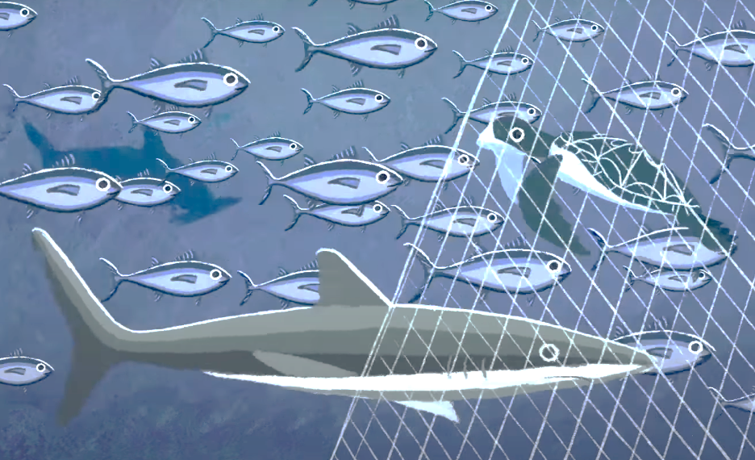
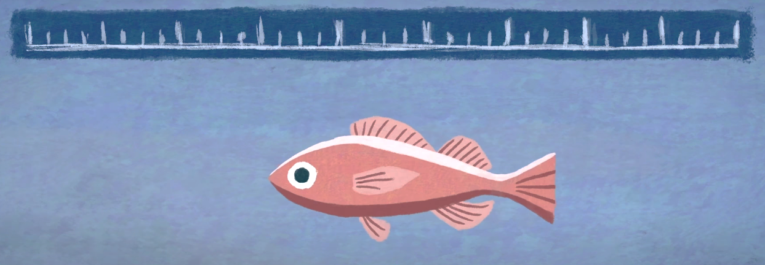
Key terms
Bycatch happens when fishing boats catch fish and animals that they don’t want or shouldn’t take. It can often be endangered or protected species such as sea birds or dolphins. It can also include young or undersized fish.
Discards are fish or other sea creatures that are thrown back into the ocean by fishers for whatever reason. Discards may be dead or alive. It can also include young or undersized fish.

Slide 24
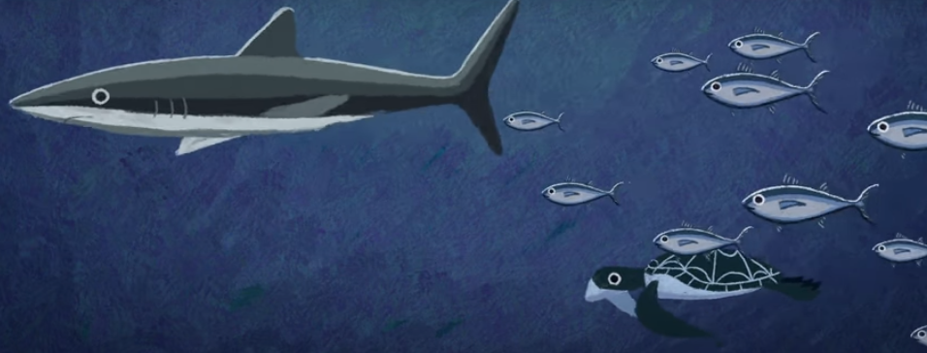
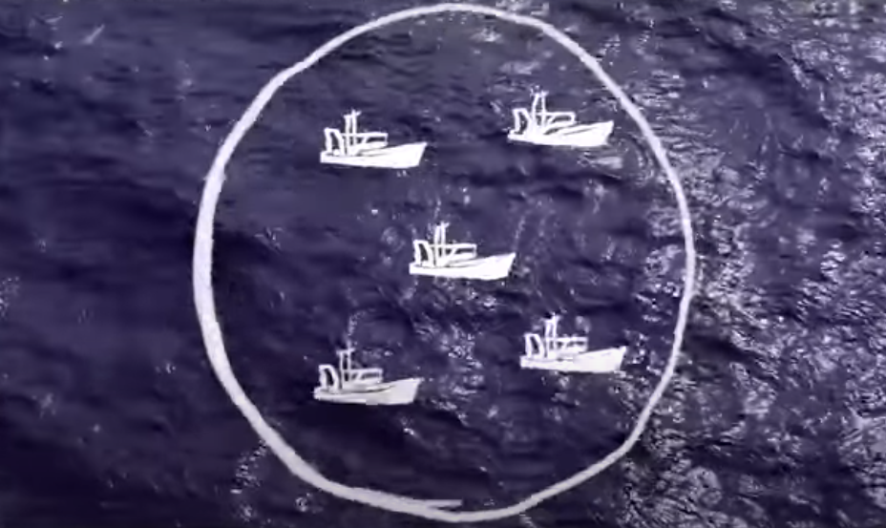
Key terms
Carrying capacity Every ecosystem has a carrying capacity. This is the maximum number of a species that can survive in that ecosystem. The ocean and forests have a higher carrying capacity than deserts.
Fishery A fishery can mean several things:
An area of the ocean where fish are caught for commercial purposes.
A group of fishing boats.
A species that is fished.
Fish stock The community of a fish species that could be caught by fishers.

Slide 25
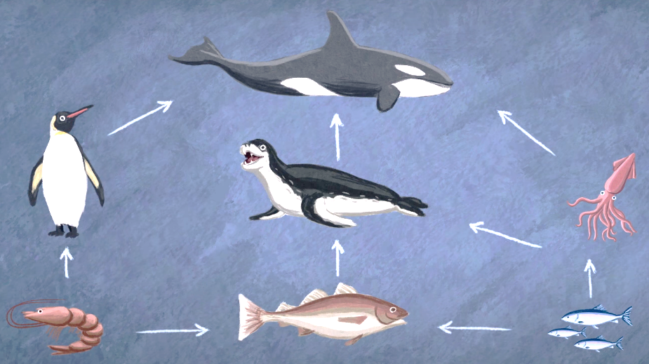
Key terms
Food web All sea life is connected in a food web of prey and predator, each relying on the others to survive. If predators such as sharks, seals or cod lose one of their main sources of food, then they too will begin to disappear.
Illegal, unreported and unregulated fishing is fishing that goes on outside of the rules set by governments and fishing management bodies.
Overfishing When a certain species of fish, are fished too much, they are unable to reproduce their numbers back to a healthy number and begin to decline.
Quota A permit to catch a certain number of a species of fish, set per fishing season.
Sustainable Fishing Fishing in a responsible way, making sure that fish populations don’t drop below levels where they can't reproduce and their numbers can't increase as fast as they are caught.

Slide 26
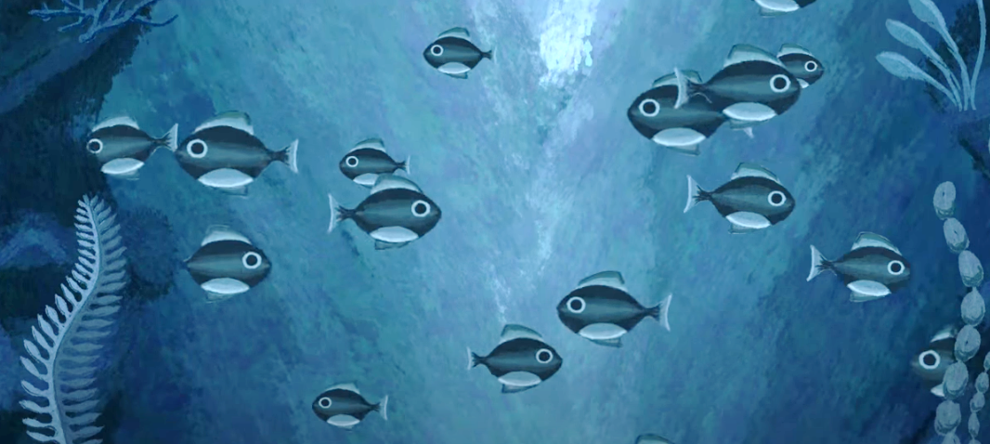
Key terms
Total Allowable Catch and Maximum Sustainable Yield
Over a third of fish stocks around the world are overfished.
The Total Allowable Catch (TAC) is a figure that informs fishers how many fish they can safely catch without causing the stock to crash. It is based on a calculation called Maximum Sustainable Yield (MSY). MSY involves assessing a fish stock and understanding that species' life cycle, so the fish stock can keep its numbers at a healthy level. This includes finding out:
how quickly they reproduce
how long they live
how quickly they grow
the numbers of adults joining the stock that can reproduce
The TAC and MSY for other sea creatures, like crabs or lobster, can be worked out in the same way.
Here’s an example: lobster don’t reach reproductive age until late in their lives. So, if they’re caught when they are too young, it doesn’t give them enough time to reproduce, and for the stock numbers of lobsters to stay at a healthy level. So, they are being overfished if they are caught too young.

Slide 27
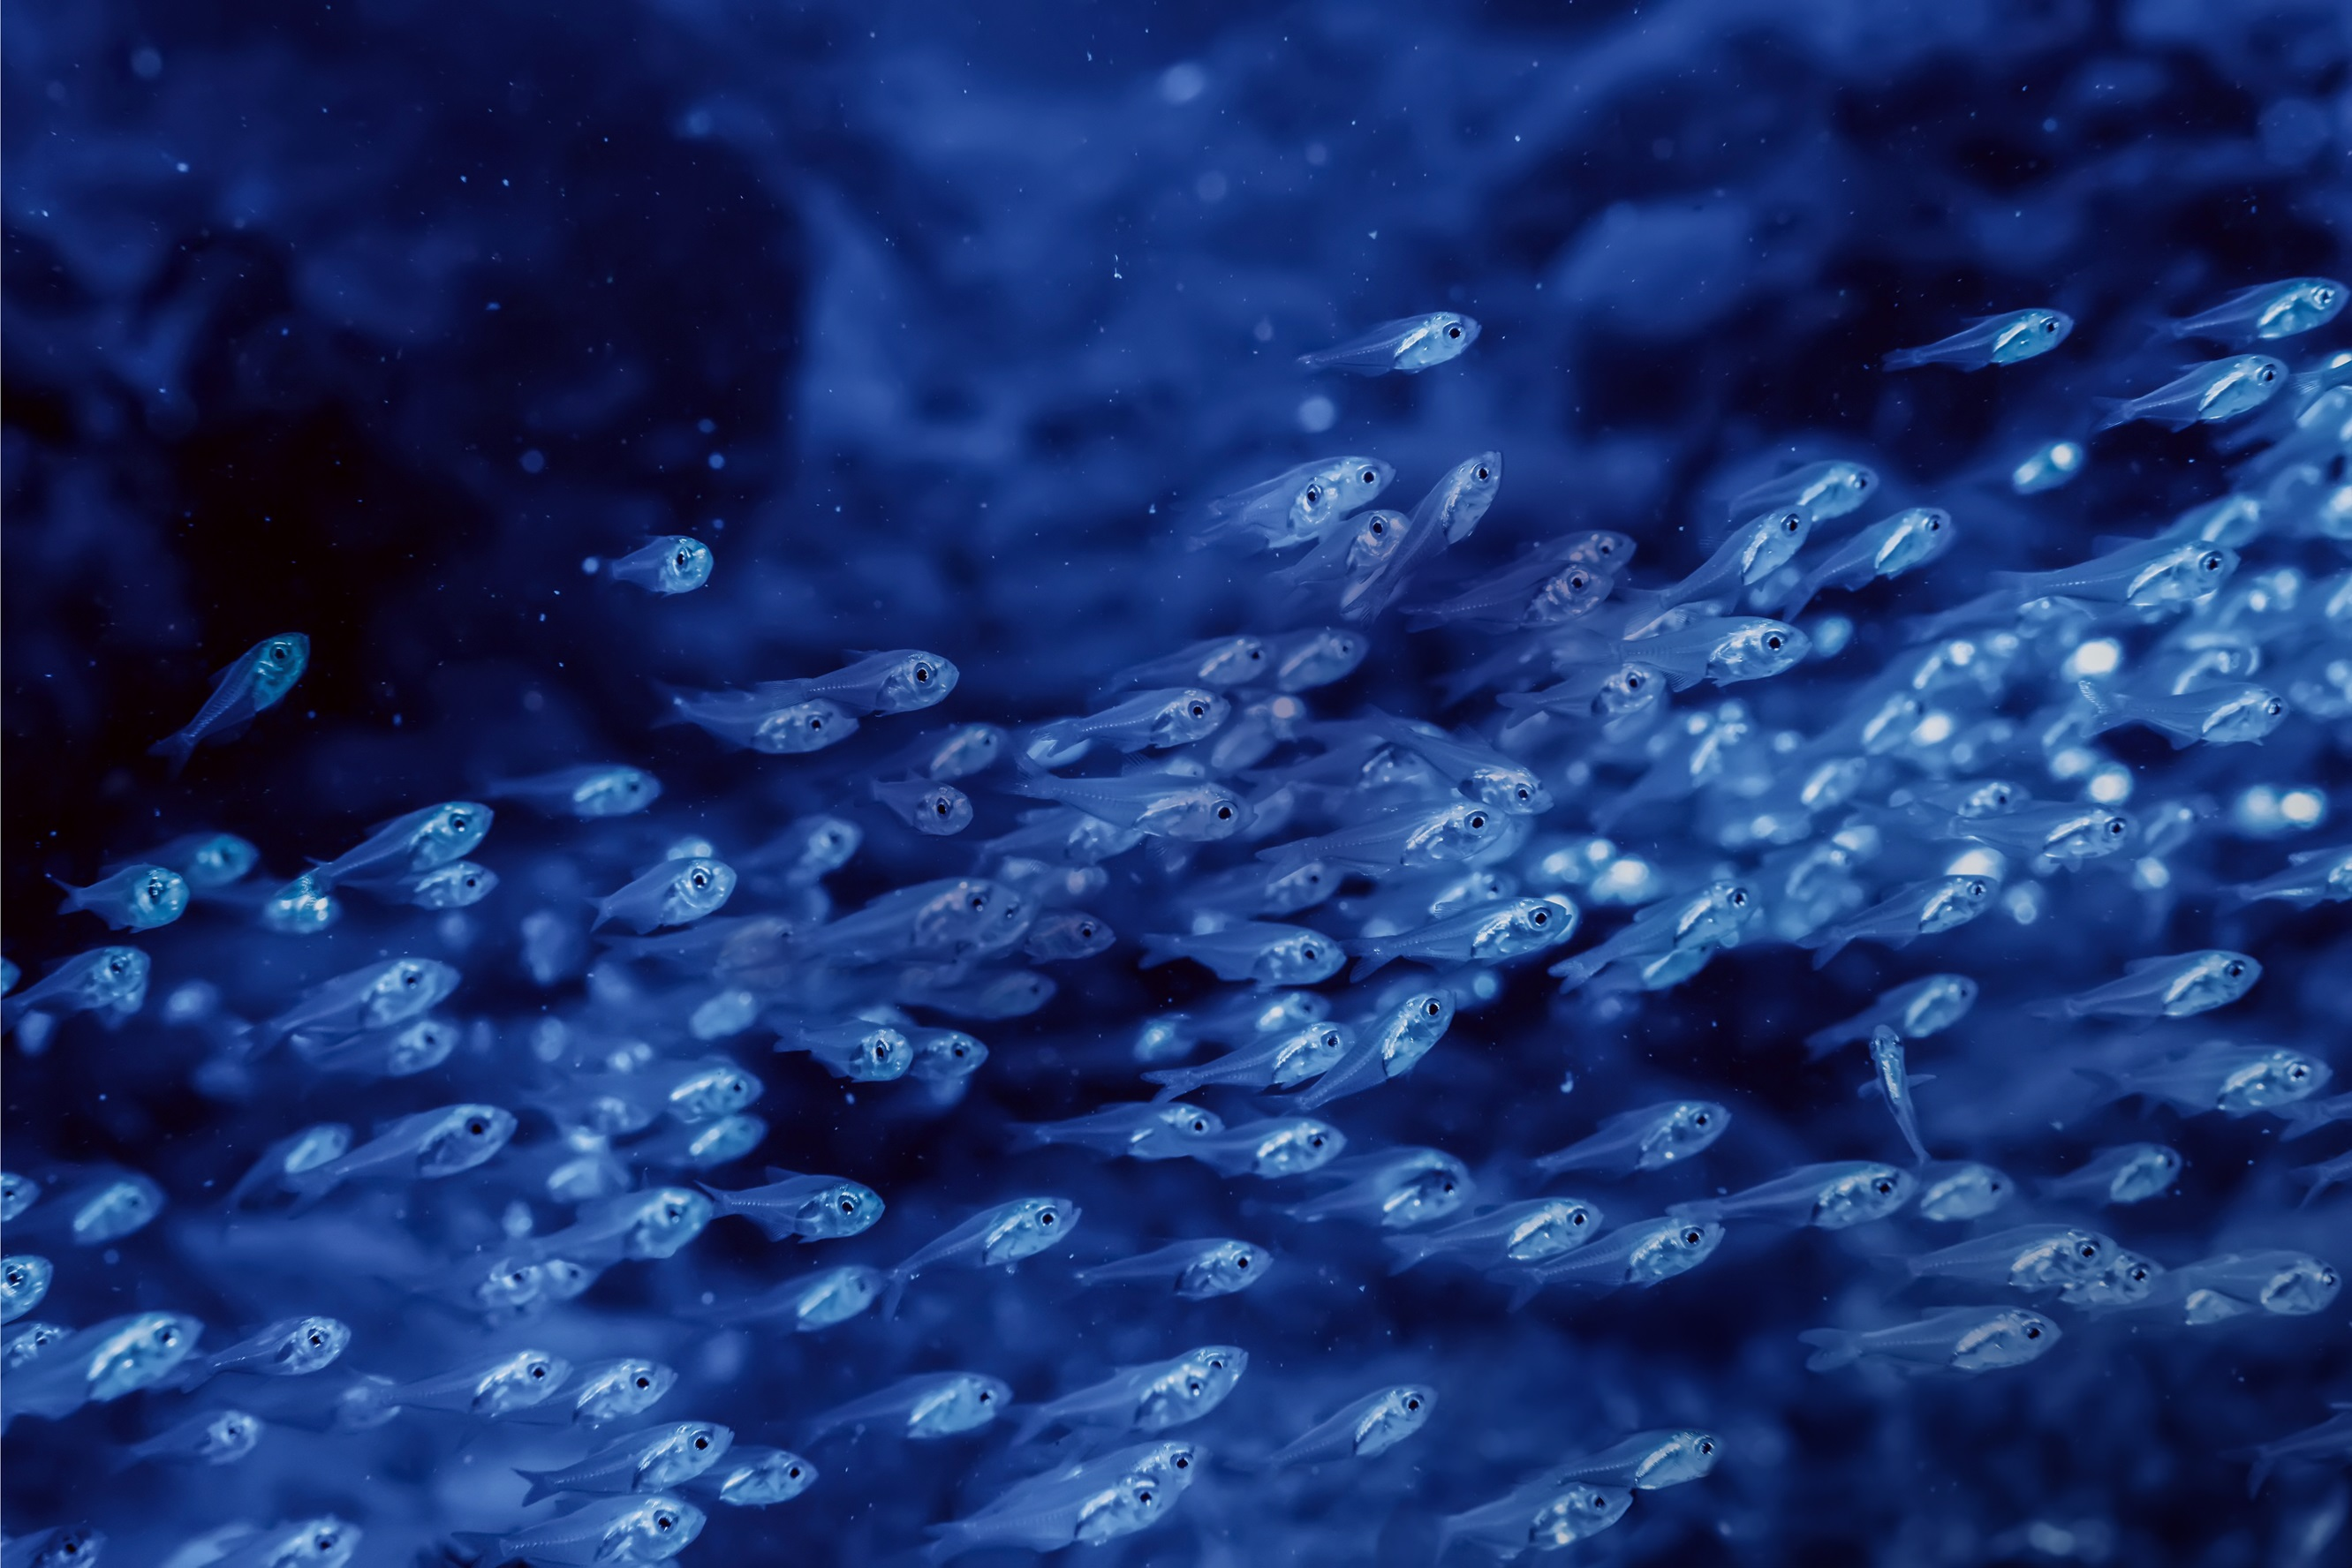
Extension and homework ideas
Learners could write up their findings or answer one or more key questions.
They could also:
Talk to someone at home about what they learnt
Write about their view on how we can protect the ocean
Ask your school canteen, local shop, or restaurants to offer more sustainable seafood to help protect the ocean
Use their mystery clues to create a World Ocean Day display, with the mystery question at the centre, links to the clues they used to make their decisions, and their own writing or drawings to provide extra information.

Slide 28
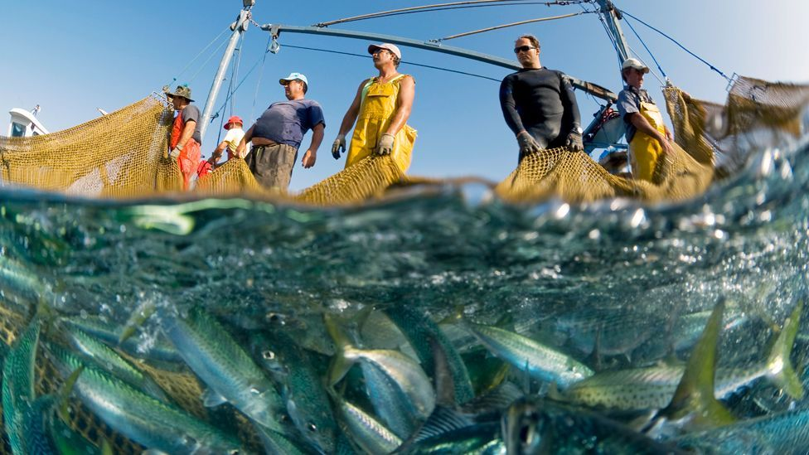
Extension Classroom Activity:
World Ocean Day – Run your own classroom competition: “Sustainable fishing means more… ideas!”
Run your own classroom competition for learners to think of a way to help make fishing more sustainable? It might involve:
a new piece of tech for scientists or fishers
a different way of fishing
a campaign to change what governments do
an idea to educate people about our ocean

Slide 29
Thank you
For more information and education
resources visit MSC webpage at
www.msc.org/tangaroa

